Slide 1
Workforce Opportunity for Rural Communities (WORC) Grants
Round 4
Managing Performance: The Ins and Outs of Reporting
Notes:
RANDY
Welcome to Managing Performance: The Ins and Outs of Reporting
This training is for Workforce Opportunity for Rural Communities Round 4 grantees

Slide 2

Welcome
Randy Painter
  Supervisory Workforce Analyst
  Office of Workforce Investment
    DOL's Employment and Training Administration
Notes:
RANDY​
I’m Randy Painter, a Supervisory Workforce Analyst with the Department of Labor
[Introduce yourself how you’d like]

Slide 3
Department of Labor Structure
Employment and Training Administration (ETA)
Office of Workforce Investment (OWI)
WORC Grants
Department of Labor (DOL)
Grant Programs
Notes:
The WORC initiative, which you are a part of, is operated by the US Department of Labor, or DOL
US DOL contains many sub-agencies, including the Employment and Training Administration, or ETA, of which the Office of Workforce Investment, or OWI, is a part.
OWI oversees several workforce development programs, including the WORC initiative.

Slide 4
The WORC initiative is a Partnership Between DOL, ARC, and DRA
WORC
DOL
DRA
ARC
Workforce Opportunity for Rural Communities (WORC)
  Department of Labor (DOL)
  Appalachian Regional Commission (ARC)
  Delta Regional Authority (DRA)
Notes:
RANDY
The WORC initiative is a partnership between the US Dept of Labor, the Appalachian Regional Commission, and the Delta Regional Authority
DOL is responsible for fiscal accountability and perf. oversight
ARC and DRA are primarily focused on technical assistance and operations
Partnership supports the success of the project

Slide 5
Training Goals
By the end of today’s training, grantees should understand…
The big picture—the high-level steps required for creating a Quarterly Performance Report (QPR)
The data collection requirements
What a participant data file is and how to submit it
How to access resources on WorkforceGPS
How to request additional technical assistance
Notes:
RANDY
Our goals for today’s session are to prepare you to complete the quarterly performance report, or QPR.
The QPR is one of the primary ways that we receive information about our grant programs like WORC, and to understand the outcomes that the program is attaining.
By the end of the hour, our hope is that you…
Understand the big picture when it comes to the QPR
Understand the data collection requirements
Understand what a participant data file is and how to submit it
Understand how to access resources on workforcegps
Understand how to request additional technical assistance

Slide 6


Today’s Speakers (1)
Kimberly Powell
  Workforce Analyst
    Office of Workforce Investment
    DOL's Employment and Training Administration
Jeff Ryan
  Business Engagement Specialist
    Office of Workforce Investment
    DOL's Employment and Training Administration
Notes:
RANDY
Before we dive into the training, I wanted to introduce the rest of our team.
Kimberly Powell works with me in the Office of Workforce Investment, leading our efforts to support performance reporting for Dislocated Worker Grants and other initiatives funded out of the Dislocated Worker National Reserve, including the WORC grants.
Jeff Ryan is our colleague in OWI. He develops policy and technical assistance for our Dislocated Worker Grant initiatives. He coordinates Business Engagement and Rapid Response efforts at the national level, connecting workforce and economic development activities and developing strategic partnerships to engage businesses.
Both Kimberly and Jeff are on the line today and will be available to answer questions during the Q&A period at the end of the session.

Slide 7


Today’s Speakers (2)
Jessie Oettinger
  Senior Associate
    Social Policy Research Associates
Ben Mahrer
  Associate
    Social Policy Research Associates
Notes:
RANDY
I am also pleased to introduce our presenters for today--Jessie Oettinger [ET-TING-GER] and Ben Mahrer [MAR] from Social Policy Research Associates, or SPR.
SPR is under contract with the Department of Labor to support performance reporting and provide technical assistance, and they will be taking us through much of the content we plan to share.
And with that, I’ll hand it over to Jessie

Slide 8
Agenda (1)
Reporting Requirements Overview
QPR Overview
Building and Submitting the Participant Data File
WorkforceGPS Resources
Technical Assistance
The Participant Data File and Data Collection
Notes:
JESSIE
The first item on today’s agenda is a review of the reporting requirements. The purpose of this review is to locate what we’ll be talking about today within the larger quarterly reporting picture.
We’ll then do an overview of the QPR, as that’s the focus of today’s training.
After doing an overview of the whole process, we’ll walk through each of the key steps involved in creating a QPR. The explanation of this process is captured by the middle two items on today’s agenda, the first of which introduces the participant data file and goes into the data that you’ll have to collect, and the second of which covers how to actually build the participant data file and submit it to WIPS so the QPR can be generated.
By the time we get through that fourth line on the agenda we’ll have reviewed the whole QPR process, start to finish.
Having done that, we’ll close out with a look at WorkforceGPS, where you can find lots of helpful reporting resources, and Technical Assistance—or who to contact for additional support.

Slide 9
Agenda (2)
Reporting Requirements Overview
QPR Overview
Building and Submitting the Participant Data File
WorkforceGPS Resources
Technical Assistance
The Participant Data File and Data Collection
Notes:
JESSIE
So let’s get started with a quick review of the performance reporting basics.

Slide 10
Reporting Overview (1)
WIPS
(Submission Platform)
QNR
QPR
Notes:
JESSIE
We’re going to start with the basics to make sure that you understand how what we cover today fits into the larger reporting picture.
So, to review…

Slide 11
Reporting Overview (2)
WIPS
(Submission Platform)
QNR
QPR
Grantees are responsible for submitting two reports each quarter: the Quarterly Narrative Report (QNR) and the Quarterly Performance Report (QPR)
Notes:
JESSIE
The two boxes represent the two reports that you are required to submit each quarter—the Quarterly Narrative Report, or QNR, and the Quarterly Performance Report, or QPR

Slide 12
Reporting Overview (3)
WIPS
(Submission Platform)
QNR
QPR
Grantees submit QNRs and QPRs to DOL through WIPS, the online reporting platform.
WIPS = Workforce Integrated Performance System.
Notes:
JESSIE
The circle represents WIPS, which is the submission platform that you will use to submit the performance reports to the Department of Labor
WIPS stands for Workforce Integrated Performance System
It’s the online platform where all ETA performance reporting is completed.

Slide 13
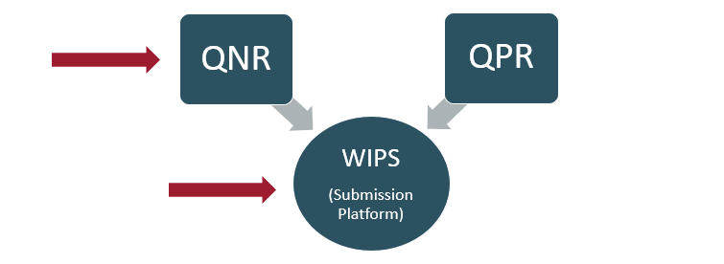
WORC Training Part 1 (1)
A previous training, available on WorkforceGPS, covered WIPS setup and QNR submission
Notes:
JESSIE
Some of you may recall that we have already hosted a performance training for WORC grantees that took place in October
In that training we walked through the steps to set up an account in WIPS, and submit a Quarterly Narrative Report, as the arrows on this slide indicate.
No worries if you missed the first training. You don’t need to have attended that to participate fully in this session today.
But if you missed it, a recording is available on WorkforceGPS.

Slide 14
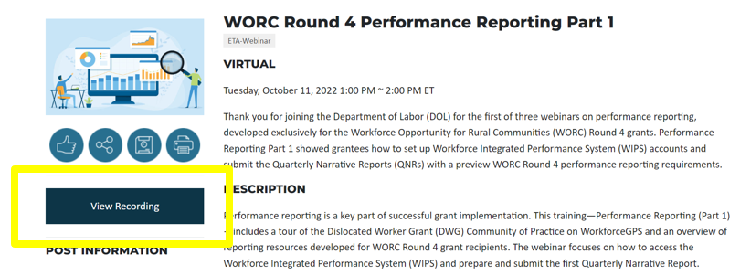
WORC Training Part 1 (2)
WORC Round 4 Performance Training Part 1 Event Page
Notes:
JESSIE
I do want emphasize that if you don’t have an account in WIPS yet, setting one up is a priority. This first training has step by step instructions on how to do that, and you can find a link to the recording on the DWG community of practice.
In addition to the direct link on this slide, we’ll review how to access WorkforceGPS resources like this training at the end of the session today.
We want to make sure that if you know where to go if you have not yet created a WIPS account, so we’ll point this recording out again at the end.

Slide 15
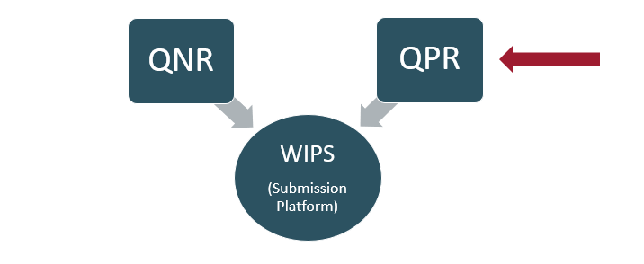
WORC Training Part 2
Notes:
JESSIE
Returning to this overview of the quarter reporting requirements, In this training we will focus on Quarterly Performance Reports.
We are sequencing the trainings in this way so they align with the timeline of most of your projects. You have to submit a Quarterly Narrative Report every quarter, so getting set up in WIPS and explaining how to submit a QNR is the first thing everyone should understand.
You only need to begin submitting a QPR once you have enrolled participants. For some of you, that may mean that you’ll submit a QPR at the next submission date in February. For others, you may not submit a QPR until later.

Slide 16
Reporting due dates
Reports are due on the 15th day of the second month following the end of the quarter
Reporting Quarter | July – Sept. | Oct. – Dec. | Jan. – Mar. | Apr. – June
Report Due Date | November 15 | February 15 | May 15 | August 15
Notes:
JESSIE
This slide shows the reporting due dates for each quarter.
The previous quarter ended in September—right after the start date for this grant. At that point, no one had any participants so you didn’t have to submit any QPRs—you just had to set up an account in WIPS and submit a QNR.
The next quarter is highlighted in yellow. It ended in December, and you will have to submit your reports for this quarter on February 15th. So we’re in the window when it would make sense to be working on those reports.
Again, if you do not have participants, you will only submit a QNR for this quarter. If you do have participants, you will submit both a QNR and a QPR. But either way, it is a good idea to start thinking about what you’ll have to do to prepare for the QPRs. That’s what we’ll cover in this training today.

Slide 17
Poll
Do you plan to submit a QPR by February 15, 2023?
Grantees that enrolled at least one participant prior to December 31st, 2022, must submit a QPR.
The QPR submission due date is February 15.
Yes, I plan to submit a QPR by February 15th.
No, I did not have participants during the Oct. – Dec. quarter.
Notes:
JESSIE
Before we dive in to the QPRs, we wanted to ask how many of you plan to submit a QPR by the February 15th due date?
If you enrolled participants in your program during the quarter—so before the new year—then you’ll need to submit a QPR. If you have not yet enrolled participants—or if you enrolled your first participants this calendar year, which is after the reporting period, you will not need to submit a QPR yet.

Slide 18
Agenda (3)
Reporting Requirements Overview
QPR Overview
Building and Submitting the Participant Data File
WorkforceGPS Resources
Technical Assistance
The Participant Data File and Data Collection
Notes:
BEN
Now that we’ve oriented ourselves in terms of the basic reporting requirements​, we can get into the main content that we plan on covering today.
We’ll be focusing on the QPRs, and we’ll start with an overview of the whole process, then walk through each stage in more detail.​
I should also mention that these slides will be available for you to view and download after the presentation, along with a recording of the session. So of course feel free to take notes, but don’t despair if you miss a detail—you’ll be able to review everything afterwards.

Slide 19
QPR Overview (1)
What is in the QPR?
The QPR contains information on grant participants, services, and outcomes.
It is based on a participant data file that grantees submit to WIPS
The participant data file contains information about the individuals served by the program.
WIPS aggregates the information in the participant data file to create the QPR.
The QPR contains aggregate information about participants served by the program.
Notes:
BEN
Let’s start by describing what a QPR is, at the most basic level.
The QPR is a data report. It has quantitative information about participants, services, and program outcomes
It’s actually based on a data file—called the participant data file—that grantees create and upload to WIPS
WIPS then takes the info in the participant data file and turns it into the QPR
The QPR is different from the participant data file that grantees upload because the QPR is aggregated info at the program level, while the data file that you submit contains information at the individual level

Slide 20
QPR Overview (2)
Participant Data File | QPR
Grantees create the participant data file and submit it to WIPS | Generated in WIPS using information from the participant data file
Individual-level information | Aggregated/program-level information
Notes:
BEN
This slide highlights these important distinctions between the participant data file and the QPR.
The participant data file is uploaded by you, the grantee, and contains information at the individual level
The QPR, on the other hand, is automatically generated in WIPS, using information from the participant data file. It contains information at the program level.

Slide 21
QPR Overview (3)
Collect Data
Create Participant Data File
Upload Participant Data File to WIPS
QPR is Generated in WIPS
Notes:
BEN
Continuing our overview of the QPRs, this graphic illustrates the basic steps that go into producing a QPR.
First, grantees have to collect data.
This data then goes into a participant data file…
Which is then uploaded to WIPS
WIPS then turns the participant data file into the QPR.

Slide 22
QPR Overview (4)
Topics We Will Cover Today
The Participant Data File: What does it look like? What information does it contain?
Walk through the four stages:
Data Collection
Data File Creation
Data File Upload
QPR Generation
Notes:
BEN
In today’s session, we’ll walk through all four of these stages.
But before we begin that walkthrough, we’re going to start by explaining a little more about the data file referenced in the second step. It’s important to understand what the participant data file is and what information it contains, because it’s what you’re building towards in the first stage when you’re collecting data.
Once we’ve described the participant data file we’ll move to that first stage of the process—data collection. We’ll talk about what data to collect and how to set up data collection processes.
And we’ll continue covering each stage from there. By the end of the session, you should have a clear picture of what the process entails.

Slide 23
Agenda (4)
Reporting Requirements Overview
QPR Overview
Building and Submitting the Participant Data File
WorkforceGPS Resources
Technical Assistance
The Participant Data File and Data Collection
Notes:
JESSIE
So let’s get started!
As Ben just mentioned, we’re going to start by describing the participant data file, and then we’ll talk about data collection.

Slide 24
What is in the Participant Data File?
The Participant Data File contains information about each individual participant enrolled in the grant program, including:
Individual Information
Program Participation Information
Services and Activities
Program Outcomes Information
Notes:
JESSIE
So, what is actually in the participant data file that you’re responsible for creating? We’ve said that it has data on individuals. To spell that out a bit further, there are several categories of information related to the individuals that come into contact with your program.
There’s…
Individual Information​
Demographic information that characterizes individuals at the time of their enrollment​
Program Participation Information​
Date of program entry/exit, participation in various program types (e.g., youth incumbent worker training, adult programs, etc.)​
Services and Activities ​
Type of services an individual receives (e.g., basic career services, training services, etc.)​
Program Outcomes Information​
Information DOL uses to calculate exit-based performance indicators​

Slide 25
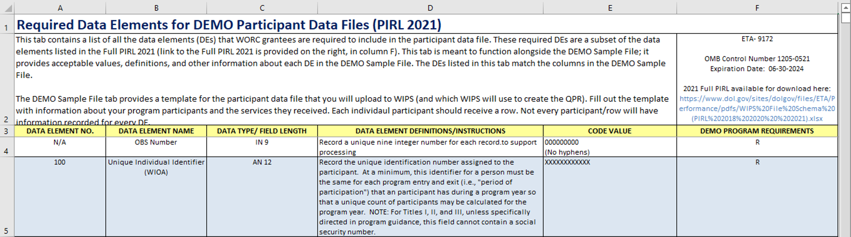
How do I know what information to include in the data file?
The Participant Data File Tool (PDFT) lists required data elements*
  The PDFT is a technical assistance resource on WorkforceGPS
  *Information in the PDFT comes from the Participant Individual Record Layout (PIRL). The PIRL is a federally approved form that contains data collection requirements for multiple workforce programs.
Notes:
JESSIE
Of course, this raises the question, “how do I know what to include in the file?”
The best place to go for a complete list of required data elements is the Participant Data File Tool.
The Particpiant Data File Tool—which we often shorten to PDFT—is a technical assistance resource that’s available on workforcegps. The PDFT will show up many times throughout this presentation as we explain how to collect data and build the participant data file. We’ll also do an in-depth explanation of how to access all the TA resources on workforcegps, including the PDFT, at the end of the session.
For now, the takeaway is that the PDFT is the best source for figuring out what data goes in the participant data file.

Slide 26
Generating a QPR
PDFT
Participant Data File
Uploaded to WIPS
QPR
Generated in WIPS from the data file
Describes what data to collect and include in the participant data file
Contains individual level participant + program info
Contains aggregated program level data
Notes:
JESSIE
Here is a visual depiction of the relationship between the PDFT, Participant Data File, and QPR. ​
​
We’ve discussed each of these things individually, but I wanted to show how they all fit together.
First, the PDFT delineates all of the required data elements. All the things you’ll have to collect data on. That data then goes into the participant data file, as represented in the second box. Then you upload the participant data file to WIPS, and the system turns the data into the QPR, as shown in the final box.​

Slide 27
QPR Data Collection
Data Collection Overview
Who to Collect Data on
27
Notes:
​JESSIE
Ok, so that was our overview of the participant data file and how it fits into the overall process.
Now we’ll move on to data collection, and take a similar approach where we start with an overview and then dive into the specifics.

Slide 28
QPR Overview (5)
Collect Data
Create Participant Data File
Upload Participant Data File to WIPS
QPR is Generated in WIPS
Notes:
JESSIE
For context, data collection is the first stage of the QPR process. We’ll talk about data collection, do a quick review, and then move on to the other stages.

Slide 29
Data Collection Overview
Grantees must collect all the information that is required for the participant data file
The required data elements are specified in the PDFT
  Refer to the PDFT as you set up your data collection processes and tracking systems
Notes:
JESSIE
The purpose behind collecting data is to include it in the participant data file, which will eventually be converted into the QPR.
The goal, then, is to align your data collection with the requirements for the participant data file. That means that the PDFT plays a critical role in telling you what you need to collect data on.

Slide 30
Data Collection Overview:
What data will you collect?
Required data collection includes:
  Participant information (e.g., demographics)
  Services provided
  Outcomes data
There are some outcomes data listed in the PDFT that can be calculated after uploading the participant data file to WIPS (data elements 1600 – 1813)
Notes:
JESSIE
We’ve already talked about what goes into the participant data file, and those same things are what you’ll be collecting data on. So that means participant information like demographics, as well as service provision—who received what services at what times—will make up the bulk of your data collection.
One important thing to note is that even though outcomes information are listed in the PDFT in Data Elements 1600 – 1813, several of these data elements can be added within WIPS after you upload the participant data file.
We’ll talk more about that process later in the training. Right now, in the context of data collection, the key takeaway is that you’ll be collecting information on all the data elements specified in the PIRL except for some data elements within the outcomes section.
​

Slide 31
Data Collection Task Summary
Your data collection task is to…
…collect all of the data elements that are required by the PDFT, except for the outcomes information in data elements 1600 – 1813.
Certain outcomes information will be calculated in WIPS after the participant data file is uploaded.
Notes:
JESSIE
This slide summarizes that takeaway I just mentioned. Your task is to collect the data that will go into the participant data file, as delineated by the PDFT. There’s a lot of information to collect, so you’ll definitely want to set up a thorough data collection system.

Slide 32
Data Collection Tips (1)
Establish data collection processes—forms, protocols, etc.
Track participant data using…
  Existing MIS
  Third party vendor
  Spreadsheet software
  Database (e.g. Access)
  Other
Management Information System (MIS) or case management software is the preferred method to store and organize data
Notes:
JESSIE
Given this data collection task, you will have to devise a way to store and organize the data that you collect. Your options for doing this include using:
An MIS or case management system that is already in use. If you go with this option, existing systems will need to be modified for reporting in WIPS.
Alternatively, you may contract with a third party vendor to provide this service
You can use a spreadsheet
You can build a database
Or some other software solution
While grantees may use any of these options, most common is working with a vendor and utilizing a MIS or case management software.

Slide 33
Data Collection Tips (2)
When building information collection processes, tools, and forms make sure…
  To protect sensitive information
  That data collection methods align to the required data elements
Notes:
JESSIE
As you set up your data collection storage system and all the processes that will generate data, it’s important to consider:​
Establishing a secure process for handling sensitive information (like any personally identifiable information)​
And ensuring that forms and tools that staff use to collect participants’ information list valid answer options for each data element. Essentially, take care to ensure that your data collection methods align with the required data elements.​

Slide 34
Who To Collect Data On
Collect data on all individuals that contact the program, regardless of services received
Additional information about the difference between reportable individuals and participants is available on Workforce GPS
Notes:
JESSIE
​
Now that we’ve described the data collection task, let’s talk very briefly about who to collect data on. ​
Essentially, you should collect information for all individuals that come into contact with your program. Of course, this includes people that received services—but it also includes people who just fill out paperwork but don’t actually receive any services. Aim to collect data on everyone that engages with your program.

Slide 35
DWG Performance Policy
Performance reporting definitions and guidance in Training and Employment Guidance Letter (TEGL) 14-18 and in the DWG Reporting Reference Guide (Appendix G).
Notes:
​JESSIE
If you’d like to read into this more, the official definitions are found in the Guidance for DWG Performance reporting, covered in TEGL 14-18. This information is also in the Reporting Reference Guide on WorkforceGPS.

Slide 36
Review
What’s in a participant data file?
Preparing for data collection
Big Picture Overview
36
Notes:
JESSIE
We’ve already covered a lot of information, so let’s do a quick review of the big picture, the participant data file, and data collection.

Slide 37
QPRs: Review (1)
Notes:
JESSIE
Here’s the super high level reporting requirements graphic again, locating today’s session in the QPR section. Again, the training from October covered WIPS set-up and the QNR, and a recording of that training is viewable on WorkforceGPS.

Slide 38
QPRs: Review (2)
Collect Data
Create Participant Data File
Upload Participant Data File to WIPS
QPR is Generated in WIPS
Notes:
JESSIE
After locating the QPR within the broader quarterly reporting environment, we did an overview of the QPR process itself. That overview showed how you will first collect data, then use the data you collected to create a participant data file. You will then upload the participant data file to WIPS, where the system will generate the QPR.

Slide 39
QPRs: Review (3)
Participant Data File
Data Collection
Notes:
JESSIE
With that process in mind, we talked about what a participant data file is—what information it contains, and why it’s important—and how to set up for data collection.

Slide 40
QPRs: Review (4)
Participant Data File
Contains individual-level data
Required data elements are listed in the PDFT
Data Collection
Notes:
JESSIE
The participant data file contains individual level information about people that come into contact with your program. This includes participants, but also reportable individuals.
The PDFT lists all of the data elements that go into the participant data file.

Slide 41
QPRs: Review (5)
Participant Data File
Contains individual-level data
Required data elements are listed in the PDFT
Data Collection
Set up MIS and data collection processes; train staff
Review data element requirements listed in the PDFT; ensure data collection processes are in alignment
Collect data on participants and reportable individuals
Notes:
JESSIE
Then, knowing that you’re working towards building a participant data file, the first actual step in this process is to set up your data collection processes and tracking systems.
You’ll want to make sure your processes align with the data element requirements that are laid out in the Participant Data File Tool.
When you’re ready, you will collect data on all individuals that come into contact with your program, even if they don’t wind up receiving services

Slide 42
Agenda (5)
Reporting Requirements Overview
QPR Overview
Building and Submitting the Participant Data File
WorkforceGPS Resources
Technical Assistance
The Participant Data File and Data Collection
Notes:
BEN
Ok, we’re now ready to move on to the next section, in which we’ll talk about:​
How to actually prepare the participant data file
the process of uploading the data file to WIPS
And how the data file is converted into the QPR​

Slide 43
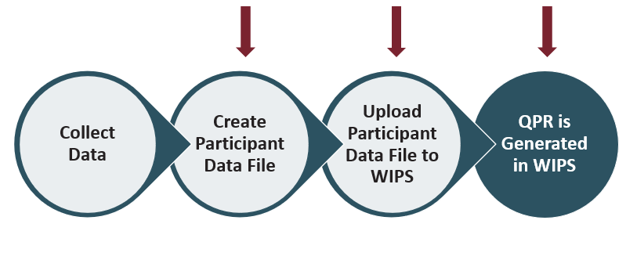
QPR Process (1)
Notes:
BEN
Each of the three topics I just mentioned correspond to the second, third, and fourth stages of the QPR process.

Slide 44
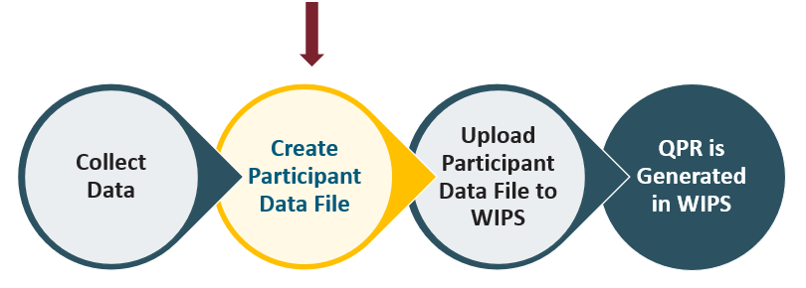
QPR Process (2)
Notes:
BEN
We’ll move through each of these three steps one at a time, starting with the creation of the participant data file.

Slide 45
Building a Participant Data File (1)
Step 1: Set up a spreadsheet with the required columns
  Columns correspond to data elements
  Rows correspond to individuals
Notes:
BEN
WIPS requires that you use a specific format, called a schema, when you build the participant data file. So we’ll explain the key steps to building a data file that meets the formatting requirements.
The first of these steps is to set up a spreadsheet with the required columns
There will be one column for each of the required data elements
And the rows will correspond to individuals
This creates a grid that is ready to be filled in with information about the people who have come into contact with your program

Slide 46
Building a Participant Data File (2)
Step 1: Set up a spreadsheet with the required columns
  Columns correspond to data elements
  Rows correspond to individuals
Step 2: Populate a spreadsheet with participant data
  Grantees that use an MIS or case management software will export required fields
  Grantees that do not use an MIS or case management system may create the file and add data manually
Notes:
BEN
The second step is to populate the spreadsheet with data
For those of you using an MIS or case management system, you will likely do this by exporting the relevant data
But populating the spreadsheet with data can also be done manually.

Slide 47
Building a Participant Data File (3)
Step 1: Set up a spreadsheet with the required columns
  Columns correspond to data elements
  Rows correspond to individuals
Step 2: Populate a spreadsheet with participant data
  Grantees that use an MIS or case management software will export required fields
  Grantees that do not use an MIS or case management system may create the file and add data manually
Step 3: Format the data
  WIPS requires participant data files to meet formatting specifications
  Data files that do not meet specifications will be rejected
Notes:
BEN
The third step is to make sure that the data are formatted properly.
WIPS has very rigorous formatting specifications for the data file, and files that don’t meet the specifications will be rejected. So it’s important to pay attention to how data for each element should be entered

Slide 48
Building a Participant Data File (4)
Use the Participant Data File Tool (PDFT)
as you prepare the data file
Located on WorkforceGPS
Notes:
BEN
Because we recognize that this is a tricky process, we’ve created a special tool designed specifically to guide you through each of these steps. It’s called the Participant Data File Tool, or PDFT for short. We highly recommend using it as you build your participant data file.
This is the same resource we referred to earlier when we were talking about finding the required data elements. But it does even more than just list the required data elements. It also contains information that is relevant to building and formatting a participant data file.
As we’ve mentioned, the PDFT is located on WorkforceGPS. We’ll show you exactly how to find it—and other resources to support your performance reporting—at the end of today’s session. Right now, we just want to emphasize that the PDFT is the best resource for this stage of the QPR process.

Slide 49
Building a Participant Data File (5)
Step 1: Set up a spreadsheet with the required columns
  PDFT shows which columns to include in the file
Step 2: Populate a spreadsheet with participant data
Step 3: Format the data
Notes:
BEN
Going back to these steps, I want to quickly highlight how the PDFT helps throughout this process.
In the first step, the PDFT shows exactly which columns, or data elements to include in the file.

Slide 50
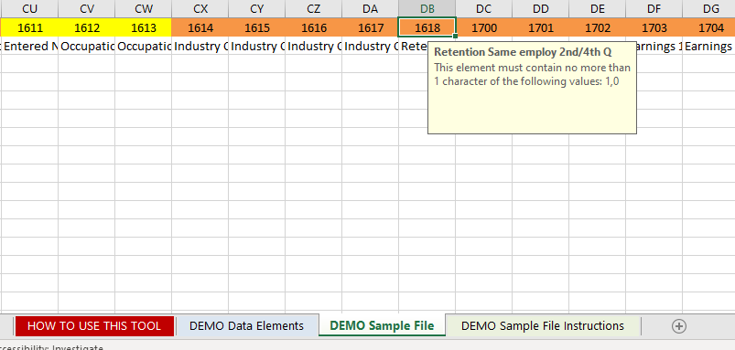
PDFT (1)
The PDFT is located on WorkforceGPS
Notes:
BEN
This is an image taken from the participant data file tool. You’ll notice that the tool has several tabs along the bottom—this Demo Sample File section is the one that is most relevant to building the participant data file.
As you can see across the top of the screen, it shows which columns to include in the file. The numbers correspond to data elements, and the text underneath is the title of each element.

Slide 51
Building a Participant Data File (6)
Step 1: Set up a spreadsheet with the required columns
  PDFT shows how to structure the participant data file (which columns to include)
Step 2: Populate a spreadsheet with participant data
  PDFT shows which columns should be filled
Step 3: Format the data
Notes:
BEN
- The next step in building your participant data file is filling the spreadsheet in with data. The PDFT helps with this step by showing which columns require data.

Slide 52
PDFT (2)
The PDFT is located on WorkforceGPS
Notes:
BEN
If we return to the image of the participant data file tool that we were just looking at, there’s actually a little bit more nuance than simply filling in every single column. You’ll notice that some of the column headers are orange, and others are yellow.
Headers that are ORANGE pertain to demo grants like WORC. These should be filled in.
Headers that are YELLOW are not specific to demo grants, but must be included in the participant data file.​
As I’ve mentioned, WIPS is very particular about file formatting, and it’s important to build the file to these exact specifications.

Slide 53
Building a Participant Data File (7)
Step 1: Set up a spreadsheet with the required columns
  PDFT shows how to structure the participant data file (which columns to include)
Step 2: Populate a spreadsheet with participant data
  PDFT shows which columns should be filled
Step 3: Format the data
  PDFT contains notes on formatting for each column/data element
Notes:
BEN
The last step to building the participant data file is formatting the data
There are lots of details to pay attention to when it comes to how the actual data is formatted. Things like whether to include leading zeros, or how to format dates. We won’t get into all of the specifics here, but suffice it to say that the participant data file tool is once again enormously helpful with this step. It contains the specifications for every single data element that you are required to include.

Slide 54
PDFT (3)
The PDFT is located on WorkforceGPS
Notes:
BEN
Returning to this image of the PDFT, you’ll notice that there’s some text in the tan box in the upper righthand portion of the screen. These are the data entry specifications.
They exist for every single column, and you can view them by clicking into the header cells.
You’ll also notice that there are a few other tabs in this tool. We’ll cover these in more detail in the next training, but there’s also a video tutorial located on workforcegps that explains the PDFT’s contents in their entirety. We’ll show you how to navigate to this tool and the accompanying video at the end of this training when we cover WorkforceGPS Resources, but there’s also a direct link at the bottom of the slide right here.
At this point, just remember that the PDFT is your go-to resource when it comes to building a participant data file.

Slide 55
Building a Participant Data File (8)
Step 1: Set up a spreadsheet with the required columns
  PDFT shows how to structure the participant data file (which columns to include)
Step 2: Populate a spreadsheet with participant data
  PDFT shows which columns should be filled
Step 3: Format the data
  PDFT contains notes on formatting for each column/data element
Notes:
BEN
We’ve now covered the key steps to building a participant data file.
It’s worth noting, however, that this process may look slightly different depending on the system you are using to collect data, and your choice regarding the file format of the participant data file.

Slide 56
Building a Participant Data File (9)
Accepted file formats: .csv, .txt, .zip
Step 1: Set up a spreadsheet with the required columns
  PDFT shows how to structure the participant data file (which columns to include)
Step 2: Populate a spreadsheet with participant data
  PDFT shows which columns should be filled
Step 3: Format the data
  PDFT contains notes on formatting for each column/data element
Notes:
BEN
The file formats that WIPS accepts are .csv, .txt, and .zip. So, some grantees may be using a case management system that makes it easier to produce a .txt file than a spreadsheet. If that’s the case, feel free to produce a .txt file.

Slide 57
Building a Participant Data File (10)
Accepted file formats: .csv, .txt, .zip
Include the appropriate data elements
  PDFT shows how to structure the participant data file (which data elements to include)
Populate your file with participant data
  PDFT shows which data elements should contain data
Format the data
  PDFT contains notes on formatting for each column/data element
Notes:
BEN
If you go this route, the steps may look a little different than those we just outlined. But the upshot is still the same. Your file will need to:
Have the appropriate data elements
Contain the required participant information
And everything, including the actual data, must be formatted correctly
Again, you may work through these steps in a slightly different order, or in a slightly different manner than what we just showed. For example, you may not need to format a spreadsheet prior to populating it with data—perhaps you will export data first, and then format the file. There are too many ways of going about this for us to cover every alternative, but our hope is that you will be able to take the key steps that we’ve gone over here, and recontextualize them in whatever data management system you are using. And the PDFT should be helpful no matter how you go about this.

Slide 58
Building a Participant Data File (11)
Final step: upload the file to WIPS
Include the appropriate data elements
  PDFT shows how to structure the participant data file (which data elements to include)
Populate your file with participant data
  PDFT shows which data elements should contain data
Format the data
  PDFT contains notes on formatting for each column/data element
Notes:
BEN
So, those are the key steps to building a participant data file. Once you are satisfied with yours, the next step will be to upload it to WIPS.

Slide 59
QPRs: Review (6)
Collect Data
Create Participant Data File
Upload Participant Data File to WIPS
QPR is Generated in WIPS
Wage matching
How to build the data file
How to pass the edit checks
Notes:
BEN
Uploading the data file to WIPS, as you might remember, is the next bubble in this graphic. We’ll talk about that step now.

Slide 60


Uploading the Participant Data File to WIPS
The DWG Performance Reporting Reference Guide 2022 contains step by step instructions for uploading participant data files to WIPS (WORC grantees can utilize DWG performance reporting requirements)
Notes:
BEN
The actual mechanics of uploading the participant data file to WIPS are quite simple and the process is fully documented in the Performance Reporting Guide. The Guide has step by step instructions and screenshots that are located in the appendixes.
So given the relative simplicity and full documentation that exists we’re not going to go into the actual process right here. Instead, we want to make sure that you know this resource exists, and at the end of the training we’ll show you where to find it on WorkforceGPS.
I’d also like to point out that, with a few small exceptions, WORC grantees follow the DWG performance reporting requirements. So don’t be put off by the DWG in the title.

Slide 61
Edit Checks
WIPS will run a series of edit checks on the submitted file.
Grantees will need to correct errors identified in the edit check and resubmit the participant data file
It is common to resubmit multiple times
Once the participant data file passes the edit checks, WIPS will generate the QPR.
Notes:
​BEN
However, uploading the participant data file will initiate a process called an edit check, and this is a stage of the upload process that contains a bit more complexity.
Once you’ve submitted your participant data file to WIPS, the system will automatically run a series of checks to make sure the file, and the data it contains, are formatted properly
Resolving errors that are identified in the edit check and re-submitting the file is an iterative process. It’s common to have to re-submit the data file multiple times.
Once you upload a data file and it passes through the edit check with zero errors, the QPR will be generated by the WIPS system for each grantee to certify.
But of course, fixing these errors can be a little bit tricky.

Slide 62
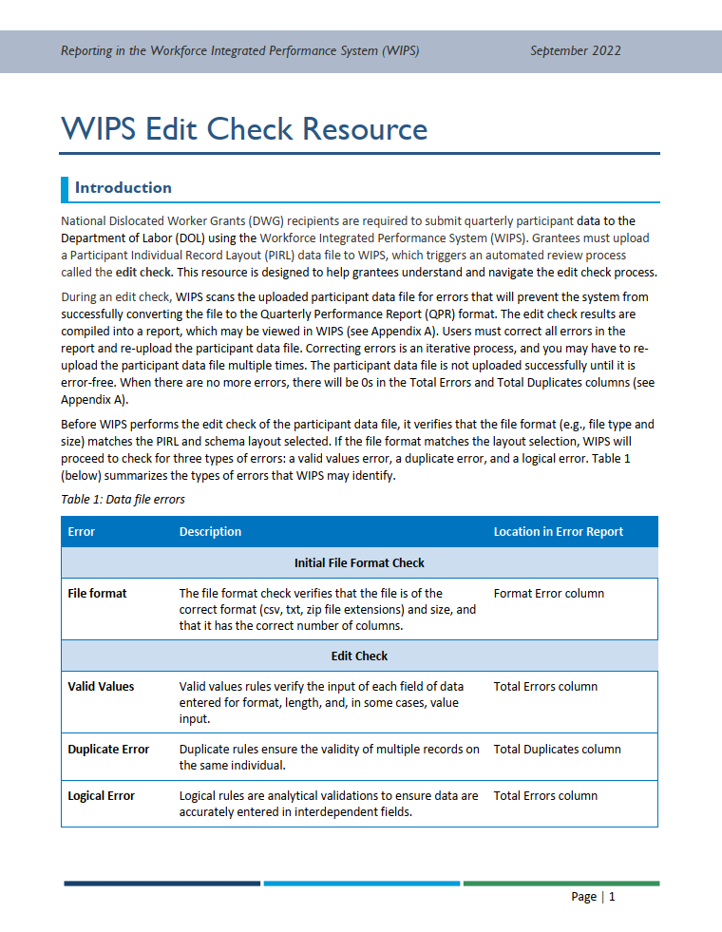
Edit Check Resource
Located on WorkforceGPS
Notes:
BEN
We have also created a resource that provides tips for navigating the edit checks
As with all the resources we’ve mentioned today, it’s located on WorkforceGPS, and we’ll point out how to access it at the end of the training

Slide 63
QPRs: Review (7)
Collect Data
Create Participant Data File
Upload Participant Data File to WIPS
QPR is Generated in WIPS
Wage matching
How to build the data file
How to pass the edit checks
Notes:
BEN
Once you have successfully uploaded an error-free data file to WIPS that passes the edit check, you’ll arrive at the last step in the process—the generation of the QPR in WIPS.

Slide 64
QPR Generation: Outcomes Data (1)
Data elements 1600 – 1813 in the PDFT pertain to program outcomes, including:
  Employment
  Job retention
  Earnings
  Skill gains
  Credential attainment
  Education
These data elements require following up with participants after program exit
Notes:
BEN
One important thing to note for this final QPR generation stage has to do with outcomes data.
In the participant data file that you upload to WIPS, data elements 1600 – 1813 pertain to program outcomes. This includes employment outcomes, earnings outcomes, skill gains, and more.
Collecting these types of outcomes data requires following up with participants after they exit the program, or using supplemental sources to collect the relevant information. We encourage you to do this follow-up data collection, and to include as much of this information as you can.

Slide 65
QPR Generation: Outcomes Data (2)
Non-state grantees may submit participant data files without employment and earnings data
Employment and earnings data elements that may be left blank:
  1602
  1603
  1606
  1607
  1618
  1704
Notes:
BEN
However, there is also a process within WIPS that is set up to retrieve employment and earnings information for a select set of data elements. Specifically, WIPS will retrieve information for the six data elements shown on this slide.
This means that you may submit a participant data file to WIPS that does not include information for these six data elements. In other words, these columns in your data file may be left blank.

Slide 66
QPR Generation: Outcomes Data (3)
WIPS retrieves participant employment and earnings outcomes through a secure third-party system
WIPS will populate QPRs with the missing information
  This process may take up to 30 days
WIPS is only able to retrieve outcomes information for individuals with a social security number (SSN) in the participant data file
Notes:
BEN
The system that WIPS uses to retrieve employment and earnings data engages a third party to match a participant’s social security number with their wages and employment status as listed in the state’s unemployment records. The system is fully secure, and DOL requires this level of rigor to verify employment.
Once the employment status is confirmed, WIPS will populate your grant's QPR with the correct data for these fields. This process takes place after you submit the participant data file and certify the QPR.
The important thing to note here is that WIPS is only able to retrieve employment and earnings information for individuals that have a social security number listed in the participant data file. Without an SSN, there is no way to match the participant with the state’s records.

Slide 67
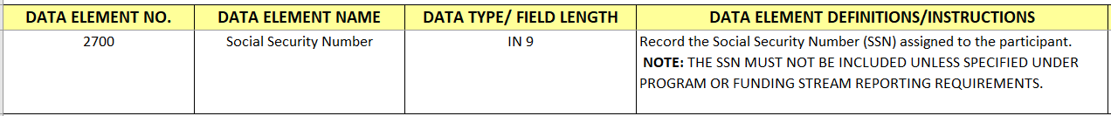
QPR Generation: Outcomes Data (4)
Social Security Numbers (SSNs)
  SSNs must be in the file for WIPS to retrieve outcomes
  That's why SSNs are included in the participant data file (data element 2700)
  SSNs are not required for individuals to participate in the program
Notes:
BEN
This is why social security numbers are listed in the PDFT as a data element. Please collect social security numbers and include them in the participant data file so that WIPS can retrieve employment and earnings data.
That being said, participants do not have to provide their SSN in order to receive services.

Slide 68
QPR Generation: Outcomes Data (5)
Summary
Follow up with participants to collect all the outcomes data you can
WIPS will retrieve employment and earnings information for individuals with SSNs recorded in the participant data file
The PDFT will indicate the data elements for which WIPS is able to retrieve information
Notes:
To summarize, I just described a process whereby WIPS will retrieve employment and earnings information for individuals who have social security numbers recorded in the data file.
WIPS will only retrieve this information for a few data elements in the outcomes section of the data file. These data elements may be left blank if you have included social security numbers in the file.
The PDFT actually does not currently highlight the exact six data elements that WIPS retrieves information for, but we are working on an update the PDFT right now and will include this information in the next version.
So, while WIPS will add these employment and earnings data to your QPR, we still encourage you to collect all of the outcomes information you’re able to on your own.

Slide 69
QPR Generation
Participant data file is uploaded to WIPS
Data file passes edit checks
Automatic generation of QPR in WIPS
Grantee certifies QPR
Complete QPR becomes viewable in WIPS
WIPS retrieves outcomes info
Notes:
BEN
Having explained that note about employment and earnings info being added during the QPR generation stage, let’s take a look at the whole process for converting a participant data file into a QPR.
Most of this should be familiar at this point, but first you upload the participant data file to WIPS. WIPS will run its edit checks, and you may have to fix some errors and re-upload the file. But once the data file passes the edit checks, WIPS will automatically generate the QPR. It will also begin retrieving the missing outcomes info, but that process typically takes a few weeks. So you will certify the QPR before the outcomes information is added.
You can then log back in and view the complete QPR with outcomes information once it’s been added, if you wish.

Slide 70
QPRs: Review (8)
Collect Data
Create Participant Data File
Upload Participant Data File to WIPS
QPR is Generated in WIPS
Notes:
BEN
That was a lot of information, so let’s do a quick review of what we’ve covered in this section.
Our first review got us up through data collection [advance slide]

Slide 71
QPRs: Review (9)
Collect Data
Create Participant Data File
Upload Participant Data File to WIPS
QPR is Generated in WIPS
PDFT contains data file creation tips
Notes:
BEN
So we’ll start with creating a participant data file. You’ll be either exporting data from your case management system or building a data file manually. Either way you’re going to have to spend some time making sure that the file is set up properly and all the data is formatted correctly.
The main thing to remember here is that the PDFT is your go-to support resource for this step of the process.

Slide 72
QPRs: Review (10)
Collect Data
Create Participant Data File
Upload Participant Data File to WIPS
QPR is Generated in WIPS
PDFT contains data file creation tips
Reporting Reference Guide contains upload instructions
Edit Check Resources for tips on fixing errors
Notes:
BEN
You’ll then upload the participant data file to WIPS. Your go-to resource for this is the Reporting Reference Guide, which contains screenshots and step by step upload instructions.
You’ll also have to contend with the edit checks and fix any errors that it finds in your data file. We have another resource that will help you navigate that process. Unsurprisingly, it’s called the Edit Check Resource.

Slide 73
QPRs: Review (11)
Collect Data
Create Participant Data File
Upload Participant Data File to WIPS
QPR is Generated in WIPS
PDFT contains data file creation tips
Reporting Reference Guide contains upload instructions
Edit Check Resources for tips on fixing errors
Outcomes information is automatically added
Notes:
BEN
Once the data file is error free, WIPS will use it to produce a QPR. And that takes us through the end of the process!

Slide 74
Agenda (6)
Reporting Requirements Overview
QPR Overview
Building and Submitting the Participant Data File
WorkforceGPS Resources
Technical Assistance
The Participant Data File and Data Collection
Notes:
JESSIE
We’d now like to take some time to show you how to access many of the reporting resources that we’ve alluded to throughout the training, including the PDFT, the edit check resource, and the Reporting Reference Guide.

Slide 75
Reporting Resources on WorkforceGPS
Navigate to workforcegps.org
Select National Dislocated Worker Grants from the Communities tab at the top of the page
  (dwg.workforcegps.org)
Scroll down to Featured Content (left side)
Open the DWG Reporting Resources page
Notes:
JESSIE
All of these resources are located on WorkforceGPS.org.
WorkforceGPS is a hub for lots of different programs, so you’ll need to find your way to the National Dislocated Worker Grant Community of Practice.
Start by navigating to workforcegps.org…
Then select National Dislocated Worker Grants from the Communities tab at the top of the page
You could also go straight to dwg.workforcegps.org
Open the DWG Reporting Resources page from the Featured Content area
WORC 4 Performance Reporting Resources
Now we’re going to walk through a series of screen shots that show this process.
We’ll be starting from dwg.workforcegps.org

Slide 76
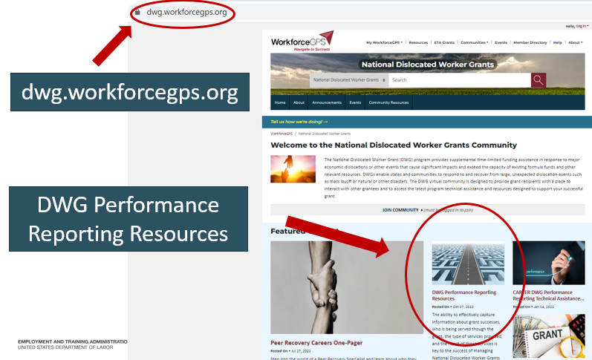
Guide to DWG Performance Reporting Resources (1)
Notes:
JESSIE
Just want to point out that we’re at: dwg.workforcegps.org
And the DWG performance Reporting Resources is located in the Featured Content Box. There’s a road visual for the page that you’re looking for.

Slide 77
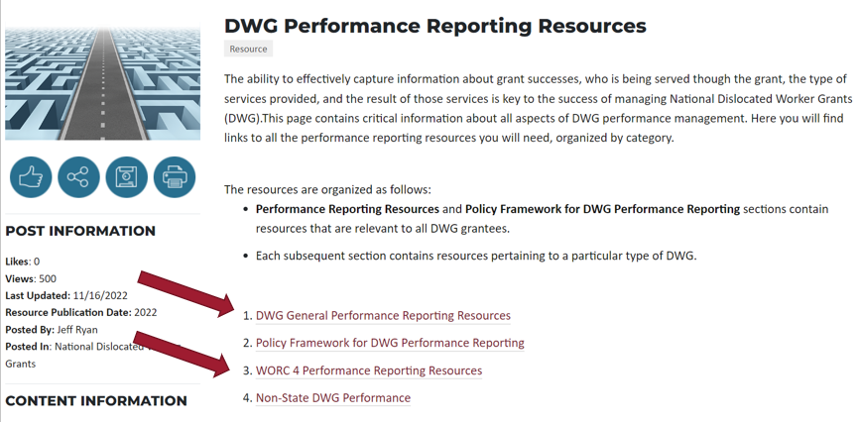
Guide to DWG Performance Reporting Resources (2)
Notes:
JESSIE
Once you click on the DWG Performance Reporting Resources you’ll see this menu. There are resources that are grouped together in a few different ways—the sections you’ll want to pay attention to are numbers 1 and 3: The DWG General Performance Reporting Resources, and the WORC 4 Performance Reporting Resources.

Slide 78
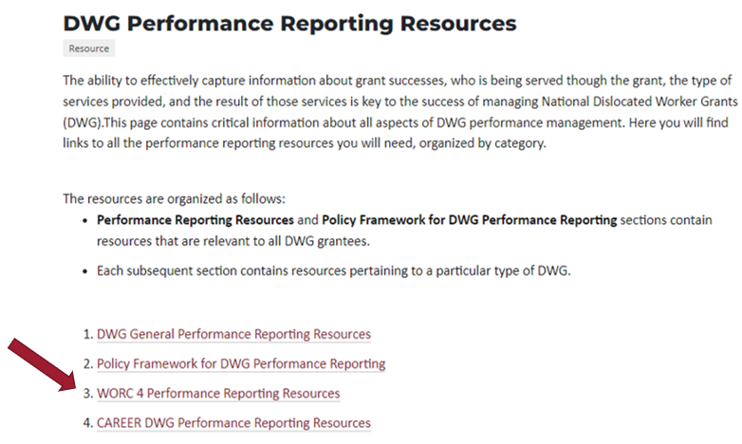
Guide to DWG Performance Reporting Resources (3)
Notes:
JESSIE
We’ll look at both, starting with the WORC 4 page

Slide 79
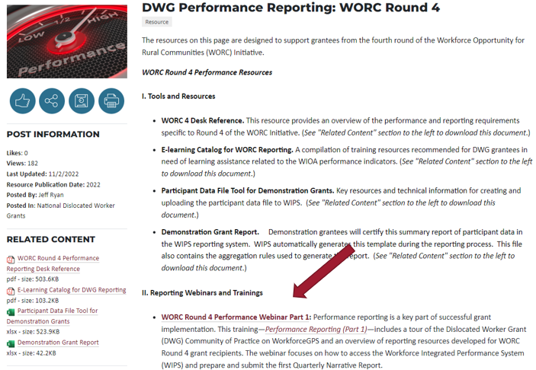
Guide to DWG Performance Reporting Resources (4)
Notes:
JESSIE
The first thing to point out here is that the WORC 4 page has a link to the previous training, which took place in October. So if you missed that training you can find it here. A recording of this training will be posted here as well.
I again want to note that the previous training has instructions on how to create an account in WIPS, so if you have not already done that please watch the recording and make sure to set up your WIPS account.

Slide 80
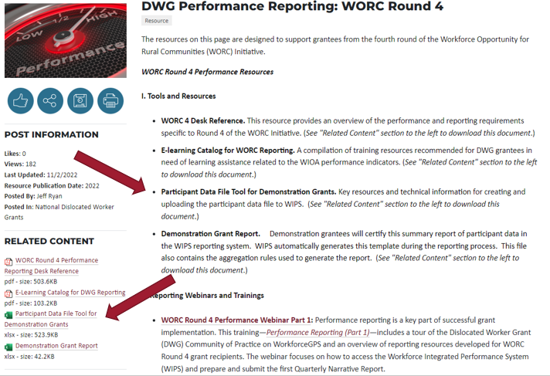
Guide to DWG Performance Reporting Resources (5)
Notes:
JESSIE
This WORC Round 4 page also has a link to the PDFT. The top arrow is pointing to where it’s described on the page, and the bottom arrow shows where it’s actually linked under Related Content. Click the link to download the tool. The structure of these workforcegps pages often requires that the actual downloadable links be located in the Related Content section as opposed to being linked in the body text.
As you can see there are other resources to explore on this page, but right now we’re going to navigate over to the General Reporting Resources page.

Slide 81
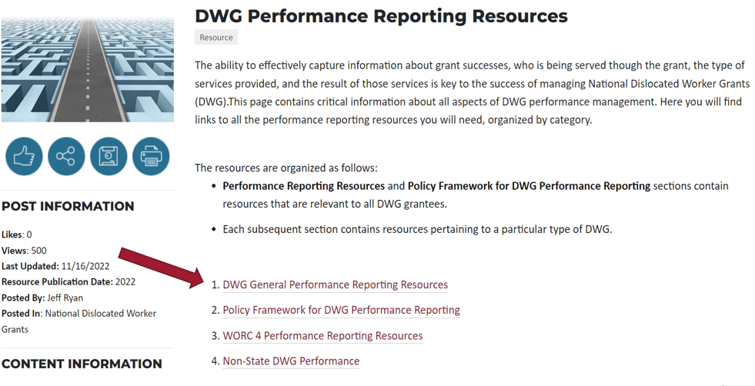
Guide to DWG Performance Reporting Resources (6)
Notes:
JESSIE
Here you can see we were just in the WORC 4 Performance Resources section that’s listed third. But now we’ll check out the DWG General Performance Reporting Resources section, which is first on the list (and that the red arrow is pointing to).

Slide 82
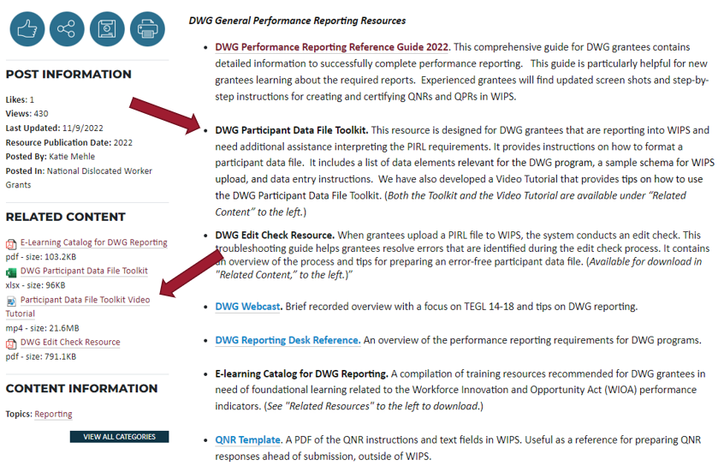
Guide to DWG Performance Reporting Resources (7)
Notes:
JESSIE
So in here you’ll notice that the PDFT also shows up. It’s worth pointing out that you should use the PDFT in the other section—the one that contains resources specifically for WORC 4. That’s because the list of required data elements is slightly different between programs.
However, if you want to watch a video tutorial of the PDFT you can find that here. The video explains how the PDFT is structured, and how grantees can use it. The structure and use is the same for both versions, there are just some small differences in content. So remember to actually use the WORC-specific version of the tool.

Slide 83
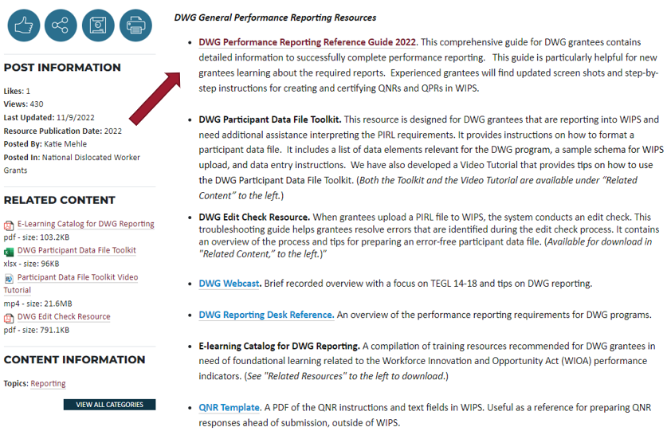
Guide to DWG Performance Reporting Resources (8)
Notes:
JESSIE
One important thing to note is that this page has a copy of the Performance Reporting Reference Guide. We highly recommend checking this out. It was updated this past summer and walks the reader through the entire reporting process. It also has lots of screenshots that illustrate how to complete each step of the process in WIPS. In this guide, WORC grantees should follow instructions pertaining to demonstration grants.

Slide 84

National Dislocated Worker Grants Quarterly Reporting Reference Guide
Notes:
JESSIE
This is the cover page of the Reporting Reference Guide. We’ve included a direct download link so you can get to it directly from these slides in addition to finding it on WorkforceGPS.

Slide 85
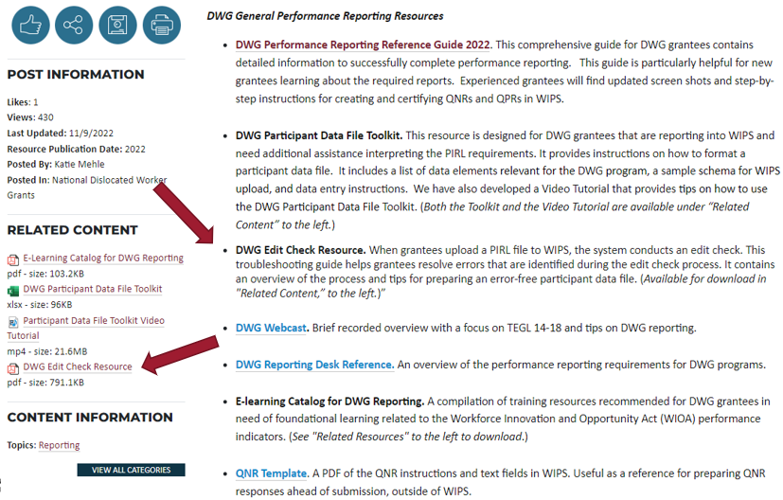
Guide to DWG Performance Reporting Resources (9)
Notes:
JESSIE
This General Resources page also has a link to the Edit Check Resource that we discussed. Like the Reporting Reference Guide, it’s listed in the main body text and the actual link to the downloadable file is on the left under Related Content.

Slide 86
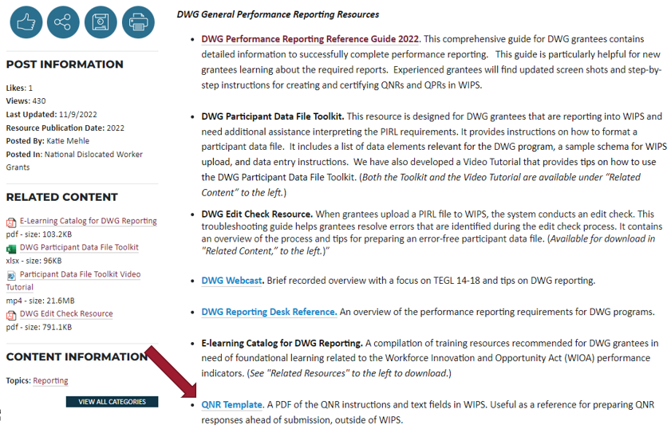
Guide to DWG Performance Reporting Resources (10)
Notes:
JESSIE
Another thing to call out is that you can find a copy of the QNR template on this page. This can be useful as you prepare your responses.
Those are the things we’ll point out for now, but the main thing to remember is that all of these can be found in the DWG Community of Practice on WorkforceGPS

Slide 87
Agenda (7)
Reporting Requirements Overview
QPR Overview
Building and Submitting the Participant Data File
WorkforceGPS Resources
Technical Assistance
The Participant Data File and Data Collection
Notes:
BEN
We’ll now wrap things up with a quick word about how to get technical assistance.

Slide 88

Federal Project Officers (FPOs)
FPOs are available to provide support—contact them at any time with questions
Notes:
BEN
​​
All the resources we just looked at on WorkforceGPS are a good first place to go if you have questions, but if you’re looking for additional support please don’t hesitate to reach out to your Federal Project Officer, or FPO. If your FPO isn’t able to answer your question themselves, they’re perfectly positioned to connect you to someone that can, whether that’s a Regional Performance Specialist or someone on our support team.​

Slide 89
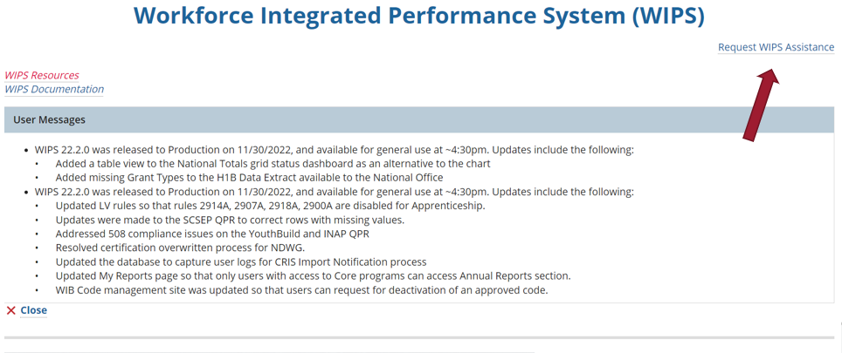
WIPS Assistance: File a TA Request (1)
Notes:
BEN
​Also, if you are having a WIPS issue, including access for new staff, you can file a TA request through WIPS.​ Click this link in the top right corner of the screen to open the TA request form, which looks like this…[advance slide]
​

Slide 90
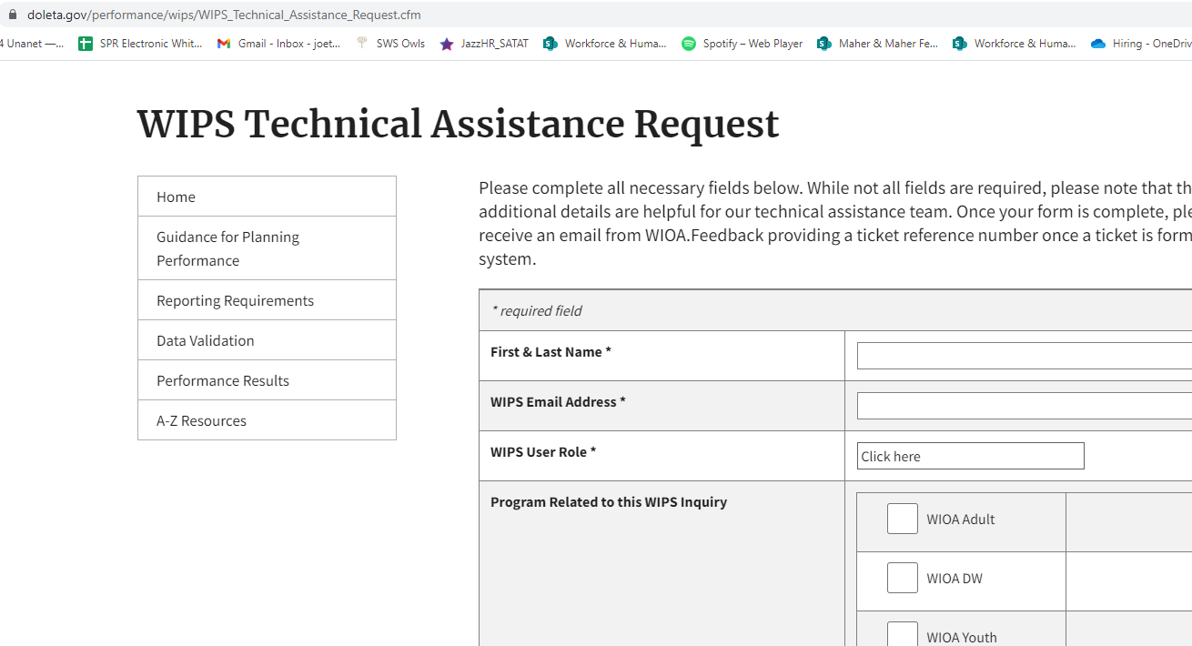
WIPS Assistance: File a TA Request (2)
Notes:
BEN
You can see the form is fairly simple—Select "DWG" for Program from the check boxes. This will ensure the ticket is routed correctly. Then describe your issue and the WIPS support team will follow through. ​
We’ve now covered all of our content and we have some time for questions.

Slide 91
Q&A
Thank you for coming today!
Notes:
Ben moderates, full team available to answer questions

