Slide 1

Legal Accessibility Requirements: 508 Compliance
PowerPoint Theme
Only use tables when standard content delivery is insufficient, never merge table cells and do not leave any cells blank.
Do not use screenshots or images of text items. All text must be editable and not blur when the screen is zoomed in.
Avoid using “Smart Art” or the “Design Ideas” tool.
Do not repurpose slide title boxes for any other use. Avoid duplicate and missing titles. Add “continued” or (1 of 3), (2 of 3), (3 of 3) at the end of the slide title (as an example) to prevent duplicate and missing title 508 errors. Every slide needs a title.
Do not use multiple spaces, empty paragraphs, or strings of tabs to visually adjust your content, as every such repeated character must then be manually stripped from all slides before posting. Instead:
  Use soft returns to bump content to the next line in lieu of spaces (Shift + Enter)
  Manage paragraph spacing and tabs in the “Paragraph” panel.
Every image or visual element used must either have alternative “alt” text applied or be marked as “decorative,” to ensure 508 compliance.
  Alt text translates visual information into verbal information, which is read aloud in screen readers, while items marked “decorative” are skipped.
    This step is required to deliver the full message provided by any graphics.
    The person who laid out the content should also provide
    that alternate information to ensure their message stays intact.
Font Type: Roboto
Bullets:
First Level
  Second level
    Third level
      Fourth level
Image Request
You may request different or additional Shutterstock images for your presentation.
Please allow two business days.
For more information, see the WorkforceGPS Shutterstock Request Quick Reference Guide

Slide 2
Intro Slide
Workforce Opportunity for Rural Communities (WORC) Initiative Round 6​
Potential Applicant Webinar

Slide 3

Moderator
Robert Kight
Division Chief, Adult Services & Governance
Office of Workforce Investment (WOI)
US Department of Labor (DOL)
Employment and Training Administration (ETA)

Slide 4
Today’s Objectives
Provide high-level overview of the WORC FOA to complement available technical assistance sessions
Provide information to help you understand the concepts and major elements of the FOA
Anticipate and clarify baseline FOA questions and details (This webcast is pre-recorded)

Slide 5
Presenters
Kinsey Walker
Cheyton Pendley ​
Program Analyst ​
Delta Regional Authority (DRA)
Rich Grogan ​
Executive Director​
Northern Border Regional Commission (NBRC)
Program Analyst
Appalachian Regional Commission (ARC)
Willette Brown​
Workforce Analyst​
US Department of Labor/ETA
Jenifer McEnery​
Grants Officer​
US Department of Labor/ETA
Sabrina Guerrier​
Grants Management Specialist​
US Department of Labor/ETA

Slide 6
WORC 6
Potential Applicant Webinar
ARC, DRA and NBRC Descriptions,
FOA Overview,
Performance Reporting,
Application Requirements, and
Pre-Applicant Technical Assistance (TA)

Slide 7
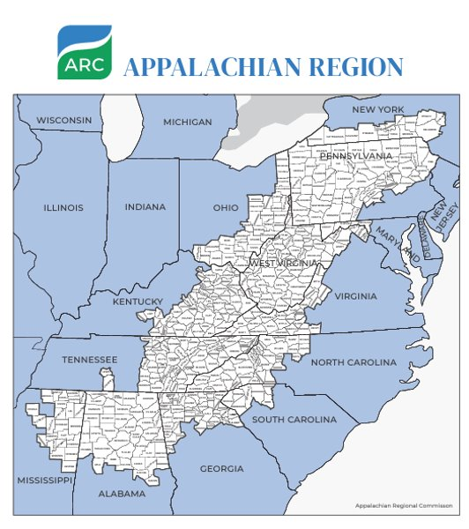
Appalachian Regional Commission​ (ARC)
The Appalachian Regional Commission (ARC) is a regional economic development agency that represents a partnership of federal, state, and local government. Appalachia is made up of 423 counties across 13 states and spans 206,000 square miles, from southern New York to northern Mississippi. The Region’s 26.3 million residents live in parts of Alabama, Georgia, Kentucky, Maryland, Mississippi, New York, North Carolina, Ohio, Pennsylvania, South Carolina, Tennessee, Virginia, and all of West Virginia.
ARC’s investment priorities are building businesses, workforce ecosystems, community infrastructure, regional culture and tourism, and local capacity building in Appalachia.

Slide 8

Appalachian Regional Commission​ (ARC)
State participation is through ARC state program managers for all 13 Appalachian states. Local participation is provided through multi-county local development districts serving 423 counties.
We have a variety of rolling and competitive funding opportunities through ARC grantmaking as well as regional programing.
  https://www.arc.gov/grants-and-opportunities/
  https://www.arc.gov/academies-and-institutes/

Slide 9
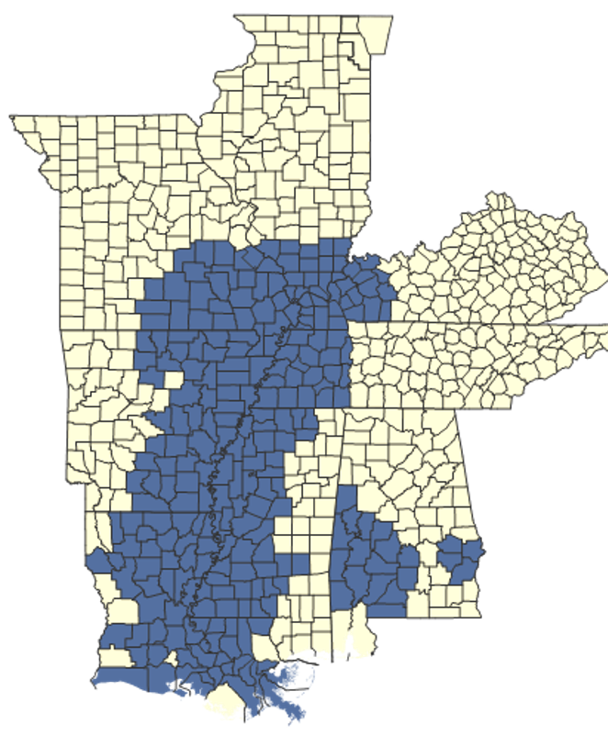
The Delta Regional Authority (DRA)
252 counties and parishes​
Mississippi Delta and Alabama Black Belt Regions​
4 Investment Priorities​
    Transportation Infrastructure​
    Basic Public Infrastructure​
    Business Development – emphasis on entrepreneurship​
    Workforce Development​
www.dra.gov

Slide 10
The Delta Authority (DRA)
Established by an act of Congress in 2000, DRA is composed of the governors of the 8 Delta states and a federal co-chair, who is appointed by the president. Local participation is provided through multi-county local development districts. DRA invests in activities that address the four goals identified in the regional development plan:​
  Goal 1: Invest in Public Infrastructure​
  Provide reliable transportation, utility, telecommunication, digital, and other services;
  encourage resource stewardship; promote digital inclusion; and advance environmental justice. ​
  Goal 2: Nurture Local Workforce Ecosystems​
    Provide workforce development resources and opportunities and access to services, funding, and programs that enable career stability, such as healthcare, education, and food security. ​
  Goal 3: Promote Business Growth and Entrepreneurship​
  Continue to support employers and attract new ones to the region and to promote the long-term growth of small businesses, a reliable source of new jobs. ​
  Goal 4: Support Community Placemaking and Capacity-Building​
  Enhance sustainable and inclusive quality of life and community capacity with a focus on community connectedness, leadership development, and federal support, especially for under-resourced groups.

Slide 11
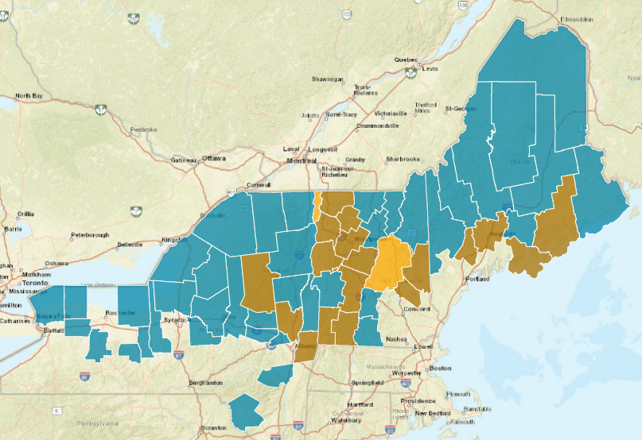
Northern Border Regional Commission (NBRC)
Created by Congress in 2008, the NBRC is a federal-state partnership serving the economic and community development needs in northern counties across Maine, New Hampshire, New York, and Vermont. Since its creation, the NBRC has awarded more than $214.8 million to 557 projects. These investments have leveraged more than $695.9 million in other public and private funds.
The Commission has long supported innovative approaches to workforce development in the region, including efforts focused on the future of the forest products industry, and training for roles in the region’s specialized manufacturing businesses. The NBRC is excited to partner with the Department of Labor to bring even more innovative approaches to our region.
NBRC Resource Map

Slide 12
WORC 6
FOA Overview
WORC Initiative, Eligibility, Grant Activities, and Partners

Slide 13
What is the WORC Initiative?
This is the 6th round of the WORC Initiative Grants
WORC is a partnership amongst the Employment & Training Administration (ETA), the Appalachian Regional Commission, (ARC) Delta Regional Authority (DRA) and the Northern Border Regional Commission (NBRC)
Grant awards for eligible entities serving participants who live and work in the Appalachian, Delta and the Northern Border regions
The WORC grants are designed to address the workforce and economic development challenges facing communities in these regions

Slide 14

What is the Purpose of the WORC Initiative? 3
The purpose of this initiative is to create economic mobility, address historic inequities for marginalized communities of color, rural areas and other underserved and underrepresented communities, and connect workers who live or work in the Appalachian, Delta, and Northern Border regions, to stable, high-quality, family-sustaining jobs, enabling them to remain and thrive in these communities.

Slide 15
Eligibility: Applicants 3
Wide range of entities eligible to apply, as described in the FOA
Regardless of type of organization, or where an organization is located, services MUST be delivered only to eligible participants who live in the Appalachian, Delta and the Northern Border regions

Slide 16
What is the Purpose of the WORC Initiative (con’t)? 3
Successful applications will propose projects that demonstrate clear and consistent strategies, activities, partnerships, and results that are built around the three Focus Areas that are central to achieving the purpose of the WORC initiative:
    Focus Areas 1: Increasing Access to Good Jobs
    Focus Areas 2: Prioritizing Equity
    Focus Areas 3: Sustaining Impact

Slide 17
Eligibility: Participants 3
Three types of eligible participants:
  Dislocated Workers As defined in WIOA sec 3(15)
  Incumbent Workers
    For the purposes of this FOA, this term refers to individuals who are employed but need employment and training services to secure full-time employment, advance in their careers, or retain their employment
  New Entrants to the Workforce
    For the purposes of this FOA, the category of “new entrants to the workforce” refers to those who have never worked before or who have been out of the workforce for a long enough time to make it as if they are entering the workforce for the first time

Slide 18
Grant Activities
WORC 6 grants are designed to offer flexibility and promote innovative solutions to specific challenges
Allowable activities in the following categories:
  Delivering training or other workforce-related services
  Providing a wide range of supportive services to participants
  Serving and Partnering with Employers
  Strategic Planning for Economic Transformation
  Equipment Purchase and Facility Renovations

Slide 19
Required Grant Partners 3
An application must include the following three types of partner entities:
  Two Employer/Industry Representatives;
  One State or Local Workforce Development Board, American Job Center operator partner program, training provider, or similar entity (except where such organization is the applicant); and
  One Community-Based Organization (except where such organization is the applicant)

Slide 20
WORC Performance Reporting3
Grant proposals must indicate the performance metrics to be considered as part of the project
Proposals must demonstrate how these measures are reflective of the project goals and strategy
All grants are also measured according to the primary indicators of performance established in the Workforce Innovation and Opportunity Act (WIOA)

Slide 21
WORC 6
Performance Reporting

Slide 22
WORC Performance Reporting 3
WORC grantees will use the Workforce Integrated Performance System (WIPS) to submit performance reports
There are 2 reports due quarterly
  Quarterly Performance Report (QPR)
  Quarterly Narrative Report (QNR)
Extensive data collection and reporting is needed for every participant served
Prospective applicants should preview a document called the Participant Data File Tool, or PDFT, to understand data collection and reporting required, available on WorkforceGPS (https://dwg.workforcegps.org)

Slide 23
WORC Performance Reporting 3
Establish data collection processes—forms, protocols, etc.
Prospective grantees should prepare and budget for the resources needed to fulfill the performance reporting requirements, including having the appropriate staffing and technological capacity.
Track participant data using…
  Existing Case management or Management Information System (MIS)
  Third party vendor
  Spreadsheet software
  Database
  Other

Slide 24
WORC 6
Application Requirements
Details and Deadlines

Slide 25
Funding Opportunity Announcement – Read Carefully 3
The Funding Opportunity Announcement (FOA) postings:
Grants.gov: https://www.grants.gov/search-results-detail/353004
ETA website: https://www.dol.gov/agencies/eta/grants/apply/find-opportunities
ARC website: https://www.arc.gov/
DRA website: https://www.dra.gov/
NBRC website: https://www.nbrc.gov/
If you encounter a problem with Grants.gov, and do not find an answer in any of the other resources, call 1-800-518-4726 or 606-545-5035 to speak to a Customer Support Representative or email: support@grants.gov

Slide 26
Content and Form of Application Submission
Section IV.B
SF-424 Application For Federal Assistance
Project Budget (SF-424A and Budget Narrative)
Project Narrative
Attachments to the Project Narrative

Slide 27
SF-424 and Project Budget
Section IV.B.1 and Section IV.B.2
SF-424 Application For Federal Assistance
  Must register with SAM.gov
  Employer Identification Number (EIN) and Unique Entity Identifier (UEI)
  Regional Designation (ARC, DRA, or NBRC) on line 15
  Fiscal Agent on line 15
  Authorized Representative signature certifies compliance with WIOA
Project Budget
  SF-424A: Budget Information Form
  Budget Narrative
You must ensure that the funding amount requested is consistent across all parts and sub-parts of the application!

Slide 28
Project Narrative 3
Section IV.B.3
Project Narrative
  20 double-spaced singled-sided 8.5 x 11 pages with Times New Roman 12-point text font and 1-inch margins
  You must number the Project Narrative beginning with page number 1
  You must use the same section headers identified for each Project Narrative section, as in the FOA
  Guidelines are found in Section IV.B.3, Project Narrative

Slide 29
Attachments to the Project Narrative 3
Section IV.B.4
In addition to the Project Narrative, applicants must submit attachments:
  Must be clearly labeled
  Only attachments listed in Section IV.B.4 of the FOA are excluded from the page limit
  No additional materials will be considered
  See Section IV.B.4 for information on valid attachment file names

Slide 30
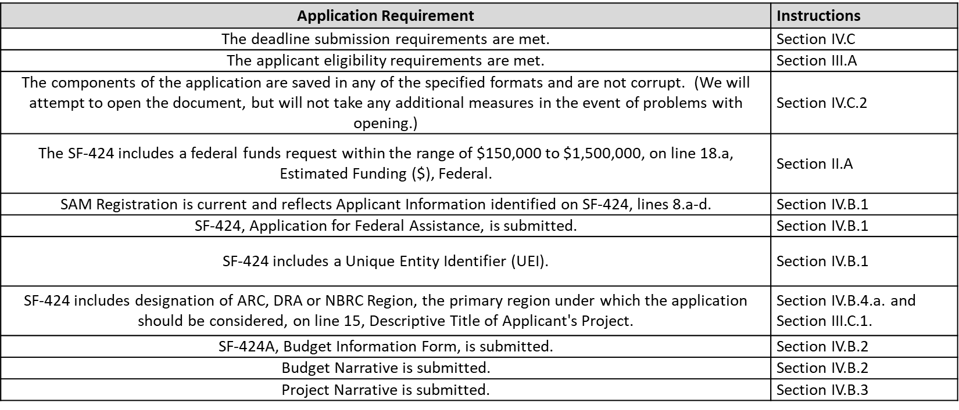
WORC 6 Application Screening Criteria 3
Section III.C.1

Slide 31
WORC 6 Application Screening Criteria 3
Section III.C.2
Number of Application Submissions
  DOL will consider only one application from each organization
  If we receive multiple applications from the same organization, we will consider only the most recently received application that met the deadline
  If the most recent application is disqualified for any reason, we will not replace it with an earlier application
  In addition to the Project Narrative, applicants must submit attachments

Slide 32
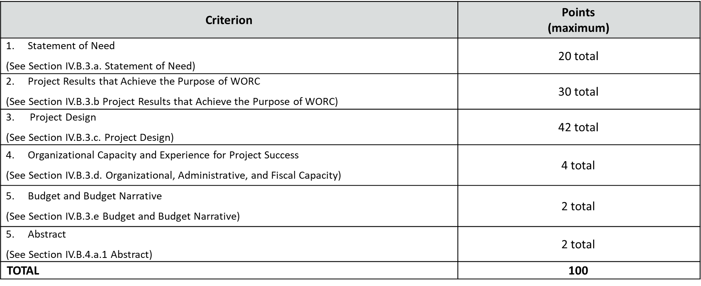
WORC 6 Application Review Information 3
Section V.A.

Slide 33
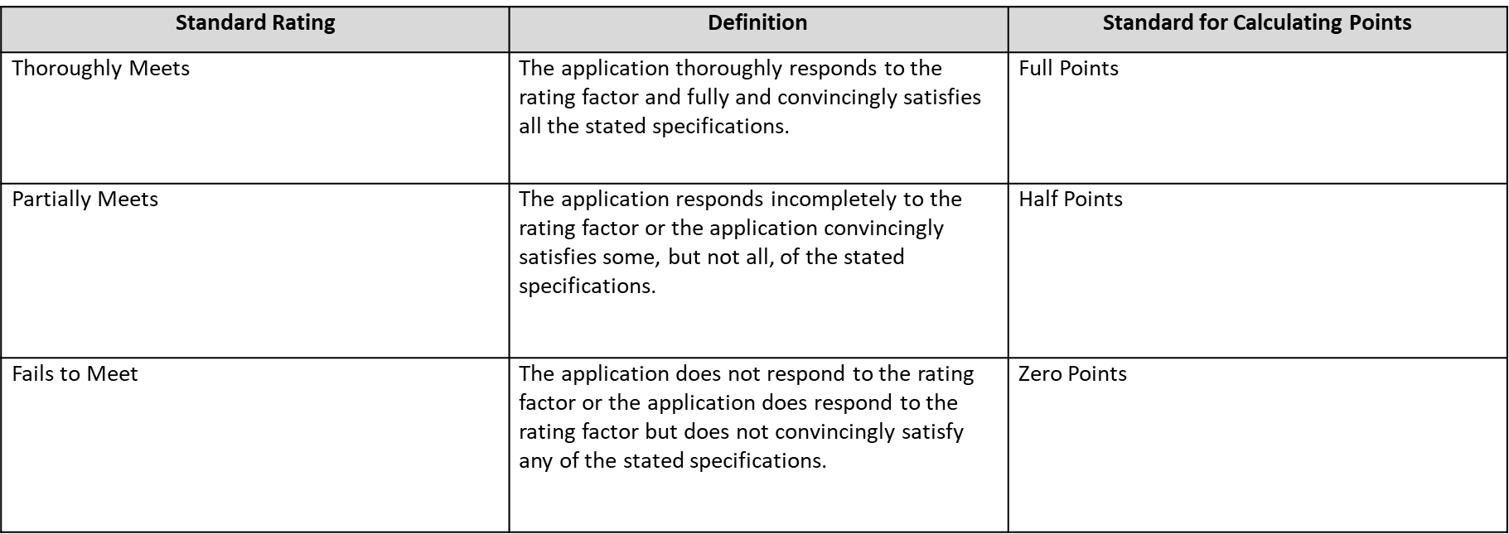
WORC 6 Standards for Evaluating Applications 3
Section V.A.

Slide 34
WORC 6 Review and Selection Process 3
Mert Review and Selection Process
A technical merit review panel will carefully evaluate applications against the selection criteria to determine the merit of applications. These criteria are based on the policy goals, priorities, and emphases set forth in this FOA. Up to 100 points may be awarded to an applicant, depending on the quality of the responses provided.
Prior to making an award, ETA will review information available through various sources, such as the OMB-designated repository of government-wide eligibility qualification or financial integrity information, such as Federal Awardee Performance and Integrity Information System (FAPIIS), and "Do Not Pay". ETA will comply with the requirements of 2 CFR Part 180 codified at 2 CFR Part 2998 (Non-procurement Debarment and Suspension).
Risk Review Process

Slide 35
Proposal Submission 3
Section IV.C
Applications must be received by 11:59 p.m. (ET) on the closing date:
June 20, 2024
Method of Submissions: Online at www.grants.gov
Reference FOA-ETA-24-08

Slide 36
Grants.gov Help Desk and Agency Contact 3
Application Submission Difficulties in Grants.gov
Contact Information
Grants.gov Customer Service
  Phone: 1-800-518-4726 or 606-545-5035
  Email: support@grants.gov
  The Grants.gov Contact Center is open 24 hours a day, 7 days a week but closed on federal holidays
FOA Technical Questions
  Office of Grants Management (OGM)
  Email: DOL-ETA-DWG@dol.gov
Reference: FOA-ETA-24-08

Slide 37
Pre-Application Workshops and Resources 3
ARC, DRA and NBRC provide pre-application technical assistance, resources, and may offer pre-application workshops. Additional information is available at:
ARC:
https://www.arc.gov/grants-and-opportunities/worc/
DRA:
https://dra.gov/programs/human-infrastructure/workforce/worc/
NBRC:
https://www.nbrc.gov/content/WORC

Slide 38
More Information 3
FAQs:
  https://www.dol.gov/agencies/eta/grants/apply/find-opportunities
  Phone: 1-800-518-4726 or 606-545-5035
  Email: support@grants.gov
  The Grants.gov Contact Center is open 24 hours a day, 7 days a week but closed on federal holidays
FOA Technical Questions
  Email the Office of Grants Management (OGM) at the U.S. Department of Labor at: DOL-ETA-DWG@dol.gov
Reference: FOA-ETA-24-08

Slide 39

Thank You!
We look forward to seeing you on WorkforceGPS.
Need Help?
Email: Support@WorkforceGPS.org

