Slide 1

Making the Case for
What Works: Using Evidence-Based Practices to Support Innovation
Online Tutorial

Slide 2
Evidence-based practices can be used to:
Inform
Improve
Communicate
2

Slide 3

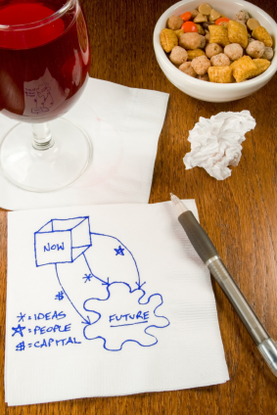
Introduction
What’s
going on
here?

Slide 4

Meet Rosa
4

Slide 5

Meet Hannah
5

Slide 6

Meet Miguel
6

Slide 7

So…..
What is evidence-based practice?

Slide 8
What is Evidence-Based Practice?
Finding, appraising, and using research
Making sound program design decisions

Slide 9



Origins

Slide 10
Evidence-Based Practices
Professional Expertise & Experience
Customer Needs
Best Research Evidence

Slide 11
So…..1
Why should I use evidence-based practice? What’s
in it for me?

Slide 12
Evidence-Based Practices
Make informed design decisions
Professional Expertise & Experience
Workforce System Needs
Learn from the lessons of others
Make a case for how your strategy works
Strengthen your proposals
12

Slide 13
So…..2
How do I use evidence-based practice?

Slide 14
How to Build
Your Case
14

Slide 15
How to Build Your Case
STEP TWO:
Ask the Question
STEP THREE: Acquire the Evidence
STEP FIVE: Apply the Evidence
STEP FOUR: Appraise the Evidence
STEP ONE: Assess the Problem & Clarify the Goal

Slide 16
Step One:
Assess Problem & Clarify Goal
STEP ONE: Assess the Problem & Clarify the Goal

Slide 17
Step Two:
Ask the Question
STEP ONE: Assess the Problem & Clarify the Goal
STEP TWO:
Ask the Question

Slide 18
What workforce strategies can help improve employment, retention, and income opportunities for young adults who have aged out of the foster care system?
18

Slide 19
Step Three:
Acquire the Evidence
STEP ONE: Assess the Problem & Clarify the Goal
STEP TWO:
Ask the Question
STEP THREE: Acquire the Evidence

Slide 20
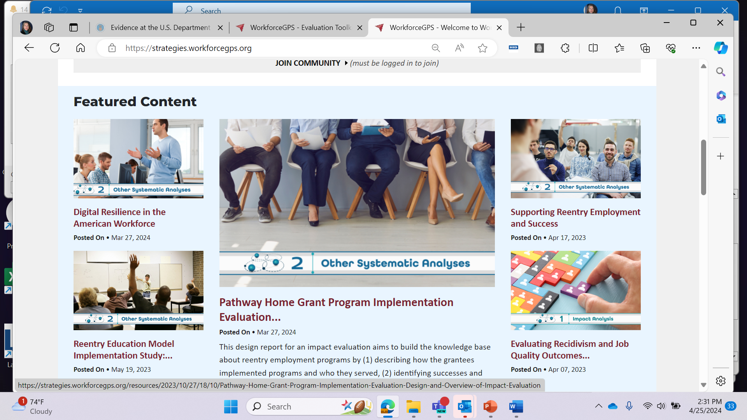
Workforce System Strategies

Slide 21

Step Three: Acquire the Evidence
21

Slide 22
Step Four:
Appraise the Evidence
STEP TWO:
Ask the Question
STEP THREE: Acquire the Evidence
STEP FOUR: Appraise the Evidence
STEP ONE: Assess the Problem & Clarify the Goal

Slide 23
Types of Evidence & Levels of Rigor
Rigorous Research
Randomized Controlled Trials (Randomization)
Quasi-Experimental
Statistical Modeling
Impact Evaluations
Outcome Evaluations
Level 1
Systemic Analyses
Characterization/Quantification
Outcome/Performance Analyses
Literature Reviews
Process Studies that Include Performance Data
Pilot/Demonstration Reports
Level 2
Supporting Resources
Models
Frameworks
Toolkits
Level 3

Slide 24

Step Four: Appraise the Evidence
24

Slide 25
Step Five:
Apply the Evidence
STEP
TWO:
Ask the Question
STEP THREE: Acquire the Evidence
STEP
FIVE:
Apply the Evidence
STEP
FOUR: Appraise the Evidence
STEP ONE: Assess the Problem & Clarify the Goal

Slide 26
Step Five:
Apply the Evidence 1
STEP TWO:
Ask the Question
STEP THREE: Acquire the Evidence
STEP
FIVE: Apply the Evidence
STEP FOUR: Appraise the Evidence
STEP ONE: Assess the Problem & Clarify the Goal
Logic Model
Goals
Inputs
Activities
Outputs
Outcomes
Impacts

Slide 27
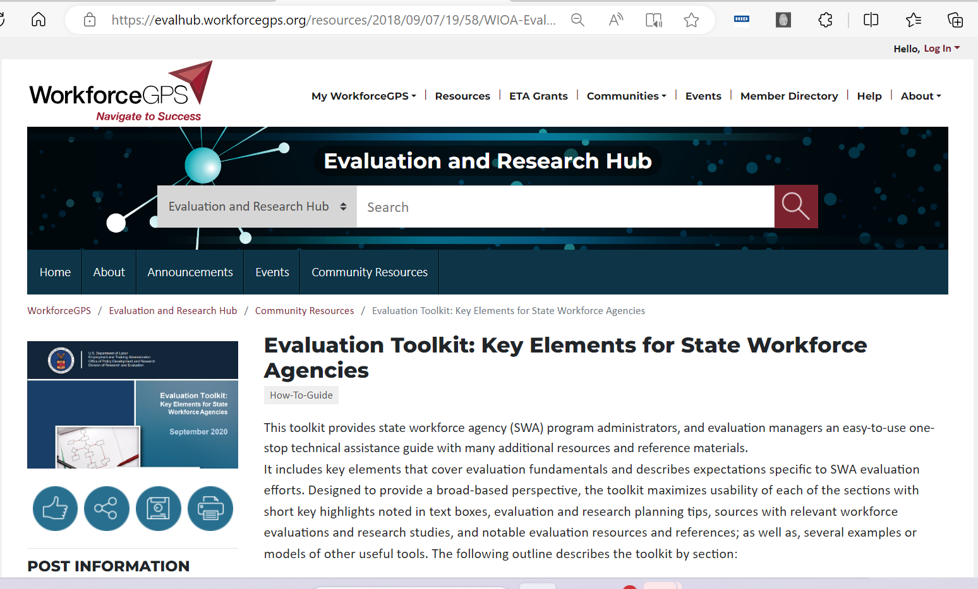
Logic Models and Other Evaluation Resources

Slide 28
Evidence-Based Practice in Action – Hannah
28

Slide 29
Evidence-Based Practice in Action – Rosa
29

Slide 30
Evidence-Based Practice in Action – Miguel
30

Slide 31
We All Need Evidence

Slide 32
Search for Relevant Evidence-Based Practices:
Workforce System Strategies
WSS is an online resource that highlights evidence-based research, emerging program practices, and useful guides. WSS is a searchable database for workforce professionals and their partners who strive to improve outcomes for job seekers and employers through evidence-based informed decisions.
https://strategies.workforcegps.org/
Evaluation and Research Hub
The Evaluation and Research Hub (EvalHub) is a community point of access to support workforce development professionals in their efforts to use evaluations to improve workforce system services and strategies and to choose evaluations and research to help inform program policies and evidence-based practices.
https://evalhub.workforcegps.org/
Using Evidence-Based Practices to Support Innovation

Slide 33
Thank You!
For questions, contact workforcepractices@dol.gov
We are glad you joined us today.

