Slide 1
Best Practices for Career Pathways & Credentials: the Minnesota and Kansas Models
Webinar Date: January 10, 2014
Presented by:
Region 5
U.S. Department of Labor
Employment and Training Administration

Slide 2
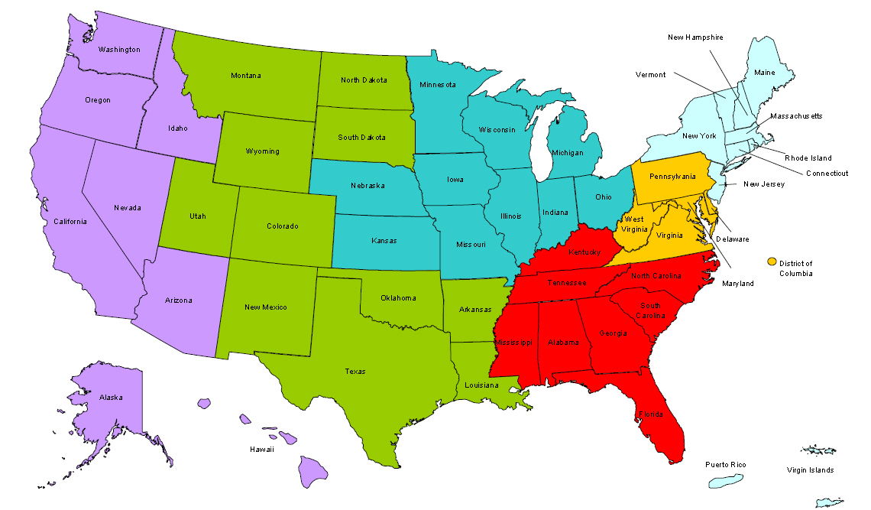
Where are you?
Enter your location in the Chat window – lower left of screen

Slide 3
Polling Question: Where are you at with Career Pathways?
How would you describe your level of engagement with Career Pathways?
Choose the answer that best reflects you (or your group):
I’m just learning about Career Pathways
I’m familiar with Career Pathways but am not currently planning or implementing a model
My area has committed to a Career Pathways approach and is in the planning stages
My area is currently implementing a Career Pathways model

Slide 4


Agenda
Welcome and Introductions Danielle Waddell, Federal Project Officer, USDOL/ETA
Keynote Eric Seleznow, Acting Assistant Secretary USDOL/ETA
Practitioner Presentations Minnesota and Kansas
Q & A
Wrap-Up

Slide 5
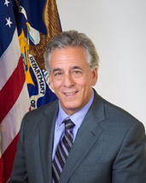
Keynote
Eric Seleznow
Acting Assistant Secretary
Employment and Training Administration
Eric focuses on two key outcomes - a properly prepared workforce to meet the current and future demands of the nation’s employers, and providing opportunities for all Americans to succeed in the 21st-century workforce. He has over twenty-five years of experience in the workforce field, including Executive Director of the Governor’s Workforce Investment Board in the State of Maryland, and as Director of Workforce Services for the Montgomery County Department of Economic Development, where he oversaw the County’s workforce development efforts.

Slide 6
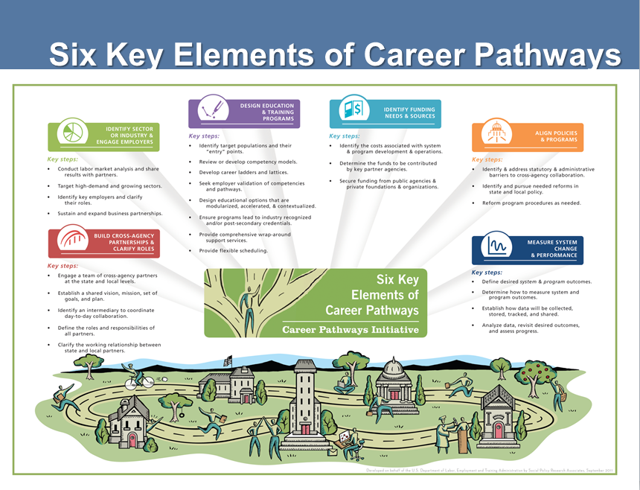
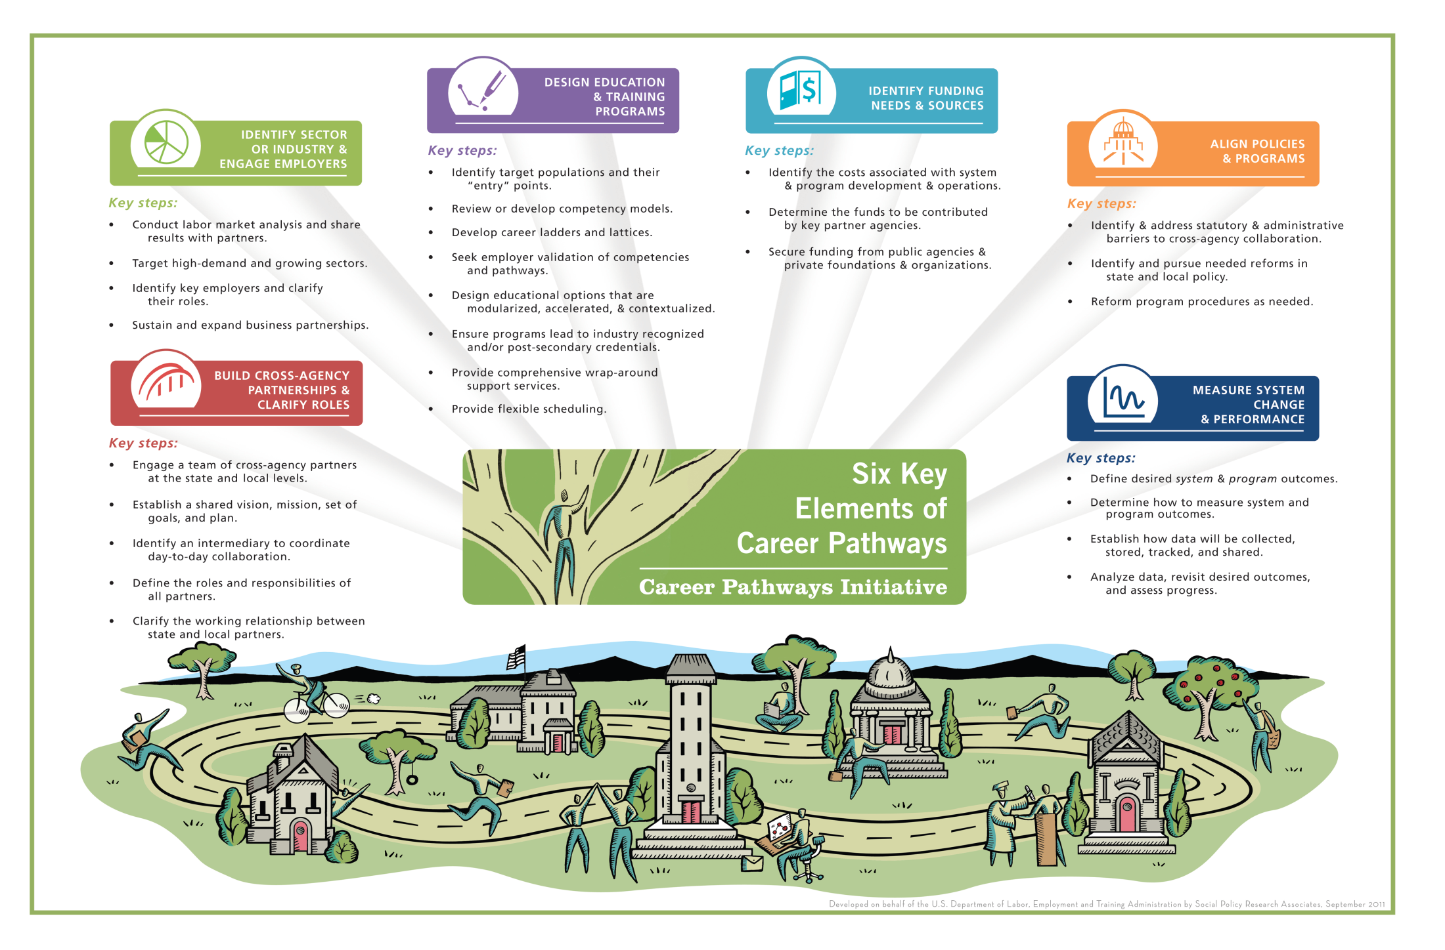
Six Key Elements of Career Pathways
Notes:
NOTES
Note that the text is programmed to automatically appear. All the bullets will appear all at once after a very brief delay.

Slide 7
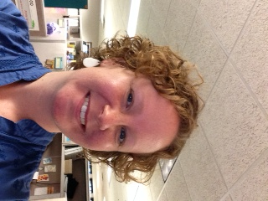
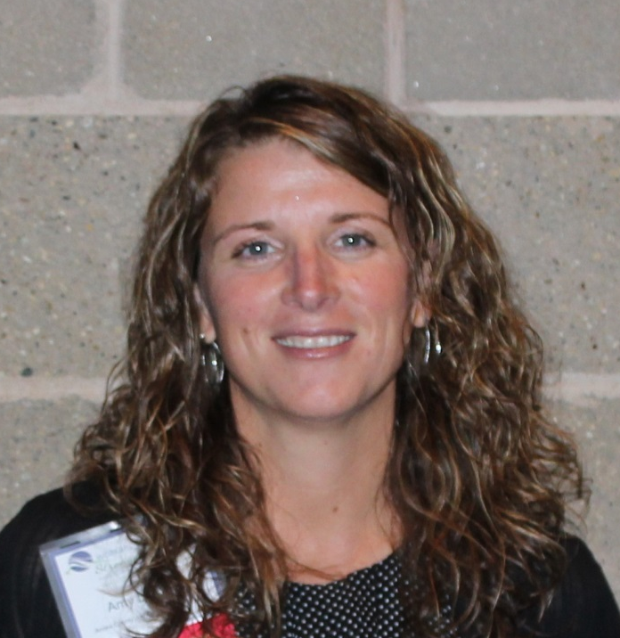
Career Pathways: The Minnesota Story
Annie Welch, Principal Planner
Dislocated Worker and Adult Programs
Minnesota Department of Employment and Economic Development
Amy Lord, Planning Coordinator
Anoka County Job Training Center

Slide 8
Career Pathways: Minnesota State Structure
State agency structure similar to that represented in the joint letter from the DOL, DOE and HHS;
CLASP’s Alliance for Quality Career Pathways;
Joyce Foundation Shifting Gears Initiative - FastTRAC (Training, Resources, and Credentialing) Adult Career Pathways;
Continued support from the United Way and other philanthropic partners;
Direct legislative appropriation to support FastTRAC Adult Career Pathways (which translates to bigger picture systems and partnerships);
Additional state-funded workforce development programming incorporates the CP model.

Slide 9

Career Pathways: Minnesota State Structure
Similar state agency structure:
  Department of Employment and Economic Development (DEED)
  Governor’s Workforce Development Council (GWDC)
  Department of Education Adult Basic Education (MDE ABE)
  Department of Human Services (DHS)
  Department of Corrections (DOC)
  Department of Labor and Industry (DLI)
  Minnesota Office of Higher Education (MOHE)
Many partners:
  Employers
  Labor Organizations
  Community College System
  Local Partners: Workforce Service Areas and Community Based Organizations
  Minnesota Workforce Council Association (MWCA)
  Minnesota State Colleges and Universities (MNSCU)
  Philanthropic Partners – United Way, Joyce, Otto Bremer, Irvine Foundations

Slide 10
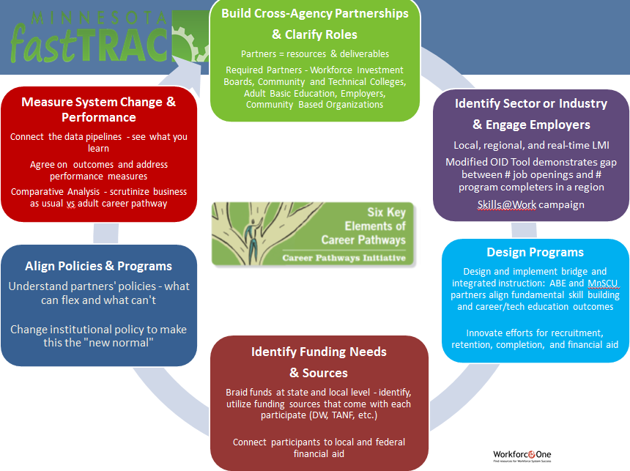


Build Cross-Agency Partnerships
& Clarify Roles
Partners = resources & deliverables
Required Partners - Workforce Investment Boards, Community and Technical Colleges, Adult Basic Education, Employers, Community Based Organizations
Identify Sector or Industry
& Engage Employers
Local, regional, and real-time LMI
Modified OID Tool demonstrates gap between # job openings and # program completers in a region
Skills@Work campaign
Design Programs
Design and implement bridge and integrated instruction: ABE and MnSCU partners align fundamental skill building and career/tech education outcomes
Innovate efforts for recruitment, retention, completion, and financial aid
Identify Funding Needs
& Sources
Braid funds at state and local level - identify, utilize funding sources that come with each participate (DW, TANF, etc.)
Connect participants to local and federal financial aid
Align Policies & Programs
Understand partners' policies - what can flex and what can't
Change institutional policy to make this the "new normal"
Measure System Change & Performance
Connect the data pipelines - see what you learn
Agree on outcomes and address performance measures
Comparative Analysis - scrutinize business as usual vs adult career pathway

Slide 11

Career Pathways: Credential Attainment
Not unique to Minnesota:
Strong focus on industry- recognized credentials that helps our program participants obtain, retain, and advance in employment;
DOL’s definition of credential as outlined in TEGL 15-10;
Career Pathways encourage flexibility to support individuals to obtain credentials while they are working.

Slide 12
Career Pathways: Leveraging WIA Funds
Workforce Investment Act Adult
  Many local partners “co-enroll” individuals in WIA Adult and a Career Pathways program such as FastTRAC Adult CP.
  Eligibility not an issue.
Workforce Investment Act Dislocated Worker
  Not as common with DW, as the “cohort model” is often challenging, and DWs often have a plan in mind.
WIA Governor’s Reserve – 10 percent
  Was a great source to supplement CP work because it was quite flexible.
Minnesota Dislocated Worker
  Added flexibility, provided eligibility.

Slide 13

Career Pathways: System Challenges
Challenges
  When to “exit” – not at time of last service for CP;
  Pressure to exit as “entered employment”;
  How to track – Workforce One has required “retro-fitting”;
  Definition of CP varies;
  Data sharing agreements and data compatibility;
  Braiding funding requires multiple (often duplicative) reporting mechanisms;
  Funding timelines and eligibility vary; and
  Folks who are underemployed at time of enrollment (but still employed) are not included in WIA performance measures.

Slide 14

Career Pathways: Partnerships
Local employers and labor market drive the Career Pathway.
Identify the need in your community.
Meet with employers to see what skill gaps they are experiencing and what training will benefit new hires.
Work with the local colleges to build the right training program
Partner with Adult Basic Education to prepare low level learners to enter the college level training successfully.

Slide 15
Career Pathways:
Integration with the Workforce System
The Role of the WorkForce Center System
  Employer/ Education/Community relationships;
  Recruiting;
  Screening;
  Career planning and assessments;
  Access to several funding sources;
  Wrap around services;
  Support services; and
  Job placement.

Slide 16
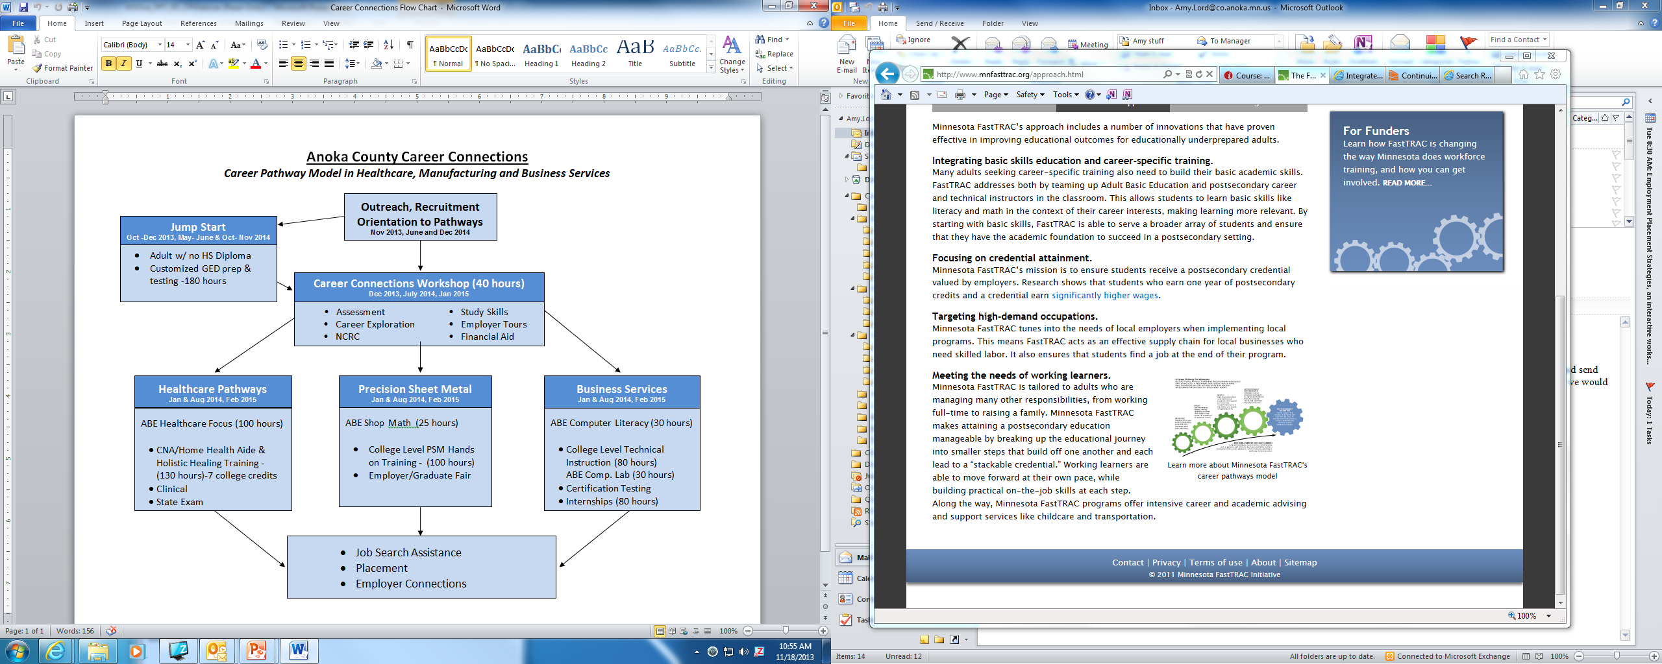
Career Pathways: Local Impact

Slide 17
Career Pathways: Local Impact
Positive Impacts:
Built capacity for large population to obtain a credential in a high demand occupation;
Credit-based training: built confidence and a clear path to continue education;
Increased partnership/understanding of colleges, ABE, employers and WorkForce Center; and
Streamlined services and one contact for student and educators.
Challenges:
Funding: braiding, timelines, duplicative reporting, and uncertainty;
We need FAFSA eligible programs that are short term and lead to credential;
Resources/ Support services including child care assistance and housing are not available for everyone (income guidelines); and
Colleges may not recognize the value of ABE training vs. Developmental Education classes.
Advice starting up – Make sure you have the right people in the planning process.

Slide 18

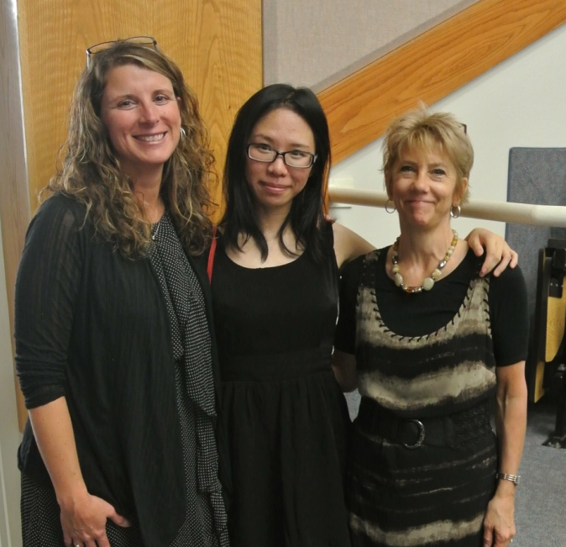
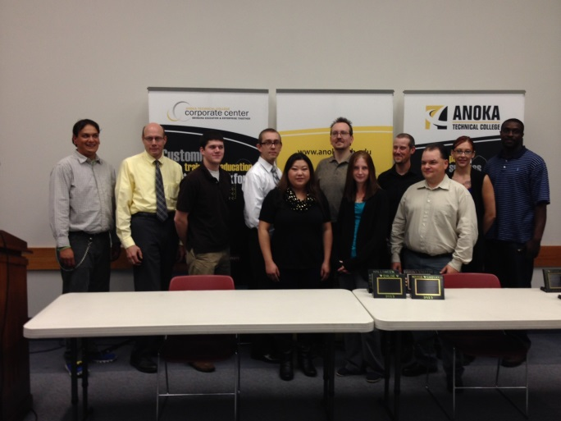
Career Pathways: Local Impact
Success Stories
PSM
Fall 2013
HCP
Spring 2012
HCP
Spring 2013

Slide 19

Questions & Answers

Slide 20
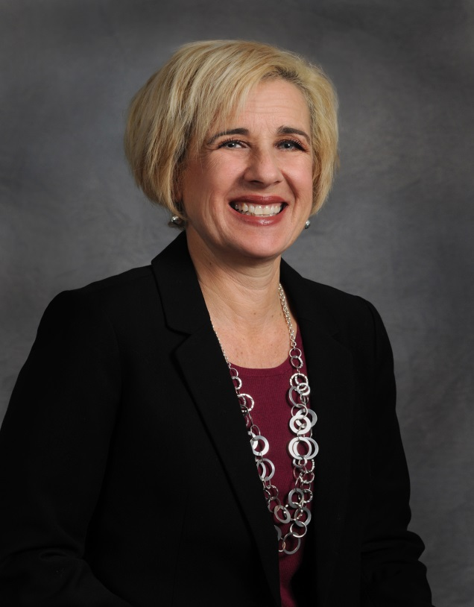

Career Pathways: the Kansas Story
Zoe Thompson
Director, Workforce Training and Education, Kansas Board of Regents and Kansas Department of Commerce
Katie Givens
Director, One Stop Operations,
Workforce Alliance of South Central Kansas

Slide 21
Career Pathways: Kansas State Structure
Career Pathways Model
Integrated in Every Initiative
Accelerating Opportunity: Kansas (AO-K)
Excel in Career Technical Education Initiative
Program Alignment Process
Workforce Aligned with Industry Demand (AID)
TAACCCT grants
Advancing CTE in Career Pathways

Slide 22
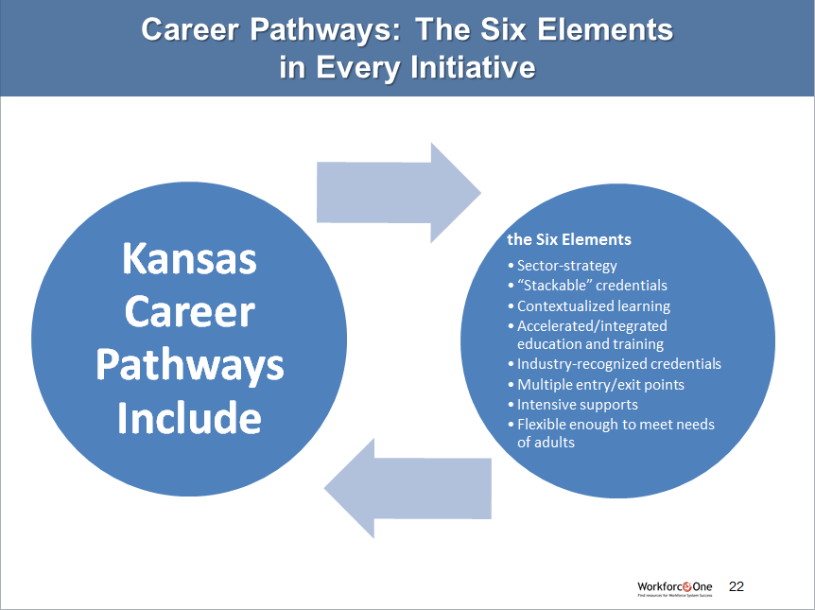
Career Pathways: The Six Elements in Every Initiative
Kansas Career Pathways Include
the Six Elements
Sector-strategy
“Stackable” credentials
Contextualized learning
Accelerated/integrated education and training
Industry-recognized credentials
Multiple entry/exit points
Intensive supports
Flexible enough to meet needs of adults

Slide 23
Career Pathways: Kansas Partnerships
Partnerships are Key to Success:
Kansas Department of Commerce and Kansas Board of Regents – liaison position
Other agency partners: Department of Labor, Department for Children and Families, Department of Education (K-12)
Community and Technical Colleges including Adult Education Programs
Local Workforce Investment Boards, State Workforce Investment Board
Employers and Businesses
Community Based Organizations/Philanthropic Partners
Universities

Slide 24
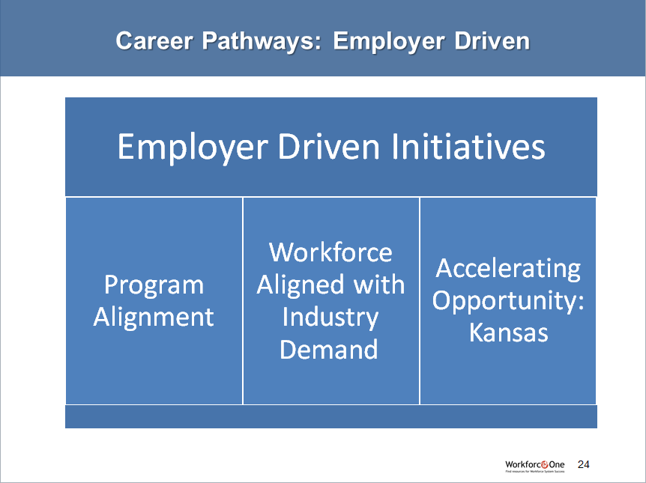
Career Pathways: Employer Driven
Employer Driven Initiatives
Program Alignment
Workforce Aligned with Industry Demand
Accelerating Opportunity: Kansas

Slide 25

Career Pathways: Employer Engagement
Employer Engagement Drives Success and Credential Attainment
Employers Drive the Process – provides better structure, connects employers and employees for better results early on
Career line of sight, leads to industry recognized credentials

Slide 26
Career Pathways: Kansas Successes
Successes at the State Level
AO-K – Partnership with Department for Children and Families provides tuition scholarships for AO-K enrolled students that are TANF eligible who complete a 12 credit career pathway
Program Alignment Process – employer driven process aligns career/technical postsecondary programs in a career pathway with stackable credentials and multiple entry/exit points

Slide 27

Career Pathways: Kansas Challenges
Challenges at the State Level
Data collection across agencies AND initiatives is challenging
-Kansas WDQI grant will address some of these issues. Scope includes integration of adult education data systems and public workforce system
-Obtaining verification of student awarded industry credentials ongoing challenge – need national clearinghouse

Slide 28






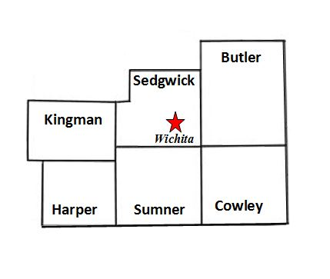
Career Pathways: South Central Kansas
No Wrong Door Approach

Slide 29



Career Pathways: South Central Kansas
Building Cross-Agency Partnerships and Clarify Roles
Resource Mapping
Identify common services and resources in the community and prevent duplication of services for mutual customers.
Clarified stakeholders roles and goals
Narrowed scope to key providers of Career
Pathway components services for low skilled or underskilled adults
‘No Wrong Door Approach’ meant extensive work on:
  Common Intake
  Common Assessments
  Aligned Policies and Programs
  Identified Funding Sources

Slide 30

Career Pathways: South Central Kansas
Identify Sector or Industry and Engage Employers
Engaging Employers
Engaged local economic development organizations
Kansas WorkReady! Certificate
Employer surveys
Employer roundtable meetings
  Started with employers
  Now includes education and training providers

Slide 31

Career Pathways: South Central Kansas
Program Design
Two fronts to program design
Employers engaged in development of
curriculum with Education/Training providers
Job Seekers; preparation to be ready to enter the training

Slide 32



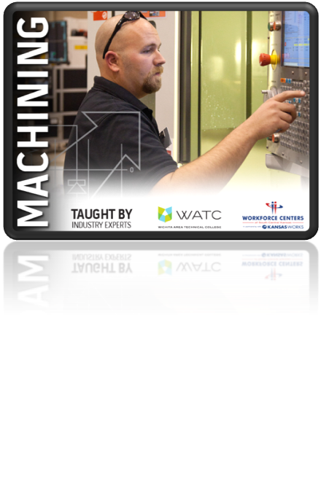
Career Pathways: South Central Kansas
Engage Employers + Program Design
Engaged Employers
Program Design

Slide 33

Career Pathways: South Central Kansas
Engage Employers + Program Design
Engaged Employers
Cross- Agency Partnerships
Program Design

Slide 34
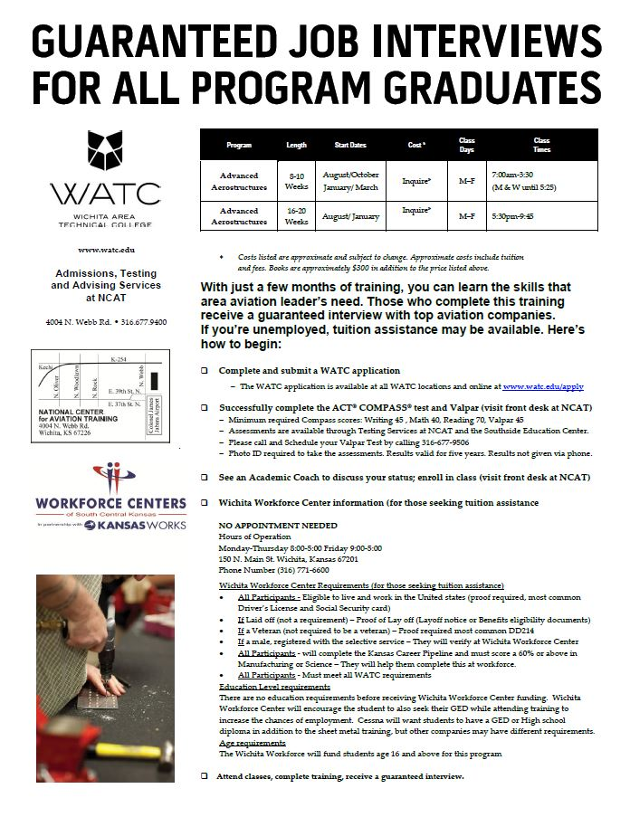
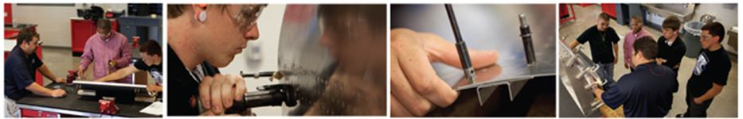
Career Pathways: SUCCESS!
Aviation Career Pathway
GED Prep/Testing /OSHA 10 Certificate
Advanced Aerostructures Training
Employment/Continued Manufacturing Education

Slide 35

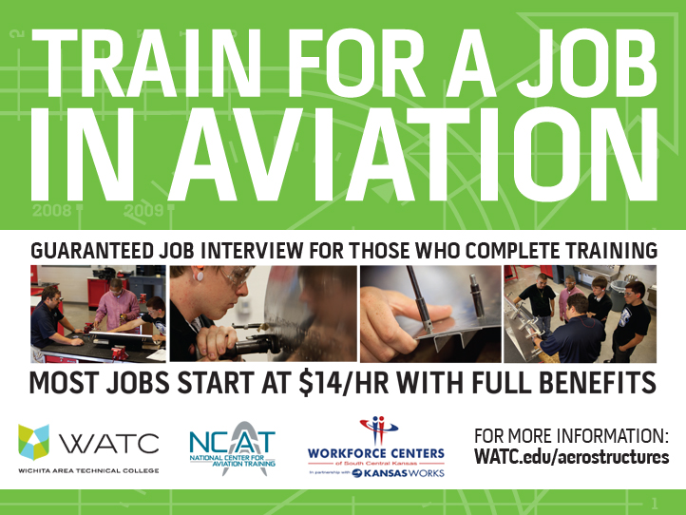
Career Pathways: SUCCESS!
Spirit Aerosystems
Employer Partner
964 Work Keys Assessments resulting in 412 new hires
25 individuals hired after taking part in advanced Aerostructure, Nondestructive Testing, and Airplane and Power Plant training
Partnership resulted in additional Aviation employers guaranteeing interviews for completion of training programs at WATC

Slide 36
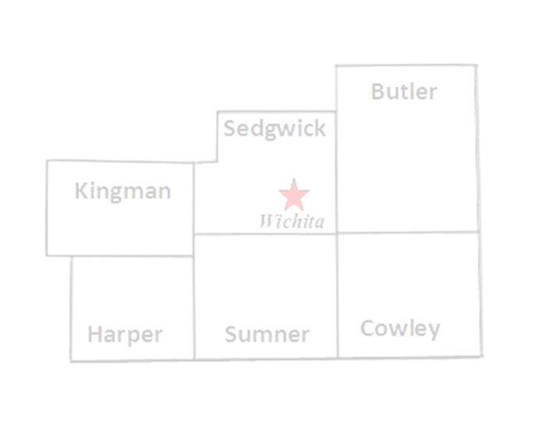

Career Pathways: Local Impact
Positive Impacts:
Employment and credential attainment
Streamlined processes
Increased communication
Adult/DW performance outcomes well above goal
Ongoing Challenges:
Communication
Availability of WIA and Non-WIA funds
Continued employer engagement

Slide 37
Questions & Answers

Slide 38
Career Pathways Resources
Career Pathways Community of Practice: https://learnwork.workforce3one.org/
Career Pathways Toolkit:
  https://learnwork.workforce3one.org/view/2001135442016073646/info
Career Pathways Readiness Self-Assessment Tool:
  https://learnwork.workforce3one.org/view/2001134059610984712/info
Office of Vocational and Adult Education (OVAE) Adult Career Pathways Training and Support Center: http://www.acp-sc.org/
Center for Post Secondary and Economic Success: A Framework for Measuring Career Pathway Innovation: A Working Paper:
http://www.clasp.org/resources-and-publications/publication-1/CLASP-AQCP-Metrics-Feb-2013.pdf

Slide 39
Thank You!
Find resources for workforce system success at:
www.workforce3one.org

