Slide 1
TAA Fiscal and State Promising Practices Webinar
Webinar Date: August 8, 2013
Presented by:
(Office of Trade Adjustment Assistance &
Office of Financial Administration and Management)
U.S. Department of Labor
Employment and Training Administration

Slide 2
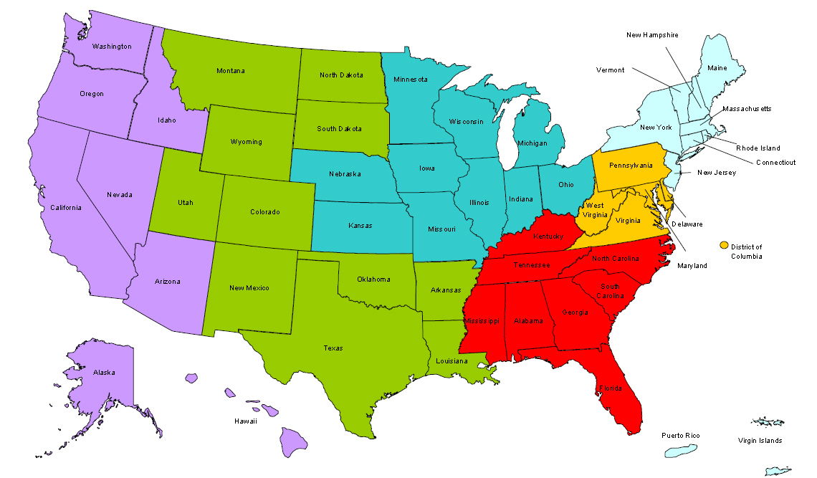
Where are you?
Enter your location in the Chat window – lower left of screen

Slide 3

WELCOME STATE FISCAL AND TAA PROGRAM STAFF!

Slide 4

AGENDA
Part One-Funding Rules and Status
TAA Funding update
Allocation Rules per Grant Year
TAA Allocation Rules in contributing to shared resources including:
  American Job Center (AJC) Infrastructure and Electronic Case Management Integration
Promising Practices: Strategies for Spending
Focus on FY 2012 FORWARD

Slide 5
AGENDA
Part Two-Examples of Promising Practices
South Carolina
  Integrated Case Management System
  Allowable modifications to TAA benefits
  and services (Commuting, Job Search)
  Trade Adjustment Assistance Community College and Career Training (TAACCCT)
Washington State
  Coordination with TACCCT
  Coordinated outreach and service delivery (RR and labor unions)
  Training Emphasis
  Incidental Supply allowance for training

Slide 6
AGENDA
Part 3- Breakout Rooms
2 Options to Learn and Share!
Fiscal Compliance and Flexibility
Clarification on Promising Practices from SC and WA and Sharing Promising Practices from other states

Slide 7
AGENDA
Part Four – Recap and Close
Recap of major points from each of the 2 breakout rooms
Future Webinar topics

Slide 8

Current Funding Status and Structure

Slide 9
TAA Current Funding Status
Authorized Funds Status – 03/31/13
Allocation | FY2011 | FY2012 | FY2013*
Funds Authorized | $495,529,970 | $575,000,000 | $575,000,000**
Funds Remaining | $116,611,176 (29%) | $404,824,698 (85%) | $575,000,000 (100%)
Count of States – Grant Expenditure Rates - 03/31/13
% Spent | FY2011 | FY2012
100% | 8 | 0
75-99% | 9 | 0
50-75% | 6 | 6
25-50% | 10 | 8
0-25% | 15 | 36
*FY2013 allocation was not distributed as of 03/31/13, however grant funds were effective as of 10/01/12
** As a result of sequestration only $534,000,000 will be distributed in FY2013.

Slide 10
TEGL 15-12
Delivery of Benefits and Services to Trade Adjustment Assistance Program Recipients through the American Job Center Network Delivery System
Commonly referred to as the Funding Source TEGL
  Program level funding sources
  Provides breakdown of commonly used funding sources (TAA Program, UI, Wagner-Peyser, WIA) to provide TAA benefits and services
  Merit staffing requirements

Slide 11
TAAEA – State Program Funding Allocation
FY2012 Allocation Forward
Admin
Job Search & Relocation
Case Management
Training *
Consolidated Allocation
$575mil. CAP
TRA
+
A/RTAA
Conditions
Not more than 10% of Consolidated Allocation may be used for Administration
Not less than 5% of Consolidated Allocation must be used for Case Management.
Note:
* Training includes Transportation and Other Training Related Costs
Reported on “new” OTAA/9130 form post-03/31/12
Reference: TEGL 13-11 (FY2012 Initial Allocation)

Slide 12
Cost Categories*
TRAINING
Tuition and related expenses
  Books
  Tools
  Academic fees
Travel or transportation
Subsistence expenses
Materials required through course curriculum
Licensures / Certification exams
Equipment rental / purchases
  Computers
ADMINISTRATION
Salaries for Admin related staff functions.
Collecting, validating, and reporting required information
Processing waivers
Administering RTAA Benefits
CASE MANAGEMENT
The list of 8 CM services as referenced in TGAAA Sec.235 (1-8)
Maintenance and enhancement of electronic case management systems to allow for improved case management services
Any other staff costs related to case management (TEGL 22-08 Sec.G(2) and G(3)
JOB SEARCH AND RELOCATION
* These lists are not intended to be all inclusive.

Slide 13

TAA Allocation Rules in Contributing to Shared Resources

Slide 14
Program, Case Management & Administrative Activities
Be mindful of FY and cost category
Costs charged must be for an allowable activity
  Case management is not an administrative cost.

Slide 15
Case Management Systems
Collecting validating and reporting data under this chapter is charged to admin
TEGL 22-08 Sec.G(2) and G(3); – Case management funds may be used for upgrading and maintaining electronic case management systems
Components of electronic case management systems that serve report functions may be charged to case management funds
Components that are exclusive to reporting functions must be charged to administration

Slide 16
MIS & IT Infrastructure
Partners or programs that utilize the MIS systems or IT infrastructure should share in its costs on an equitable basis including the TAA program
TAA should and can share in the costs of maintaining an American Job Center (AJC) system’s case management and reporting systems

Slide 17
2 CFR Part 225 Uniform Cost Principles
Consistent treatment
  Sharing of costs has to be consistent between partners, programs, and reporting periods
Benefit Received
  Charging costs can not be based on budgets. Must be allocable to the program as reasonable and necessary

Slide 18
Promising Practices: Strategies for Spending
Establish a routine method to look at existing obligations to move monies out of expired or inactive contracts
Limit the amount of funds being obligated up front
  TEGL 28-10
Remind service providers and training institutions of timely invoicing

Slide 19

Promising Practices: Strategies for Spending

Slide 20

PROMISING PRACTICES

Slide 21


SOUTH CAROLINA CASE MANAGEMENT SYSTEM
Pietà (Michelangelo)
It is not the tools, but the way you use them that makes the difference.

Slide 22
SOUTH CAROLINA CASE MANAGEMENT SYSTEM
Goals of SCWOS
Accurate
Efficient
Secure
User-friendly
Invisible

Slide 23
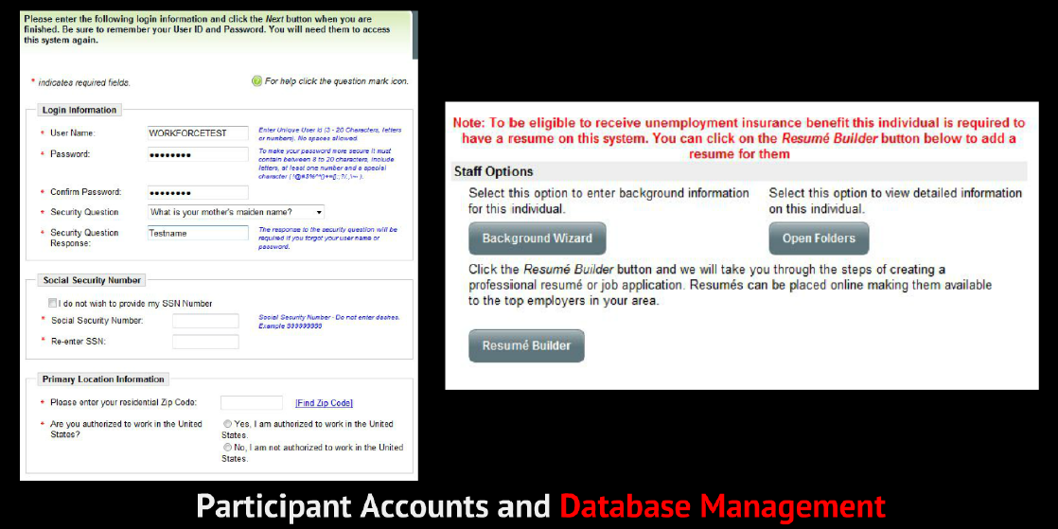
SOUTH CAROLINA CASE MANAGEMENT SYSTEM
Participant Accounts and Database Management

Slide 24
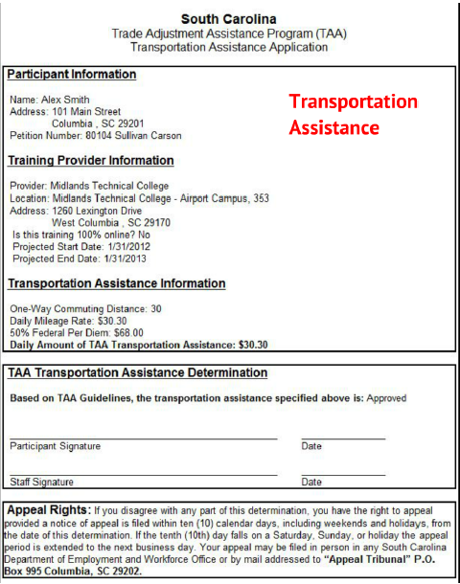
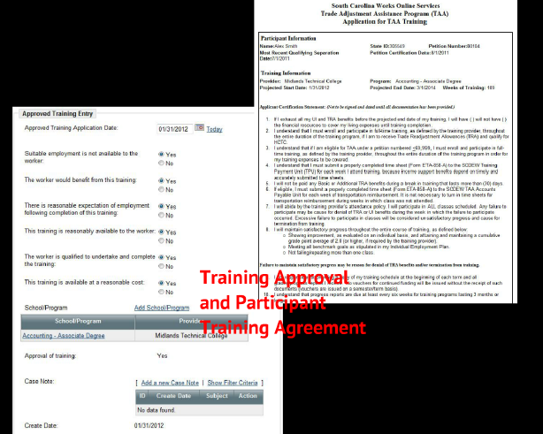
SOUTH CAROLINA CASE MANAGEMENT SYSTEM
Keeping TAA Application Organized

Slide 25
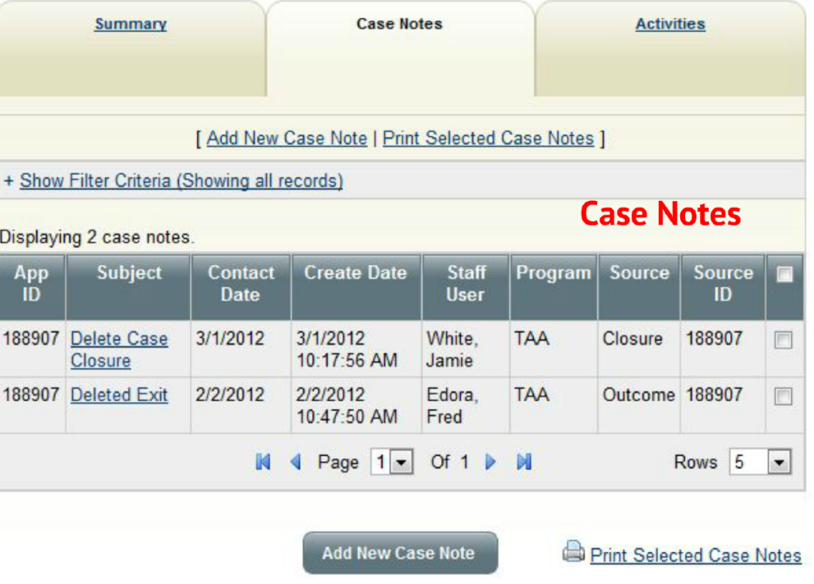
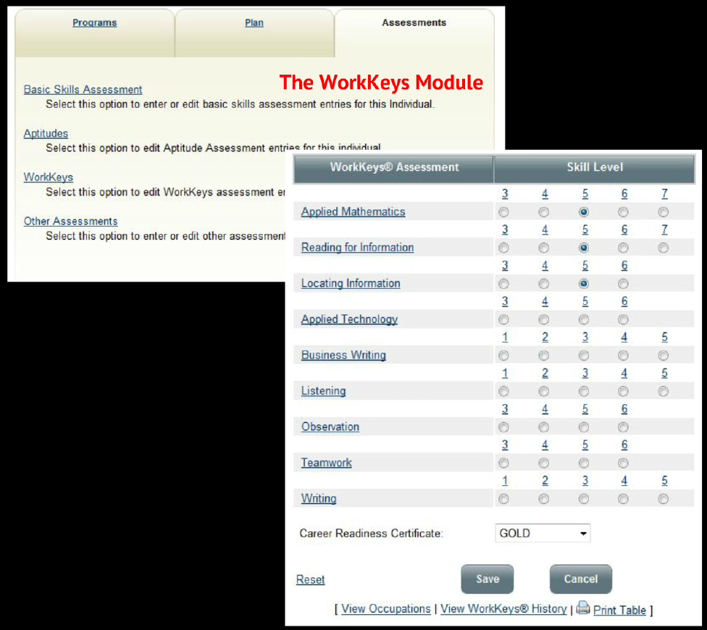
SOUTH CAROLINA CASE MANAGEMENT SYSTEM
Case Notes and Assessments

Slide 26
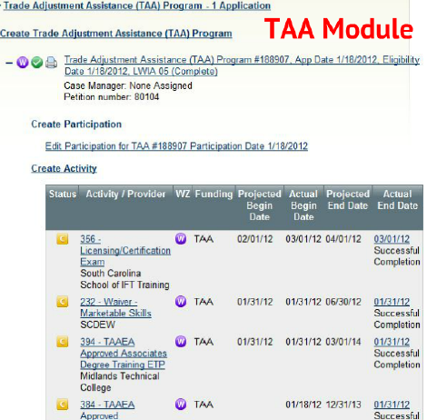
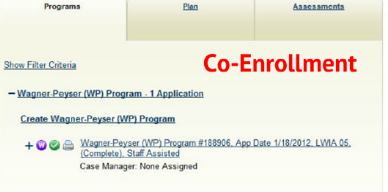
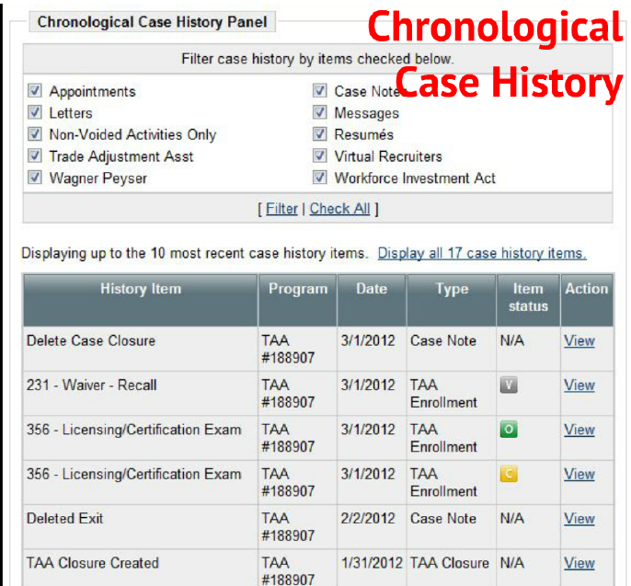
SOUTH CAROLINA CASE MANAGEMENT SYSTEM
Participant Activities and Co-Enrollment

Slide 27
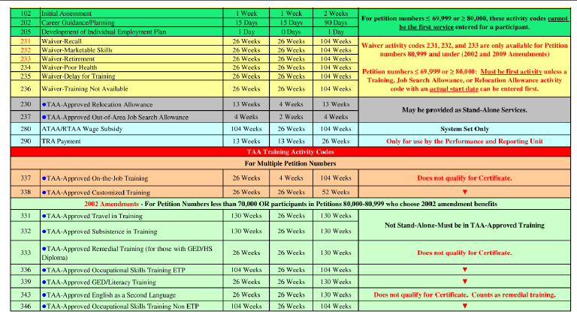
SOUTH CAROLINA CASE MANAGEMENT SYSTEM
Following TAA Participants through Activity Codes
TAA codes are separated by petition number grouping
Tracks other types of job related activities (resume assistance, LMI assistance, etc.)

Slide 28
SOUTH CAROLINA CASE MANAGEMENT SYSTEM
Keeping track of TAA Payments
via Individual Fund Tracking

Slide 29
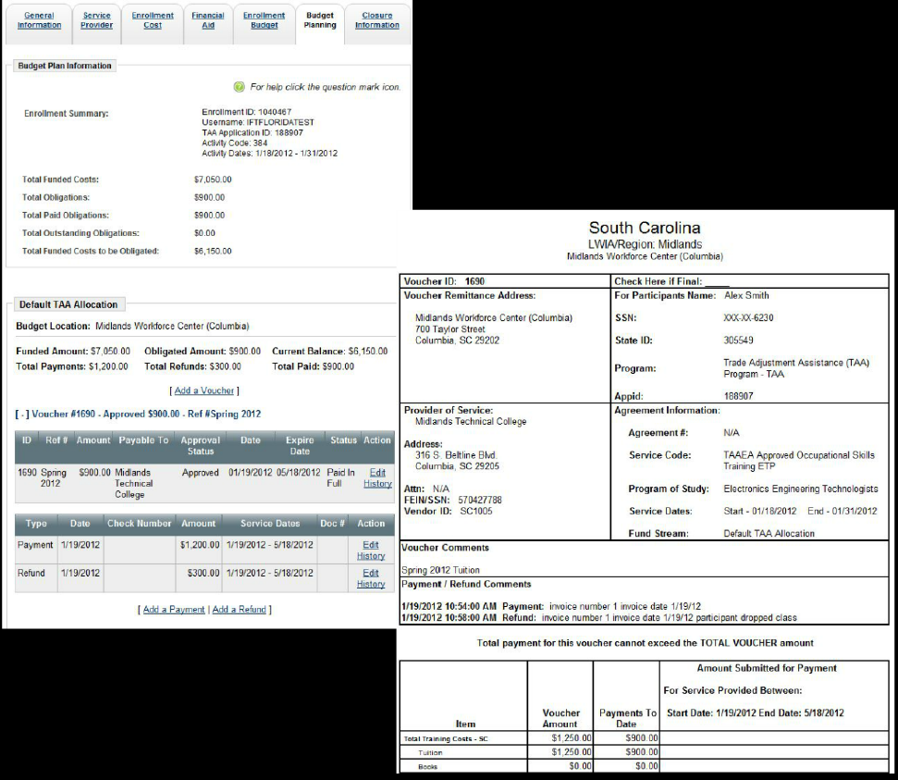
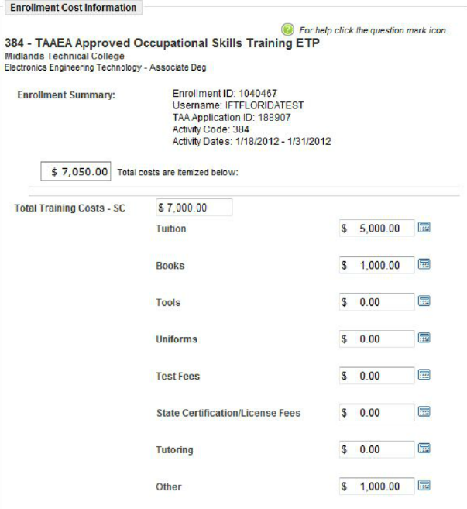
SOUTH CAROLINA CASE MANAGEMENT SYSTEM
Tracking TAA Payments via Individual Fund Tracking

Slide 30
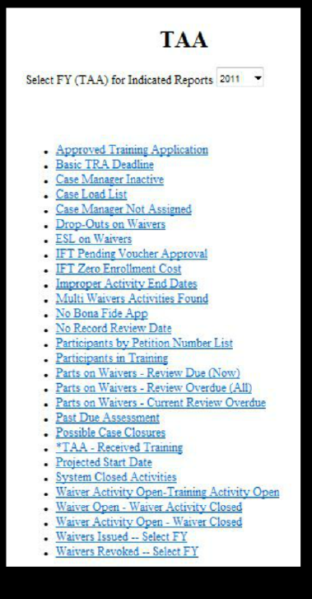
Monitoring and Managing SC TAA
Reports include
  Case Load lists
  Waiver Reports
  Participants in Training
  System Closed Activities
  Reporting Issues
  IFT Pending Vouchers

Slide 31

SOUTH CAROLINA CASE MANAGEMENT SYSTEM
Fred Edora
  Performance and Reporting Manager, SC Department of Employment and Workforce
  Phone: 803-737-2166
  Email: fedora@dew.sc.gov

Slide 32
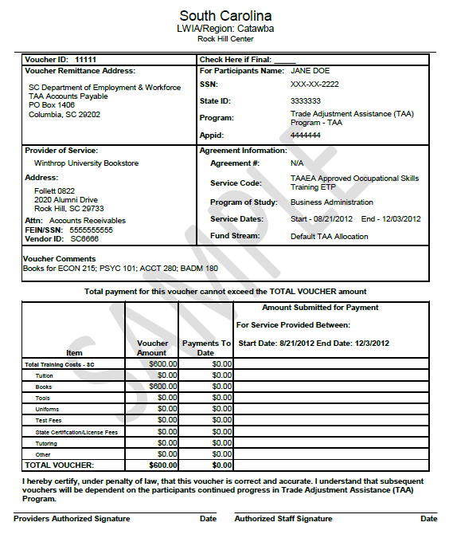
SOUTH CAROLINA CASE MANAGEMENT SYSTEM
Fiscal Tracking and Case Management

Slide 33
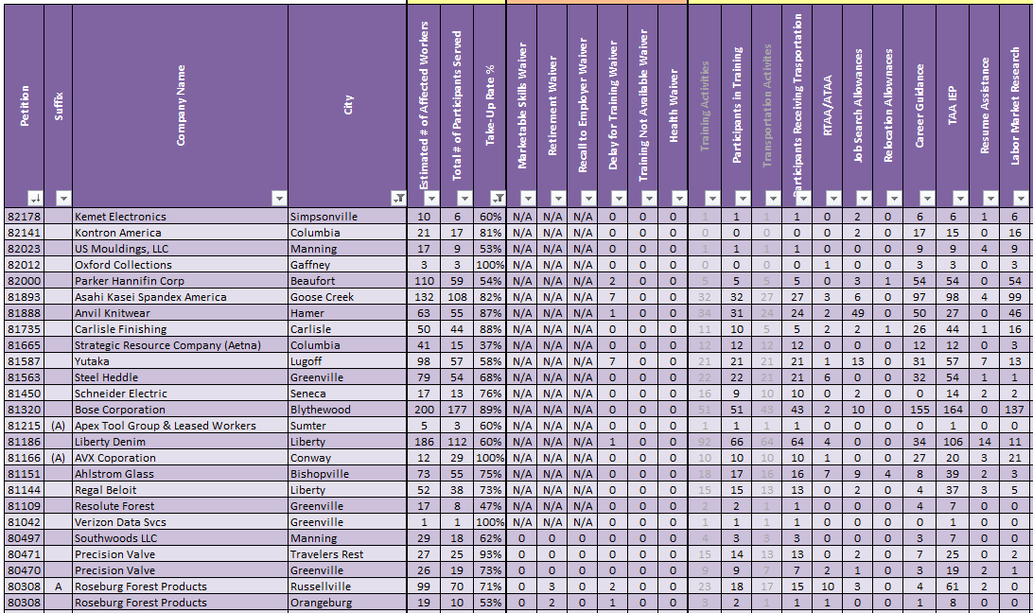
SOUTH CAROLINA CASE MANAGEMENT SYSTEM
Utilizing Performance Outcomes in Program Management

Slide 34
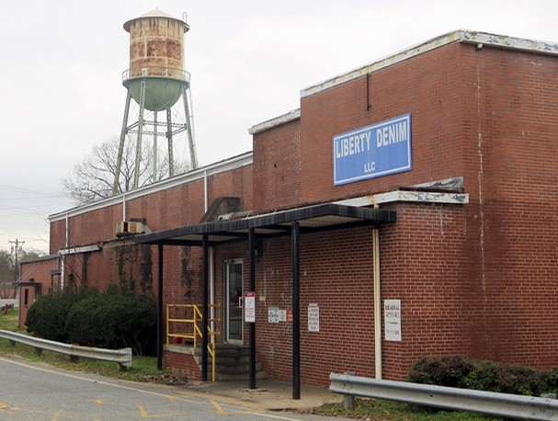
SC PROMISING PRACTICES
Modifying Commuting Distance

Slide 35

SC PROMISING PRACTICES
Modifying Commuting Distance

Slide 36

SC PROMISING PRACTICES
Modifying Commuting Distance
Commuting Distance has been reduced to 3 miles.
This type of policy is only allowable in states that do not have a commuting distance definition per the state UI law.

Slide 37
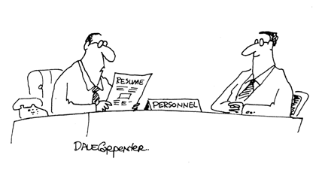
SOUTH CAROLINA PROMISING PRACTICES
Job Search Allowance Modification
Modifications to Job Search Allowance policies promote more aggressive job search strategies.

Slide 38
SOUTH CAROLINA PROMISING PRACTICES
Job Search Allowance Modification
Traditionally, job search activities within TAA consisted of interviews and job fairs.
The redesigned policy considers a variety of allowable job search activities, including but not limited to:
  Making an in-person visit with a potential employer to discuss potential job openings,
  Going to an SC Works Center, copy shop, or post office to print, copy, mail, or fax a job application or a résumé,
  Going to a local public library or community center to use online job matching systems, including SC Works Online Services (SCWOS), and
  Using professional employment resources such as a headhunter.

Slide 39
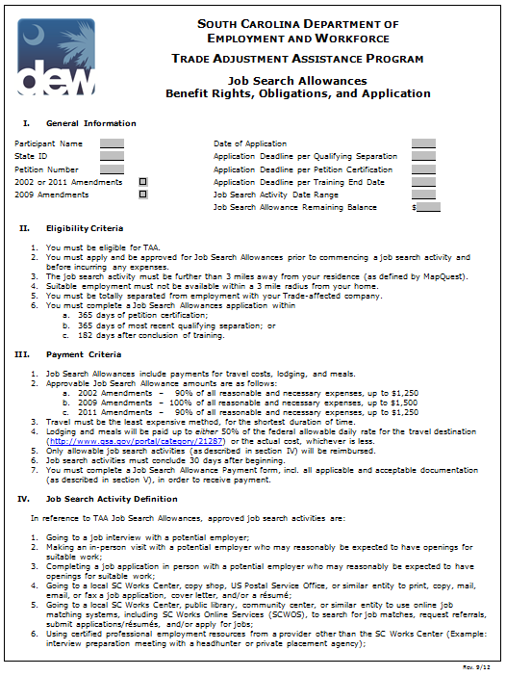
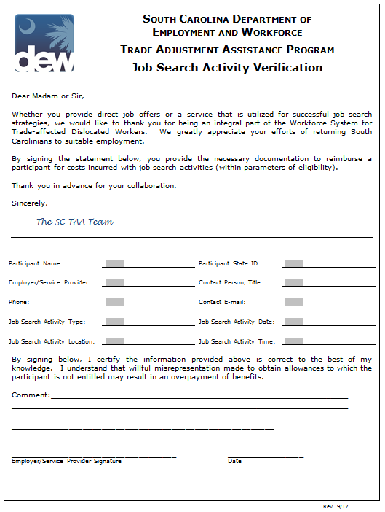
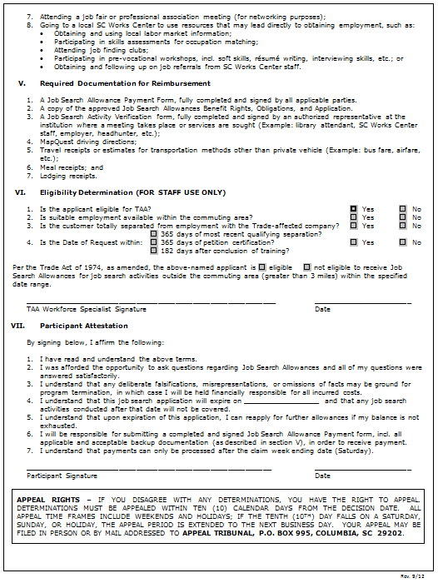
SOUTH CAROLINA PROMISING PRACTICES
Job Search Allowance Modification

Slide 40
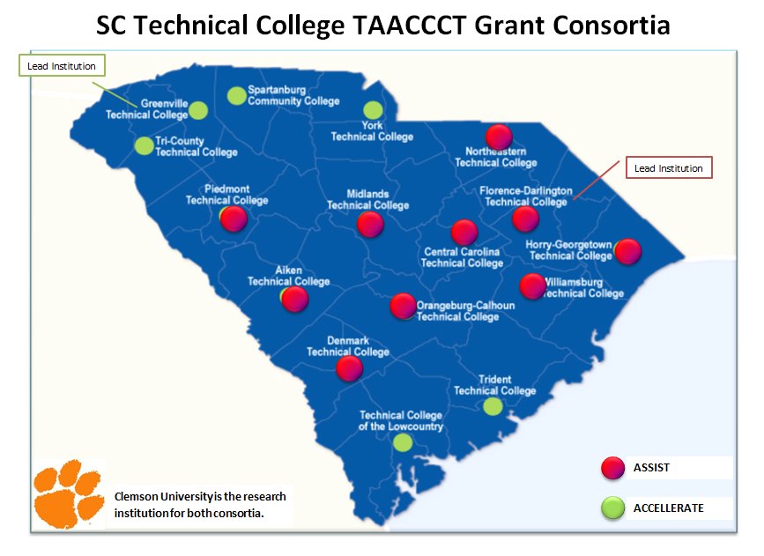
SOUTH CAROLINA PROMISING PRACTICES
Coordination with TAACCCT

Slide 41

SOUTH CAROLINA
Promising Practices
Silvia A. Middleton, TAA Program Manager
SC Dept. of Employment and Workforce
Office: 803.737.2583 | Cell: 803.834.9216 | TTY: 711
Fax: 803.737.0921
smiddleton@dew.sc.gov
http://www.scworks.org/taa.asp

Slide 42

WASHINGTON
PROMISING PRACTICES

Slide 43
  WASHINGTON STATE
  Training Emphasis
TAA is primarily a Training Program
Longer training yields better results for some
Not judging “any” college as sufficient education
Getting participant to next available level
Combine pre-existing postsecondary credits with TAA training to get to Bachelor’s or next highest credential level

Slide 44
  WASHINGTON STATE
  Coordinated outreach and service delivery (RR and labor unions)
TAA staff coordinate outreach with RR units (calculated gamble)
Labor Unions Provide Peer Workers/Liaison Capacity
Encourage training for “training resistant demographic”

Slide 45
WASHINGTON STATE
Coordination with TACCCT
Air Washington Project (Round 1)
  $20 million
  Driven by Industry Needs
  Workforce system channeling dislocated workers
High-level of communication between CCs and workforce system in general.
Regularly scheduled meetings for addressing participant needs
High level of industry engagement:
  for designing curriculum
  identifying pre-existing proficiencies/skills

Slide 46
  WASHINGTON STATE
  Incidental Supply Allowance for training
Provides for those items that are not included in training related costs.
Includes:
  Items not listed on curriculum
  Calculators, pencils, paper, folders, binders
  Anything essential to course of study
$40 “soft” cap

Slide 47

WASHINGTON STATE
Questions?
Amy L. Smith, MA, LMHC
  Director of Policy, Program Administration & Technical Assistance
  Washington Employment Security Department
  Phone: 360/407-1376
  Email: asmith@esd.wa.gov

Slide 48

BREAKOUT ROOMS
CONVERSATION WITH SPEECH BUBBLES

Slide 49
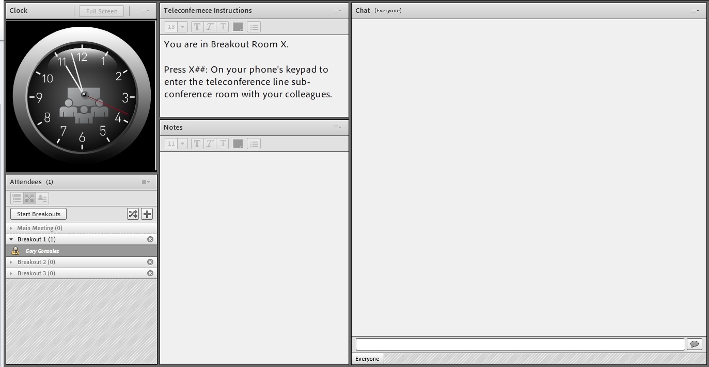
BREAKOUT ROOMS
Press *6 to unmute your line and participate in an open discussion with presenters and peers
Be courteous. Reduce extraneous noise for the best audio quality by muting your phone, if you are not speaking.
Choose the discussion room based on the number shown on your screen.

Slide 50

RECAP
REVIEW

Slide 51

TOPICS FOR FUTURE WEBINARS
Pleading girl

Slide 52
Poll: Topics for Future Webinars
Choose as many topics as you like:
TAACCCT Coordination
Outreach/Rapid Response
Coenrollment
Coordination with UI
RTAA
Completion TRA/Benchmarks
Union collaboration/peer counseling
Other (please type in chat window)

Slide 53

Please enter your questions in the Chat Room!

Slide 54

Speakers’ Contact Information
Speaker: Garrett Prendergast
Title: Program Analyst
Organization: DOLETA/ OTAA
Email: prendergast.garrett@dol.gov
Telephone: 202-693-2637
CONTACT
US!
Speaker: Deborah Galloway
Title: Program Analyst
Organization: DOLETA/OFAM
Email: galloway.deborah@dol.gov
Telephone: 312-596-5456
Speaker: Susan Worden
Title: Program Analyst
Organization: DOLETA/OTAA
Email: worden.susan@dol.gov
Telephone: 202-693-3517

Slide 55
Thank You!
Find resources for workforce system success at:
www.workforce3one.org

