Slide 1


INTRODUCTION TO WIOA COMMON PERFORMANCE MEASURES: Measurement and Data Collection
Presented at:
INA Multi-Regional Conference
Miami, FL
January 2017
Ron D’Amico
Social Policy Research Associates
Oakland, CA
Notes:
Congress amended the Workforce Investment Act and the result? The Workforce Innovation and Opportunity Act

Slide 2

WORKSHOP GOALS
Explain the WIOA measures and how they differ from WIA
Legislative authority
Timeline
Key terms and how different from WIA
How standards are to be set
Observations and implications for reporting

Slide 3

WHERE TO START?

Slide 4
Who says so?
Authority in the WIOA law
Section 116(b) defines the common measures
The INA program is subject to the common measures [WIOA Sections 166(e) and 166(h)]
WIOA Section 166(i) allows INA grantees to request waivers from most statutory requirements
Guidance in the Final Rule and TEGLs
Additional guidance on the measures is provided in the regulations
ETA issued several TEGLs providing clarification

Slide 5
WIOA IMPLEMENTATION TIMELINE
PY 2014 | PY 2015 | PY 2016 | PY 2017
INA performance & reporting requirements
may go into effect
(TEGL 24-15 & TEN 8-16)
Most provisions take effect (except performance)
7/1/15
TEGL 10-16 clarifies the common measures
(12/19/16)
Final Rule issued
(8/19/16)
New reporting requirements are approved
(6/29/16)
WIOA signed into law 7/22/14
Performance requirements go into effect (except INA)
(7/1/16)

Slide 6

IMPORTANT NOTE
There may be further guidance specific to the INA program that is yet to come
WIOA common measures and reporting for the INA program take effect no sooner than PY 2017

Slide 7

KEY DEFINITIONS
Participant
Date of Participation
Qualifying Service
Exit Date
Exit Quarter

Slide 8
PARTICIPANT
Eligible for INA Program
Receives a Qualifying Service
No change from WIA
Notes:
Both criteria must be met to be counted as a participant. If an individual has been determined eligible for WIOA Section 166 but never receives a WIOA service they are not counted in the performance measures because they are not a participant.
This makes them “active.”

Slide 9

DATE OF PARTICIPATION
Eligible
Received a qualifying service
Date of participation is the date the participant got the first qualifying service
No change from WIA
Notes:
It follows that the date of participation is the first day that an individual begins receiving a service funded by the program. This is the start of program participation and will be key to understanding the timing of common measure calculations.
Bear Tracks automatically makes someone “active” (a participant) as soon as they are determined eligible and assigned a Qualifying Service.

Slide 10
QUALIFYING SERVICE
Qualifying services include (among other things)
Initial and comprehensive assessments
Does not include
Eligibility determination
Career counseling
Development of employability plan
Individualized assistance with job search
Training, prevocational services, & work experience
Self-services
Providing general information
Follow-up services after exit
For the INA program, no change from WIA

Slide 11
NEW NAMES FOR SOME SERVICES
WIA CORE
WIA Intensive
WIOA
Career
Services
WIA core & intensive services combined into WIOA career services

Slide 12
DATE OF EXIT
The exit date is the last date the individual received a Qualifying Service.
Exit must occur when:
  The participant has not received a Qualifying Service for 90 days, and
  No further Qualifying Services are planned (i.e., there is no planned gap)
  BearTracks will automatically exit someone with no service after 90 days, unless there is a planned gap
Exit date is the date of last service, not the end of the 90-day period
No change from WIA

Slide 13

CALENDAR QUARTERS
Quarters
Exits and outcomes are measured in calendar quarters
  Jan-Mar
  Jul-Sept
The exit quarter is the
calendar quarter in which
the exit date falls
No change from WIA
  Apr-June
  Oct-Dec

Slide 14
The Scenario
  Eligibility determination is April 21st
  First service (assessment) is provided May 4th
  Customer receives career counseling and job placement assistance
  Last service (job referral) is provided August 18th
  No further services are provided for the next 90 days
  Customer gets a job September 15th
What Is
  The date of participation?
  The date of exit? the exit quarter?
EXAMPLE

Slide 15
EXAMPLE
The exit quarter is the quarter in which the date of exit occurs
Apr | May | June | July | Aug | Sept | Oct | Nov | Dec
Period of participation
90 days with no service
Date of first service 5/4/16
Date of last service
(Exit date)
8/18/16
End of 90-day period
11/16/16
Exit Quarter
7/1 to 9/30

Slide 16
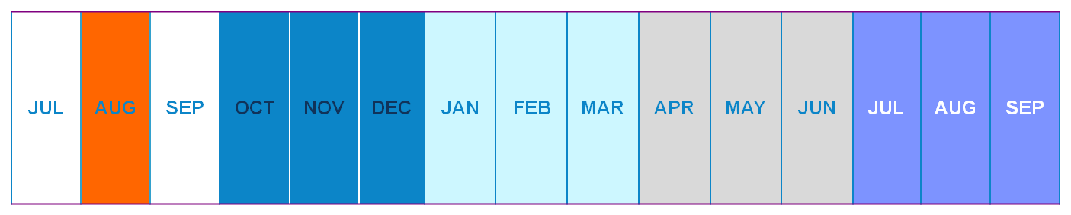
MEASUREMENT QUARTERS
Outcomes are measured in the four quarters after
the exit quarter
Exit date
8/18/16
CY 2016
CY 2017
Exit Quarter
1ST Qtr After
2nd Qtr After
3rd Qtr After
4th Qtr After

Slide 17

WHY USE CALENDAR QUARTERS?
Performance is measured using Unemployment Insurance (UI) wage records.
UI records are reported quarterly, and include earnings for the quarter. They usually cannot identify the date of employment, hours of employment, or hourly wages
Use of UI data implies a lag of 2 quarters before data become available
Notes:
We also use calendar quarters because performance is measured using Unemployment Insurance (UI) wage records. UI records are reported quarterly, and include earnings for the quarter. They usually cannot identify the date of employment, hours of employment, or hourly wages. More on this later in the presentation…

Slide 18

GLOBAL EXCLUSIONS
Participants are excluded from the common measures for the following reasons:
  Medical condition expected to last more than 90 days causes the person to exit the program
  and precludes employment
  Incarcerated
  Hospitalized or in other treatment
  facility
  Deceased
  Reservists called to active duty

Slide 19

THE MEASURES

Slide 20
WIOA MEASURES
Adult Measures
Employed in the 2nd quarter after exit
Employed in the 4th quarter after exit
Median earnings in the 2nd quarter after exit
Credential attainment
Skill gains
Service to employers
Other measures as determined
Youth Measures
Employed or in education or training in the 2nd quarter after exit
Employed or in education or training in the 4th quarter after exit
Median earnings in the 2nd quarter after exit
Credential attainment
Skill gains
Service to employers

Slide 21
Measure 1: 2ND QUARTER EMPLOYMENT RATE
DEFINITION: The percent of exiters who were employed anytime in the second quarter after the exit quarter
Number employed in second quarter after exit quarter
All exiters (except global exclusions)
Notes
Unsubsidized employment anytime in the second quarter after
the exit quarter counts as a positive outcome
Evidence can come from UI wages, federal employment, or supplemental data
Differs from WIA Entered Employment Rate
  Outcome is measured in the 2nd quarter, not the 1st quarter
  WIA excludes those employed at participation, WIOA does not

Slide 22
2ND QUARTER EMPLOYMENT RATE – EXAMPLE
Based on our example:
Date of Exit = August 18, 2016
Exit Quarter = July to September 2016
Measurement Quarter = January to March 2017
Exit date
8/18/16
CY 2016
CY 2017
JUL | AUG | SEP | OCT | NOV | DEC | JAN | FEB | MAR | APR | MAY | JUN | JUL | AUG | SEP
Exit Quarter
2nd Qtr After

Slide 23
2ND QUARTER EMPLOYMENT RATE QUIZ
Scenario
First service is May 4th
What is
The measurement quarter for the employment rate?
Last service (job referral) is August 18th
Customer gets a job Sept 15th
Customer loses job Dec 30th
Customer finds another job April 10th
Is the customer a positive on this outcome?

Slide 24
2ND QUARTER EMPLOYMENT RATE – QUIZ
JUL | AUG | SEP | OCT | NOV | DEC | JAN | FEB | MAR | APR | MAY | JUN
Exits
8/18
Gets
Job
Loses
Job
Gets
Job
2nd Qtr After Exit
Exit Quarter

Slide 25
Measure 2: 4th QUARTER EMPLOYMENT RATE
DEFINITION: The percent of exiters who were employed anytime in the fourth quarter after the exit quarter
Number employed in fourth quarter after exit quarter
All exiters (except global exclusions)
Notes
Unsubsidized employment anytime in the fourth quarter after
the exit quarter counts as a positive outcome
Evidence can come from UI wages, federal employment, or supplemental data

Slide 26
4th QUARTER EMPLOYMENT RATE – EXAMPLE
Exit date
8/18/16
2016
2017
JUL | AUG | SEP | OCT | NOV | DEC | JAN | FEB | MAR | APR | MAY | JUN | JUL | AUG | SEP
Exit Quarter
4th Qtr After

Slide 27
Measure 3: MEDIAN EARNINGS
DEFINITION: The median quarterly earnings of those employed in the second quarter after the exit quarter
Notes
Measured only for those employed anytime in the 2nd quarter
  Evidence can come from UI wages, federal employment, or supplemental data; you must measure earnings if you measure 2nd quarter employment using supplemental data
Differs from WIA Average Earnings
  Measurement quarter is different
  WIOA measures median earnings, WIA measured average earnings
  WIOA includes earnings measured from supplemental data

Slide 28
MEDIAN EARNINGS – EXAMPLE
Exit date
8/18/16
2016
2017
JUL | AUG | SEP | OCT | NOV | DEC | JAN | FEB | MAR | APR | MAY | JUN | JUL | AUG | SEP
Exit Quarter
2nd Qtr After

Slide 29
CALCULATING A MEDIAN
 | Earnings in 2nd Quarter
Person 1 | $1,500
Person 2 | $2,200
Person 3 | $2,700
Person 4 | $3,000
Person 5 | $3,500
Person 6 | $6,200
Person 7 | $8,200
Sum | $27,300
    Half of people below midpoint
    Midpoint
    Half of people above midpoint
    Median= $3,000 (the earnings of the person at the midpoint)
_{Average =} 27300 _{= $3,900}
  7

Slide 30
MEDIAN MINIMIZES THE EFFECT OF
EXTREME VALUES
Scenario 1
Person 1 | $1,500
Person 2 | $2,200
Person 3 | $2,700
Person 4 | $3,000
Person 5 | $3,500
Person 6 | $6,200
Person 7 | $8,200
Sum | $27,300
Scenario 2
Person 1 | $1,500
Person 2 | $2,200
Person 3 | $2,700
Person 4 | $3,000
Person 5 | $3,500
Person 6 | $6,200
Person 7 | $14,000
Sum | $33,100
    Midpoint
    Median= $3,000 (the midpoint)
    Median= $3,000 (the midpoint)
_{Average =} 27300 _{= $3,900}
  7
_{Average =} 33100 _{= $4,729}
  7

Slide 31
CALCULATING A MEDIAN WITH AN EVEN
NUMBER OF PARTICIPANTS
 | Earnings in 2nd Quarter
Person 1 | $1,500
Person 2 | $2,200
Person 3 | $2,700
Person 4 | $3,000
Person 5 | $3,200
Person 6 | $3,500
Person 7 | $6,200
Person 8 | $8,200
    ^{Middle two people}
    _{Median= (3000 + 3200) =$3,100}
    ₂

Slide 32
Measure 4: CREDENTIAL RATE
DEFINITION: Percent of those enrolled in education or training (excluding OJT & customized training) who obtain a postsecondary credential or high school diploma or equivalent by the 4th quarter after exit. Those obtaining a high school diploma or equivalent count as a success only if they are employed or in education or training leading to a recognized post-secondary credential within the year.

Slide 33
CREDENTIAL RATE
Who counts as a success?
Those who obtain a postsecondary credential anytime during participation or within one year after exit, plus
Who is in the base?
Exiters who were in postsecondary education or training (other than OJT or customized training), plus
Those who obtain a secondary school diploma or equivalent during participation or within one year after exit, but only if they are also employed or enrolled in postsecondary education leading to a credential anytime within the year after exit
Exiters who were in secondary school (at or above the 9th grade level and without already having a high school diploma or equivalent)

Slide 34
CREDENTIAL RATE – EXAMPLE
Exit date
8/18/16
2016
2017
JUL | AUG | SEP | OCT | NOV | DEC | JAN | FEB | MAR | APR | MAY | JUN | JUL | AUG | SEP
Exit Quarter
1st Qtr After
2nd Qtr After
3rd Qtr After
4th Qtr After
Measurement Period

Slide 35
CREDENTIAL RATE
What counts as a credential?
High school diploma or equivalent (but only if employed or in other training within the year after exit)
Recognized postsecondary credential, which includes:
  an industry-recognized certificate awarded in recognition of attainment of technical/occupational skills,
  a certificate of completion of an apprenticeship,
  a license recognized by State or Federal government, or
  an associate, baccalaureate, or graduate degree
Work-readiness certificates do not count

Slide 36
Measure 5: SKILL GAIN
DEFINITION: Percent of participants who, during the course of the program year, are in education or training programs that lead to a recognized postsecondary credential or employment and who are achieving measurable skill gains, defined as documented academic, technical, occupational, or other forms of progress, towards such a credential or employment

Slide 37
SKILL GAIN continued
Indicators of Skill Gains
Designed to measure interim progress of participants
Documentation includes:
Increasing at least one educational functional level for those in programs below the postsecondary level
Attainment of high school diploma or GED
Making satisfactory progress in school (e.g., earning sufficient credit hours)
Making satisfactory progress towards measurable standards as attested by an employer or training provider
Passing an exam designed to measure occupational or technical skills

Slide 38
Measure 6: SERVING EMPLOYERS
Effectiveness in serving employers

Slide 39
SERVING EMPLOYERS continued
Three Approaches Being Considered
Repeat Employer Customer: Percent of employers served during the year who were also served in any of the prior 2 years
Employer Penetration Rate: Percent of all employers in the service area who use WIOA services
Retention: Percent of exiters employed in the 2nd quarter after exit who are employed with the same employer in the 4th quarter after exit (calculated using UI wage records)

Slide 40
Measure 7. INA SPECIFIC MEASURE
WIA
No specific measure, but ability to effectively serve native peoples and communities has always been understood as a critical part of grant responsibility
WIOA
In addition to the required measures, ETA, in consultation with the Advisory Council, “must develop a set of performance indicators and standards that are applicable to the INA program.”
Discussion
ETA hasn’t made much progress on these measures yet
This is a statutory requirement, so work on this should start soon

Slide 41

The Youth Measures
Notes:
(apply to those enrolled in the Supplemental
Youth Services Program)

Slide 42
Measure 1: 2ND QUARTER EDUCATION or EMPLOYMENT RATE
DEFINITION: The percent of exiters who were employed or in education or training anytime in the second quarter after the exit quarter
Number employed or in education/training anytime in second quarter after exit quarter
All exiters (except global exclusions)
Notes
Unsubsidized employment or participation in secondary or postsecondary education or occupational training anytime in the second quarter counts as a positive outcome
Evidence of employment can come from UI wages, federal employment, or supplemental data

Slide 43
Measure 2: 4th QUARTER EDUCATION or EMPLOYMENT RATE
DEFINITION: The percent of exiters who were employed or in education or training anytime in the fourth quarter after the exit quarter
Number employed or in education/training anytime in fourth quarter after exit quarter
All exiters (except global exclusions)
Notes
Unsubsidized employment or participation in secondary or postsecondary education or occupational training anytime in the fourth quarter counts as a positive outcome
Evidence of employment can come from UI wages, federal employment, or supplemental data

Slide 44

OTHER WIOA YOUTH MEASURES
The remaining youth measures are identical to adult program measures just discussed:
Median Earnings
Credential Attainment Rate
Skill Gain
Service to Employers

Slide 45
HOW OUTCOMES ARE MEASURED
Both UI Wage Matching and Grantee Data Can be Used
  UI Wage Matching
    Grantees submit SSNs of participants in the SPIR each quarter
    DOL matches against Unemployment Insurance (UI) wage files, containing a record of (nearly) everyone employed in the U.S.
  Supplemental Data Provided by Grantees
    Also as part of the SPIR, grantees indicate which participants are employed according to the grantee's own records

Slide 46
SETTING STANDARDS
Using an Adjustment Model
  For the State programs, standards should be set using a statistical model that takes into account:
    Economic conditions
    Characteristics of participants
Performance standards for the Section 166 program should use “to the extent practicable, the statistical adjustment model” used for states [WIA Section 166(h)]

Slide 47
OBSERVATIONS
Implementation Not Until PY 2017
Have additional time to seek further guidance and provide input
Statutory Language Limits DINAP’s Options
Legislation requires use of common measures for program
Some Important Flexibility
Grantees can seek waivers
Advisory Council can help develop INAP specific measures
Notes:
Observations and speculation:
Statutory Language Limits DINAP’s Options: Legislation requires use of common measures for program
Some Important Flexibility: 1) Grantees can seek waivers. 2) Advisory Council can help develop INAP specific measures

Slide 48
MORE OBSERVATIONS
Follow-up services will be key for program and participant success
In some ways the WIOA measures are more straightforward
Most measures are calculated as a percent of all exiters/participants, rather than subsets
Think about budget allocation for follow-up services; beyond merely contacting people for employment and education status

Slide 49
MORE OBSERVATIONS
However, there are significant challenges
For program management, it is harder to time exits to maximize success on Employment measure
Measuring as far out as 4 quarters after exit is more of a challenge
Measuring skill gains and employer services could be difficult
Measures for the Supplemental Youth program are especially challenging, given the meager funding
Lots of uncertainty remains (e.g., services to employers)
Significantly greater burden for grantees

Slide 50
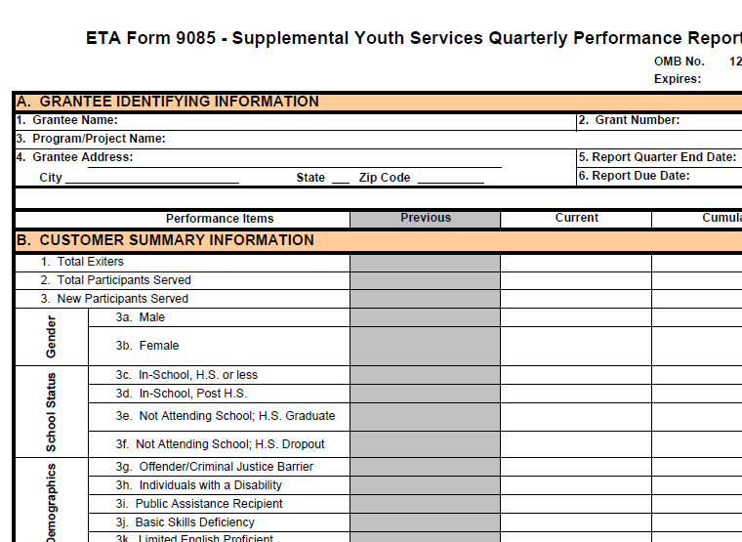
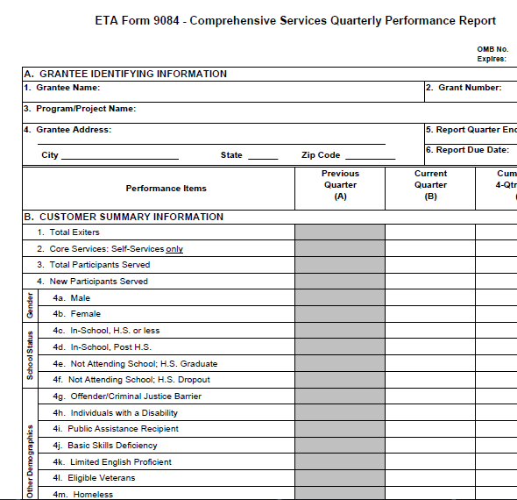
IMPLICATIONS FOR DATA COLLECTION & REPORTING continued
Changed reporting forms:
9084 & 9085 will be replaced
PIRL replaces the SPIR

Slide 51
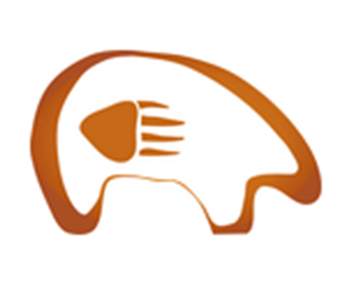
IMPLICATIONS FOR DATA COLLECTION & REPORTING
Bear Tracks will need to be modified or replaced
  Concepts of core and intensive services no longer apply
  New outcomes need to be reported
  Some changes to info on participant characteristics is required (but not many)
  May need to provide data on participants, not just exiters

Slide 52
RESOURCES
Final Rule for ETA (issued 8/19/16)
Final Joint Rule (issued 8/19/15)
Approved Information Collection Request
Provides regulations for ETA-only WIOA provisions
Regulations for the INA program at Section 684
Available from the Federal Register at
https://www.gpo.gov/fdsys/pkg/FR-2016-08-19/pdf/2016-15975.pdf
Describes performance standards requirements (see Section 677)
Available from the Federal Register at
https://www.gpo.gov/fdsys/pkg/FR-2016-08-19/pdf/2016-15977.pdf
Describes proposed new individual-level record layout (to replace the SPIR) and new aggregate report
Available from Regulations.Gov at:
https://doleta.gov/performance/reporting/eta_default.cfm

Slide 53

QUESTIONS
Notes:
What challenges do you see?
Questions?

Slide 54
CONTACT INFORMATION
54
Ron D’Amico
Principal
Social Policy Research Associates
510-788-2484
Ron_damico@spra.com

