Slide 1

Case Management Practices and Tools to
Help You Go from Reactive to Proactive

Slide 2
Presenters
Melissa Mack
Vinz Koller
Social Policy Research Associates

Slide 3
Let’s Get to Work: Your Help is Needed
  You are the One-Stop Center Manager
  12 Case Managers have informed you they are ready to walk off the job. Their complaints are:
    Overworked, large case loads
    Confused about their roles
    Claim that partner agency that moved into One-Stop Center is out to get their jobs
    Claim that data entry is too cumbersome

Slide 4
Your Challenge For Today
  The Workforce Division Director and her advisory team expect a crisis response plan by noon. Questions for you to address are:
    What short-term steps are you proposing?
    What long-term operational changes are you prepared to make?
    How do you plan to make your decisions and communicate with your staff?
    Will partner agencies co-housed at the Center be involved, and if so how?

Slide 5



Supporting Integrated Intake and Effective Case Management is a Technical Assistance
Project of the
Employment Training Administration of the US Department of Labor

Slide 6
Workgroup
Elizabeth Waiters Carrie Snidar Cheryl Martin
Elizabeth Laird Haydee Cuza Helen Thatcher
Jane Cho Jerry Yeoward Kajuana Donahue
Lauren Wright Linda Avila Lisa Rosendale
Michelle Derr Michelle Paczynski
Myrna Andres Nestor Leon Pamela Holcomb
Patricia Drummond Charlotte Schifferes
Stephanie Carlo Susan Worden Terri Lonowski
Vinz Koller Winston Tompoe Brittany Tate

Slide 7
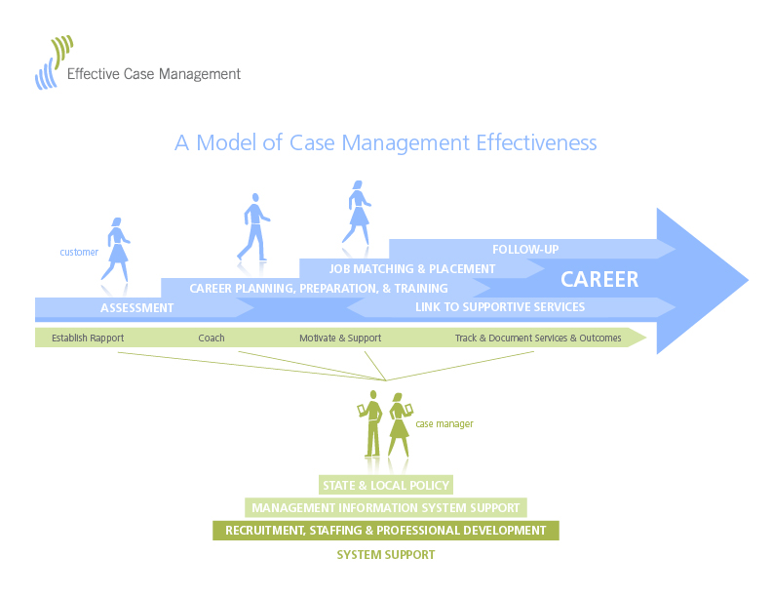

Slide 8
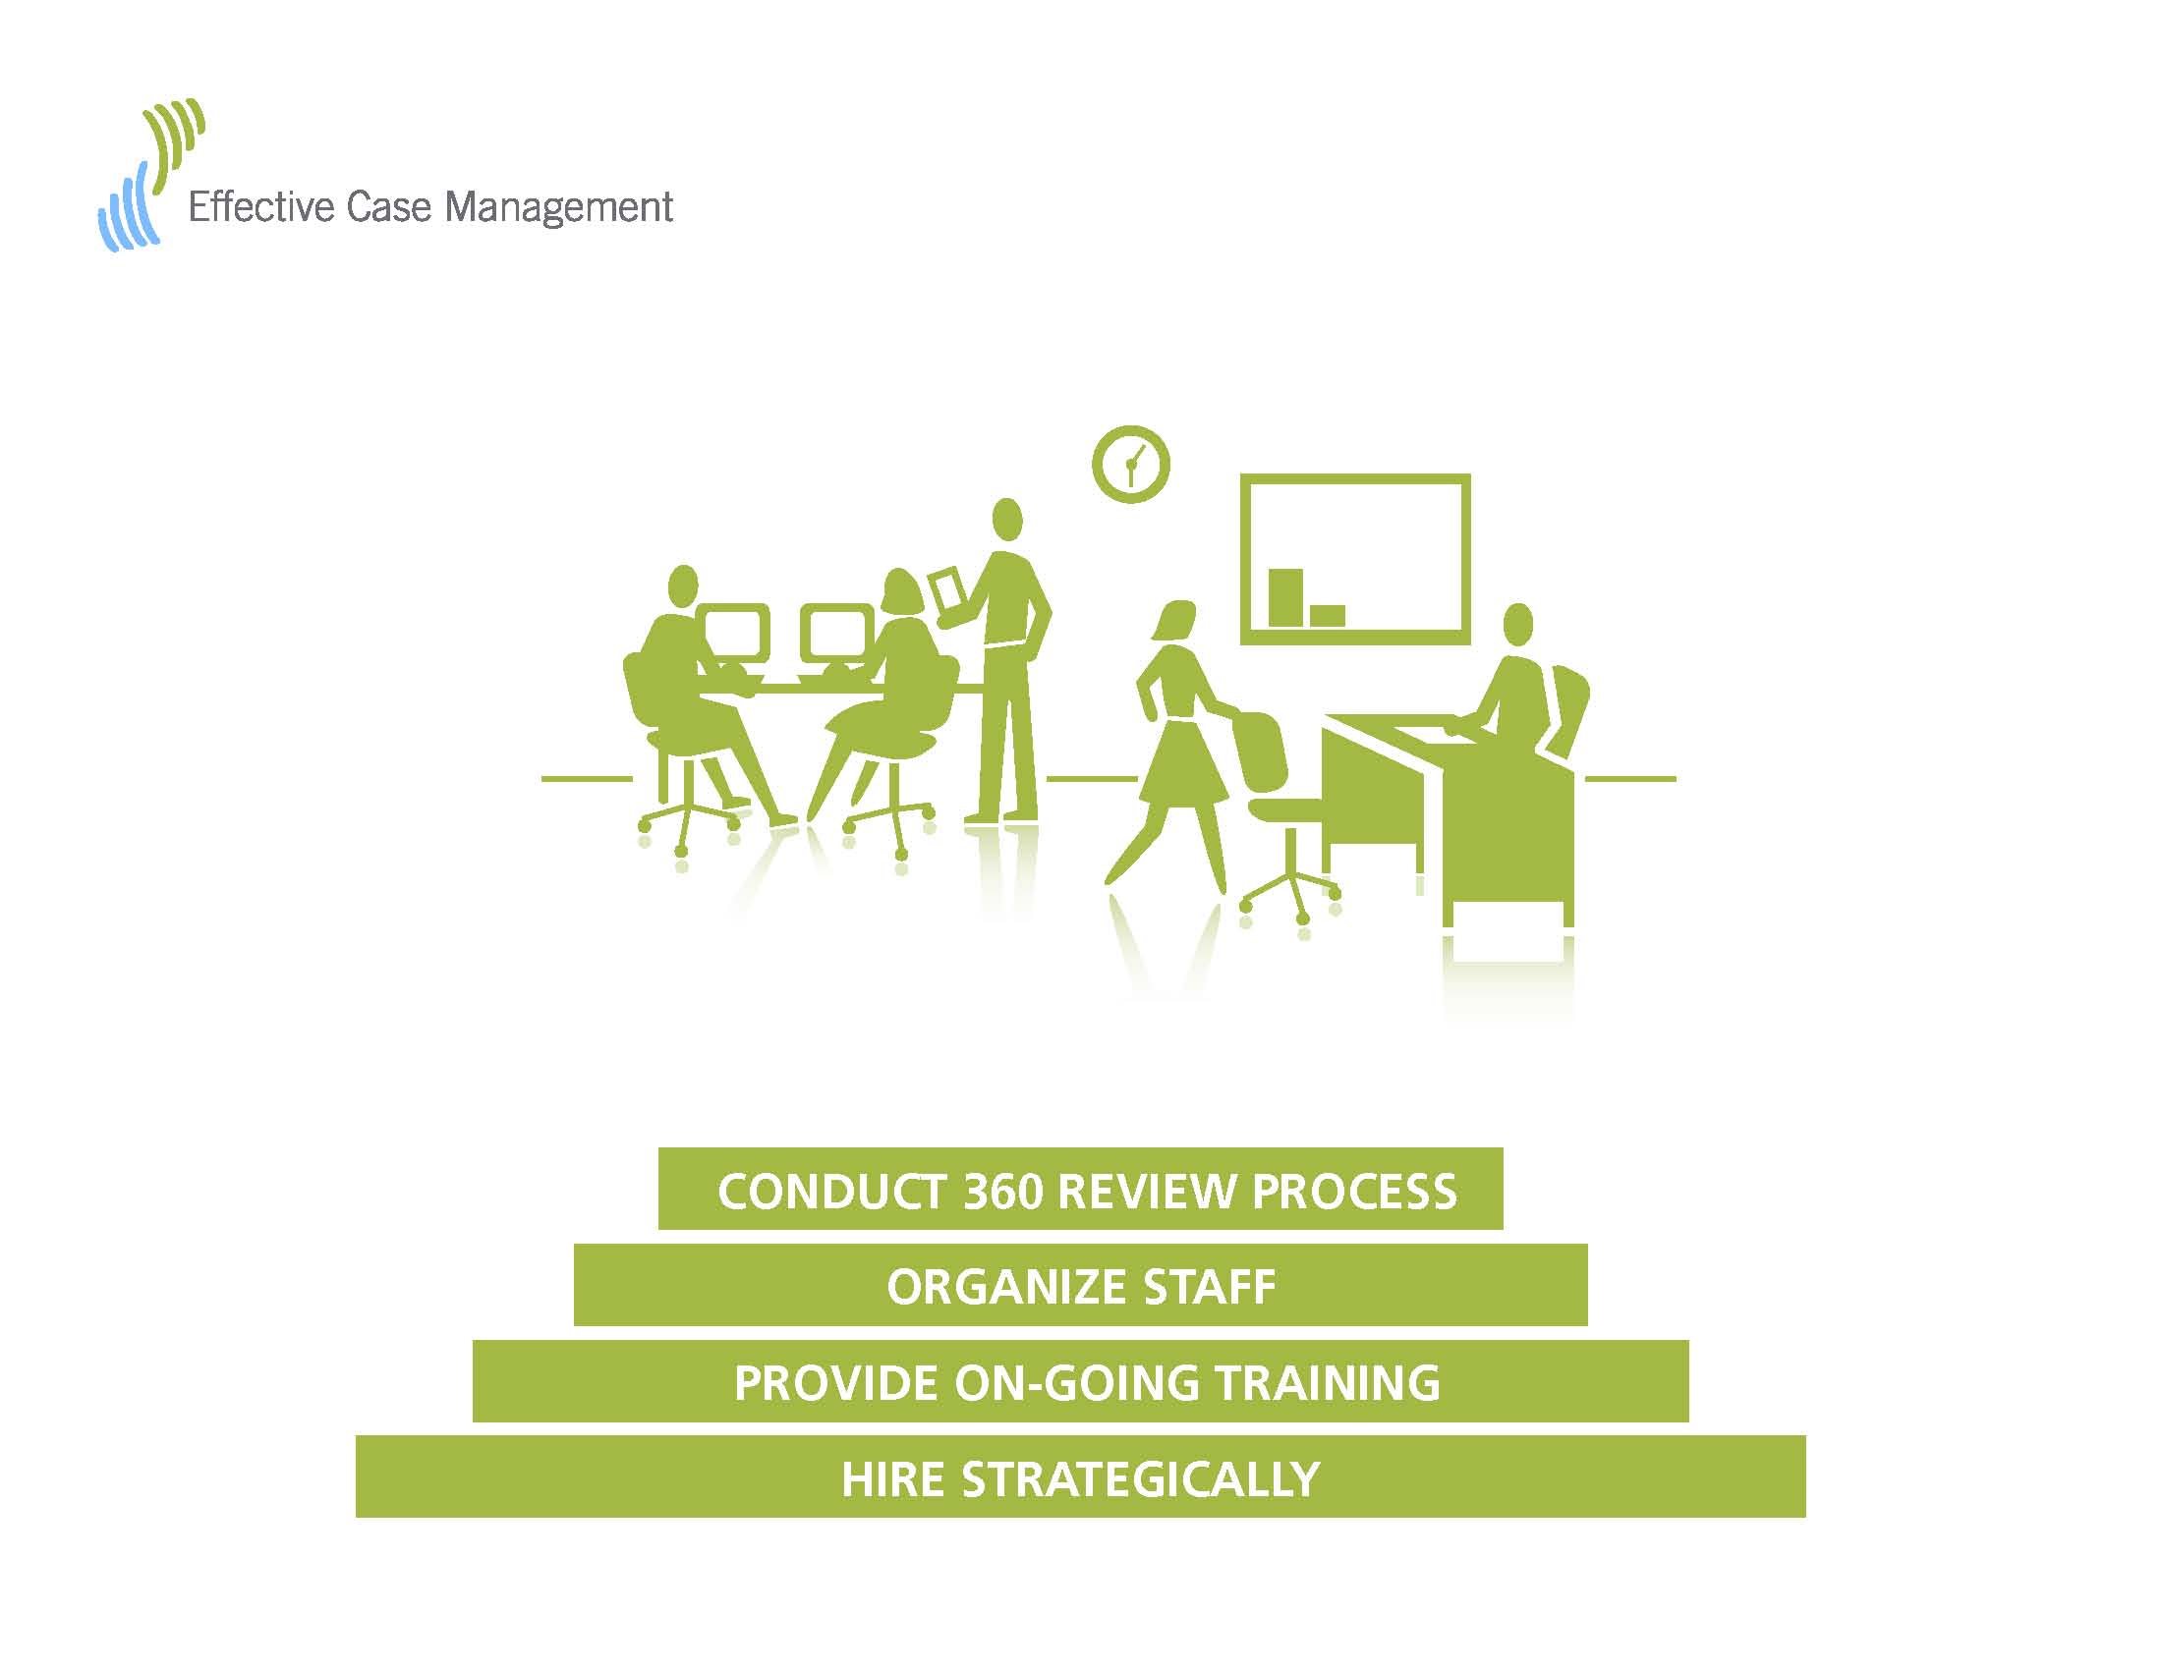

Slide 9


Slide 10



Slide 11

Hire Strategically

Slide 12


Slide 13

Provide On-Going Training

Slide 14
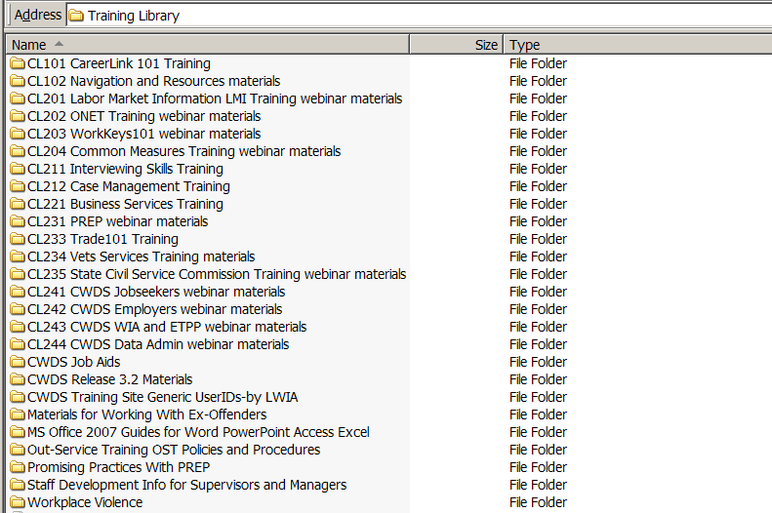
Pennsylvania: Electronic Training Library

Slide 15


Slide 16

Organize Staff to Support Your Vision

Slide 17


Slide 18


Slide 19


Slide 20
Conduct 360 Review Process
Case Managers
Employers
Customers
Supervisors
Managers

Slide 21

UTAH: 360 Review Process
Improvement Process
Gathering Feedback
Office Visits
Usability Studies
User Steering Group
Notes:
This slide was developed by Elizabeth Carver, Utah Department of Workforce Services

Slide 22
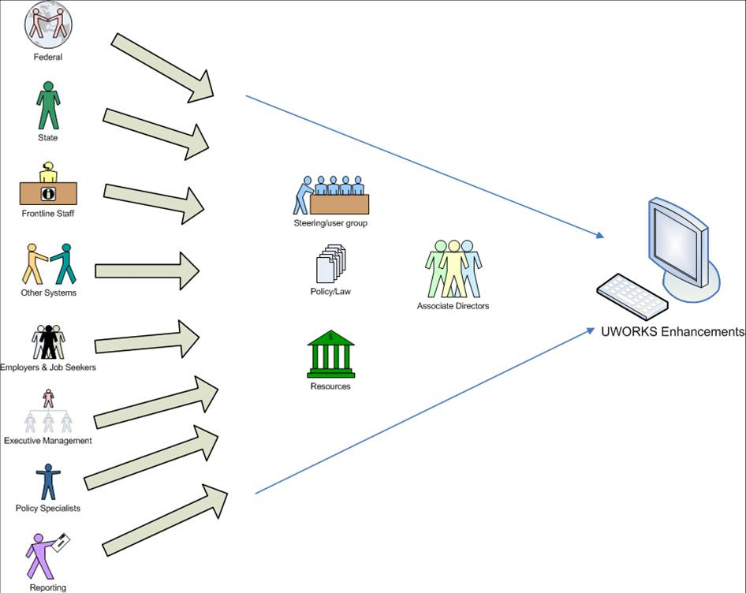

UTAH: 360 Review Process
Notes:
This slide was developed by Elizabeth Carver, Utah Department of Workforce Services

Slide 24
For More Information
VISIT
www.workforce3one.org
Keyword Search: Case Management

Slide 25
Contact
Melissa Mack
Project Manager
(510) 763-1499 ext 670
Melissa_Mack@spra.com
Vinz Koller
Project Director
(831) 622-0749
Vinz_Koller@spra.com

