Slide 1
AGA’s Blended and Braided Funding Guide
Helena Sims
Director of Intergovernmental Relations

Slide 2
AGA’S Intergovernmental Focus
Intergovernmental Partnership
Established in Cooperation with OMB
High Ranking Federal, State and Local Officials
Open Lines of Communication Among Governments
Free, Online Tools and Guides

Slide 3
AGA’S Free Online Tools
Blended and Braided Funding: A Guide for Policy Makers and Practitioners
Making Better Decisions: Leveraging Government Resources in Challenging Financial Times
Risk Assessment Monitoring Toolkit
Subrecipient vs. Contractor Checklist
Cooperative Audit Resolution and Oversight Initiative (CAROI) Guide
Fraud Prevention Toolkit
Candidate Assessment Toolkit for Grants Managers
Partnerships Matter: How
a Federal, State and Non-Profit Collaboration Improved Efficiencies in Delinquent Debt Collection

Slide 4
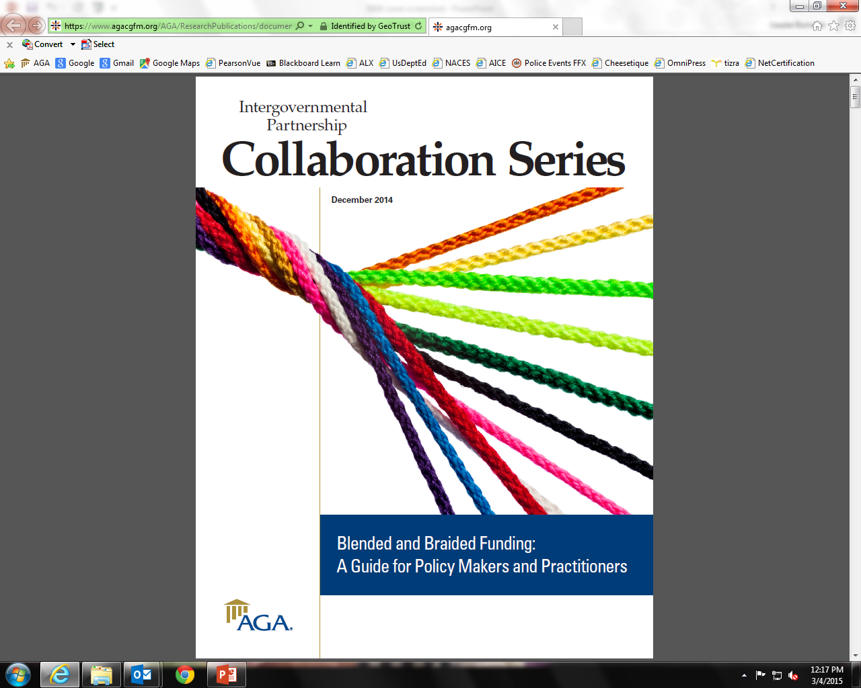

Slide 5
The Blending & Braiding Guide:
Serves as a conversation starter
Explains advantages and challenges
Provides practical, experience-based examples
Answers fundamental questions
Provides suggested statutory language

Slide 6
B&B Process - Oversimplified
Convene Stakeholders
Conduct Needs Assessment
Develop a Consolidated Plan
Develop a Consolidated Budget
Collaborate in Implementing the Plan
Audit Against the Plan
Cooperatively Resolve Any Findings
Provide Feedback on Lessons Learned

Slide 7
Dept. of Education
Schoolwide Programs
Title I of the No Child Left Behind Act
Encouraged schools to consolidate funds from other Federal, State, and local sources
Required state educational agency tomodify or eliminate State fiscal and accounting barriers
Act reauthorized in December 2015 as the Every Student Succeeds Act – the Department is sorting through 1,000 pages

Slide 8
EPA’S Performance Partnership Grants
Concept piloted in 1993
Authorized in Appropriations Act of 1996 and codified at 40 CFR 35 in 2001
Allows states to combine up to 19 separate environmental program grants into a single grant
46 states, 2 territories, and DC participate
Administrative efficiencies are valued as much as programmatic flexibility

Slide 9
Key features & how they work:
Flexibility!
  States have the ability to direct resources across programs based on their unique environmental priorities and needs
Administrative Efficiency!
  One grant work plan, budget, performance/progress report, and financial status report for up to 19 grants
  Funds are not required to be tracked by individual grant program (see Flexibility!)
  Offers help for states in meeting cost-share requirements.

Slide 10
Questions?
Helena Sims:
  hsims@agacgfm.org
  Tools:
    : https://www.agacgfm.org/tools

