Slide 1

Customer-Centered Design
Implementing WIOA
With the Customer in the Center

Slide 2
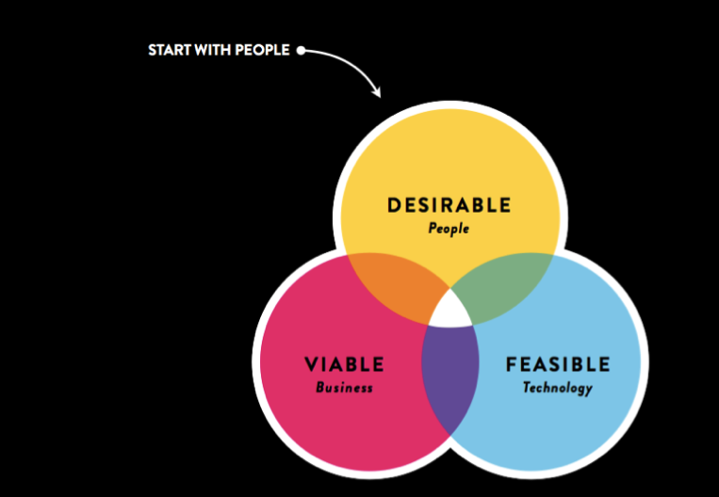
Using
Human
Centered
Design
#

Slide 3

The HCD Process
A collaborative, discovery-based journey.
Get inspired by
the people
you’re serving.
Start by listening to people to get new ideas about how to design
for them.
Identify patterns and surprising insights to
inspire new opportunities
for design.
Brainstorm new ways to serve
your customers.
Try out your
ideas and get feedback from customers – so you can revise your prototypes and get more feedback.
Try out a pilot program and experiment with ways to implement your new ideas.

Slide 4


Services to older Adults to reach self-sufficiency (SOARS)
October 22, 2015

Slide 5

Form your Teams
Design Challenge: How might we put for-profit employers in the center of our sector strategies and career pathway work as it pertains to the Senior Community Service Employment Program (SCSEP) and older workers?
Team Members:
Debbie Edmonds – Older Worker Services (OWS)/SCSEP Program Manager, Goodwill Industries International (GII)
Crystal Odom – SCSEP Assistant National Director, Easter Seals
Suzie Paulson – OWS/SCSEP Program and Compliance Monitor, GII
Kristin Ortun – Skills Attainment Program Manager, GII
Lauren Koons – Grant Accountant/SCSEP, GII
Nancy Mina – OWS/SCSEP Specialist, GII
Assignment 1
Assignment 2
Assignment 3
Assignment 4

Slide 6
Inspiration phase – plan your research
We planned our individual activities to learn from the people we are designing for and explored unfamiliar contexts — we learned from people and experts, immersed ourselves in context, and found an analogous inspiration.
Assignment 1
Assignment 2
Assignment 3
Assignment 4

Slide 7
People
Some Experts
State and American Job Center staff
SCSEP program mangers, case managers
Goodwill, Easter Seals career center staff
Brad Turner, GII Director of Mission Strategy
Kim Clemans, Allied Barton
Charles Lilly, HUB International
Barbara Hoenig, CVS
Bridget Brown - NAWDP
People to Learn From
Employers who hire older workers (CVS, Allied Barton, etc.)
Employers who do not hire older workers
Older workers looking for work
Workforce professionals who work with businesses
Workforce professional who do not work with businesses
Direct Employers Association
Hiring managers/HR staff
Recruiters

Slide 8
Opportunities for design
After conducting our external customer interviews and site visits, our team decided to put together a survey for our internal customers or SCSEP staff so we might capture more specific reasons on why businesses are NOT at the center of their program placement strategies. The resulting 3 top themes and insight statements are key to help drive the design of our prototype solution.
Assignment 1
Assignment 2
Assignment 3
Assignment 4
Notes:
Design Challenge: “How might we put employers in the center of our sector strategies and career pathway work as it pertains to SCSEP?” Assignment 3: Create Insight A: Insights 1. Theme: What prevents you from making business contacts?
a. Insight: Lack of time was listed as a common response b. Insight: Some, in my opinion are a bit unclear of their roles/responsibilities in a job training program c. Insight: Other responses included lack of training and limited manpower d. Insight: Time is an issue for the highest number plus other responses include time management. I feel that time management is an excuse, especially with a program like SCSEP. Better case management, possibly group sessions, meetings.
2. Theme: Do you target employers that hire older workers?
a. Insight: Many of the responses indicated that they do however I’d like to dig deeper into how this relationship is developed and cultivated
b. Insight: Is there anything taking place with employers that don’t hire older workers? For example, is there a “Black-List” or do we challenge them to go even further by educating them on the benefits OR sharing successes from our “Champions” (Employers that hire older workers)
c. Insight: 31% were n/a…I would love to know what that means?
3. Theme: Do you think for-profit businesses provide employment opportunities for SCSEP participants?
a. Insight: Many require higher skill sets or education than our typical participant demonstrates – then what is a typical participant? They have four years in the program, so is there a career path that should start immediately with developing those higher skills, such as computer skills, etc.? Are we really developing a career pathway to employment or just waiting for the four years and then push a job? We should have a pipeline of employers. Too many felt this was the answer: Requiring higher skill sets. Just wondering what they are doing about it.
4. Theme: There are plenty of companies looking for employees, jobs are available.
a. Employers are at the table and ready to hire talented and qualified applicants. Our problem is a shortage of those kind of workers, so we are experiencing the
same thing that employers are facing

Slide 9
B. Top 3 Insights & How Might We
1. Theme: From a business perspective
  Insight: Employers are at the table and ready to hire talented and qualified applicants; increasing revenues and reducing time spent looking for talent.
  How might we become the job source for local businesses?
2. Theme: From program staff perspective
Insight: WFD programs require business engagement buy-in from senior management
    How might we influence program leadership to implement business engagement activities as a primary source for jobs?
3. Theme: From job seeker perspective
Insight: Older job seekers can feel insecure, have less technical skills (computer) and education
. How might we encourage a job seeker toward a higher employment goal?

Slide 10
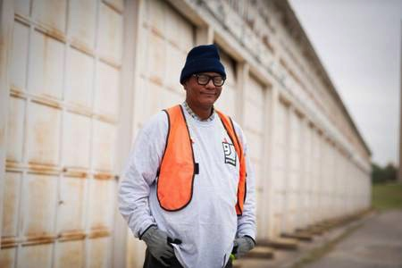
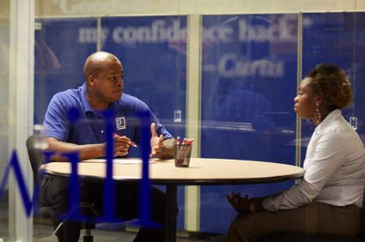
Our next Steps
Assignment 4
Redesign our last 3 surveys to exclude low scoring questions and include feedback comment section on what constitutes a 5 or highest rating on program elements
Develop a business engagement Learn & Lead Lab for senior leadership integrating businesses, job seekers & staff
Design a career assessment toolkit for case managers working with job seekers
Develop a new business engagement toolkit for all staff

Slide 11
RESEARCH

Slide 12
The mission was to figure out ….?

Slide 13
Our challenge was:
"How might we design services and programs for out-of-school youth that will engage them and produce great outcomes?"

Slide 14
On the morning of October 9, 2015, six youth attending Operation Fresh Start entered The Dane County Job Center as “Secret Shoppers.”
The youth are all age 18 to 22 year olds.
The youth were instructed to observe their interactions with the physical space and staff.
Specific youth were provided with some specific directions:

Slide 15
Before this what was your interaction with Job Centers?
What was your experience? How long before some approached you?
Did you walk out with better chances of getting a job than you went in with?
How long did it take for you to get some help?
What did you go there to accomplish?
Did you accomplish it to your satisfaction?
Did your needs get met?
What would you recommend?
Do you think they care about your future?

Slide 16
The Theme
Communication issues: seemed to be the greatest in the minds of the youth. They would have appreciated developing rapport with the staff before trying to address needs, but perhaps more importantly, none of them left knowing what services are available beyond use of computers, maybe getting some job leads, mailbox access, and receiving some applications.
Quality of help was inconsistent and even the best experience reported didn't get into proactive assessment of employment needs. The burden for success is placed on the visitor, who must know what is needed and to ask for it yet, in this group, the visitor was unaware of the range of services available.

Slide 17
SYNTHESIZE

Slide 18

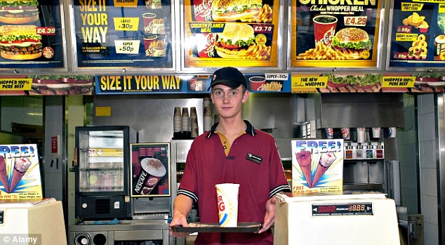


Stakeholder feedback was that restaurants are a great way to interact with young adults. Posting flyers and making a presence at selected restaurants during the lunch hour (11-1pm)will guarantee a return!
A young adult from our focus group mentioned going to restaurants located around alternative schools.
Notes:
Describe the importance of immersing yourself in the “customer’s” (jobseeker & employer) environment. What can you learn by immersing yourself? Provide examples from your team’s experiences. Encourage members of the audience to share their CCD Challenge team’s immersion process: How did they interview and observe customers? What did they learn? Any key findings? Are there any ideas other audience members have of ways to go beyond employer or jobseeker surveys to really learn from their environment?

Slide 19
North Shore WIB
We put the North Shore to work!
Activities and Research
Workshops, readings and discussions;
Interviewing several companies - asking two questions:
  a.) What is the best hiring experience you have ever had – what truly worked to get you the talent you needed in the most effective way possible?
  b.) Where are your current pain points?

Slide 20
North Shore WIB
We put the North Shore to work!
What did we learn?
Hiring success through intermediaries (internal or external) who know them and quickly find the talent they need
Hiring events if done right are also key
Pain points – specific skill gaps AND getting people to come to the north shore to work.

Slide 21
North Shore WIB
We put the North Shore to work!
What did we learn? (cont.)
Relationship building/understanding employer needs are the Key to Success
Quicker Delivery of Service is a must
We need to use Data and constant communication for forecasting
Front End Mapping and Lean Training is needed
We need to solve transportation issues to and on the North Shore

Slide 22
North Shore WIB
We put the North Shore to work!
What are our Next Steps:
Design a pilot/Prototype:
  Long Term (over the next six months) – Front End Mapping and Lean training for Staff
  Short Term (over the next two months) – build around our new motto – Everyone’s Job is Building Relationships – and using our technology (MOSES) to assist with our relationships.

Slide 23
IDEATE

Slide 24

Play Dates
Notes:
Here is an example of an out there idea that inspired a better long-term solution: A group of adult educators were participating in a CCD workshop focused on WIOA implementation. During a “rapid ideation” group activity one of the team members through out the idea of play dates to increase referrals across one-stop partners. The group later further prototyped this idea. They realized that simply organizing partner staff in areas of functional alignment by job task would not necessarily result in staff understanding each program and how they could benefit job seekers. The end result could just be that office furniture was moved...
But what if they implemented “play dates”; which were scheduled 15 minute weekly chat sessions rotating across partner staff. This 15 minutes would allow staff to share their personal and professional perspectives with staff they may not otherwise get to know. By chatting about their grandkids, or sharing a interaction with a client, the staff will get to know each other on a personal level... But also the sharing will help the staff learn more about the other program offerings. They also will build relations among staff so they know if they have a question who they might can ask in order to provide better service to their clients.

Slide 25


Design rich and inspiring spaces that engage youth?
Provide services that motivate, support and empower our customers?
  Engage our employers in
  more meaningful ways?
  Immerse ourselves in employers environments to better understand their needs?
Notes:
Have each group select one of these questions. Spend about 5 minutes in “rapid ideation” where you encourage them to provide as many ideas as possible. Make sure you leave yourself 4-5 minutes for the groups to report out to the audience at large some of the ideas they came up with. Creating an environment where they not only learn to rapid brainstorm, but also walk away with ideas by listening to the other groups, helps to model the importance of creating environments where people share ideas (including bring people with diverse backgrounds together i.e. employer & OSY).

Slide 26
PROTOTYPE

Slide 27


Notes:
This image is of a prototype (left image) of a surgical tool. The image on the right is the final product. The prototype image was developed using simple tools such as markers, film canister, and clip in order to provide the customer giving feedback a visual aid to describe their needs.
The image demonstrates a greater them as well. When it’s rough, we see potential.. But we’ve been trained when something is a finished product to take a red pen to it much like a term paper. We see the negatives instead of the possibilities.

Slide 28

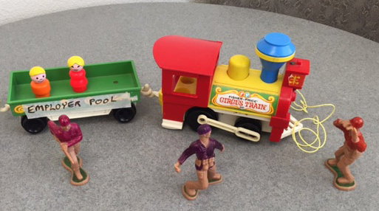
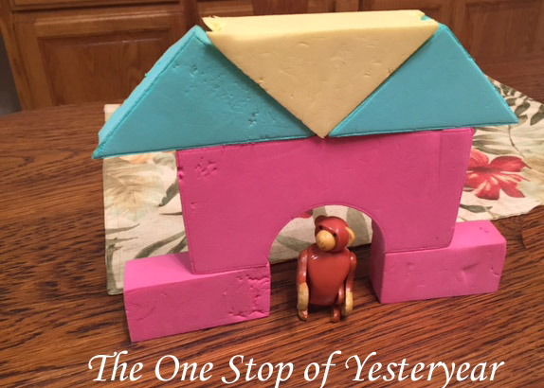
Individual Partner Agencies Fighting Over the
Same Employer Pool
The One Stop of Yesteryear
Notes:
These images come from CCD challenge teams who were prototyping their issues and solutions. The top image is of all the partners connecting with employers. The train shows the employer pool being surrounded by multiple programs. But there is no clear connection between employment programs, or recognized path. The bottom image demonstrates the vagueness or lack of familiarity employers have with the one-stop services. Next slide...

Slide 29
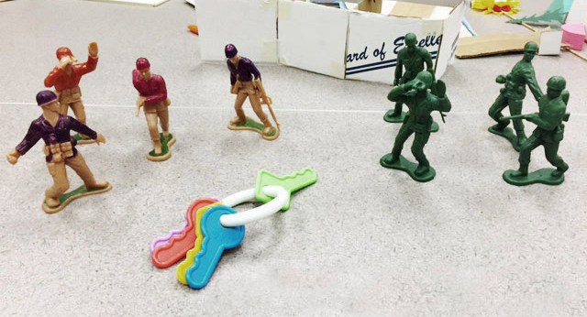
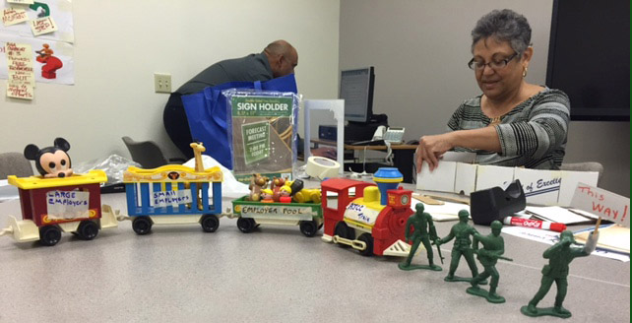
The key is to form ONE team
and
to be SEEN as ONE team
One team LEADING THE WAY for
small and large employer pool to the
workforce resource center (AJCC)
Together as one
Notes:
As this CCD Challenge team out of Santa Barbara, CA continued to story board their idea they were able to visually demonstrate how making the one-stop services a “unified team” that provided services to employers would allow the employers to see the clear path to valuable services.

Slide 30



Future U
Tank
PAID INTERNSHIP & LEADERSHIP ACADEMY PROTOYPING Course – Nov. 2015
Design Question
How do we drive and increase out-of-school youth to see value in accessing Arapahoe/Douglas Works! programming and resources?

Slide 31
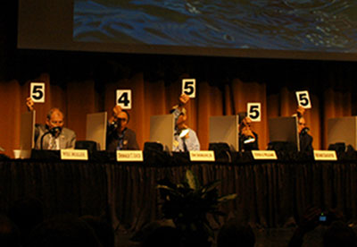
The Competitors
& the Sharks
The Sharks:
  Employers and Workforce Center Staff will compromise the panel that will judge the Marketing Plans
The Competitors:
  The 12 Students who completed the 4-8 week Academy
  Young Adults between 18 and 25 years old
Design Question
How do we drive and increase out-of-school youth to see value in accessing Arapahoe/Douglas Works! programming and resources?

Slide 32
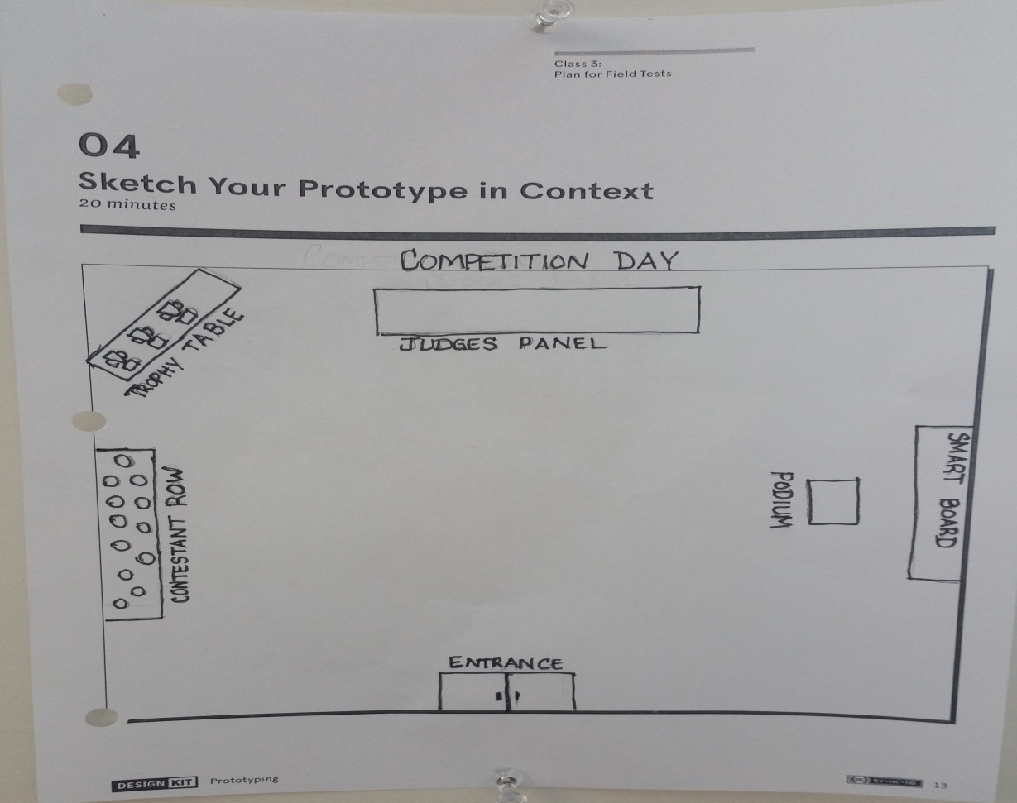
prototype sketch in context
Competition Day

Slide 33
TEST

Slide 34



Reminder
Access existing technical assistance at:
wioa.workforce3one.org
Including
Quick Start Action Planners
WIOA Action Plan Template
Variety of Resources by Topical Area
Voices of Experience

