Slide 1
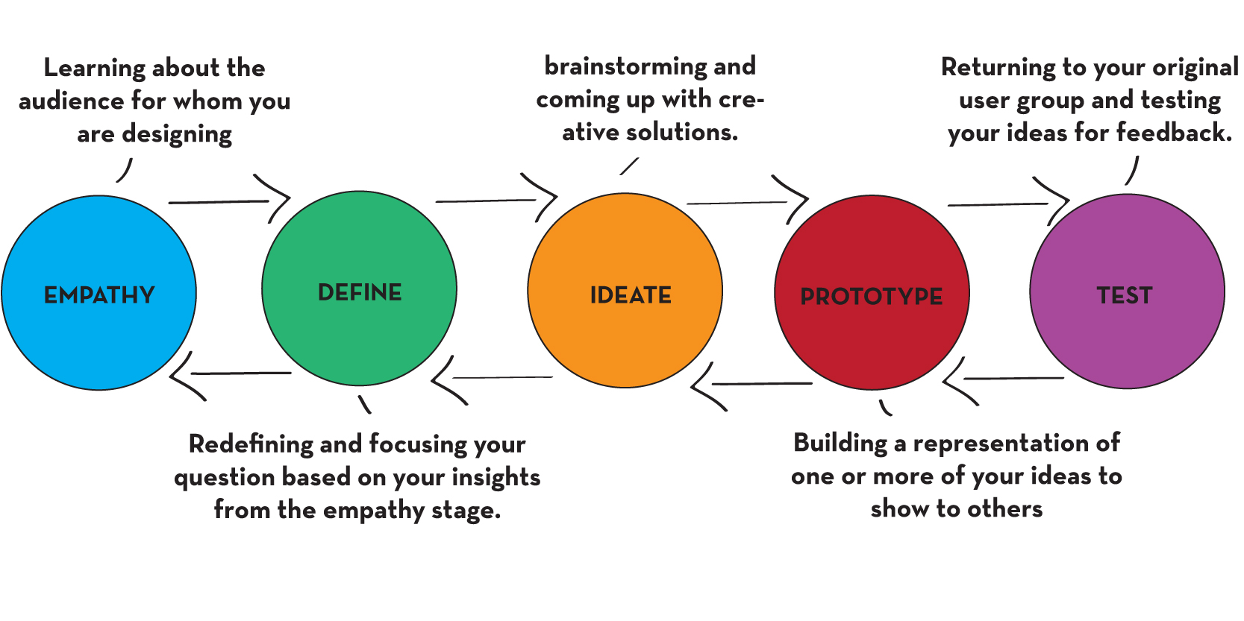
Ideate

Slide 2
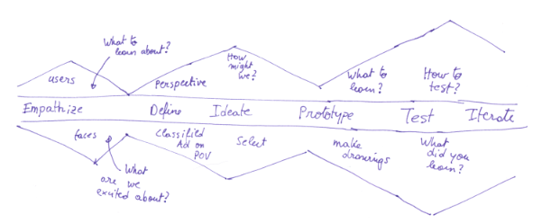
Human Centered Design Approach

Slide 3
Human Centered Design Approach
Discover
Ideate
Prototype

Slide 4
Human Centered Design Approach
Discover
Ideate
Prototype
“Ah-ha” Data
Guessing
Testing & Tweaking

Slide 5
Discover
New and Old Sources
Facilitated exercises
Interviewing
Focus Groups
Data Combing
Combination of Sources
Example: An interview/group focus group to provide context to data

Slide 6

Discover (Youth)

Slide 7
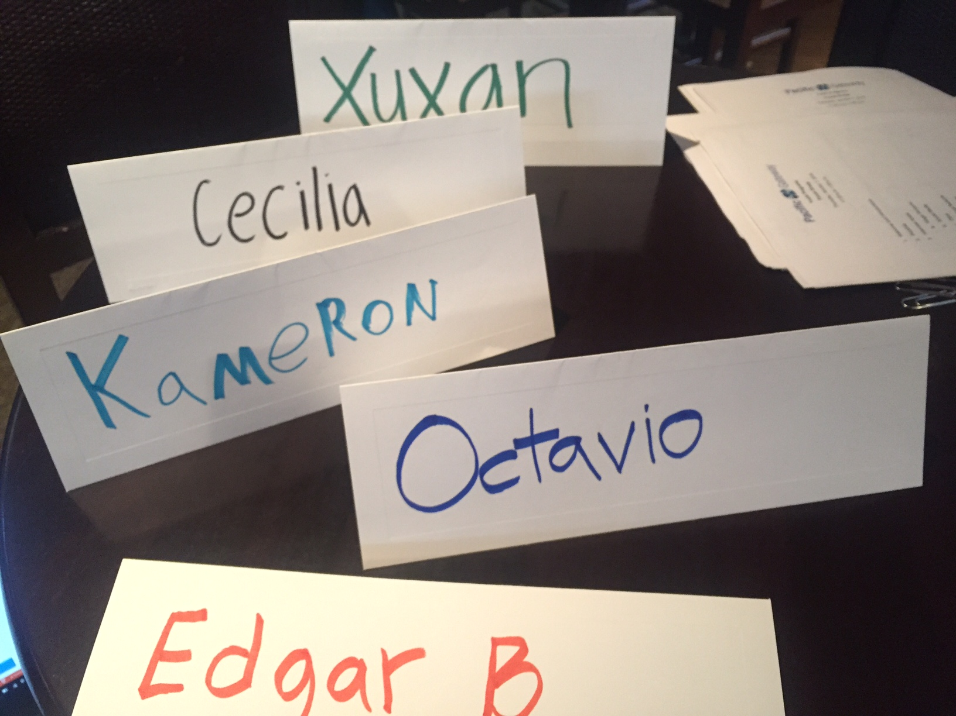
Discover
Pacific Gateway – Last Week’s Focus Group
1 ½ hours
Internally developed and led (by staff member they did not previously know)
Key questions for insight

Slide 8
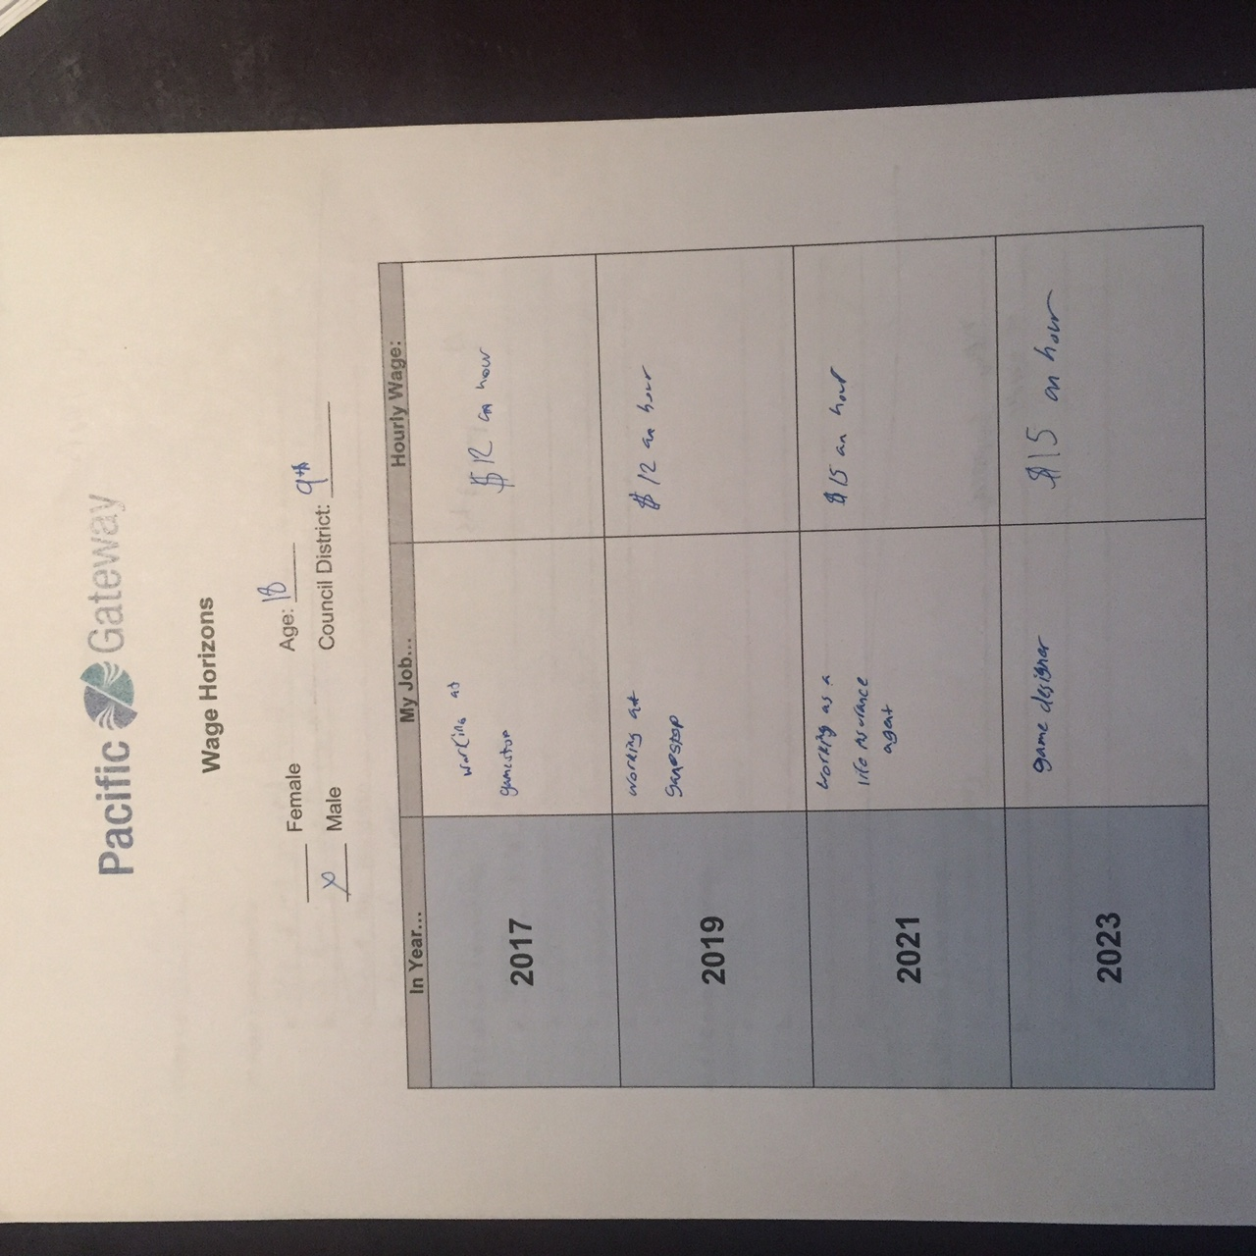
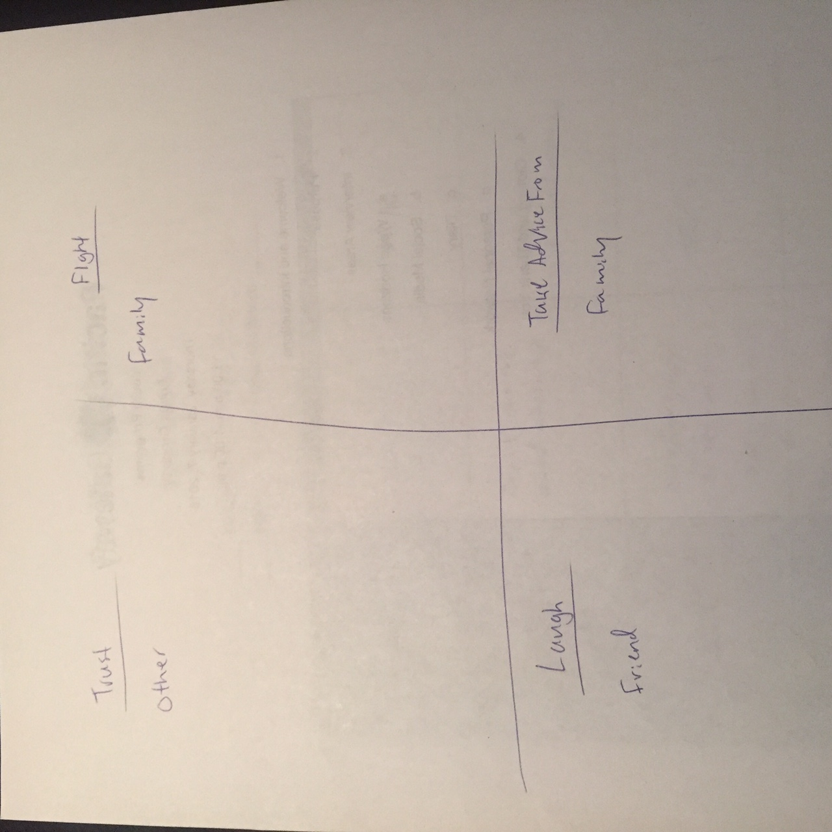
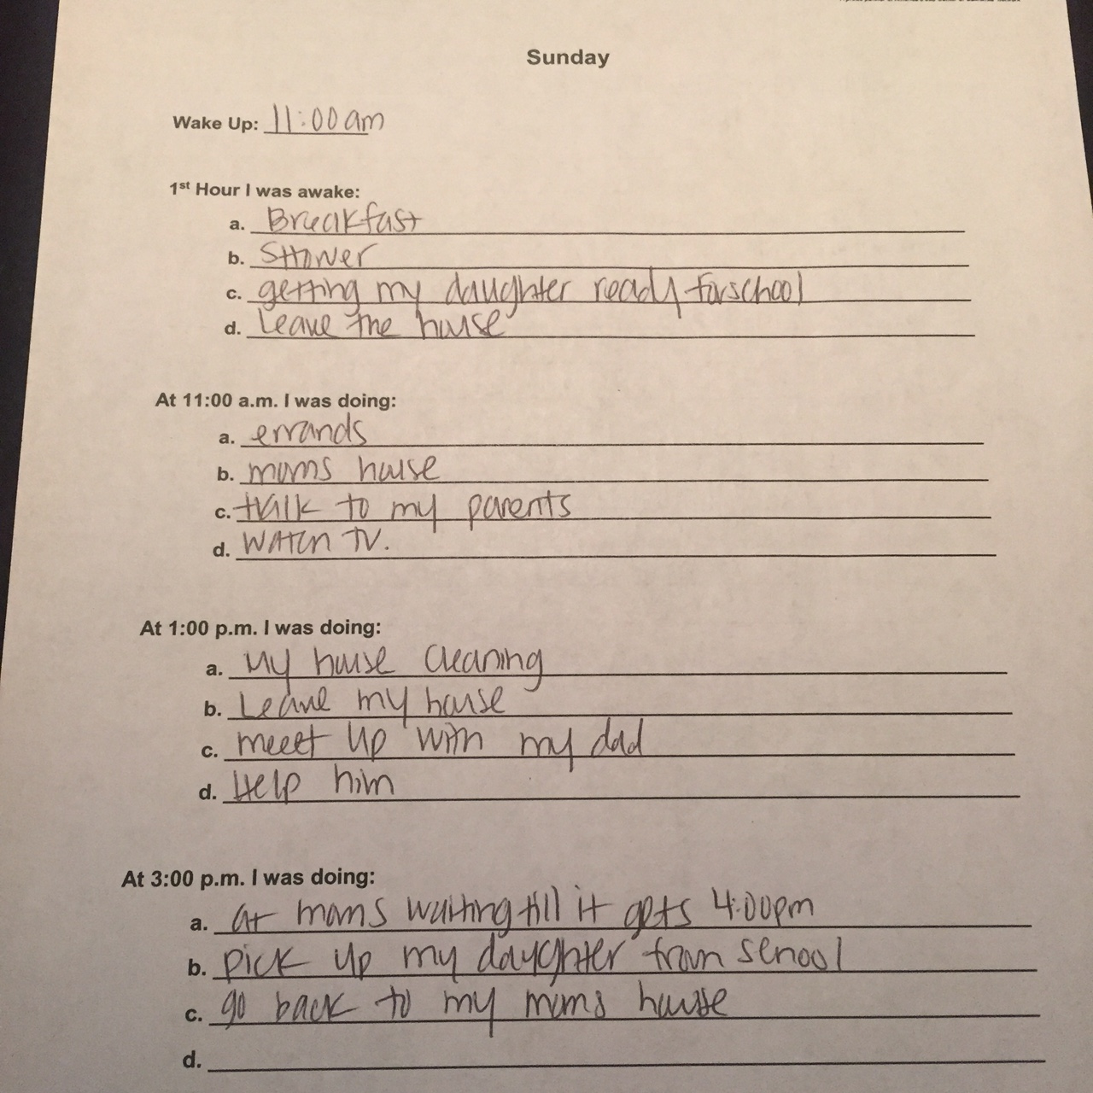
Discover

Slide 9
Discover
 | Xuxan (26) | Kameron (18) | Octavio (24) | Edgar (20) | Cynthia (18)
Sam’s Life Change | 4 years | 4 years | 2 years | 6 months* | 2 years
60 Pounds | 7 months | 4 months | 3 years | 3 years | 3 months
$500 | Laptop | Stuff | Mac Laptop | A Car | Art Supplies

Slide 10
Ideate
What are we aiming at? What are we shining light on?
Is there pain in a system or process?
Is there a product module we are trying to create?

Slide 11
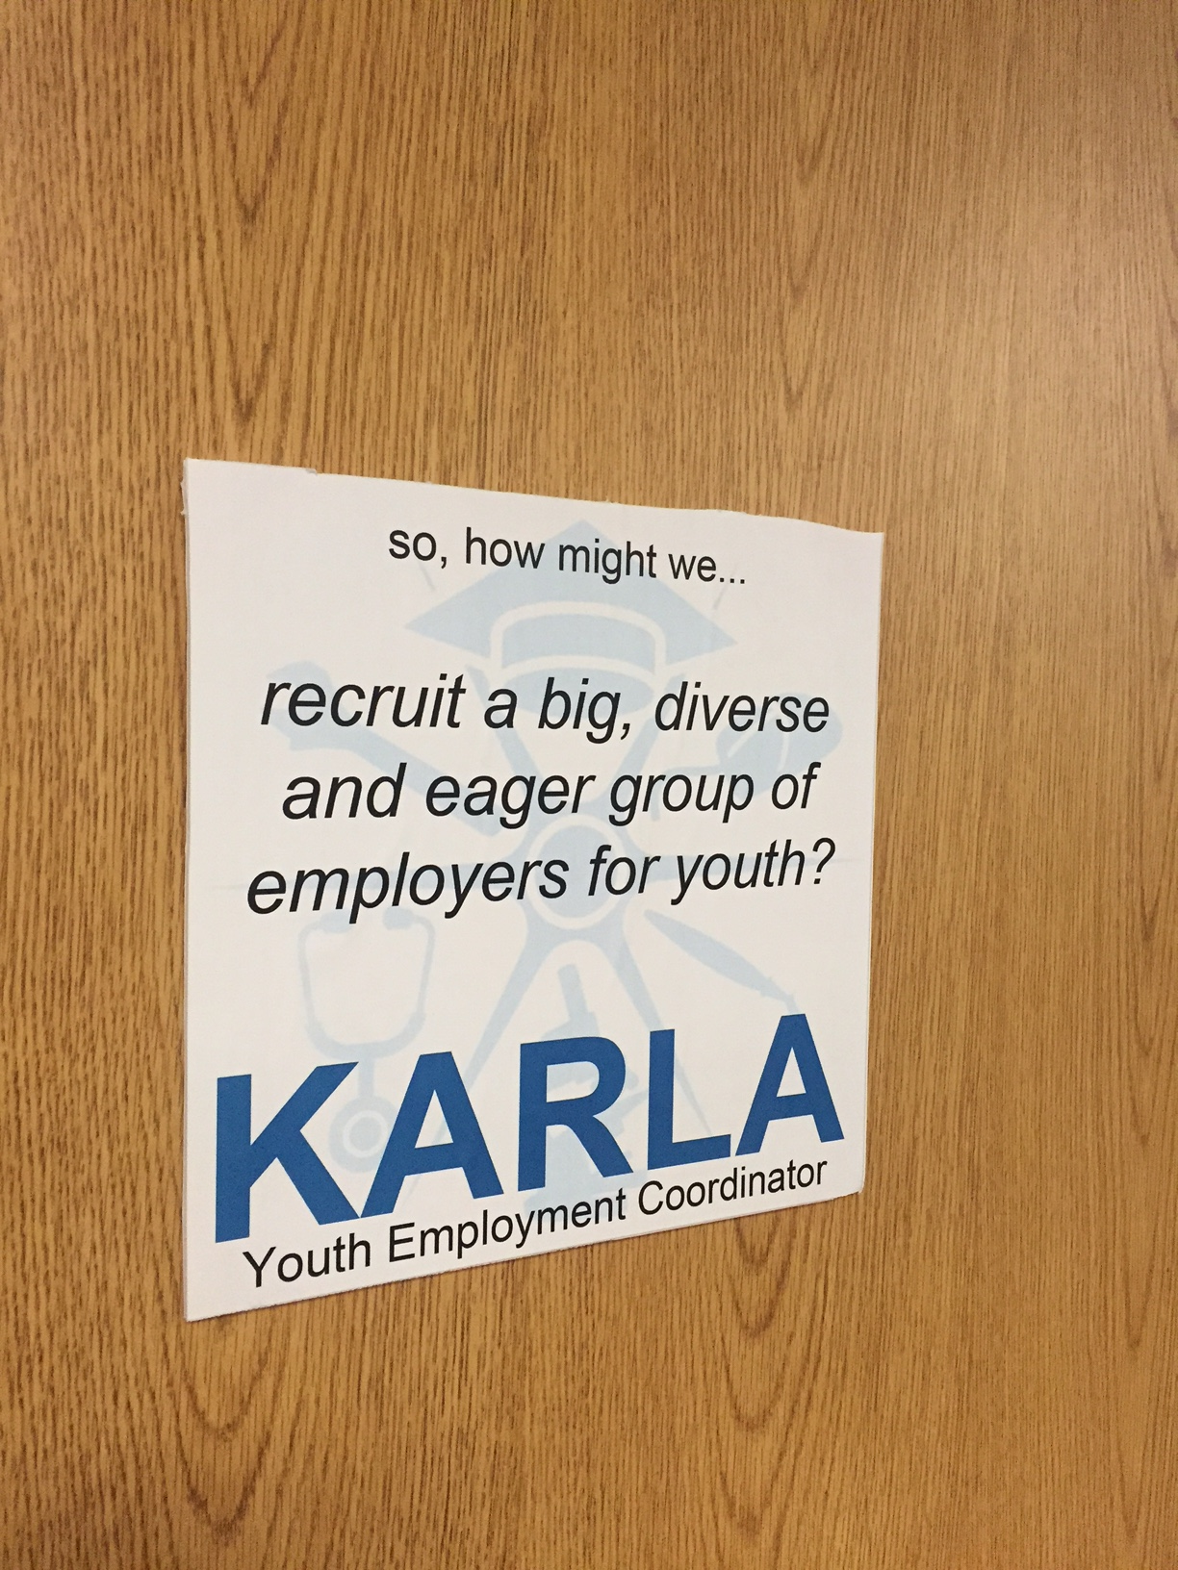

Ideate – Embedding the Concept

Slide 12
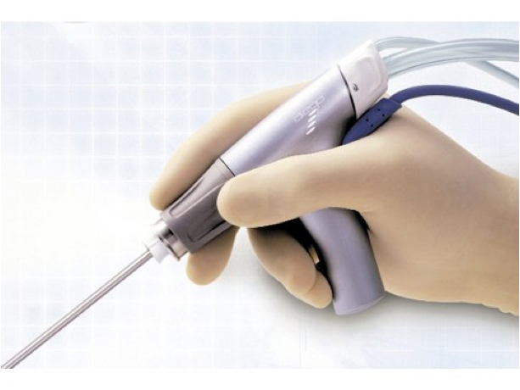
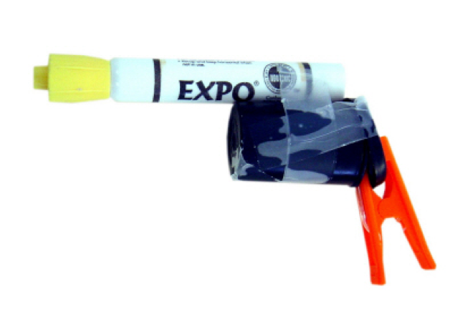
Prototype

Slide 13
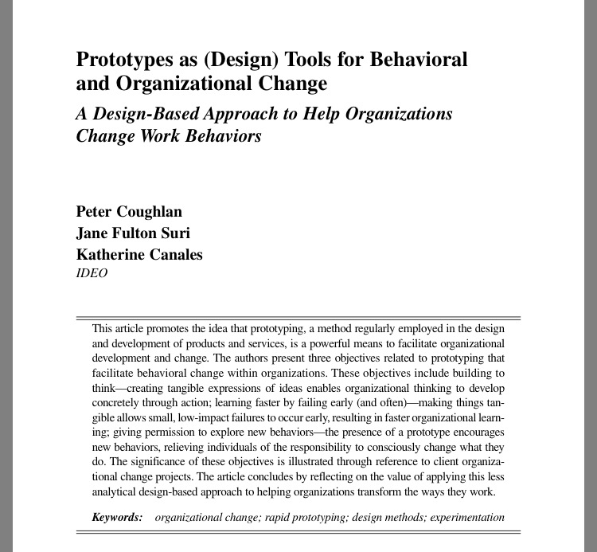
Prototype
Prototyping the right effective way
Building to Think
Learning by Failing Early
Freedom to Explore New Behaviors

Slide 14
Prototype
Prototyping the right effective way
Building to Think

Slide 15
Prototype
Prototyping the right effective way
Learning by Failing Early

Slide 16
Prototype
Prototyping the right effective way
Freedom to Explore New Behaviors

Slide 17
Prototype
Freedom and Parameters
Report-back dates and processes
Inclusion

Slide 18
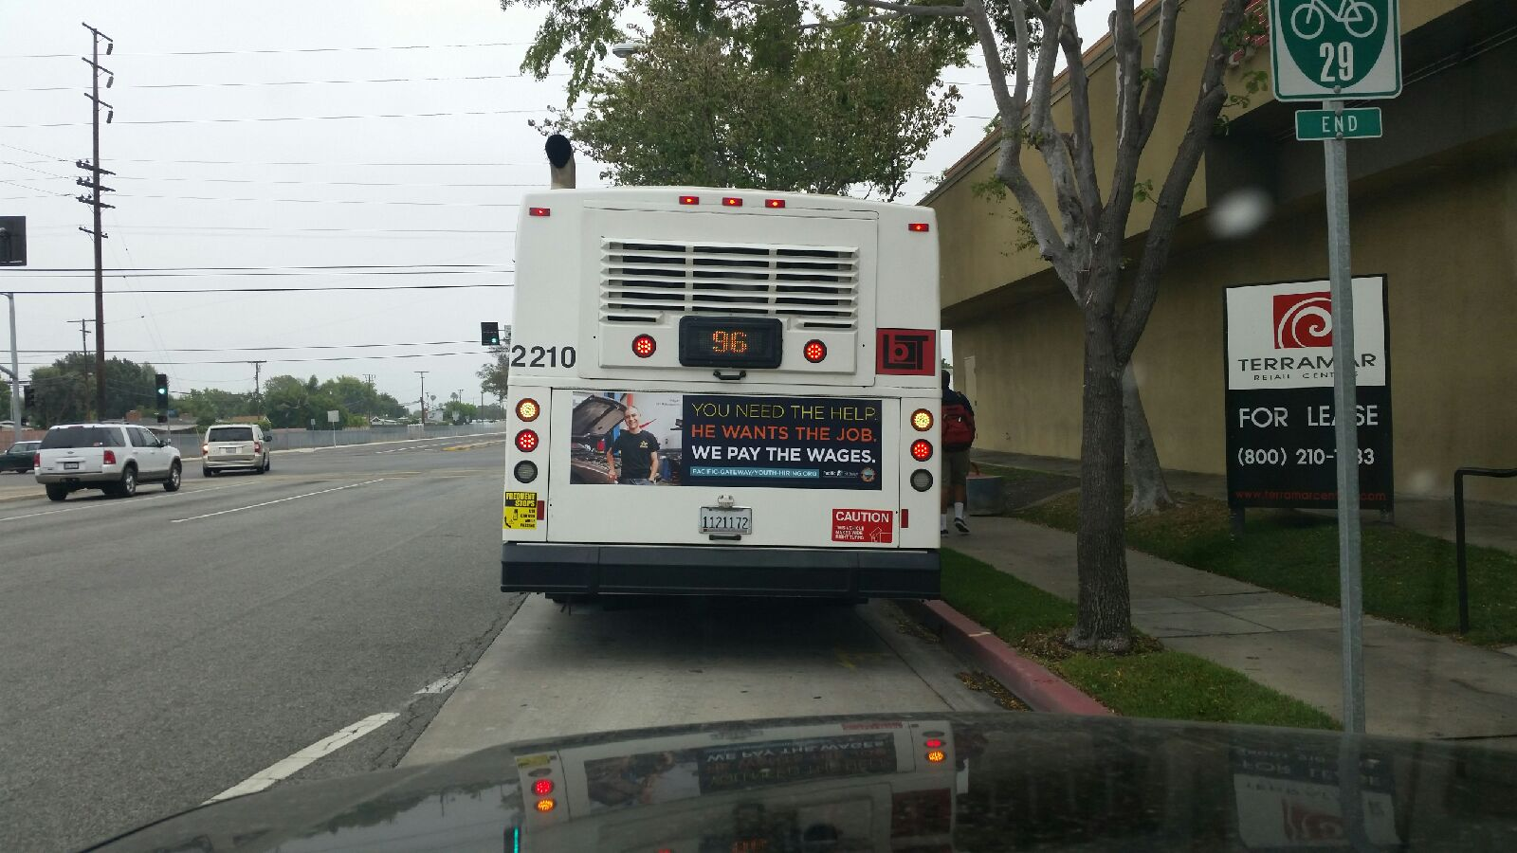

HCD Outputs

Slide 19
Key Thoughts
Big Stuff and Little Stuff
Embed for Organizational Shift

