Slide 1
Connecting unemployment insurance and workforce development
AARON r. Fichtner, Ph.D.
Deputy Commissioner
New Jersey Department of Labor and Workforce Development

Slide 2
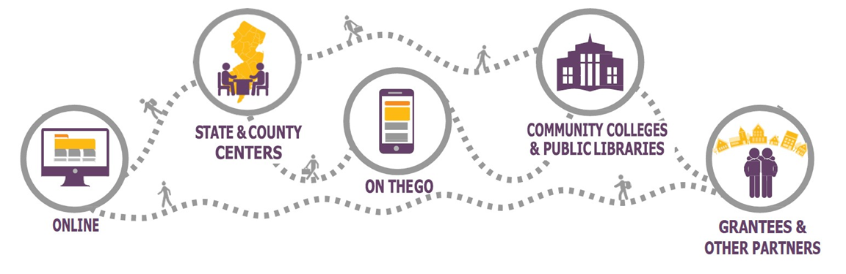
New Jersey Career Connections
PLAN
Your Finances
Get the support you need
PREPARE
Master the Art of Networking
Top-Notch Resumes
SUCCEED
Applying & Interviewing
Lifelong Career Success
Find the right career for you
Stay Motivated
Update your skills
Documents you need for employment
On-Line Applications
Interviewing Skills
Connect to a Talent Network

Slide 3
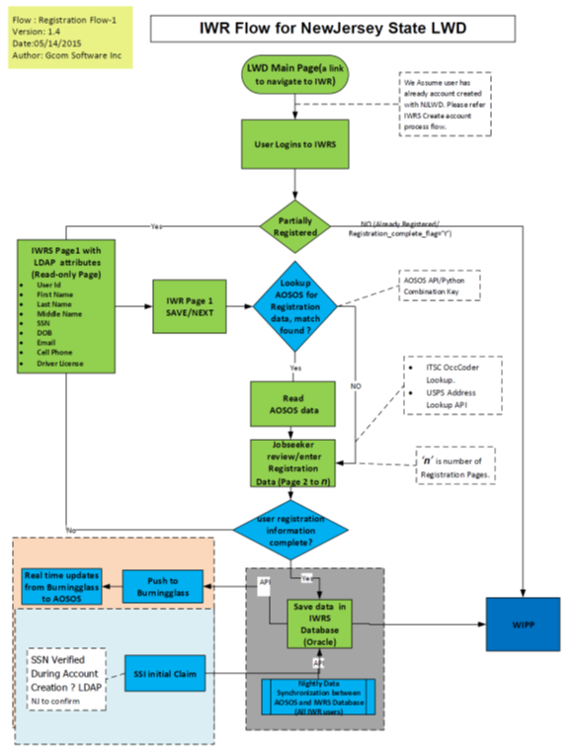
Systems Integration
IWRS and WIPP
NJ’s IWRS and WIPP Consolidates Job-Seeker Data from 6 Different Systems
IWRS: Integrated Workforce Registration System (single sign-on)
WIPP: Workforce Integrated Profile Page

Slide 4
Benefits of an Integrated Data System
Providing customer support in one application with a complete view of a customer’s reemployment and unemployment information.
Empowering job seekers with a customized page that provides all the latest tools and resources in one convenient place.
Gathering of the most accurate, integrated data through the registration process for better reporting, decision making, and service.
IWRS is integrated with our Workforce and UI case management systems for smooth navigation

Slide 5
Benefits of an Integrated Data System (continued)
Convenient information sharing and organization tools (i.e.: mass emails, calendar, etc.)
Better communication between job seekers, departments, and agency staff.
Use of data mining and predictive data analytics tools to slice and dice the data to find hidden patterns and trends.
Can be customized to meet new/evolving programs and services.

Slide 6
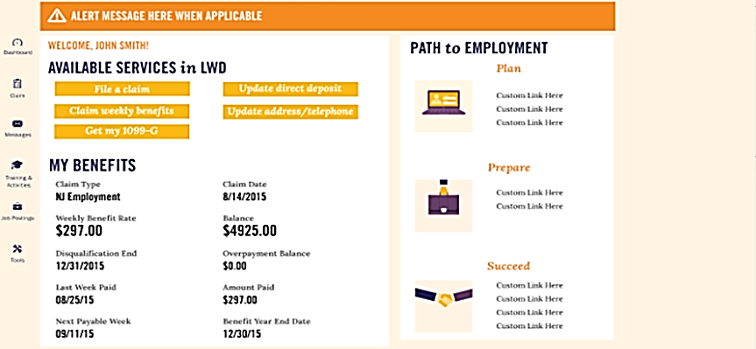
Workforce Integrated Profile Page

Slide 7
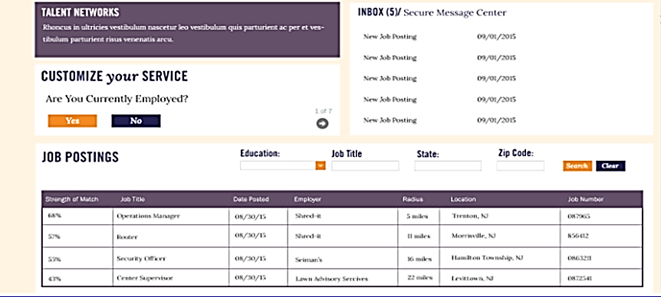
Workforce Integrated Profile Page

