Slide 1

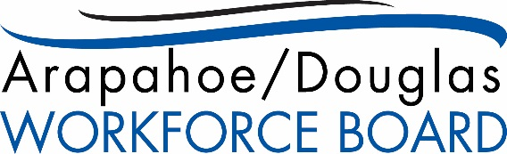



Partnering with Economic Development
January 2016

Slide 2
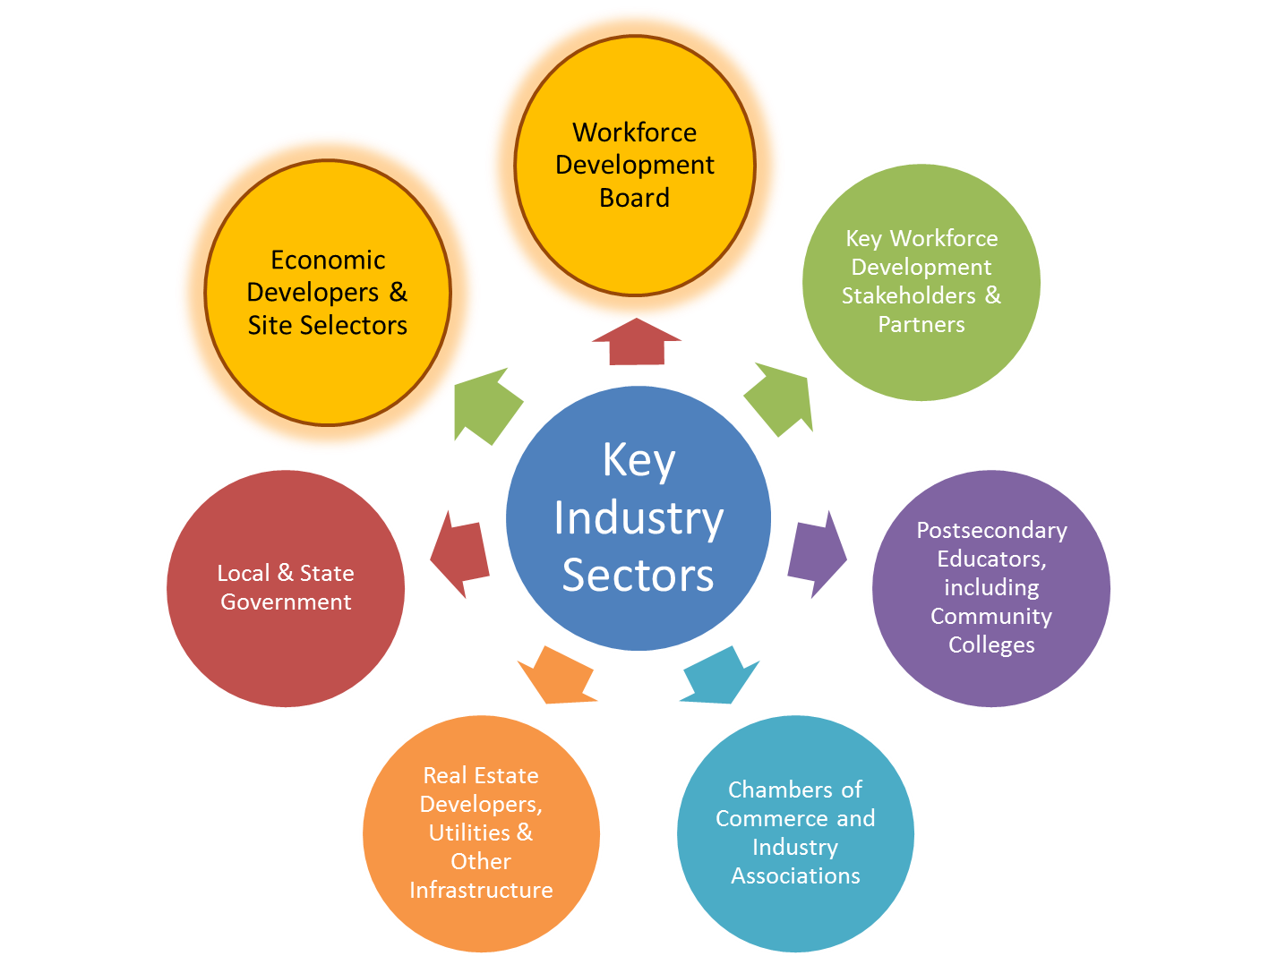
Key to a Vibrant & Growing Economy
These partners are part of a ‘service infrastructure’ that must work in tandem to ensure a business friendly environment that keeps existing business, attracts new business and grows jobs.
“The most professional and seamless partnership we’ve ever dealt with.”
Tim Messner, Vice President & General Counsel
Dish Network

Slide 3

State Level Partnership
We operate with the mindset that Workforce Development IS Economic Development, the two cannot operate independently
  To demonstrate that, the director of the state ED agency is a voting member of the state board
To facilitate partnership, there is one point person within OEDIT who is the connection to activities and initiatives of the CWDC
Our sectors strategy is integrated with economic development by focusing on the key industries identified through a bottom up process

Slide 4
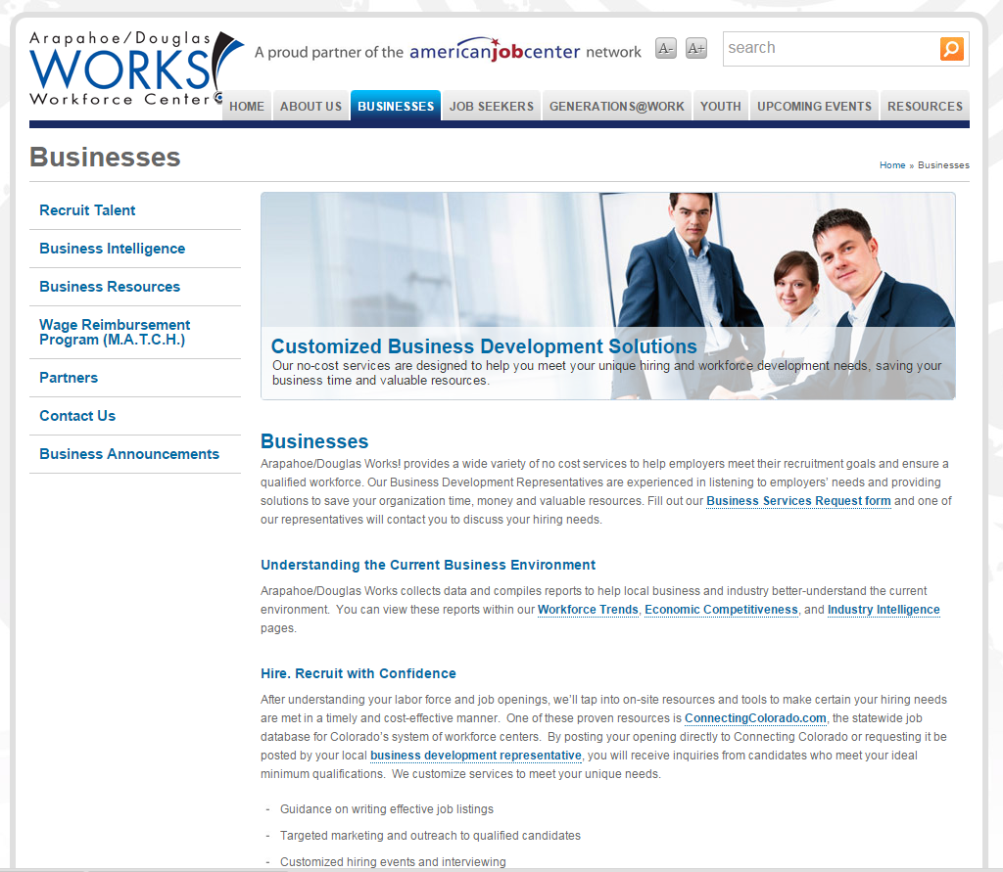

Successful Collaboration
Economic developers and site selectors need TWO CRITICAL things from Workforce Development Boards:
  Timely delivery of accurate data on the local labor force
  Professional help in staffing up, including outreach, screening, assessment, space to interview, and targeted hiring events

Slide 5
Workforce Development at the Speed of Business
WDB service delivered through local governments in larger urban areas and by the state in rural areas
Shared statewide job seeker and employer database accessible by local workforce development areas
Statewide collaboration on business services and shared data allows regional approach – we can have resumes from qualified candidates coming in within minutes

Slide 6
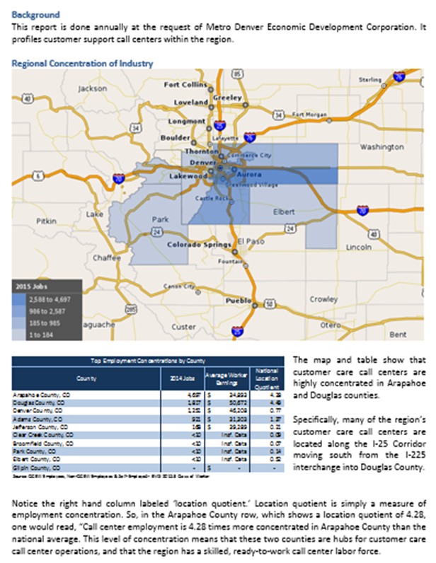
How Site Selection Requests are Made
Requests come in from economic developers who may be working with a site selection firm representing a business client on a short timeframe.
A conversation with the economic developer drives the scope and data sources used in the report. This is a sample report.
Some of the data tools/sources used:
EMSI Developer
Wanted Analytics
US Census Bureau
Bureau of Labor Statistics
Bureau of Economic Analysis
State demography office
State department of labor and employment
Local demographers
Notes:
This is a report Metro Denver EDC requests from us every year because they talk to so many site selectors regarding call centers

Slide 7
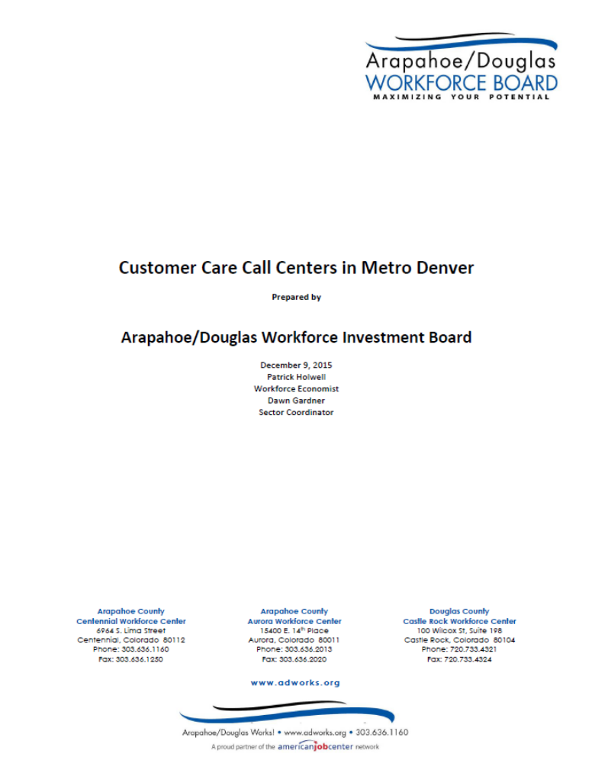
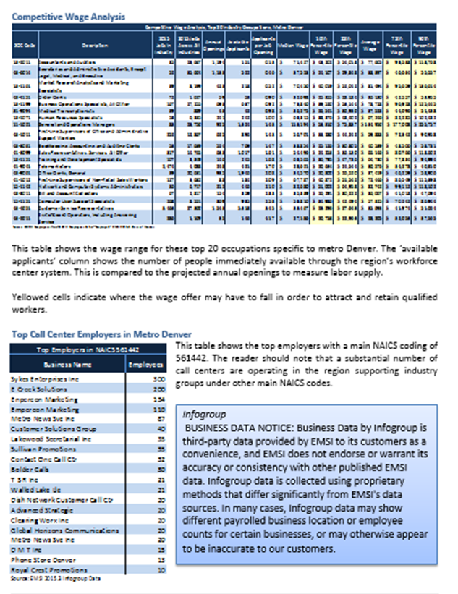
Sample Report (cont.)
Once a workforce development board has established itself as a reliable and accurate data source, requests from economic developers, local governments, chambers of commerce, individual businesses and postsecondary educators come often. The Arapahoe/Douglas Workforce Board fielded over 30 requests per month during PY14.

Slide 8
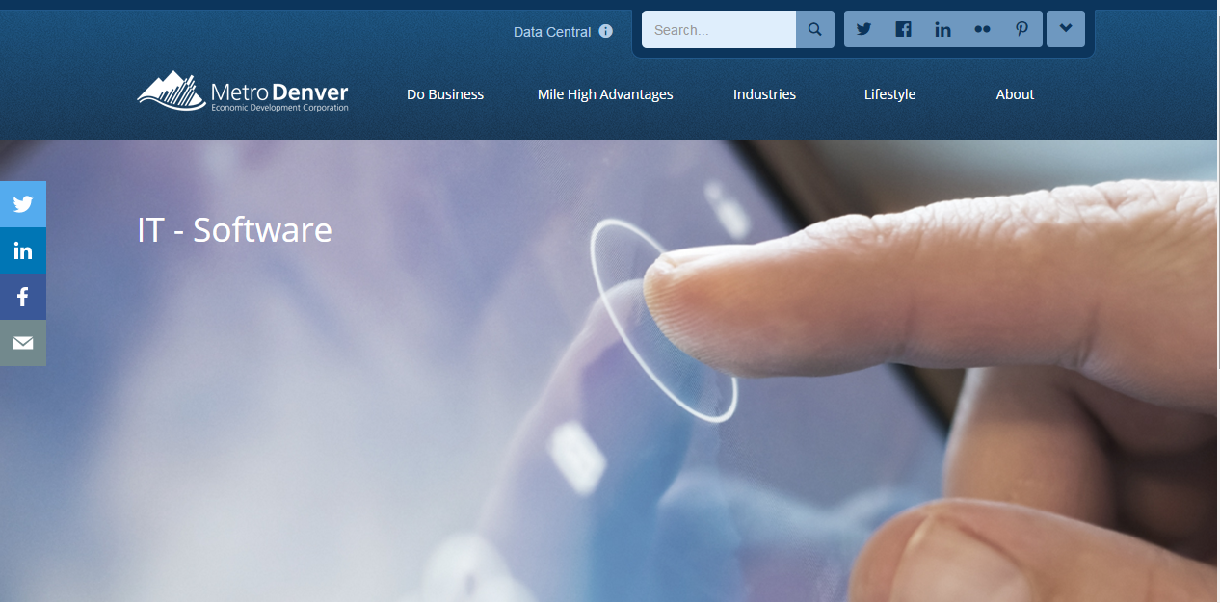
Example of ECODEVO Collaboration
For the past three years, the Arapahoe/Douglas WDB’s staff economist has provided workforce data for Metro Denver Economic Development Corporation’s yearly career cluster reports, which contain both regional and statewide information. Here is a link to the most recent IT/Software cluster report:

Slide 9
What do Economic Developers Say About Us?
Economic developers will ask you to build the case for the local labor force ONCE and if you are successful with this, then…
They will ask you for help with business clients and may want you to help them actually work with site selectors or existing business clients
“Arapahoe/Douglas Works! is the best in the metro area. They have been able to meet the needs of new employers better than most private employment agencies. They are a great asset to economic developers like Metro Denver Economic Development Corporation.”
Tom Clark, CEO, Metro Denver Economic Development Corporation
Notes:
Metro Denver Economic Development Corporation’s 2014 Metropolitan Cooperation Award winners from Arapahoe/Douglas Works! and Adams County Workforce Center

Slide 10
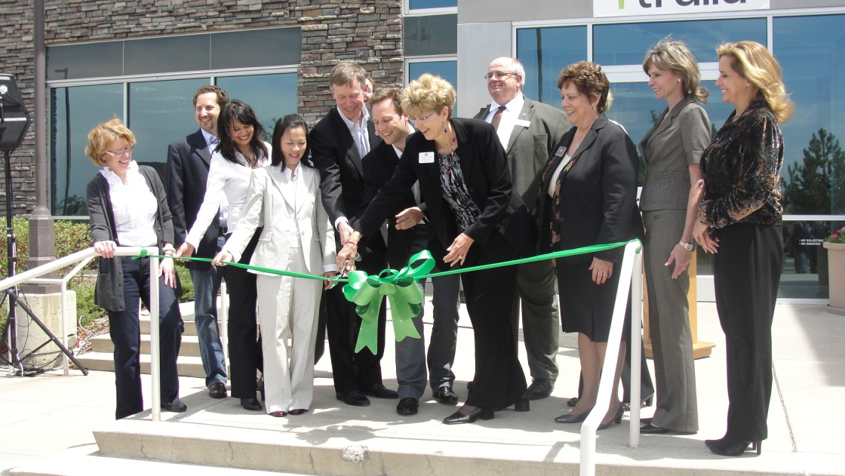
Successful partnerships bring in new jobs!
Denver South Economic Development Partnership was lead organization
Arledge Partners was Site Selector
Expansion of San Francisco based company
The Arapahoe/Douglas Workforce Development Board provided data making the case for the region’s labor force and help with staffing
160 jobs brought in to greater metro Denver region
Gov. Hickenlooper Joins Area Elected Officials and Trulia Executives at the Grand Opening of the New Trulia Centennial Office

Slide 11
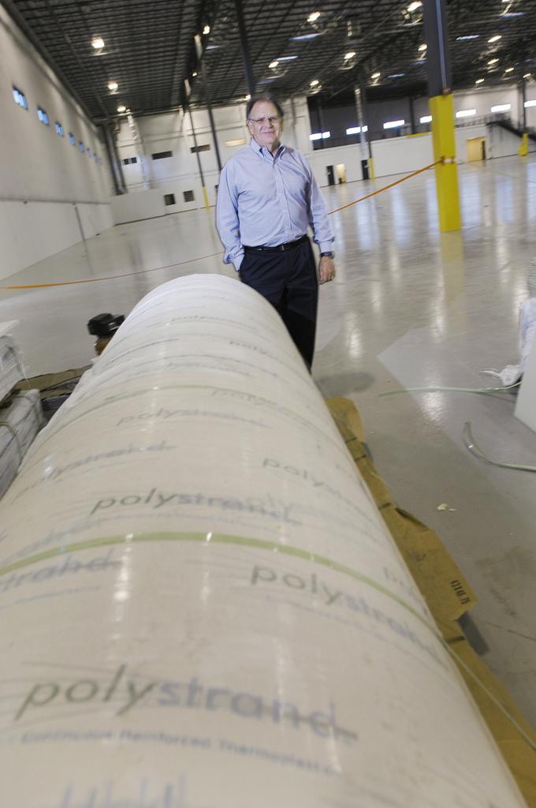
Gordon Composite/Polystrand
Denver South Economic Development Partnership (DSEDP) was lead economic developer
Gordon Composites Inc. (GCI) moving HQ to Centennial, CO from Montrose, CO
DSEDP Partnership
  Xcel Energy
  Douglas County
  Arapahoe/ Douglas Workforce Development Board
Arapahoe/Douglas Works! was AT the table with data on local labor force and hiring needs

Slide 12
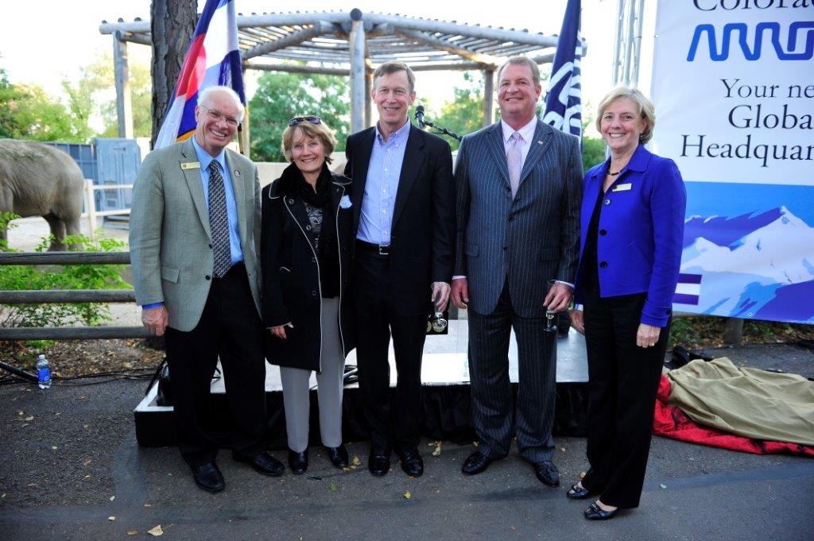
Arrow Electronics Expansion
Chief Elected Official in Arapahoe/Douglas Area, WDB members, Governor Hickenlooper and Mike Long from Arrow Electronics

Slide 13
Challenges & Opportunities
Key Challenges
Full employment (unemployment rate <4.9%)
Reaching deeper to bring underutilized people into the labor force
Some training pipeline issues
Opportunities
Strong sector partnerships driving more relevant training
Work with industry to develop work based learning opportunities
Industry leaders using data supplied by workforce development to review existing training pipeline
Notes:
Examples of strong sector partnerships driving relevant training:
TEC-P grant, IT leaders identified software development engineer as their most difficult to fill job and drove the creation of a boot camp approach aided by workforce development, postsecondary educators and the industry association
The Greater Metro Denver Healthcare Partnership’s sector leaders identified six occupations as being critical and worked with education and workforce development to recruit and train people to meet sector business need
Arapahoe/Douglas WDB supplied Greater Metro Denver Healthcare Partnership with custom data including exhaustive look at regional training pipeline

Slide 14
Strategy for Statewide Business Engagement
Colorado Blueprint identified eleven key industry sectors
Local workforce boards build on this in their areas and planning region
Statewide business development strategies – data training, LEAN training, partner alignment, and streamlining processes
Notes:
The statewide BDR group will be conducting a LEAN training process which will include mandatory partners so that systematic outreach to businesses can be made more effective and efficient. This will include developing common measurements for tracking and outcomes.

Slide 15
Tracking Outcomes
Colorado’s workforce development boards are beginning to track the economic impact of workforce development operations
Arapahoe/Douglas WDB provides an example…

Slide 16
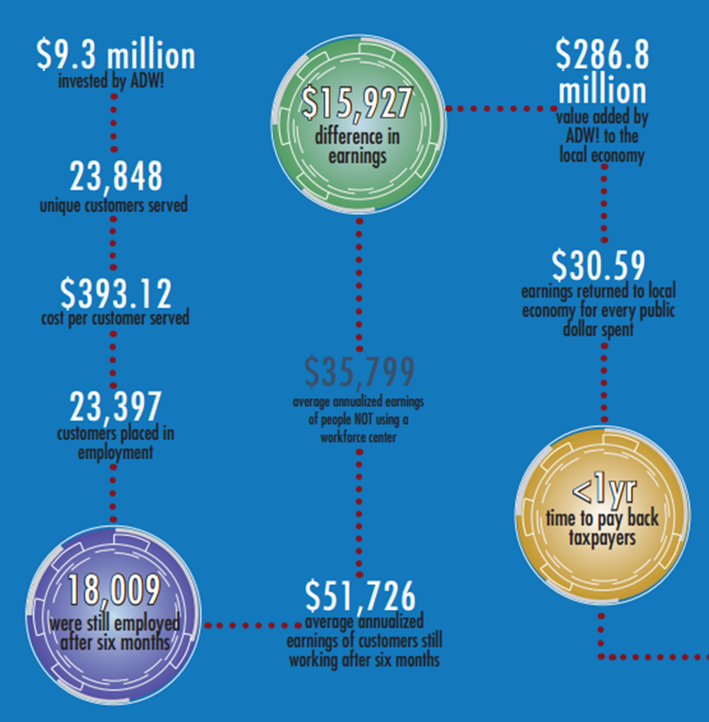
Tracking the Value of Workforce Development in Dollars & Cents
With the assistance of the Colorado Department of Labor and Employment (CDLE), workforce development boards throughout Colorado can now tell a very compelling story about the tremendous value of focused, business-driven workforce development

Slide 17
