Slide 1
Workforce Innovation and Opportunity Act National Convening
January 27, 2016

Slide 2
Traditional approach to higher ed
$150 billion
Calendar
Space allocation
Faculty workload
Progress
Program design
Seat time
CREDIT HOUR
Time is fixed.
Learning is variable.
Actual
learning
Student
needs
Employer
needs
New
delivery
Notes:
JULIAN
Focus has been around credit hour – A $150 billion industry.
Student is not at the center

Slide 3





The way forward: Competency-based education
  Focuses on the
  demonstration of
  articulated skills
  knowledge and
  abilities
  Defines learning
  but makes time flexible
  Is not based on
  credit hours or
  seat time
  (though may “translate”
  to credit hours
  for administrative
  convenience or necessity)
Notes:
JULIAN
CBE is an effective approach to addressing what’s important to employers – what will help them overcome their challenges and meet their business goals -- while at the same time meeting rigorous academic requirements.
Focuses on the demonstration of articulated skills, knowledge, and abilities.
Time becomes flexible -- CBE programs allow students to advance based on mastery of competencies and not on credit hour or seat time.
Roughly 600 higher ed institutions offer some type of CBE.
Many employers nationwide use it for hiring, promotions, and assessments.
CBE creates high-quality learning pathways that are not only affordable, but also tailored to a wide variety of industries.
CB models are built on learning outcomes that explicitly reflect the practical application of workplace knowledge and skills.

Slide 4


The College for America model
An accredited, nonprofit college built to help
employers develop and promote talent through
competency-based higher education
  Applicable in
  the workplace
  Built for working adults
  Affordable for every employee
Notes:
JULIAN
Key message: We reengineered higher ed specifically to work for working adults and their employers.
College for America at Southern New Hampshire University is a nonprofit, accredited college that partners with employers nationwide – from Anthem to Goodwill to some of the country’s largest hospitals and health systems – to make a college degree possible for every frontline employees.
We do it through competency-based education that lets students show what they know and can do through project-based learning.
CfA students earn an accredited Associate or Bachelor’s degree, and full college credit from Southern New Hampshire University – an 82 year old nonprofit university. But the learning path is built specifically for working adults and their employers:
Students complete projects to learn and develop these competencies – and they have to master every one to graduate.
It’s applicable in the workplace. Directly informed by labor market data and employer input, and focused on competencies, not seat time.
It’s flexible for busy lives. Students can move quickly through subjects they already know and fit it in their life after work and family priorities.
The AA degree requires mastery of 120 specific competencies mapped from the university's traditional degree—and although traditional courses are tethered to a preset length of time, CfA requires mastery of every competency regardless of time.
An employee who has been working with numbers for years in her job may breeze through CfA mathematics competencies far more quickly than the traditional 16-week course required at a local college, but she may spend a few months or more working with a CfA coach on a plan to learn to write clearly.
It’s low cost. Our entire tuition is just $2,500/year – less than the typical employer already offers today for tuition reimbursement.
AA fully eligible for federal student aid).
$10K BA
The accessibility of our program helps employers offer an incredible opportunity to frontline employees who wouldn’t otherwise have an opportunity for higher education or for upward mobility within their organization.

Slide 5

Partnering with employers for workforce development
  Help employees
  develop
  promotable skills
  Promote
  engagement and
  loyalty
  Build talent and
  leadership
Notes:
JULIAN
College for America is centered around workforce development and helping working adults succeed, which is why we only accept students through partnerships with employers like Anthem.
There is no fee for partnership – we just ask for their active help in bringing this opportunity to every employee.
Today, Starrann is studying to receive a Bachelor’s degree in Communications with a concentration in business. She says this opportunity has reinvigorated her life and given her the opportunity to see a dream for her career that was buried many years ago. Her boss agrees. And at College for America, we want to bring that same opportunity to every frontline employee in this country.

Slide 6
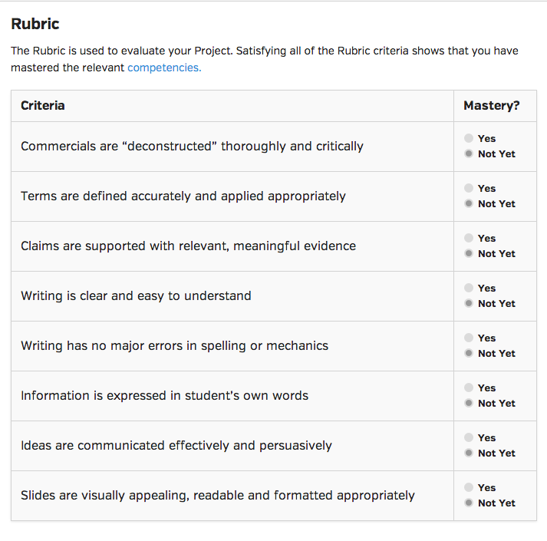
COMPETENCIES MUST BE MASTERED
Reviewers—trained educators with advanced degrees and subject-matter expertise—evaluate projects.
Detailed feedback is returned to students within 48 hours of a project being submitted.
Instead of traditional grade points, every project is evaluated as “Mastered” or “Not yet.”
Students can revise and resubmit projects until they demonstrate mastery—there is no failure.
Every competency must be mastered to achieve degree.
Notes:
Online, project-based learning

Slide 7
RESULTS
Graduation Data
Of our first year of associate’s degree graduates at College for America:
More than 50% report getting a promotion or increased
responsibilities at work
70% say they now have new career goals
2 of 3 have already gone on to enroll in a bachelor’s program
9 in 10 are still with the same employer
Student Survey Data
From a survey commissioned by the Bill and Melinda Gates Foundation:
99% would recommend CfA to friends, family, and/or coworkers
85% said CfA projects have increased skills related to their current job(s)
Notes:
CfA graduation data is based on CfA survey of graduates three months after graduation

Slide 8
COMPETENCY-BASED EDUCATION STACKS UP
CfA TOTAL SCORE 439.5 IS AT THE 67th PERCENTILE (AA-SOPH AVERAGE=435.6)

Slide 9

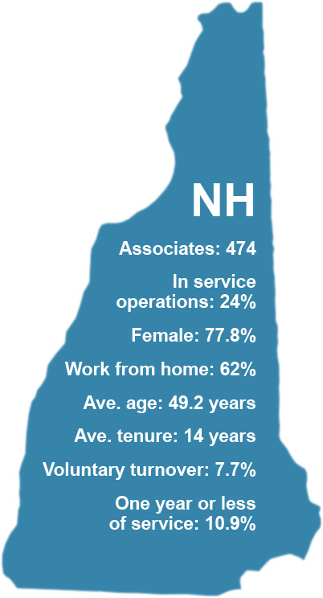
Anthem Blue Cross and Blue Shield in NH
`
Workforce challenges:
Promotability
Turnover of high performers
War for talent
Notes:
Add bullets:

Slide 10
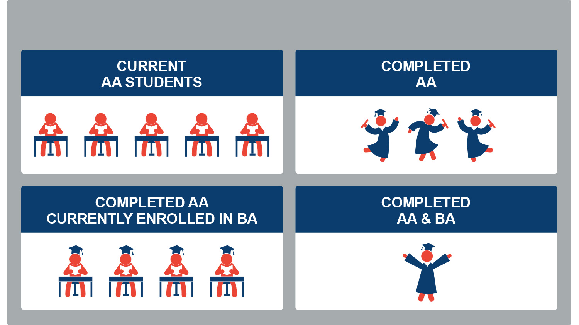
Giving employees an unmatched opportunity
Pilot group outcomes
Notes:
LISA
So let’s come back to Anthem. Not many things can legitimately be called a “no brainer”, but for me, the decision to join the pilot was one.
Describes pilot --
[add a slide that shows the timeframe to graduate]
Add speaker notes to talk about “guinea pig” nature.
College for America uses retention and pace-to-graduation as two of our most critical performance indicators of our program.
The vast majority of students are still with us in their second year, which is a retention rate notably higher than the typical figures for an open-enrollment institution awarding two-year degrees, where that is typically true for less than half of all students who enroll.
Our median Associate of Arts degree student is on track for graduating in 2.2 years.
Early data from Anthem shows even stronger indications for both retention and pace, though most are still less than six months into their program.

Slide 11

What does student success look like?
“Because of CfA, I think differently, I research more, and most importantly, I have confidence in my learning abilities. My journey has made me more confident, showed me I have a great deal of transferable knowledge and encouraged me to spread my wings and continue growing!”
Darby Conley
17+ year associate, earned associate’s degree in less than a year
“I graduated from CfA in January 2014 with my associate’s degree. In March of 2014, I was offered a promotion to a new position as a Corporate Communications Specialist. In October of 2014, I began the bachelor’s program!”
Starrann Freitas
5+ year associate, CfA AA and BA graduate
Notes:
LISA
DARBY CONLEY
16+ year associate, mother of 3
Achieved an associates degree from College for America in 9 months, is currently pursuing a Bachelor's degree
Started at Anthem as a Customer Service Rep and is currently a Director
Less than 50% of associates hold bachelor’s degrees: program provides flexibility, affordability
Full quote:
“Through CFA I still have the requirement of exploring traditional school topics such as math, writing, social responsibility, and economics. However, the courses are not geared toward memorization but towards understanding and application into real world scenarios. As a result of my experience with CfA, I think differently, I research more, and most importantly, I have confidence in my learning abilities. My journey with CfA has made me more confident, showed me I have a great deal of transferable knowledge and encouraged me to spread my wings and continue growing!”
STARRANN FREITAS
4+ year associate
Earned College for America associates degree in 8 months
Promoted from Administrative Assistant to Corporate Communications Specialist
Starrann worked for years as an administrative assistant at Anthem Blue Cross Blue Shield. 52 years old, raised two sons as a single mother, and poured most of her life and energy into her work and raising them well. Higher education was never a serious option for her until her boss reached out to her asking if she was interested in enrolling in an accredited college degree program 100% paid for by Anthem, called College for America. Nine months later she graduated with an Associate of Arts in General Studies -- and based on the new skills she was already applying at work, she has been promoted.
Program Results:
STEPHANIE MALLEY
15+ year associate
Achieved an associates degree from College for America in 8 months, is currently pursuing a Bachelor's degree
Started at Anthem as an Enrollment and Billing Processor and is currently a Business Consultant
MICHELLE COPPOLA
7+ year associate
Acheived an associates degree from College for America in 7 months
Started at Anthem in the Enrollment Department and was promoted to Sales Account Service Representative after receiving her degree

Slide 12
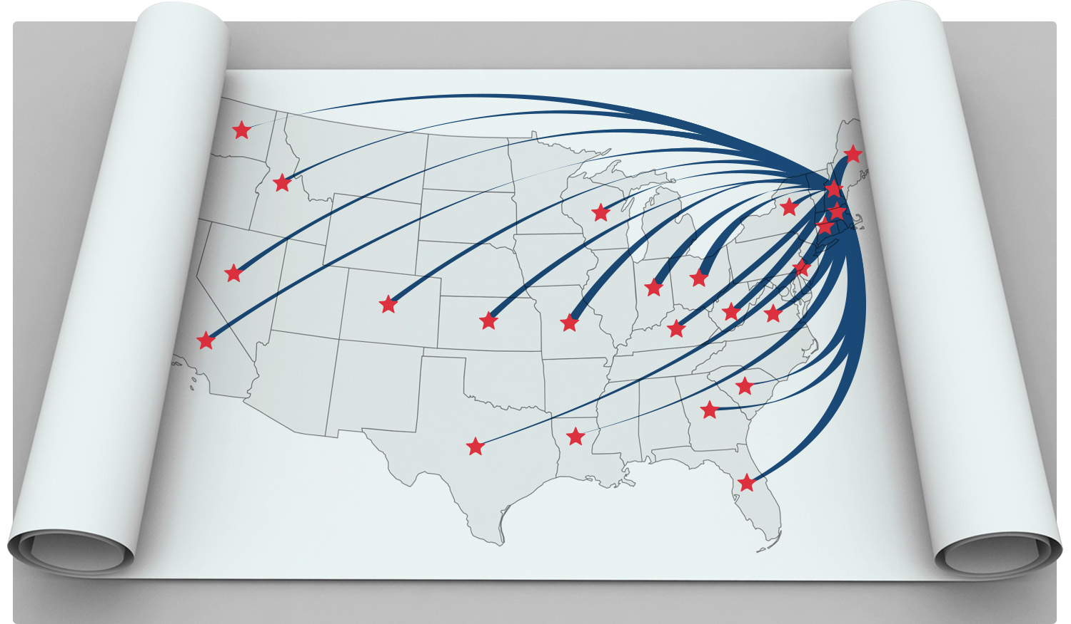
Rolling out the program to all of Anthem
Notes:
AIMEE
Serious about redesigning Total Rewards
Learning and Dev mattered a lot to employees (according to associate survey) – focusing on it, but scores weren’t quite satisfactory (since seen a 6 point jump)
How do we fit it into comprehensive L&D strategy? How do we fit in into our Total Rewards package? Corporate people strategies?
How do we get the message out in an effective manner?
Who are the people who will be affected by the program? Need the rollout to go smoothly and get people on the same page.
TA program
Manager impact
Understand what happens, when, and the role

Slide 13

Initial enrollment results
Of Anthem’s 50,000 employees,
as of October 1:
Expressed interest online
Applied
10,000+
3,075
Currently enrolled
Graduates
1,555
37
Notes:
More than 200 people continuously enrolling per month

