Slide 1


Notes:
Over the next few minutes we will provide an overview of the Health Profession Opportunity Grants program but at the heart of it, we’re trying to build pathways to a brighter future. To help hard working people take their initial steps on a healthcare career pathway and to help communities meet their workforce needs.
What makes HPOG unique is that it provides a combination of training and education and support services to as many barriers as possible so that students can complete the program and take a lot of steps toward self-sufficiency.

Slide 2

What is HPOG?
Goal: To provide education and training to TANF recipients and other low-income individuals for occupations in the healthcare field that pay well and are in high demand.
Authorized by the Affordable Care Act
5 year Project (currently in Year 5)
Grant Forecast for FY 2015 Competition: http://www.acf.hhs.gov/hhsgrantsforecast/index.cfm?switch=public.advancedsearch.main

Slide 3
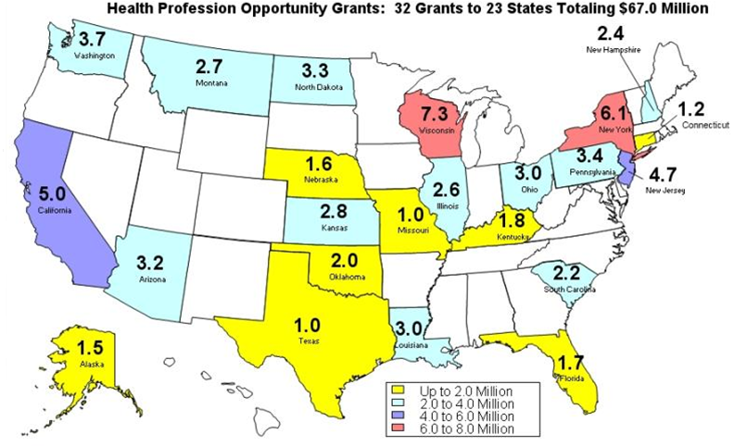
HPOG Awards
Notes:
32 entities located across 23 states
4 state entities
9 local workforce investment boards (three of whom are also WIA One-Stop operators)
12 institutions of higher education (consisting of one university, 9 community colleges and two community college districts)
2 community based organizations
The authorizing legislation required that awards be made to at least 3 tribal organizations. We drafted a separate Funding Opportunity Announcement for which only tribes could apply and five awards were made.
1 tribal council
4 tribal colleges

Slide 4
Required Partners
HPOG programs partner with employers, community organizations, and workforce developers.
  State agency responsible for
  administering TANF program
  Local Workforce Investment Board
  State Workforce Investment Board
  State Apprenticeship agency
Notes:
HPOG students are typically non-traditional students; often they are first-generation college students, and are not always comfortable in academic settings. They may need some assistance as they enter and progress through their training programs. As a result, HPOG grantees offer intensive, wrap-around support services. The majority of grantees are offering over 10 types of support services. Many of them are providing the services directly, while some are leveraging the resources of community partners.
HPOG students are offered a number of academic and wrap-around support services, including
Intensive case management
Transportation assistance
Childcare assistance
Academic assessment
Tuition assistance
Developmental Instruction
Soft skills training
Tutoring
Housing Assistance
Counseling/Advising
Job Placement Assistance

Slide 5
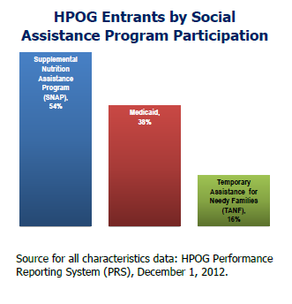
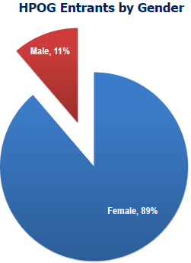
Who is Served?
Notes:
Approximately 60% receive some kind of public assistance.
About half of the participants are under the age of 30 and about half are over.
Most are not presently married. In fact, 57% have never married.
Approximately 65% have one or more children

Slide 6
Performance Data
(cumulative program data from September 30, 2010 – September 30, 2014)
31,900 enrolled and provided some kind of service.
26,100 enrolled in healthcare occupational training.
17,600 have completed at least one healthcare occupational training.
15,000 have become employed in any sector since intake.
11,600 have become employed in healthcare sector or occupation since intake.
The average wage for those employed in healthcare sector or occupation is $12.65.

Slide 7
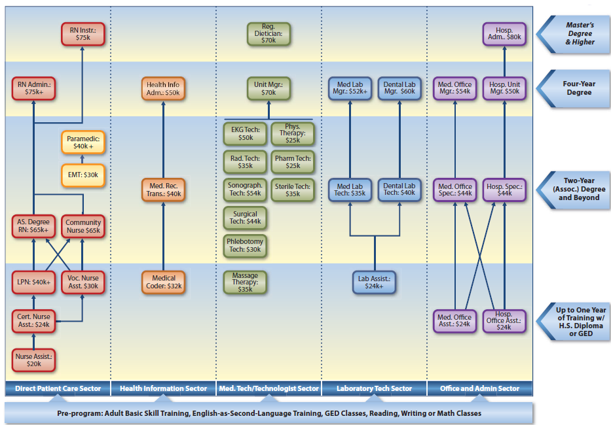
Career Pathways
Notes:
Many of you are very familiar with what a career pathway is. In fact, you probably have a better understanding of the career pathways in healthcare than I do. But I’ve included this slide because I think it points to some things that our grantees are doing and some things that we’ve been working with them to do.
Its not just reflective of career pathways but it shows that there are lots of occupations in the healthcare sector. Our grantees have provided training for more than 50 distinct occupations. Some of the most common are:
Nursing Assistant, Aide, Orderly, Attendant
Licensed Practical and Vocational Nurse
Registered Nurse
Medical Assistant
Medical Records & Health Information Technician
Home Health Aide
Phlebotomist
Pharmacy Technicians
It shows nicely that when people talk about the healthcare sector that there are also many subsectors within the broader healthcare sector. The nice thing about that is that there are a lot of different kinds of roles that participants can aim for. Some may have greater interest in doing office work whereas others have greater interest in working directly with people.
The career pathways concept has been a way for us to help our grantees think about preparing people not just for a particular job but for a career. Sometimes that means stretching in a direction to make education more accessible to people that still need adult basic education. Sometimes that means strengthening the system so that students can transition more easily from the non-credit side of a college to a for-credit side or from a two-year college to a four-year college.

Slide 8
Evaluation
Multi-pronged strategy that includes:
  Performance Reporting System
  Implementation Evaluation
  Impact Study
  Tribal Evaluation
  Innovative Strategies for Increasing Self-Sufficiency
  University Partnership Research Grants
Notes:
ACF is using a multi-pronged research and evaluation strategy to examine outcomes and impacts for HPOG participants as well as program implementation and systems change resulting from HPOG programs. The HPOG impact evaluation uses a rigorous random assignment design that will show how variations in program services affect program impacts. The HPOG impact evaluation report, to be released in 2016, will report on education impacts such as credential attainment and impacts on employment and earnings as well as job quality for participants 15 months after program entry.
All HPOG grantees are participating in a companion study on program implementation, systems change, and outcomes. ACF will complete and release interim reports from this study in 2014 and a final report in 2017, as well as interim and final tribal program evaluation reports in 2014 and 2015.

Slide 9

http://hpogcommunity.acf.hhs.gov

Slide 10
Contact Information:
Stan Koutstaal
Stanley.Koutstaal@acf.hhs.gov
202-401-5457

