Slide 1

Agriculture Labor Program
Program Guidance
Summer 2013
Notes:
Welcome to the presentation, and thank you for taking time to be with me today. As the busy agricultural season unfolds, we wanted to take the time to meet with DEWS staff and share program information and goals for the season. We will review various topics of information, as well as allow for questions from the group.

Slide 2

Topics
Agriculture Labor Program/State Monitor Advocate
General Agricultural Job Orders
H-2A Job Orders/Referrals
Farm Jobs Bulletins
MSFW Identification in OSOS
Language Access
Notes:
The topics that we will discuss during this presentation include:
A general overview of the Agriculture Labor Program and the State Monitor Advocate Program
A review of general agricultural job orders
Information related to H-2A job orders and referrals
The agriculture labor program’s new Jobs Bulletin service
How to identify a Migrant and Seasonal Farmworker, and how to note this in OSOS
Details of the Language Access Initiative and how it relates to DEWS staff

Slide 3
Agriculture Labor Program
Provide dual services to agricultural employers and farmworkers
Connect agricultural employers with skilled labor
Provide meaningful assistance to agricultural employers about labor laws as they relate to farming
Provide outreach to farmworkers
Respond to farmworker complaints
Notes:
AgLS: “Employers” and “farmworkers” link to Ag Labor Program specific page for each stakeholder, for demonstration purposes
The Agriculture Labor Program meets the goal of providing dual services to both agricultural employers and farmworkers. These services are provided through several core activities. One core activity is that of employment services. Agriculture Labor specialists strive to connect agricultural employers with skilled agricultural labor.
Another core activity is meaningful assistance regarding labor laws as they relate to farming. We make every effort to build positive relationships with agricultural employers and to help them achieve and maintain labor law compliance. This service also includes providing outreach to farmworkers, reviewing their rights as farmworkers under New York State and Federal labors laws.
When necessary, the Agriculture Labor Program also responds to farmworker complaints. The Agriculture Labor Specialist will leverage their knowledge of labor laws and their positive relationships with both the agricultural employer and the farmworker to amicably and quickly resolve complaints.

Slide 4
State Monitor Advocate
Ensures that services are being equitably provided to Migrant/Seasonal Farmworkers
Conducts “Significant Office Reviews” of Career Centers designated as being situated near agricultural activity
Acting State Monitor Advocate for NYS:
  Jeanette Lazelle
290 Main Street Suite 209
Buffalo, NY 14202
Office: 716-851-2755
Mobile: 518-461-2599
Notes:
The State Monitor Advocate Program is a federal effort to ensure that the services provided to Migrant and Seasonal Farmworkers are equivalent and proportionate to the services provided to other job seekers. According to the information provided on the US Department of Labor website, this means that Migrant and Seasonal Farmworkers “should receive all workforce development services, benefits, and protections on an equitable and non-discriminatory basis, including career guidance, testing, job development, training, and job referral”.
Each state has a Monitor Advocate to monitor these services. Services to Migrant and Seasonal Farmworkers are reviewed through “Significant Office Reviews.” During these reviews, the State Monitor Advocate reports on services provided in “Significant Offices.” Significant Offices are those that have been designated as being situated near agricultural activity. Therefore, not all offices are deemed significant and are thus not reviewed. The offices currently designated as significant in New York State are Albion, Lockport, Hudson, Kingston, Lyons, Patchogue, Pine Island, and Syracuse. Dunkirk and Plattsburgh offices are not officially designated as significant, but are still reviewed due to their proximity to agriculture. This designation can change based on yearly demographic information.
Jeanette Lazelle is currently the Acting State Monitor Advocate for New York.

Slide 5

Agricultural Employers
All business services should extend to agricultural employers
  Agricultural employers can benefit from OJT, bonding programs, job order services, etc.
  Agriculture Labor Specialists act as “mobile career centers” for employers as well as workers
Notes:
Business Services should extend to agricultural employers. Many agricultural employers can benefit from these services. OJT programs can help train farmworkers to take on new duties and skills, such as skilled equipment operators or licensed CDL drivers. Bonding programs and job order services can also encourage agricultural employers to hire local, domestic labor.
When Agriculture Labor Specialists visits farms, they do their best to act as a “mobile career center” for agricultural employers and farmworkers alike. Though your contact with agricultural employers may be limited, we encourage you to offer business services to agricultural employers when you do interact with them.

Slide 6
General Agricultural Job Orders
Agriculture Labor Specialists encourage agricultural employers to post job orders with the NYS DOL
Agriculture Labor Specialists contact all agricultural employers in their region to offer job order services
  Anticipated season needs
  Job duties and salary
  Housing and transportation
Notes:
Job order services are one of the core services that the Agriculture Labor Program provides to agricultural employers. Agriculture Labor Specialists assist with posting the job order, as well as focus on providing matching and referral services to these posted agricultural job orders. This ease of use encourages the employer to use the system regularly in meeting their ongoing labor needs.
Agriculture Labor Specialists contact the agricultural employers at the start of their individual growing season, and then thereafter at peak points of production to offer assistance in posting job orders to find skilled, qualified workers. Employers are also welcome to contact the Agriculture Labor Specialist at any time to request assistance with employment services. While discussing a job order with an employer, we are sure to discuss the anticipated season needs, the job duties and salary of the position in question, and the details related to housing and transportation. Housing and transportation are concerns that may not come up with non-agricultural job orders, but can be significant when dealing with seasonal agricultural work.
Once the job order is posted, the Agriculture Labor Specialists make every effort to fill the position with farmworkers that meet the requirements and needs of the farm in question.
These general agricultural job orders are different from the H-2A program, where the employer follows a series of prescribed steps to bring in foreign workers to perform farm work on a temporary visa. We will discuss the H-2A program and these job orders at length as the presentation progresses.

Slide 7
General Agricultural Job Orders
Make referrals to these jobs as you would to other general Job Orders
  Follow up with customers and note results in OSOS
  Conduct matching services
“Informal referrals” should not be made through Career Centers
  Workers referred to farm jobs must be registered in OSOS
  Workers must be referred to jobs that are posted in OSOS
Notes:
Agriculture Labor Specialists will focus on matching and referring customers to Agricultural Job Orders, but DEWS staff should also make matches and referrals to these jobs whenever appropriate. As with other referrals, DEWS staff should follow up with customers on the outcomes of their referrals and note the result in OSOS.
Care should be taken not to make “informal referrals” through the Career Center. Only workers who are registered in OSOS may be referred to jobs. Referrals should only be made to jobs that are posted in OSOS. Therefore, if a customer comes in and mentions that they are looking for farm work, the customer should be registered and then matched with posted positions in the system. They should not be informally sent to a farm that may be looking for workers.

Slide 8
General Agricultural Job Orders:
New York Farm Jobs Bulletin
Local agricultural jobs
Translated Spanish/English
Posted:
  Online: http://www.labor.ny.gov/immigrants/agriculture-labor-program/services-for-agriculture-workers.shtm
  At Career Centers
  Throughout community
Notes:
AgLS Note: click on link to access current New York Farm Jobs Bulletin.
Part of the Agriculture Labor Program’s efforts in matching skilled labor with agricultural employers includes reaching out to local workers outside of the OSOS Job Matching and Referral system. This is being achieved through use of the New York Farm Jobs Bulletin. When a general agricultural job order is accepted by an Agriculture Labor Specialist to be posted in OSOS, the agricultural employer is informed of the opportunity to also post the job in the Farm Jobs Bulletin. If the agricultural employer agrees, a version of the job order is translated into Spanish and is published in the bulletin.
The statewide Farm Jobs Bulletin is posted online. The bulletin is also distributed locally to be displayed at Career Centers and throughout the community. Public locations that see significant farmworker traffic, such as churches, grocery stores, and community meeting places will have the Farm Jobs Bulletin posted and updated on a regular basis.
Customers who access these Farm Jobs Bulletins are instructed to contact the employer directly to apply for the listed positions. Therefore, only Job Bulletins are created and posted for those agricultural employers that agree to having the job orders translated, distributed, and posted for the public to access and apply directly to the job.
Jobs bulletins can be helpful for customers who come into the office and wish to merely access information in the resource room without accessing other services. Jobs bulletins can also be helpful if a Farm Labor Contractor comes into the office looking for employment for a crew of workers.

Slide 9

Resource Room
Customers should have access to the resource room without having to register
Pertinent information should be kept current
  New York Farm Jobs Bulletin
  Local agricultural jobs
  Translated documents when available
Notes:
We just mentioned that workers may wish to merely browse the resource room without accessing other services, and this is an important point. Customers should have access to the resource room and the postings therein without being required to register. Information such as the Farm Jobs Bulletin, job postings or binders, and various leaflets and pamphlets should be available to individuals who merely wish to browse the available information. Some customers may feel uncomfortable interacting with Department of Labor staff, and should be allowed to access services at their convenience.
The Farm Jobs Bulletin and other posted jobs should be kept current and up to date. Documents offering translations should be available whenever possible. The translated document should be placed next to the English version. To allow for easy Language Access services, an “I Speak” poster should be readily visible in the resource room. The worker at the front desk should also have an “I Speak” poster nearby, as well access to Language Line instructions and information. We will discuss Language Access and the related information further later in the presentation.

Slide 10
General Jobs Orders vs. H-2A Job Orders
H-2A is a program that allows agricultural employers to hire foreign nationals on a temporary agricultural work visa
The agricultural employer must demonstrate that:
  There are not sufficient U.S. workers to fill the jobs; and
  The employment of foreign H-2A workers will not adversely affect similarly employed US workers
It is the role of the Agriculture Labor Program and the Department of Labor to help place domestic workers in these open jobs
Notes:
The H-2A temporary agricultural program allows agricultural employers who anticipate a shortage of domestic workers to bring nonimmigrant foreign workers to the U.S. to perform agricultural labor or services of a temporary or seasonal nature.
It must be determined that there are not sufficient able, willing, and qualified U.S. workers available to perform the temporary and seasonal agricultural employment, and that employment of H-2A workers will not adversely affect the wages and working conditions of similarly employed U.S. workers
Department of Labor Career Centers are required to post H-2A job orders in the job bank, and to assist in recruiting local workers to fill these positions. It is the responsibility of the New York State Department of Labor to ensure that qualified domestic workers have the opportunity to apply for these agricultural positions.

Slide 11
H-2A Referrals: Agricultural Employer Requirements
To assure that requirements are met, agricultural employers are required to accept qualified domestic applicants for 50% of the H-2A contract term
  Career Centers can refer workers during the active recruitment period
  Workers can self-refer up to 50% of the H-2A contract term
Agricultural employers are required to offer the same pay and benefits to domestic workers
Notes:
Growers who apply for H-2A workers are required to document positive recruitment efforts for local workers to fill the positions. This positive recruitment includes posting the job order with the career center. There are two different time frames in which workers can apply to work on an H-2A contract: workers can be referred by the career center during the active recruitment period, and workers can self-refer to the position up to 50% of the H-2A contract term. We will discuss the details of these time frames as they relate to referrals momentarily.
Agricultural employers are obligated to hire domestic workers that meet the job order requirements. They may only deny employment to workers who do not meet the specific requirements of the job order or who are not available for the entirety of the contract term. In addition, agricultural employers are required to offer the same pay and benefits to domestic workers as they do to the foreign workers.

Slide 12
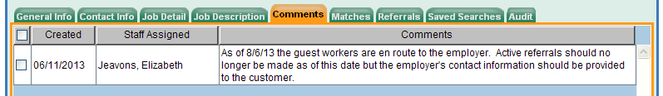
H-2A Referrals: When?
Staff should make referrals of qualified applicants
Last date for making “active referrals” noted in comments section
Notes:
Staff should only refer qualified applicants, a term which will be defined shortly.
These active referrals of qualified applicants to H-2A job orders can be made during the active recruitment period. This period lasts from the time the job is posted until the date listed in the comments section of the Job Order. You must always check the comments section of the H-2A job order for this note. Active referrals should not be made and posted in the system after this date has been met. Efforts should be made to make matches and referrals to other H-2A job orders with active recruitment periods, or to general agricultural job orders.
The reason for this limited time frame is for the benefit of the agricultural employer as well as the incoming foreign worker. The date noted in the comments section is three days before the foreign workers are due to arrive; generally the date that foreign workers have left their home country to travel to the United States. Referring domestic workers at this point would burden both the agricultural employer as well as the foreign worker who is en route to the farm, as the agricultural employer would be required to either hire the additional labor or to send a foreign worker home. As a staff member making a referral, you won’t have to worry about determining this date for yourself – the information will already be input for you.

Slide 13
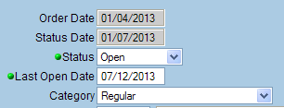
H-2A Referrals: When?
If a customer has knowledge of the position, they can self-refer up to the 50% period of job order
After the 50% period has passed, the employer is no longer obligated to accept/interview new applicants
Notes:
That being said…
If a customer comes in with knowledge of the H-2A position, and requests a referral for that position, contact information for the job order should be provided to the customer. As the agricultural employer has the responsibility to accept domestic workers up to 50% of the job order period, the Career Center must provide application information to any domestic worker who requests it during this 50% period. The last date in this 50% period is noted in OSOS as the “Last Open Date.”
In this case, a referral would not be recorded in OSOS, as an active referral is not being made. The Career Center is not matching a customer with a job and then making a referral, but is merely responding to a customer’s specific request for information related to a posted job. This process can be known as “self – referral”.
After this 50% period has ended, the agricultural employer no longer has any obligation to hire the domestic worker.
Some employers may be eligible to apply for an exemption to the 50% rule, in which case the “Last Open Date” of the job order would be changed to reflect this. In this situation, the “Last Open Date” of the job would be the same as the last date in the active recruitment period, which is three days before the foreign workers have left their home country to travel to the United States.

Slide 14
H-2A Referrals: Who?
What is a qualified applicant?
  Someone who…
  Meets the experience requirements
  Is able to perform the work required
  Is willing to perform the work required
Information can be found in OSOS Job Description
  NYS Department of Labor Website: H-2A Job Orders
Notes:
AgLS Staff: Last line of text links to NYS Department of Labor website with posted Agricultural Clearance Orders
Career Centers have a responsibility to only refer qualified applicants to H-2A job orders. Qualified applicants are those who meet the specific experience requirements and are able and willing to perform the work required. Some individuals may not have a clear understanding of the demands, both physical and mental, that agricultural employment entails. For example, if a job describes work cutting cabbage, this means that workers will be expected to bend over repeatedly, cut cabbage cleanly with a large knife, stand up, and throw it into a truck bed, repeatedly, for a full work day. If a job order is for picking apples, this means that workers will be climbing a ladder, while weighed down with a thirty pound picking basket, reaching into the tree, and loading their basket, then climbing back down the ladder and unloading their basket, all without bruising even one apple. It is worthwhile to remind your customers of these demands, especially if they indicate that they have limited farm experience.
Some H-2A job orders also have very specific experience requirements, and these should be noted and explained to the customer as well.
After identifying and discussing this pertinent information from the job order, the worker should then ask if the customer can meet these requirements. Aside from this verbal confirmation, Career Center staff is not required to otherwise verify a customer’s qualifications for an H-2A job.
The entire H-2A job orders can be found on NYS DOL Website, under Individuals, Find a Job, H-2A Agricultural Clearance Orders. The orders are listed with the most recent on top; generally you should be able to find the order if you are within the timeframe to make referrals. If you cannot find the full H-2A job order and feel that you need it to properly apprise a customer of job duties, contact your areas AgLS for assistance in locating the full job order.

Slide 15

H-2A Referrals: Contact/Follow-up
An AgLS will follow-up on posted referrals when visiting H-2A farms
Contact your local AgLS with any questions
All H-2A Job Orders are input by the Foreign Labor Certification Unit
Contact:
Elizabeth Martin
Foreign Labor and Agriculture Specialist
New York State Department of Labor
Division of Immigrant Policies and Affairs
(518)457-7304
  foreignlaborcert@labor.ny.gov
Notes:
Agriculture Labor Specialists are required to visit some H-2A farms during the season. During these visits, the Agriculture Labor Specialist will take note of any posted referrals and will follow up with these referrals during their visit to the farm.
Your local Agriculture Labor Specialist can assist you with any questions or concerns.
For your information, H-2A job orders are reviewed, approved, and posted to the Job Order system by the Agriculture Labor Program’s Foreign Labor Certification Unit, located in Albany.

Slide 16
Migrant and Seasonal Farmworkers
Seasonal Farmworker
Within the previous 12 months worked in farm work at least an aggregate of 25 days, earned at least 50% of income from farm work, and did not work for the same employer all year.
Migrant Farmworker
Meets the same criteria as above AND was unable to return to his/her permanent residence within the same day.
Migrant Food Processing Worker
Within previous 12 months worked in food processing at least an aggregate of 25 days, earned at least 50% of income from food processing work, did not work for the same employer all year, AND was unable to return to his/her permanent residence within the same day.
Notes:
The correct classification of Migrant and Seasonal Farmworkers in OSOS is important to allow for proper reporting of services. OSOS allows for identification through a several step process.
Understanding the definition of Migrant and Seasonal Farmworkers is the first step in proper identification. A seasonal farmworker is an individual who, within the previous 12 months, workers in farm work at least a total of 25 days, earned least 50% of their income from farm work, and did not work for the same employer all year. An example of a seasonal farmworker might be an individual who works at an onion farm from March until June, an apple farm from July until November, and a packing house from December until February.
A migrant farmworker meets the same criteria as a seasonal farmworker, and is unable to return to their permanent residence within the same day. A migrant farmworker might work at an onion farm from March until June, an apple farm from July until November, and then return to their permanent residence in Florida from December until February.
A migrant food processing worker within the previous 12 months worked in food processing at least 25 days, earned at least 50% of their income from food processing work, did not work for the same employer all year, and was unable to return to their permanent residence within the same day. This might include a group of food processing workers who travel from Puerto Rico to work in a food processing plant in New York from June until December, and then return to their residences in Puerto Rico from January until May. Keep in mind that not everyone who works at a processing plant will fall under these qualifications. Some workers in the plant may be local workers who are employed alongside the migrant food processing workers.

Slide 17
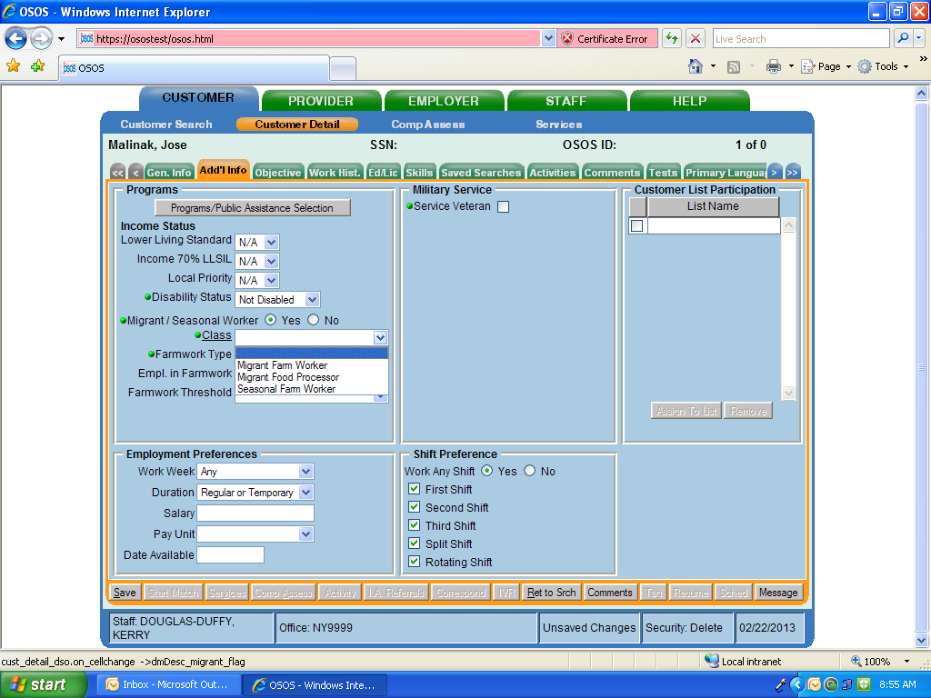
MSFW Identification
Notes:
AgLS: Distribute MSFW desk aid to staff members for reference
Based on preliminary conversation with the customer, you may decide that he/she is an MSFW. You must select “Yes” for the other criteria to appear. The dropdown information cannot be selected until discussion with the customer takes place to determine work history. Upon further discussion, you may determine that you need to go back to the original selection for Migrant/Seasonal Worker and change it to “No.”
First you must determine what class the MSFW may fall under. Please refer to the Migrant/Seasonal Worker OSOS Guide and/or one page Migrant Farmworker, Seasonal Farmworker, Migrant Food Processing Worker desk aid for the definitions to determine what class the customer falls under based on previous work history and transportation status. The OSOS guide is posted on the NYSDOL Internet. The link to the one-page desk aid is included on the last page of the OSOS guide.

Slide 18
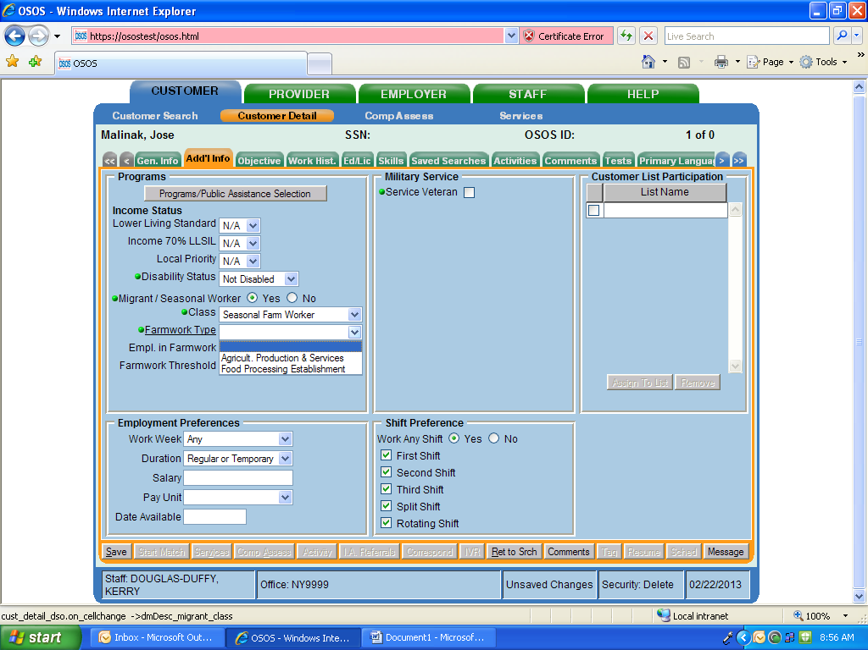
MSFW Identification
Notes:
Next, you must determine farm work type: either Agricultural Production & Services, or Food Processing Establishment.
Agricultural Production & Services includes occupations such as planting, cultivating, harvesting, and picking at Apple Orchards, Nurseries, and Vegetable Farms. This includes NAICS codes such as 111219 (Vegetable and Melon Farming), 111331 (Apple Orchards), and 111421 (Nursery and Tree Production).
Food Processing Establishment includes canning and manufacturing of agricultural goods such as meat, frozen fruit, juice, fruits, and vegetables. This includes NAICS codes such as 311411 (frozen juice or juice concentrate), 311421 (fruit manufacturing, brining, canning), 311611 (meat canning), and 311612 (veal, pastrami, bacon, cured meats).

Slide 19
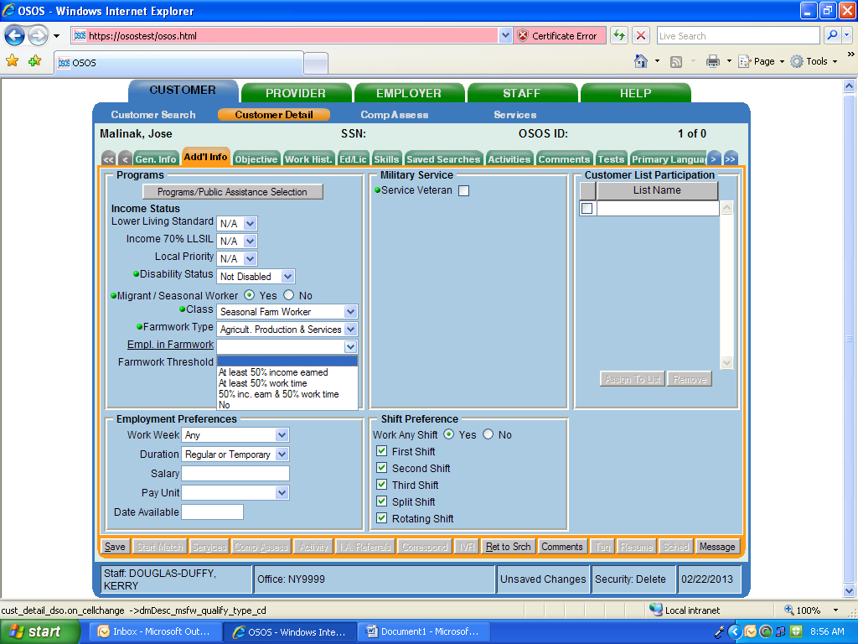
MSFW Identification
Notes:
The next step is to confirm that the customer meets one of the requirements for being “employed in farmwork”.
To meet this requirement, the customer must have earned at least 50% of the past year’s income in farm work or food processing OR worked at least 50% of all days worked in the past year in farm work or food processing. The customer can also meet both criteria. If neither applies, the customer is not an MSFW and the Migrant/Seasonal Worker classification must be changed to No.

Slide 20
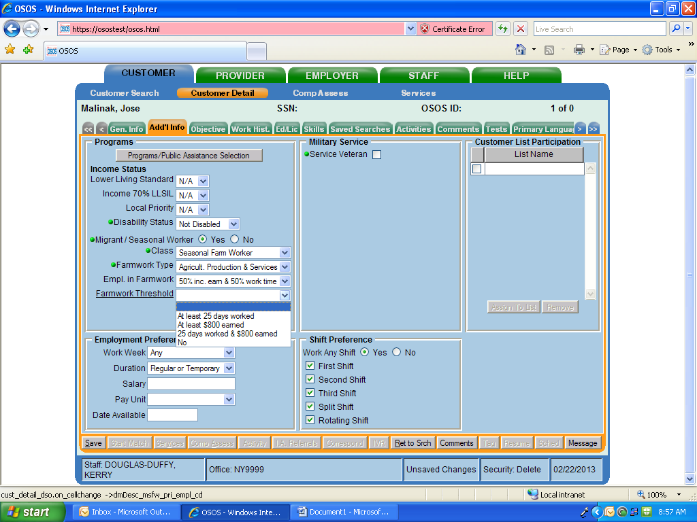
MSFW Identification
Notes:
Finally, to be classified as an MSFW, the customer also must meet a farmwork threshold. The customer must have worked at least 25 days in farm work or food processing OR earned at least $800 from farm work or food processing in the past year. The customer may also meet both criteria. If neither criteria is met the customer is not an MSFW and the Migrant/Seasonal Worker designation must be changed to No.

Slide 21
MSFW Identification – Flow Chart
Potential MSFW?
Type:
Ag Production
Food Processing
Threshold:
25 Days Worked
$800 earned
Class:
Migrant FW
Migrant FP
Seasonal FW
Employed in FW:
Income
Worktime
Both
MSFW
*For internal use only. Current as of August, 2013
Notes:
This flowchart will allow us to review the steps for determining MSFW status in OSOS.
If you think you are meeting with a potential MSFW, follow this flowchart:
Determine the class of farmworker: migrant farmworker, migrant food processor, or seasonal farm worker. Use the Desk Reference to make this determination.
If the customer seems to meet one of these criteria, move to the next step and determine what type of work the customer did: Agricultural Services and Production, or Food Processing Services.
Next, determine whether the worker meets the criteria of being employed in farm work through either working in farm work for 50% of their time in the past year, or through earning 50% of their income in the past year.
Finally, the worker must reach a certain threshold of time worked or payment earned. This threshold is met by working either 25 days in farm work or by earning at least $800 through farm work.
If all of these criteria have been met, the worker has been correctly identified as an MSFW.

Slide 22

MSFW Identification:
Common Questions
What if the customer cannot remember the name, dates of employment, and/or location of the last farm he/she worked on?
  If the customer does not know the name or location of the farm, but can tell you that he/she worked at a farm in North Carolina May-October 2012, you should enter this information in Comments. This customer should still be designated as an MSFW.
If the customer worked in farm work in the past 12 months and meets the other criteria, but no longer wants to work in farm work, should he/she still be designated as an MSFW?
  Yes, but be sure to include O*NET titles outside of farm work in the Objective tab.
Notes:
Entering this information (state name, approximate months worked, etc.) placed in the Comments tab is sufficient to prove the customer is an MSFW if information required in the Work History tab cannot be provided. Be sure to include appropriate crop information so there is a record of what kind of crop experience the worker has.
As an FYI, farm work related O*NET titles are found under “Farming, Fishing, and Forestry.”
Keep in mind that not everyone working at a farm or processing plant is automatically an MSFW. Year round workers and staff who do not directly deal with production and harvesting of agriculture (for example, office staff) would not be considered MSFWs.

Slide 23
Language Access &Postings
The Division of Immigrant Policies and Affairs is tasked with carrying out the agency’s language access policy
What is Language Access?
  “I speak” poster
  “Right to file a complaint” poster
  Should be posted in an accessible, visible location
  Updated copies of these posters were recently issued – AgLS will check to be sure that you have the most updated version and provide it if necessary
Notes:
AgLS: Link to main language access page, as well as to each poster for demonstration purposes.
On October 6, 2011, Governor Cuomo issued Executive Order 26, which directed state agencies to provide language assistance services (translation and interpretation) to people of Limited English Proficiency (LEP). The Division of Immigrant Policies and Affairs is tasked with carrying out the agency’s language access policy.
US Census data has determined that the top six languages requiring translation are Spanish, Chinese, Russian, Haitian Creole, Korean, and Italian. State agencies must provide vital documents translated into these languages. Some agencies, including the Department of Labor, have determined that they encounter more than the top six languages determined by the US Census and thus, also provide vital document translation in those additional languages. The Department of Labor provides vital documents in Spanish, Chinese, Russian, Haitian-Creole, Korean, Italian AND Polish.
The Department of Labor provides telephonic interpretation services in all languages.
Career Centers should already have these Language Access posters, but new and updated posters were issued recently. Newest versions of posters may have subtle differences. An Agriculture Labor Specialist will check the dates on posters to ensure that you have the most recent copy.

Slide 24

Language Access: Forms
Waiver of Right to Free Interpretation Services
Language Access Complaint Form
Notice of Important Document
Notes:
AgLS: Slide links to each document
Waiver of Right to Free Interpretation Services: This document is for use when an individual expresses that they do not want interpretation services. This may happen even when you feel that the customer could benefit from interpretation services. In this situation, you should attempt to make the customer feel comfortable with the interpretation services. Explain the services to the best of your ability. Understand that some customers may be unfamiliar and uncomfortable with the services. They may be concerned about your perception of them, or about their own privacy. Remember, and do your best to express, that the interpreter is a tool to allow for successful communication, nothing more.
Language Access Complaint Form: This document is to be used if a customer feels that they did not receive appropriate language services. Keep in mind that not offering and providing appropriate language services is discriminatory. There have been concerns about this in offices across the state. If a customer encounters a staff member that does not speak their language, and is told that they need to come back at a later time to meet with a different staff member, or that they cannot receive services, this is considered discrimination. The complaint form is also available in Spanish, Chinese, Russian, Haitian-Creole, Korean, Italian, and Polish.
Notice of Important Document: This should be included with any documents given to a customer that is considered important and for which there is no current translated document in the customer’s language.

Slide 25
Language Access: Interpretation
Language Line: 1-800-593-2835
  Client ID number: 12345
  Organization name: Division of Employment and Workforce Solutions
  DEWS Access Code: 1234
This service should be utilized whenever necessary
  Calls are tracked by code number to determine which offices are making use of the service
Language Line Demonstration
Notes:
The Department of Labor offers telephonic interpretation services for use at any time. Each division may have their own access code for the system. Use of the system is tracked to determine how frequently the service is accessed, and charges for use of the Language Line vary depending on what language is being accessed. The fact that departments are being charged for this service should not dissuade staff members from making use of this service whenever it is needed.
The language line demo/tutorial is helpful and gives a clear understanding of how the process will work when you use it. Let’s listen to the demo now:
AgLS: Call Language Line demo number at 1-800-996-8808. A brief description comes on, and you may then choose a demonstration to listen to. Option number 2, a medical conversation interpreted into Spanish, is a good option.
As you can see, when using language line, you are communicating directly with the customer. The interpreter will relay your message in a clear and concise manner to the customer. As the customer responds, the interpreter will relay the message directly back to you.
Therefore, you communication should not be: ”Tell the customer that I need their full name”
Instead, communicate as though you are speaking directly to the customer, as in: “Please tell me your full name.”

Slide 26
Questions?
Contact your local Agriculture Labor Specialist:
Caylin Gwise
587 East Main Street
Batavia NY 14020
Mobile: 585-815-5113
caylin.gwise@labor.ny.gov
Territory Map
Notes:
AgLS: Last line links to AgLS territory map.
If you have any questions about the information discussed, or about other topics under the purview of the Agriculture Labor Program, feel free to contact your local Agriculture Labor Specialist. If you need information about an agricultural job order, employer, or situation in another part of the state, your local Agriculture Labor Specialist can guide you, or you can consult our program territory map to determine who to contact.

Slide 27

Thank you!
Notes:
Thank you!

