Slide 1
RETENTION improvement Strategies
AFOP Mini-Conference
Feb. 2/15/13
Washington, DC
Barb Simcoe, PPEP

Slide 2

PPEP’s Retention Rate History
P YEAR GOAL Our Average)
2012 76.5% 74% (1st Qtr.)
2011 72.0% 67.4% (all 4 Qtrs.)
2010 71.6% 62.48 (all 4 Qtrs.)
2009 71.8% 57.78% (all 4 Qtrs.)

Slide 3
Retention TEAM Formed in early 2010

Slide 4
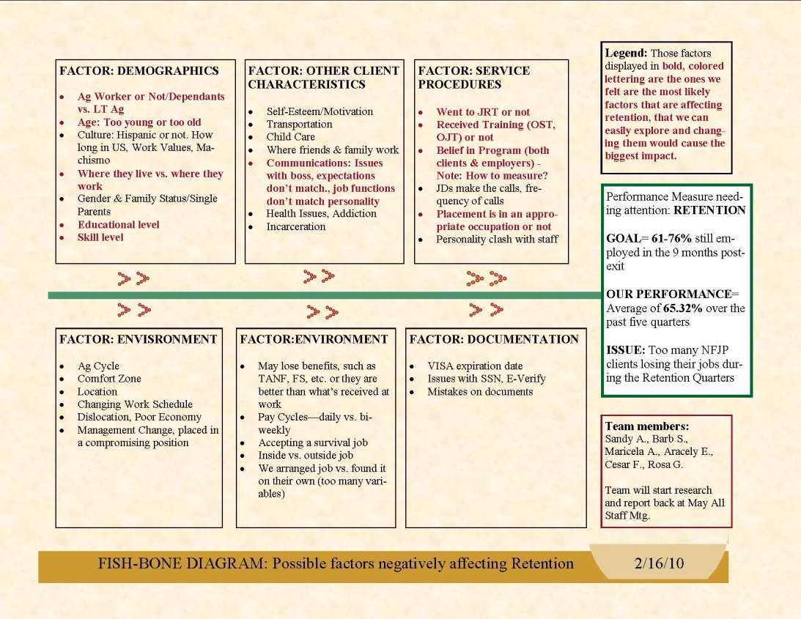
Using the Fishbone Diagram, we identified characteristics we could explore that might cause the biggest impact

Slide 5
Pulled a report from CERTSS, listing most of the demographic characteristics, on “Exiters” from the previous three years.
Using that list of 510 “Exiters”, the team met to analyze the characteristics of the 251 who retained their jobs.

Slide 6
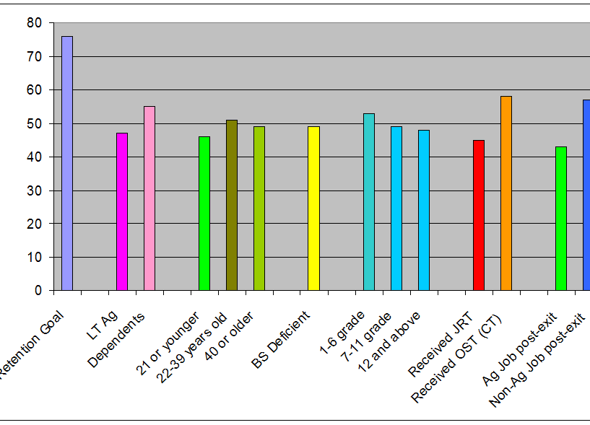
Characteristics of “Exiters” who retained their jobs

Slide 7
OBSERVATIONS MADE

Slide 8
POSITIVE CHARACTERISTICS
  Dependents
  Those Ages 22-39
  Received Occupational Training (Classroom training, not post-placement OSTs)
    Only 28% of the total “Exiters” received occupational training (at that time).
  Employed in a Non-Ag job post-exit.

Slide 9
ANALSIS OF THOSE RECEIVING TRAINING

Slide 10
NEGATIVE CHARACTERISTICS = Vulnerable
  LT Ag workers
  Those 21 & under
  Basic Skills Deficient
    who represented 76% of our overall exits
  Employed in an ag job post-exit.

Slide 11
RECCOMMENDATIONS
WHAT WE COULD DO DIFFERENTLY,
BASED ON THIS ANALYSIS

Slide 12
QUALITY COMMUNICATIONS
Quality communications between staff and the participants is necessary and crucial throughout the program.
Explain to vulnerable participants what they might be able to do in order to improve their chances of retention
  i.e. how to develop positive characteristics.

Slide 13
Focus on the “vulnerable” participants and give them more specialized services.
  Develop & provide a workshop designed for young participants, who may be new to the world of work, explaining what employers are looking for, what to expect, etc. (i.e. a specially designed JRT).
  Develop & provide a workshop, which includes information on retirement choices and the benefits of working year-round in a job (probably non-Ag) with medical benefits, etc.

Slide 14
OTHER STRATEGIES:
Strongly encourage those who are Basic Skills Deficient to enroll into basic skills training.
Provide JRT to as many job-ready participants, as possible.
Provide career counseling & career exploration assistance to those who are eligible for occupational training
  Last year 53% of our participants received occupational training

Slide 15
During the Follow-up period
Focus on the Retention quarters
  Front line supervisors keep a color-coded list of follow-ups, identifying which participants are in the Retention Quarters, so that they can remind staff to help with re-employment.
Obtain paystubs, when necessary
  If the Over-rides show no salary data, we still have two quarters to enter the data and get credit.

Slide 16
Job-Readiness Workshop developed for vulnerable participants:
  Explaining the benefits of working & what employers expect, identifying realistic career goals & developing a plan of action
  Offered in Yuma County by Campesinos sin Fronteras.
RESULTS on Attendees (compared to Average Exiter):
EER Qtr/Met? Retention Qtrs/Met? Aver. Earnings/Met?
16/17 = 94% 10/12 = 83% Average = $7457/$9050 (8/9)=
Exceeds Exceeds within 82% or 3 % Below Goal
(& below $8703 averaged by all Exits that year)

Slide 17
Data Collection Strategy
Staff Training provided
Numerous staff training sessions & interactive activities provided on Performance Measures
Each person is accountable for their involvement in helping their customers retain their jobs.
  Awards were presented to those who did well in certain areas of performance (ie. high Retention Rate or Average Salary.
PPEP’s MIS staff collects data from UI, prior to the monthly reports being submitted to DOL, to assure that all the most recent data is being utilized.
Ag-Upgrades now require the employer’s signature

Slide 18
RAO Better Utilized
Study of Basic Skills students showed that most of them were not going to work and retaining their jobs
  Re-instituted the RAO for Basic Skills & trained staff on how and when to use it.
  A Plaza Communitaria was established
    for those participants who need to improve foundation skills in their first language & get a GED.
  An ESL Instructor was hired.
  RESULTS: both RAO Basic Skills (Adult Basic Ed and ESL) students, as well as those participants enrolled into more Intensive services attend classes to improve their academic standing and language skills.
    Workbooks on computer use and Workplace English have been incorporated.
    Customers who really only wanted English or Adult Basic Education are not being forced into more Intensive or Training Services.
      Those who decide they want more are welcomed into the rest of the program, but those who only want Basic Skills do not negatively impact PPEP NFJP’s Retention Rate.

Slide 19
QUESTIONS/ANSWERS

