Slide 1

Participant Lifecycle
Outreach to enrollment

Slide 2
Virtual Meeting Recording Notice
The American Institutes for Research® (AIR®) allows for the recording of audio, visuals, participants, and other information sent, verbalized, or utilized during business related meetings. By joining a meeting, you automatically consent to such recordings. Any participant who prefers to participate via audio only should disable their video camera so only their audio will be captured. Video and/or audio recordings of any AIR session shall not be transmitted to an external third party without the permission of AIR.

Slide 3






Inclusive Meeting Guidelines
Hosting and Participating in Meetings
ENGAGE EVERYONE
BE HEARD AND SEEN
ACKNOWLEDGE SPEAKER
MAXIMIZE MICROPHONES
MINIMIZE NOISE
MAXIMIZE VISUAL DISPLAYS
These guidelines are intended to improve the meeting experience for virtual participants, as well as people with hearing loss, visual impairment, and those for whom English is an additional language.

Slide 4
Introductions and Agenda

Slide 5


Presenters
Chris Herzog
  Principal TA Consultant
    AIR
Lori Collins
  Senior TA Consultant
    AIR

Slide 6
AGENDA
Welcome and Introductions
Introduction to the Participant Support Lifecycle
Discussion of Challenges and Solutions (Breakout Rooms for Track 1 and Track 2)
  Outreach and Recruitment
  Intake, Onramps, and Enrollment
Breakout Room Summaries and Q&A
Upcoming Events

Slide 7
Introduction to the Participant Support Lifecycle

Slide 8
Participant Support Lifecycle
Goals
  To support understanding of participant journeys
  To identify loss points
  To identify ongoing opportunities for support

Slide 9
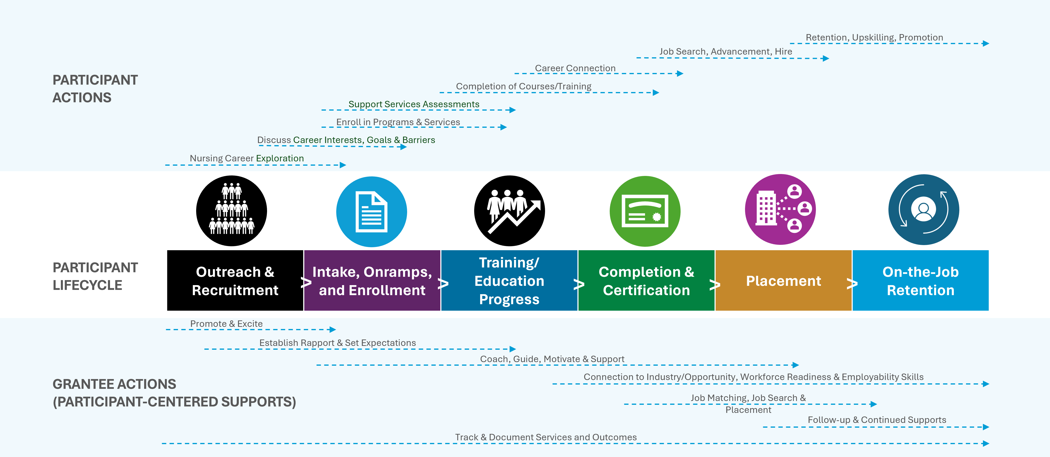
Participant Lifecycle Track 2

Slide 10
Track 2
Outreach & Recruitment | Intake, Onramps, and Enrollment | Training/Education Program Progress | Completion & Certification | Placement | On-the-Job Retention
Key Considerations & Components Outreach to promote opportunities Community connections and recruitment strategies Program/ opportunity overviews and promotion Strategic recruitment targets and events | Key Considerations & Components Various onramps to programming Equity of access Intake processes Career guidance Eligibility determinations Initial case management Assessment tools Info/data collection and expectations Assessment of barriers and supportive services Transition to training Tracking progress/ conversion to trainee/student Enrollment, documentation of participant | Key Considerations & Components Required training/ education – through completion Learning progression Supportive services for retention/ success Practical application, work-based learning Ongoing career and guidance counseling Identification of needed academic and resource interventions Tracking of process toward graduation Networking and peer connections | Key Considerations & Components Last 25% of courses Academic and career advising Career trajectory discussions – to employment or additional training/ education Connection to career opportunities Course completion Required exams and assessments Credential application and attainment Tracking and reporting of milestones and outcomes | Key Considerations & Components Connections to employers Resumé prep Interview prep Job search Job acquisition Tracking of placement outcomes | Key Considerations & Components Retention for 3-, 6-, 9-, and 12-months Retention supports (career and supportive services) Upskilling Promotion along or across career pathways

Slide 11
Track 1 Grantees
Breakout Room Slides

Slide 12

Introductions
Please share:
Your name, organization, and role
Your current geographical location

Slide 13
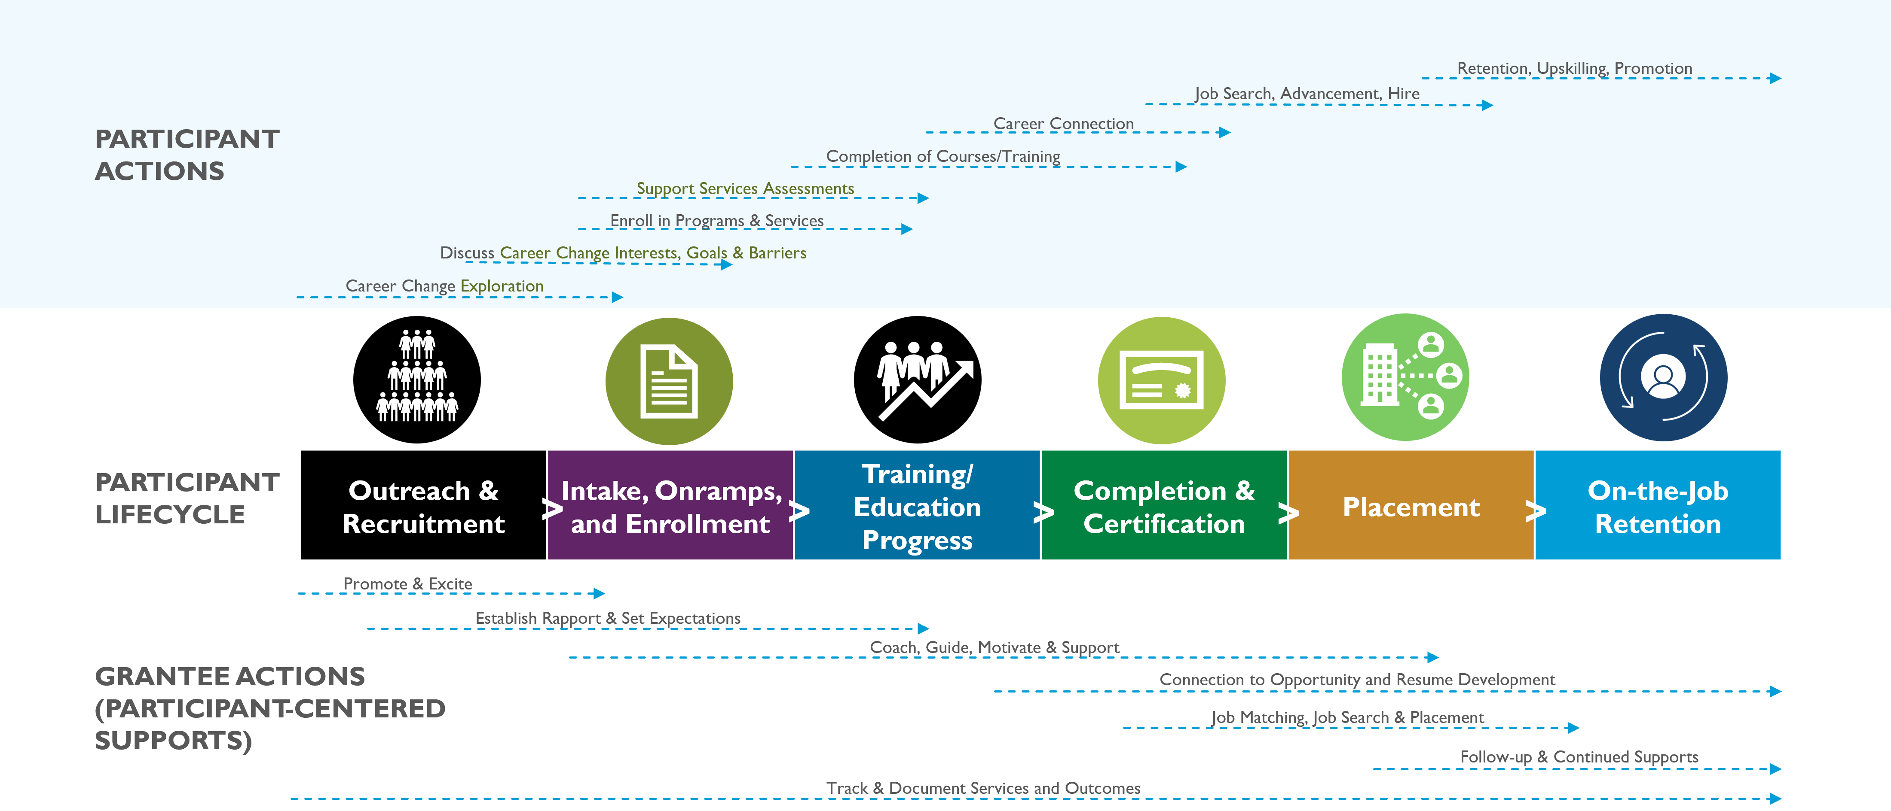
Participant Lifecycle Track 1

Slide 14
Track 1
Outreach & Recruitment | Intake, Onramps, and Enrollment
Key Components & Milestones Outreach to promote opportunities Community connections and recruitment strategies Program/opportunity overviews and promotion Strategic recruitment targets and events | Key Considerations & Components Various onramps to programming Equity of access Intake processes Career guidance Eligibility determinations Initial case management Assessment tools Info/data collection and expectations Assessment of barriers and supportive services Transition to training Tracking progress/conversion to trainee/student Enrollment, documentation of participant

Slide 15
Prompt Questions: Outreach and Recruitment
Successes
Challenges
Populations
Learning
What are your most successful strategies to date for recruitment and enrollment of grant participants?
Have challenges emerged?
Have you changed your strategy?
What specific challenges or successes have you had with particular populations?
What questions do you have for your peers about the strategies they discussed, or you have tried?

Slide 16


Prompt Questions: Enrollment
Challenges
What challenges have you encountered during the enrollment process (data collection, participant contact, tracking enrollments, etc.)?
Successes
What enrollment processes have been successful for your grant?
Have you experienced challenges in converting people who are interested into actual enrollees?
Have you had challenges with documentation? This might include knowing what documentation you need or how to collect and store the documentation.
If your enrollment process is going smoothly, what strategies do you feel have enabled your success?
16

Slide 17
Track 2 Grantees
Breakout Room Slides

Slide 18
Track 2 Introductions
Please share:
Your name, organization, and role
Other team members on the call
A brief introduction of your grant program
Questions for our peers or challenges you want to make sure we discuss

Slide 19
Participant Lifecycle - Track 2

Slide 20
Track 2 (2)
Outreach & Recruitment | Intake, Onramps, and Enrollment
Key Components & Milestones Outreach to promote opportunities Community connections and recruitment strategies Program/opportunity overviews and promotion Strategic recruitment targets and events | Key Considerations & Components Various onramps to programming Equity of access Intake processes Career Guidance Eligibility determinations Initial case management Assessment tools Info/data collection and expectations Assessment of barriers and supportive services Transition to training Tracking progress/conversion to trainee/student Enrollment, documentation of participant

Slide 21
Prompt Questions: Outreach and Recruitment
Successes
Challenges
Populations
Learning
What are your most successful strategies to date for recruitment and enrollment of grant participants?
Have challenges emerged?
Have you changed your strategy?
What specific challenges or successes have you had with particular populations?
What questions do you have for your peers about the strategies they discussed, or you have tried?

Slide 22
Prompt Questions: Enrollment (2)
Challenges
Successes
What enrollment processes have been successful for your grant?
If your enrollment process is going smoothly, what strategies do you feel have enabled your success?
What challenges have you encountered during the enrollment process (data collection, participant contact, tracking enrollments, etc.)?
Have you experienced challenges in converting people who are interested into actual enrollees?
Have you had challenges with documentation? This might include knowing what documentation you need or how to collect and store the documentation.
22

Slide 23
Facilitators Report:
What we discussed in breakouts

Slide 24
Questions?

Slide 25
Upcoming events
MAY
  Quarterly Reporting Office Hours: May 9 from 2:00-3:00 PM EST
  QNRs Due May 15
JUNE
  Preceptorship Programs TA Event June 4 from 3:00 – 4:00 PM EST
  Performance Reporting Orientation 301: June 13 from 3:00 – 4:30 pm EST
  Participant Lifecycle: Training and Education TA Event: June 26 from 3:00 – 4:00 PM EST

Slide 26

Thank you!
The American Institutes for Research® (AIR), completed this project with federal funds, under contract number 1605C2-23-Q-00074 Nursing Expansion Grant TA, from the U.S. Department of Labor, Employment and Training Administration. The contents of this publication do not necessarily reflect the views or policies of the Department of Labor, nor does mention of trade names, commercial products, or organizations imply endorsement by the U.S. Government. AIR is a nonpartisan, not-for-profit organization that conducts behavioral and social science research and delivers technical assistance to solve some of the most urgent challenges in the U.S. and around the world.

