Slide 1


Embracing A Holistic Approach to Business Services in the Workforce System
NAWDP Business Services Academy Pre-Conference Session
August 2024

Slide 2




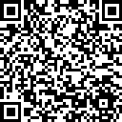

About NLN
U.S. Department of Labor, Employment & Training
Administration (ETA)
About NLN…
U.S. DOL ETA’s vehicle for short- and long-term technical assistance
to state and local
workforce boards
throughout the
U.S. and its territories.

Slide 3

Agenda
Introductions
Explaining Workforce Development…
Talent Pipelines and Workforce Populations
Supply vs. Demand
Next Steps
Q&A Session
Closing

Slide 4
Explaining Workforce Development…

Slide 5
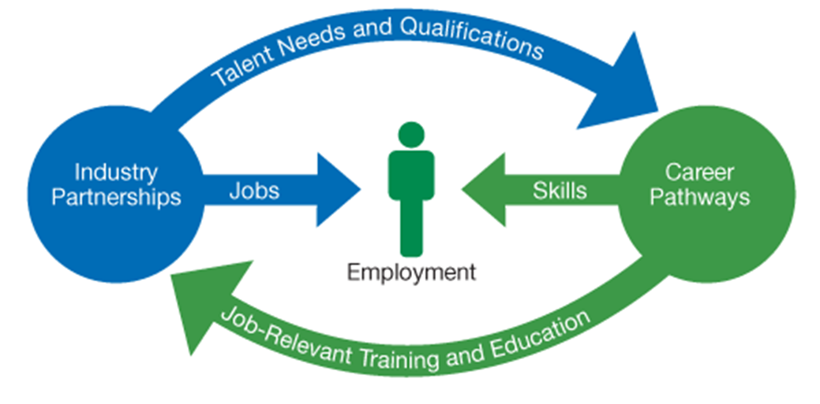



What Has “Work Ready” Traditionally Meant?
Labor Supply
Employer Demand
2021

Slide 6

Getting Started…
What Data Do You Analyze When Looking at Your
Workforce Development Ecosystem?
What Questions Do You Ask?
Where Do You Start?

Slide 7

What Does “Work Ready” Really Mean? – Examples 1
2022 Data
Nationally
Working Age Population without a HSD or GED? (Census Bureau Releases New Educational Attainment Data)
Working Age 25-64? / Employed or Not Employed? / Self Sustainable?
8-9%
High School Grad Only? (Census Bureau Releases New Educational Attainment Data)
With a Credential? / As a Pre-Apprentice or Apprentice? / With OJT / OJL? / Etc.
27 -28%
Population with Some College, but No Degree? (Census Bureau Releases New Educational Attainment Data)
What’s Important to Your Employers? / Consider RA Programs? Etc.
14-15%
Population with Associates Degree as Highest (Census Bureau Releases New Educational Attainment Data)
Industry Requirements? / Occupation? / Alignment? / Stackable Credentials? / Paid For?
10-11%

Slide 8
What Does “Work Ready” Really Mean? – Examples 2
2022 Data
Nationally
Population with 4 Year Degree as Highest (Census Bureau Releases New Educational Attainment Data)
Employer Needs and Industry Alignment? / Debt Incurred? / Etc.
37-38%
Registered Apprentices in Year 2022 = 605,963
Employer Understanding? Is RA Utilized? Do Jobseekers Understand RA? Workforce System Collaboration? / Etc.
< 1%
Employers Who Have DEIA Programs (Just Capital – Survey)
Disability Community / Minority Population / Immigrant and Refugees / Veterans / Ex-Offenders / Medicaid Populations / Etc.
94%
Jobs Which Allow Working From Home
Build It and It Will Come? / Customization for Needs / Internet Availability and Speed / Work From Home Opps? / Etc.
17-18%

Slide 9
What Does “Work Ready” Really Mean? – Examples 3
2022 Data
Nationally
Disabled Population Unemployment Rate (Persons with a Disability Labor Force Characteristics 2022)
Working Age 16-64? / Employed or Not Employed?
7-8%
Veteran Population Unemployment Rate(Economics Daily: U.S. Bureau of Labor Statistics (bls.gov))
With a Credential? / MOS (Military Occupational Specialty) is Relevant
53-54%
Formerly Incarcerated / Ex-Offender Population Unemployment Rate(Prison Policy Initiative)
Second Chance Programs?? / Consider RA Programs? Second Chance Legislation
60-65%

Slide 10
What Does “Work Ready” Really Mean? – Examples 4
2022 Data
Nationally
Percentage of Childcare of Median Income
(Department of Labor data shows | U.S. Department of Labor (dol.gov))
Employer Childcare Incentives / On Site Daycare Arrangements / Provisional Arrangements
8-20%
Medicaid Population (not disabled) who is Employed (ASPE (hhs.gov))
Myth Busting / Benefit Cliff Issues / Lack of Understanding
60%

Slide 11
Building a Holistic Approach to Engaging Businesses Through Data Handout
 | National Estimates | State Estimates | Local Estimates | Follow Up Needed
"WorkReady" Data
Working Age Population without a HSD or GED
High School Grad Only
Population with Some College, but No Degree
Population with Associates Degree as Highest
Population with 4 Year Degree as Highest
Registered Apprentices in Year 2022
Employers Who Have DEIA Programs
Jobs Which Allow Working From Home
Disabled Population Unemployment Rate
Veteran Population Unemployment Rate
Formerly Incarcerated / Ex-Offender Unemployment Rate
Percentage of Childcare of Median Income
Medicaid Population (not disabled) who is Employed

Slide 12

Who Should Be at the Table?
Education (Early Childcare, K-12, Adult Ed, Post Secondary, Proprietary)
Business (Sectors and Location Representation)
Workforce Development (LWDB, SWDB, AJC Partners, Etc.)
Economic Development (National, State, Local, Private and Public)
Elected Officials (Local, State and Federal)
Social Services (Justice, HHS, VR, Health, CBO, Etc.)
Representation of Marginalized Populations
Anyone Who Can Supply You with Good Data!

Slide 13




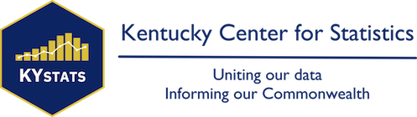









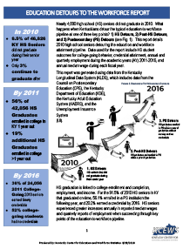

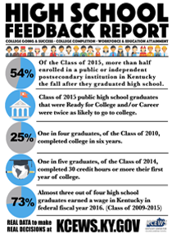


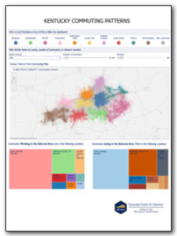

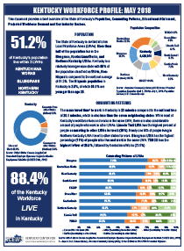



Examples of Data Sources from Across the Country

Slide 14


Kentucky Work Read Communities: Example
Welcome To Kentucky Work Ready Communities - workready
Encourages counties to take a credible inventory
of the current and future workforce, identify the gaps and
carry out strategies to achieve a
more knowledgeable, trained workforce.

Slide 15
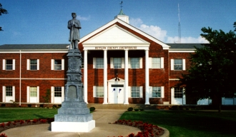
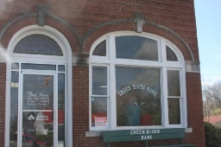

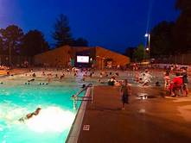
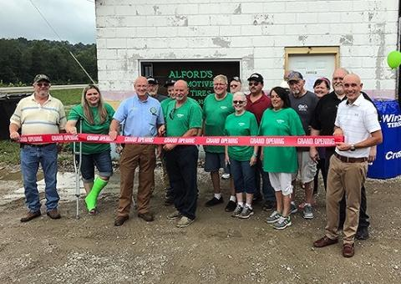
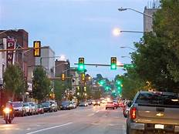
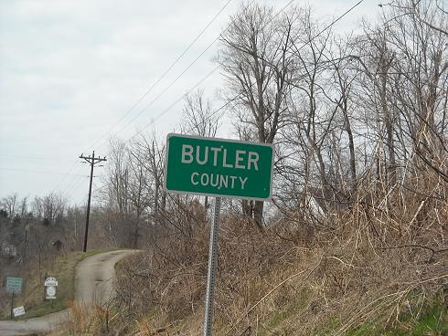
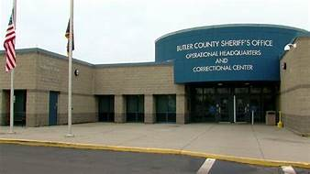
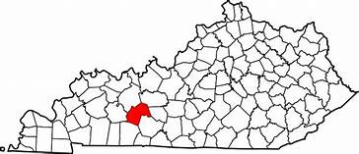

Explaining
Workforce
Development
Butler County
and
Surrounding Counties
Kentucky Example

Slide 16
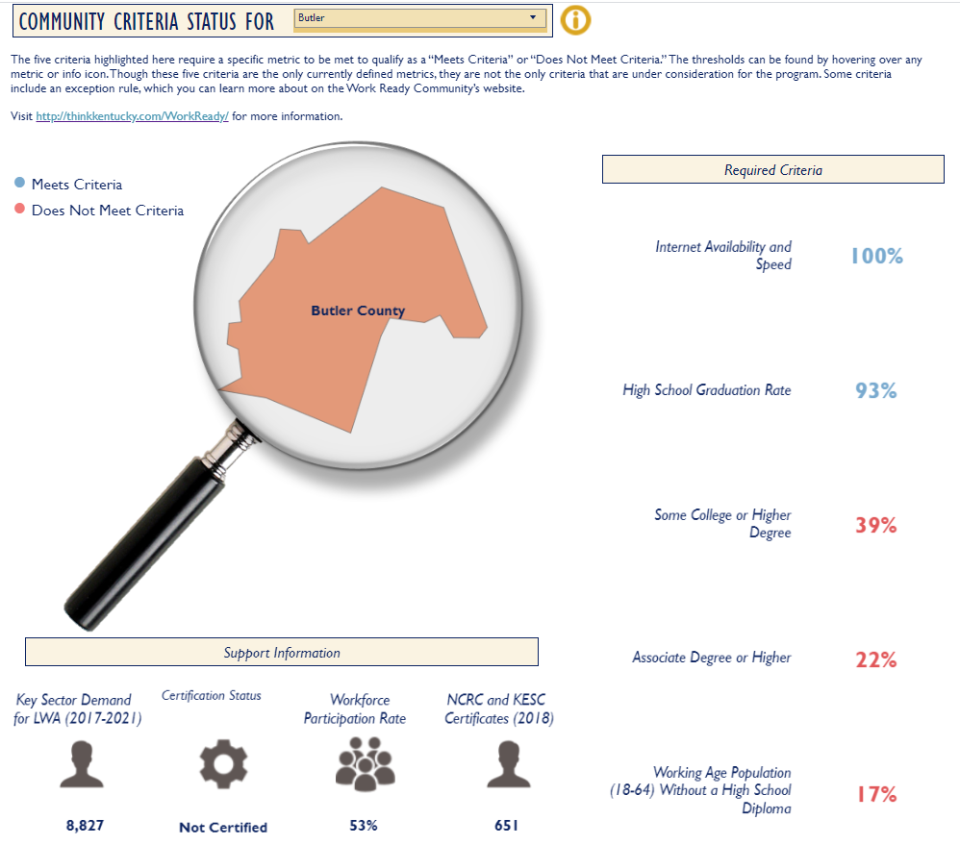
WorkReady
Butler County 1
Butler
Required
Criteria
100%
@
25 MPS
90%
43%
25%
KY EXAMPLE
15%

Slide 17
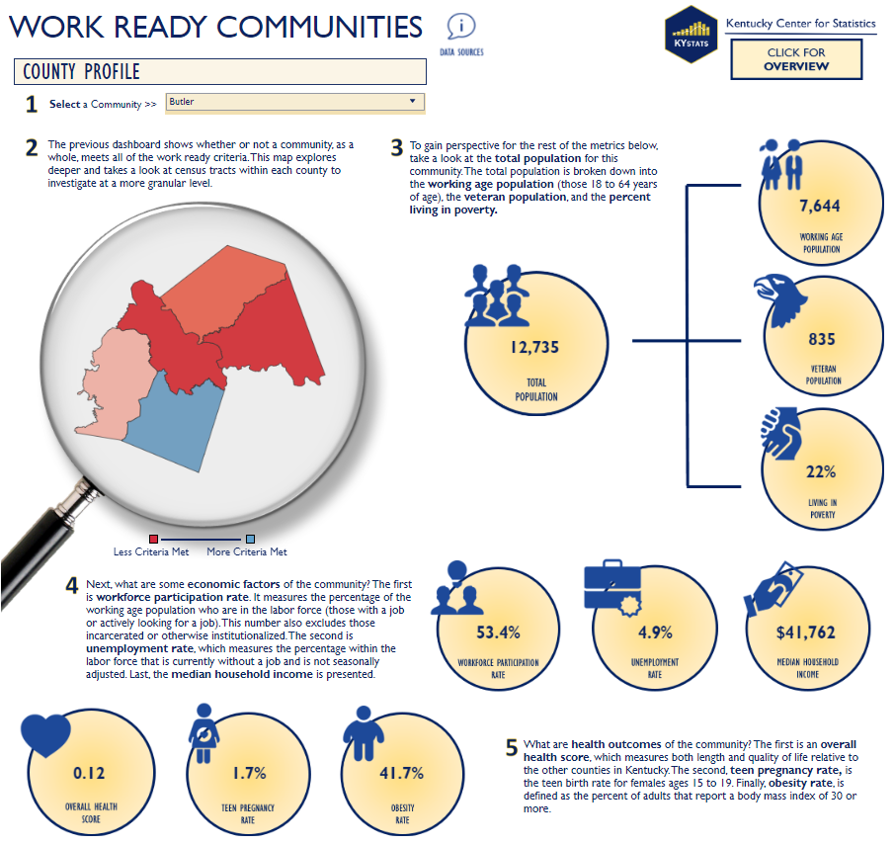
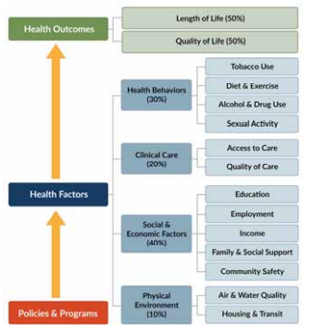
WorkReady
Butler County 2
Health Scores:
Worst: Owsley County – 2.01
Best: Oldham County – 1.82
KY EXAMPLE

Slide 18
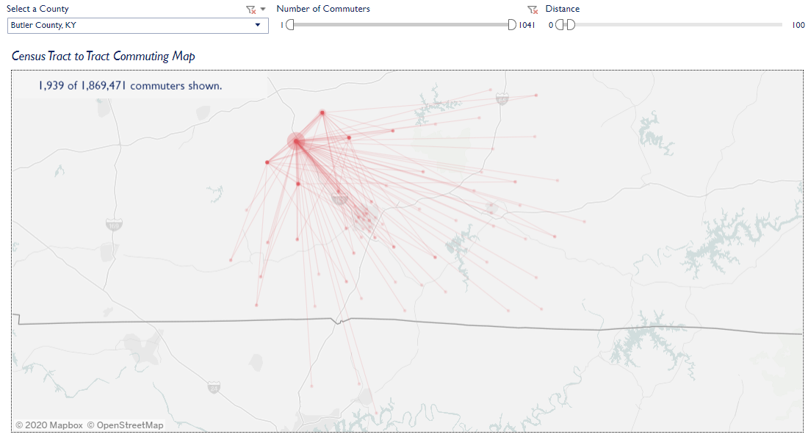
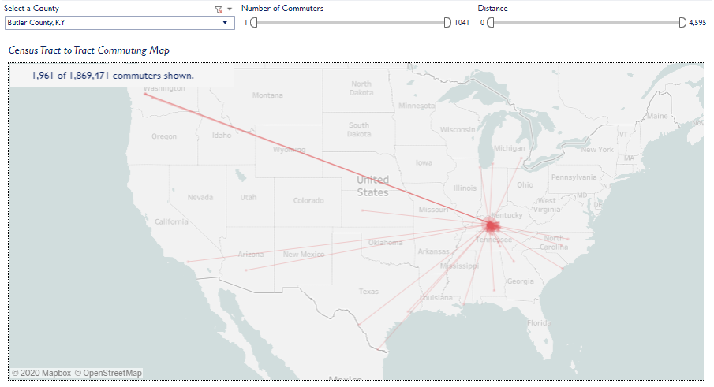
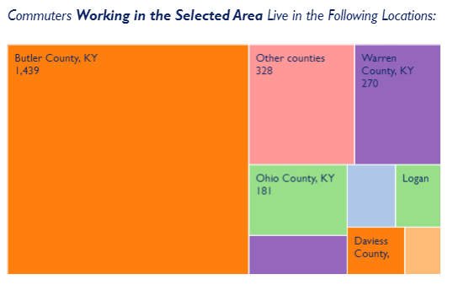
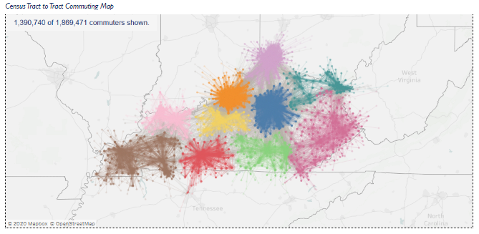
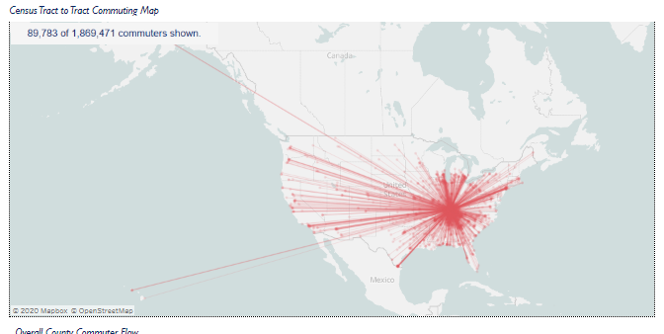
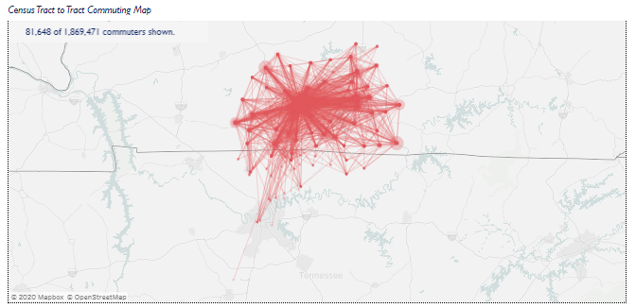
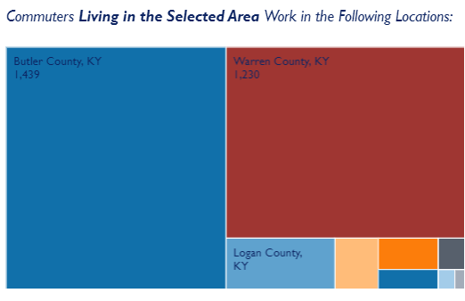

Commuting Patterns
Supply…
Hart County
Edmonson County
Hart County
Butler County
Edmonson County
Barren County
Metcalfe County
Metcalfe County
Logan County
Monroe County
Logan County
Robertson County TN
Macon County TN
Monroe County
Simpson County
Allen County
Summer County TN
At Least 1 Commuter
Davidson County TN
At least 5 Commuters
Sumner County TN
KY EXAMPLE
Commuting Patterns

Slide 19
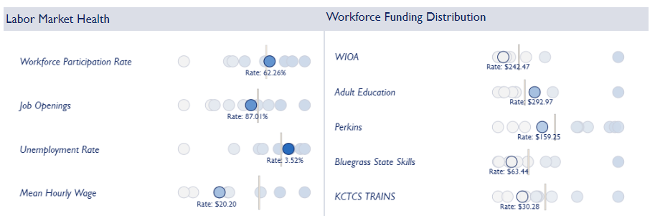
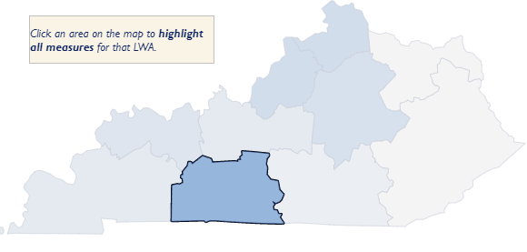
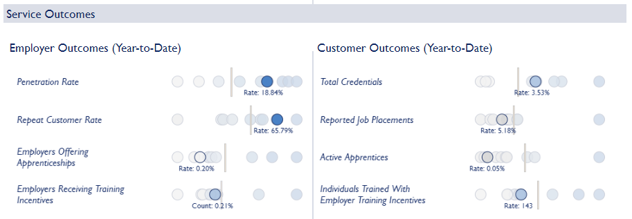
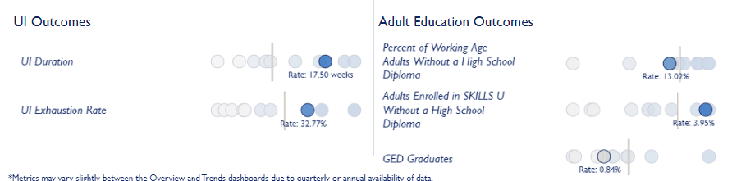
Regional Stats…
Kentucky Example
Health of the Workforce

Slide 20
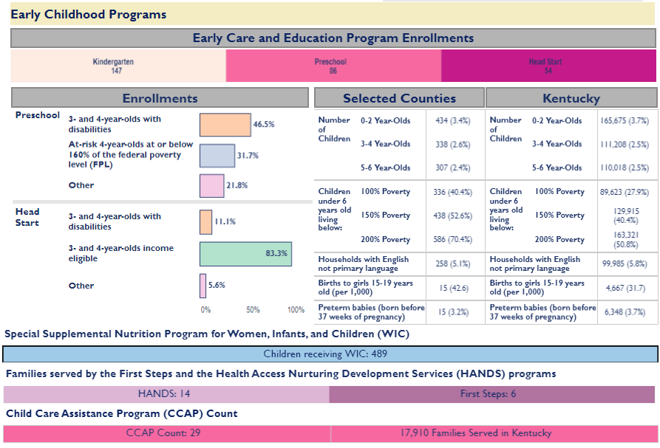
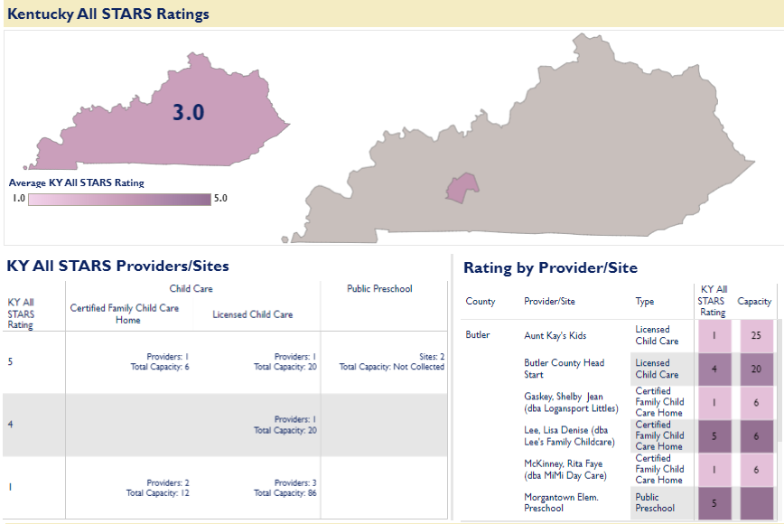
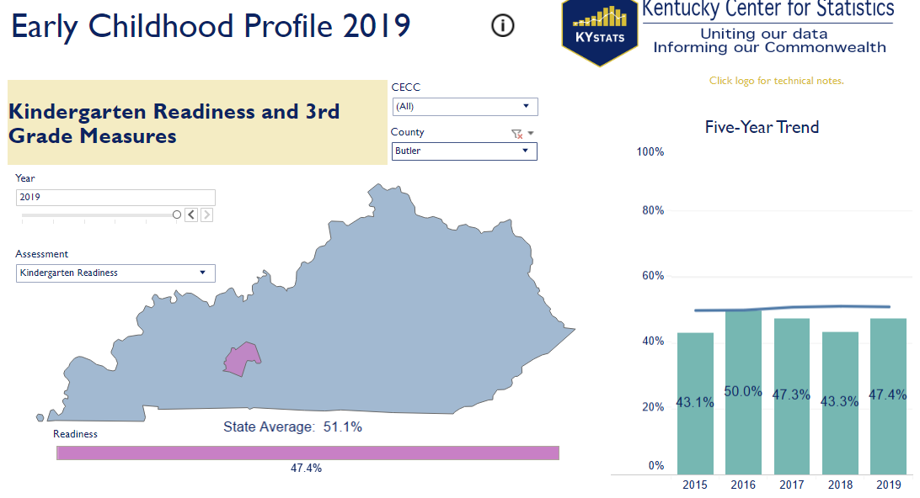

Early Care and Education Program Enrollments Data

Slide 21
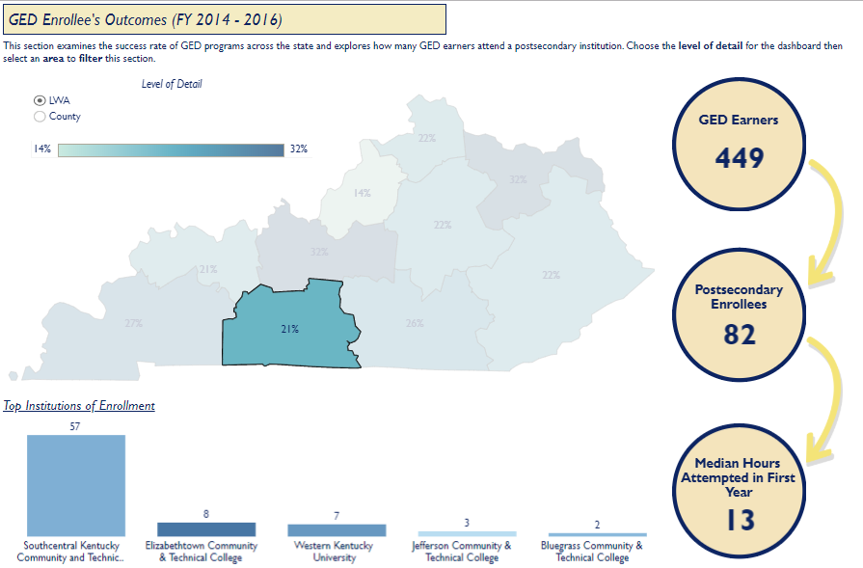
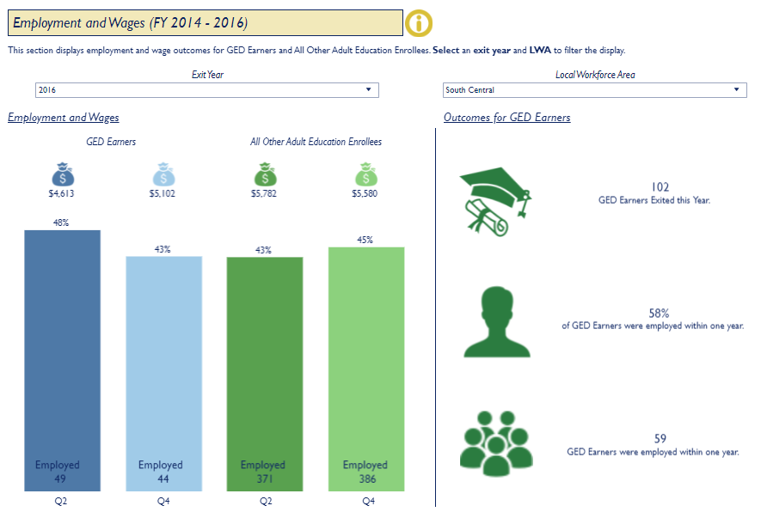
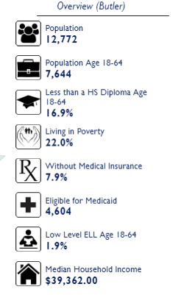
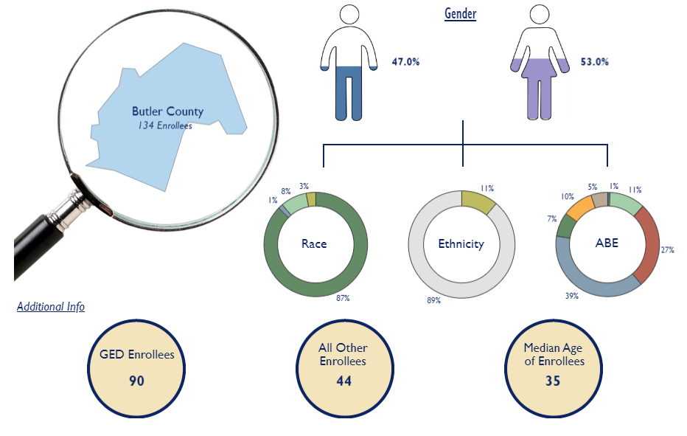
Additional Butler County Data
Supply…
Kentucky Example
Skills U
Less than a High School Diploma Age 18-64: 2014-2016

Slide 22
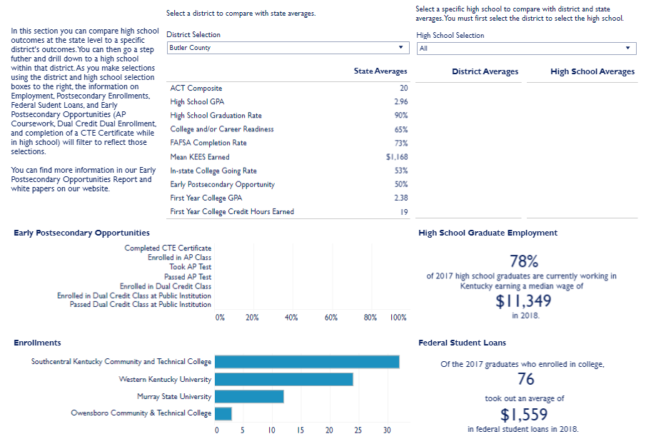
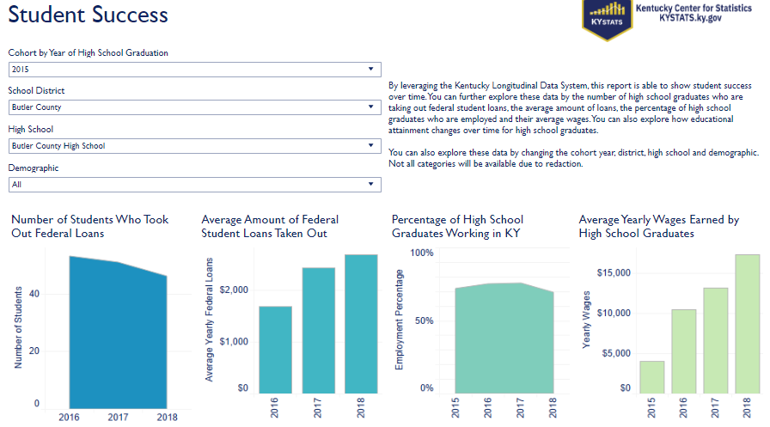
State Data
Supply…
State
Secondary /
Post-Secondary
Feedback
Kentucky Example

Slide 23
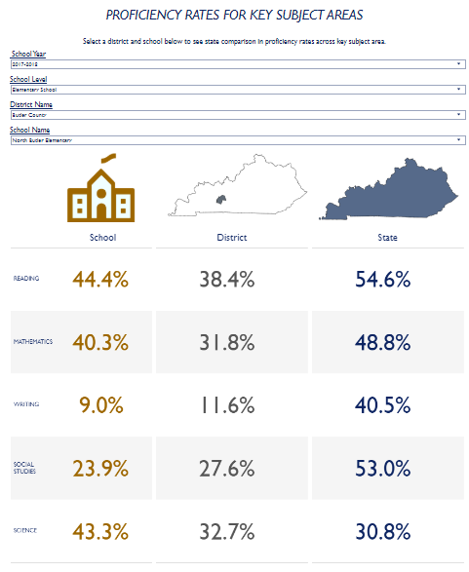
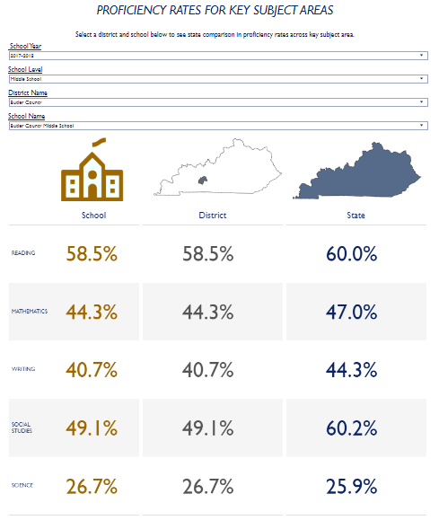
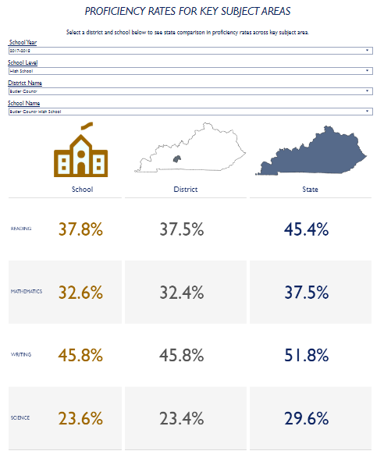
Proficiency Rates for Key Subject Areas- Kentucky Examples
North Butler Elementary
Butler Middle
Butler High
Kentucky Example

Slide 24
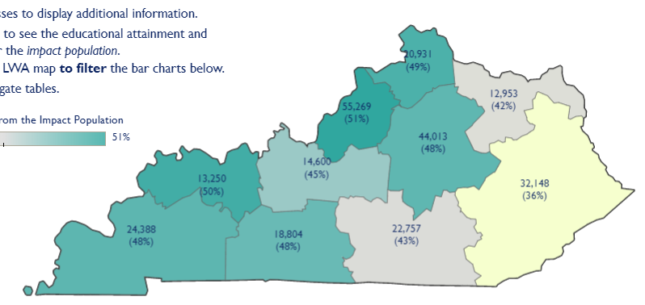
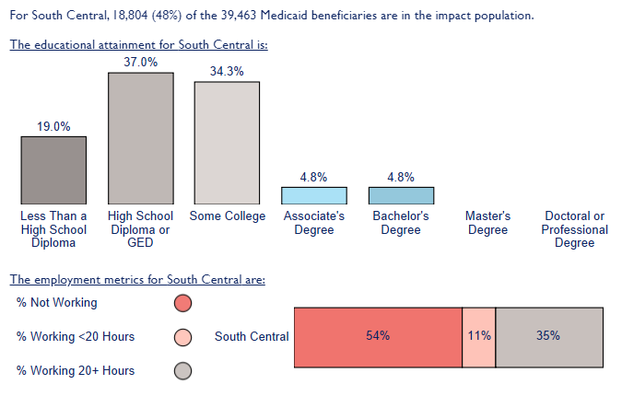
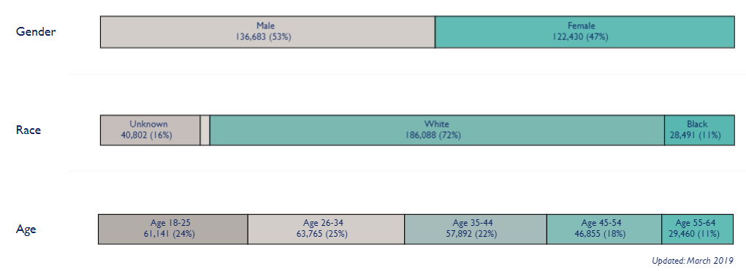
Supply…
Kentucky Example
Able Bodied

Slide 25

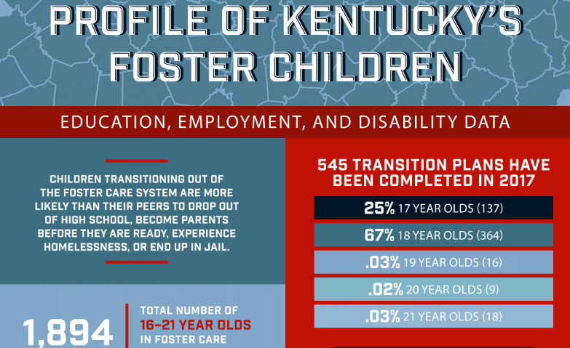
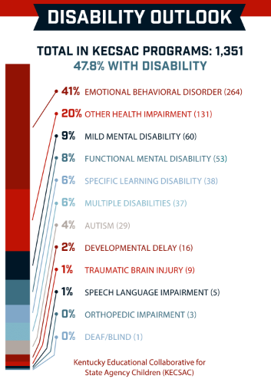
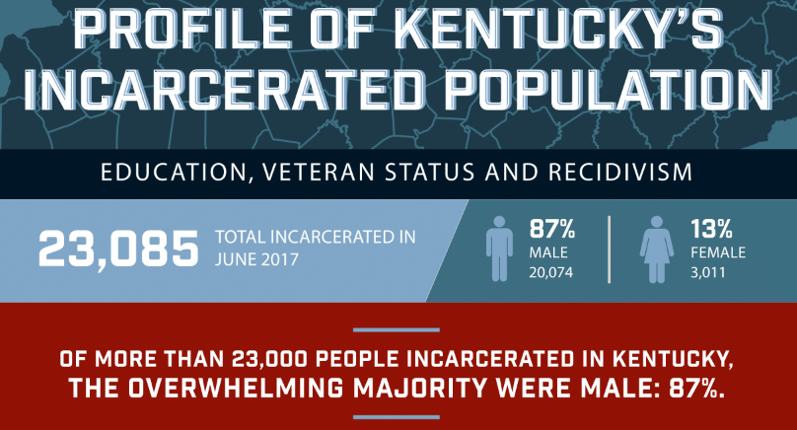
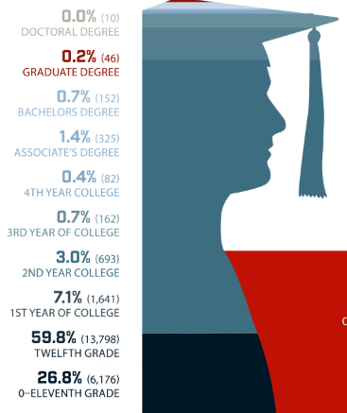
Examples of Kentucky’s Populations
Kentucky Example

Slide 26
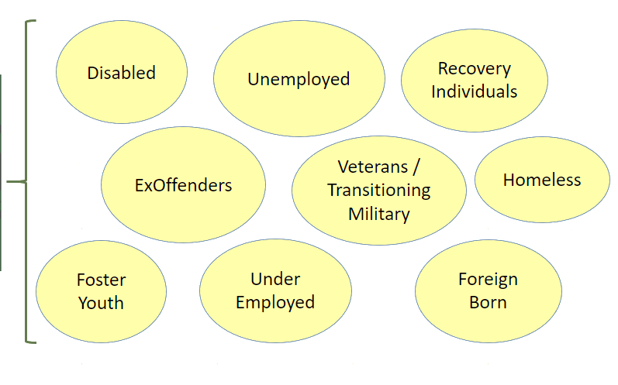
Work Ready Supply
As a workforce community and region, you need to be focusing on all SUPPLY POPULATIONS…
data is available for each category!!!!
“Work Ready”
Supply
Includes:

Slide 27
Supply vs.
Demand

Slide 28
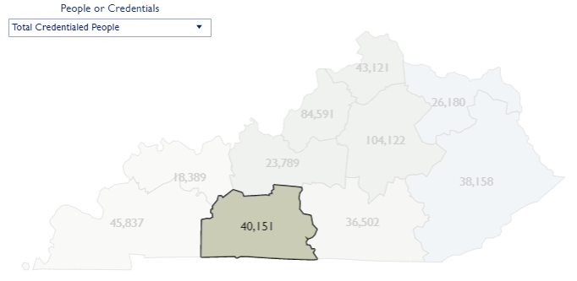





Credentialed Individuals Across Education Levels
Kentucky Example

Slide 29
What Does “Work Ready” Actually Mean?
Employer Demand
Labor Supply

Slide 30
Employer Demand
Childcare
Soft Skills Training
Retention Planning
Transportation
Multi Skilled / Cross Training
New Way of Working
New Ways of Training
Fill In Shift Scheduling
Syncing Generations
Culture
Mentoring
Do More With Less
DEIA
Elderly Care Support
Employee Planning
Employee Support

Slide 31
Labor Supply
Valued Culture
Mentoring
Connection
Wage Comparison
Today’s Benefits
Inclusion
JIT Paychecks
Support in Learning
Childcare
Work Life Balance
WFH / Flex Hours
Vacation / Personal Leave
Transportation Housing
Gig Economy Jobs
Job Satisfaction
Rewarding with Room to Grow
Free Lunches
Planned Downtime

Slide 32






Wage vs. Demand Levels
Demand…
Highest Wage, Lowest Demand
Highest Wage, Highest Demand
Lowest Wage, Lowest Demand
Lowest Wage, Highest Demand
KY EXAMPLE

Slide 33

Trained Individuals vs. Projected Demand
Kentucky Example

Slide 34

Trained Individuals vs. Projected Demand continued

Slide 35





CRITICAL SUCCESS FACTORS
Labor Market
Information
Partnerships

Slide 36

Gig Economy
A segment of the service economy based on flexible, temporary, or freelance jobs, often involving connecting clients and customers through an online platform.

Slide 37
Let’s start by quantifying the massive the shift towards gig work:
Over 75 million people currently freelance in the US — representing nearly half (48%) of the overall workforce (MBO Partners)
Their ranks are projected to surge to 86.5 million people by 2025, and over 100 million by 2028 (MBO Partners)
52% of all US workers are forecast to freelance in some capacity by 2023 (MBO Partners)
89% of companies intend to increase their usage of freelance talent over the next 5 years (Upwork)
Age:
The average freelancer age is 38 years old with 53% female and 47% male (MBO Partners)
49% are Millennials, born between 1981 and 1996 (Upwork)
37% belong to Gen Z, born 1997 onwards (Upwork)
Gig economy in the U.S. - statistics & facts | Statista
Gig Economy Statistics and Key Takeaways for 2024 | Upwork
mbopartners.com

Slide 38





Gig Job Boards

Slide 39




TYPES OF JOBS?

Slide 40

Get That Gig..

Slide 41















Factors that Make Up the Talent Pipeline
Talent Pipeline

Slide 42
Next Steps…

Slide 43
Next Steps
Who isn’t at the table who needs to be (within the city / county / area and outside of the city / county / area)?
How often are you meeting with other BS reps vs. how often do you need to meet with each other to create a true strategy and understanding of your labor market (supply and demand)?
What approach should you take: “Just X County” vs. a regional approach... employers don’t care about lines!
Supply and demand…. Is education at the table and are they getting the support they need for the supply side? Are conversations being had about curriculum?

Slide 44
Continued Next Steps…
Business and industry… how are you reaching out and how far are you willing to go to understand their needs and to effectively help them?
Culture and environment… what needs to change – It’s 2024! Don’t stay on a path just because “we’ve always done it this way.”
Programs and services… are you using them effectively and do your employers understand the resources available for them, their incumbents, and their new employees?
  Registered Apprenticeship / On-the-Job Training / Customized Training / Social Services / Etc.

Slide 45


Q & A

Slide 46



Resources
Next Level Now Community on WorkforceGPS
Business Services Representatives (BSR) Assessment Findings and Strategies for Improvement
Yes, WIOA Can! Building Strong Business Partnerships
React Collaboratively and Quickly for Rapid Response Events: Yes, WIOA Can!
Engage Businesses Through Registered Apprenticeships: Yes, WIOA Can!
Not Just Smoke and Mirrors: Economic Development Strategic Partnerships
Modernizing Business Services for Today's Employer
Incorporating the Worker Voice within the Sector Strategy Framework
Tips for Employer Engagement and Incorporating Sector Strategies
WIOA and Registered Apprenticeship: A Proven Strategy

Slide 47
Resources continued
Center of Excellence on Registered Apprenticeship
DOL Business Services Toolkit

Slide 48

Quick Evaluation
Please take 2 minutes to give us feedback on this workshop!

Slide 49


For More Info on the NEXT LEVEL NOW Collaborative…
Reach out to us to
request technical assistance
on today’s topic
or other workforce topics!

Slide 50


Thank You!
Melissa Aguilar-Southard
Project Director, Safal Partners
melissa.aguilar-southard@safalpartners.com
Molly Deahl
Senior Workforce Associate, Safal Partners
molly.deahl@safalpartners.com

