Slide 1

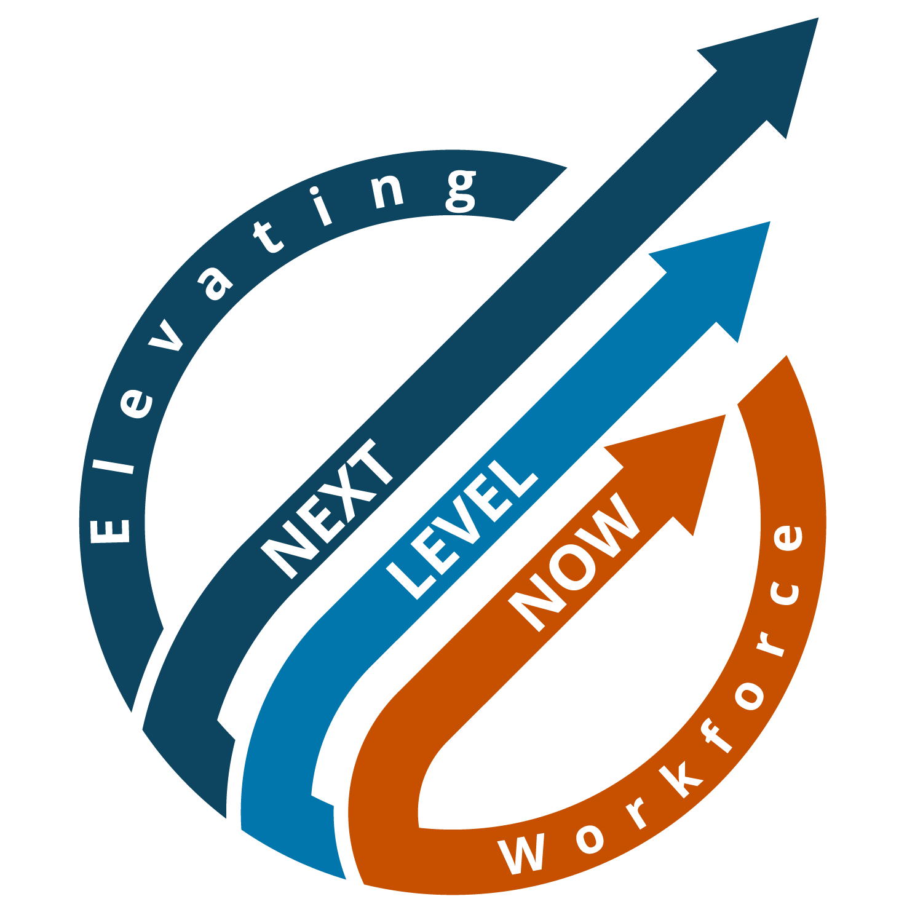
Board Governance Cohort:
Session 1- Requirements and Functions of Workforce Boards
Region 2 -
January 2025
Notes:
Lisa

Slide 2






About NLN
U.S. Department of Labor, Employment & Training
Administration (ETA)
About NLN…
U.S. DOL ETA’s vehicle for short- and long-term technical assistance
to state and local
workforce boards
throughout the
U.S. and its territories.
Notes:
Lisa

Slide 3
Agenda
Introductions
State and Local Workforce Boards
State and Local Workforce Development Board Composition
Recruitment and Retention of Board Members
Importance of Board Composition
Impact to Workforce Board Functions
Quality Bylaws
Q&A
Resources
Closing
3
Notes:
Lisa

Slide 4


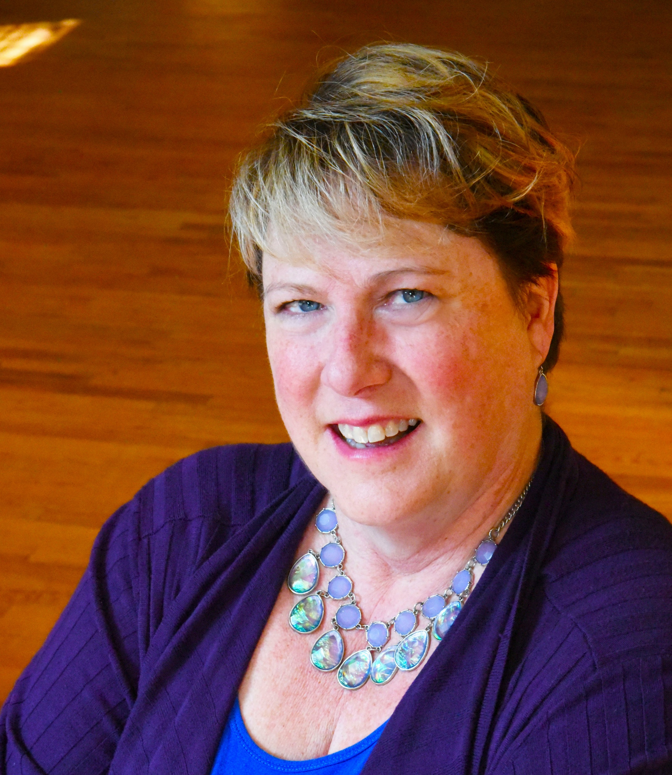
Presentation Speakers
Ron Painter
Principal, Forbes Field Associates, LLC
rdp033@forbesfieldassociates.com
Laurie Bouillion Larrea
Senior Advisor
National Association of Workforce Boards
larreal@nawb.org
Lisa Rice
Subject Matter Expert
Safal Partners
Lisa.rice@safalpartners.com
Notes:
Lisa to start and hand off to Ron and then Laurie

Slide 5
State and Local Workforce Boards
Notes:
Lisa

Slide 6
State & Local Workforce Boards
  Scope:
    A state workforce board looks at the entire state's workforce needs, sets statewide policies and strategies and allocates funding to local areas.
    A local workforce board focuses on a specific geographic area to coordinate the delivery of workforce development services to meet the needs of the community.
  Funding Distribution:
    The state workforce agency typically receives WIOA funding and then, with the state boards assistance, distributes it to local boards based on formularies within the WIOA Section 101 (d).
    At the local level, funding is distributed through the board’s budget which highlights areas of focus (i.e., registered apprenticeships).
Notes:
Ron –
We know that some of you are new and some of you have been around for awhile. This is meant to be a way for us to level set and remind us all about what the law says for our boards about governance.
Let’s start by understanding the difference between a state and local workforce board.
Scope –
A "state workforce board" oversees workforce development initiatives at the state level, setting statewide policies and allocating funding to local areas, while a "local workforce board" focuses on a specific region within a state, coordinating workforce development programs and services tailored to the needs of that local community, often in collaboration with local businesses and educational institutions; essentially, the state board sets the broader direction while the local board implements strategies at a more granular level within their area.
Funding Distribution –
At the state level the development of allocation formulas for the distribution of funds for employment and training activities for adults and youth workforce investment activities, to local areas as permitted under WIOA secs. 128(b)(3) and 133(b)(3); is done by the Governor with the state board’s assistance.
At the local level funding is distributed by the board through the budgeting process. This is where the board’s strategic vision gets paired with the allocation of resources.

Slide 7
State & Local Workforce Boards cont’d
  Responsibilities:
    The state board focuses on:
      policy development
      workforce trends analysis
      strategic priorities and planning for the overall economy of the state
      alignment of resources in different state agencies
      oversight of performance measures
    The local board focuses on:
      strategic priorities and planning for the local area
      meeting the needs of local businesses
      selecting training providers
      addressing specific needs of job seekers
      coordinating resources across the region to grow the economic vitality
Notes:
Ron-
While both boards focus on getting people employed there are a couple of differences in their responsibilities.
First the state board is focused on policy development that will impact the local boards. Having board members from the local areas who have served on their local boards can bring more of a frontline perspective to these policies.
Looking at workforce trends and the future of workforce is part of the work at the state level. This can then inform the locals about new industries that are growing or technology that is impacting an industry. As AI grows in various industries having the board members who are at the cutting edge will help with some of this forecasting.
Strategic priorities for the state are generally very large in scope. They may include things like wanting to focus on electric vehicle manufacturing, aligning opportunities for life-long education in the state, or supporting small businesses. These priorities then lead to the work of aligning resources from across state agencies to make them a reality.
And of course, the state board oversees the performance of all of the local areas to ensure that the WIOA common measures are being achieved.
The local board has a slightly different focus. Sure, it has policy development and looks at the local workforce trends, but it is truly more focused on how to meet the needs of the local businesses. This includes ensuring that selected training providers are meeting the needs of employers with their curriculum. One of the ways some boards are doing this is by contracting with their community college to staff and engage businesses on their different advisory committees. This give direct input to the educational system and keeps them up to date on the ever changing skills in the business world.
As a local board the oversight of the American Job Centers is really all about addressing the needs of job seekers. This is when the local board looks at performance, the demographics of those being served and ways they can help with resources such as training space, doing mock interviews or presenting industry information to job seekers.
And finally, the board is looking to coordinate resources around their community to help grow the economy of the area. The connectivity of the board in the region is important to this responsibility.
Let’s look at board membership a bit - Laurie

Slide 8
State and Local Workforce Development Board Composition
Notes:
Laurie - Let’s take a look at our State board composition now

Slide 9
State Workforce Board Members
Governor
Legislative Members – from each chamber
Business Representatives – 51% policy making or hiring authority, are from in-demand industries, and 1 small business
Labor Representatives – 20%
Community-Based Organizations – focus on veterans and individuals with disabilities
Core Partners – WIOA (Title I), Adult Ed (Title II), Wagner-Peyser (Title III), and Vocational Rehabilitation (Title IV)
  Unique representation
  Titles I and III allowed to have the same person
Other Stakeholders – Governor may appoint additional people
Notes:
Laurie – I’m sure you know these requirements for the state workforce board membership but we want to ensure you are thinking about them as we continue with the training.
The Governor of each state or territory is the one to appoint the board members.
There are legislative members, but the biggest area is of course business.
With businesses there is the requirement here for 1 small business owner as defined by SBA – which is looking at the size of the business, that they are for-profit, independently owned and operated, physically located in the area for this determination.
There are Labor requirements which includes the Registered Apprenticeship requirement for at least one of the members
The community-based representatives typically focus on organizations that are serving either veterans or individuals with a disability
And the core partners are typically the head of these agencies where the programs you see here are housed. Let’s also talk about the unique representation on the state board. An example would be where the agency that oversees Adult ED and Community Colleges uses 1 person to represent both programs. This is not considered unique representation for the state board purposes. The only titles that can use the same person to represent them on the state board are Titles 1 and 3.
Of course there are additional stakeholders that the governor may appoint, but each one leads to another business member being needed and most boards are trying to keep their numbers down.

Slide 10
Local Board Composition
Members are selected by the Chief Elected Official (CEO)
Business – 51%, policy-making or hiring authority and in-demand industries
  Two members must represent small business
Labor / Workforce – 20%
  Community-based organizations with veterans or individuals with disabilities focus
  May include youth organizations
Notes:
Laurie
And now let’s look at our local boards
Just as the state board has member requirements so does the local board. Let’s look at the similarities and differences as we look at the membership.
Not the Gov in this case but the CEO none the less
This starts out the same as the state, but we add that there need to be two small business representatives as defined by US Small Business Administration
Labor – same 20% requirements as at the state and same requirements for including the Registered apprenticeship member. And it also includes the Community Based Organizations in this section. Again, there is the focus on serving veterans or those with disabilities. And youth organizations that help youth with employment and training, especially those serving out of school youth, are also encouraged to be a member.
For reference only
§ 679.320 Who are the required members of the Local Workforce Development Board?
(a) For each local area in the State, the members of Local WDB must be selected by the chief elected official consistent with criteria established under WIOA sec. 107(b)(1) and criteria established by the Governor and must meet the requirements of WIOA sec. 107(b)(2).
(b) A majority of the members of the Local WDB must be representatives of business in the local area. At a minimum, two members must represent small business as defined by the U.S. Small Business Administration. Business representatives serving on Local WDBs also may serve on the State WDB. Each business representative must meet the following criteria:
(1) Be an owner, chief executive officer, chief operating officer, or other individual with optimum policy-making or hiring authority; and
(2) Provide employment opportunities in in-demand industry sectors or occupations, as those terms are defined in WIOA sec. 3(23).
(3) May include one or more representatives of community-based organizations that have demonstrated experience and expertise in addressing the employment, training or education needs of individuals with barriers to employment, including organizations that serve veterans or provide or support competitive integrated employment for individuals with disabilities; and
(4) May include one or more representatives of organizations that have demonstrated experience and expertise in addressing the employment, training, or education needs of eligible youth, including representatives of organizations that serve out-of-school youth.
(c) At least 20 percent of the members of the Local WDB must be workforce representatives.
These representatives:
(1) Must include two or more representatives of labor organizations, where such organizations exist in the local area. Where labor organizations do not exist, representatives must be selected from other employee representatives;
(2) Must include one or more representatives of a joint labor-management, or union affiliated, registered apprenticeship program within the area who must be a training director or a member of a labor organization. If no union affiliated registered apprenticeship programs exist in the area, a representative of a registered apprenticeship program with no union affiliation must be appointed, if one exists;
(3) May include one or more representatives of community-based organizations that have demonstrated experience and expertise in addressing the employment, training or education needs of individuals with barriers to employment, including organizations that serve veterans or provide or support competitive integrated employment for individuals with disabilities; and
(4) May include one or more representatives of organizations that have demonstrated experience and expertise in addressing the employment, training, or education needs of eligible youth, including representatives of organizations that serve out-of-school youth.
(e) The membership of Local WDBs may include individuals or representatives of other appropriate entities in the local area, including:
Entities administering education and training activities who represent local educational agencies or community-based organizations with demonstrated expertise in addressing the education or training needs for individuals with barriers to employment;
Governmental and economic and community development entities who represent transportation, housing, and public assistance programs;
Philanthropic organizations serving the local area; and
Other appropriate individuals as determined by the chief elected official.
(f) Members must be individuals with optimum policy-making authority within the entities they represent.
(g) Chief elected officials must establish a formal nomination and appointment process, consistent with the criteria established by the Governor and State WDB under sec. 107(b)(1) of WIOA for appointment of members of the Local WDBs, that ensures:
(1) Business representatives are appointed from among individuals who are nominated by local business organizations and business trade associations;
(2) Labor representatives are appointed from among individuals who are nominated by local labor federations (or, for a local area in which no employees are represented by such organizations, other representatives of employees); and
(3) When there is more than one local area provider of adult education and literacy activities under title II, or multiple institutions of higher education providing workforce investment activities as described in WIOA sec. 107(b)(2)(C)(i) or (ii), nominations are solicited from those particular entities.
(h) An individual may be appointed as a representative of more than one entity if the individual meets all the criteria for representation, including the criteria described in paragraphs (c) through (g) of this section, for each entity.
(i) All required WDB members must have voting privilege. The chief elected official may convey voting privileges to non-required members.

Slide 11
Local Board Composition continued
4. Required Core Partners
  WIOA (Title I)
  Adult Education and Literacy (Title II)
  Higher Education
  Economic Development
  State Employment Services – Wagner-Peyser Act (Title III)
  Vocational Rehabilitation (Title IV)
5. Optional
  Educational organizations addressing education needs for individuals with barriers to employment
  Governmental entities who represent transportation, housing or public assistance programs
  Philanthropic organizations that serve the area
  Others determined by the CLEO as appropriate
Notes:
Laurie
Required Core partners are here as well and they are not different from the state board.
However, at the local level you can have one person represent multiple seats, unless there are state restrictions on this. Example: If you have a Community College that runs Title 2 and is also the higher education entity then they could represent both seats with 1 person. A word of caution, if there are multiple community colleges in the area then nominations are solicited from those entities and the CLEO would approve which one of them will sit on the board. This usually means there is an agreement to rotate which community college is on the board.
Then we have the optional ones – the board member types you may have as appropriate to your area.
The options category is where we see a lot of extra people being added to boards which makes it harder to meet the 51% business membership requirements. And some of the extra governmental people being added are unconventional to have on the board. Such as, extra representatives from the CLEO or others who could be influencing other members because of their position in government.

Slide 12
Optimum Policy-Making Authority or Hiring Authority
Remember they can have either one of these designations:
  Optimum policy-making authority - An individual who can reasonably be expected to speak affirmatively on behalf of the entity he or she represents and to commit that entity to a chosen course of action
  Demonstrated experience and expertise
    Workplace learning advisor
    Contributes to the field of workforce development, HR, training & development or a core program function
    Recognized by the board for valuable contributions in education or workforce development
Notes:
Laurie
Let’s also remember that all of these board members at either the state or local board are to have optimum policy-making or hiring authority.
Optimum policy making means they can speak on behalf of the organization they represent and make commitments to take action
A good example of having hiring authority in an organization is often the HR Director or it could be a Hiring Manager in a specific department of the organization. Your goal is to always seek the highest level of authority with your membership. However, in smaller, rural areas this can be a challenge and hiring authority sometimes needs to be what you lean on.
The demonstrated experience and expertise clause that is in WIOA also needs a little exploring. Essentially, they are a workplace advisor, which means they still have that optimum authority, but they also contribute to the field and the board sees the value in their education or workforce development contributions.
For reference only
§ 679.340 What is meant by the terms “optimum policy-making authority” and “demonstrated experience and expertise”?
For purposes of selecting representatives to Local WDBs:
(a) A representative with “optimum policy-making authority” is an individual who can reasonably be expected to speak affirmatively on behalf of the entity he or she represents and to commit that entity to a chosen course of action.
(b) A representative with “demonstrated experience and expertise” means an individual who:
(1) Is a workplace learning advisor as defined in WIOA sec. 3(70);
(2) Contributes to the field of workforce development, human resources, training and development, or a core program function; or
(3) The Local WDB recognizes for valuable contributions in education or workforce development related fields.

Slide 13
Recruitment & Retention of Board Members
Notes:
Lisa – we are going to look now at recruitment and retention of board members at both the state and local levels

Slide 14
Equity and Inclusion
Although not stated, data should play a role in your board appointments. Reflect on both the letter and the spirit of the law!
Consider these items:
Demographics- 679.110(b)
Industries
Non-Profits
Languages spoken in your area
Notes:
Lisa
To begin there are equity and inclusion considerations for both the state and local board makeup.
The demographic representation is a requirement for state boards according to 679.110 (b)
As you begin looking at your board member recruitment, it is critical for you to use Labor market data to help you determine the predominate industries and the emerging industries in your state or local area.
And there are some other questions and data you may want to explore as you begin your recruitment.
Locally - Who’s in your community and who benefits from your services. Map it! Will your Board members represent the entire geographic area?
State and locally - Who are your largest employers by number employed? What about the small and medium sized employers? Which industries do these fall into?
Check your year-over-year data; which employers or industries are using workforce services?
How big is your government sector by number employed?
Which industries were actually hiring last year?
Locally - Which community-based organizations are most involved with your services or your neighborhoods? Bigger is not always best
How many languages are spoken in the state or local area, and how many are recognized by your local governments?

Slide 15

Recruitment of Board Members
Use a framework:
  Engaged Partnerships
  Data-Informed Decision Making
Key elements to consider:
  Alignment
  Resources and Capacity
  Industry Engagement
  Service Delivery
  Continuous Improvement
Notes:
Lisa –
All of those questions and data lead you into being ready to use a framework.
I know this may sound different, but the new Sector Strategies Framework can be very useful to use to determine your board member recruitment. This is useful whether you are at the state or local board level.
The reason it works is because SS is industry-driven just like the board is business-driven.
Here are some ways it can help you find your board members:
Engaged partnerships – the more your board members are engaged in the community the more partnerships they can bring to the table.
Data Informed Decision Making – as we said earlier using data is critical for finding your board members.
Worker Voice and Job Quality – ok, we have all probably had that one business member on the board that we hear the rumors about how they go through their HR directors every 90 days, or they keep people at part-time so they don’t have to pay benefits. Part of our job as a system is to lead by example. Vet your prospective board members with the Good Jobs Principles to see where they stand and if they represent the kinds of businesses you want leading workforce in your community.
Key elements to consider
Alignment – do prospective board members share the vision of the workforce system? Are they bought into fostering collaboration and bringing new ideas to the table?
Resources and Capacity – This is again part of the screening process you should do with potential members. Do they have the time to commit to being on the board, to engaging in committee activities and will they be able to contribute resources to the effort? We are not saying that if they don’t have resources don’t take them, but a simple question about who they know could open the door to a new partnership for office space, or for incentives for youth.
Industry engagement – Are they keeping up on the trends of their industry? Explaining to recruits that you want their knowledge about industry trends and their insights on workforce needs is a key step to take when talking to them about board membership.
Service Delivery – Do they have knowledge about the needs of the workforce in an industry that can guide the board with service strategies? Even exploring how they handle career pathways or opportunities for their workers to advance in their careers can give you insight to their philosophy about some of the core services in workforce development.
Continuous Improvement – to they have a growth mindset, are they goal oriented, do they look for solutions instead of focusing on the challenges? These are the characteristics you are looking for.
Board recruitment shouldn’t be taken lightly – they are influencing lives in your community with their engagement on the board.
Laurie what else would you say on recruitment of board members? (Next slide)

Slide 16
Recruitment of Board Members continued
Recruitment Strategies:
  Think of new partnerships
  Involve Others
  Provide extensive details
  CLEO understands the process
  Start at the committee level
  Stay focused and prepared for members to move on…have a plan and stay on top of vacancies.
Notes:
Laurie –
Think of New partnerships – with the amount of money going into infrastructure and clean energy, do you have board members that either come from these areas or who can help you partner with these industries?
Involve Others - the CLEO, Board Chair, other Board members, a Committee of the Board for recruitment and retention, or whatever might provide the broadest opportunity for recruitment that will bring the appropriate representation to the Board.
Provide Extensive details - to those who are recruiting including meeting dates and time for the next year, mission, vision, fiscal condition and budget amount, and an impact statement. You want prospective members find passion in your purpose.
Make sure the CLEO is comfortable with the process and trusts those who will be suggesting candidates.
Start potential board members with committee work

Slide 17
Recruitment & Retention of Board Directors
Retention Strategies:
  Involve
  Onboarding (CRITICAL)
  WIIFT – What’s In It For Them?
  Speakers Bureau
  Succession Planning
  Get Creative
  Exit Interview
Notes:
Laurie
Involve - your board in more than meetings, events and media events! Let them know your needs that are within board purview, but never ask them to do the work of the board staff!
Onboarding - Give members the right information for explaining the work of the board. Have you ever had a board member leave after 2 or 3 meetings? That often happens when we don’t onboard them with all of the info they need to be a good board member. And a promising practice – make it bite sized information at regular intervals instead of a firehose orientation.
WIFT Feature news stories and social media posts welcoming new members and recognizing the “career” accomplishments of existing members.
Speakers Bureau - Ask for volunteers to form a “speakers bureau.” The CEO/Executive Director can share some of the responsibility for informing the community about your board’s work.
Build a board and officer succession plan. “Leaders leading leaders” require movement. Take a page from Chambers of Commerce – limit the time in the Chair and have one or two Vice Chairs in line to lead. Provide meaningful work for the Vice Chairs!
Get creative - Form a funds committee! With the restrictions and declining resources in WIOA, ask for creativity to raise funding and garner additional support.
Exit Interview – when you do have someone leave - Always ask a departing member for suggestions to replace themselves

Slide 18
Importance of Board Composition
Notes:
Lisa – let’s look at why board composition at both the state and local level is so important to the workforce system

Slide 19

Importance of Board Composition 1
Board functions
Examples to the state and local community
Increases partnerships, resources, and the pipeline for the board
Provides supply and demand connectivity
Notes:
Lisa
All of the board composition work relates to the governance of the board, the functions of the board.
First – if you have board members that can Address industry talent needs and thereby support employers’ economic competitiveness with service strategies then your board will be more innovative with outreach and service delivery.
With businesses that represent Good Jobs Principles you are looking to address career pathway development and listening to worker’s about how to increase their economic well-being. This in turn raises your communities economic vitality.
Board members who bring in partnerships, other resources, other potential board members are part of the solutions for you to grow vibrant and thriving economic regions.
Expands networks – when you have a board that is well connected then you can expand your reach into new areas. One example is Invest in America Act funding.

Slide 20
Importance of Board Composition 2
Expands network (i.e., discretionary funding)
Resources to Explore:
  Challenge.gov
  FDIC Insured Banks
  Economic Development Administration
Notes:
Lisa
Next slide

Slide 21
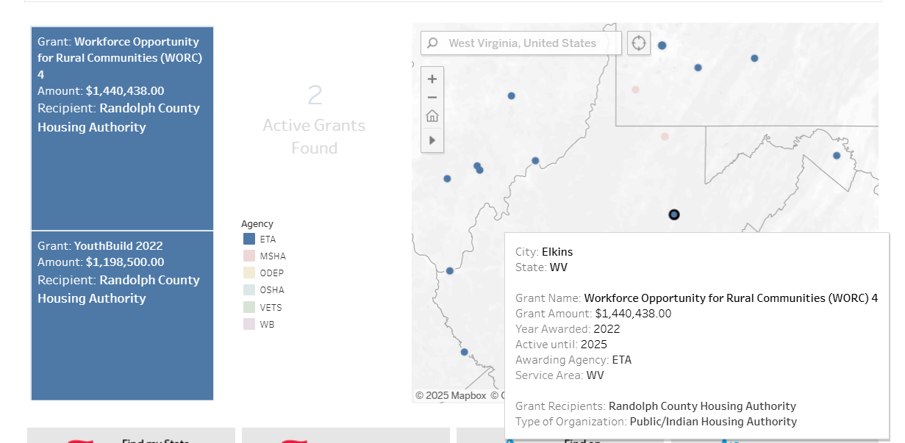
Importance of Board Composition 3
Notes:
Lisa –
WV – WORC grant with Randolph County Housing Authority.
But the question is how deep is that connection? And I’m not saying that it isn’t deep in this case, what I’m trying to make you aware of is that when you use this interactive map to look at all the discretionary funds in your area you may find some new connections for you to work with. And you may find that a board member is already familiar with the organization it was awarded to and would be able to help make the right introductions so you can truly grow your partnerships.
Awareness of discretionary funds in your state and local area is the first step to making these connections and your board members are the links.

Slide 22
Impact to Workforce Board Functions
Notes:
LIsa
Let’s look at how board composition impacts the functions of the workforce system at both the state and local levels

Slide 23



Impact to Workforce Board Functions 1
4-year state or local plans
Meeting the needs of employers
Balancing the needs of the many
Youth – so many impacts!
Notes:
Lisa
The required 4 year state/local plans are one of the most significant ways that the board composition can impact the work of the board. If you are truly seeking input from your board members on the state or local plan, as well as from stakeholders, then you are hearing the needs of industry and applying it to the overall strategic direction of the board. In many cases we look at these plans as just a check mark we need to do rather than the roadmap of our actions over the next 4 years. If that’s all it is, then board members aren’t very engaged with it. But when you turn it into your guide for actions with board member input then you realize how important it is to have members that can review data, analyze it against the reality they are experiencing and produce suggestions for moving forward.
Let me give you an example. One of the newer components of plans is the use of technology. And I’m pretty sure most of the state and local plans say thing about websites, maybe online chat, and holding webinars online. But with the right board member – such as an IT CEO – you get ideas about using AI to send out notices to customers, or recommending customized training programs based on career seekers needs and career goals. This is when you impact the service delivery across the state and in the AJCs to be at a higher level with more efficiencies. And at the state level you hear about how AI can help analyze labor market trends and employment data that can then guide decisions on in-demand industries or easily be shared with local boards to help them make informed decisions.
With State plans you are not only outlining the strategy for achieving the goals over the next 4 years but you are also indicating how core and partner programs will help achieve those goals. Additionally, the setting of performance goals (which then relates to the local boards goals) is important to measure your progress. It also can push the system to achieve more with the 6 common WIOA goals.
And one of the critical parts of the state plan is the allocation of the funds to different programs and services. This is where you are not only allocating funds to the local areas but you are placing priorities for your state. For instance, several states have placed a priority on registered apprenticeship and that is demonstrated in how they are prioritizing allocations for registered apprenticeship infrastructure and programs.
Meeting the needs of employers is another huge function of workforce boards, but without people who have industry knowledge and are engaged in the work of the board, you miss out on gathering this information, When you recruit passionate and engaged business or stakeholder members you need to ensure they have the ability to provide their insight in an ongoing fashion or you will lose them. Their input feeds your business services, rapid response and layoff aversion activities.
When you have mandatory partners who also have their own goals and strategic visions combined with business, education and economic development interests you end up having to balance the needs of all of them. This balance comes when you have board members that understand a growth mindset, who hold each other accountable with respect, and who understand the goals of each entity represented on the board. This investment of their time is not just about workforce goals but about all the goals and how you can collaborate to make them happen. Being purposeful about having information from each stakeholder provided with ideas about how it aligns with workforce goals is a promising practice for a board to pursue.
Let me explain. If we know Adult Ed is having a hard time keeping students because the students need to go to work, then how could the workforce board and other entities work together to provide the adult education in a earn and learn setting? These are the types of strategic discussions both state and local boards are meant to have. Where can they assist or provide resources? Because if we help each of our partners reach their goals, we will likely be meeting the goals of the workforce system.
Let’s face it - Youth programs are challenging. But with the right board members they can actually be very visionary and impactful to the youth of today. Because WIOA has 14 elements that should be available to youth who need them we absolutely must lean in on board members to achieve these elements and provide youth with stability. At the state level this attention to youth programs could be tied to initiatives using the Governor’s set aside funds or convening youth organizations statewide to tackle specific challenges.
And with the local area this attention to youth services begins with the 14 elements you have to deliver if a youth needs those items. Who has seen a youth in a WIOA program that doesn’t need a mentor? This is where the impact can happen in both the life of the youth and the board member mentor. Yep, get them engaged to mentor youth, to provide the leadership development training, to have youth shadow them. This simple step can’t happen if you don’t have board members who are willing to be engaged. We know they are busy but make it easy for them to participate. And for the board member that is gung-ho about youth services give them a voice in your youth committee. I know this isn’t news to most of you, but my question is – are you doing it? If not, why not? Have you got the right people on the board for this very important service that impacts the future of our states and communities?

Slide 24

Impact to Workforce Board Functions 2
Training programs
Budgeting of WIOA funds
Relationships between state and local boards
Notes:
Laurie –
We all know and love the eligible training provider list, right? Well, what kind of evaluation does your board do of these training providers? How involved are they or their industry peers in the curriculum being offered at the local college? Remember, expanding the pool of businesses who are able to give feedback about training programs can really highlight areas of improvement for the college and it give businesses the voice they often feel they don’t have. Some of you may be thinking but that’s why colleges have business advisory boards. Yes, it is. How effective are they? Do they meet often and is it the same old group of folks?
Budgeting of WIOA funds is an area that we have seen is mostly left up to the staff to determine. That’s understandable because it is kind of complicated on how you can use the various funds. However, the strategic vision from the 4-year plan should also be reflected in the budget and good fiscally attuned board members understand this. When you have board members who understand the need to strategically align resources with goals then you impact your budget in positive ways. Board members like Labor Unions who emphasize apprenticeship activities may be one of those who asks why don’t we set aside funds for registered apprenticeships? Or those who are involved with the youth program may see a need for incentives for youth and wonder why it isn’t in the budget. These are the kinds of discussions you need to have when the budget is being discussed each year.
I want to add another important part for budgeting that board members should be aware of and asking questions about. And that’s the discretionary grants that come to your area. You may even have a board member affiliated with an organization that got a discretionary grant. They can then be your conduit to a partnership with that other organization. While it may not mean funding to the local board it can mean referrals of career seekers or additional services for businesses.
This last one can often be difficult, but it doesn’t have to be. Most states have associations of the local boards which include at least the board chair and usually the vice chair too. These associations are a conduit to improving relationships with the state.

Slide 25
Quality Bylaws
Notes:
Ron – let’s shift our focus now to quality bylaws

Slide 26
Quality Bylaws Components
Clarity
Comprehensive
Consistent
Flexibility
Legality
Practicality
Notes:
Ron –
High-quality bylaws are like a well-built foundation; they ensure smooth operations and clear governance. Here's what makes them stand out:
Clarity: Language is straightforward and unambiguous, making it easy for everyone to understand.
Comprehensiveness: They cover all necessary aspects of the organization’s operations, from membership criteria to board responsibilities.
Consistency: Aligned with the organization's mission, vision, and other governing documents.
Flexibility: Allow for amendments as the organization evolves without being too rigid or cumbersome.
Legality: Comply with federal, state, and local laws, ensuring legal protection for the organization and its members.
Practicality: They should be realistic and applicable to the actual operations and needs of the organization.
In essence, high-quality bylaws provide a strong framework for governance while being adaptable enough to grow with the organization. How does that resonate with your understanding of effective bylaws?
We need to note that the formation of the initial bylaws for boards is done by the CLEO. However, most of you already have these bylaws in place so the question becomes whether or not your agreement with your CLEO has the board designated as the one to create any changes to the bylaws.

Slide 27
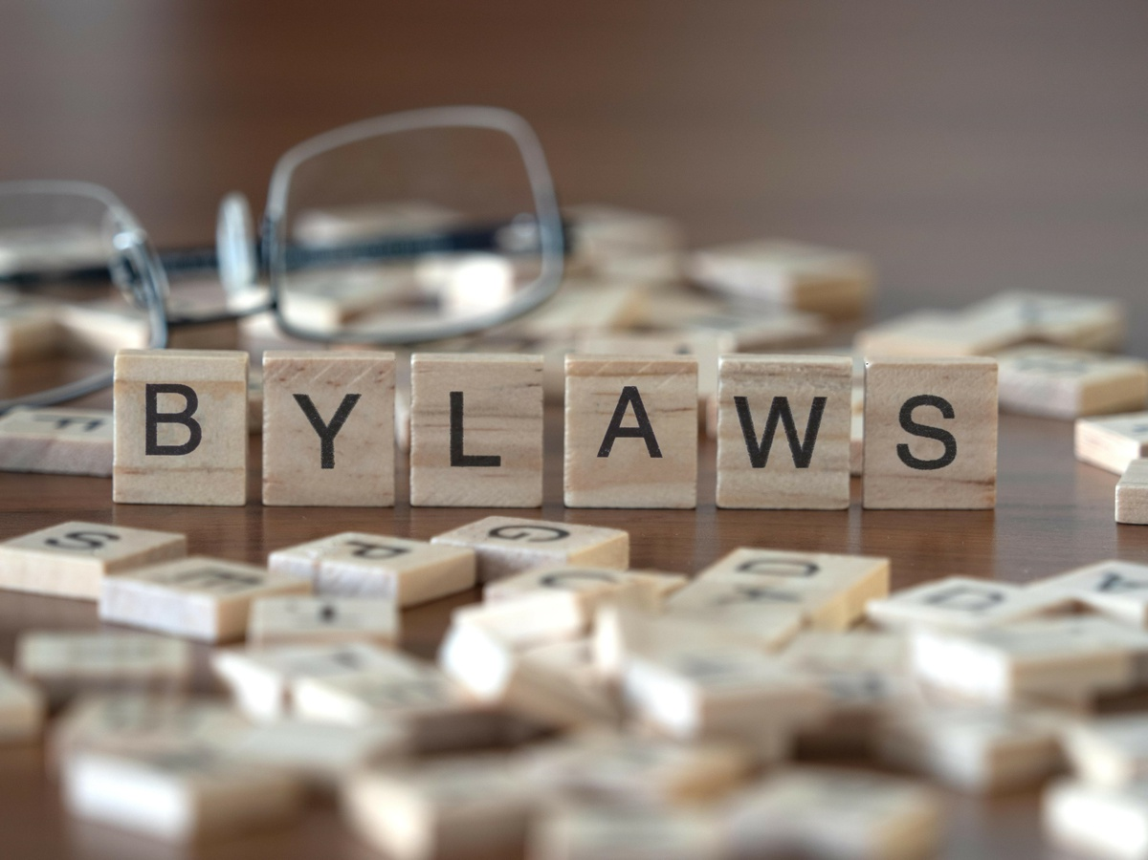
Why Do Quality Bylaws Matter?
Bylaws are the backbone of the organization
  Define roles and responsibilities
  Provide operational guidance
  Legal compliance
  Roadmap for conflict resolution
Notes:
Ron -
Bylaws are the backbone of the organization and need to include Core Components such as Mission statement, board structure, roles and responsibilities, meeting protocols.
They should define roles and responsibilities of who will do what, including any voting privileges or proxies
Operationally they talk about meetings including frequency, who can call them, the notification period and e-voting of members. Committees are often defined in bylaws either with set standing committees (Reference 679.360 for standing committee language that must be met if you are setting things up this way) or with lots of flexibility to have ad hoc committees. A promising practices is to have your Executive and Finance committee be standing committees and to have the rest be ad hoc committees that address specific goals.
You may be wondering about a standing youth committee. Many boards have this, but others have taken the approach of creating ad hoc committees around specific projects like youth mentorship or youth entrepreneurship. When they get to a point where things are running then they disband and go to the next project. This keeps your members engaged and the agendas are very lively since you are typically working on a timeline. However, there are specific considerations for you if you decide to have a youth committee (Reference 681.100 through 120) and the biggest point here is that you have to have a youth on that committee!
Bylaws define quorums and voting procedures, like Roberts Rules of Order. There should also be information about electing or appointing board members and how long their tenure is for. Financial management can also be a part of your bylaws by establishing who has financial oversight or handling of funds.
The Legal pieces of your bylaws should include the normal things like liability, amendments to bylaws, records maintenance, transparency or sunshine laws. Please note I’m not hitting all of the legal items in the bylaws and you should consult WIOA for more information on what to include in them.
However, one main point is the inclusion of the conflict of interest pieces as WIOA stipulates that board members may not vote on a matter under consideration or engage in any activity that could influence the vote if it will result in a direct financial benefit to them or to their immediate family. This section is there to protect the board’s integrity.

Slide 28

Why Do Quality Bylaws Matter? continued
Going beyond with bylaws
  More business membership
  Values
  Employer engagement/ Career pathways
  Training of members
Notes:
Ron -
But we can go beyond the basics of bylaws to impact the work of the board even more. For instance, your board may want to have more than just 51% business membership to ensure you have all the in-demand industries represented or to be more inclusive with your diversity on the board.
Or to include the values of the organization. This can be very useful when facing challenging times or looking for answers to reduced funding. What values do you fall back on? Innovation? Collaboration? Or possibly technology usage to streamline efforts?
Or maybe you want to ensure that items like employer engagement or career pathways are emphasized as a part of what you will be focused on as a board.
Training of members can also be codified in your bylaws. This makes new board members aware that they not only get an orientation, but they will have ongoing training as well.
Don’t make your bylaws too cumbersome with these items. However, you may find that solidifying what matters the most to the board in your bylaws is a promising practice for you.

Slide 29
Cautions About Bylaws
Superseding and/ or conflating
Check State policy
Who the executive director reports to
Names vs. positions
Don’t forget to review
Notes:
Ron
There are some cautions we want to include here about your bylaws.
You can’t give over the functions of the local board in your bylaws to a different organization, like the fiscal agent or just to the executive committee. And you can’t have two organizations responsible for the same thing. For instance if there is a non-profit organization that the board set up, you can’t have that non-profit organization have the same responsibilities as the local workforce board. If a board’s bylaws are included in a document that serves multiple functions such as outlining the fiscal agent functions, or in an intergovernmental agreement, you still must clearly define what the local board must do by law and this can’t be given over to any other organization in the document.
Remember, your state may have some additional items they want to see in your bylaws. For instance, some states require that vacancies on a board must be filled within a certain time frame. Again, this is why having good board members who are referring potential members into committee work is so vital, because you have a pool of ready applicants then.
Your state may also require descriptions of a removal process for board members for cause.
Bylaws often state that the executive director is under the direction of the chair or the executive committee, when in fact by law they are under the direction of the entire local board. By stating they are under the Chair or the Executive committee you are taking away the authority of the full board. Your bylaws can also language that the board by WIOA law is the one to hire the executive director. Even if this position is under a county or city, the board would be the one to choose the position classification, is directly involved in developing the job description and they are the ones to select the person for the position. Likewise the board must take a vote to terminate the ED, the CLEO can not do this termination on their own recourse. The process that must be taken for hiring or terminating an ED when they are a city or county employ is the City or County’s process, but the Board has to do the actual hiring and/or terminating.
Don’t use names in bylaws as those change on a regular basis, instead use the positions like Chair, Treasurer, etc.
Bylaws should be reviewed on a regular basis, which is typically every 2 or 3 years, to see if there need to be any changes. The initial review can be done by staff, the executive committee or even the full board. Any changes must come to the full board for a vote though.
Another cautionary tale, is that your bylaws should not indicate that the CLEO or other entity, has the authority to not agree with a board decision and return it for reconsideration. CLEOs do not have this authority.
Review your agreement with your CLEO to ensure that your board is the one to write and amend bylaws. This is often just taken for granted, but technically should be a part of your agreement. And then the bylaws should be reviewed at least every two years for any pertinent changes with the input and approval of your CLEO.

Slide 30

Don’t cut corners!
Notes:
Laurie – what else did you want to add?????

Slide 31

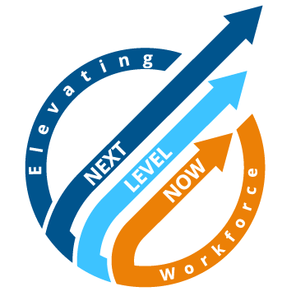
Q & A
Notes:
Lisa

Slide 32
Resources
WIOA Governance Training Webcast Series
Call to Action for Workforce Development Boards
Board Governance Series: Article 1- New Board Members Responsibilities and Engagement
Workforce Solutions Gulf Coast
Careersource Broward Bylaws (Incorporated Board)
NOVA Works Bylaws
Orange County Workforce Development Board Bylaws
How Can Workforce Development Boards Accelerate Positive Outcomes for Job Seekers and Businesses?
Governing the Public Workforce System: The Structure and Priorities of Local Workforce Investment…
Department of Labor Grants
National Science Foundation (NSF) Interactive Map

Slide 33
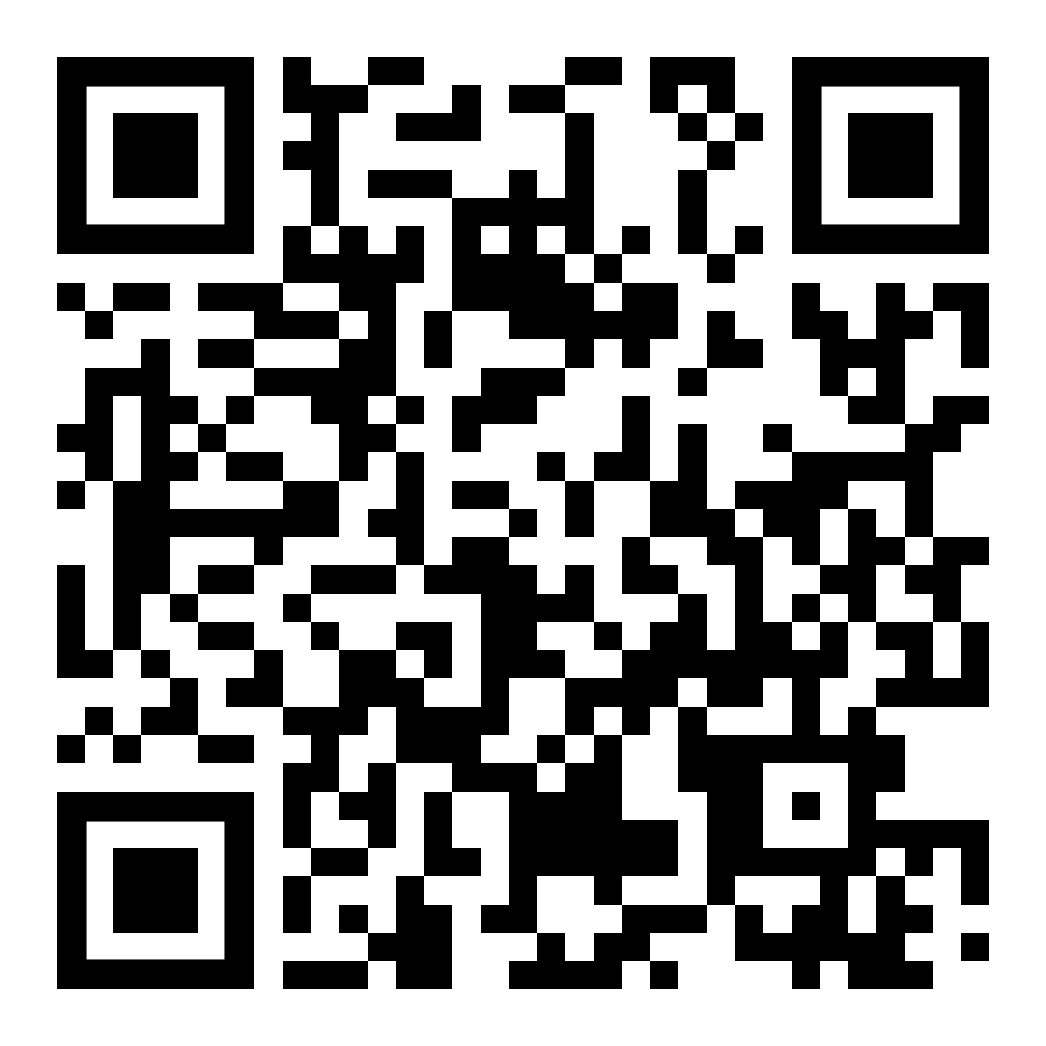
Quick Evaluation
Please take two minutes to give us feedback on this workshop!

Slide 34
Thank You to Our Presentation Team!
Ron Painter
Principal, Forbes Field Associates, LLC
rdp033@forbesfieldassociates.com
Laurie Bouillion Larrea
Senior Advisor
National Association of Workforce Boards
larreal@nawb.org
Lisa Rice
Subject Matter Expert
Safal Partners
Lisa.rice@safalpartners.com
Notes:
Lisa to start and hand off to Ron and then Laurie

Slide 35
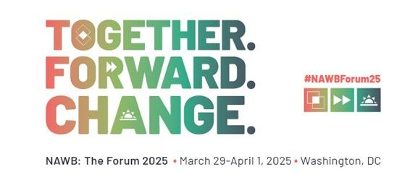


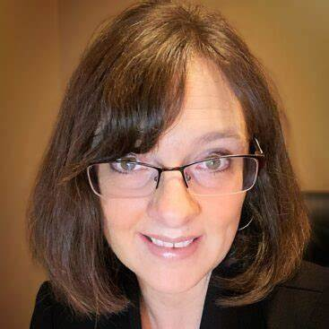
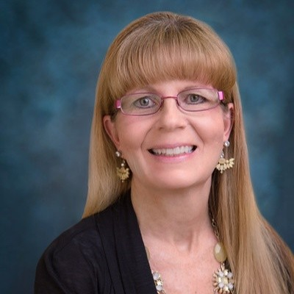
For More Info on the NEXT LEVEL NOW Collaborative…
Register now for NAWB: The Forum 2025!
Submit Question / TA Request
Become a member of our Next Level Now Community of Practice!
The Next Level Now Community of Practice can be found at www.nextlevelnow.workforcegps.org/
Feel free to reach out to us to request technical assistance on today’s topic or other workforce topics!
Melissa Aguilar-Southard
  Director and SME
    Melissa.Aguilar-Southard@safalpartners.com
Judy Blanchard
  Project Manager
    Judy.Blanchard@safalpartners.com

Slide 36
Thank You!
36

