Slide 1


Virtual Fiscal Academy
Maximizing Resources for Effective Fiscal Management
Session #1

Slide 2



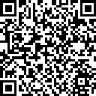

The NEXT LEVEL NOW Collaborative…
Become a Member
of our Next Level Now Community of Practice on WorkforceGPS!
Submit Workforce Related
Questions or Technical Assistance Requests
Melissa Aguilar-Southard
  Director and SME - Safal Partners
    Melissa.Aguilar-Southard@safalpartners.com
Judy Blanchard
  Project Manager - Safal Partners
    Judy.Blanchard@safalpartners.com
Submit Workforce Related
Promising Practices

Slide 3
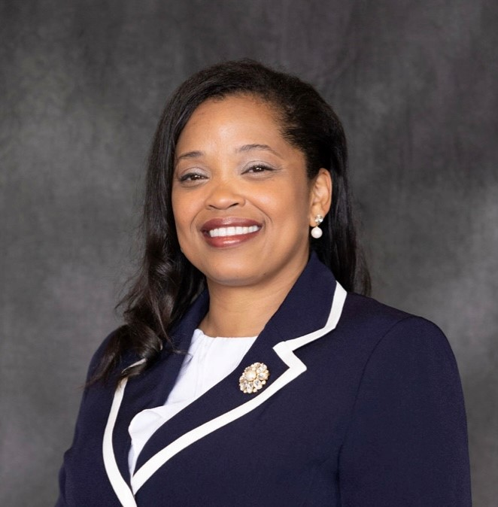

About the Presenter
Zaskia Ruiz
EVP & Chief Operating Officer
KRA Corporation
(she/her/hers/ella)

Slide 4
Fiscal Virtual Academy
Session 1: Fiscal Resources: Maximizing Resources for Effective Fiscal Management
Session 2: Financial Management: Strategies for Effective Fiscal Oversight
Session 3: Strengthening Internal Controls: Enhancing Accountability and Mitigating Risks
Session 4: Indirect and Direct Costs for Effective Budgeting & Resource Allocation
Session 5: Differentiating Administrative and Programmatic Costs - Best Practices for Budgeting and Financial Management Purposes
Session 6: Procurement Standards: Streamlining Processes for Effective Resource Acquisition
Session 7: Navigating Financial Reporting: Best Practices for Compliance and Transparency
Session 8: Audit Requirements: Ensuring an Audit Ready Environment

Slide 5
Fiscal Resources Learning Objectives
To equip participants with the knowledge and skills necessary to optimize financial resources within their organization:
  Understand the fiscal resources that govern the appropriate use for the funding source.
  Explore online tools and technologies that can streamline financial management processes.
  Develop an action plan to organize and integrate financial resources into company policies and procedures.
  Learn strategies for incorporate fiscal resources into training plan for fiscal staff and others within the organization.
  Develop an action plan for organizing required resources.
  Explore strategies that promote collaboration, communication and information share within your organization.
TIPS for SUCCESS?
Write Down Questions
Organize Resources
Watch Again
Dig Further

Slide 6

What’s the Purpose?
What’s the vision/mission of the organization?
What’s the vision/mission of the grantor(client)?
What’s the purpose of the funding source(s)?
What role do you play in achieving success?

Slide 7
What Type of Organization Do You Represent?
Federal Entity
State
Sub-recipient/Other
Local Board

Slide 8

What is Fiscal Management in Workforce Development?

Slide 9
Fiscal Management in Workforce Development
WHAT IS FISCAL MANAGEMENT?
Refers to the process of planning, organizing, directing and controlling financial resources in order to achieve specific goals and objectives. It involves the effective and efficient management of funds, budgeting, financial decision-making, and the overall financial health of the organization.
WHAT IS WORKFORCE DEVELOPMENT?
  Refers to a comprehensive set of strategies, initiatives and programs aimed at improving the knowledge, skills and abilities of individuals in the workforce. It promotes employment by using a reciprocal approach of addressing the needs of both job seekers and employers. It focuses on enhancing the employability and productivity of workers, as well as meeting the evolving needs of industries and sectors.

Slide 10
1. § 200.302 Financial Management
(a) Each State must expend and account for the Federal award in accordance with State laws and procedures for expending and accounting for the State's funds. All recipient and subrecipient financial management systems, including records documenting compliance with Federal statutes, regulations, and the terms and conditions of the Federal award, must be sufficient to permit the preparation of reports required by the terms and conditions; and tracking expenditures to establish that funds have been used in accordance with Federal statutes, regulations, and the terms and conditions of the Federal award. See § 200.450.

Slide 11
2. § 200.302 Financial Management
(b) The recipient's and subrecipient's financial management system must provide for the following (see §§ 200.334, 200.335, 200.336, and 200.337)
  Identification of all Federal awards received and expended and the Federal programs under which they were received.
  Accurate, current, and complete disclosure of the financial results of each Federal award or program in accordance with the reporting requirements in §§ 200.328 and 200.329.
  Maintaining records that sufficiently identify the amount, source, and expenditure of Federal funds for Federal awards.

Slide 12
3. § 200.302 Financial Management
  Effective control over and accountability for all funds, property, and assets.
  Comparison of expenditures with budget amounts for each Federal award.
  Written procedures to implement the requirements of § 200.305.
  Written procedures for determining the allowability of costs in accordance with subpart E and the terms and conditions of the Federal award.

Slide 13
1. 20 CFR § 679.420 - What are the functions of the local fiscal agent?
(a) In order to assist in administration of the grant funds, the chief elected official or the Governor, where the Governor serves as the local grant recipient for a local area, may designate an entity to serve as a local fiscal agent. Designation of a fiscal agent does not relieve the chief elected official or Governor of liability for the misuse of grant funds. If the CEO designates a fiscal agent, the CEO must ensure this agent has clearly defined roles and responsibilities.

Slide 14
2. 20 CFR § 679.420 - What are the functions of the local fiscal agent?
(b) In general, the fiscal agent is responsible for the following functions:
    Receive funds.
    Ensure sustained fiscal integrity and accountability for expenditures of funds in accordance with Office of Management and Budget circulars, WIOA and the corresponding Federal Regulations and State policies.
    Respond to audit financial findings.
    Maintain proper accounting records and adequate documentation.
    Prepare financial reports.
    Provide technical assistance to subrecipients regarding fiscal issues.

Slide 15
3. 20 CFR § 679.420 - What are the functions of the local fiscal agent?
(c) At the direction of the Local WDB or the State WDB in single-area States, the fiscal agent may have the following additional functions:
    Procure contracts or obtain written agreements.
    Conduct financial monitoring of service providers.
    Ensure independent audit of all employment and training programs.

Slide 16
In Summary…
Policies and Procedures must comply with the requirements.
Financial Systems must have the ability to track funds separately in the financial system (expenses, revenues, cash flows, assets, etc.).
Financial Transactions must be supported with documentation.
Internal Controls must safeguard assets and personally identifiable information(PPI) and prohibit a single person from having sole control of assets.
Procurement guidelines must be adhered to for purchases.
Monitor financial activities for service providers and contracts issued.
Financial Reports must produce accurate (verified) results.
Audit requirements must be adhered to.

Slide 17

What is Required?
Fiscal Resources

Slide 18
Rules, Regulations, and Guidelines
Request for Proposal (RFP)/Grant Application/Funding Opportunity Announcement (FOA)
Assistance Listings (formerly Catalog of Federal Domestic Assistance (CFDA) numbers) are the publicly available listings of Federal assistance programs (WIOA Adult 17.258, WIOA Youth 17.259, WIOA Dislocated Worker 17.278).
Compliance Supplement - used by auditors to test programmatic and financial compliance – Sample compliance supplement/Grid from the compliance
Enabling Statute - the “Act”, signed into law/existence (WIOA, etc.).
Implementing regulations located at 20 CFR 600-699.
TAKE A MOMENT TO LOCATE THESE RESOURCES!

Slide 19
Rules, Regulations, and Guidelines (continued)
The Uniform Guidance (2 CFR § 200)
Technical Corrections and DOL adoption of Uniform Guidance published 12/19/2014 at 2 CFR 2900
DOL/State/Agency Policies/Monitoring Guide
Agreement Terms
TAKE A MOMENT TO LOCATE THESE RESOURCES!

Slide 20

Put Into Action!
Comprehensive List of Required Resources
Policy vs. Procedures
Enterprise Resource Planning Software
Staff Development and Training
Ongoing Communication
Continuous Quality Improvement

Slide 21
Policy vs. Desk Procedure
Policy - A statement of intent and must be implemented as a procedure or protocol.
Procedure - an established or official way of implementing the policy These are the series of steps, method, system, strategy, way, approach, formula, mechanism, methodology, drill and practice

Slide 22
What Systems are You Currently Using?
Procurement
Sign Contracts
Time record collection (timesheets)
Payroll
Accounts Payable
Accounting
Banking
Storage of Confidential Information
Storage of Company Assets
Other?
Record Time
Calculate Earnings
Authorize Pay
Store Records
  Are these systems integrated?
  Do they support a sound internal control environment?
  Enterprise Resource Planning (ERP) is a software system that integrates all the essential business processes of an organization.

Slide 23
Types of Training
Workshops/seminars (can be costly)
Group setting onsite
One-on-One
Self-guided (reading, fiscal virtual academy, etc.)
Consider learning style, current expertise of staff and budget
Must be on-going (rules change, technology changes)

Slide 24
Implementing Training and Development
Award Orientation/Overview – develop a checklist of all resources that fiscal staff should review and have access to.
Training Timeline
How long does it take to master fiscal management for workforce development?

Slide 25
Implementing Training and Development (continued)
In-person (or virtual) tour of center where services are delivered.
Share success stories and achievements of businesses and job-seekers.
Understanding the impact and importance of your function to the big puzzle.
Assign research projects for staff to report on.
Cross Train
Report on summary of topics learned from recent conferences/virtual academy attended
Make good use of staff meetings – include quizzes, polls, etc.
Networking – reach out to colleagues in other organizations

Slide 26
COMING UP…
Session 2:
Financial Management: Strategies for Effective Fiscal Oversight
Thank You!

