Slide 1


Virtual Fiscal Academy
Financial Management:
Strategies for Effective Fiscal Oversight
Session #2

Slide 2
Brought to You by the…
Next Level Now Collaborative

Slide 3
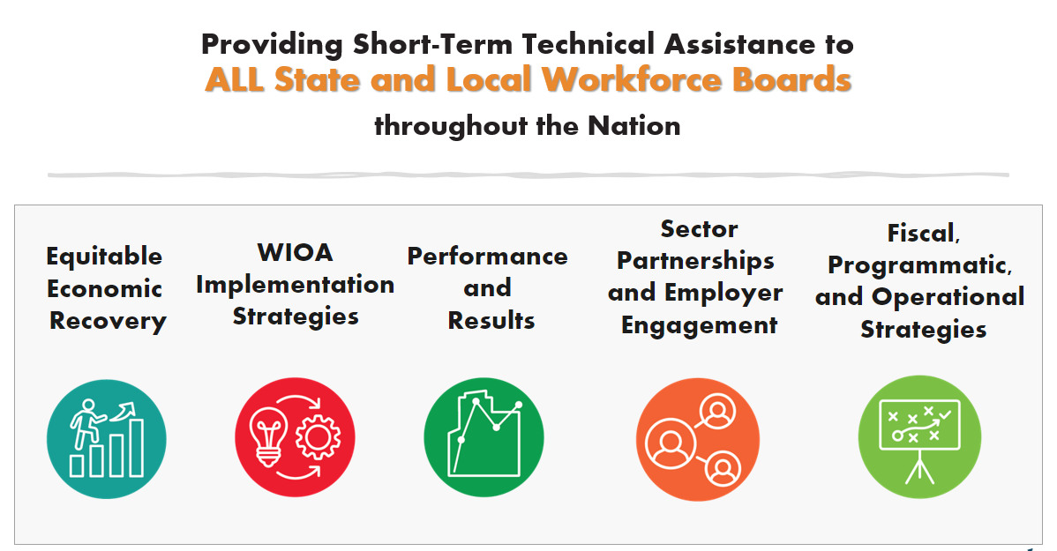






Next Level Now Collaborative...
U.S. Department of Labor, Employment & Training
Administration (ETA)
For More Info on NLN Community…

Slide 4
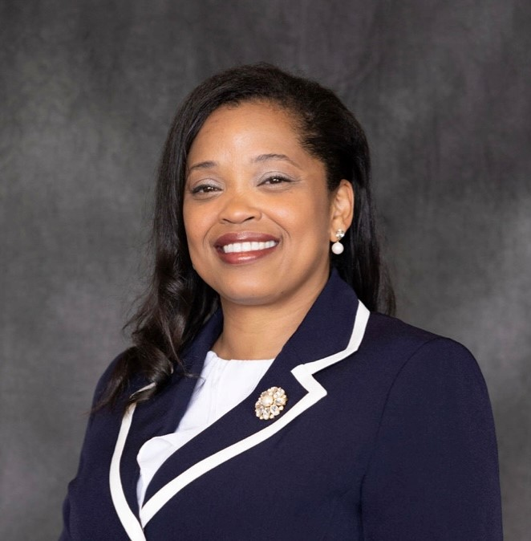

About the Presenter
Zaskia Ruiz
EVP & Chief Operating Officer
KRA Corporation
(she/her/hers/ella)

Slide 5
Fiscal Virtual Academy
Session 1: Fiscal Resources: Maximizing Resources for Effective Fiscal Management
Session 2: Financial Management: Strategies for Effective Fiscal Oversight
Session 3: Strengthening Internal Controls: Enhancing Accountability and Mitigating Risks
Session 4: Indirect and Direct Costs for Effective Budgeting & Resource Allocation
Session 5: Differentiating Administrative and Programmatic Costs - Best Practices for Budgeting and Financial Management Purposes
Session 6: Procurement Standards: Streamlining Processes for Effective Resource Acquisition
Session 7: Navigating Financial Reporting: Best Practices for Compliance and Transparency
Session 8: Audit Requirements: Ensuring an Audit Ready Environment

Slide 6
Fiscal Management Learning Objectives
To provide participants with the essential knowledge and skills to excel in financial management and ensure effective fiscal oversight within their organization:
  Understand the role of financial management in achieving organizational goals and ensuring fiscal responsibility.
  Understand the requirements of the Uniform Guidance (2 CFR 200)
  Learn techniques for budgeting, forecasting, and cash flow management to optimize resource allocation.
  Gain insights into financial analysis and performance metrics to evaluate organizational financial health and identify areas for improvement.
  Explore strategies for cost control and expense reduction without compromising quality.
  Discover approaches to financial decision-making that align with organizational objectives and priorities.
  Understand the role of financial reporting and transparency in effective fiscal oversight.
TIPS for SUCCESS?
Write Down Questions
Organize Resources
Watch Again
Dig Further

Slide 7

Reflection from
Previous Session…
What’s our purpose?
What is fiscal management in workforce development?
What rules, regulations and guidelines apply?

Slide 8
Fiscal Management in Workforce Development
WHAT IS FISCAL MANAGEMENT?
Refers to the process of planning, organizing, directing and controlling financial resources in order to achieve specific goals and objectives. It involves the effective and efficient management of funds, budgeting, financial decision-making, and the overall financial health of the organization.
WHAT IS WORKFORCE DEVELOPMENT?
  Refers to a comprehensive set of strategies, initiatives and programs aimed at improving the knowledge, skills and abilities of individuals in the workforce. It promotes employment by using a reciprocal approach of addressing the needs of both job seekers and employers. It focuses on enhancing the employability and productivity of workers, as well as meeting the evolving needs of industries and sectors.

Slide 9
§ 200.302 Financial Management Summary…
Policies and Procedures must comply with the requirements.
Financial Systems must have the ability to track funds separately in the financial system (expenses, revenues, cash flows, assets, etc.).
Financial Transactions must be supported with documentation.
Internal Controls must safeguard assets and prohibit a single person from having sole control.
Procurement Guidelines must be adhered to for purchases.
Monitor financial activities for service providers and contracts issued.
Financial Reports must produce accurate (verified) results.
Audit Requirements must be adhered to.

Slide 10
Rules, Regulation, and Guidelines
Request for Proposal (RFP)/Grant Application/Funding Opportunity Announcement (FOA)
Assistance Listings (formerly Catalog of Federal Domestic Assistance (CFDA) numbers) are the publicly available listings of Federal assistance programs (WIOA Adult 17.258, WIOA Youth 17.259, WIOA Dislocated Worker 17.278).
Compliance Supplement - used by auditors to test programmatic and financial compliance – Sample compliance supplement/Grid from the compliance
Enabling Statute - the “Act”, signed into law/existence (WIOA, etc.).
Implementing regulations located at 20 CFR 600-699.
TAKE A MOMENT TO LOCATE THESE RESOURCES

Slide 11
Rules, Regulation, and Guidelines (continued)
The Uniform Guidance (2 CFR § 200)
Technical Corrections and DOL adoption of Uniform Guidance published 12/19/2014 at 2 CFR 2900
DOL/State/Agency Policies/Monitoring Guide
Agreement Terms
TAKE A MOMENT TO LOCATE THESE RESOURCES

Slide 12

Financial Statements – The Big Picture
The financial “report card” for the organization.
What do these say about the organization, contract or project?
How can these be used to make decisions?

Slide 13
Three Financial Reports (The Big Picture)
Balance Sheet
(Statement of Financial Position)
Profit & Loss Statement
(Statement of Activity)
The Balance Sheet displays the company’s total assets and how the assets are financed, either through either debt or equity.
It can also be referred to as a statement of net worth or a statement of financial position.
The balance sheet is based on the fundamental equation: Assets = Liabilities + Equity (Net Assets).
The Statement of Cash Flows report the cash generated and spent during a specific period of time (e.g., a month, quarter, or year).
The statement of cash flows acts as a bridge between the Profit & Loss Statement and the Balance Sheet by showing how money moved in and out of the business
Three Sections: Operating, Financing and Investing
Non-Profit Organizations:
Not small businesses. Net Assets (profits) are reinvested into the organization
to further its mission rather than being owned by the owners or shareholders.

Slide 14
Three Financial Reports (The Big Picture) continued
Statement of Cash Flows
A Profit & Loss Statement (P&L) shows their profit and loss over a period of time. The profit or loss (Net Assets) is determined by taking all revenues and subtracting all expenses from both operating and non-operating activities.
The statement displays the company’s revenue, direct costs, gross profit, indirect expenses, other expenses and income, taxes paid, and net profit in a coherent and logical manner.
Non-Profit Organizations:
Not small businesses. Net Assets (profits) are reinvested into the organization
to further its mission rather than being owned by the owners or shareholders.

Slide 15


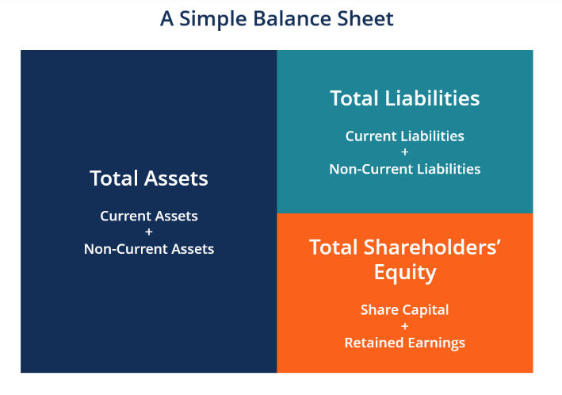
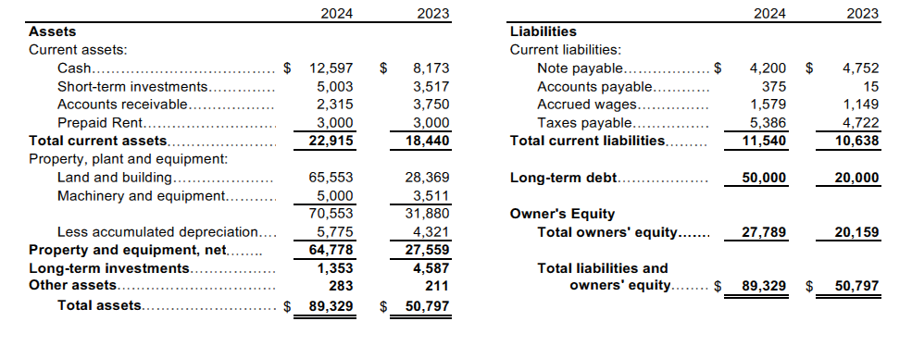

Simple Balance Sheet
Non-Profit Organization:
Balance Sheet = Statement for Financial Position
Total Shareholders’ Equity = Net Assets

Slide 16
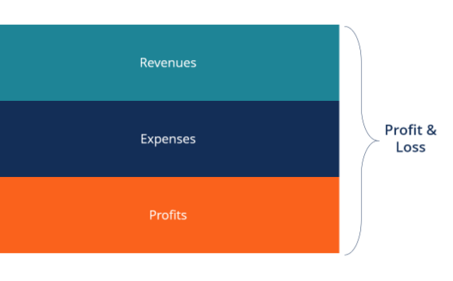
Simple Profit & Loss Statement
 | 2024 |  | 2023
Contract revenue
Professional Consulting | $ 600,000 |  | $ 500,000
Workforce Development Services | 28,250,946 |  | 25,000,837
Other Services | 1,284,000 |  | 1,200,000
Total contract revenue | 30,134,946 |  | 26,700,837
Direct contract costs
Direct labor | 22,914,578 |  | 20,459,445
Public outreach | 25,000 |  | 20,000
Rent | 370,800 |  | 360,000
Utilities | 65,108 |  | 62,008
Insurance | 128,750 |  | 125,000
Consultants | 18,540 |  | 18,000
Office supplies | 81,900 |  | 78,000
Other contract costs | 690,098 |  | 663,008
Total direct contract costs | 24,294,775 |  | 21,785,461
Gross profit | 5,840,171 |  | 4,915,376
Indirect costs | 2,839,963 |  | 2,704,727
Operating Income | 3,000,207 |  | 2,210,649
Non-Operating Gains (Losses)
Interest Income, Net | 92,000 |  | 80,000
Loss on Sale of Assets | -4,800 |  | 0
Total Non-Operating Gains (Losses) | 87,200 |  | 80,000
Provision for Income Taxes | 64,000 |  | 27,000
Net Income (Loss) | $ 3,023,407 |  | $ 2,263,649
Non-Profit Organization:
Profit & Loss Statement = Statement of Activities
Profits/Loss = Net Assets
*Should tie to the Schedule of Expenditures of Federal Awards (SEFA) and Single Audit, discussed in session 8.

Slide 17
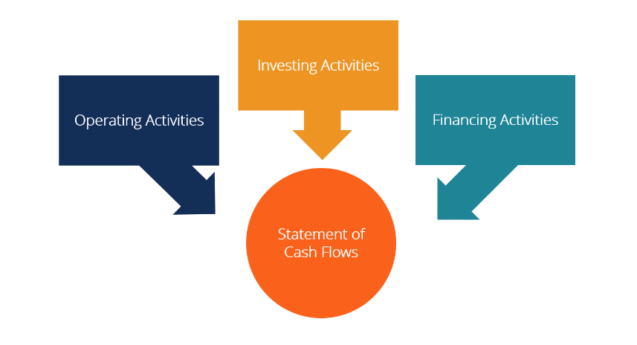
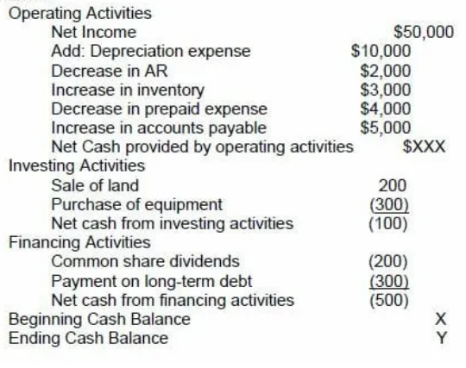
Simple Statement of Cash Flows
Cash from operating activities can be compared to the company’s net income to determine the quality of earnings. If cash from operating activities is higher than net income, earnings are said to be of “high quality.”
This statement is useful to investors because, under the notion that cash is king.

Slide 18
Financial Terminology
Revenue
It is the total amount of income generated by providing services related the agree-upon terms in the project contract.
It is often referred to as the "top line" because it sits at the top of the Profit and Loss Statement.
The pace % at which the project consumes its allocated revenue budget, is referred as the burn rate in project management.
Revenue after all expenses (direct and indirect) is net income (net assets).
Expenses (Costs)
These are the cost of operations that a company incurs to generate revenue.
It is simply defined as the cost one is required to spend on obtaining something.
As the popular saying goes, “it costs money to make money.”
Common expenses include payments to suppliers, employee wages, leases, and equipment.
An expense incurred but not yet paid is called an accrual.
Expenses can be direct and indirect

Slide 19
Where Does the Revenue Come From?
Federal Entities
State
Local Boards
Private/Other

Slide 20

What Are Financial Awards (Grants)?
Funds provided to State and Local Governments, and other entities to carry-out federal programs.
Money given to support specific purposes, topics or causes.
Payment for services to be provided with legal obligations to services outlined in the grant proposal.
Taxpayer’s Investments

Slide 21
Cost Classification (2 CFR 200.403)
To be allowable under Federal awards, costs must meet the following general criteria:
Be necessary and reasonable for the performance of the Federal award and be allocable thereto under these principles; Prudent person test –what would a reasonable person do in a similar situation?
Conform to any limitations or exclusions set forth in these principles or in the Federal award as to types or amount of cost items;
Be consistent with policies and procedures that apply uniformly to both federally-financed and other activities of the recipient or subrecipient;
Be accorded consistent treatment;

Slide 22
Cost Classification (2 CFR 200.403) continued
To be allowable under Federal awards, costs must meet the following general criteria:
Be determined in accordance with generally accepted accounting principles (GAAP), except, for State and local governments and Indian Tribes only, as otherwise provided for in this part;
Not be included as a cost or used to meet cost sharing requirements of any other federally-financed program in either the current or a prior period. See § 200.306(b);
Be adequately documented;
Administrative closeout costs may be incurred until the due date of the final report(s).

Slide 23
What’s Never Allowable (Billable)?
Alcoholic beverages
Foreign travel
Lobbying
Entertainment
Good and services for personal use
Interest expense
Political activities
Losses, penalties and fines
Legal claims against the Federal government
Donations, contributions, or gifts
General fundraising (wages and other expenses)
And other items based on contractual agreement

Slide 24


Creating a Budget
Seeking Input
Balancing the Budget

Slide 25
Updating the Budget with Actuals and Forecast
Budgeting
Budget to Actuals
Financial plan for the performance period
Using data to evaluate predictions
Why Budget? Establishes how much funding is needed to sustain operations and achieve performance goals. Creates an initial roadmap towards success.
What to Include?
  Staffing
  Other expenses
  Indirect
  Start-up costs, and potential unrecoverable costs.
  Revenue goals
How Long it Should Cover? The entire period of performance
Why Budget to Actuals? Check your performance against estimates and allow an opportunity to make timely adjustments.
What to Include?
  Actuals including accruals
  % of progress towards revenue and expense goals.
  Justification for significant variances
How Often Should it Be Done? Monthly

Slide 26
Updating the Budget with Actuals and Forecast continued
Forecasting
Predictions for the remaining period of performance.
Why Forecast? Predict future needs and make data-driven business decisions.
What to Include? Forecast based on known factors, and make allowances for unexpected fluctuations (vacancies, inflation, unliquidated obligations, etc.).
How Far Ahead to Forecast? For the remainder of the performance period broken down into monthly amounts.

Slide 27
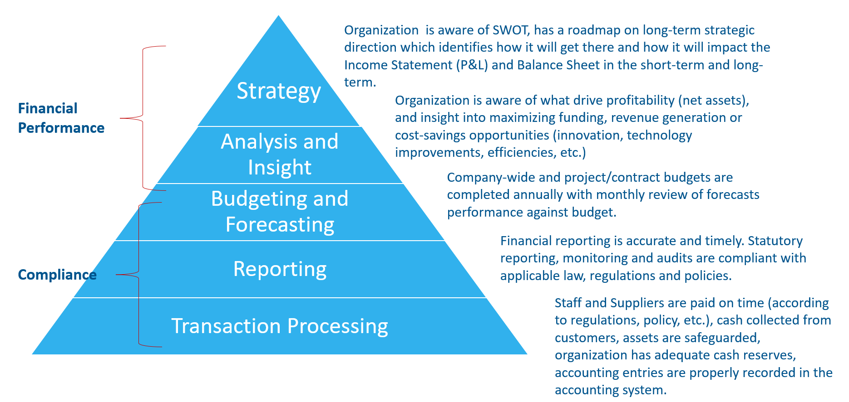
1. Revisit Your Financial Management Strategy

Slide 28

2. Revisit Your Financial Management Strategy
Financial Performance
Strategy: Organization is aware of SWOT, has a roadmap on long-term strategic direction which identifies how it will get there and how it will impact the Income Statement (P&L) and Balance Sheet in the short-term and long-term.
Analysis and Insight: Organization is aware of what drive profitability (net assets), and insight into maximizing funding, revenue generation or cost-savings opportunities (innovation, technology improvements, efficiencies, etc.)
Budgeting and Forecasting: Company-wide and project/contract budgets are completed annually with monthly review of forecasts performance against budget.
Strategy
Analysis and Insight
Budgeting and Forecasting

Slide 29
3. Revisit Your Financial Management Strategy
Budgeting and Forecasting: Company-wide and project/contract budgets are completed annually with monthly review of forecasts performance against budget.
Reporting: Financial reporting is accurate and timely. Statutory reporting, monitoring and audits are compliant with applicable law, regulations and policies.
Transaction Processing: Staff and Suppliers are paid on time (according to regulations, policy, etc.), cash collected from customers, assets are safeguarded, organization has adequate cash reserves, accounting entries are properly recorded in the accounting system.
Compliance
Budgeting and Forecasting
Reporting
Transaction Processing

Slide 30





For More Information on the NEXT LEVEL NOW Collaborative…
Become a Member
of our Next Level Now Community of Practice on WorkforceGPS!
Submit Workforce Related
Questions or
Technical Assistance Requests
Melissa Aguilar-Southard
  Director and SME - Safal Partners
    Melissa.Aguilar-Southard@safalpartners.com
Judy Blanchard
  Project Manager - Safal Partners
    Judy.Blanchard@safalpartners.com
Submit Workforce Related
Promising Practices

Slide 31
Coming Up Next:
Session #3-
Strengthening Internal Controls: Enhancing Accountability and Mitigating Risks
Thank You!

