Slide 1


Virtual Fiscal Academy
Strengthening Internal Controls: Enhancing Accountability and Mitigating Risks
Session #3

Slide 2
Brought to You by the…
Next Level Now Collaborative

Slide 3
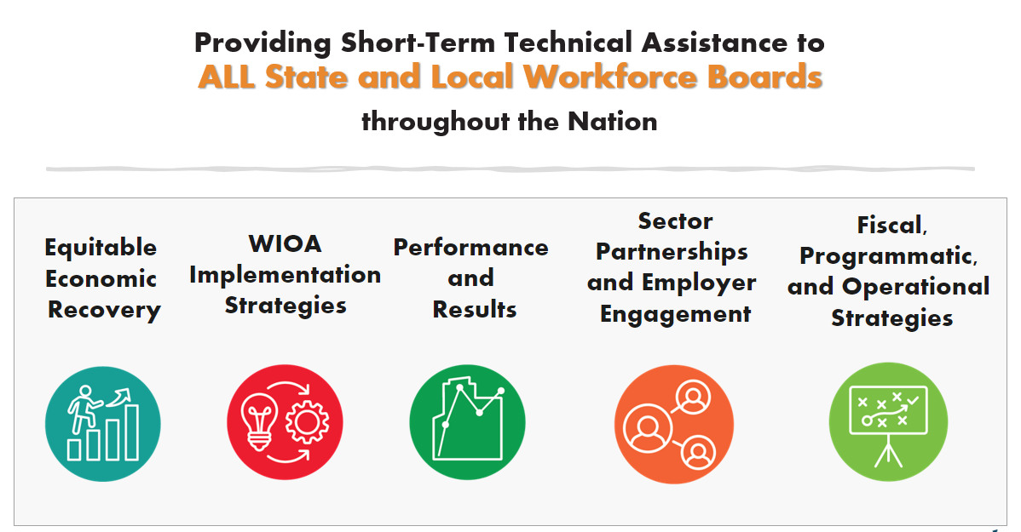




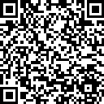

Next Level Now Collaborative...
U.S. Department of Labor, Employment & Training
Administration (ETA)
For More Info on NLN Community…

Slide 4
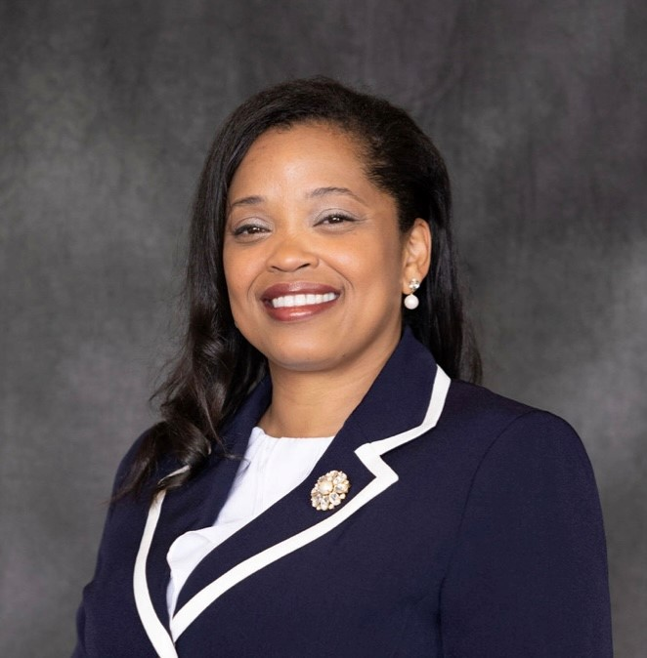
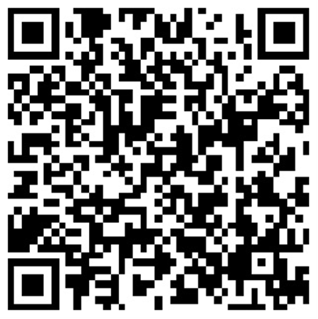
About the Presenter
Zaskia Ruiz
EVP & Chief Operating Officer
KRA Corporation
(she/her/hers/ella)

Slide 5
Fiscal Virtual Academy
Session 1: Fiscal Resources: Maximizing Resources for Effective Fiscal Management
Session 2: Financial Management: Strategies for Effective Fiscal Oversight
Session 3: Strengthening Internal Controls: Enhancing Accountability and Mitigating Risks
Session 4: Indirect and Direct Costs for Effective Budgeting & Resource Allocation
Session 5: Differentiating Administrative and Programmatic Costs - Best Practices for Budgeting and Financial Management Purposes
Session 6: Procurement Standards: Streamlining Processes for Effective Resource Acquisition
Session 7: Navigating Financial Reporting: Best Practices for Compliance and Transparency
Session 8: Audit Requirements: Ensuring an Audit Ready Environment

Slide 6
Internal Controls Learning Objectives
To provide participants with the knowledge and skills to establish and enhance robust internal control systems within their organization:
  Understand the fundamental concepts and principles of internal controls and their significance in promoting accountability and mitigating risks.
  Identify common control weaknesses and vulnerabilities within organizational processes.
  Learn how to assess and evaluate the effectiveness of existing internal control systems.
  Explore strategies for designing and implementing strong internal control procedures.
  Understand the role of segregation of duties in preventing fraud and enhancing accountability.
  Understand the importance of internal controls in compliance with regulatory requirements and industry standards.
  Explore best practices for establishing a culture of accountability and ethical behavior within the organization.
TIPS for SUCCESS?
Write Down Questions
Organize Resources
Watch Again
Dig Further

Slide 7

Reflection from
Previous Session…
What’s our purpose?
What is fiscal management in workforce development?
What rules, regulations and guidelines apply?

Slide 8
Fiscal Management in Workforce Development
WHAT IS FISCAL MANAGEMENT?
Refers to the process of planning, organizing, directing and controlling financial resources in order to achieve specific goals and objectives. It involves the effective and efficient management of funds, budgeting, financial decision-making, and the overall financial health of the organization.
WHAT IS WORKFORCE DEVELOPMENT?
  Refers to a comprehensive set of strategies, initiatives and programs aimed at improving the knowledge, skills and abilities of individuals in the workforce. It promotes employment by using a reciprocal approach of addressing the needs of both job seekers and employers. It focuses on enhancing the employability and productivity of workers, as well as meeting the evolving needs of industries and sectors.

Slide 9
§ 200.302 Financial Management Summary…
Policies and Procedures must comply with the requirements.
Financial Systems must have the ability to track funds separately in the financial system (expenses, revenues, cash flows, assets, etc.).
Financial Transactions must be supported with documentation.
Internal Controls must safeguard assets and prohibit a single person from having sole control.
Procurement Guidelines must be adhered to for purchases.
Monitor financial activities for service providers and contracts issued.
Financial Reports must produce accurate (verified) results.
Audit Requirements must be adhered to.

Slide 10
Rules, Regulation, and Guidelines
Request for Proposal (RFP)/Grant Application/Funding Opportunity Announcement (FOA)
Assistance Listings (formerly Catalog of Federal Domestic Assistance (CFDA) numbers) are the publicly available listings of Federal assistance programs (WIOA Adult 17.258, WIOA Youth 17.259, WIOA Dislocated Worker 17.278).
Compliance Supplement - used by auditors to test programmatic and financial compliance – Sample compliance supplement/Grid from the compliance
Enabling Statute - the “Act”, signed into law/existence (WIOA, etc.).
Code of Federal Regulation (implementing regulations 20 CFR 600-699 )
TAKE A MOMENT TO LOCATE THESE RESOURCES

Slide 11
Rules, Regulation, and Guidelines (continued)
The Uniform Guidance (2 CFR § 200)
Technical Corrections and DOL adoption of Uniform Guidance published 12/19/2014 at 2 CFR 2900
DOL/State/Agency Policies/Monitoring Guide
Agreement Terms
TAKE A MOMENT TO LOCATE THESE RESOURCES

Slide 12
Cost Classification (2 CFR 200.403)
To be allowable under Federal awards, costs must meet the following general criteria:
Be necessary and reasonable for the performance of the Federal award and be allocable thereto under these principles; Prudent person test –what would a reasonable person do in a similar situation?
Conform to any limitations or exclusions set forth in these principles or in the Federal award as to types or amount of cost items;
Be consistent with policies and procedures that apply uniformly to both federally-financed and other activities of the recipient or subrecipient;

Slide 13
Cost Classification (2 CFR 200.403) continued
To be allowable under Federal awards, costs must meet the following general criteria:
Be accorded consistent treatment;
Be determined in accordance with generally accepted accounting principles (GAAP), except, for State and local governments and Indian Tribes only, as otherwise provided for in this part;
Not be included as a cost or used to meet cost sharing requirements of any other federally-financed program in either the current or a prior period. See § 200.306(b);
Be adequately documented;
Administrative closeout costs may be incurred until the due date of the final report(s).

Slide 14
What’s Never Allowable (Billable)?
Alcoholic beverages
Foreign travel
Lobbying
Entertainment
Good and services for personal use
Interest expense
Political activities
Losses, penalties and fines
Legal claims against the Federal government
Donations, contributions, or gifts
General fundraising (wages and other expenses)
And other items based on contractual agreement

Slide 15

“Internal” Controls – Trust but Verify!
What are effective internal controls?
How do we ensure assets are safeguarded?
Who is initiating, reviewing and approving transactions?
Who has custody of the asset, and who checks?

Slide 16
Internal Control Requirements (2 CFR 200.303)
The recipient and subrecipient must:
Establish, document, and maintain effective internal control over the Federal award that provides reasonable assurance that the recipient or subrecipient is managing the Federal award in compliance with Federal statutes, regulations, and the terms and conditions of the Federal award. Internal controls should align with “Standards for Internal Control in the Federal Government” issued by the Comptroller General of the United States or the “Internal Control-Integrated Framework” issued by the Committee of Sponsoring Organizations of the Treadway Commission (COSO).
Comply with the U.S. Constitution, Federal statutes, regulations, and the terms and conditions of the Federal award.
Evaluate and monitor the recipient's or subrecipient's compliance with statutes, regulations, and the terms and conditions of Federal awards.
Take prompt action when instances of noncompliance are identified.
Take reasonable cybersecurity and other measures to safeguard information including protected personally identifiable information (PII) and other types of information.

Slide 17
Internal Controls Cont. - What is Needed?
Written Policies and Procedures – availability and assessment (relevant and up to date?)
Operations in compliance with policies – system of checks and balances
Safeguarding of Assets and Confidential Information
Segregation of Duties (SOD)
Designation of Authority/Approval
“Reasonable Assurance”
Operations meets applicable laws, regulations and program agreements
How does the organization “ensure” that all staff are aware of financial requirements?

Slide 18
Segregation of Duties (SOD)
A system of internal controls within an organization that acts as the first line of defense when protecting organizations against noncompliance and fraudulent activity.
SOD is concept that separates “incompatible duties” so that 1 person doesn’t have all 3 duties (the ARC of SOD):
  Authorization = approving
  Recordkeeping = keep track of the asset/liability
  Custody = holding the asset or access to asset

Slide 19
Accounts Payable Cycle
Determination of Goods Required
Procurement Process
Search for Suppliers
Request for Proposal
Review Receiving Quotation
Negotiation
Purchase Order
The Supplier’s Confirmation
Supplier’s Duty
Successful Delivery of Goods/Services
Invoice Entry
Payment

Slide 20
Accounts Payable Cycle (continued)
A collective process of identifying, analyzing and recording the accounting events of a company. It is a standard 8-step process that begins when a transaction occurs and ends with its inclusion in the financial statements.
1. Identify Transactions
8. Close Books
2. Record Journal Entries
7. Financial Statements
3. Post Ledger Entries
6. Adjusted Trial Balance
4. Unadjusted Trial Balance
5. Adjusted Entries

Slide 21
What Systems are You Currently Using?
Procurement
Sign Contracts
Time record collection (timesheets)
Payroll
Accounts Payable
Accounting
Banking
Storage of Confidential Information
Storage of Company Assets
Other?
Record Time
Calculate Earnings
  Are these systems integrated?
  Do they support a sound internal control environment?
  Enterprise Resource Planning (ERP) is a software system that integrates all the essential business processes of an organization.
Authorize Pay
Store Records

Slide 22





Personnel and Systems Must Support SOD
Review Organizational Chart and Individual Job Descriptions
Review Departmental Processes and Approval Authority and ensure that appropriate personnel are assigned.
Telecommuting and Confidentiality Agreements
Inventory of Assets (equipment, cash equivalents, etc.)
Cyber Security coverage and firewalls
Phishing Attacks Soar 220% During COVID-19 Peak as Cybercriminal Opportunism Intensifies

Slide 23
Internal Controls - Who Checks?
Funder/Client/Pass-through Entity – During Invoice Review, etc.
Funder/Client’s Monitor(s) – Required per WIOA (Sec. 183 & 184) and Uniform Guidance (2 CFR 200.329). The recipient and subrecipient must monitor its activities under Federal Awards to assure compliance with applicable Federal requirements and performance expectations are being achieved.
Auditors – Required for Non-Federal entities that spend at least $750,000 in federal award expenditures (annually). Increasing to $1,000,000 (per Uniform Guidance revisions, Final Rule April 22, 2024, effective October 1, 2024).
To “Monitor” = to watch, observe, listen to or check (something) for a special purpose over a period of time.
OIG, DOL, State, etc. Millions of dollars were put at risk during and post pandemic.

Slide 24
What Went Wrong?
Cash Management – Expenditures not properly documented
Sub-recipient Monitoring – Procedures not in place for financial or performance reporting
Questioned Costs – expenses not for allowable project/program activities; Expenditures outside of the period of performance; Unallowable costs such as late fees, penalties and excess compensation charged to the program/agreement.
Reporting – Required reporting not filed on time or not traceable to grantee’s financial system; Procedures not in place for financial or performance reporting.
Lack of internal controls – one single employee has control over entire process.
Embezzlement

Slide 25

Remedies for Non-Compliance (2 CFR 200.339)
Temporarily withhold cash payments
Disallow costs
Wholly or partly suspend or terminate the Federal Award
Initiate suspension or debarment proceedings
Withhold further awards
Take other legal remedies

Slide 26
Sample Segregation of Duties
Tasks/Job Title | President & CEO | Program Director | Program Assistant | Accounting Manager | Director, Finance, Accounting and Compliance | Project Budget Analyst | Senior Accountant | Associate Accountant
Approves Purchase Orders
Verifies Receipt of Order
Authorizes disbursement
Prepares Checks to Vendors
Signs Checks
Custodian of Check Signing Device
Custodian of Blank Checks
Prepares Checks for Payment
Distributes Checks
Reviews Checks Post Printing
Post Disbursement
Computes Cost Allocations
Prepares request for funds/Client Billing
Receives Cash
Posts Receipts
Deposits Receipts
Maintains General Ledger
Prepares Financial Statements
Approves Financial Reports

Slide 27
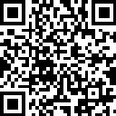


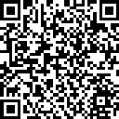

For More Information on the NEXT LEVEL NOW Collaborative…
Become a Member
of our Next Level Now Community of Practice on WorkforceGPS!
Submit Workforce Related
Questions or
Technical Assistance Requests
Melissa Aguilar-Southard
  Director and SME - Safal Partners
    Melissa.Aguilar-Southard@safalpartners.com
Judy Blanchard
  Project Manager - Safal Partners
    Judy.Blanchard@safalpartners.com
Submit Workforce Related
Promising Practices

Slide 28
Coming Up Next:
Session #4-
Indirect and Direct Costs for Effective Budgeting & Resource Allocation
Thank You!

