Slide 1


Virtual Fiscal Academy
Indirect and Direct Costs for Effective Budgeting & Resource allocation
Session #3

Slide 2
Brought to You by the…
Next Level Now Collaborative

Slide 3
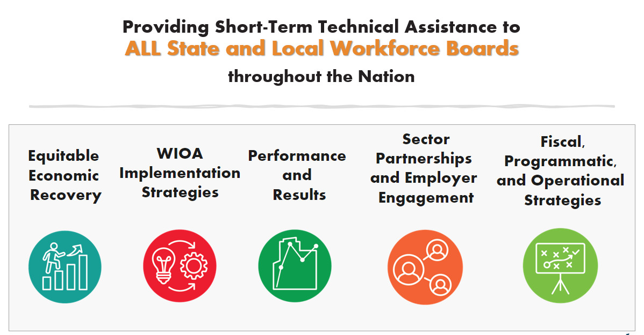




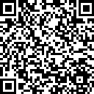

Next Level Now Collaborative...
U.S. Department of Labor, Employment & Training
Administration (ETA)
For More Info on NLN Community…

Slide 4

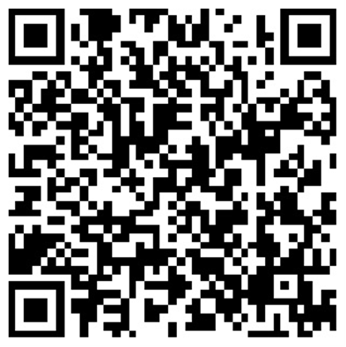
About the Presenter
Zaskia Ruiz
EVP & Chief Operating Officer
KRA Corporation
(she/her/hers/ella)

Slide 5
Fiscal Virtual Academy
Session 1: Fiscal Resources: Maximizing Resources for Effective Fiscal Management
Session 2: Financial Management: Strategies for Effective Fiscal Oversight
Session 3: Strengthening Internal Controls: Enhancing Accountability and Mitigating Risks
Session 4: Indirect and Direct Costs for Effective Budgeting & Resource Allocation
Session 5: Differentiating Administrative and Programmatic Costs - Best Practices for Budgeting and Financial Management Purposes
Session 6: Procurement Standards: Streamlining Processes for Effective Resource Acquisition
Session 7: Navigating Financial Reporting: Best Practices for Compliance and Transparency
Session 8: Audit Requirements: Ensuring an Audit Ready Environment

Slide 6
Indirect and Direct Costs Learning Objectives
To provide participants with an understanding of direct and indirect costs and their impact on budgeting and resource allocation within organizations.
  Understand the distinction between direct and indirect costs and their significance in budgeting and resource allocation.
  Explore the types and examples of direct and indirect costs within different organizational contexts.
  Learn techniques for identifying and categorizing direct and indirect costs accurately.
  Explore strategies for controlling and managing direct and indirect costs to optimize budget utilization.
  Learn how to develop cost allocation plans to allocate indirect costs appropriately.
  Understand the role of cost drivers and cost behavior in analyzing and forecasting direct and indirect costs.
TIPS for SUCCESS?
Write Down Questions
Organize Resources
Watch Again
Dig Further

Slide 7

Reflection from Previous Sessions…
What’s our purpose?
What is Fiscal Management in Workforce Development?
What rules, regulations and guidelines apply?
What are allowable costs?
What’s never allowable under federal awards?

Slide 8
Fiscal Management in Workforce Development
WHAT IS FISCAL MANAGEMENT?
Refers to the process of planning, organizing, directing and controlling financial resources in order to achieve specific goals and objectives. It involves the effective and efficient management of funds, budgeting, financial decision-making, and the overall financial health of the organization.
WHAT IS WORKFORCE DEVELOPMENT?
  Refers to a comprehensive set of strategies, initiatives and programs aimed at improving the knowledge, skills and abilities of individuals in the workforce. It promotes employment by using a reciprocal approach of addressing the needs of both job seekers and employers. It focuses on enhancing the employability and productivity of workers, as well as meeting the evolving needs of industries and sectors.

Slide 9
§ 200.302 Financial Management Summary…
Policies and Procedures must comply with the requirements.
Financial Systems must have the ability to track funds separately in the financial system (expenses, revenues, cash flows, assets, etc.).
Financial Transactions must be supported with documentation.
Internal Controls must safeguard assets and prohibit a single person from having sole control.
Procurement Guidelines must be adhered to for purchases.
Monitor financial activities for service providers and contracts issued.
Financial Reports must produce accurate (verified) results.
Audit Requirements must be adhered to.

Slide 10
Rules, Regulation, and Guidelines
Request for Proposal (RFP)/Grant Application/Funding Opportunity Announcement (FOA)
Assistance Listings (formerly Catalog of Federal Domestic Assistance (CFDA) numbers) are the publicly available listings of Federal assistance programs (WIOA Adult 17.258, WIOA Youth 17.259, WIOA Dislocated Worker 17.278).
Compliance Supplement - used by auditors to test programmatic and financial compliance – Sample compliance supplement/Grid from the compliance
Enabling Statute - the “Act”, signed into law/existence (WIOA, etc.).
Implementing regulations located at 20 CFR 600-699.
TAKE A MOMENT TO LOCATE THESE RESOURCES

Slide 11
Rules, Regulation, and Guidelines (continued)
The Uniform Guidance (2 CFR § 200)
Technical Corrections and DOL adoption of Uniform Guidance published 12/19/2014 at 2 CFR 2900
DOL/State/Agency Policies/Monitoring Guide
Agreement Terms
TAKE A MOMENT TO LOCATE THESE RESOURCES

Slide 12
Cost Classification (2 CFR 200.403)
To be allowable under Federal awards, costs must meet the following general criteria:
Be necessary and reasonable for the performance of the Federal award and be allocable thereto under these principles; Prudent person test –what would a reasonable person do in a similar situation?
Conform to any limitations or exclusions set forth in these principles or in the Federal award as to types or amount of cost items;
Be consistent with policies and procedures that apply uniformly to both federally-financed and other activities of the recipient or subrecipient;
Be accorded consistent treatment;
Be determined in accordance with generally accepted accounting principles (GAAP), except, for state and local governments and Indian tribes only, as otherwise provided for;
Not be included as a cost or used to meet cost sharing or matching requirements of any other federally-financed program in either the current or a prior period; and,
Be adequately documented
Administrative closeout costs may be incurred until the due date of the final report(s).

Slide 13
What’s Never Allowable (Billable)?
Alcoholic beverages
Foreign travel
Lobbying
Entertainment
Good and services for personal use
Interest expense
Political activities
Losses, penalties and fines
Legal claims against the Federal government
Donations, contributions, or gifts
General fundraising (wages and other expenses)
And other items based on contractual agreement

Slide 14

What are direct costs?
What are indirect costs?
What choices are available to recover indirect costs?
What are some examples of indirect vs. direct costs?
Direct and Indirect Costs
Costs Directly and Indirectly contributing to success

Slide 15
Reflection from Session 2 - Simple Profit & Loss Statement
 | 2024 |  | 2023
Contract revenue
Professional Consulting | $ 600,000 |  | $ 500,000
Workforce Development Services | 28,250,946 |  | 25,000,837
Other Services | 1,284,000 |  | 1,200,000
Total contract revenue | 30,134,946 |  | 26,700,837
Direct contract costs
Direct labor | 22,914,578 |  | 20,459,445
Public outreach | 25,000 |  | 20,000
Rent | 370,800 |  | 360,000
Utilities | 65,108 |  | 62,008
Insurance | 128,750 |  | 125,000
Consultants | 18,540 |  | 18,000
Office supplies | 81,900 |  | 78,000
Other contract costs | 690,098 |  | 663,008
Total direct contract costs | 24,294,775 |  | 21,785,461
Gross profit | 5,840,171 |  | 4,915,376
Indirect costs | 2,839,963 |  | 2,704,727
Operating Income | 3,000,207 |  | 2,210,649
Non-Operating Gains (Losses)
Interest Income, Net | 92,000 |  | 80,000
Loss on Sale of Assets | -4,800 |  | 0
Total Non-Operating Gains (Losses) | 87,200 |  | 80,000
Provision for Income Taxes | 64,000 |  | 27,000
Net Income (Loss) | $ 3,023,407 |  | $ 2,263,649
Why are these direct costs?
What makes up indirect costs?

Slide 16
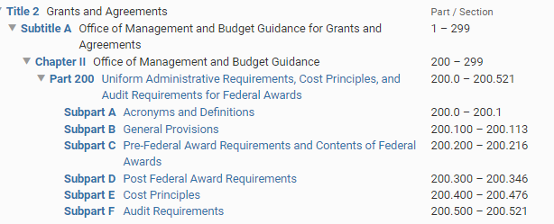

Where can I find this information?
*Google electronic code of federal regulations

Slide 17
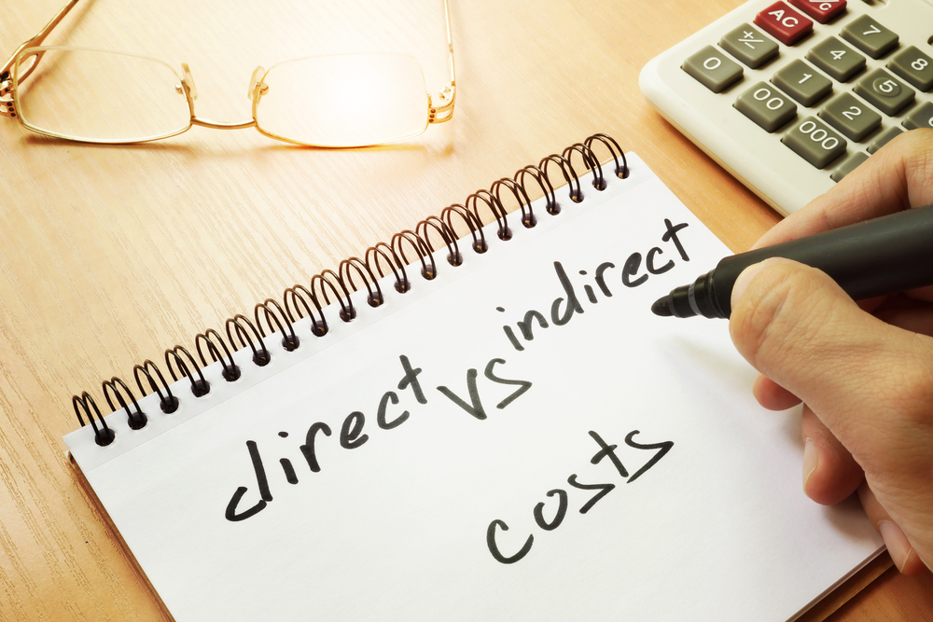
Taking a Deeper Dive into Cost Types
Direct Costs
  Program
  Administrative
Shared Direct Costs
  Program
  Administrative
Indirect Costs
  Program
  Administrative

Slide 18
What are Direct Costs?
Those costs that can be easily identified with a particular cost objective (2 CFR 200.413). Examples are costs that are specific to a single program:
Salaries for a case manager who only works with your grants participants
Square footage of space occupied by the case manager
Supplies used by the case manager
Communications devices, such as a cellphone used by the case manager

Slide 19
1. What are indirect costs?
Costs incurred for common or joint purposes, benefiting more than one cost objective, and are not readily identifiable to a specific cost objective.
Administrative Salaries
Executive Director Salary*
Administrative space and operational expenses
*§ 683.290(a) No funds available under title I of WIOA or the Wagner-Peyser Act may be used by a recipient or subrecipient of such funds to pay the salary and bonuses of an individual, either as direct costs or indirect costs, at a rate in excess of the annual rate of basic pay prescribed for level II of the Executive Schedule under 5 U.S.C. 5313, which can be found at https://www.opm.gov/

Slide 20

What are Direct Shared Costs?
Costs that benefit more than one program:
  Salaries for a case manager who only works with adult, dislocated workers, and youth participants
  Facilities costs related to several programs being operated within the same space.
  Communications devices, such as a cellphone
  used by the case manager
  Supplies used by the case manager
  Will be allocated to final cost objective based on benefits received.
  THINK of roommates having to share household expenses.
  One cost multiple identifiable parties benefiting.

Slide 21
Cost Allocation – Definition (2 CFR 200.1)
2 CFR 200.1
Allocation
  The process of assigning a cost, or a group of costs, to one or more cost objective(s), in reasonable proportion to the benefit provided or other equitable relationship.
  The process may entail assigning a cost(s) directly to a final cost objective or through one or more intermediate cost objectives.

Slide 22
Cost Objectives – Definitions (2 CFR 200.1)
Cost Objective
  a program, function, activity, award, organizational subdivision, contract, or work unit for which cost data are desired and for which provision is made to accumulate and measure the cost of processes, products, jobs, and capital projects.
Intermediate Cost Objective
  A cost objective used to accumulate indirect or service-center costs that are subsequently allocated to one or more indirect cost pools or final cost objectives
  Example: WIOA One-stop’s facilities costs (rent, utilities, repairs and maintenance costs, etc.)
Final Cost Objective
  Both direct and indirect costs are allocated to it
  One of the final accumulation points: an award, internal project, other direct activity
  Example: WIOA Adult program award

Slide 23
Cost Pooling
  Direct charge costs to a final cost objective when possible
  When that is not possible or practical, use an intermediate cost objective (cost pool)
  For any type of cost or grouping of similar costs not readily identified with a single final cost objective (Example: case management function; salaries, space cost, supplies, etc.)
  Ultimately allocated to final cost objectives in proportion to the relative benefits received (Example: WIOA Adult, DW, Youth programs)
  Limited to shared direct and indirect costs
  Only actual, not budgeted, costs may be pooled when being charged to awards
  All costs in the pool must be allowable costs for all the cost objectives to which the pooled costs will subsequently be allocated

Slide 24
Measuring Benefit
  Costs are allocable to a particular cost objective to the extent of relative benefits provided to that cost objective
  If no benefit received, then it is not allocable to that objective
  Method used for measuring benefit is an integral part of the process for allocating costs
  The method used is the allocation base
  Costs pooled or assigned to intermediate cost objectives must be allocated to final cost objectives using an acceptable allocation base

Slide 25

Cost Allocation Plan (CAP) – Definition
What is a cost allocation plan?
  A document that identifies, accumulates, and distributes allowable costs and identifies the allocation methods used for distribution.

Slide 26
Cost Allocation Plans (CAPs)
Minimum requirements
In writing
Supported by formal accounting records
Signed by authorized agency official
Include a process for reconciliation and adjustment
Periodically validated and updated
Costs should then be allocated in accordance with the methodology contained in the CAP

Slide 27
CAP Elements
Background and mission statement, including organizational chart
Description of the types of services provided
Copies of financial statements and current budgets
Shared expenses included in the cost of services to be allocated
Allocation bases used for distributing expenses to benefitting cost objectives
Certification by authorized official

Slide 28
Unacceptable Allocation Bases
Funds Available
Plans, budgets or estimates not adjusted for actual costs
Non-contemporaneous data such as results from prior periods
Job descriptions
Number of staff hours budgeted to an activity not adjusted to actual hours
Planned expenditure levels
Planned participant levels

Slide 29
Treatment of Costs
Direct Charge Whenever Possible
Consistent Treatment
  In Accounting System
  Over Time
Measuring Benefit
  Benefit Determines Allocation

Slide 30
Indirect Costs Defined (2 CFR 200.1)
Indirect costs
  Costs incurred for a common or joint purpose benefitting more than one cost objective, and not readily assignable to the cost objectives specifically benefitted, without effort disproportionate to the results achieved.
  To facilitate equitable distribution of indirect expenses to the cost objectives served, it may be necessary to establish a number of pools of indirect costs.
  Indirect cost pools must be distributed to benefitted cost objectives on bases that will produce an equitable result in consideration of relative benefits derived.
  The term facilities and administrative (F&A) cost is often used to refer to indirect costs by Institutions of Higher Education.

Slide 31
2. What are indirect costs?
Costs incurred for common or joint purposes, benefiting more than one cost objective, and are not readily identifiable to a specific cost objective.
Administrative Salaries
Executive Director Salary*
Administrative space and operational expenses

Slide 32
Indirect Costs
In accordance with 2 CFR 200.332(a)(4), all pass-through entities in sub-awarding some or all of the Federal award to eligible sub-recipients must approve either:
The Federally-negotiated indirect cost rate
Negotiate an indirect rate with the sub-recipient, which can be based on a prior negotiated rate between a different pass-through entity and the same sub-recipient. If basing the rate on a previously negotiated rate, the pass-through entity is not required to collect information justifying this rate, but may elect to do so.
The 10% de Minimis rate. Increasing to 15%, per revisions to the Uniform Guidance, published April 22, 2024, effective October 1, 2024.

Slide 33
Federally-Approved Rate Applies to All Grants
All Federal agencies accept the rate as Federally approved for their grants as well.
Includes situations when the organization is a subrecipient of another grant
Actual allowable charges may be limited
  Grant budget
  Cost limitations
  Federal regulations
  Available funds

Slide 34
Cognizant Federal Agency (Direct Recipient)
Cognizant agency for indirect costs (2 CFR 200.1)
The Federal agency responsible for reviewing, negotiating, and approving cost allocation plans or indirect cost proposals on behalf of all Federal agencies
ICR proposal submitted to the cognizant Federal agency.
Largest dollar volume of direct Federal funding (normally) determines the cognizant agency. Concept flows down to state, local, or other levels of funding.
HHS is cognizant for all States’ Statewide Indirect Cost Allocation Plans (SWICAP) and for most educational institutions; for info: http://rates.psc.gov/
If DOL recipient, visit Division of Cost Determination (DCD) for info.

Slide 35
Types of Bases Used to Determine ICR
Direct salaries
Direct salaries and fringe benefits
Total direct costs
Modified Total Direct Costs (MTDC)

Slide 36
De Minimis Rate – Definition
2 CFR 200.414(f) An eligible entity
  Has indirect costs; never received a negotiated indirect cost rate
  May charge 10% of modified total direct costs (MTDC), revised to 15% with the Final Rule.

Slide 37
Modified Total Direct Costs
Modified Total Direct Costs (MTDC):
Actual salaries, wages, fringe benefits, materials and supplies, services, travel; subawards up to the first $25,000 of each subaward (changing to 50,000).
MTDC Exclusions:
Equipment, capital expenditures, patient care, rental costs, tuition and participant support costs
Portion of each subaward in excess of $25,000 (changing to 50,000).
Other items may be excluded by Federal cognizant agency

Slide 38
Sample Indirect Costs based on 2024
 | 2024 |  | 2023
Contract revenue
Professional Consulting | $ 600,000 |  | $ 500,000
Workforce Development Services | 28,250,946 |  | 25,000,837
Other Services | 1,284,000 |  | 1,200,000
Total contract revenue | 30,134,946 |  | 26,700,837
Direct contract costs
Direct labor | 22,914,578 |  | 20,459,445
Public outreach | 25,000 |  | 20,000
Rent | 370,800 |  | 360,000
Utilities | 65,108 |  | 62,008
Insurance | 128,750 |  | 125,000
Consultants | 18,540 |  | 18,000
Office supplies | 81,900 |  | 78,000
Other contract costs | 690,098 |  | 663,008
Total direct contract costs | 24,294,775 |  | 21,785,461
Gross profit | 5,840,171 |  | 4,915,376
Indirect costs | 2,839,963 |  | 2,704,727
Operating Income | 3,000,207 |  | 2,210,649
Non-Operating Gains (Losses)
Interest Income, Net | 92,000 |  | 80,000
Loss on Sale of Assets | -4,800 |  | 0
Total Non-Operating Gains (Losses) | 87,200 |  | 80,000
Provision for Income Taxes | 64,000 |  | 27,000
Net Income (Loss) | $ 3,023,407 |  | $ 2,263,649
Simple Indirect based on 2024:
Indirect Costs (Pool) = $ 2,839,963
Direct Costs (Base) = $22,914,578
(E.g., Direct Salaries & Benefits)
Indirect Cost Rate = 12.40%
How to lower indirect cost rate?
- Decrease the indirect Costs (pool) OR
+ Increase Direct Cots (base)

Slide 39
Applying an Indirect Rate – Example
Program A
Approved NICRA | 12.40%
Base Rate (Salary + Fringe Cost Pool) | x $800,000
Calculated Indirect that could be recovered from Program 1 | $99,200

Slide 40
Indirect Costs at Grant Closeout
Indirect costs are reportable in section 13 of ETA-9130
Unrecovered indirect costs may be included as part of cost sharing or matching only with the prior approval of the Federal awarding agency or pass-through entity. 2 CFR 200.306(c).
Unrecovered indirect cost means the difference between the amount charged to the Federal award and the amount which could have been charged to the Federal award under the recipient's or subrecipient's approved indirect cost rate
If you use a provisional indirect cost rate during the grant period of performance but receive a different final rate at grant closeout, you should make adjustments to expenses and submit an amended closeout package.

Slide 41
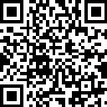


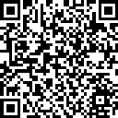

For More Information on the NEXT LEVEL NOW Collaborative…
Become a Member
of our Next Level Now Community of Practice on WorkforceGPS!
Submit Workforce Related
Questions or
Technical Assistance Requests
Melissa Aguilar-Southard
  Director and SME - Safal Partners
    Melissa.Aguilar-Southard@safalpartners.com
Judy Blanchard
  Project Manager - Safal Partners
    Judy.Blanchard@safalpartners.com
Submit Workforce Related
Promising Practices

Slide 42
Coming Up Next:
Session #5-
Differentiating Administrative and Programmatic Costs - Best Practices for Budgeting and Financial Management Purposes
Thank You!

