Slide 1


Virtual Fiscal Academy
Differentiating Administrative and Programmatic Costs – Best Practices for Budgeting and Financial Management Purposes
Session #5

Slide 2
Brought to You by the…
Next Level Now Collaborative

Slide 3
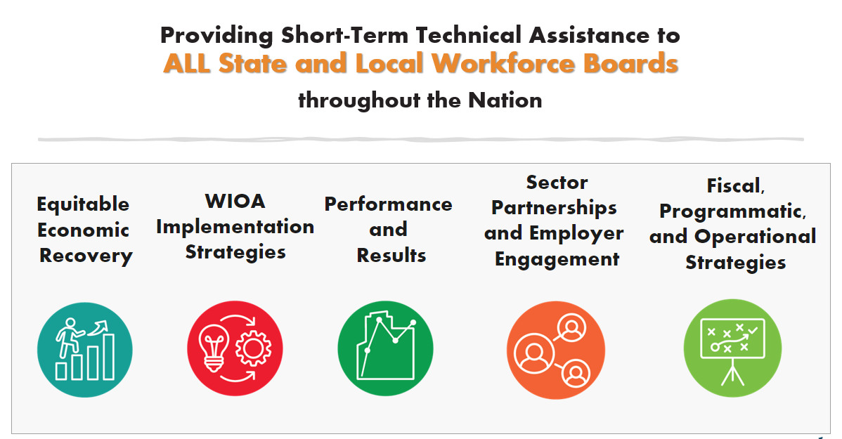




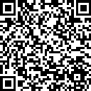

Next Level Now Collaborative...
U.S. Department of Labor, Employment & Training
Administration (ETA)
For More Info on NLN Community…

Slide 4

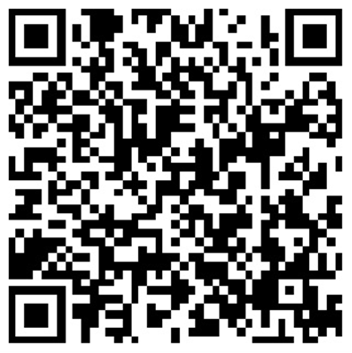
About the Presenter
Zaskia Ruiz
EVP & Chief Operating Officer
KRA Corporation
(she/her/hers/ella)

Slide 5
Fiscal Virtual Academy
Session 1: Fiscal Resources: Maximizing Resources for Effective Fiscal Management
Session 2: Financial Management: Strategies for Effective Fiscal Oversight
Session 3: Strengthening Internal Controls: Enhancing Accountability and Mitigating Risks
Session 4: Indirect and Direct Costs for Effective Budgeting & Resource Allocation
Session 5: Differentiating Administrative and Programmatic Costs - Best Practices for Budgeting and Financial Management Purposes
Session 6: Procurement Standards: Streamlining Processes for Effective Resource Acquisition
Session 7: Navigating Financial Reporting: Best Practices for Compliance and Transparency
Session 8: Audit Requirements: Ensuring an Audit Ready Environment

Slide 6
Differentiating Administrative and Programmatic Costs Learning Objectives
To provide participants with a solid understanding of the distinctions between administrative and programmatic costs and their significance in budgeting and financial management.
  Understand the definitions and distinctions between administrative and programmatic costs and their impact on budgeting and financial management.
  Explore regulatory guidelines and compliance requirements related to the differentiation of administrative and programmatic costs.
  Learn best practices for accurately identifying, categorizing, and allocating administrative and programmatic expenses.
  Explore strategies for optimizing budgeting processes by effectively managing administrative and programmatic costs.
  Learn techniques for forecasting, monitoring, and controlling administrative and programmatic expenses to ensure financial stability.
  Discover approaches for aligning administrative and programmatic costs with organizational goals and objectives.
TIPS for SUCCESS?
Write Down Questions
Organize Resources
Watch Again
Dig Further

Slide 7

Reflection from Previous Sessions…
What’s our purpose?
What is Fiscal Management in Workforce Development?
What rules, regulations and guidelines apply?
What are allowable costs?
What’s never allowable under federal awards?
What are direct, shared, and indirect costs?

Slide 8
Fiscal Management in Workforce Development
WHAT IS FISCAL MANAGEMENT?
Refers to the process of planning, organizing, directing and controlling financial resources in order to achieve specific goals and objectives. It involves the effective and efficient management of funds, budgeting, financial decision-making, and the overall financial health of the organization.
WHAT IS WORKFORCE DEVELOPMENT?
  Refers to a comprehensive set of strategies, initiatives and programs aimed at improving the knowledge, skills and abilities of individuals in the workforce. It promotes employment by using a reciprocal approach of addressing the needs of both job seekers and employers. It focuses on enhancing the employability and productivity of workers, as well as meeting the evolving needs of industries and sectors.

Slide 9
§ 200.302 Financial Management Summary…
Policies and Procedures must comply with the requirements.
Financial Systems must have the ability to track funds separately in the financial system (expenses, revenues, cash flows, assets, etc.).
Financial Transactions must be supported with documentation.
Internal Controls must safeguard assets and prohibit a single person from having sole control.
Procurement Guidelines must be adhered to for purchases.
Monitor financial activities for service providers and contracts issued.
Financial Reports must produce accurate (verified) results.
Audit Requirements must be adhered to.

Slide 10
Rules, Regulation, and Guidelines
Request for Proposal (RFP)/Grant Application/Funding Opportunity Announcement (FOA)
Assistance Listings (formerly Catalog of Federal Domestic Assistance (CFDA) numbers) are the publicly available listings of Federal assistance programs (WIOA Adult 17.258, WIOA Youth 17.259, WIOA Dislocated Worker 17.278).
Compliance Supplement - used by auditors to test programmatic and financial compliance – Sample compliance supplement/Grid from the compliance
Enabling Statute - the “Act”, signed into law/existence (WIOA, etc.).
Code of Federal Regulation (implementing regulations 20 CFR 600-699 )
TAKE A MOMENT TO LOCATE THESE RESOURCES

Slide 11
Rules, Regulation, and Guidelines (continued)
The Uniform Guidance (2 CFR § 200) ​
Technical Corrections and DOL adoption of Uniform Guidance published 12/19/2014 at 2 CFR 2900​
DOL/State/Agency Policies/Monitoring Guide​
Agreement Terms
TAKE A MOMENT TO LOCATE THESE RESOURCES

Slide 12
Cost Classification (2 CFR 200.403)
To be allowable under Federal awards, costs must meet the following general criteria:
Be necessary and reasonable for the performance of the Federal award and be allocable thereto under these principles; Prudent person test –what would a reasonable person do in a similar situation?
Conform to any limitations or exclusions set forth in these principles or in the Federal award as to types or amount of cost items;
Be consistent with policies and procedures that apply uniformly to both federally-financed and other activities of the non-Federal entity;
Be accorded consistent treatment;
Be determined in accordance with generally accepted accounting principles (GAAP), except, for state and local governments and Indian tribes only, as otherwise provided for;

Slide 13
Cost Classification (2 CFR 200.403) continued
To be allowable under Federal awards, costs must meet the following general criteria:
Not be included as a cost or used to meet cost sharing or matching requirements of any other federally-financed program in either the current or a prior period; and,
Be adequately documented
Must be incurred during the approved budget period.

Slide 14
What’s Never Allowable (Billable)?
Alcoholic beverages
Foreign travel
Lobbying
Entertainment
Good and services for personal use
Interest expense
Political activities
Losses, penalties and fines
Legal claims against the Federal government
Donations, contributions, or gifts
General fundraising (wages and other expenses)
And other items based on contractual agreement

Slide 15

From Session 4
Direct Costs
  Program
  Administrative
Shared Direct Costs
  Program
  Administrative
Indirect Costs
  Program
  Administrative

Slide 16





What are program costs?
What are administrative costs?
What are some the administrative limitations?
What are some strategies to streamline administrative processes?
Program vs. Admin - Both are essential, one is limited

Slide 17
Program Costs
Costs tied to the direct provision of workforce investment services including services to participants and employers. Such costs may include the following:
  career services;
  business services for employers;
  performance measures/outcomes;
  continuous improvement activities;
  tracking or monitoring of participant and performance information;
  employment statistics information, including job listing information, job skills information, and demand occupation information;
  performance and program cost information on eligible training providers, youth activities, and appropriate education activities;
  local area performance information;
  information related to supportive services; and
  information related to unemployment insurance claims for program participants
Source: WIOA Admin vs Program vs Indirect Handout

Slide 18
Program Costs (continued)
All costs incurred for functions and activities of subrecipients, except those entities listed as “General Guidelines”, and contractors are charged as program costs.
  For example, an entity contracted to provide youth services incurs incidental costs for processing youth work experience. The entity’s payroll may charge all of its costs to program costs.
Costs of the following information systems, including the purchase, systems development and operating (e.g. data entry) costs are charged as program costs. Unless funding, award or other notices say otherwise.
Negotiation of a Memorandum of Understanding (MOU) or Infrastructure Funding Agreement (IFA) (20 CFR 683.205(a)(5)).
Source: WIOA Admin vs Program vs Indirect Handout

Slide 19
1. Administrative Costs
General Guidelines:
Costs that are not related to the direct provision of workforce investment services, including services to participants and employers. These costs can be both personnel and non-personnel and both direct and indirect.
Administrative Costs may be incurred by:
  State and Local Workforce Development Boards,
  Regions, and
  Direct grant recipients including:
    State grant recipients,
    Local grant recipients,
    One-stop operators,
    Local grant subrecipients, and
    Local fiscal agents.

Slide 20
2. Administrative Costs
General administrative functions and coordination of the following functions (20 CFR 683.215(b)(1)(i-x)):
  accounting, budgeting, financial and cash management;
  procurement and purchasing;
  property management;
  personnel management;
  payroll functions;
  resolution of findings arising from audits, reviews,

Slide 21
3. Administrative Costs
General administrative functions and coordination of the following functions (20 CFR 683.215(b)(1)(i-x)):
  investigations and incident reports;
  audits;
  general legal services functions;
  information system development (see item # 5)
  development of systems and procedures including information systems, for administrative functions; and
  fiscal agent responsibilities.

Slide 22
4. Administrative Costs
Performing oversight and monitoring related to WIOA Administrative functions (20 CFR 683.215(b)(2)).
Costs of goods and services required for administrative functions of the program, including goods and services such as (20 CFR 683.215(b)(3)):
  rental or purchase of equipment
  Utilities
  office supplies
  postage, and
  rental and maintenance of office space.
Travel costs incurred for official business in carrying out administrative activities (20 CFR 683.215(b)(4)).

Slide 23
5. Administrative Costs Cont.
Costs of information systems related to administrative functions including the purchase, development, and operating costs of such systems (20 CFR 683.215(b)(5)). For example:
  Personnel,
  procurement and purchasing,
  property management, and
  accounting and payroll systems.
Awards to subrecipients or contractors that are solely for the performance of administrative functions.

Slide 24
Administrative or Program Costs
These costs might be charged as administrative or program costs depending on the circumstance.
Personnel and related non-personnel costs of staff who perform both administrative functions and programmatic services are allocated to the benefitting cost objectives/categories
Continuous improvement activities are charged based on the purpose or nature of the activity to be improved. Documentation of such charges must be maintained.

Slide 25
Administrative or Program Costs
Infrastructure costs for title I programs
  Title I WIOA partner programs can use administrative and program funds to pay for infrastructure costs. However, the definition of administrative costs may differ in other partner programs. Partner’s contributions for infrastructure costs are subject to the partner programs’ administrative cost definition and limitations. For title IV WIOA partner programs, such as Vocational Rehabilitation (VR), agencies must report funds spent for infrastructure costs as administrative costs (20 CFR 678.720).

Slide 26
Maximum Spending Requirements on Admin
Conform to any limitations or exclusions set forth in these principles or in the Federal award as to types or amount of cost items (2 CFR 200.403)
No funds available under title I of WIOA or the Wagner-Peyser Act may be used by a recipient or subrecipient of such funds to pay the salary and bonuses of an individual, either as direct costs or indirect costs, at a rate in excess of the annual rate of basic pay prescribed for level II of the Executive Schedule under 5 U.S.C. 5313, which can be found at https://www.opm.gov/; $221,900 for Year 2024; applies to subrecipients and not contractors. (20 CFR 683.290)
Local area expenditures for administrative purposes under WIOA formula grants are limited to no more than 10 percent of the amount allocated to the local area. Remember administrative can be indirect and indirect, and this is a different limitation than the “de minimis” indirect (increased from 10% or 15% per the recent Uniform Guidance revisions).
Grantors may impose additional limitations.
What are some other examples of administrative limitations?

Slide 27

Minimum Spending Requirements on Program
Workforce Boards have a judiciary responsibility to ensure appropriate use and management of funds, to include investment of funds in employment and training activities to maximize performance outcomes (20 CFR 679.370).
WIOA Youth Formula prioritizes work experience through a 20% minimum expenditure rate for the work experience program element.
What are some other examples of program expenditure requirements?

Slide 28
Personnel Charge Examples
Corporate Personnel
Indirect
PERSONNEL COSTS | Admin | Program | Total | Unallowable | Total
CEO | 221,900 |  | 221,900 | 58,100 | 280,000
CFO | 221,900 |  | 221,900 | 8,100 | 230,000
Legal Counsel | 221,900 |  | 221,900 | 15,000 | 236,900
Human Resources Director | 190,000 |  | 190,000 |  | 190,000
Information Technology Officer | 53,000 | 168,900 | 221,900 | 16,100 | 238,000

Slide 29
Personnel Charge Examples (continued)
Center Personnel
Funding Source 1
Funding Source 2
PERSONNEL COSTS | Admin | Program | Total | Admin | Program | Total | Unallowable | Total
Director of Workforce | 5,000 | 57,071 | 62,071 | 6,000 | 60,410 | 66,410 |  | 128,481
Business Services Manager | 0 | 40,322 | 40,322 | 0 | 32,849 | 32,849 |  | 73,171
Career Agent/WIOA 01 | 0 | 23,626 | 23,626 | 0 | 25,442 | 25,442 |  | 49,068
Career Agent/WIOA 02 | 0 | 23,626 | 23,626 | 0 | 25,442 | 25,442 |  | 49,068
Eligibility/Intake Specialist 01 | 0 | 22,550 | 22,550 | 0 | 24,430 | 24,430 |  | 46,980
Eligibility/Intake Specialist 02 | 0 | 22,550 | 22,550 | 0 | 24,430 | 24,430 |  | 46,980
Project Accountant | 40,322 | 0 | 40,322 | 32,849 | 0 | 32,849 |  | 73,171
Program Assistant | 0 | 20,765 | 20,765 | 0 | 22,495 | 22,495 |  | 43,260
Quality Assurance Specialist II | 0 | 31,057 | 31,057 | 0 | 22,812 | 22,812 |  | 53,869
Resource Room Specialist 01 | 0 | 38,036 | 38,036 | 0 | 19,422 | 19,422 |  | 57,458
Resource Room Specialist 02 | 0 | 18,036 | 18,036 | 0 | 19,422 | 19,422 |  | 37,458
Workshop Facilitator 01 | 0 | 28,281 | 28,281 | 0 | 29,806 | 29,806 |  | 58,087

Slide 30

Strategies for Success
Detail chart of accounts that can separate each funding source, admin and program, and unallowable costs.
Project Management accounting system for cost pooling and indirect allocation.
Budget and monthly budget updates to monitor “minimum and maximum” spending requirements.
Timesheet entry must allow personnel to charge to multiple funding streams, based on their actual efforts for the pay period.
Efforts must be made to streamline the services and functions to reduce administrative costs by minimizing duplication and effectively using information technology to improve services.
How are you using Generative AI for Accounting and other processes?
Other recommendations?

Slide 31
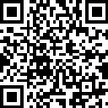


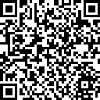

For More Information on the NEXT LEVEL NOW Collaborative…
Become a Member
of our Next Level Now Community of Practice on WorkforceGPS!
Submit Workforce Related
Questions or
Technical Assistance Requests
Melissa Aguilar-Southard
  Director and SME - Safal Partners
    Melissa.Aguilar-Southard@safalpartners.com
Judy Blanchard
  Project Manager - Safal Partners
    Judy.Blanchard@safalpartners.com
Submit Workforce Related
Promising Practices

Slide 32
Coming Up Next:
Session #6-
Procurement Standards: Streamlining Process for Effective Resource Acquisition
Thank You!

