Slide 1
Aligning the Workforce and Apprenticeship Systems:
Registered Apprenticeship and WIOA 101 for Case Managers
July 2024
Notes:
Haylie – welcoming people

Slide 2


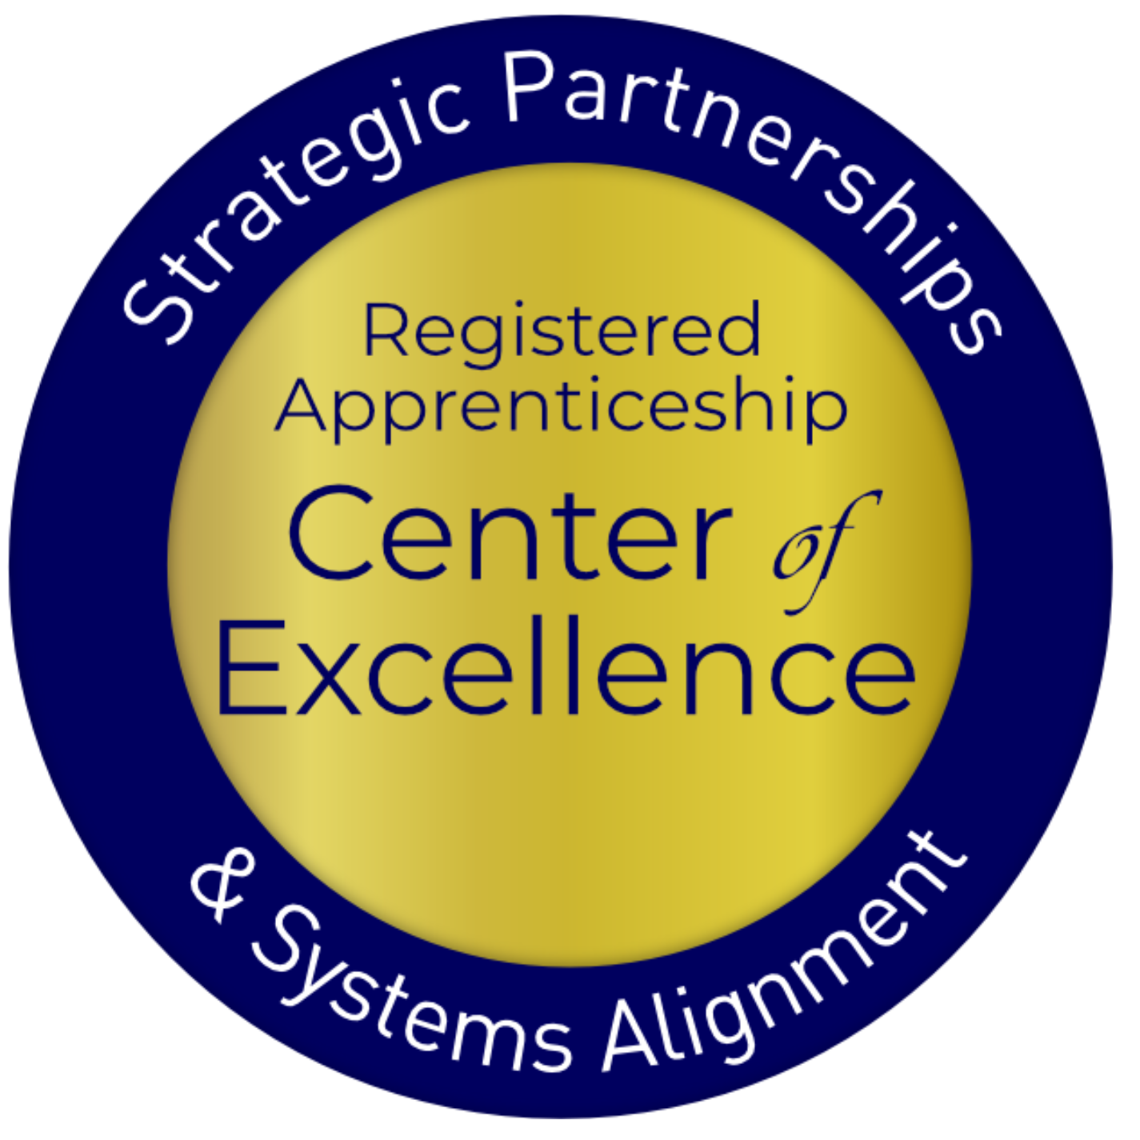
Presenters
Haylie Schuster
Lisa Rice
Engagement Manager
Safal Partners
Subject Matter Expert
Safal Partners
Notes:
Haylie and Lisa – self introductions

Slide 3
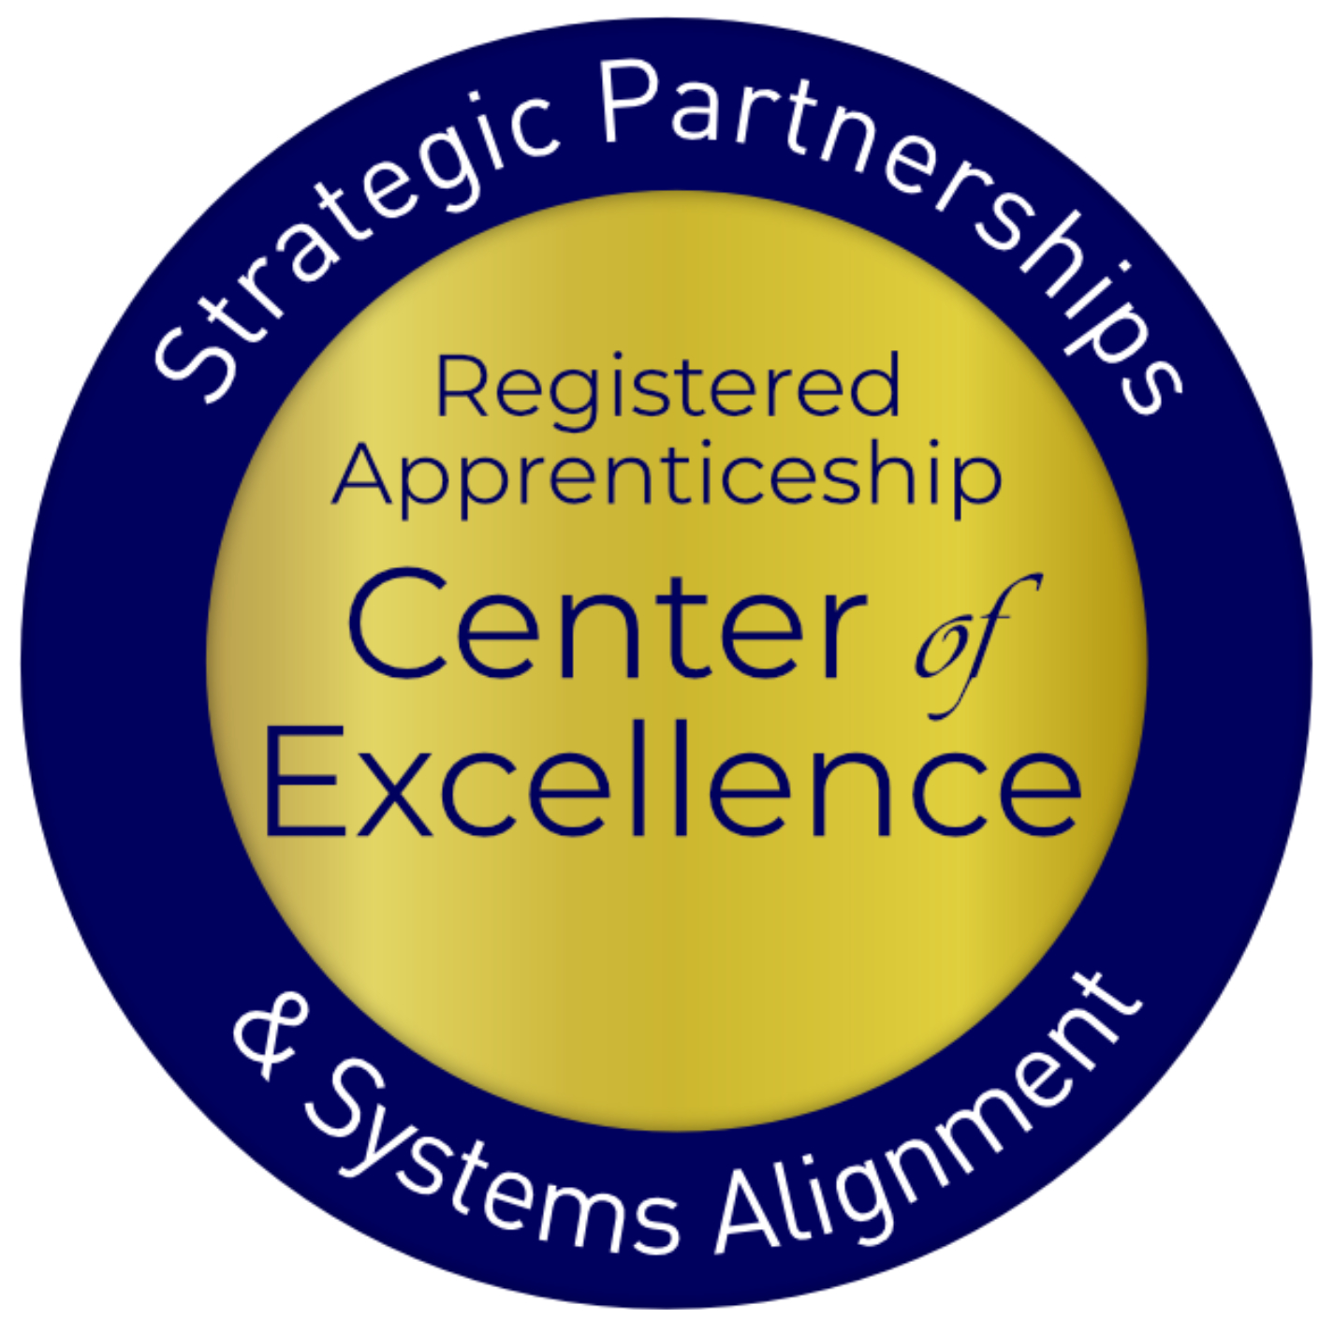
Welcome and Agenda
Center of Excellence Overview
Registered Apprenticeship Basics
Case Managers as SMEs
  New Tool
  Co-Enrollment
Questions and Discussion
Safal Partners © 2024
Notes:
Haylie

Slide 4



Center of Excellence Overview
U.S. DOL initiative to increase systems alignment across apprenticeship, education, and workforce
Led by Safal Partners; 5 national partners
We provide no-cost TA including:
  Monthly webinars
  Quarterly virtual office hours
  Individual TA/coaching sessions
  Online resources (desk aids, guides, frameworks, etc.)
Visit our website, request TA
Notes:
Haylie
Safal was awarded the opportunity to lead the US DOL Registered Apprenticeship Technical Assistance Center of Excellence for Strategic Partnerships and Systems Alignment in 2021.
We are here to help close the gap between the apprenticeship and workforce systems and accelerate partnerships across education, economic development, and other partners to increase adoption of RA nationwide.
The Center is supported by five national partners including the National Association of Workforce Development Professionals, the Coalition on Adult Basic Education, the National Disability Institute, FASTPORT, and the Wireless Infrastructure Association.
Our national partners were strategically chosen to help us reach specific groups whether on the workforce, education or employer side
California Workforce Association (CWA) is our partner in the state, helping increase workforce system awareness and utilization of RA as a workforce solution for both employers and jobseekers.
The Center of Excellence provides no-cost technical assistance – online, in-person and through hybrid delivery - to accelerate sustainable partnerships and align apprenticeship, workforce and education systems.

Slide 5
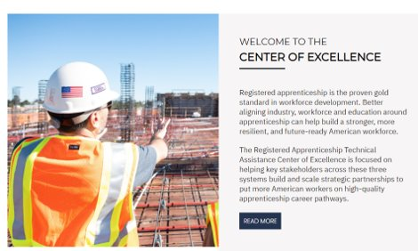
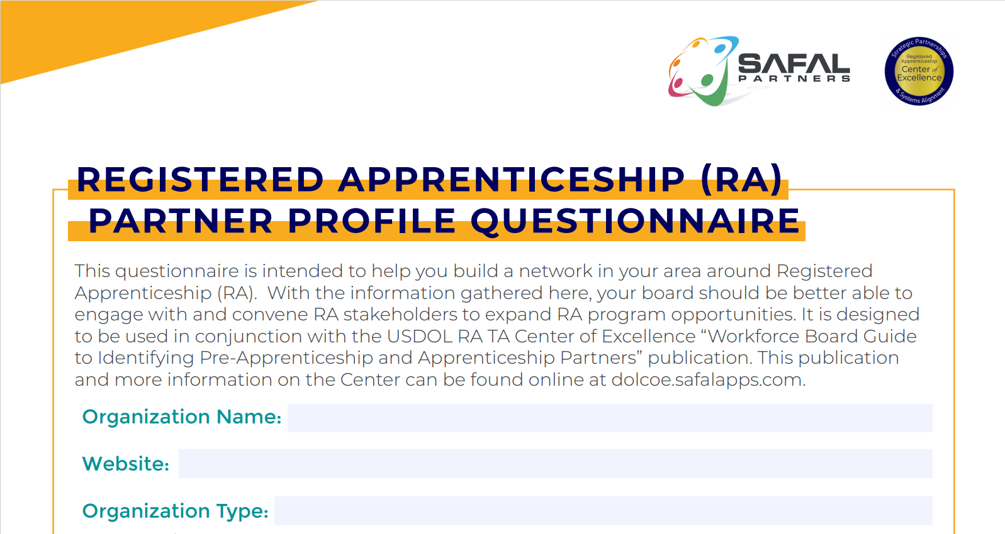

Online Resources, On-Demand TA
Registered Apprenticeship Partner Profile Questionnaire
https://dolcoe.safalapps.com/resources/resourcesandtools
Notes:
Haylie
Our website is continually updated with relevant news, TA resources and tools including frameworks, case studies, webinars, customizable templates, questionnaires, and more.
Since 2021 more than 3,000 organizations have become no-cost Center partners and utilized our tools – such as the "RA Partner Profile Questionnaire" - to accelerate their organizations' understanding and effective usage of RA.
Link to Questionnaire - https://dolcoe.safalapps.com/sites/default/files/2022-11/Partnership%20Questionnaire.pdf
This questionnaire is intended to help you build a network in your area around Registered Apprenticeship (RA). With the information gathered here, your board should be better able to engage with and convene RA stakeholders to expand RA program opportunities. It is designed to be used in conjunction with the USDOL RA TA Center of Excellence “Workforce Board Guide to Identifying Pre-Apprenticeship and Apprenticeship Partners” publication. This publication and more information on the Center can be found online at dolcoe.safalapps.com﻿

Slide 6

Poll – Getting to Know You
Notes:
Lisa

Slide 7
Registered Apprenticeship Basics
Safal Partners © 2024
Notes:
Haylie

Slide 8

What is Registered Apprenticeship?
Registered Apprenticeship is a proven, customizable, and structured model to find and train diverse
new talent as well as upskill current workers in critical occupations.
Safal Partners © 2024
Notes:
Haylie
Three main characteristics
Great way to recruit new talent and train them exactly the way you want them to be trained
Also a great way to identify talent already in your organization and upskill them – help them move to new levels in your org and help them gain the education to complement their work experience

Slide 9



Five Core Components of RA
Employer Involvement
Structured On-the-Job Learning (OJL)
Related Instruction (RI)
Rewards for
Skill Gains
National Occupational Credential
Safal Partners © 2024
Notes:
Haylie
There are 5 core components of RA.
Apprenticeship is an employer-driven tool for the workforce system.
It includes On the Job Learning at the job site
And of course the related instruction which can be either at the job site or with an external training provider
There are wage gains as people meet milestones in the apprenticeship journey
And finally, when they are done there is a nationally recognized occupational credential

Slide 10
Case Managers as SMEs
Safal Partners © 2024
Notes:
Lisa

Slide 11
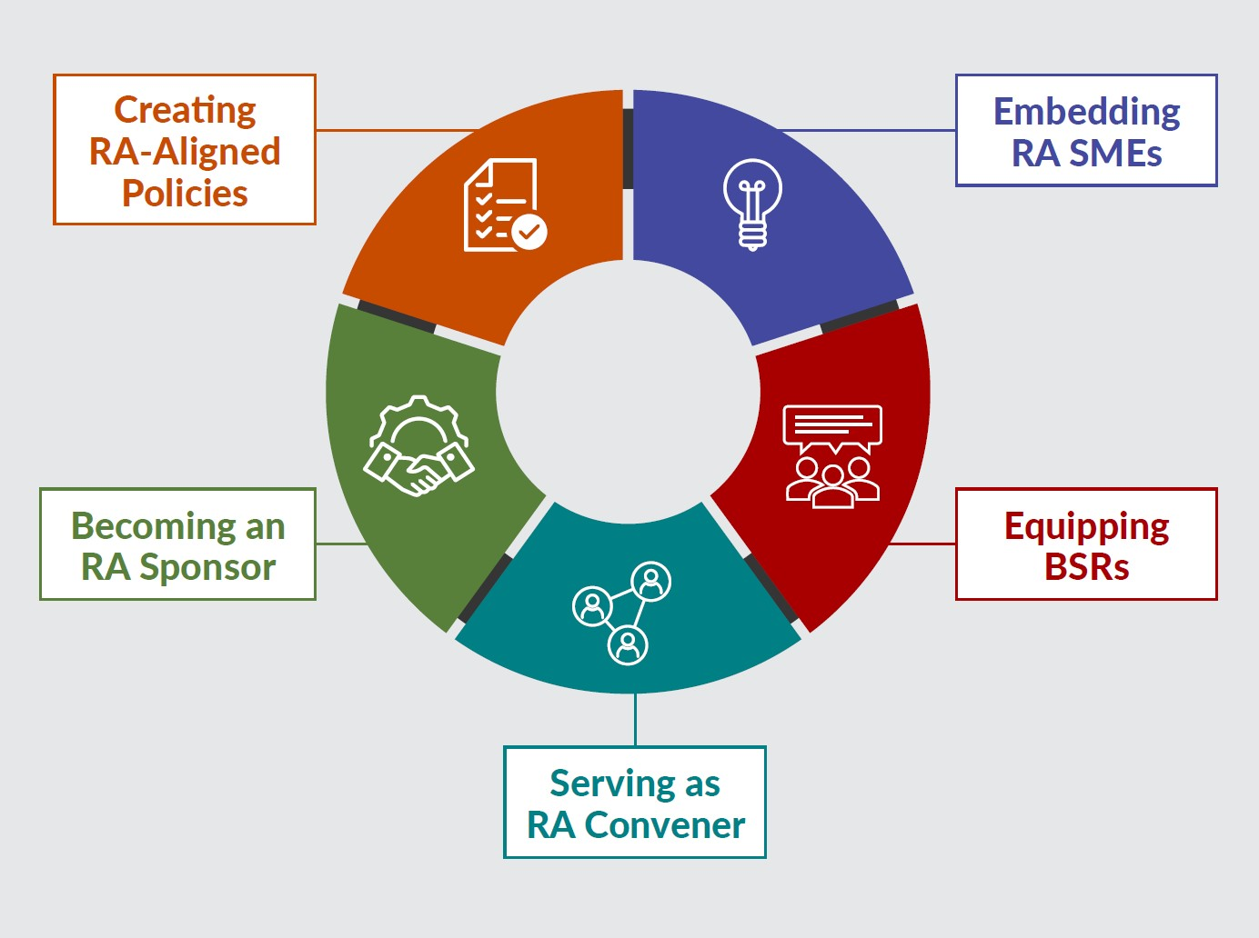
New Tool
Key Components of Workforce System Alignment with Registered Apprenticeship
https://dolcoe.safalapps.com
Safal Partners © 2024
Notes:
Lisa –
The reason this tool was built was to help the workforce system and it’s partners look at ways that you can enhance your RA efforts. They are not linear, you could be doing things in several different areas and we acknowledge that this is not all inclusive, but rather it gives you a starting point to grow your RA work.

Slide 12

Embedding RA SMEs
State/LWDBs embed RA expertise in the AJC frontline staff to actively help BSRs engage local employers in adopting RA and help case managers create a pipeline of job seekers as RA candidates for local sponsors.
State/LWDBs hire, designate and train staff as RA navigators/SMEs, embed within AJCs or serve entire regions
Case managers purposefully screen and refer job seekers to RA programs
Co-enrollment procedures are used consistently by case managers and across all mandatory partners
Apprentices are supported throughout the RA program
Mandatory partners work with AJCs to engage “shared” job seekers in RA programs
Outreach to job seekers targets underserved populations and communicates benefits of apprentices
Case managers receive regular RA training to effectively engage job seekers and communicate benefits
Wagner-Peyser staff share RA information to job seekers and employers with a warm handoff to AJC/BSR staff as warranted
Safal Partners © 2024
Notes:
Lisa
How many of you have an Apprentice Navigator or someone in the AJC that is your SME on RA?
This section is really all about the frontline staff – case managers and Wagner-Peyser staff – who can help influence job seekers to pursue RA opportunities. If they have the right knowledge base. Which requires training….
Let’s have a little fun – raise your hand and we’ll call on you for this question - What is one thing you say to your job seekers when you are trying to get them to look at an RA program?

Slide 13
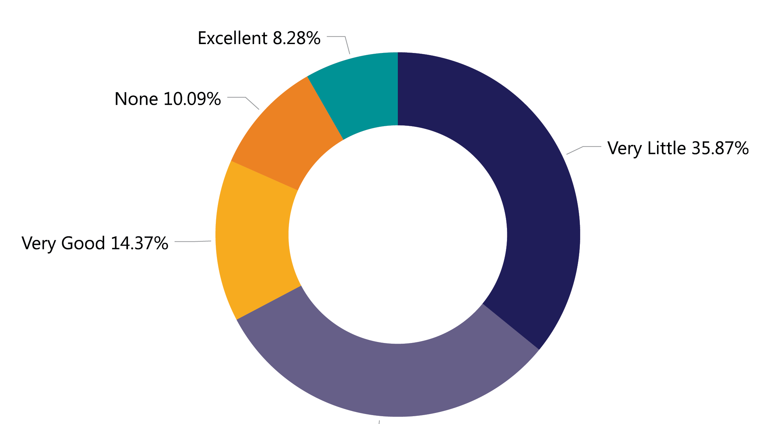
RA & WIOA Performance Measures
How would you rate your knowledge on how Registered Apprenticeship correlates with performance measures?
Source: 2023 Workforce System Registered Apprenticeship Baseline Knowledge Assessment Report - USDOL Center of Excellence, Safal Partners, NAWDP
Safal Partners © 2024
Notes:
Lisa –
When you think about system knowledge, we are looking at things like RA’s impact on WIOA performance measures. What is one performance measure that RA has a positive impact on? Entered Employment, Credential, Measurable Skills Gain, Employment for 2nd and 4th quarters, median earnings.
There are lots of reasons why RA can really be beneficial to job seekers, but there’s also the performance metrics that it can help us with.

Slide 14
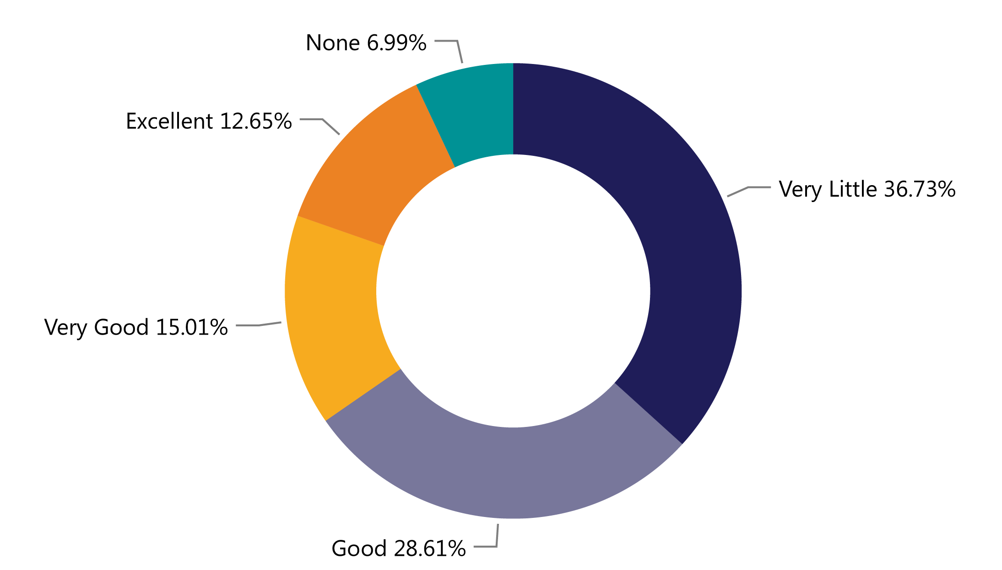
Programs Paying for RA
How would you rate your knowledge of
who pays for each part of an apprenticeship program (related instruction, wages, administration)?
Source: 2023 Workforce System Registered Apprenticeship Baseline Knowledge Assessment Report - USDOL Center of Excellence, Safal Partners, NAWDP
Safal Partners © 2024
Notes:
Lisa –
Funding Knowledge centered on what sources of funding can pay for components of RA and how to use WIOA funding for RA activities. As you can tell about 43% had little or no knowledge about paying for RA activities?
How many of you use WIOA funds to pay for the related instruction portion of a RA program? What about paying for OJT’s?
As a case manager why is it important to know this?
Because you want to provide as many services as you can to help them through the RA program.
Hands up if you are using WIOA funds for RI, how about supportive services, Ojts?

Slide 15
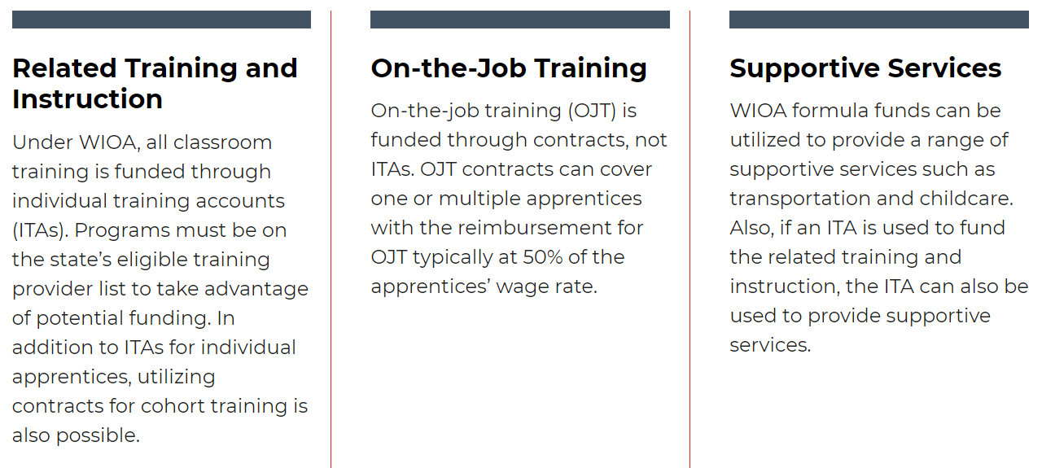
WIOA Funding, Supports for RA
Notes:
Lisa –
How many of you use WIOA funds to pay for the related instruction portion of a RA program? What about paying for OJT’s? Supportive Services?
As a case manager why is it important to know this?
Because you want to provide as many services as you can to help them through the RA program.
Does anybody have a board policy or funding allocation that targets engaging job seekers in RA’s?

Slide 16
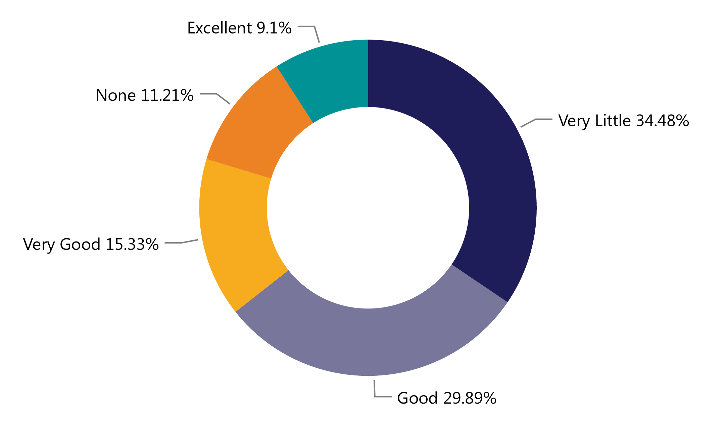
RA & ETPLs
How would you rate your knowledge of the relationship between
Registered Apprenticeship
related instruction and your state or local eligible training provider list?
Source: 2023 Workforce System Registered Apprenticeship Baseline Knowledge Assessment Report - USDOL Center of Excellence, Safal Partners, NAWDP
Notes:
Lisa –
Sharing Knowledge is about communicating the benefits of RA to your customers, which means you need to know not only the basics but also what programs are available.
What can you tell me about RA and the ETPL?
RA programs are automatically eligible to be placed on the ETPL but some choose not to. Why would a RA sponsor choose not to have their program on the ETPL?
So sponsors have to opt in – they have to request that the program is on the ETPL, but it doesn’t have to go through all the regular scrutiny of a training program because it has already been through that and approved by the approving agency. TEGL 13-16, change one has more information on this.

Slide 17
WIOA Engagement Poll
What does
your current
WIOA
co-enrollment
look like?
NON-EXISTENT- there is no interest or knowledge of WIOA co-enrollment
EMERGING - there is interest in WIOA co-enrollment, but we are not sure where to start
ADVANCING - there is an active plan to co-enroll WIOA participants
LEADING – we are actively co-enrolling WIOA participants in Registered Apprenticeship programs
Notes:
Haylie – Ok, we have a quick poll for you now.

Slide 18
RA Co-Enrollment and WIOA Benefits
Unlock additional sources of RA program support for employers who sponsor programs or hire apprentices and for job seekers hired as apprentices
Shared outcomes
Boost overall alignment
for workforce system
Notes:
Lisa

Slide 19

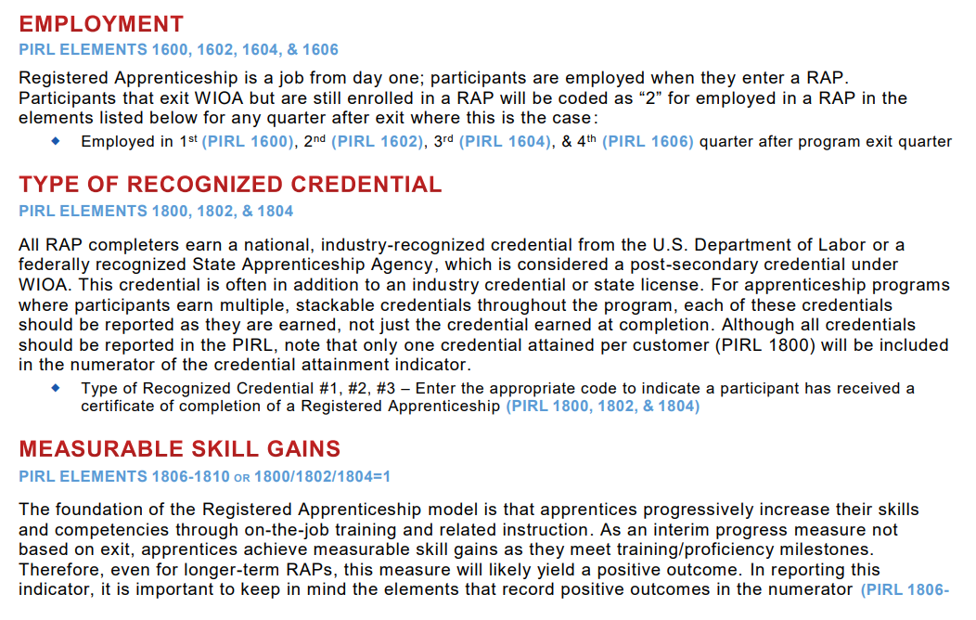
RA Co-Enrollment and WIOA
Understand how to correctly report
RA and WIOA
Co-Enrollment
Notes:
Lisa
WIOA Desk Reference that helps you understand what each field of the PIRL related to RA is about. Finding that many check that a person went to training and may even indicate it is a RA program, but then there is another box – 931 – that is about the type of training and when that is check for RA then you have co-enrollment that is captured and reported. Why is that important? Clear data, helps with grants when you can point to the validated number in PIRL.
Personal Information Record Locator - PIRL 931

Slide 20

How You Can Help With RA
Provide WIOA funding (Individual Training Account (ITA) / Supportive Services) to support RA costs.
Provide pipeline of potential students to enroll in programs.
Know the RA programs on your Eligible Training Provider List (ETPL) and how to refer customers to them.
Notes:
Lisa

Slide 21

How You Can Help RA - Continued
Publicize RA program openings and screen candidates.
Encourage your organization to host RA job fairs – specific to open RA positions in your area.
Connect potential apprentices to other resources available within the community
Create an RA work group
Share your knowledge with leadership, BSRs, other Case Managers
Notes:
Lisa
Publicizing RA program openings – you may think that’s not my job. Why not? Why not have a little flyer or sticky note that customers see that says something like ask me how you can earn and learn at the same time?
Outreach – telling people about open positions, RA programs, that’s all allowable. TEGL 03-23
RA job fairs – has anyone done one of this that is specific to RA job openings?

Slide 22

Share RA Knowledge
Explain the benefits of RA to your career seeker customer
Have career seeker explore the RA jobs in your area –
Communicate with Business Services Representatives
https://www.apprenticeship.gov/apprenticeship-job-finder
Safal Partners © 2024
Notes:
Lisa
What is one of the first benefits you talk about to a career seeker when you tell them about RA?
What else do you talk about? Provide them with some stats on RA – like according to the Bureau of Labor Statistics 93% of apprentices retain employment after completing an apprenticeship program. And
Exploring the jobs
Talk to BSR’s about your apprentice candidates, their skills and desire to enter into a RA

Slide 23

Questions, Thoughts, Discussion?
Safal Partners © 2024
Notes:
Haylie – pull any questions from chat

Slide 24
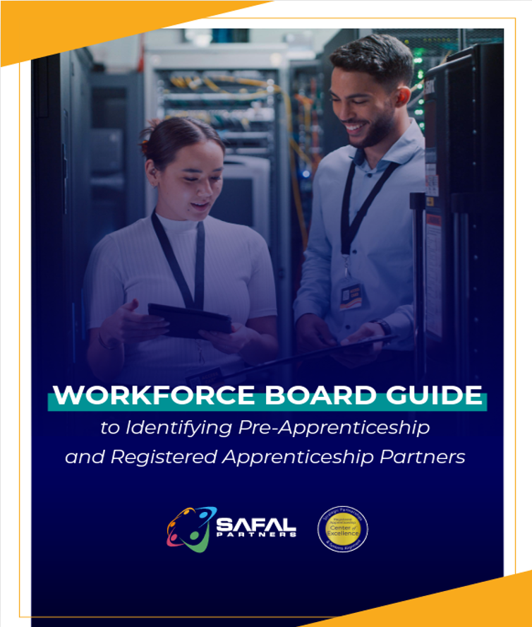

No-Cost Resources
Guide to Identifying Partners
Safal Partners © 2024
Notes:
Haylie

Slide 25

Save the Date
August 22 from 1 – 2 ET
  Topic: Bridging Education and Apprenticeship
  September 20 from 1 – 2 ET
  Topic: Registered Apprenticeship as a Talent Development Solution for Employers and Workforce
Visit our Events Page for upcoming events and the latest news.
Safal Partners © 2024
Notes:
Haylie

Slide 26

Contact Us, Become a Partner
Scan for Partner Form
Receive no-cost expert TA,
materials, and assistance
Network with potential
partners nationwide
Be nationally recognized for your work
Notes:
We want to thank all of you for joining us today. We appreciate your participation.
We’d like to encourage you to become a partner with the Center of Excellence if you have not signed up yet. Please take a moment to scan the QR code on the screen. As a partner you have the opportunity to receive no-cost technical assistance and materials, network with partners nationwide, and be nationally-recognized for your work.

Slide 27
Thank You for Joining Us
Email us your questions at RA_COE@SafalPartners.com
For more information, visit: dolcoe.safalapps.com

