Slide 1


Region 1
Fiscal Management Virtual Academy
Subrecipient Management and Monitoring
Session #3
December 2024

Slide 2
Brought to You by the…
Next Level Now Collaborative

Slide 3






Next Level Now Collaborative
Technical Assistance
Is Currently Available To YOU!
Ask a Question / Submit a TA Request
U.S. Department of Labor, Employment & Training
Administration (ETA)
U.S. DOL’s ETA’s Training Hub for Workforce Grantees and Partners
Equitable Economic Recovery
WIOA Implementation
Fiscal, Administrative, Programmatic
and Operational Strategies
Sector Partnerships and Employer Engagement
Performance and Results

Slide 4

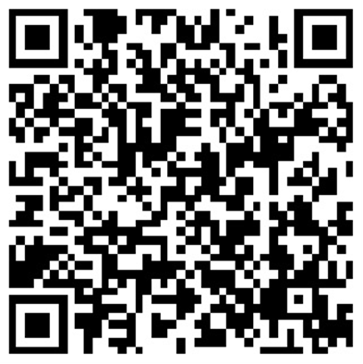
About the Presenter
Zaskia Ruiz
EVP & Chief Operating Officer
KRA Corporation
(she/her/hers/ella)

Slide 5
Region 1 - Fiscal Management Virtual Academy
Session 1: Contract Management
Session 2: Subrecipient Management and Monitoring
Session 3: Attendee Q&A

Slide 6

Attendee Q&A Session Objectives
To provide attendees with guidance related to sessions #1 and #2.

Slide 7

Reflection from Session #1

Slide 8
Session 1- 2
Q: Will we get templates to keep track of steps in the processes?
  A: Templates will not be provided. However, the PowerPoint presentations and references mentioned can be used to develop templates tailored to your organization.
Q: If a person is not familiar with this process [administrative requirements for federal awards], where can a person go to learn more?
  A: The Uniform Guidance (2 CFR 200) and the compliance supplement for the funding source are two great resources to get started.
Q: Will you speak to contracts that are based on tuition payments for training when the contractor doesn't determine eligibility and isn't responsible for any other service?
  A: These are not subrecipient subawards but should require contract clauses that clearly state the terms of payment based on meeting the objectives.
Q: Why are Performance-Based your preferred type of Contract?
  A: Because they require the awardee to perform in order to receive payment. No performance. No payment.

Slide 9
Session 1-3
Q: Can you emphasize the difference between Performance-based and Firm Fixed Price?
  A: Performance-Based contracts focus on the outcomes, or the results of the work performed. Firm Fixed Price focus on the agreed-upon payment schedule. Performance-based requires the contractor/vendor to perform.
Q: We are in the process of putting our policies, procedures and practices on paper. Is there someone from the feds who can look over our draft?
  A: You can establish an open comment period which allows stakeholders to review and provide feedback. You can also request technical assistance from your assigned contact at the state level or DOL/ETA to review.
Q: Do you have a copy of the federal procurement procedures, or where can we find it?
A: 2 CFR Part 200 Subpart D - Procurement Standards

Slide 10
Session 1-4
Q: Will you please explain "Procurement arrangements using strategic sourcing" and an example of how this would be used rather than the competitive process?
  A: Non-competitive procurement would be an example. Example: unique piece of software developed by a specific company that is essential to a project, where no other alternative exists. When is a non-competitive process is allowed:
  The acquisition of property or services, the aggregate dollar amount of which does not exceed the micro-purchase threshold;
  The item is available only from a single source;
  The public exigency or emergency for the requirement will not permit a delay resulting from publicizing a competitive solicitation;
  The recipient or subrecipient requests in writing to use a noncompetitive procurement method, and the Federal agency or pass-through entity provides written approval; or
  After solicitation of a number of sources, competition is determined inadequate

Slide 11
Session 1-5
Q: Do you have templates for these phases that you can share? (This question was asked in multiple fashions and at different portions of the training. This answer is meant to cover all those questions.)
  A: Templates will not be provided. However, the PowerPoint presentations and references can be used to develop templates tailored to your organization’s requirements.
Q: Are there templates for the procurements/checklists?
  A: Unfortunately, templates were not part of this engagement. However, the PowerPoint presentations and references can be used to develop templates tailored to your organization’s requirements.

Slide 12
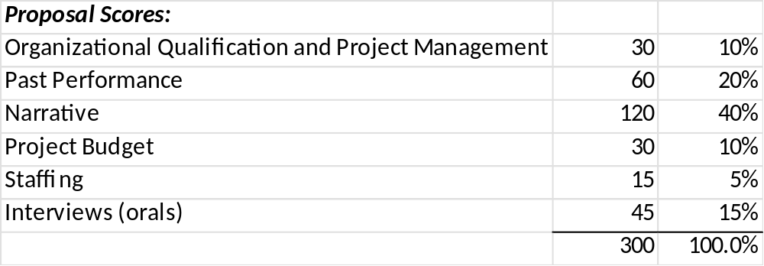
Session 1-6
Q: Is there a baseline set of criteria that must be included in the evaluation/scoring sheets?
  A: There isn’t a universally mandated baseline set of criteria that must be included in evaluation or scoring sheets. However, the criteria should reflect how well each proposal aligns with the goals and objective. Below is an example:

Slide 13
Session 1-7
Q: What is the rationale for Sealed bids being driven by lowest price?
  A: The rationale for using the sealed bid method, particularly when awarding contracts based on the lowest price, is rooted in several key principles and objectives:
  Maximizing Competition
  Cost Efficiency
  Simplicity and Speed
  Transparency and Accountability
  Objective Decision-Making

Slide 14
Session 1-8
Q: What happens if you destroy your documents at 3 years - then the state decides to monitor you for 4 years back and you no longer have the records?
  A: You will not be able to supply the records. However, you should make every effort to find alternative methods to retrieve required documents (back-up files, etc.).
Q: Does the DOL use the FDP contract templates? Are they sufficient for DOL awardees to use to issue subawards?
  A: Federal Demonstration Partnerships are a great starting point. However, you must add any other requirements according to WIOA, State, local government, etc.
Q: Are digital records sufficient or are paper required?
  A: Electronic records can serve as substitutes for paper copies as long as quality control reviews ensure their integrity (2 CFR 200ˌ336).

Slide 15
Session 2
Q: How do we know when a contract is federally funded? Is there a way to look it up?
  A: Yes, the Assistance Listing Number should be included in the subaward. You can use this number to identify the requirements of the program.
Q: Where is sub award supposed to be ‘clearly identified’?
  A: According to 2 CFR 200.232 (b), every subaward must be clearly identified to the subrecipient as a subaward and includes the information required within that section. This is essentially the contract between the subrecipient and the passthrough entity.
Q: Is there a contact we can have for specific questions?
  A: You may contact Safal Partners. See QR code towards end of the presentation.

Slide 16
Session 2-1
Q: Did I hear you correctly? If our subrecipient has a negotiated rate with the feds, the pass-through entity can adopt that indirect cost rate for themselves as well?
  A: No. The passthrough should honor the subrecipient's federally-approved rate.
Q: Where do we find the updated De minimus rate?
  A: This information is within the Uniform Guidance 2 CFR 200ˌ414(f)
Q: If we were awarded a grant before October and the de minimis rate we had in our agreement was 10% do we stick with that rate through the end of the contract and any new contracts have we would increase to 15%?
  A: You must abide by the rate that was approved by the passthrough entity. The de minimis rate is an up to 15% but is not automatic and must be agreed-upon by the passthrough entity and the subrecipient.

Slide 17
Session 2-2
Q: Who signs the certification of a subrecipient report and invoice (cash drawdown) at the subrecipient level? The WDB director and/or the fiscal agent?
  A: The responsible official must be appointed as part of your internal control environment. Generally, the person assigned this task must be an official who is authorized to legally bind the subrecipient .
Q: I have a specific question about personnel vs contractor. Who should I contact?
  A: The best source for this will be the IRS.

Slide 18
Session 2-3
Q: Also, how far nationally do we have to go to seek other vendors if we have few vendor options in an under resourced area?
A: 2 CFR 200.321 does encourage recipients of federal funds to consider small businesses, minority-owned businesses, women's business enterprises, veteran-owned businesses, and labor surplus area firms in their procurement processes. However, it does not specifically mandate that recipients must solicit these organizations nationally if they are not available locally.
The regulation emphasizes the importance of promoting inclusivity and providing opportunities to diverse businesses, but it also allows recipients to use their discretion in how they approach this procurement requirement. If local options are not available, recipients are encouraged to seek out these businesses at a broader level, but they are not required to conduct a national search.
In practice, this means that while recipients should make reasonable efforts to engage these types of businesses, the approach can vary based on the specific circumstances and the availability of qualified firms. Recipients should document their efforts and rationale for their procurement decisions to demonstrate compliance with the intent of the regulation.

Slide 19
Session 2-4
Q: Are pass-through entities supposed to conduct a risk evaluation of sub-recipients during the bids/proposals? Can the risk evaluation be conducted during the monitoring review once the award has been granted to the subrecipient?
  A: A proactive approach would be conducting the risk of noncompliance to detect issues before selecting the subrecipient and entering into agreement without the appropriate additional conditions.
Q: If you have current sub-awards and have not followed all of these procedures, what is the best way to document? Do you just perform and document all of these steps now?
  A: A proactive approach would be to train your subrecipients and provide technical assistance which will allow them time to correct any deficiencies before the official monitoring visit.
Q: Are there templates for the monitoring process? Where can I find the DOL Monitoring guide?
  A: The latest version of the Core Monitoring Guide is found on the DOL website.

Slide 20
Session 2-5
Q: It sounds like we are being asked to be auditors. How much reliance can be placed on audited financial statements/single audits that should have gone through all of this internal control and transaction testing.
  A: The monitoring process is quite comprehensive. However, the audit is conducted by external third parties. The audit report should provide reasonable assurance all testing and evaluations have been completed according to the requirements.
Q: It was $750,000 before October 1st final rule. if you received an award before the final rule then you would use that threshold, right?
  A: This the expenditure threshold for your fiscal year. If your fiscal year ends on June 30, 2025, you must comply with the requirement in effect at the time of the fiscal year. However, your passthrough entity may impose stricter requirements. You must abide by the contractual terms on the subaward.
Q: Sub award start date is Nov 1st…should we include $1,000,00 as the audit threshold in the sub agreement?
  A: Yes.

Slide 21
Reflection from Session #2

Slide 22


Q & A

Slide 23
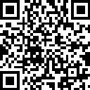
For More Info on the NEXT LEVEL NOW Collaborative…
Reach out to us to
request technical assistance
on today’s topic
or other workforce topics!

Slide 24
You Made It!
Thank You!

