Slide 1
WIOA Performance Negotiations & Sanctions
Overview of Revised Guidance Issued May 10, 2023

Slide 2



Today’s Speakers
LaToya Newson
  Director of the Division of Adult Education and Literacy
    Office of Career, Technical, and Adult Education
    U.S. Department of Education
Michael Quinn
  Management and Program Analyst
    Rehabilitation Services Administration
    U.S. Department of Education
Cesar Acevedo
  Economist
    Employment and Training Administration
    U.S. Department of Labor

Slide 3




Today's Agenda
Background
Revised Guidance
Functional Example
Next Steps and Conclusion

Slide 4

Background

Slide 5
Original Guidance
On February 6, 2020, the Departments issued joint guidance:
Negotiations and Sanctions Guidance for the WIOA Core Programs.
Establish the process for negotiating levels of performance;
Delineate the timeline and process for state performance assessments; and
Explain the two instances where a state may be sanctioned.
ETA Guidance:
TEGL 11-19
RSA Guidance:
TAC 20-02
OCTAE Guidance:
PM 20-02

Slide 6
Revised Guidance
On May 10, 2023, the Departments published a revision to joint guidance: Negotiations and Sanctions Guidance for the WIOA Core Programs.
Revised approach described therein will be applied to PY 2022 state performance assessments as the Departments make every effort to avoid further delays in performance accountability.

Slide 7

Revised Guidance

Slide 8

Summary of Changes
Revise approach to using the statistical adjustment model for the purpose of assessing state performance;
Clarify the implementation of potential financial sanctions for consecutive performance failures occurring across multiple State Plan periods; and
Clarify that states can be sanctioned up to 10 percent of the Governor’s Reserve Allotment if there is consecutive performance failure and a failure to report for the same program year.

Slide 9

Original Assessment Approach
The model coefficients used to estimate performance for negotiations were “locked in” based on data available at the time and used for the performance assessments that occurred 2 and 3 years later.
Estimate0 is not updated with additional data that becomes available after the negotiations process and during the program years that follow.
This approach limited our ability to conduct performance assessments that can account for rapid changes in grantee performance and novel economic shocks (e.g., the pandemic).

Slide 10
Revised Assessment Approach​
Refit: using the same model specification (same variables),
the Departments re-estimate the coefficients and state performance projections using available data.​
After the program year ends and before assessing state performance,
the Departments will refit the models to include more data that has become available.
The refit models will produce new pre-PY and post-PY state performance estimates.
The pre-program year performance estimate used during the negotiations process (before the program years began) is no longer used.
The new estimates will be used to calculate the Adjustment Factor,
which will then be used to adjust the Negotiated Level of Performance
(Negotiated level + Adjustment Factor).

Slide 11
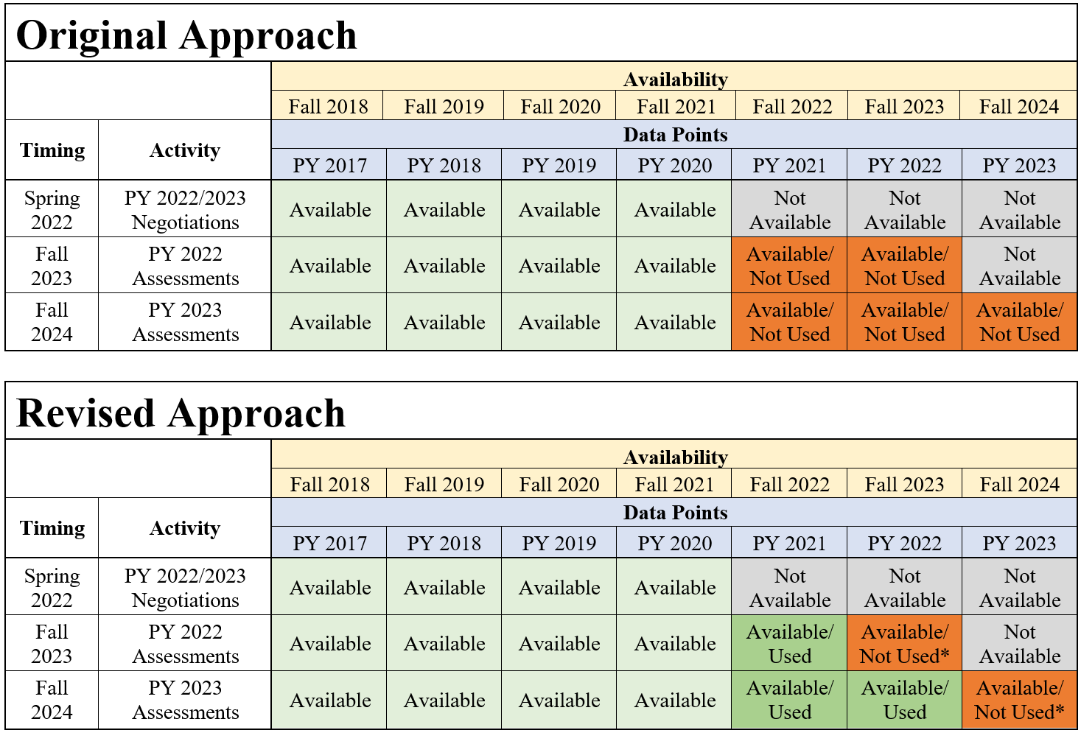
Improved Data Usage
*The Departments will not use data from the program year being assessed to inform the re-estimation of the statistical adjustment model at the end of the program year.

Slide 12

Functional
Example
Illustration of Original
& Revised Approach

Slide 13
Review of Terms
Expected levels of performance
Levels of performance proposed by the state in the initial submission of the Unified or Combined State Plan and in the required two-year modification prior to negotiations for each primary indicator

Slide 14
Review of Terms
Expected levels of performance
Levels of performance proposed by the state in the initial submission of the Unified or Combined State Plan and in the required two-year modification prior to negotiations for each primary indicator
Estimated levels of performance
Estimated outcomes produced by the statistical adjustment model (SAM)

Slide 15
Review of Terms
Expected levels of performance
Levels of performance proposed by the state in the initial submission of the Unified or Combined State Plan and in the required two-year modification prior to negotiations for each primary indicator
Estimated levels of performance
Estimated outcomes produced by the statistical adjustment model (SAM)
Negotiated levels of performance
Levels of performance mutually agreed to by the state & the Department. The negotiations process must be based on four factors described in the guidance. These negotiated levels of performance must be incorporated into the approved Unified or Combined State Plan and the approved two-year modification of that Plan

Slide 16
Review of Terms (continued)
Actual level of performance
Outcome reported by a state on the Statewide Performance Report (ETA-9169) for each primary indicator of performance for each core program.
Actual levels of performance will be compared to the adjusted levels of performance at the close of the program year to determine the state’s performance success or failure;

Slide 17
Review of Terms (continued)
Actual level of performance
Outcome reported by a state on the Statewide Performance Report (ETA-9169) for each primary indicator of performance for each core program. Actual levels of performance will be compared to the adjusted levels of performance at the close of the program year to determine the state’s performance success or failure;
Adjusted level of performance
Reflects a positive or negative difference that will be added to the negotiated level of performance once actual performance data is available.
This difference is called the adjustment factor.
Adjusted levels of performance reflect the potential for change in economic and participant conditions between the estimated levels made prior to the start of the program year (Estimate₀) and the actual conditions reflected after the close of the program year (Estimate₁).

Slide 18
Original Assessment (Illustration)
PY 2022 Individual Indicator Score: Employment Rate 2nd Quarter after Exit
Expected Level of Performance | 47.0%
Estimated Level of Performance (Estimate₀) | 45.0%
Negotiated Level of Performance | 48.0%
Actual Level of Performance
Re-Estimated Level of Performance (Estimate₁)
Adjustment Factor (Estimate₁ - Estimate₀)
Adjusted Level of Performance
Individual Indicator Score (Actual/Adjusted)

Slide 19
Original Assessment (Illustration)
PY 2022 Individual Indicator Score: Employment Rate 2nd Quarter after Exit
Expected Level of Performance | 47.0%
Estimated Level of Performance (Estimate₀) | 45.0%
Negotiated Level of Performance | 48.0%
Actual Level of Performance | 52.0%
Re-Estimated Level of Performance (Estimate₁)
Adjustment Factor (Estimate₁ - Estimate₀)
Adjusted Level of Performance
Individual Indicator Score (Actual/Adjusted)

Slide 20
Original Assessment (Illustration)
PY 2022 Individual Indicator Score: Employment Rate 2nd Quarter after Exit
Expected Level of Performance | 47.0%
Estimated Level of Performance (Estimate₀) | 45.0%
Negotiated Level of Performance | 48.0%
Actual Level of Performance | 52.0%
Re-Estimated Level of Performance (Estimate₁) | 59.0%
Adjustment Factor (Estimate₁ - Estimate₀)
Adjusted Level of Performance
Individual Indicator Score (Actual/Adjusted)

Slide 21
Original Assessment (Illustration)
PY 2022 Individual Indicator Score: Employment Rate 2nd Quarter after Exit
Expected Level of Performance | 47.0%
Estimated Level of Performance (Estimate₀) | 45.0%
Negotiated Level of Performance | 48.0%
Actual Level of Performance | 52.0%
Re-Estimated Level of Performance (Estimate₁) | 59.0%
Adjustment Factor (Estimate₁ - Estimate₀) | 59.0% - 45.0% = 14.0%
Adjusted Level of Performance
Individual Indicator Score (Actual/Adjusted)

Slide 22
Original Assessment (Illustration)
PY 2022 Individual Indicator Score: Employment Rate 2nd Quarter after Exit
Expected Level of Performance | 47.0%
Estimated Level of Performance (Estimate₀) | 45.0%
Negotiated Level of Performance | 48.0%
Actual Level of Performance | 52.0%
Re-Estimated Level of Performance (Estimate₁) | 59.0%
Adjustment Factor (Estimate₁ - Estimate₀) | 59.0% - 45.0% = 14.0%
Adjusted Level of Performance | 62.0%
Individual Indicator Score (Actual/Adjusted)

Slide 23
Original Assessment (Illustration)
PY 2022 Individual Indicator Score: Employment Rate 2nd Quarter after Exit
Expected Level of Performance | 47.0%
Estimated Level of Performance (Estimate₀) | 45.0%
Negotiated Level of Performance | 48.0%
Actual Level of Performance | 52.0%
Re-Estimated Level of Performance (Estimate₁) | 59.0%
Adjustment Factor (Estimate₁ - Estimate₀) | 59.0% - 45.0% = 14.0%
Adjusted Level of Performance | 62.0%
Individual Indicator Score (Actual/Adjusted) | 52.0% / 62.0% = 84.0%

Slide 24
Revised Assessment (Illustration)
PY 2022 Individual Indicator Score: Employment Rate 2nd Quarter after Exit
Expected Level of Performance | 47.0%
Initial Estimated Level of Performance | 45.0%
Negotiated Level of Performance | 48.0%
Estimated Level of Performance (Estimate₀)
Actual Level of Performance
Re-Estimated Level of Performance (Estimate₁)
Adjustment Factor (Estimate₁ - Estimate₀)
Adjusted Level of Performance
Individual Indicator Score (Actual/Adjusted)

Slide 25
Revised Assessment (Illustration)
PY 2022 Individual Indicator Score: Employment Rate 2nd Quarter after Exit
Expected Level of Performance | 47.0%
Initial Estimated Level of Performance | 45.0%
Negotiated Level of Performance | 48.0%
Estimated Level of Performance (Estimate₀) | 53.0%
Actual Level of Performance
Re-Estimated Level of Performance (Estimate₁)
Adjustment Factor (Estimate₁ - Estimate₀)
Adjusted Level of Performance
Individual Indicator Score (Actual/Adjusted)

Slide 26
Revised Assessment (Illustration)
PY 2022 Individual Indicator Score: Employment Rate 2nd Quarter after Exit
Expected Level of Performance | 47.0%
Initial Estimated Level of Performance | 45.0%
Negotiated Level of Performance | 48.0%
Estimated Level of Performance (Estimate₀) | 53.0%
Actual Level of Performance | 52.0%
Re-Estimated Level of Performance (Estimate₁)
Adjustment Factor (Estimate₁ - Estimate₀)
Adjusted Level of Performance
Individual Indicator Score (Actual/Adjusted)

Slide 27
Revised Assessment (Illustration)
PY 2022 Individual Indicator Score: Employment Rate 2nd Quarter after Exit
Expected Level of Performance | 47.0%
Initial Estimated Level of Performance | 45.0%
Negotiated Level of Performance | 48.0%
Estimated Level of Performance (Estimate₀) | 53.0%
Actual Level of Performance | 52.0%
Re-Estimated Level of Performance (Estimate₁) | 59.0%
Adjustment Factor (Estimate₁ - Estimate₀)
Adjusted Level of Performance
Individual Indicator Score (Actual/Adjusted)

Slide 28
Revised Assessment (Illustration)
PY 2022 Individual Indicator Score: Employment Rate 2nd Quarter after Exit
Expected Level of Performance | 47.0%
Initial Estimated Level of Performance | 45.0%
Negotiated Level of Performance | 48.0%
Estimated Level of Performance (Estimate₀) | 53.0%
Actual Level of Performance | 52.0%
Re-Estimated Level of Performance (Estimate₁) | 59.0%
Adjustment Factor (Estimate₁ - Estimate₀) | 59.0% - 53.0% = 6.0%
Adjusted Level of Performance
Individual Indicator Score (Actual/Adjusted)

Slide 29
Revised Assessment (Illustration)
PY 2022 Individual Indicator Score: Employment Rate 2nd Quarter after Exit
Expected Level of Performance | 47.0%
Initial Estimated Level of Performance | 45.0%
Negotiated Level of Performance | 48.0%
Estimated Level of Performance (Estimate₀) | 53.0%
Actual Level of Performance | 52.0%
Re-Estimated Level of Performance (Estimate₁) | 59.0%
Adjustment Factor (Estimate₁ - Estimate₀) | 59.0% - 53.0% = 6.0%
Adjusted Level of Performance | 54.0%
Individual Indicator Score (Actual/Adjusted)

Slide 30
Revised Assessment (Illustration)
PY 2022 Individual Indicator Score: Employment Rate 2nd Quarter after Exit
Expected Level of Performance | 47.0%
Initial Estimated Level of Performance | 45.0%
Negotiated Level of Performance | 48.0%
Estimated Level of Performance (Estimate₀) | 53.0%
Actual Level of Performance | 52.0%
Re-Estimated Level of Performance (Estimate₁) | 59.0%
Adjustment Factor (Estimate₁ - Estimate₀) | 59.0% - 53.0% = 6.0%
Adjusted Level of Performance | 54.0%
Individual Indicator Score (Actual/Adjusted) | 52.0% / 54.0% = 96.0%

Slide 31

Next Steps
& Conclusion

Slide 32
Next Steps
PY 2022 State Performance Assessment
PY 2024/2025 Performance Negotiations
Annual Performance Reports due October 2, 2023
Once reporting is complete, federal agencies will work to produce state assessments according to the revised guidance
State/Federal negotiations will take place in the Spring of 2024
Negotiated levels of performance due June 30, 2024

Slide 33

Thank You!
Please reach out to the appropriate federal agency with questions.
      ETA ETAperforms@dol.gov
      OCTAE NRS@ed.gov
      RSA RSAdata@ed.gov

