Slide 1

Introduction to Workforce ITSC
Amber Gaither
NASWA Workforce Technology Project Manager

Slide 2
Outline
NASWA
Workforce ITSC
Workforce Connect

Slide 3
About NASWA
National Association of State Workforce Agencies (NASWA) is the national organization representing all 50 state workforce agencies, D.C. and U.S. territories.
NASWA provides policy expertise, shares promising state practices, and promotes state innovation and leadership in workforce development.
Our members deliver training, employment, career, and business services, in addition to administering the unemployment insurance, veteran reemployment, and labor market information programs.
Notes:
NASWA is the national member association for SWA. Our members are the title III, Wagner-Peyser programs within your systems.

Slide 4
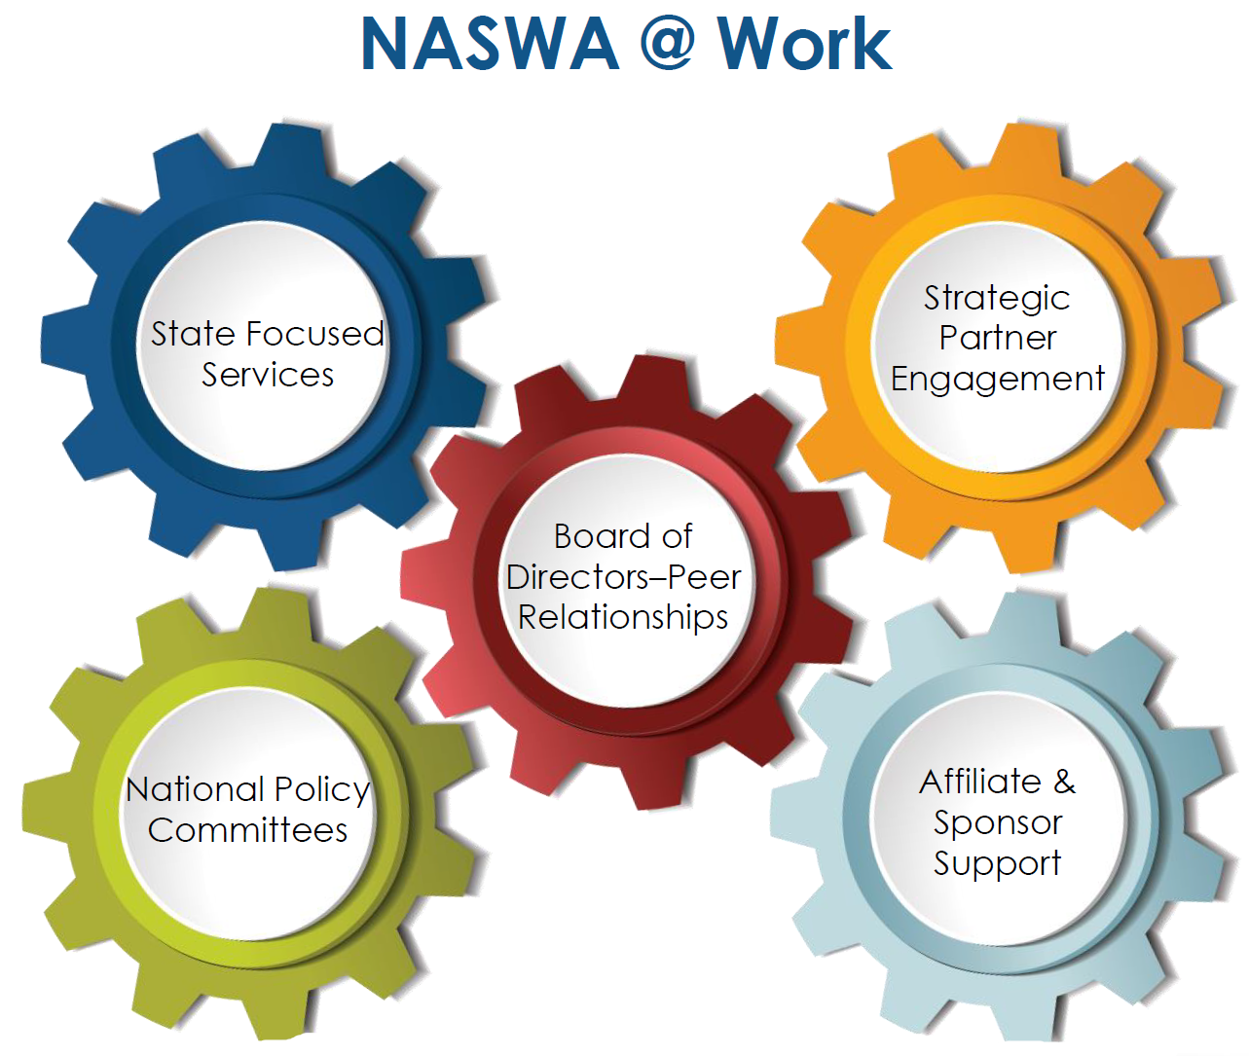
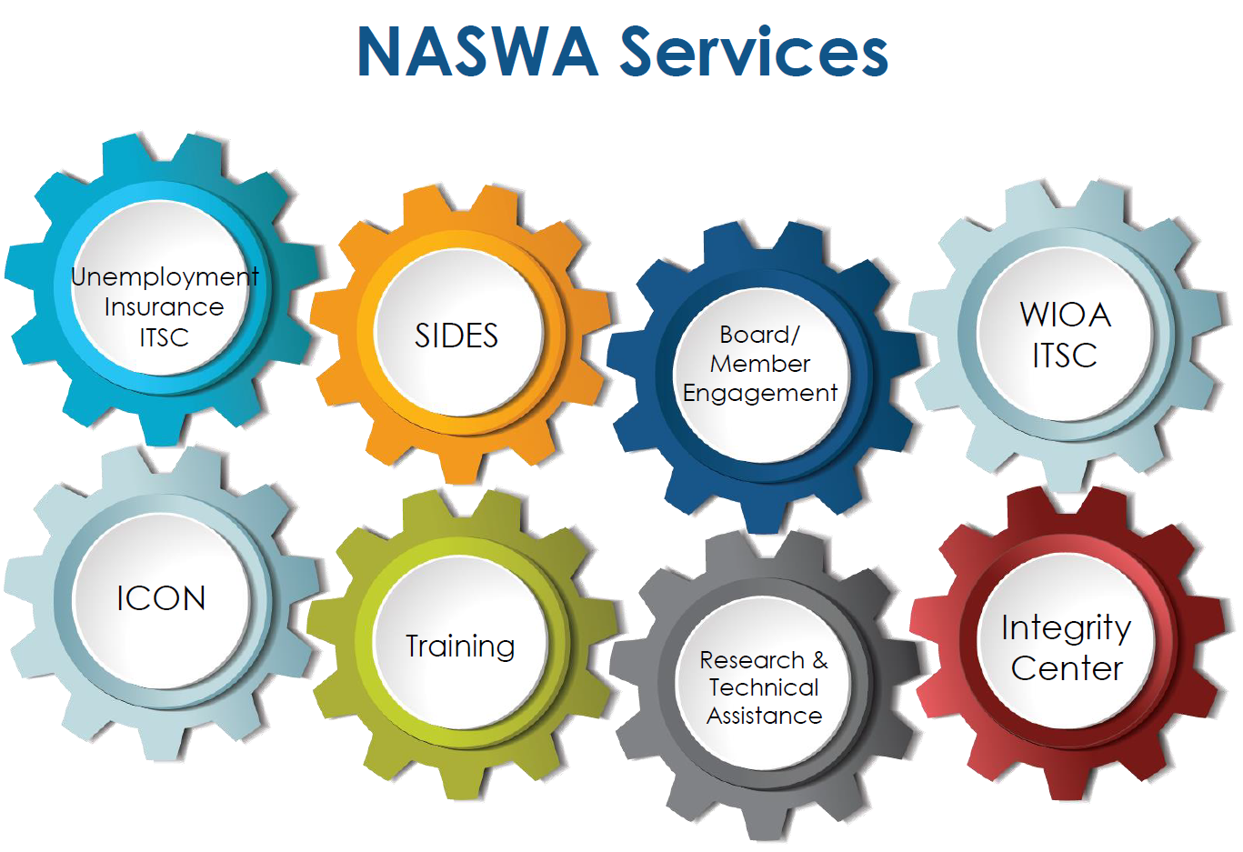
NASWA
Notes:
Our approach involves a variety of offerings that include 10 national policy committees and 8 focused state services.
8 NASWA Service Hubs:
Technology and technology assistance for business process challenges and improvements
Online and e-library solutions for education and training
Research and technical assistance
10 Policy Committees:
Opportunities to network, share promising practices and information about business processes and policy changes
Facilitate collaborative efforts to resolve critical state issues and create bipartisan, consensus-driven issue papers
E&T, WLMI, A&F, EO, UI, NLx, Veterans, Communication, Technology,

Slide 5
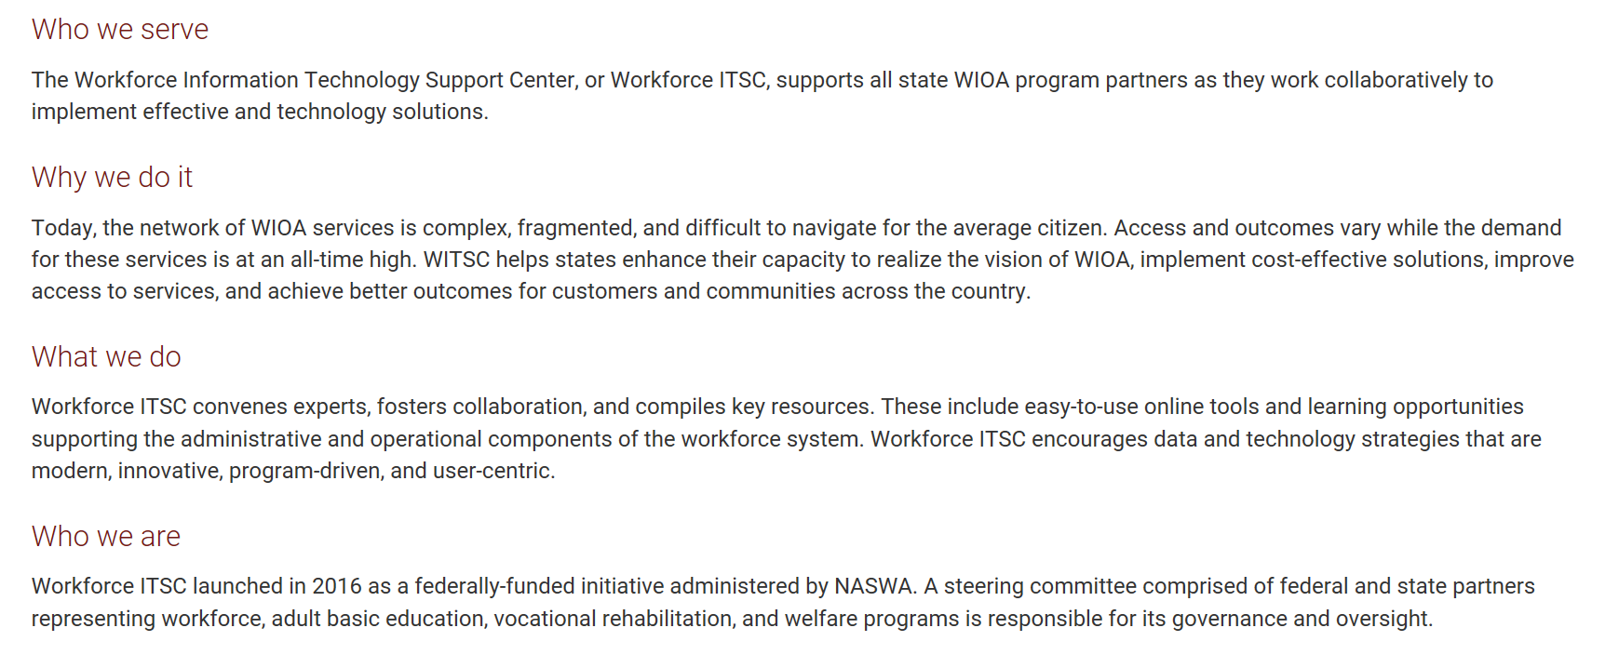
About Workforce ITSC
Notes:
As state administrators meeting the requirements of WIOA is one of the many responsibilities on your plate.
A critical piece of those requirements is the delivery of aligned customer services - working closely with other state core partners like Adult-Ed and TANF; each of which have their own priorities, technology and funding limitations.
We can all agree that technology plays a key role in the delivery of any customer service, including WIOA programs and services. And this pivotal role has become the framework for not only service delivery, but also administration and performance reporting.

Slide 6
Workforce ITSC Highlights
Newly established NASWA initiative funded by USDOL supporting states as they work to implement integrated technology solutions.
To achieve this goal, we follow a three-pronged approach: (1) sharing resources through online tools, (2) delivering learning opportunities, and (3) coordinating consulting services.
Our guiding principles in providing this support:
  Engage all WIOA program partners
  Leverage existing resources and expertise
  Focus on business processes driving technology
  Promote innovative practices
Notes:
Now lets imagine a center, a trusted space where you and your staff can turn to get the information, capacity building and the assistance you need around the “business of workforce technology.”
This very vision was first born within NASWA’s E&T community, who as late as 2015, included a recommendation for such an effort in NASWA’s recommendations to USDOL on the Implementation of the Performance Accountability Provisions of WIOA.
The very next year, USDOL in alignment with our recommendations came to NASWA with some seed money to kick off this effort.

Slide 7
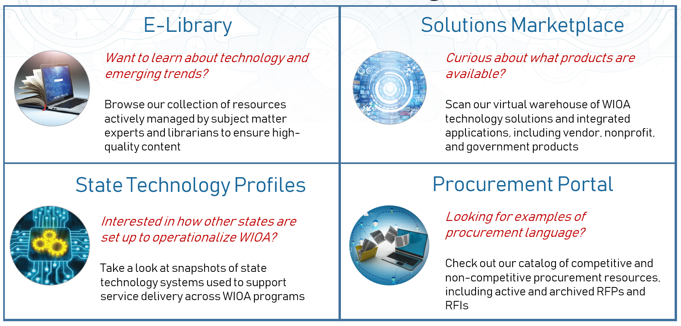


Workforce ITSC Business Lines
Portfolio of Online Tools
Technical Assistance Catalog
Academy
Need help building capacity within your agency to meet the needs of the digital age?
Explore our learning offerings to find the training you are looking for.
Consulting Services
Have a customized support request or interest in participating in a national project tackling a big workforce development challenge?
We can help connect you to subject matter experts to address state-specific issues or to future workforce system initiatives.
Notes:
STCO:
Encourage data and technology strategies that are modern, innovative, program-driven, and user-centric.
Promote transparency in the marketplace of technology systems and solutions used by state WIOA programs.
Connect stakeholders and brokers to better align workforce programs with available resources.
Portfolio of Online Tools: Build awareness and transparency, allowing authorized users to browse resources, technology solutions, and promising practices.
Technical Assistance Center: Create and deliver relevant and cutting edge learning paths and WIOA technology-specific consulting services in support of mission.
All resources are designed to support the administrative and operational components of the workforce system

Slide 8
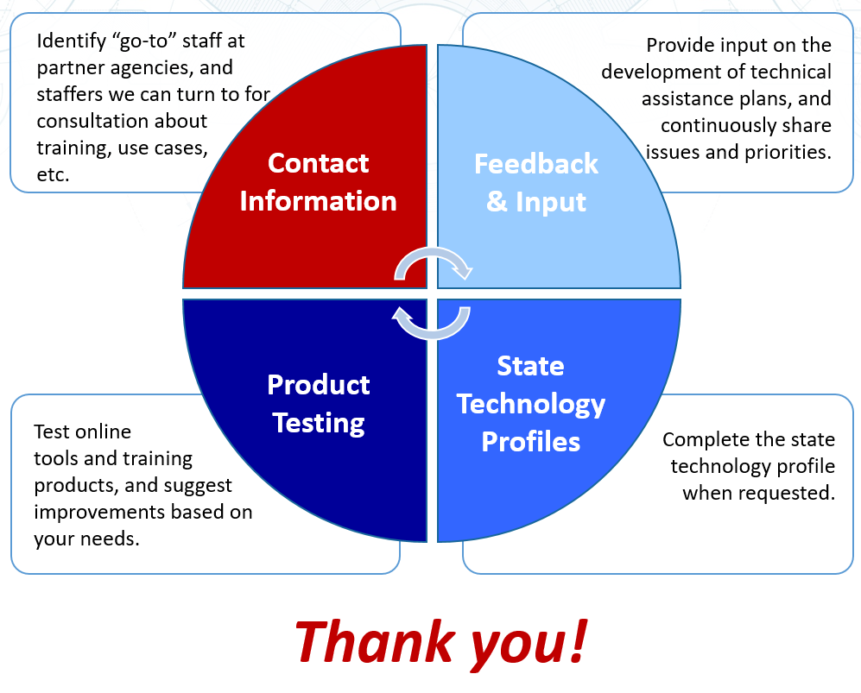
Workforce ITSC Partnership
Notes:
Please let me know if you, your agency or state is interested in any of the following activities:
Providing contact information of “go-to” staff in your agency or within other WIOA titles – that we can connect with about technical assistance needs
Providing ongoing feedback and input into what WITSC is creating or planning to create
Testing products or reviewing learning objectives, impacts, etc. associated with curriculum
Helping to coordinate the state technology profiles for your state

Slide 9
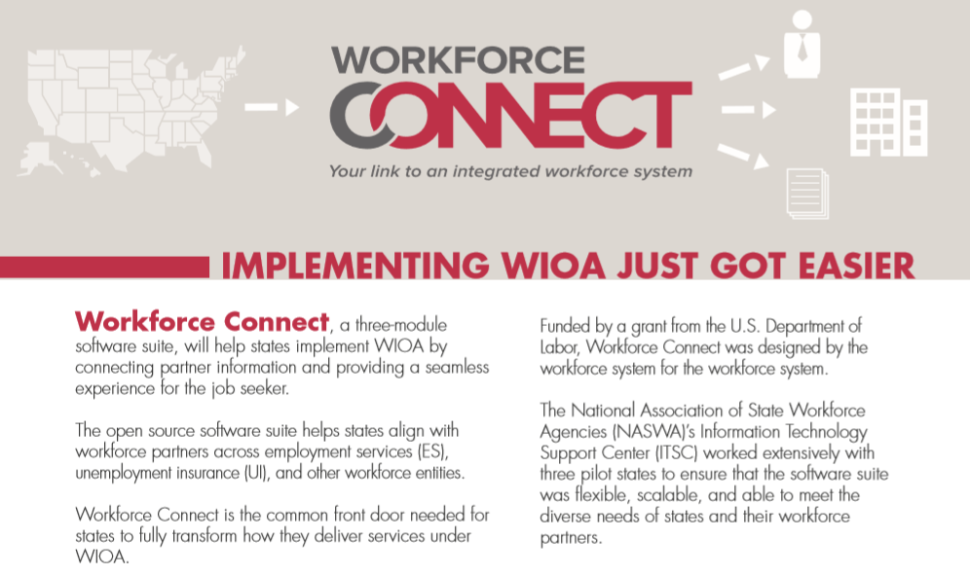
Workforce Connect
A jobseeker framework that enables state partners to provide a streamlined and personalized environment to exchange information
3 Module Suite:
Single Sign-On
Integrated Registration
Workforce Profile Dashboard
Workforce Connect Roadmap
My Reemployment Plan
WIOA Common Case File
Notes:
USDOL funded the creation of a framework to connect partner information and provide seamless customer experience
User-friendly interface and flexible design, open-source
Jobseekers can register for multiple programs at once
Quick access to real-time, personalized information
Improves customer satisfaction and streamlines work processes

Slide 10

Workforce Connect
For the State:
WIOA Implementation
Totally Customizable
Automated Password Recovery
Streamlined Customer Service
For Customers:
Easy Registration
Access Personalized Information
Secure Messaging
Track Status
Notes:
For the State:
WIOA
Workforce Connect helps you implement WIOA by integrating UI, ES and workforce IT systems so they “speak” to each other. Workforce Connect also allows for easy expansion of the modules to new partners in your workforce system, such as adult basic education and vocational rehabilitation. It also interfaces with your state’s job postings and other resources, such as labor market information, career fairs, workshops, and social media links, which results in real-time personalized information for the job seeker.
Totally Customizable
Workforce Connect is totally customizable by the state agency, allowing you to align it with your state brand. You can name it/rename it, place your logo on it, select a color palette and even write the questions/fields to ensure it integrates with your backend data systems.
Plus, Workforce Connect comes with a translator, so you can present questions in multiple languages.
Automated Password Recovery
If a user forgets or loses his or her password, recovery is done through an automated, self-service password reset. No human interaction is required, no phone calls for look up or reset!
Streamlined Customer Service
Because Workforce Connect is personalized to the job seeker’s needs and information and the functions are automated, the job seeker has easy access to information that in the past required a call or even a visit into your offices. This means potentially fewer customer service phone calls that your staff has to field.
For Jobseeker:
Easy Registration
Job seekers can register for multiple programs at once thanks to the Integrated Registration module, which was created to eliminate the need for job seekers to enter and re-enter information multiple times. This easy registration process collects the information and data that is common across partners and passes it along to relevant workforce systems.
Access Personalized Information
Once the job seeker registers, the Integrated Profile Page provides information that is tailored to that job seeker’s needs, including job fairs, workshops, job matches, labor market information (LMI) and other important information, all in real time.
Secure Messaging
Rarely can a job seeker ask questions and receive answers from the state systems without having to pick up the phone. With the secure messaging function in the Profile Page, job seekers now can query the workforce agency and receive answers, notices and updates from the states.
Track Status
Another great feature of the Profile Page is that the job seeker can track the status of UI claims as well as other paperwork. This not only makes life easier for the job seeker, but may eliminate some incoming calls to your agency

