Slide 1
Today’s TAADI

Slide 2

Today’s Speaker / Today’s Moderator
Susan Manikowski
  Technical Expert
    Office of Trade Adjustment Assistance

Slide 3
Webcast Schedule
What is TAADI?
  Including background
Review of certain TAADI measures
TAADI Resources
  Including the quarterly report card & Self-Checks
Responding to TAADI quarterly reviews
Annual review process

Slide 4
What is TAADI and
Why Does It Matter?

Slide 5
Why does TAADI matter?
Accuracy of data to share about value of the TAA program
Allows for reviewing data for programmatic implications
Trade Adjustment Assistance Data Integrity (TAADI) is an opportunity to draw together the Fiscal, UI, Program, and IT Units

Slide 6
What is TAADI?
It is a snapshot of data used to:
  Ensure data accuracy
  Review, “What can we see through the data that has programmatic implications?”

Slide 7
What is TAADI? Five Categories
Cross Validation of Fiscal Data
Underreporting or Reporting with Substandard Service Delivery Implications
Validating Standardized Codes
Wage Outliers
Record Consistency

Slide 8
Guidance
Training and Employment Guidance Letter (TEGL) 01-19 and its changes is the guidance for TAADI
Includes:
  Definitions of common TAADI terminology
  Processes and timeline of TAADI
Guidance allows for flexibility for measure additions and removals, as well as target changes

Slide 9
Recent Measure and
Target Changes

Slide 10
Why We Change Measures, Calculations, and Targets
Removed measures mean either:
  Most states are meeting the reporting expectation
  OR
  Edit checks have been introduced that disallow or require values once checked in TAADI
Measures are added when the Department identifies new areas needing focused attention
Calculations are adjusted to better match the intent of the measure, as we collect more information over time.
Increased targets mean states are performing better so we can raise expectations!

Slide 11
Fiscal Year 2024
Measure removed: Job Search and Relocation
Measure removed: Rapid Response
Fiscal handling:
  Due to 9130 reporting changes, fiscal results will be evaluated Q1-Q3 only
  Q4 will receive an “Explained”
  Annual review will be based on the 3 quarters available

Slide 12
Resources Available

Slide 13
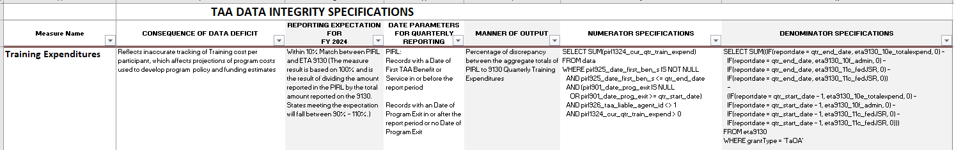
Descriptions Tab

Slide 14
Descriptions Tab - Columns
A | Measure Name | TAADI Measure
B | Element Number | PIRL Data Element #s included in calculation + 9130 rows, when applicable
C | Data Element Name(s) | Names associated with each data element
D | Definition/Relationship Targeted | Explanation of the relationship
E | Source/Requirement | Statutory, regulatory, or guidance language supporting the TAADI Measure
F | Consequence of Data Deficit | Why is this measure included? What might it mean if the results are below target?
G | Reporting Expectation for FY 20## | Target in FY 20##
H | Date Parameters for Quarterly Reporting | Explains the cohort reviewed for the Measure (e.g. Current Participants, etc.)
I | Manner of Output | Percentage or record IDs
J | Numerator Specifications | SQL for numerator calculation
K | Denominator Specifications | SQL for denominator calculation

Slide 15
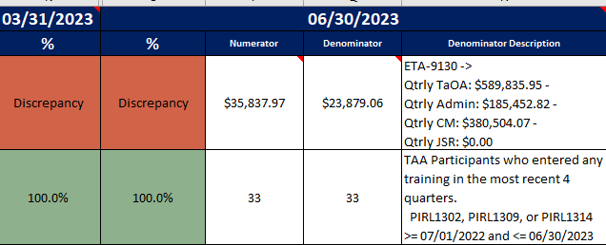
Results
Current quarter results, numerators, and denominators
Previous quarter results
Denominator descriptions – fiscal and non

Slide 16
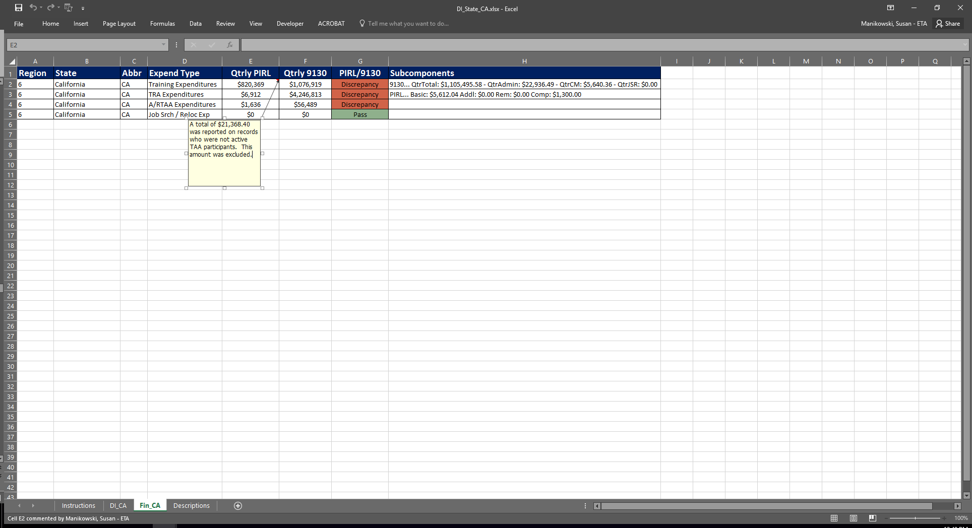
Dash
See your state in comparison to others
Yellow = Your state
Blue = Other states
Red = Measure target

Slide 17
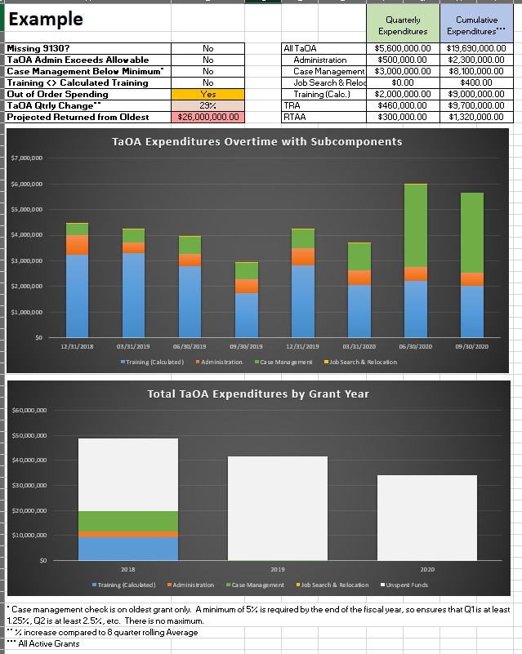
Quarterly Financial Analysis
Highlights fiscal reporting issues
Lists expenditure subcomponents
Displays Training and Other Activities (TaOA) Expenditures:
  Overtime
  By Grant Year

Slide 18
TAADI and Performance Self-Check
Posted on the TAA website
  Check regularly for updated files and the change log
Displays unofficial TAADI & Performance results, after:
  Setting submission quarter
  Pasting PIRL files – Full or SIRS format
  Entering 9130 values
Allows you to filter to individual records and review common 9130 reporting issues

Slide 19
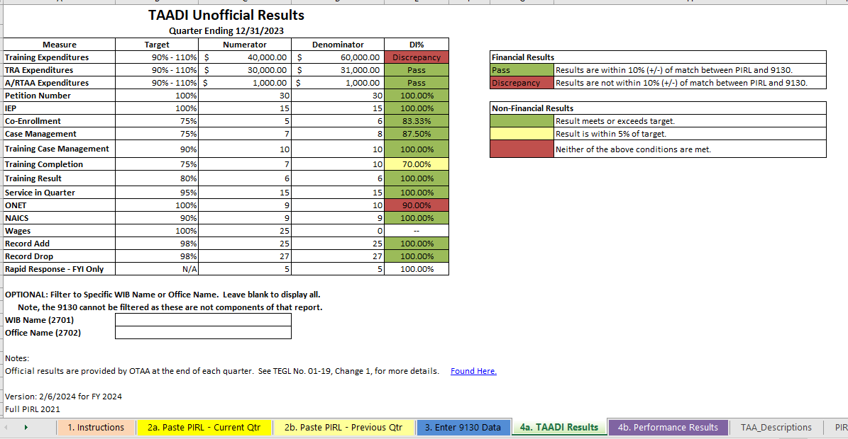
Self-Check - TAADI
When to use it
  Prior to submission of PIRL file
  After receipt of official TAADI workbook
Filter TAADI Results by:
  WIB Name or Office Name
    Note: 9130 cannot be filtered by these

Slide 20
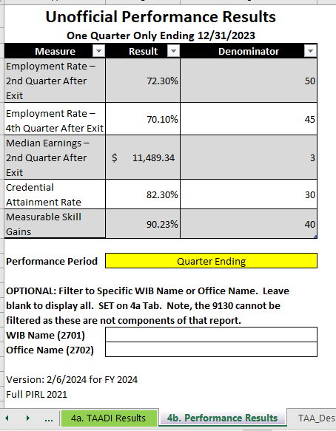
Self-Check: Performance
Unofficial Performance Results
Two performance periods to select:
  Quarter Ending
  Rolling Four Quarters
Filters will carry over from 4a. TAADI Results

Slide 21
Self-Check: Demonstration
See Recorded version

Slide 22
Responding to TAADI Quarterly Reviews

Slide 23
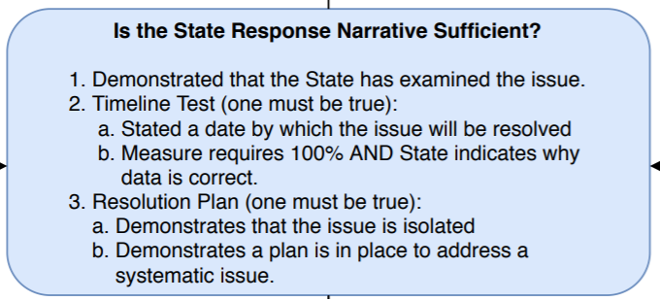
Quality of the Narrative
Identified the issue – Problem Type
Timeline test - Solve by Quarter
Resolution plan – Resolution

Slide 24
Quality of the Narrative - Examples
Strong Response 1
Measure | Problem Type | Solve by Quarter | Resolution
Training Result | Not Accurately Captured | FY24 Q3 | In November an email with instructions/screenshots was put out to field staff on how to report Credentials. It is believed staff was not fully aware of RR services offered and how to take proper credit for it in the database.
Strong Response 2
Measure | Problem Type | Solve by Quarter | Resolution
Training Result | Data Migration/Translation | FY24 Q4 | Some of the data collected for RR was not included for the collection in PIRL. It is being rectified by work with our contractor to develop additional code.
Strong Response 3
Measure | Problem Type | Solve by Quarter | Resolution
TRA Expenditures | Partner Program Communication | FY24 Q3 | Some TRA expenditures were not communicated to the PIRL reporting group. Changes in communication have been made to reduce these instances in the future.

Slide 25
Quality of the Narrative - Examples
Weak Response 1
Measure | Problem Type | Solve by Quarter | Resolution
Training Case Management | Not Accurately Captured | FY24 Q3 | We have improved and continue to work on improving this measure.
Weak Response 2
Measure | Problem Type | Solve by Quarter | Resolution
Training Result | Data Migration | FY24 Q4 | Will continue to be fixed under the new case management system

Slide 26
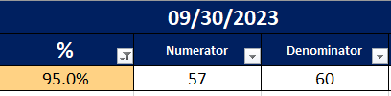
Quality of the Narrative - Examples
Response prompting Technical Assistance 1
Measure | Problem Type | Solve by Quarter | Resolution
IEP | Other | FY24 Q4 | 1 Participant was missing an IEP. It will be entered.
Response prompting Technical Assistance 2
Measure | Problem Type | Solve by Quarter | Resolution
Co-Enrollment | Other | FY24 Q4 | We will encourage co-enrollment with our DW partners.

Slide 27
Use of “Explained”
Result is an “Explained” and not a “Discrepancy” or “red”/“yellow” result
Prior to receiving official TAADI results:
  Do you know that the result won’t hit the target?
    AND
  The data is accurate & is not a service delivery problem?
Example:
  Wage records
Send us your explanation when you certify your PIRL file

Slide 28
Optional Comment Section
TAADI Report Cards have an optional comment section where the state can supply overall reporting or TAADI information
This section will:
  1. Allow for broader discussion than a measure by measure response
  2. Reinforce that Efforts to Improve Outcomes are not for reporting/TAADI comments

Slide 29
Annual Review Process

Slide 30
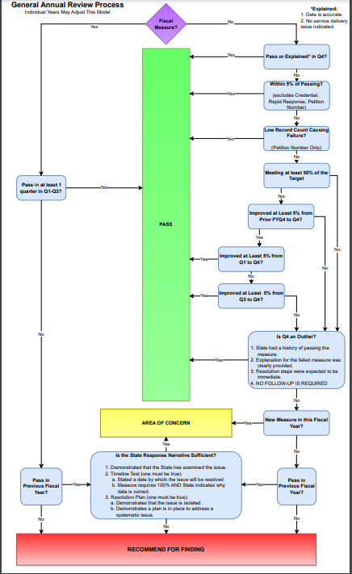
Decision Making and Recognizing Improvement
Among decisions considered:
  Has there been improvement?
  Is the Q4 result an outlier?
  Is the result close to the target?

Slide 31
Annual Review Results - Pass, Area of Concern, or Fail
Influence of the Narrative
May get to “Pass” if narrative demonstrates immediate resolution

Slide 32
Findings
Require response back to Regional Office
Area of Concern + Area of Concern = Fail
No new measure receives a “Fail” in the first year

Slide 33
Resources: TAADI and Its Calculations
TAA_Descriptions tab in quarterly workbooks
TAADI Self-Check
  Including Fiscal-Only Self-Check
Ask Me Anything Sessions (AMAs)
  18 per year
  Contact Susan M. to be added to this invitation list
Reporting Timelines Spreadsheet
  Use this to better understand the cohorts
Regional Staff
  TAA Coordinators & Reporting Leads
National Office Staff
  Susan Manikowski – Manikowski.Susan@dol.gov
TAADI TEGL 01-19, Change 1

Slide 34
Resources
TAA Participant Data page
  PIRL reporting materials, specific to TAA
    https://www.dol.gov/agencies/eta/tradeact/practitioners/participant-reporting
WIPS Resource Page
  Find information on the Workforce Integrated Performance System (WIPS)
    https://www.dol.gov/agencies/eta/performance/wips
WorkforceGPS Performance Reporting Site
  Find information on performance reporting
    https://performancereporting.workforcegps.org/
TAA Community on WorkforceGPS
  Find TAA Program materials, including discussion from AMAs
    https://taa.workforcegps.org
Trade Adjustment Assistance PIRL Reporting
  Introduction to Trade Adjustment Assistance (TAA) reporting under the new Participant Individual Record Layout (PIRL) format for Fiscal Year (FY) 2018 reporting.
    https://www.workforcegps.org/events/2017/09/27/12/03/Trade-Adjustment-Assistance-PIRL-Reporting
The TAA 9130 Report: Changes and Common Questions
  This webinar will include a presentation and discussion on the Trade Adjustment Assistance (TAA) financial reporting through the ETA-9130(M) form, including recent changes to the form and additional validation being implemented.
    https://www.workforcegps.org/events/2016/08/19/08/17/The_TAA_9130_Report-_Changes_and_Common_Questions
Promising Practices that Support Accurate Fiscal Tracking and Reporting
  Hear from Florida, Georgia, and the MassHire Hampden County Workforce Board about their fiscal tracking systems and successes. The webinar also has discussion of accrual accounting which is the required reporting method for federal grants.
    https://www.workforcegps.org/events/2019/05/07/14/11/Promising-Practices-that-Support-Accurate-Fiscal-Tracking-and-Reporting

Slide 35
Contact Us
Susan Manikowski
  Technical Expert
    Office of Trade Adjustment Assistance
      Manikowski.Susan@dol.gov
        202-693-3545
Regional Trade Coordinators
https://www.dol.gov/agencies/eta/tradeact/contact/regional-office

Slide 36
Thank You!
Need help? Email: Support@workforceGPS.org

