Slide 1




On-the-Job (OJT) Training

Slide 2
Agenda
Overview and Purpose
Employer Eligibility
On the Job Training (OJT) Process
Technical Assistance/Resources
Q & A’s

Slide 3
On-the-Job (OJT) Training
Earn While You Learn Model
Hands on training that the employer designs
A payment to offset training costs
An opportunity to train employees and provide knowledge or skills essential to the full and adequate performance of a job
An investment in the company

Slide 4
How Does It Work?
Qualified (eligible) applicants are matched with approved job openings with eligible employers.
A training plan is developed that meets the needs of the employer and participant
A contract is developed and executed
The employer gets reimbursed a percentage of the participants wages to offset the costs of training during the OJT period

Slide 5
Employer Eligibility
Federal Requirements
Layoffs within Last three years
Previously exhibited a pattern of failing to provide OJT Trainees with continued employment
Relocation
OJT Funds cannot be used to assist, promote or deter union organizing
State Requirements
Debarment
Tax Status
U.I Status

Slide 6
On the Job Training (OJT) Process
☐Step 1: Meet with the Employer – Employer Eligibility Checklist
☐Step 2: DRAFT of the OJT Training Plan
☐Step 3: Identify OJT Participant(s)
☐Step 4: OJT Pre-Contract and Skills Gap Form
☐Step 5: OJT Contract and OJT Training Plan Design
☐Step 6: OJT Contract Start-Up
☐Step 7: Invoice and Progress Report
☐Step 8: Monitoring
☐Step 9: Follow Up

Slide 7
Prospecting Employers
Current Employer Database Scan
  Identifying Existing Sector Clusters
Identifying New Employers and Sector Clusters
Developing a Career Center Employer Outreach Plan
Utilizing Other Career Center Events/Activities to engage the On-the-Job Training Model.

Slide 8
Step: 1 Meeting with Employer
Building a Trust Relationship
Learning About the Employer
Employer Value-Added Touch Points:
Cost Reduction :Wages, Advertising, Recruiting
Applicant Assessment and Filter
Time Saver
Customized Training for New Hires; Train Your Own
Training Template for Future Hires
Connection to Career Center Services and Supports

Slide 9
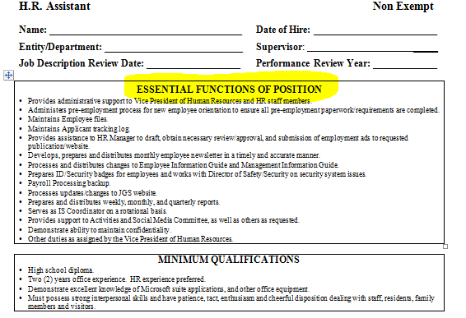
Step 2: DRAFT of the OJT Training Plan
OJT Training Position
  Job Title
  Job Description

Slide 10
Step 2: DRAFT of the OJT Training Plan
O’NET Narrative Content
  O*NET
  http://www.onetonline.org/
  Specific Vocational Preparation (SVP)
  Job Zones
  Wages
  Labor Market

Slide 11
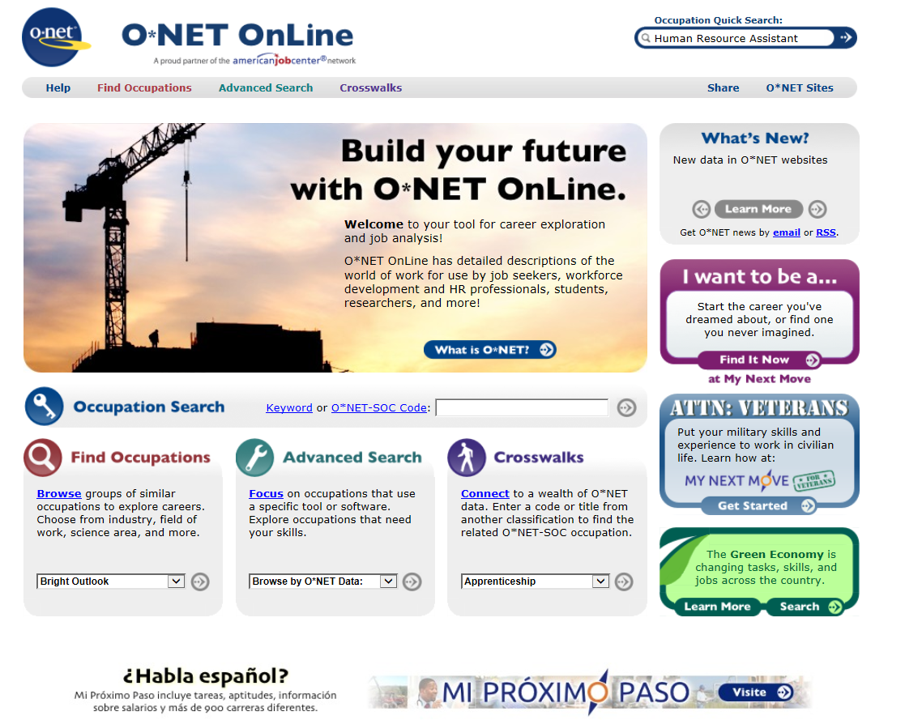

Slide 12
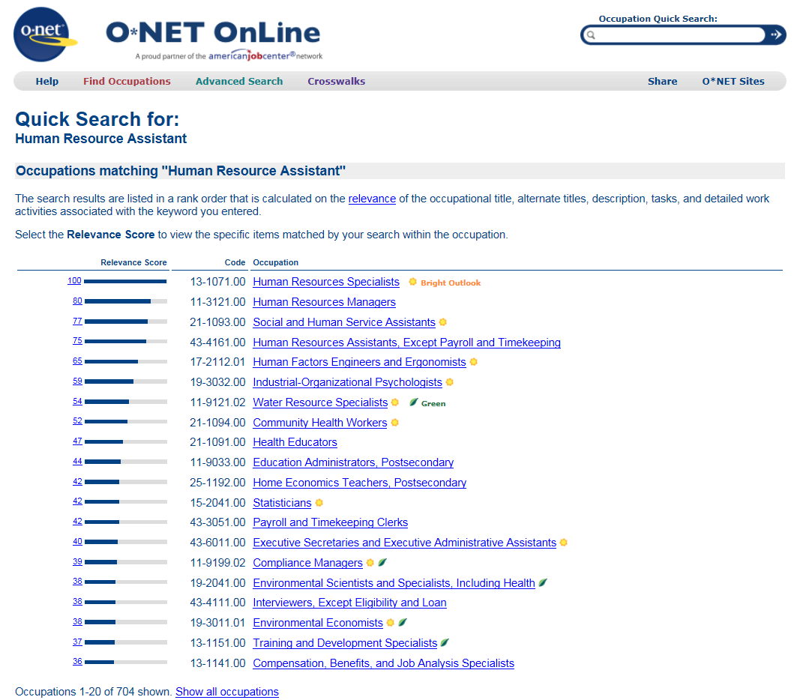

Slide 13
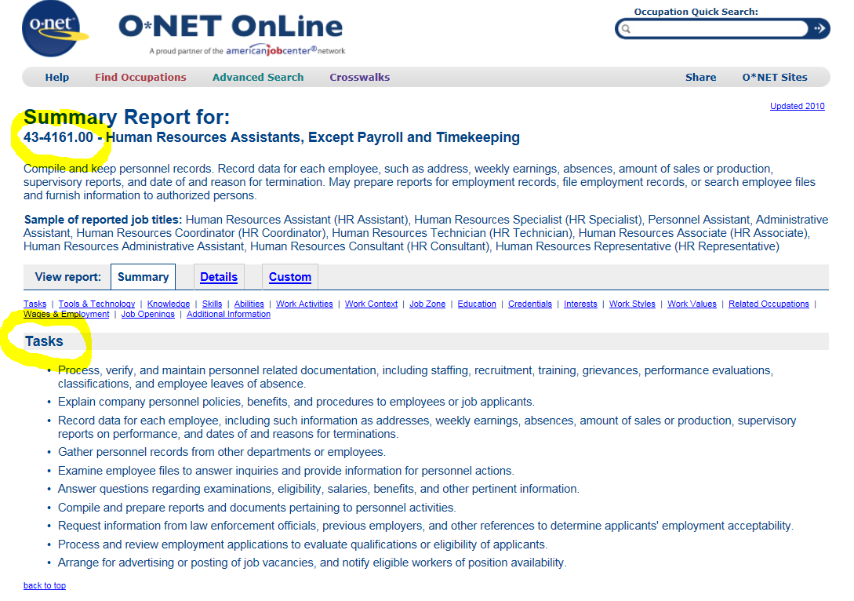

Slide 14
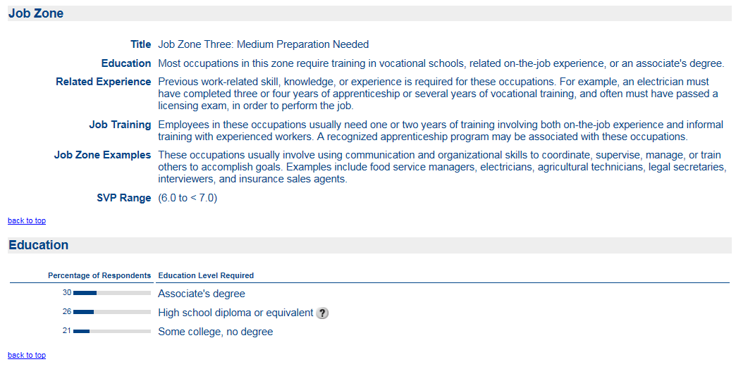

Slide 15
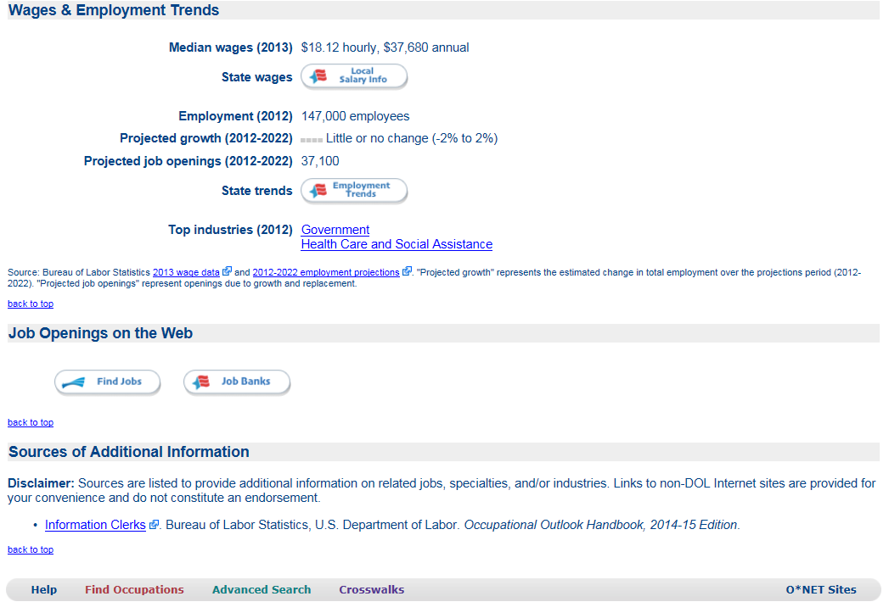

Slide 16
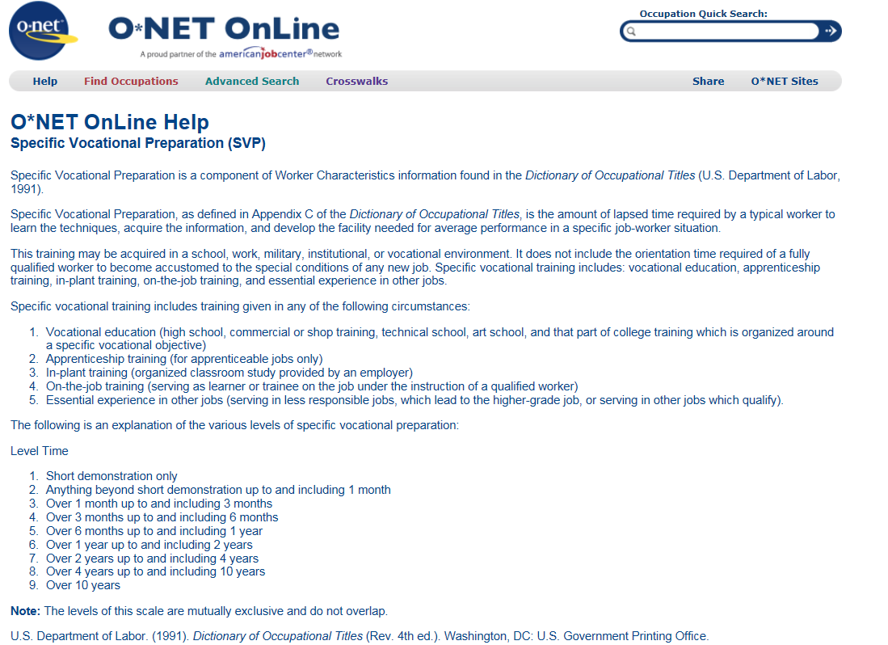

Slide 17
Step 2: DRAFT of the OJT Training Plan
Training Plan
  Utilized for OJT Matching process
  Identify potential OJT candidates skill gaps
Connection to OJT Contract & Monthly Progress Report
  Training Plan is embedded into the OJT Contract and Monthly Progress Report

Slide 18
Training Plan Example
Human Resource Assistant
Tasks | Competency Based Skills | Est. Hours | Instructional Method | Evaluation Method
Provides administrative support to Vice President of Human Resources and HR staff members. | Provides timely and accurate administrative support to HR department, includes files for Vice President; drafts letters, policies; develops spreadsheets; designs presentations and flyers; department supplies. | 50 | V=Verbal/Written Instruction S=Shadowing W=-Supervised Direct Work A= Assigned Readings | D= Observable Demonstration P= Product Review Q= Meets Performance Quota/Standard
Administers pre-employment process for new employee orientation to ensure all pre- employment paperwork requirements are completed. | Processes appropriate paperwork as outlined in pre-employment chart for new hire orientation. Maintains HR department files including employee records, CORI results, I-9 information, applicant tracking, updating In-Service tracker, etc., in a timely and accurate manner | 100 | V=Verbal/Written Instruction S=Shadowing W=-Supervised Direct Work A= Assigned Readings | D= Observable Demonstration P= Product Review Q= Meets Performance Quota/Standard
Maintains Employee files | Updates and distributes Employee Information Guide and Manager’s Guide, as directed by Vice President of HR. | 50 | V=Verbal/Written Instruction S=Shadowing W=-Supervised Direct Work A= Assigned Readings | D= Observable Demonstration P= Product Review Q= Meets Performance Quota/Standard

Slide 19
OJT Training Plan Resources
OJT Training Plan Examples
OJT training plans created and used by Massachusetts' local Workforce Investment Areas.
They are offered as examples only -- training plan elements, including training hours
and skills to be learned must be unique to each OJT Trainee.
http://www.massworkforce.org/OJT/TrainingPlanExamples/index.htm

Slide 20
Step 3: Identify Eligible OJT Participant(s)
Referral Options and Eligibility
  The participant must meet eligibility criteria for the opportunity.
  The DRAFT OJT training plan will guide the match process based on competencies outlined for the OJT position.

Slide 21
Assessment Process
Assessment Process
  Utilize local assessment process
Employer Interview Selection Process
  Forward ONLY eligible candidates
  Prepare candidates for interview

Slide 22
Step 4: OJT Pre-Contract and
Skills Gap Analysis
Participant Assessment and Skill Level
The OJT Pre-Contract form which includes the Skills Gap Analysis is completed with the name of the trainee and length of contract based on skills identified during the assessment. Trainee signs this section of the form. Now able to indicate to the employer the potential length in hours of OJT Contract and the amount of reimbursement.
Securing the funds!
Once approved informs OJT employer that funding has been approved and contract development will begin.

Slide 23
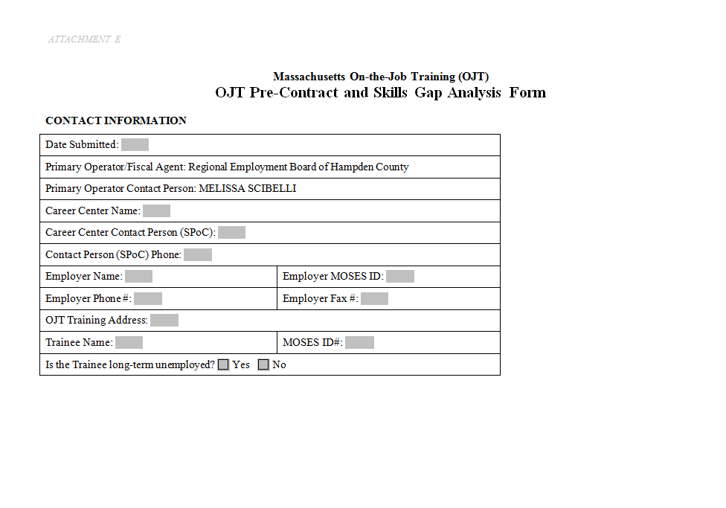

Slide 24
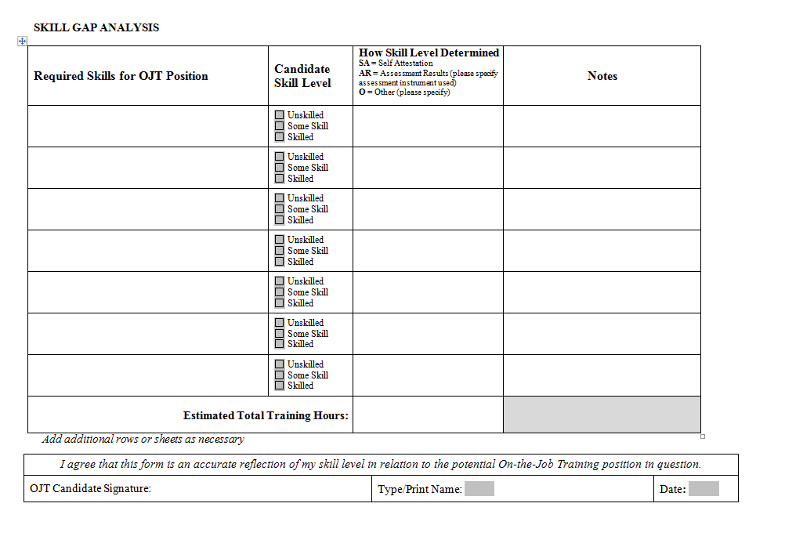

Slide 25
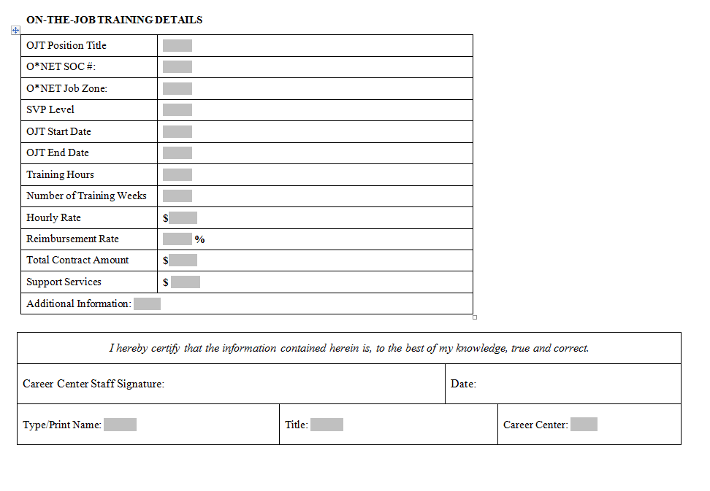

Slide 26
Step 5: OJT Contract and
Final Training Plan Design
Finalizing the OJT Training Plan with the Employer
DRAFT OJT Contract with outline of final OJT Training Plan embedded in contract is submitted to Employer for Review.
Employer approves and authorizes preparation of OJT Contract

Slide 27
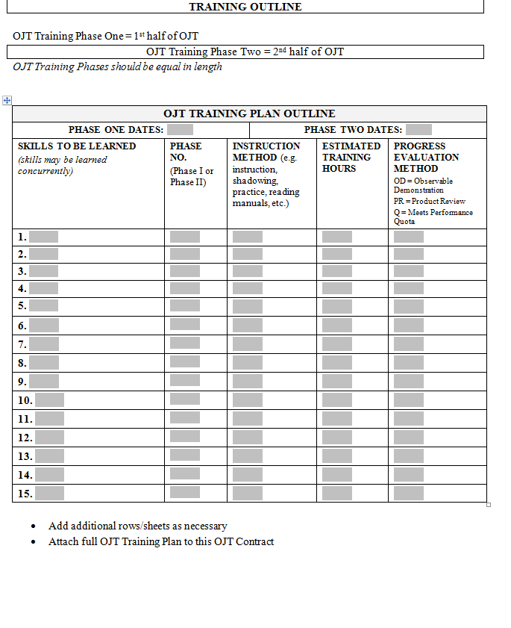

Slide 28
Step 6: OJT Contract Start-Up
At time of contract signing or prior to; the SPOC reviews the following with employer:
Invoicing Process
Monthly Progress Report
Local Monitoring

Slide 29
Step 7: Invoice and Progress Report
Invoice – Monthly Process
The Employer submits Invoice with backup documentation with the OJT Monthly Progress Report.
Verify for accuracy.
Process payment directly to the employer within 30-days of receipt of the invoice.

Slide 30
Step 8: Monitoring:
Local Area Monitoring
  Minimum two local area OJT monitoring visits
    One on-site visit, will be conducted during the term of the OJT
    Compliance with the training plan and other contractual stipulations.
    Discussions with both the employer and trainee to determine the trainee’s progress and to identify issues in need of resolution.

Slide 31
Step 9: Follow Up
Contract Modifications
Surveying the Customer and the Employer
New Business Needs

Slide 32
Questions, Comments, Closing Thoughts?

