Slide 1
U.S. Department of Labor Employment and training administration
REO Region 1 Peer to Peer Training Boston, Massachusetts April 12-14, 2016
Grants Management Training

Slide 2
Session Objectives
This session is designed as a general overview of grants management. Topics to be covered include:
finding answers to your questions
when to submit a request to modify your grant agreement
the importance of filing timely and accurate quarterly fiscal and program reports
preparing for onsite monitoring
common findings from onsite monitoring visits
Uniform Guidance for program managers

Slide 3
Where do I find answers to my questions?
If you have a question first reference your grant agreement. Is the answer there? Refer to your Statement of Work. What did you say you would do? Were you specific or broad in your plan? Reference the Special Clauses and Conditions No -→
Reference to your SGA/FOA – Is the topic mentioned in your SGA/FOA? No →
Section 169 of the Workforce Innovation and Opportunity Act (WIOA) No→
Section 212 of the Second Chance Act of 2007 No→
Reference TEGLs and TENs No→
Reference the Uniform Administrative Requirements and/or Cost Principles. No →
Still unsure? Email or call your FPO.
As you become a more experienced grant recipient you may start to feel confident that you can make your own decisions based on the information in the references. Document your decisions. Give your FPO a heads up on your decisions so there are no surprises during monitoring.
Notes:
When you call your FPO these are the materials they will reference.
Your FPO has no authority to provide approval, they provide guidance.
Your FPO may be able to provide you with guidance related to historic treatment of issues, can also consult the program and fiscal/admin offices.

Slide 4
Grant Modifications
Post Award Changes to the Grant Agreement

Slide 5
Learning Objectives
Become Familiar with Post Award Grant Agreement Changes
Understand Prior Approval Requirements
Identify the Source of Prior Approval Requirements
Understand Monitoring Implications

Slide 6
Learning Objectives Continued
Understand when a Modification is Necessary
Understand the Federal Project Officer (FPO) Role
Understand the Bases for Modification Approval
Receive Technical Instructions for Modifications – request procedures

Slide 7
Types of Modifications
What is a Modification?
A modification is the formal process used to make changes to your grant agreement
There are two Types of Modifications:
Grant Officer Initiated - Unilateral
Grantee Requested – Bi-lateral - needing Prior Approval

Slide 8
Grant Officer Initiated Modifications
Sample:
Increasing Funding
Decreasing Funding (Rescission)
Authorizing Pre-award Costs
Placing Special Conditions on the grant
Designation as “high risk” (per 29 CFR 95.14 or 29 CFR 97.12)
Disallowing Costs
Imposing Sanctions or Corrective Action Plans (CAPs)

Slide 9
Grantee Requested Modifications
Sample:
Administrative Corrections
Budget Realignment
Approved Indirect Cost Rate Agreement Incorporation
No Cost Extension
Equipment Purchase/Lease
Statement/Scope of Work Change
Novation Change (Organizational Name Change)
Changes in Key Personnel (SF-424)
Change of Fiscal Agent
Renovation and Alteration
Prior Approval for Specific Costs

Slide 10
When May A Modification Be Necessary?
This is not a comprehensive list however if there are changes to the 7 P’s, you probably will need a modification to your grant agreement
Partner – Grantee, Grantee name change, named partner
Personnel – includes signatory official, POC
Place – includes mailing address; EIN and DUNS; work site
Performance – includes changes in the scope or statement of work; performance targets
Period – includes start and end dates of the grant
Parts – includes equipment
Price – includes increase or decrease in grant award; changes in budget line items

Slide 11
When May a modification be necessary? continued
Administrative Corrections
Sample:
Grantee address was listed wrong on the 424
Grantee changes address
Spelling errors on the 424
Other administrative errors
Notes:
Now I will go through some of the most common modifications
For the purposes of this session we are going to focus on grantee requested modifications

Slide 12
Budget Modification
Realign Budget
Information needed:
Narrative explanation for the change either in the request letter or revised budget narrative
Revised 424A
Budget Change Summary Form
*Always consider if proposed changes will impact the statement or scope of work
Notes:
If it is a simple change you can just explain the change in your request letter. For more substantial changes you may be asked to submit a revised budget narrative.

Slide 13
Clause #1:-Budget Line Item Flexibility
Flexibility is allowed within the grant budget (except wages, salaries and fringe benefits, and indirect cost rates), provided no single line item is increased or decreased by more than 20%. Changes in excess of 20% and any changes in wages, salaries and fringe benefits, and indirect cost rates must receive prior written approval from the Grant Officer.
Any changes in mix or match within the wages and salaries line do not require a grant modification. However, your assigned DOL Federal Project Officer (FPO) must review these changes prior to implementing these changes. Failure consult with your FPO may result in cost disallowance.
Notes:
Common change – Putting Personnel and Fringe costs of subrecipients on the Personnel and Fringe line items of the 424A. These should go under contractual.
*FPOs do not have the authority to give prior approval. This has been interpreted to mean a “heads up.” FPO puts email in the grant file so there are no surprises during monitoring.
Increased or Decreased = In or Out

Slide 14
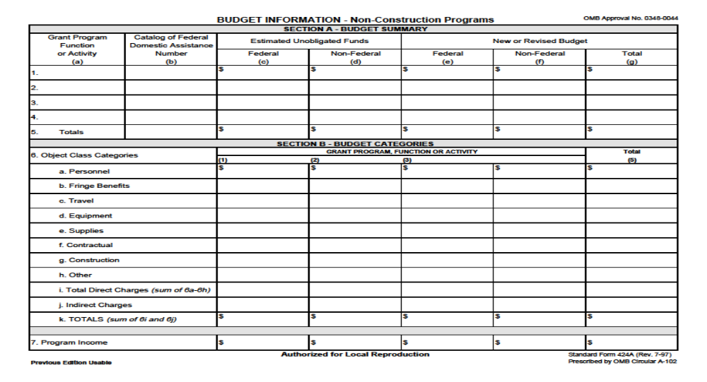
SF 424A

Slide 15
Approved Indirect Cost rate Incorporation
If your organization receives a newly approved indirect cost rate agreement this must be submitted for incorporation into your grant agreement
If there is a change in your agreement (rate or base) you may have to submit a corresponding budget realignment

Slide 16
No-Cost Extension
When the period-of-performance is extended to allow time to complete the project/program and/or utilize funding to achieve increased benefits in terms of greater number of participants trained and employed
More than one request for a no-cost extension is discouraged
Having surplus funding near the end of the grant period is not justification alone for a No-Cost Extension
Notes:
Start-up delays either on the part of the Federal Government or you, the grantee, may be grounds for a No-Cost Extension
Need to have demonstrated performance or the ability to perform
The regulations say “one-time” no cost extension.
Regulations say that no cost extensions given to “spend down remaining funding” is unallowable.

Slide 17
No-Cost Extension Request
Narrative with a detailed justification
Revised timeline for extension of more than three months
Address if the funds still be available if the period of performance is extended – Funds have a “life cycle”.
Regional Office Provided No Cost Extension Table
Requests for a no cost extension should be received no later than 90 days before the end of the grant
Notes:
How will the No-Cost Extension support the goals and outcomes of the grant?

Slide 18
No Cost Extension review table
Performance Indicator in approved SOW | Goal | As of Last APR | If Grant Ends as Scheduled | Activity within Extension Period | Total After Extension Period
Participants Enrolled | 2300 | 500 | 1500 | 800 | 2300
Participants Completed Training | 1900 | 300 | 1000 | 1000 | 2000*
Participants obtaining credentials
Participants obtaining a degree
Participants placed in unsubsidized employment
Participants Retained in Employment
Grant Expenditures | $2,500,000 | $1,200,000 | $2,000,000 | $500,000 | $2,500,000
Notes:
*If you are behind in your goals please don’t feel the need to raise your goals unless that is feasible.

Slide 19
Equipment
29 CFR 95.2 Definitions Equipment:
mean tangible non-expendable personal property including exempt property charged directly to the award having a useful life of more than one year and an acquisition cost of $5,000 or more per unit. However, consistent with recipient policy, lower limits may be established. Equipment includes, but is not limited to, equipment acquired before the publication of these regulations and equipment transferred from prior years.

Slide 20
Grant Agreement Part IV – Special Conditions
2. Equipment: Awardees must receive prior approval from the DOL/ETA Grant Officer for the purchase and/or lease of any equipment with a per unit acquisition cost of $5,000 or more, and a useful life of more than one year.
This includes the purchases of ADP equipment.
The grant award does not give approval for equipment even if it is specified in a grantee’s statement of work unless specifically approved in the grant award execution letter by the Grant Officer. If not, the awardee must submit a detailed description list to the FPO for review within 30 days of the grant/agreement award date. Failure to do so will necessitate the need for approval of equipment purchase on an individual basis.*
Notes:
*Per purchasing event – Don’t rush to do this, because you may end up with an approved list that doesn’t make sense when it is time to actually purchase equipment

Slide 21
Equipment Request Things to Consider before Requesting Approval
Verify that funds are budgeted
Maintenance of the equipment
Consider the “life” of your funding
Equipment should be purchased near the start of your programming
Notes:
You can buy a Ferrari when you have the governments money at your disposal but can you afford to put gas in it? Get the oil changed? If something breaks and you can’t afford to fix it the whole cost of the equipment could be disallowed as non-allocable.
The timing of your request will be looked at. - equipment in the last year may be non- allocable
Grant Officer Equipment Approval means that you may now go ahead with procurement

Slide 22
Equipment Request required items
Item/s name
Item description and basic specifications
Estimated useful life of equipment if not commonly know
Item cost estimated
Total cost of equipment purchase if multiple items
Include the cost to put the asset(s) in place and make it useable for the purposes it was acquired
Purpose of acquisition: a description of how the equipment will be used to support the grant and a reference to the approved activities in the Statement of Work (and the page numbers) This description and justification are critical as the information will provide the documentation that the costs to be incurred are or approved grant related activities and in the best interest of the government
Contact name and telephone number if additional information is required by the Grant Officer.
Notes:
Grant Officer approval doesn’t give you the authorization to purchase the exact brand etc of equipment you put in your request and at that amount. Grant Officer approval give you the authority to procure the equipment using your policies and procedures that are in compliance with the federal standards. All of the liability is still on the grantee to make sure that the equipment is reasonable, necessary, allocable.

Slide 23
Change to the Statement or Scope of Work
Any change to the products/deliverables, number of participants to be trained, industries for training, place of training (geographic location) or other performance criteria
Request should include:
Justify the change
Revised timeline/work schedule
Consideration of Budget
Notes:
Performance is never reduced – competitive award – pre award competitiveness
This is a bit of an art. Often times it comes down to how broad or how specific you were in your Statement or Scope of Work. If you said you would train in advanced manufacturing and that was it, you would have the flexibility to do any training within advanced manufacturing you want without having to mod the grant. If you said you were going to do Robotics and now that the grant has started robotics no longer makes sense and want to pivot to Metrology a modification would have to be done.
Many Scope or Statement of Work Changes come with Budget Realignment requests. Explain….
See Scope of Work focused slides at the end of this presentation.

Slide 24
Renovation
Renovation and alteration is allowable with prior approval from the Grant Officer
ETA historically has not given prior approval for Capital Improvements (which are technically allowable with prior approval) as they are difficult to justify in employment and training programs.\
ETA views renovation/alteration as occasionally a necessary cost to make a space usable for training or to make a space usable for a particular piece of equipment
Making a space ADA compliant is allowable with prior approval
Notes:
Note: As a general rule grants funds are not to be used to make a space “pretty” they are to make a space usable.
Note: When considering the cost of renovation ask yourself would you do the same renovations, pick the same fixtures etc. if the college was using its own money? If it was coming out of your pocket? Prudent person test.

Slide 25
Novation Change (organization changes its legal name)
These occur when a grantee or administrative entity’s name changes legally or as a result of other substantive changes in the entity receiving the grant (e.g., merger/buy out) and accountable for the funds, as opposed to an administrative correction to the grantee name.
If only the name of the recipient institution changes, and the rights and obligations of the recipient are not affected, it is the recipient’s responsibility to notify the grantor agency of the change and to provide the following documents:
• a copy of the instrument that effected the name change, authenticated by an appropriate official of the state having jurisdiction;
• an opinion of counsel for the recipient that the change of name was properly effected in accordance with applicable law; and
• a list of all grantor agency grants and cooperative agreements awarded to
The recipient organization, accompanied by a new application face page for each award showing the new name of the organization and the signatures of any new principal officers, if there are any, inserted above the old organization’s name and the signatures of the old principal officers. Receipt of the above documents and written acknowledgment of acceptance the appropriate grants official constitute a name change agreement.
Notes:
Quickly talk about this
Busy slide, I know but I would like you to have this information

Slide 26
Changes in Key Personnel
Signatory Change
Current Signatory leaves grantee organization or duties change
Current Signatory delegates authority to another staff person*
Request should include:
-Revised 424 (not 424A)
-Explanation of change
-When possible signed by both old and new signatories
-Supporting legal documentation
Point of Contact (POC) Change
May or may not required a modification
Notes:
In general “key personnel named in the grant documents” would equal the two individuals listed on the 424.
*This should not be taken lightly. The signatory is usually someone at the college that has the authority to sign grants/contracts and make high level decisions. This is usually the President of the Chancellor, President, Provost, Commissioner, Secretary, or other high ranking official. Signatory authority should be designated in your organization's by-laws. Delegating this responsibility
to a person below this level could have negative repercussions for your institution. Your institution will ultimately be financially responsible for any misuse of federal funds.
If we had to do mods every time a program manager changed…

Slide 27
Prior Approval for Grant Agreement Changes
Prior Approval Definitions
Sources of the Requirements
Monitoring and Auditing Prior approval requirements
Notes:
Where do federal agencies get their authority to modify grant agreements? It comes from the requirement in the federal regulations that grantees obtain written prior approval for certain actions and costs.
Prior approvals are necessary because of the extensive financial or programmatic impact on the grant if the recipient were allowed to undertake such changes in the budget or scope of work without grantor agency authorization. Furthermore, the grantor agency cannot exercise its financial and programmatic stewardship responsibilities without having prior approval requirements in place.

Slide 28
Definitions of Prior Approval
Non-Profits and Institutions of Higher Education and Hospitals
29 CFR 95.2 Definitions Prior Approval: mean written approval by an authorized official evidencing prior consent.
States and Local Governments
29 CFR 97.3 Definitions Prior Approval: means documentation evidencing consent prior to incurring specific cost.

Slide 29
Sources of Prior Approval Requirements
Non-Profits and Educational Institutions
DOL Regulations: 29 CFR 95.25 Revision of budget and program plans (from the Uniform Administrative requirements at 2 CFR 215.25)
Cost Principles: 2 CFR 220 App B 15. Equipment and other Capital Expenditures (Educational Ins) 2 CFR 230 (Non-Profits)
Grant Agreement Special Clauses and Conditions
Solicitation for Grant Applications (SGA)
Notes:
This is where you can go to find the exact language about prior approvals and changes to your grant agreement.
Many other specific costs require prior approval from the Grant Officer as found in the Cost Principles – Unallowable, Allowable with Prior Approval from Awarding Agency, Allowable

Slide 30
Sources of Prior approval requirements
States and Local Governments
DOL Regulations: 29 CFR 97.30 Changes. (from the Uniform Administrative Requirements at OMB Circular A-102 _.30)
Cost Principles: 2 CFR 225 App B 15. Equipment and other Capital Expenditures
Grant Agreement Special Clauses and Conditions
Solicitation for Grant Applications (SGA)
Notes:
This is where you can go to find the exact language about prior approvals and changes to your grant agreement.
Many other specific costs require prior approval from the Grant Officer as found in the Cost Principles – Unallowable, Allowable with Prior Approval from Awarding Agency, Allowable

Slide 31
Monitoring Prior Approval
FPOs are responsible for monitoring grants to ensure prior approvals were obtained by looking to see
that the scope of work, as stated in the approved grant award, has not changed
that grant funds are being spent in accordance with the approved budget
equipment purchased was done so with prior approval
Notes:
Auditors should also be checking to make sure prior approvals were obtained

Slide 32
Monitoring Prior Approvals Continued
FPOs will check to make sure that grantees have written policies and procedures related to prior approvals
Do you have a written policy explaining to staff which types of changes require prior approval?
How is this policy disseminated?
Are internal approvals designed to prevent accidental expenditures that should have been approved by the awarding agency before being incurred?
Notes:
Not only will FPO check to see if you have policies and procedures they will check to see if you followed them

Slide 33
Change was made without prior approval
Costs associated with the change may be disallowed
You must address the fundamental problem of why prior approval was not obtained. Internal Controls Issues?
You may be required to develop a corrective action plan to rectify the issue
Notes:
Just because you received prior approval doesn’t make the cost necessarily allowable. Important to highlight: Even where the recipient has authority for rebudgeting actions, if it is determined, through monitoring, audit or otherwise, that the costs do not meet the required tests of allowability, allocability, applicability, or reasonableness, the costs may be disallowed.
If it is discovered at close-out that you made changes to your budget without prior approval the costs may be disallowed

Slide 34
FPO Role – Modification Process
The FPO is responsible for evaluating and recommending requests for modifications
FPO evaluates the proposed change, as well as the decision to recommend acceptance, partial acceptance or rejection of proposed changes
FPO monitors to verify that prior approval for certain grant changes were obtained
Notes:
Recommendation is to the Grant Officer

Slide 35
Bases for Modification Approval
Help or not hurt government position (public interest)
Better use of resources
Necessary (& lawful)
Reasonable (& lawful)
Allocable (supports grant goals)
Increases external support (tangible or intangible)
Increases sustainability (after grant expires)
Is replicable
A good idea (best practice)
Labor Market Information dictates a change
Doesn’t compromise your pre-award competitiveness
Notes:
Grant was awarded on a competitive basis, this is taken into account when we evaluation modifications.
Only the Grant Officer who signed the Grant Agreement, or a designate, has the authority to provide written approval or disapproval of prior approval requests. This is important to understand. While an FPO may express that your modification justification is sound, that doesn’t mean that you have obtained prior approval. FPOs do not have the authority to provide prior approvals. So if an unauthorized official responds to the request, such responses are not considered binding on the government.

Slide 36
Technical Instructions
As soon as you think you may need a modification you should call or email your FPO
Submit a complete draft of the required paperwork as one PDF containing all required documents to the FPO via Email
FPO reviews the draft and provides feedback/corrections to the Grantee
If next version is acceptable they will ask you to get the request signed and submit it back to them
FPO initiates the grant modification process
Grant Officer either approves, approves with conditions, or denies
Note: Do not submit anything to the National Office either via regular mail or via email. All mods are processed electronically through your FPO.
Notes:
Mutually proactive process between the FPO, the grantee, and the Grant Officer
A modification may be initiated by either party to the grant. The FPO may discover though an on-site review, reviewing reports, or though phone or email that the grantee is off track and may suggest a modification.
Submitting a draft to your FPO saves having to go back to the grant signatory if changes are needed to the request
Allow one month for the request to be processed and approved. It may be more or less. Make sure that you consider this when planning.

Slide 37
All Modification Requests Should Include:
Letter on official organization letterhead
Signed by the grant signatory
Addressed to the Grant Officer listed on your grant agreement
Sent via email to your FPO
Letter must include language explaining the need for a modification and how the modification supports the goals of the grant.
Contact name and telephone number if additional information is required by the Grant Officer.
Notes:
Even though the actual letter is address to the grant officer listed on your grant agreement, the documents are sent to your FPO via email
Note: for budget mods a revised 424A is always required – see slide on budget mods

Slide 38
Modification Quiz – True or False
You listed equipment in your grant proposal and your proposal was accepted and awarded. You may now go ahead and purchase the equipment
A revised timeline/work schedule should be included with a No Cost Extension and Statement of Work request
I can make changes to my budget as needed and then later request a budget realignment to reflect actual spending.
Notes:
False. Approval of your award does not constitute prior approval
Maybe, if the request is for an extension longer than 3 months. This helps the FPO and Grant Officer in evaluating your request
False. Budget Realignments (outside of your flexibility) require prior written approval. Never assume you have approval until you receive the modification

Slide 39
Modification Quiz Continued – True or False
My organization is going to buy 20 laptop computers at $2000 a piece. This is equipment so I need to get prior approval from the Grant Officer.
I have completed my grant and met all the goals and objectives, however I have $20,000 remaining. I should request a No-Cost Extension to “use the money up.” I think I could update my organization's computer lab.
I stated in my grant proposal that I would be training Mammographers. Now that the grant is up and running we are hearing from the industry that there is no longer a demand for Mammographers; Sonographers are now in high demand. I don’t need a modification because I’m still training in Healthcare.
Notes:
False. Per unit the laptops are $2000. They are considered supplies by the Federal definition. Exception! Creating a new LAN. The new LAN is considered a unit by ETA Grant Officer case history. Explain…
False. Coming in under cost, having met all of the goals and objectives of your grant, is not justification for a no-cost extension.
Maybe! You need to discuss this with your FPO. Chances are, you would need an SOW modification because you are changing your statement work.

Slide 40
New Regulations
Uniform Guidance
200.407 Prior written approval (prior approval)
Specifies approval is in writing
See list after Uniform Guidance: Cost Principles
DOL Exceptions to Uniform Guidance
2900.16 Prior written approval (prior approval)
Non-Federal entity must request approval
Submit not less than 30 days prior to action date
Only Grant Officer has authority to approve
  For formula grants, authority delegated to Governor
Items in award budget not constitute prior approval
  For example, individual pieces of equipment under the equipment line
Notes:
Written approval must be obtained before the cost is actually incurred. Approval for a cost already charged to the grant may lead to disallowance of the cost. The Uniform Guidance addresses prior approval requirements at 2 CFR 200.407—Prior written approval (prior approval), and the clarifications and additional requirements for DOL grants are found at 2 CFR 2900.16. The Uniform Guidance requirements specify that approval must be in writing. The DOL guidance further specifies that the non-Federal entity must request such approval, that the request be submitted at least 30 days prior to the date the requested action is to occur, that only the Grant Officer has the authority to issue such approvals on behalf of ETA, and that having any items included in a grant budget is not equivalent to meeting these requirements. For formula grants, the ETA has delegated such prior approval authority to the Governor for their costs and for all such costs that require prior approval at the subrecipient level.

Slide 41
Prior Written Approval?
  IMPORTANT!!!
  Before incurring cost
    Must be submitted in writing to the Grant Officer
    Must be approved in writing by the Grant Officer
      Cannot be an email from the Federal Project Officer
    Inclusion of items in the grant budget does not constitute prior approval
    Non-compliance may lead to disallowed costs
Notes:
To recap: Prior approval requirements are formally defined as prior written approval. This means that telephone conversations with your FPO are not considered as approval. The DOL guidance specifies that only the Grant Officer has the authority to approve. What is the practical effect of that? Well, it means an e-mail from your FPO is not adequate unless your FPO has been identified in the grant agreement as having that authority.
Approval must be obtained before the cost is actually incurred. All requests must be made in writing and must be formally approved by the Grant Officer.
Requesting approval or failure to obtain prior approval for a cost already charged to the grant may lead to disallowance of the cost.
Approval of the budget as awarded does not constitute prior approval of those items requiring prior approval, including those items specified in the cost principles or the grant award as requiring prior approval such as equipment. The Grant Officer is the only official with the authority to provide prior written approval.
In the case of a pass-through entity’s subrecipient, because these costs are shown on the recipient’s contractual budget line, the Uniform Guidance requirement does not directly apply to adjustments in a subrecipient’s budget line items. The agreement between the pass-through entity and the subrecipient should clearly state when approval is required for changes in the subrecipient budget. DOL’s authority to approve certain expenditures, such as equipment purchases, applies regardless of whether the grant funds are expended by the recipient or a subrecipient.

Slide 42
Conferences
Requirements for Conference and Conference Space
Conferences sponsored in whole or in part by the recipient of Federal awards are allowable if the conference is necessary and reasonable for the successful performance of the Federal Award. Recipients are urged to use discretion and judgment to ensure that all conference costs charged to the grant are appropriate and allowable.
For more information on the requirements and allowability of costs associated with conferences, see 200.432.
Notes:
Use of grant funds for conferences and conference space must meet necessary and reasonable tests associated with successful performance of the Federal Award.
The Uniform Guidance contains additional requirements at 200.432.

Slide 43
Travel Expenses
Funding for Travel to and from Meetings with an Executive Branch Agency
Grant funds may not be used for the purposes of defraying the costs of a conference held by any Executive branch department, agency, board, commission, or office unless it is directly and programmatically related to the purpose for which the grant or contract was awarded.
Must comply with Office of Management and Budget Memorandum M-1-12 dated May 11, 2012. (P.L. 113-6, 3003 (c)(d)(e)).
Notes:
In addition, use of grant funds for travel associated with an Executive Branch agency is restricted to programmatically-related conferences.

Slide 44


THE GRANT MODIFICATION
PROCESS
Notes:
In this section of the training, we will review the types and reasons for a grant modification and the responsibilities of the pass-through entities for subrecipient actions.

Slide 45
When Do You Need a
Grant Modification?
200.308 Revision of budget and program plans
A grant modification is a change to
  Period of Performance (POP)
  Budget
  Statement of Work
  Equipment Purchase
  Administrative
A grant modification is the vehicle through which the Grant Officer provides prior written approval for these grant-related actions
Notes:
Just what is a grant modification? It is a FORMAL change to the grant agreement. The slide lists the five basic categories of grant modifications. It may be a change to the budget, how the budget is aligned, to the Statement of Work in the expected time frames and performance required under the grant or a change to one of the other terms and conditions listed in the grant agreement. There are also administrative modifications that change the signatory official, addresses or other administrative requirements. It may also involve prior grant officer approval to purchase equipment, or to engage in obtaining conference space. Grant modifications may occur throughout the life of the grant depending on need and circumstances; however, the Grant Officer must always ensure that the modification does not materially change the basis upon which the initial award was made. ETA provides prior written approval through a grant modification.

Slide 46
Who Initiates the Action?
Unilateral
  Awarding agency initiates changes
Bilateral
  Submitted primarily by the non-Federal entity
  Requires written approval by the Grant Officer
Notes:
Modifications may be initiated by the recipient, the Grant Officer or both. There are two overall categories for grant modifications:
Unilateral: In a unilateral modification, the Grant Officer will initiate the change and it does not need the agreement of the recipient prior to becoming effective. These modifications are generally done to change the name of the Federal Project Officer assigned to the grant, to impose additional conditions on the grant or include new requirements or information in the grant agreement.
Bilateral: While the Grant Officer may initiate a bilateral modification, these actions are most often initiated by the recipient. They require both acceptance and approval (signature) by the Grant Officer. Examples of bilateral modifications include period of performance extensions or approval to incur specific costs.

Slide 47
Submission Requirements
All requests need a dated cover letter, on
organizational letterhead, providing:
  Basics
    Grant number
    Award amount
    Period of performance
  The specific type of modification requested
Notes:
Whatever type of modification is being requested, it is very important that you make a solid business case to the Grant Officer for approval. While there is no specific template or required format for a grant modification, if the request is made with the following criteria or elements included, your chances of approval are enhanced.
All formal requests should be made using the organizational letterhead and be dated.
The request should contain the following information that will allow ETA to quickly have all pertinent information in a single source document:
Always include the basics such as the grant number, award amount and the period of performance. You should specify the type of modification that’s being requested. Depending on the type of modification being requested, it may be helpful to include the number of participants enrolled to date as well as the expenditures to date. In addition, depending on the type of modification, you will need to provide supporting documentation and solid rationale for the modification.

Slide 48
Specific Supporting
Information
Additional information needed:
  An explanation of the need for the request
  Why modifying the grant is necessary to achieve
  grant goals and performance measures
  Signature of the authorized representative
Notes:
To make the best case for approval, additional supporting information should be included with every single request:
An explanation of the need for the request. Provide detailed information on the need for the request including the exact impact on the grant. For example, if you are requesting a modification to extend the period of performance, this would include additional performance goals and how the modification will allow you to meet those expanded goals.
Why is modifying the grant is necessary to achieve grant goals and performance measures? For example, if you are requesting prior approval for conference space, you should describe the impact on grant performance if the approval is not granted. Or how the grant activity will be enhanced through implementing a more collaborative chain of participant support actions that will come out of the meeting, etc. It’s important that modification requests are made with the government’s best interests in mind. The more you can “make the case” for the Grant Officer, the more probable approval will happen.
Signature of the authorized representative. All grant modifications must be signed by the organizational representative with the authority to commit the recipient to undertake the actions requested.

Slide 49
Modification Type:
Period-of-Performance Extension
A POP Extension:
  Extends the grant period (Period of Performance)
  No additional funding
  No change to
    The budget or
    Performance measures or
    The Statement of Work
Notes:
Known as a POP, a period of performance extension is done to extend the grant period.
There is no additional funding provided by ETA and this type of modification will not result in changes to the budget, the overall performance measures or goals nor to the Statement of work. All that is done is to extend the amount of time available to expend grant funds (and achieve performance) by the recipient.
Extensions are typically done in six-month increments, for up to one year beyond the award’s original end date.
This is very often done in order to achieve the full grant outcomes specified in the grants. These might be lagging in completion due to a late start-up or for some other legitimate reason. In order to receive an approval from the Grant Officer, it is important to understand that you must make a business case for the extension. You should have documentation that support the claim that performance can be achieved if the POP extension is granted.

Slide 50
Requesting a
Period-of-Performance Extension
Recipient needs to provide:
  Evidence that existing funds are adequate to
  extend the grant
  Any other supporting information requested by
  the FPO
If circumstances warrant, ETA may extend
the period up to one additional year, typically
in six-month increments
Having money leftover at the end of a grant is not adequate
justification to extend the POP
Notes:
When you request a POP extension, there are additional materials to be included with the request. As stated before, all modification requests should be made attached to the cover letter on organization letterhead signed by official representative.
To support the request, you need to provide ETA with rationale for the request, including any additional actions that you will take to ensure that performance goals will be met and assurances that these actions will result in either the original or in some instances additional performance goals are accomplished
These would include a month-by-month timeline of grant activities, the actions and timeline should also be tied to expenditures over the course of the extended period. This is needed to ensure the grant officer that the existing funds in the grant will be adequate to undertake all the actions. You would also need to include any other supporting documentation that the FPO requests in support of the request.
REMEMBER—Just having money left at the end of a grant is never going to be considered as adequate justification to extend the period of performance.

Slide 51
Modification Type:
Budget Realignment
A Budget Realignment
  Redistributes grant funds among the budget line items on the 424A
  Does not change the
    Grant award
    Period of performance
    Measures/goals or
    Statement of Work
Notes:
A budget realignment modification is done to redistribute the overall funding among the budget line items on the SF-424A. There are a number of reasons why the need to realign a budget arises: Underspending in one or another category, unanticipated need to redesign service delivery, finalization of an interim indirect cost rate or an increase in travel costs over projections are among the reasons.
The sole result of a budget realignment modification is the recategorization of funds within the object classes on the SF-424A, to better indicate how the funds will be expended in accordance with the grant terms and conditions and to achieve the grant outcomes. A budget realignment modification does not change the grant award amount or the period of performance. Neither does it impact the overall goals of the grant, the statement of work nor the performance measures. Rather it refines the spending patterns to better identify how the funds will be spent by object class or budget line item.

Slide 52
What Is a
Budget Realignment?
200.308 Revision of budget and program plans
(b) Recipients are required to report deviations from budget or project scope or objective, and request prior approvals from Federal awarding agencies for budget and program plan revisions, in accordance with this section.
The awarding agency may restrict the transfer of funds among direct cost categories if the cumulative amount exceeds 10 percent of the last approved budget (200.308(e))
Notes:
As we have stated, a budget realignment is simply a shifting of budget authority between the cost objectives of the SF-424A.
Prior approval is required if the realignment between categories exceeds 10 percent of the approved budget.
This is a significant change to alert you to. For grants awarded after Dec 26, 2014, DOL-ETA will change the criteria for budget realignment to mirror the Uniform Guidance.
For grants awarded prior to December 2014, the existing conditions contain in your grant will remain in effect which includes criteria for budget realignment which is a bit different than the new guidelines. For these grants, the conditions specify that any change for salaries, fringe benefits and indirect costs, regardless of the percentage or amounts, will require grant officer approval. Also the maximum allowable change between the other cost categories is set at 20%. Moving forward, any new award of monies will be governed by the Uniform Guidance criteria, which is set at 10%.

Slide 53
Budget Line Item Flexibility
Flexibility for all line items
Prior approval when the cumulative amount of
transfers exceeds or is expected to exceed 10
percent of the total budget
Prior approval must be written
Process re-starts after each approval
Consult your FPO if in doubt
Notes:
Recipients are allowed to shift funds between any or all of the budget line items although there are certain conditions or criteria that must be approved in advance by the Grant Officer. First, budget line adjustments cannot exceed 10 percent of the grant budget without the prior written approval of the Grant Officer. Failure on the part of the recipient to obtain such prior written approval may result in disallowed costs. ETA further recommends that your Federal Project Officer (FPO) review within-line changes prior to implementation to ensure they do not require a modification.
When modifying the grant, these changes become cumulative—in other words, if you realign the budget multiple times, you still have to compare the new budget to the most recently approved version to determine whether the changes trigger the requirement to get prior approval.
Once you have a budget realignment approved, the process resets, or starts over, so from that approval, any subsequent changes of over 10 percent would trigger another prior approval request.
Again, this approval must be formal, i.e., written. As discussed in other modules, a system of budget controls is essential to make sure that you manage the costs against the budget line items. When in doubt, check with your FPO!

Slide 54
Requesting a Budget Realignment
Recipient needs to provide:
  Cover letter on organization letterhead
    Identify the budget categories which are changing and by how much
  Include the current 424A budget and a revised 424A budget
  A revised budget narrative
  Any other information requested by the FPO
Notes:
When you request a budget realignment modification, there are additional materials to be included with the request. As stated before, all modification requests should be made attached to the cover letter on organization letterhead signed by official representative.
To support the request, you need to provide ETA with rationale for the request, including any additional actions that you will take to ensure that performance goals will be met. As the recipient, you also need to provide a copy of the new proposed SF-424A along with the current budget form and a detailed explanation of why the changes are necessary. This explanation may be in addition to or included with a revised budget narrative. Remember, that for every increase to a line item, there is concurrent decrease in one or more other budget line items that would need to be addressed. A budget realignment does not add funds to the project.
For example, if you are adding funds to the personnel line item, you would need to indicate if the funds are for additional staff persons or simply more funding for current staff. If the latter, then you would need to have supporting documentation such as Board minutes that authorize additional salary costs. You would also need to include any additional information to support the request that is requested by the FPO.

Slide 55
Modification Type:
Change to Statement of Work
Any change to the
  Major objectives of the project
  Major activities of the project
  Performance outcomes
  Population to be served
  Other major component of the project
Notes:
A Statement of Work modification involves a request to change to the major objectives of the project, to the major activities outlined in the project or to the proposed performance outcomes specified in the grant agreement.
It also includes any proposed changes to the population to be served or other components of the project.
Statement of Work modifications are not done often. If the proposal was submitted and evaluated as part of an FOA, then changes to any of the major components would invalidate the selection process and therefore not be approvable. So changes need to be in line with overall goals of the solicitation in order to receive approval.
In order to change material parts of the statement of work, the recipient would need to make a strong case, backed up by documentation, that such changes are in the best interests of the government.

Slide 56
Modification Type:
Equipment Purchase
200.439 Equipment and other capital expenditures
$5000 or more per unit acquisition cost
Useful life of more than one year, or as negotiated in the Indirect Cost Rate Agreement
Grant award itself is not prior approval
No equipment purchases in last year of grant
Approval will be provided in writing
Notes:
Equipment is defined as tangible property (different from intellectual property) with a useful life of at least a year and an acquisition cost of $5,000 or more. That cost threshold also includes any ancillary costs associated with the acquisition.
The requirements for approval of equipment purchases are described in Item 9.e of the grant Terms and Conditions. That approval is then requested through an equipment modification.
All recipients and subrecipients must receive prior approval from the DOL/ETA Grant Officer for such purchases. This includes the purchases of ADP equipment. Equipment purchases must be made in accordance with the equipment requirements specified in the Uniform Guidance at 200.439. The prior approval does not relieve recipients of following appropriate procurement procedures for the actual acquisition.
There is also a further restriction that equipment may not be purchased in the last year of performance. If any approved acquisition has not occurred prior to the last year of performance, approval for that item(s) is rescinded and any funds expended for such purposes would be subject to disallowance.

Slide 57
Additional Criteria
Should be budgeted for as equipment in the 424A,
  The item of equipment specifically described
  and need explained in the budget narrative
Requires prior ETA approval, even if included
in the application, grant SOW, budget, or
other documents
Notes:
In order to receive a modification approval, the costs should be budgeted as the line item equipment on the SF-424A. Each item should be specifically described and the need for the equipment thoroughly explained in the budget narrative. The request should also address any changes to the previously supported material.
The acquisition of equipment requires the prior approval of the ETA Grant Officer. It does not matter if the costs were included in the grant application, the grant statement of work, approved budget, budget narrative or any other document. Failure to obtain the prior approval or request the modification can result in disallowed costs.

Slide 58
Required Elements
of Request (ETO 2-12)
Item name
Item description and basic specifications
Estimated useful life of equipment, if not commonly known
Item cost, actual or estimated, (and total cost if multiple items) including the cost to put the asset(s) in place and make it usable for the purposes it was acquired, if known
Purpose of acquisition: a description of how the equipment will be used to support the grant, with reference to approved activities in the Statement of Work
Contact name and telephone number if additional information is required
For some programs, program office concurrence
Notes:
In requesting prior written approval for equipment purchase, these are the key elements that must be part of that request. You must describe how the equipment relates to the project activities, and provide specific page numbers in the Statement of Work, if known. This description and justification are critical as the information will provide the documentation that the costs to be incurred are for approved grant-related activities and in the best interests of the government.
See Employment and Training Order No. 2-12 for additional detail.

Slide 59

Modification Type:
Administrative Change
An Administrative Change is a change to general grant
or recipient information, such as
Mailing address
Phone number
Contact information
Authorized Representative
Key Personnel
Notes:
An administrative change modification is a request to change or update general information, either about the grant or the recipient organization.
Examples of administrative changes would be changes to
The recipient’s mailing address
The recipient organization phone number
Any changes in contact organization
A change in the signatory official for the grant and
Any changes in key personnel listed in the grant

Slide 60
Requesting
Administrative Changes
What information is changing and why
An effective date for the changes
Any other information requested by the FPO
Notes:
In order to request an administrative modification, the recipient should submit a cover letter on organization letterhead. The request should detail what information is changing and the reasons for the change. The letter should also specify an effective date for the changes.
On occasion, the FPO will request additional information to support the request. For example, the FPO may request a copy of Board Minutes to support a change in signatory authority or a document signed by the Board Chair or other authorized official.

Slide 61
Factors Considered by
the Grant Officer
Decisions are made with ETA objectives in mind
  In the spirit and letter of ETA expectations
  Needed to achieve ETA return on investment (grant goals and performance measures)
Recipient Request
ETA Needs
Notes:
In the end, the decision to approve or disapprove a modification request rests with the ETA Grant Officer. He or she will make the decision with ETA objectives in mind and in both the spirit and letter of ETA expectations. Any approved modification action must assist ETA to realize a return on the Federal investment in light of the expected grant outcomes and meeting of performance measures. As we discussed previously, the Grant Officer looks to the bases for the modification in approval or disapproval of the request.
For the Grant Officer to approve a modification request, both the recipient needs (request) and ETA needs must converge.

Slide 62
ETA Roles
FPO:
  Provides technical assistance to recipients
  Participates in the review process
  Provides the Grant Officer with recommendation to approve or not
  Communicates with recipients
Regional Office Grant Officer
  Reviews modification requests
  Approves or disapproves equipment requests
  Forwards other recommended modifications to the Grant Officer
  Directs FPO to initiate any necessary follow-up with recipient
National Office (Awarding) Grant Officer
  If the Grant Officer concurs with recommendation, he/she will issue an approval notice to the recipient
Notes:
A number of individuals in ETA have responsibilities for modification requests.
The Federal Project Officer or FPO is the primary point of contact for all grant related activity. For modifications, the FPO provides technical assistance in preparing the request and ensuring that all appropriate documents are included. He or she also participates in the review process and will provide the Grant Officer with a recommendation on whether the modification request should or should not be approved. As the primary point of contact, the FPO is responsible for all communication with the recipient.
The Regional Grant Officer reviews the modification requests with the FPO, and makes determinations on equipment requests. If the modification request is not deemed sufficient, or for any further follow-up action, he or she will have the FPO return the request to the recipient for further refinement. The Regional Grant Officer is responsible for forwarding the request to the awarding Grant Officer in the National Office along with a recommendation for disposition.
The awarding Grant Officer is the one who signed the grant agreement on behalf of ETA. If the Grant Officer concurs with the recommendation of the Regional Office, a signed approval notice is issued to the recipient. If they do not concur with the recommendation, they will either deny the request or return the request to the Regional Office for more information.

Slide 63
Subgrant Modifications
Criteria should mirror Federal requirements
Pass-through entity must ensure:
  Prior approval is obtained for subrecipients
  Criteria for modifications are monitored
  Modifications are done timely
Notes:
The process for modifications of subawards is similar to the Federal requirements.
The pass-through entity must ensure that they have a process in place to modify subawards and that the criteria for approval is transmitted to subrecipients or contained in the agreement’s terms and conditions.
They are responsible for obtaining the necessary prior approvals for subrecipients, especially for equipment, and ensuring that the subrecipient complies with requirements that the recipient submit and obtain approval from the ETA Grant Officer prior to incurring the costs. For formula grants, the State is the approving authority for required modifications including prior approval of costs/equipment.
Pass-through entities (whether formula or discretionary ETA recipients) are also responsible for monitoring and updating the criteria for modifications and informing subrecipients of any changes in the process that may impact their program activities and performance. In addition, they must ensure that the modifications are done timely and notice of approval or denial provided to the subrecipients also in a timely manner.
The processes we have discussed in this module can be applied and incorporated into your system for agreement management.

Slide 64
Financial Reporting
Importance of On time Reporting
Importance of Reporting on an Accrual Basis
Notes:
On time reporting in GEMS risk assessment
If you can’t report on time with 45 days what else is going on at your organization?

Slide 65
On-Site Monitoring
Monitoring not Auditing
Core Guide
Financial Supplement to Core Guide
Partners in the process
Make you Audit Proof
Notes:
Use core guide, financial supplement to core guide
Need to focus on administrative aspect. No time for the dog and pony show.

Slide 66
Monitoring process
Findings/Corrective Action
Areas of Concern/Suggested Action
Noted Practices
Monitoring Process - Dates
Notes:
30 days from exit to get them the report
30 days from receipt of report to respond
Finding resolution

Slide 67
Common Findings
Accrual Reporting
Selective Service Registration
Cost Allocation
Procurement
Cash Management
Subrecipient Monitoring
Policies and Procedures for conducting and documenting eligibility
Notes:
Accrual reporting - recipients’ financial management systems shall provide for the following: (1) Accurate, current and complete disclosure of the financial results of each federally-sponsored project or program in accordance with the reporting requirements set forth in 95.52. Though DOL requires reporting on an accrual basis from a recipient that maintains its records on other than an accrual basis, the recipient shall not be required to establish an accrual accounting system. These recipients may develop such accrual data for its reports on the basis of an analysis of the documentation on hand.
Selective Service Registration
Cost Allocation Issues – space and personnel time
Procurement of training providers – naming someone in your proposal is not justification for sole source
Cash management – drawing down funds
Subrecipient monitoring
Policy and Procedure for conducting and documenting eligibility – not prescribed in the FOA usually by your own grant proposal.

Slide 68
Subrecipient Monitoring and Management
200.330 Subrecipient and Contractor Determination
  Characteristics substantially the same as before
  Changes term vendors to contractors
  Affects audits, procurement and other requirements
Subrecipient
  Determines eligibility
  Responsible for programmatic decision making
  Carries out a program for public purpose
Contractor
  Obtains goods and services for use of awardee
  Normal business operations and ancillary to Federal program
Notes:
Now found in the section on Subrecipient Monitoring and Management, the characteristics of both subrecipients and contractors are substantially the same as the language in A-133, with the exception that the word “vendor” has been replaced with “contractor” to clarify the requirements.
This distinction and classification of each subaward can have a material affect on whether the requirements for audits, procurement and other administrative rules are applied.
A subrecipient relationship is established when the non-Federal entity undertakes such responsibilities as determining eligibility, is responsible for programmatic decision making such as enrollment or determining appropriate action, and carries out its program for the public good. It is important that you understand that the Federal regulations follow the Federal dollars awarded to all subrecipients, their subrecipients and on down. In other words, if your organization is a subrecipient 3 levels removed from the direct recipient, then you must still comply with all Federal requirements, and these are to be reflected in your award documents.
[Continued on next page]

Slide 69
Subrecipient Monitoring and Management
200.330 Subrecipient and Contractor Determination
  Characteristics substantially the same as before
  Changes term vendors to contractors
  Affects audits, procurement and other requirements
Subrecipient
  Determines eligibility
  Responsible for programmatic decision making
  Carries out a program for public purpose
Contractor
  Obtains goods and services for use of awardee
  Normal business operations and ancillary to Federal program
Notes:
[Continued from previous page]
A contractor, on the other hand, simply provides goods and services for the use of the prime awardee, and provides these goods and services as part of their normal business operations. The goods and services are considered ancillary to the Federal program, and while necessary to program operations, are not considered essential to achieving the program outcomes.
The Guidance is also quite clear that it is the relationship that defines the determination. It does not matter if the recipient calls its subawards contracts or grants or awards, but rather whether the activity in the agreement meets the specific criteria. Changes to the procurement requirements impact how these awards are procured.

Slide 70
Subrecipient Monitoring and Management (2)
200.331-332
Requirements for Pass-through Entities
  Subrecipient monitoring tools & guidance
Indirect costs guidance
Pass-through Entities
  Must use judgment based on criteria
  Must classify each subaward as:
    A Subrecipient
    A contractor
Fixed Amount Subawards – new provision
Notes:
The next section of guidance is titled Subrecipient Monitoring and Management. In this section of the regulations, the requirements for the management and monitoring of subrecipients are addressed, as well as specify the responsibilities of pass-through entities. Guidance on requirements for indirect costs are also included and will be addressed on the next slide.
Included in this section are requirements that pass-through entities classify each and every award of funds as either a “subrecipient” or a “contractor” using their best judgment based on the criteria listed in the regulations and the specific requirements that apply to subagreements, as well as the management and monitoring of subrecipients.
There is also a provision for fixed amount awards which as we have discussed, are rarely used by ETA.

Slide 71
Subrecipient Monitoring and Management (3)
Ensure subawards appropriately identified
Specifies required information for each award
  Includes Federal Award Identification Number (FAIN) and DUNS numbers
  CFDA Number and dollar amount of each
Evaluate risk of non-compliance
Monitor subaward activities
  Specified actions
Verify audit coverage as required
Notes:
All pass-through entities (or PTEs) have additional responsibilities specified in the guidance. They must ensure that subawards are appropriately identified, including the inclusion of specific information in the award document. This includes specifying the unique entity identifier, which in the short term is the DUNS number for each organization, and listing the dollar amount of each award by CFDA number. If there are multiple sources of funds, all CFDA numbers and amounts must be clearly identified.
Pass-through entities must also evaluate the risk for non-compliance by each subrecipient and impose specific conditions to ensure compliance if warranted. If required, they must also verify that audit coverage has been obtained.
Pass-through entities must also honor the organization’s current indirect cost rates, negotiate a rate in accordance with guidelines, or provide the minimum flat rate known as the “de minimus rate”.
Finally, the section adds specific subrecipient monitoring tools that were in the audit Compliance Supplement. They incorporate and combine subrecipient monitoring guidance.

Slide 72
Transitioning to the Uniform Guidance

Slide 73
Uniform Guidance (UG)
Why this session is needed?
The Uniform Guidance is the first consolidation of Federal grant management requirements in many years
There are a number of important changes to the Guidance that will impact your grants and how they are managed.
There are additional DOL exceptions to the Uniform Guidance
There are many changes in Subpart A – Definitions
Review of Implementation period
Notes:
Among the reasons this session is important are:
The Uniform Guidance is the first consolidation of Federal grant management requirements in many years. Federal grant financial and administrative requirements were found in eight separate documents. This represents the first time they have been consolidated into a single set of regulations and also represents the first time they have been updated in many years.
There are a number of important changes to the Guidance that will impact your grants and how they are managed. Not only is the Guidance updated, but there are changes throughout the document that will have a direct impact on your management processes and systems.
There are additional DOL exceptions to the Uniform Guidance that apply specifically to the awarding and management of DOL awards and these are critical to your compliance requirements. These are now codified at 2 CFR Part 2900.
There are many changes in Subpart A - Definitions. While we will briefly review these here, we also will cover them in more detail in the module titled: OMB Uniform Guidance: Definitions and Cost Principles.
In the December 19, 2014 Federal Register Final Guidance, OMB has included a grace period for full compliance with the procurement standards. This allows a full fiscal year for certain organizations to fully comply with the procurement standards and will be covered further.
And finally, there is additional information related to the implementation of the Uniform Guidance for ETA funded recipients.

Slide 74
Why UG?
Nine Goals
Eliminating duplicative and conflicting guidance
Focusing on performance over compliance for accountability
Encouraging efficient use of IT and Shared Services
Providing for consistent and transparent treatment of costs
Limiting allowable costs to best use federal resources
Standardizing business processes using data definitions
Encouraging family-friendly policies
Strengthening oversight
Targeting audit requirements on risk of waste, fraud, and abuse
Notes:
Goal 1 – Duplication reduced by the consolidation of 8 Circulars
Goal 2 – FEDS realized you cant have good grant management without good performance - Not only do you show me the money but what did I get for the money. Allow additional flexibility to achieve or increase performance through innovative approaches
Goal 3 – It’s the 21st Century we, grantees, subs and feds should use technology to its advantage to be more cost efficient and more productive
Goal 4 – With the UG those items of costs are treated the same and to avoid additional burden in managing . DE Minimis rate is an ideal solution
Goal 5 – To reduce the loopholes – to maximize the use of grant funds. Forgo those employee morale boosting item – tickets to the school football games, membership to the college gym or lengthy employee relocation.
Goal 6 – Standardizing certain business processes so the game doesn’t change with each federal grant agency – all will have similar and required features in each of its funding opportunity announcements (aka SGA) and will have common baseline measures for performance and financial reporting.
Goal 7 – To assist working parents and not just working female scientists in navigating child care while at conferences or traveling
Goal 8 – always a motto at ETA but now a integral theme in the UG – can give out all this money and not know where or how it was spent
Goal 9 – To enhance the Feds efforts in pushing for accountability not only through risk mitigation but oversight, wants the Single Audit process to be completely transparent to the general public in the way of FFATA and Recovery.gov and to bring Internals Controls front and center and should never been on the secondary team – but a starting player. Move ICs rom a defensive position - guarding the back field to prevent a touchdown instead move them to the offensive line , helping the quarterback – (i.e. company) as the wider receiver moving the ball and being front and center.

Slide 75
Before
Uniform Guidance
8 OMB Circulars
  3 Administrative Requirements
  3 Cost Principles
  2 Audit Requirements
Varying applicability and standards

Slide 76
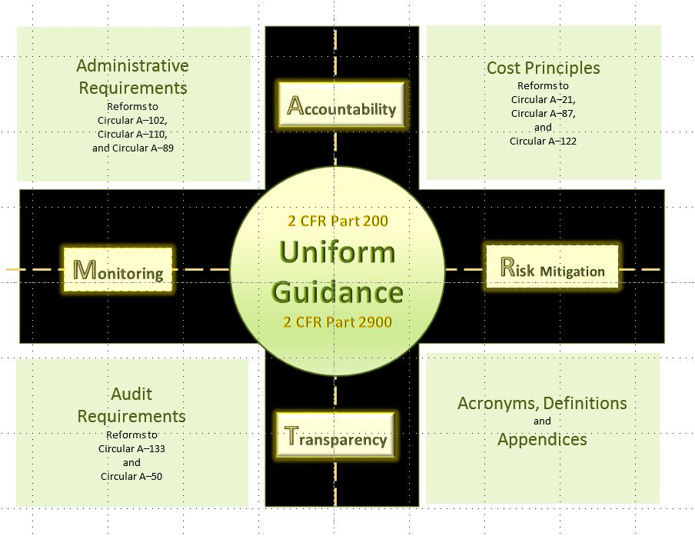
After
Uniform Guidance
Notes:
The uniform Guidance takes 8 existing Circulars on Administrative Requirements, Cost Principles, and Audit Requirements and revamps them or essentially takes the best pieces of each and houses them under one roof, one vehicle in which all Circulars lead to. There are no longer 3 different roads for Cost Principles – It is one single road now in which all entities must follow – the UG.
Before UG (BUG) turns into AUG.

Slide 77
Structure
2 CFR Part 200 and 2 CFR Part 2900
Acronyms & Definitions
  Subpart A
    New and updated terms
General Provisions
  Subpart B
    Includes effective dates
Pre-Federal Award Requirements
  Subpart C
  Appendix I – Full Text of Notice of Funding Opportunity
Post Federal Award Requirements
  Subpart D
  Appendix II Contract Provisions
Notes:
Turn to page 76081 of the Federal Register December 19 2014 publication.
Applicability – DOL expanded the definition of Non Federal Entity to include for profit and foreign entities including foreign governments. In the past, we had to specify coverage for commercial entities – i.e. through WIA and the Single audit and there was no coverage for foreign entities and this was an important inclusion since ILAB issues grants. See 200.69 page 78615
Budget – 6 different exceptions that specify that the awarding of a grant does not offer blanket approval for all items requiring prior approval nor does it waive prior approval requirements. Also the only to grant prior approval is the Grant Officer and the request has to come in not later than 30 days from the requested action or effective date. Also included is the requirement to extend period of performance which must be modified and approved by DOL.
As part of a merit review of proposals from grant applicants, the feds or DOL can also include or consider not only findings stemming from a Single Audit but findings from a monitoring report from a FPO, GO or authorized representative – OIG , GAO or other. Also the expanded audit resolution process also can deem findings contained in the same reports and attach Questioned costs to them.
1 Term from the original 98 definitions was removed - DUNS 200.32 leaving only 97 Definitions

Slide 78
Structure
2 CFR Part 200 and 2 CFR Part 2900
Continued
Cost Principles
  Subpart E & 7 Appendices
    Appendix III —Indirect (F&A) Costs Identification and Assignment, and Rate Determination for Institutions of Higher Education (IHEs)
    Appendix IV —Indirect (F&A) Costs Identification and Assignment, and Rate Determination for Nonprofit Organizations
    Appendix V —State/Local Government wide Central Service Cost Allocation Plans
    Appendix VI —Public Assistance Cost Allocation Plans
    Appendix VII —States and Local Government and Indian Tribe Indirect Cost Proposals
    Appendix VIII —Nonprofit Organizations Exempted From Subpart E— Cost Principles of Part 200
    Appendix IX to Part 200—Hospital Cost Principles
Notes:
Turn to page 76081 of the Federal Register December 19 2014 publication.
Applicability – DOL expanded the definition of Non Federal Entity to include for profit and foreign entities including foreign governments. In the past, we had to specify coverage for commercial entities – i.e. through WIA and the Single audit and there was no coverage for foreign entities and this was an important inclusion since ILAB issues grants. See 200.69 page 78615
Budget – 6 different exceptions that specify that the awarding of a grant does not offer blanket approval for all items requiring prior approval nor does it waive prior approval requirements. Also the only to grant prior approval is the Grant Officer and the request has to come in not later than 30 days from the requested action or effective date. Also included is the requirement to extend period of performance which must be modified and approved by DOL.
As part of a merit review of proposals from grant applicants, the feds or DOL can also include or consider not only findings stemming from a Single Audit but findings from a monitoring report from a FPO, GO or authorized representative – OIG , GAO or other. Also the expanded audit resolution process also can deem findings contained in the same reports and attach Questioned costs to them.

Slide 79
Structure
2 CFR Part 200 and 2 CFR Part 2900
Continued
Audit Requirements
  Subpart F & 2 Appendices
  Appendix X —Data Collection Form (Form SF–SAC)
  Appendix XI —Compliance Supplement
    2015 Edition release April 2015
Notes:
Turn to page 76081 of the Federal Register December 19 2014 publication.
Applicability – DOL expanded the definition of Non Federal Entity to include for profit and foreign entities including foreign governments. In the past, we had to specify coverage for commercial entities – i.e. through WIA and the Single audit and there was no coverage for foreign entities and this was an important inclusion since ILAB issues grants. See 200.69 page 78615
Budget – 6 different exceptions that specify that the awarding of a grant does not offer blanket approval for all items requiring prior approval nor does it waive prior approval requirements. Also the only to grant prior approval is the Grant Officer and the request has to come in not later than 30 days from the requested action or effective date. Also included is the requirement to extend period of performance which must be modified and approved by DOL.
As part of a merit review of proposals from grant applicants, the feds or DOL can also include or consider not only findings stemming from a Single Audit but findings from a monitoring report from a FPO, GO or authorized representative – OIG , GAO or other. Also the expanded audit resolution process also can deem findings contained in the same reports and attach Questioned costs to them.

Slide 80
Implementation
  Training Employment Guidance Letter TEGL 15-14
  All new grant awards or grant modifications released on or after December 26, 2014 MUST adhere to the Uniform Guidance
  Options A & B require grant modification
    A – Formula grantees can apply the UG to existing or old grant awards
    B – Discretionary grantees can apply the UG to existing grant awards

Slide 81
Implementation
  Training Employment Guidance Letter TEGL 15-14
  Selection - Options A & B
    Submit modification request in writing to your Federal Project Officer
    Include a list of grants (by grant number) in which the UG will be applicable
  Selection – Neither Option A or B
    UG applies to all new grant awards or funding released on or after December 26, 2014
    Previously awarded funds follow terms of grant agreement
      This may mean maintaining 2 sets of policies and procedures!

Slide 82
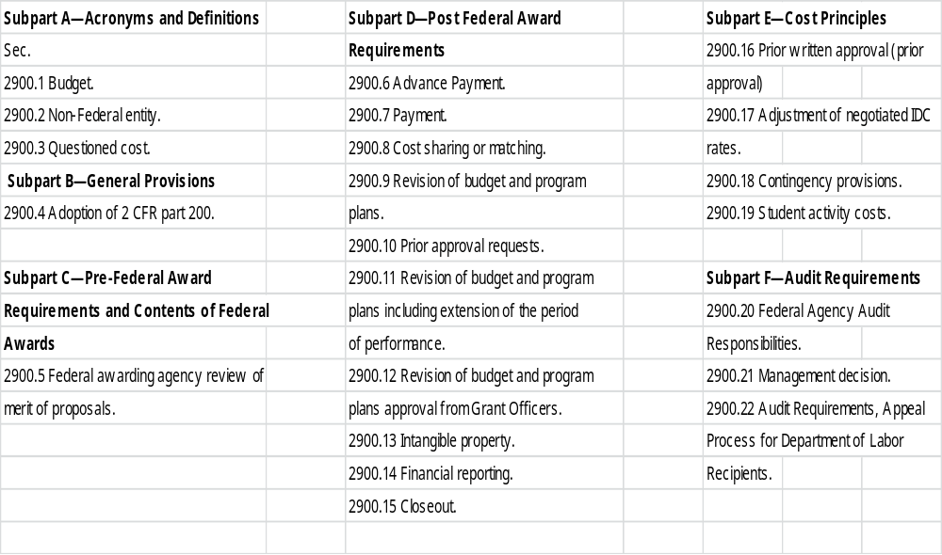
DOL Exceptions
2 CFR Part 2900
Notes:
There are 21 Exceptions and also the adoption of 2 CFR 200 by DOL at 2900.4 which technically isn't an exception but is the ‘official notice’ to the system of DOL’s buy in of the UG.

Slide 83
Definitions & New Items
Important additions or changes to the following:
  Conflict of interest
  Procurement Methods
  Support for Indirect Cost rates
  De Minimis Rate
  Reasonable Costs
  Fixed Unit Price
  Computing Devices
  Improper Payments
  Personally Identifiable Information (PII)
  COSO
Notes:
It is the Council of Sponsoring Organizations of the Treadway commission – they have standards that UG recommends grantees follow

Slide 84
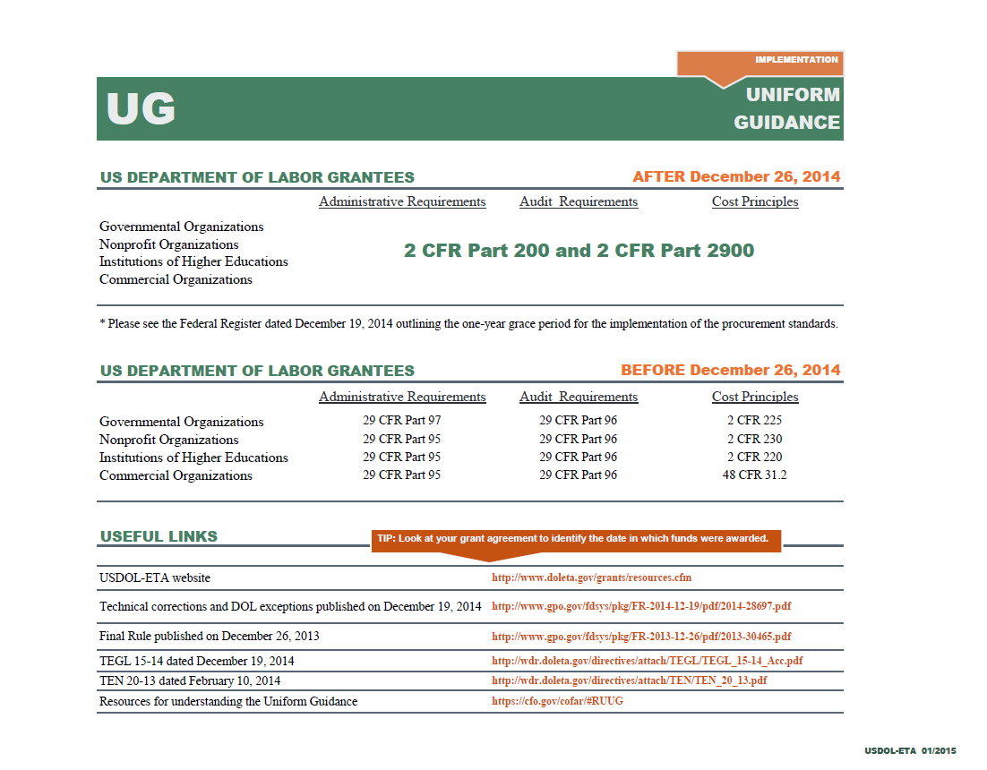
Resources
Notes:
Provide the chart as a handout

Slide 85
Federal Project Officer (FPO)
Grants Specialist
Trevor Capon
US DOL/ETA
JFK Federal Building, Room E-350
Boston, MA 02203
p. 617-788-0391
capon.trevor@dol.gov

