Slide 1
Trade Adjustment Assistance 101
2015 - 20 CFR 618
August 2021

Slide 2
Materials Overview
Alphabet Soup
A Brief History of Trade Act Legislation
Trade Adjustment Assistance for Workers

Slide 3
Alphabet Soup
There’s an acronym for that.

Slide 4
Alphabet Soup
Speaking the Language of Trade
ATAA = Alternative Trade Adjustment Assistance
CSA = Cooperating State Agency
DOL = U.S. Department of Labor
DW = WIOA Dislocated Worker program
ES = Employment Service
ETA = Employment and Training Administration
GSA = Governor Secretary Agreement
HCTC = Health Coverage Tax Credit
NWDG = National Dislocated Worker Grant
OTAA = Office of Trade Adjustment Assistance
PIRL = Participant Individual Record Layout
RR = Rapid Response
RTAA = Reemployment Trade Adjustment Assistance
TAA = Trade Adjustment Assistance for Workers
TEGL = Training and Employment Guidance Letter
TEN = Training and Employment Notice
TRA = Trade Readjustment Allowances
UI = Unemployment Insurance
UIPL = Unemployment Insurance Program Letter
ITC = International Trade Commission
WIOA = Workforce Innovation and Opportunity Act

Slide 5
A Brief History of Trade
It’s always best to begin at the beginning.

Slide 6
Trade Act Origins & Major Legislation
1962 – Trade Expansion Act of 1962
  Provided TRA payments in addition to UI
1974 – Trade Act of 1974
  Established a training benefit
1988 – Omnibus Trade and Competitiveness Act of 1988
  Moved TRA to the end of the UI claim and required enrollment in training to receive Additional TRA
1993 – North American Free Trade Agreement (NAFTA)
  Established the precedent for enrollment deadlines to receive TRA

Slide 7
Trade Act Origins & Major Legislation
2002 – Trade Reform Act of 2002
  Established HCTC
  Established ATAA as a demonstration project
  Expanded applicability of enrollment deadlines
  Expanded eligibility to secondary firms
  Provided additional weeks of TRA for Remedial training
    Up to 130 weeks of income support
2009 – Trade and Globalization Adjustment Assistance Act of 2009
  Expanded eligibility to service sector workers and public sector workers
  Extended weeks of TRA
    Up to 156 weeks of income support
  Established RTAA as a permanent program and expanded benefits

Slide 8
Trade Act Origins & Major Legislation
2011 – Trade Adjustment Assistance Extension Act of 2011
  Ended eligibility for public-sector worker groups
  Removed Remedial TRA
  Established Completion TRA
    Up to 130 weeks of income support
  Reduced benefit levels under RTAA
  Established the same HCTC rate for all eligible Trade participants
  Reduced types of training waivers for TRA eligibility

Slide 9
Trade Act Origins & Major Legislation
2015 – Trade Adjustment Assistance Reauthorization Act of 2015
  Same benefits, services, and eligibility as 2011
  Aligned performance measures with WIOA
  Legislation effective on June 29, 2015
    Authorized for six years
    Retroactive to January 1, 2014
    Reversion on July 1, 2021
    Sunset on July 1, 2022

Slide 10
Trade Adjustment Assistance for Workers
Heigh ho, heigh ho, it’s into the weeds we go!

Slide 11
TAA for Workers Materials Overview
Petition Process / Worker Group Eligibility
Training
TRA
  General Qualifications
  Basic TRA, Additional TRA, Completion TRA
  Waivers
  Earnings Disregard, Election Provisions
Enrollment Deadlines
  Federal Good Cause & Equitable Tolling
Employment and Case Management Services
RTAA
Job Search and Relocation
Financial Management of the Trade Program
Program Reporting Requirements and Data Validation
References, Guidance and Contacts

Slide 12
Petition Process &
Worker Group Eligibility
Subpart B
Because who doesn’t love government forms?

Slide 13
Who Can File a Petition?
Group of 2 or more workers
Company Official
Union
State Workforce Official
American Job Center Network Partner
  Rapid Response, Employment Service, Unemployment Insurance, WIA provider, etc.

Slide 14
Filing Petitions
Online: www.dol.gov/agencies/eta/tradeact
Email: taa.petitions@dol.gov
Fax: (202) 693-3586
Mail:
U.S. Department of Labor,
Office of Trade Adjustment Assistance
200 Constitution Avenue, NW, Room N-5428
Washington, DC 20210

Slide 15
Petition Processing
Upon receipt of petition, investigators contact the company
Company provides information on a confidential basis to the Department
Investigator recommends decision to a Certifying Officer who issues the decision
States ensure the provision of Rapid Response services, if not already provided
  Also must provide appropriate career services

Slide 16
Appealing Petition Denials
Request administrative reconsideration of the determination – 618.245;
  ETA-9185
Seek judicial review of a final determination - 618.255;
  Appeals heard by the U.S. Court of International Trade

Slide 17
Criterion 1 for All Certifications
Criterion 1:
  Significant number/proportion of workers totally or partially separated or threatened with total or partial separation

Slide 18
Worker Group Eligibility (2015)
Affected Workers may include workers in firms that produce articles and workers in service sector firms, based on:
  increased imports of like or directly competitive articles or services; or,
  increased imports of a finished article for which the workers’ firm produces component parts or supplies services; or,
  increased imports of articles directly incorporating foreign components that are like or directly competitive with the component parts made by U.S. workers; or,
  shifts in production of articles or supply of services to any foreign country; or,
  workers in firms that supply component parts or services to firms with TAA-certified workers or perform additional, value-added production processes to firms with TAA-certified workers; or,
  workers in firms identified in International Trade Commission “injury” determinations
  NOTE: Certifications under 2015 are limited to the private sector. No public sector certifications were ever certified even when available.

Slide 19
TAA Program Worker Group Eligibility Matrix
Program Version | 2002 | 2009 | 2011 | Reversion 2014 | 2015
Production | YES | YES | YES | YES | YES
Services | NO | YES | YES | NO | YES
Public Sector | NO | YES | NO | NO | NO
ITC-based Petition | NO | YES | YES | NO | YES
Shift in Production / Secondary Certs | Limited Countries | Any Country | Any Country | Limited Countries | Any Country
A/RTAA Group Eligibility | YES | NO | NO | YES | NO

Slide 20
Training
Subpart F
“I was training to be an electrician. I suppose I got wired the wrong way round somewhere along the line.” - Elvis Presley

Slide 21
Mission of Training
Trade’s Axiom:
The least amount of training at the lowest reasonable cost in the shortest amount of time to be able to obtain “suitable employment.”

Slide 22
Training - Guidance
There is no entitlement under Trade to receive training
  All 6 criteria must be met before training can be approved
There is no entitlement to receive the maximum number of weeks of training
When approving training, CSAs must look at the requirements for the occupation as found on O*NET and actual job postings
  Additional add-ons and other certifications not listed in job postings are not always appropriate

Slide 23
Six Criteria for Approval of Training
There is no suitable employment available
The worker would benefit from appropriate training
There is a reasonable expectation of employment following completion of such training
Training approved by the Secretary is reasonably available to the worker
The worker is qualified to undertake and complete such training
Such training is suitable for the worker and available at a reasonable cost

Slide 24
1. Suitable Employment – 618.110
Suitable employment means, with respect to a worker, work of a substantially equal or higher skill level than the worker's past adversely affected employment, and wages for such work that are not less than 80 percent of the worker's average weekly wage. Part-time, temporary, short-term, or threatened employment is not suitable employment.

Slide 25
2. Benefit from the Training
Is there a direct relationship between the needs of the worker for skills training or remedial education and the training program under consideration?
Will the worker be job ready on completion of the training program?

Slide 26
3. Reasonable Expectation of Employment
Based on labor market information, job postings, letters of commitment from employers, etc.
  Does not need to be a promise of guarantee of employment.
Can be in the current commuting area or an area to which the participant would relocate
Does the training program show a record of successful outcomes?

Slide 27
4. Reasonably Available
The proposed training is suitable and reasonably accessible either inside or outside the current commuting area
  If outside the commuting area, the transportation / subsistence costs are reasonable

Slide 28
5. Qualified to Undertake the Training
This means that the participant has the knowledge, skills and abilities that will allow them to increase these as a result of the training
The participant has the mental and physical capabilities to undertake and complete the training
Are the worker’s financial resources (including UI, TRA, savings, spousal support, etc.) adequate to undertake and complete the training

Slide 29
6. Suitable and Reasonable Cost
Are the costs of the proposed training reasonable in comparison with the average costs of training other workers in similar occupations?
  Costs include all tuition, fees, supplies and transportation/subsistence.
Is the training appropriate for the worker given the worker’s capabilities, background, and experience?

Slide 30
One Training Per Certification
A worker may only be approved for one training program per certification.
    A training plan may be modified – 618.665
Note: A training program may be comprised of several training components (i.e.: remedial training first, then vocational training, may also combine classroom and OJT)
  618.620(b)
  Training programs may include multiple types of training at multiple providers, etc.

Slide 31
Full-Time vs Part-Time Training
2015
  Allows for part-time training
  TRA is not payable during weeks of part-time training
  Definition of full-time training [618.110]
    Full-time training means:
      (1) Attendance in training in accordance with the training provider's established full-time hours in a day (or credit hours) and days in a week; and
      (2) In the last semester of training, if the remaining course(s) to complete the training approved under subpart F of this part do not meet the training provider's usual definition of full-time, States must consider the participation in training as full-time training, if no additional training or coursework will be required to complete the training program.

Slide 32
Length of Training
2015
  The maximum length of Trade-approved training is 130 weeks
    OJT is limited to 104 weeks – 618.635(a)(3)(ii)
    Apprenticeships
      Work-based learning portion limited to 130 weeks
      Related instruction limited to length of apprenticeship
  At the end of approved training, there must be a reasonable expectation of employment.
    OJT must have expectation of suitable employment

Slide 33
Breaks in Training
2015
  Up to 30 days allowed
  Additional TRA may not be paid for breaks longer than 30 days
Training plans should seek to avoid breaks
Unscheduled breaks are not the same thing as scheduled breaks
Excludes weekends and holidays unless training would normally have occurred on those days

Slide 34
Training Prior to Separation (2015)
NOTE: This does not apply to worker groups certified as a result of a Petition approved following an injury determination by the International Trade Commission.
Training may be approved before separation for adversely affected incumbent workers. The incumbent worker must be someone who:
Is a member of a group of workers that has been certified as eligible to apply for TAA benefits
Has not been totally or partially separated from employment, and
Is determined to be individually threatened with total or partial separation (will be monitored via case management).

Slide 35
Remedial / Prerequisite Training
Remedial education can occur concurrently with other training
  Ideally, they should occur either simultaneously or part of a customized training program that blends together occupations and remedial education together
  Example: Basic math & writing skills, English as a second language, GED, etc.
No additional weeks of TRA are provided. The maximum number of training weeks and benefit payments is 130.

Slide 36
TAA Program Training Matrix
Program | 2002 | 2009 | 2011 | Reversion 2014 | 2015
Maximum Weeks of Approved Training* | 130 | 156 | 130 | 130 | 130
Part-Time Training Allowable | NO | YES | YES | NO | YES
Breaks in Training (Days) for TRA | 30 | 30 | 30 | 30 | 30
Remedial Training / Prerequisite Courses | YES | YES | YES | YES | YES
Online Training | YES | YES | YES | YES | YES
* OJT and apprenticeships are treated differently under the various versions of the program.

Slide 37
Training-Related Costs
Allowable
  All tuition & fees;
  Books, uniforms, supplies, equipment
  Transportation costs (mileage, mass transit, parking)
  Laptops and software may be purchased if required for all students by the institution
  Health insurance premium costs, if all students are required to carry health insurance and they are not otherwise covered
  Costs of licensing exams required for employment in the field of training
Not Allowable
  Child care, Auto repair, etc.
  These can be covered through co-enrollment with WIOA or other partners

Slide 38
Trade Readjustment Allowances (TRA) and Training Waivers
Subpart G
“…those injured by that competition should not be required to bear the full brunt of the impact.” - JFK

Slide 39
Qualifying TRA Requirements
An individual must:
Be an adversely affected worker;
Have a first qualifying separation occur on or after the impact date of the certification & before the expiration of the 2-year period beginning on the date of certification;
Have 26 weeks of employment at wages of $30 or more a week in adversely affected employment with a single firm or subdivision of the firm in a 52-week period ending with the week of the first qualifying separation; and,
The individual must have been entitled to (or would have been entitled had they applied) UI for a week within the benefit period of the individual's first qualifying separation

Slide 40
Qualifying TRA requirements (cont.)
Have exhausted all rights to UI to which the individual was entitled:
(1) Accept any offer of suitable work & apply for any suitable work the individual is referred by a State, &
(2) actively engage in seeking work & provide tangible evidence of such efforts, & (3) register for work and be referred by the state agency to suitable work,
AND
(1) be enrolled in or participating in a TAA approved training program approved by the state agency, or
(2) have completed a TAA approved training program approved by State agency after a total or partial separation from adversely affected employment (3) have received from the state agency a written statement waiving the TAA participation-in-training requirement [617.11(a)(2)(i)–(iv)]

Slide 41
Basic TRA
Payable only upon exhaustion of UI benefits
52 weeks minus UI
  Including all state and Federal benefits
Participant must be in full-time training or on a waiver from training
Participant must meet the enrollment deadline
  26 weeks from separation, or
  26 weeks from certification of the Petition

Slide 42
Additional TRA
A worker can receive the additional weeks of TRA only if they are participating in approved training (including allotted breaks in training)
In order to receive additional benefits, workers must have met the enrollment deadline
If an individual becomes entitled to UI after commencing receipt of TRA, they may elect to remain on TRA instead of having to exhaust their UI;

Slide 43
Completion TRA
Completion TRA aligns with the Department’s larger aim to increase the completion of recognized credentials
Provides participants with up to 13 more weeks of TRA within a 20 week period in order to complete training plan
Conditions of Completion TRA:
  The requested weeks are necessary for the worker to complete a training program that leads to a degree or post-secondary credential;
  The worker is participating in training in each such week; and
  The worker has substantially met the performance benchmarks established in the approved training plan; and
  The worker is expected to continue to make progress toward the completion of the approved training; and
  The worker will be able to complete the training during the period authorized for receipt of Completion TRA
Notes:
43

Slide 44
Training Waivers Under 2015
Health – The worker is unable to participate in training due to the health of the worker, except that this basis for a waiver does not exempt a worker from the availability for work, active search for work, or refusal to accept work requirements under Federal or State unemployment compensation laws.
Enrollment Unavailable – The first available enrollment date for the worker’s approved training is within 60 days after the date of the training determination, or, if later, there are extenuating circumstances for the delay in enrollment, as determined under guidance issued by the Secretary.
Training Not Available – Training approved by the Secretary is not reasonably available to the worker from either governmental agencies or private sources (which may include area vocational schools as defined in section 3 of the Carl D. Perkins Vocational and Technical Education Act of 1998 (20 USC 2302) and employers), no suitable training for the worker is available at reasonable cost, or no training funds are available.

Slide 45
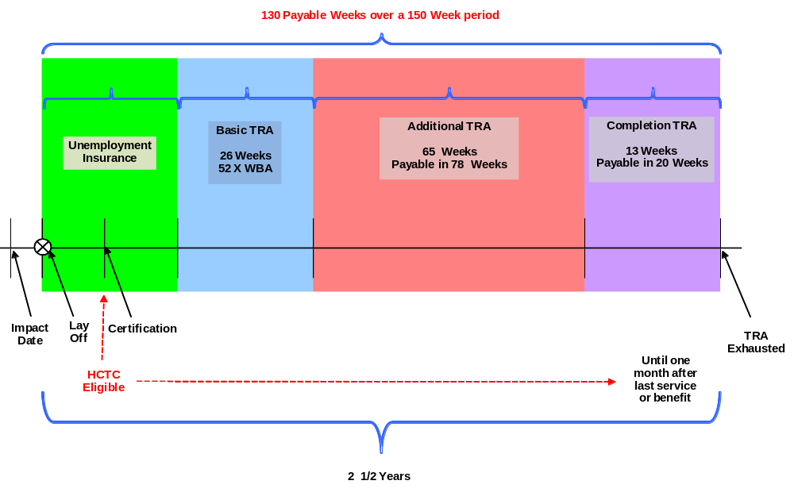
2015 Program Benefits: TRA Timeline
Notes:
45

Slide 46
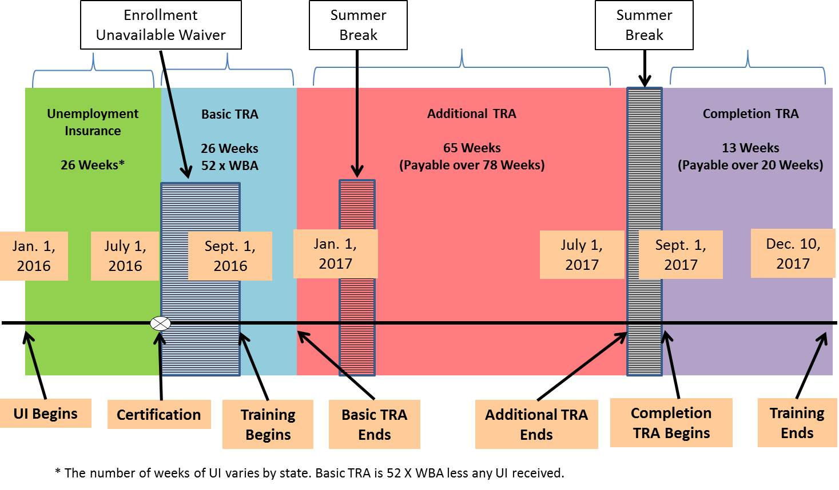
TRA Timeline: Real-World Operations

Slide 47
Earnings Disregard – 618.745
For adversely affected workers in Trade-approved training:
  No deduction is made for earnings from work for a week up to an amount that is equal to the worker’s most recent UI benefit amount
  This provision will affect only the benefit computation for workers who are participating in full-time training other than on-the-job training
  State penalties only apply to the earnings in excess of the participant’s weekly benefit amount
Notes:
47

Slide 48
TRA Election Provision – 618.720(e)(2)
Allows adversely affected workers to elect TRA instead of UI where:
  1) The worker is entitled to receive UI as a result of a new benefit year based in whole or in part upon part-time or short-term employment in which the worker engaged after the worker’s most recent total separation from adversely affected employment This provision will affect only the benefit computation for workers who are participating in full-time training other than on-the-job training
  2) The worker is otherwise entitled to TRA.

Slide 49
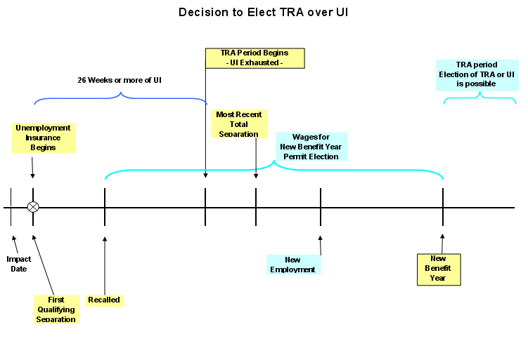
TRA Election Provision
26 weeks* of UI
* Number of weeks will vary based on state law and/or Federal extensions.

Slide 50
Training Benchmarks – 618.660
Reviews conducted at a minimum 60 day intervals from the start of the training plan
  Most states have 30 day requirements
Documented in individual employment plan and signed by participant
Two Evaluation Criteria
  Satisfactory academic standing
  On track to complete training within the agreed upon timeframe
Encourages early intervention and modification of unsuccessful training plans
Supports modification measures in order to increase training completion and credentials
Notes:
50

Slide 51
Training Benchmarks
Required for Completion TRA eligibility
Must be established at the beginning of all training programs- except for very short training programs
Encouraged because they strengthen case management efforts
Notes:
51

Slide 52
Training Benchmarks
Participant Meets Benchmarks
130 weeks of training
IEP Developed
with benchmark
requirements
documented
and signed
Up to 15 benchmark reviews through point of Completion TRA eligibility
Completion TRA begins
Participant Fails Benchmarks
IEP Developed
with benchmark
requirements
documented
and signed
2nd
Failure
Participant may continue in original approved plan with no Completion TRA
Modified plan may include Completion TRA eligibility
Participant fails one of two benchmarks
Revise plan
Modify IEP

Slide 53
Additional TRA Matrix
Program | 2002 | 2009 | 2011 | Reversion 2014 | 2015
Total Weeks Payable | 52 | 78 | 65 | 65 | 65
Payable Within Weeks | 52 | 91 | 78 | 78 | 78
TRA Election | NO | YES | YES | NO | YES
Earnings Disregard | NO | YES | YES | NO | YES
Remedial / Prerequisite TRA (Weeks) | YES (26 R) | YES (26 R/P) | NO | NO | NO
Completion TRA (Weeks) | NO | NO | YES (13) | YES (13 | YES (13)

Slide 54
TRA Deadline Related Provisions Matrix
Enrollment Deadline Provisions | 2002 | 2009 | 2011 | Reversion 2014 | 2015
45-day Extenuating Circumstances Extension | YES | YES | YES | YES | YES
State Good Cause Provisions Allowable | NO | YES | NO | NO | YES
Federal Good Cause Provisions Allowable | NO | NO | YES | NO | YES
Military Service Deadline Extension Available | NO | YES | YES | NO | YES
210-day Bona Fide Application for Training Rule | YES | NO | NO | YES | NO
Equitable Tolling Allowable | YES | YES | YES | YES | YES
Allowable Grounds for Extension of 104 Week Eligibility Period for Basic TRA | 2002 | 2009 | 2011 | Reversion 2014 | 2015
Judicial or Administrative Review Extension | NO | YES | YES | NO | YES
Justifiable Cause to Extend the Period | NO | YES | YES | NO | YES
Military Service Deadline Extension | NO | YES | YES | NO | YES

Slide 55
Appeals
Trade appeals follow the UI appeals process
  State required to provide ETA copies of any appeals on request – 618.840(c)(i)
  States are required to notify ETA of appeals filed with highest authority – 618.840(c)(ii)
  State must notify ETA of any court proceedings on appeals – 618.840(c)(iii)
Unlike regular UI, ETA has the authority to demand additional appeals to higher levels (i.e.: courts)
  618.840(c)(2)

Slide 56
Enrollment Deadlines
618.725
“A goal is a dream with a deadline.” – Napoleon Hill

Slide 57
26/26 Week Deadline
Participant must be enrolled in training no more than:
  26 weeks from the date of the petition certification; OR
  26 weeks from the worker’s most recent total separation from adversely affected employment
  45-day “extenuating circumstance” extension is possible
  Good Cause
    Federal good cause & justifiable cause provision allowable
    State good cause is not applicable
TRA eligibility:
  The above does not apply to be eligible for TRA, if the determination is made before the training deadlines.
  A worker may receive TRA prior to the 26/26 if all other eligibility has been met in the Section 231(a) of the Act.
  Once the enrollment deadline (26/26), is reached the training requirement must be met: enrolled in training or receipt of a waiver.

Slide 58
Deadlines – Intent
TEGL 11-02
  “These deadlines may be waived for specified reasons… However, the intent of the time limitations is that adversely-affected workers who are in need of training be enrolled in training quickly in order to expedite their adjustment and reemployment.”

Slide 59
“Enrolled in Training”
618.110
  Enrolled in training means that a worker's application for training is approved by the State under subpart F of this part, and the training provider has furnished written notice to the State that the worker has been accepted in the approved training program, which is to begin within 30 calendar days of the date of such approval.
    Once “enrolled in training,” a participant is no longer subject to UI work search requirements

Slide 60
Federal Good Cause &
Equitable Tolling
Death, taxes, first penalty at the Forum!

Slide 61
Highlights for Federal Good Cause
A waiver for good cause of the time limitations “with respect to an application for TRA or enrollment in training” means:
      26/26 week enrollment in training deadline
      618.730
Notes:
61

Slide 62
Federal Good Cause and Equitable Tolling are Separate and Distinct Provisions
 | Federal Good Cause | Equitable Tolling
Statutory | Yes | No
Program | Applicable under the 2011 & 2015 Program | Available in 2002, 2009, 2011, & 2015 Programs
Deadlines | Can be applied ONLY to application for TRA and enrollment in training | Applies to any TAA deadline
When Available | Effective with TAAEA (2011 Act) | Effective with issuance of TEGL 08-11 618.888

Slide 63
Employment and Case Management Services
Subpart C
“The purpose of these employment and case management services is to provide workers the necessary information and support for them to achieve sustainable reemployment.” – TEGL 22-08

Slide 64
Case Management
2015
  Requires that case management services be made available to all adversely affected workers and adversely affected incumbent workers
    Trade funds are provided to support these services
    Co-enrollment with WIOA dislocated worker program is required
      618.325
      Trade participants are, by definition, dislocated workers under WIOA
    Trade funds can pay for provision of employment and case management services regardless of which staff provides these services – 618.890

Slide 65
Case Management
Services
  Comprehensive and specialized assessment of skill levels and service needs;
  Development of an individual employment plan to identify employment goals
  Information on:
    training available in local and regional areas, information on
    individual counseling to determine which training is suitable training, and
    how to apply for such training
    how to apply for financial aid
  Short-term prevocational services
    development of learning skills, communications skills, interviewing skills, punctuality, personal maintenance skills, and professional conduct

Slide 66
Case Management
Services
  Individual career counseling, including job search and placement counseling, during the period in which the individual is receiving a trade adjustment allowance or training under this chapter, and after receiving such training for purposes of job placement.
  Provision of employment statistics information, including the provision of accurate information relating to local, regional, and national labor market areas
  Information relating to the availability of supportive services, including services relating to child care, transportation, dependent care, housing assistance, and need related payments that are necessary to enable an individual to participate in training
    Support services are available through WIOA and other partner programs or local community organizations

Slide 67
Reemployment Trade Adjustment Assistance (RTAA)
Subpart E
“It's just a job. Grass grows, birds fly, waves pound the sand. I beat people up.” - Muhammad Ali

Slide 68
What is the RTAA program?
Wage supplement program for workers age 50 and over
May be employed full or part-time
  Full-time employment as defined by applicable state law
    If part-time, must also be in training
May be combined with training
Can receive RTAA after TRA
  Weeks of TRA are deduced from RTAA benefit
Cannot receive TRA after RTAA

Slide 69
RTAA Basics
50% of difference between reemployment wages and wages earned at separation
  Payments may not last more than the eligibility period (i.e., not to exceed two years)
  Total payments may not exceed $10,000
Qualifying reemployment is not employment at the same “firm” or subdivision of the firm as the qualifying separation (review certification for details)
  This includes successors-in-interest
Group eligibility is automatic with certification of a Trade petition

Slide 70
RTAA Clarification
A worker need not be 50 or older when obtaining RTAA qualifying reemployment. The worker must; however, meet the eligibility period.
Eligibility Period
  If TRA is not received, then it is for a period not to exceed two years beginning on the earlier of (1) worker exhausts all rights to UI or (2) the date worker obtains reemployment
  If TRA is received, then it is for a period of 104 weeks beginning on the date the worker obtains reemployment reduced by # of weeks of TRA)

Slide 71
ATAA / RTAA Matrix
Trade Program | 2002 | 2009 | 2011 | Reversion 2014 | 2015
Full Time Employment | YES | YES | YES | YES | YES
Part Time Employment | NO | YES | YES | NO | YES
Training + RTAA | NO | YES | YES | NO | YES
Maximum Amount | $10,000 | $12,000 | $10,000 | $10,000 | $10,000
Deadline for Reemployment | 26 weeks from separation | 104-week period to qualify for and claim | 104-week period to qualify for and claim | 26 weeks from separation | 104-week period to qualify for and claim
* Under ATAA, multiple jobs can be combined to equal full-time employment.

Slide 72
Job Search and Relocation
Subpart D
Where the jobs are.

Slide 73
Job Search Allowance
To cover allowable costs related to travel outside of a participant’s commuting area to seek suitable employment
  Usually related to job interviews.
  Must be within the “United States”
    Limited to the 50 states, DC & Puerto Rico
  Must be pre-approved by the state

Slide 74
Job Search Benefit Amount
In accordance with the regulations of 20 CFR 618.425 and 618.430
  90% of allowable costs up to $1,250
  May included multiple trips
  Governed by Federal Travel Regulations at 41 CFR §301

Slide 75
Relocation Allowance
To cover allowable costs to relocate a participant, their immediate family and their household goods to suitable employment outside of their commuting area
  Limited to the 50 states, DC & Puerto Rico
  Must be pre-approved by the state

Slide 76
Relocation Benefit Amount
In accordance with the regulations of 20 CFR 618.455 and 618.460
  90% of allowable relocation costs
  Additional lump sum payment of up to $1,250
  Governed by Federal Travel Regulations at 41 CFR §302

Slide 77
Job Search / Relocation Matrix
Job Search | 2002 | 2009 | 2011 | Reversion 2014 | 2015
% Reimbursement | 90% | 100% | 90% | 90% | 90%
Up to Amount | $1,250 | $1,500 | $1,250 | $1,250 | $1,250
Relocation | 2002 | 2009 | 2011 | Reversion 2014 | 2015
% Reimbursement | 90% | 100% | 90% | 90% | 90%
Up to Amount (Lump Sum) | $1,250 | $1,500 | $1,250 | $1,250 | $1,250

Slide 78
Health Coverage Tax Credit (HCTC)
Take two of these and call me in the morning.

Slide 79
Health Coverage Tax Credit (HCTC)
Tax credit is administered by the IRS
Claimed on a monthly basis, or when filing taxes at the end of the year.
States provide the IRS data via the ICON system
See www.irs.gov/hctc for more.
Notes:
79

Slide 80
Trade & WIOA
All in the Family

Slide 81
Trade as a One-Stop Partner
Required Partner under WIOA Sec. 121(b)
  Sec. 121(b)(1)(B)(vii) – 618.305
Co-enrollment in WIOA DW is required – 618.325
  All adversely affected workers under Trade are, by definition, dislocated workers under WIOA
TAA funding available to support infrastructure and operational costs of the one-stops
  Infrastructure support limited to 1.5% of the state’s allocation
Cross training of staff needed to ensure trade-impacted workers are identified
TAA funding may be used to provide employment and case management services regardless of who provides them
  618.890
Notes:
81

Slide 82
Required WIOA Services
Rapid Response is required for all worker groups that file a petition
  If not already provided to the worker group, as soon as possible after the petition is filed
  Regardless of the size of the layoff
  Whether or not a WARN notice is filed
  618.816 – Sec. 221(a)(2)(A)
Appropriate WIOA career services must also be provided to worker groups for whom as petition is filed
  Independent of whether the petition is ever certified
  618.816 – Sec. 221(a)(2)(A)
Notes:
82

Slide 83
Trade & UI
First Cousins, Once Removed

Slide 84
Trade and UI
TRA and UI are closely related
  Initial weekly benefit amount uses the same calculation
  Dependent allowances
  Taxes and child support deductions still made
  Uses the same appeals process
Not all state UI provisions apply to Trade participants
  Under certain circumstances, Trade participants may refuse work and can leave non-suitable employment and still be eligible for benefits
  TRA recipients may earn up to their weekly benefit amount without penalty
  All decisions subject to review by USDOL and the State can be ordered to act on erroneous decisions
Notes:
84

Slide 85
Financial Management
Follow the money.

Slide 86
Trade Funding Types
TAA = Training, job search, relocation, case management & related costs
TRA = Income support benefits
RTAA = Wage insurance payments

Slide 87
Funding For FY 2015 through 2021
Job Search & Relocation
Case Management
Admin
Training
TRA
RTAA
Uncapped Funds
Consolidated Allocation Cap
Conditions: Not more than 10 percent for administration; Not less than 5 percent for case management

Slide 88
Recapture and Financial Reporting
USDOL may recapture funds from States with remaining un-obligated funding – 618.950
  USDOL may distribute recaptured funds to States in need of additional funding
Trade-specific ETA-9130-M financial report now in use
Notes:
88

Slide 89
Merit Staffing / Staffing Flexibility
20 CFR 618.890
  All determinations must be made by state or state merit staff
  All redeterminations must follow UI rules and be performed by state merit staff
  Employment and case management services can be provided by anyone and funded by Trade

Slide 90
Additional Allowable Costs
Trade Funds Can Pay For…
Operating costs of American Job Centers
MIS development, appropriate upgrades and maintenance
Supplies and equipment
Assessments, labor market information, career counseling

Slide 91
Case Management Systems
Case management funds may be used for upgrading and maintaining electronic case management systems
Maintenance and enhancement of electronic case management system to allow for improved case management services
Collecting validating and reporting required information is charged to admin

Slide 92
Program Reporting Requirements
618.864
Mean, and median, and mode! Oh, my!

Slide 93
PIRL
A “flat file” of participant and exiter information
Submitted quarterly by each state
Includes performance, services, benefits and financial information
Trade primary indicators of performance measures same as WIOA

Slide 94
Trade Adjustment Assistance Data Integrity (TAADI)
Conducted quarterly
Email to states from Region with results
Response required for failures
Annual formal notice sent to states that have not made progress or identified the cause of integrity failures and outlined corrective actions
Only data integrity process of its kind within USDOL

Slide 95
References and Contacts
Because knowing is half the battle.

Slide 96
Internet References
TAA Homepage
  http://www.dol.gov/agencies/eta/tradeact
HCTC
  www.irs.gov/hctc
TAA Community
  https://taa.workforcegps.org
Notes:
96

Slide 97
Key References
Trade Act of 1974, as amended
  19 USC 12
    Public Law 93-618 (Trade Act of 1974)
    Public Law 100-148 (aka: The 1988 Amendments)
    Public Law 106-113 (FY2000 consolidated appropriation)
    Public Law 107-210 (Trade Reform Act of 2002)
    Public Law 111-5 (Trade and Globalization Adjustment Assistant Act of 2009)
    Public Law 112-40 (Trade Adjustment Assistance Extension Act of 2011)
    Public Law 114-27 (Trade Adjustment Assistance Reauthorization Act of 2015)
20 CFR 618 (TAA Program Regulations)

Slide 98
Contact Info
Timothy Theberge
Lead Program Analyst
Office of Trade Adjustment Assistance
(202) 693-3401
theberge.timothy@dol.gov
Notes:
98

