Slide 1
TAA Regional Provider Training
Fall 2018
Karen Carter-King |TAA Career Specialist| 9-26-2018

Slide 2
Trade Adjustment Assistance
A federal program that assist workers who have lost their jobs due to foreign trade.
  The program seeks to provide trade-affected dislocated workers with opportunities to obtain the skills, resources, and support needed to become reemployed.
United States Department of Labor (USDOL) administers the program
Tennessee Dept. of Labor & Workforce Development (TDLWD) acts as an agent for USDOL in administering this program in Tennessee.

Slide 3
Trade Adjustment Assistance
The Trade Act of 1974, P.L. 93-618, has been amended numerous times since its enactment in January 1975.
The latest amendment - Trade Adjustment Assistance Reauthorization Act 2015 (TAARA)was signed into law on June 29, 2015.

Slide 4
Trade Adjustment Assistance
Who is considered a Trade Impacted Worker?
  A worker that is covered by a certified trade petition.
  A worker that has received notice of or has been laid off from a trade impacted company.

Slide 5
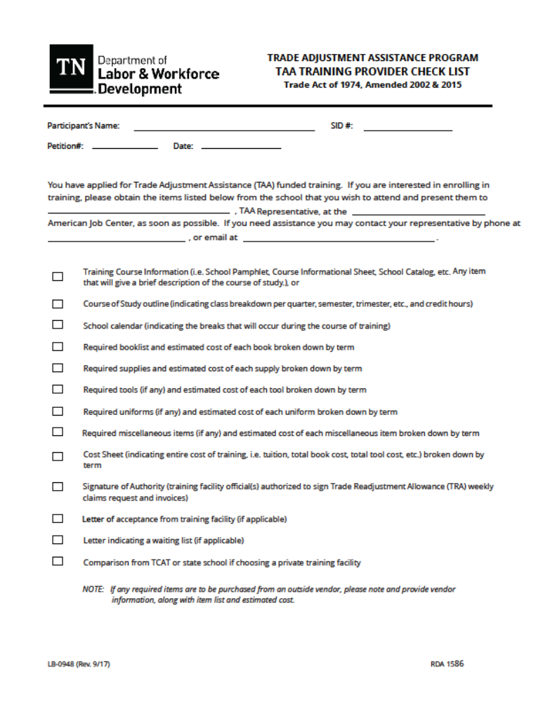
TAA Training Enrollment Checklist

Slide 6
TAA Training Enrollment
Participant Checklist:
When a TAA participant visits your facility to gather training information he/she should bring a copy of the Training Check List (form LB-0948) with them when requesting information for TAA funded training.
If all items on the form are supplied there should be few if any questions.
Why do we need the information?
TAA uses this information to help determine if the participants training request meets Criteria for approval and as guideline for participants progress throughout training.
Note: If any required items are to be purchased from an outside vendor, please note and provide vendor information, along with item list and estimated cost. TAA must have this information up front in order to include it when determining if total cost of training is reasonable.

Slide 7
TAA Training Enrollment
What is school information used to determine?
  Total Weeks of training: (Cannot exceed 130)
  The Academic Plan, Course Outline, school calendar are used to determine total number of weeks it will take the participant to complete training.
  Reasonable Cost: Cost breakdowns verify Reasonable Cost and provide Information for TAA to provide accurate vouchers.
  Occupation Demand: Course Outline of Credential to be received must be verified as an In Demand or have a 70% school placement rate provided.
  Benchmarks: The Academic Plan and Course Outline are used to be sure participant is meeting Benchmarks and staying on track throughout their training.

Slide 8
TAA Vouchers
Vouchers are issued on a term to term basis
Vouchers are issued as Pending to allow for changes in things such as books cost etc.
The 1st term voucher will be sent with training approval documents
Vouchers may be issued for tuition, fees, books and required supplies together or separately if bookstore or outside vendors are used.
Previous term invoices should be submitted for payment before next term voucher is issued.
Participant should be meeting Benchmarks for next voucher to be issued.

Slide 9
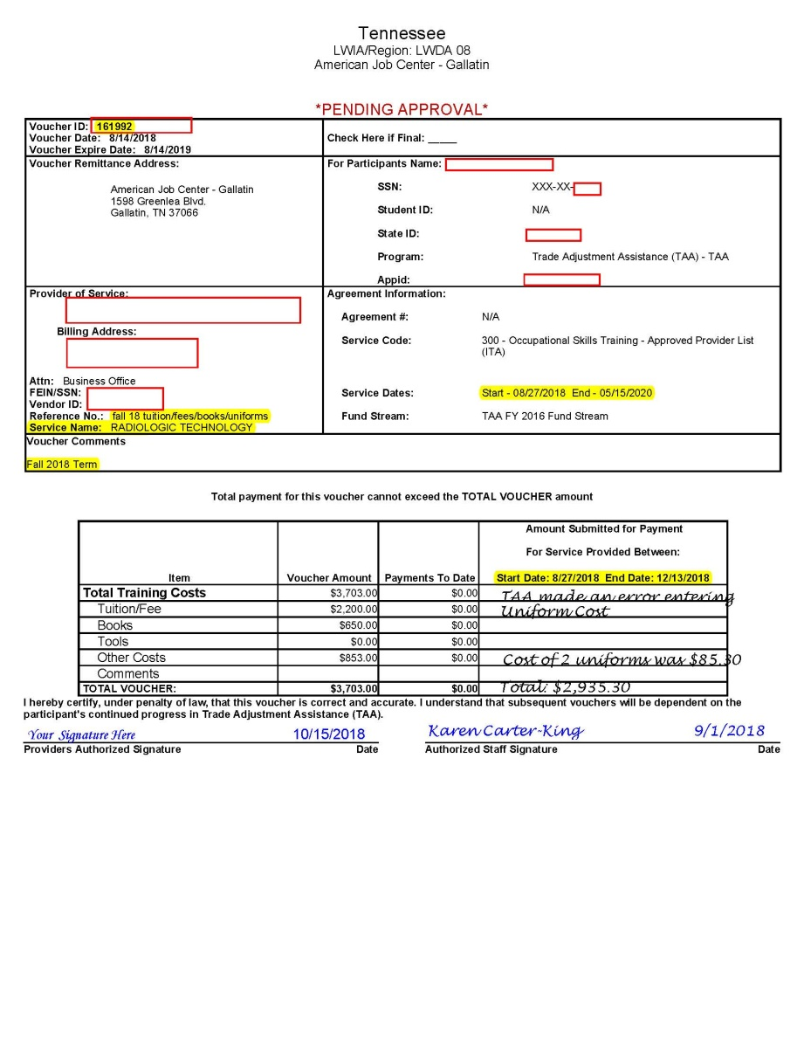
TAA Voucher Example

Slide 10
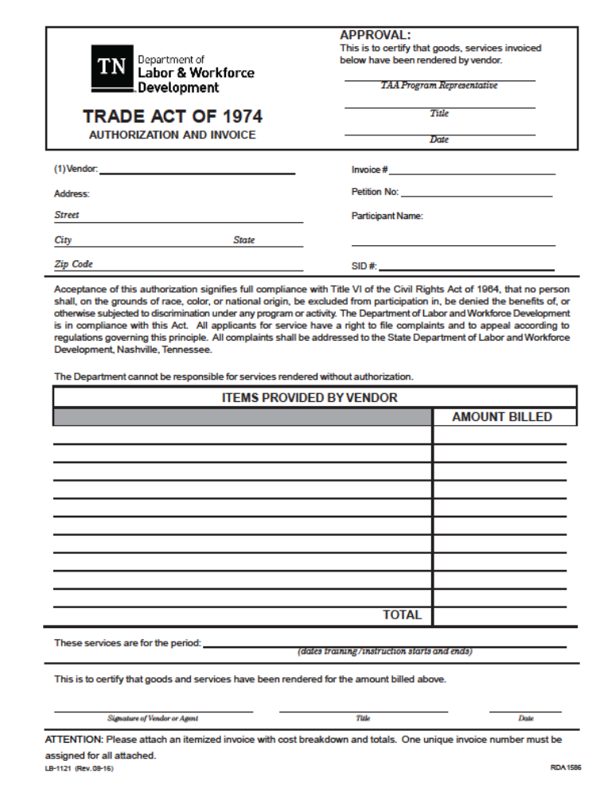

Slide 11
TAA Invoicing and Payments
All invoices should be submitted to:
tdlwd.taa@tn.gov
Payment of approved training facility or vendor costs will be processed upon receipt of following:
    Signed VoucherTA-2 (Form LB-1121)
    Invoice with cost the breakdown for the current term from the training institution
  The Voucher must be signed by an authorized school official (person who signed the signature of authority.)
  Each TA-2 and backup invoice must have a unique invoice number in order to be processed.
  Jobs4TN SID number will replace SSN on the TA-2.
  There should be no highlighting on either document.

Slide 12
TAA Invoicing and Payments
  The amount listed on the TA-2 must match the amount listed on the vendor's invoice.
  The charges on the bill must be for the term the voucher is issued.
  The TAA Fiscal Specialist or his/her backup will review each invoice for completeness and accuracy.
  If any changes are necessary, the TAA Specialist will make changes to the internal Voucher before approving and processing payment.
NOTE: If an invoice amount is greater than the amount on the voucher issued, additional documentation will be request that justifies the increased cost. Provider’s should provide information on what changed (tuition increased), book cost increased), etc. Provider can make written notation on the voucher showing cost changes.

Slide 13
TAA Participant Benchmarks
TAA law requires participants to report to their TAA Representative for progress report(Benchmarks) to be completed every 60 days (or less).
On average Benchmark reviews will occur about mid term and end of term for each participant.
Mid-term Benchmarks should include a progress report from instructor or a copy of grades/progress to date.
End of term Benchmarks requirements:
  Grades
  Updated Academic Plan/Course Outline (must show classes participant is registered for next term)
  Updated Costs breakdowns (show participant cost for next term)

Slide 14
TAA Participant Benchmarks
Why does TAA required update documents?
  To verify participant is meeting his/her Benchmark.
  To verify participant is taking classes that are in their academic plan
  To review and/or verify any cost increase.
  To generate the voucher for the upcoming term.

Slide 15
TAA Weekly Certifications
Weekly Request for Allowance by Worker in Training LB-0429?
The TAA participant is required to provide the signed completed form to their local TAA Case Manager every week while he/she is in training.
The form shows that the participant is attending training as required by law.
It is used to verify attendance for UI & TRA payments.
It is used to verify travel days for travel reimbursement
Informational Note: Participants cannot sign their form before the Saturday claim week ending date. It is then submitted to the TAA/TRA Units on the following Monday for processing.

Slide 16
TAA Weekly Certifications
As the Authorized School Representative:
  Review the claim week ending date at top of form and do not sign forms for upcoming weeks.
  Review sheet specifically (A)(5) to see if the participant has checked the dates they attended
  Complete (D.) Please complete and date no sooner than the last day of each week the participant attends training.
  The participant is responsible to submit the form to the local TAA Representative by email, postal mail, or hand delivering in order for it to be uploaded and Nashville TAA/TRA Units notified.

Slide 17


Slide 18
Contact Information
Name/Title Phone: Email Address
Robin V. Wright-TAA Coordinator 615-253-6668 robin.v.wright@tn.gov
Eric Schweitzer-TAA Specialist 615-532-1007 eric.schweitzer@tn.gov
Tracy Bunch-TAA/Career Specialist 615-494-4260 tracy.bunch@tn.gov
East TN Region
Karen Carter-King-TAA/Career Specialist 615-206-6642 karen.p.carter@tn.gov
    Middle TN Region
Edward Jenkins-TAA/Career Specialist 901-543-2054 edward.c.jenkins@tn.gov
West TN Region

