Slide 1
TAA Resources Webcast
Where to find resources for each audience – a guided tour.

Slide 2


Today’s Speakers
Susan Manikowski
  Program Analyst
    Office of Trade Adjustment Assistance
Robert Hoekstra
  Program Analyst
    Office of Trade Adjustment Assistance

Slide 3
About this Webcast

Slide 4
General Audiences for this Webcast
Who to Contact
Workers
Company Official
Government Stakeholders
Researchers
TAA Partners (next slide)

Slide 5
OTAA Partner Audiences for this Webcast
Rapid Response & Petition Coordinators
State TAA Coordinators
Case Managers
State Reporting Staff

Slide 6
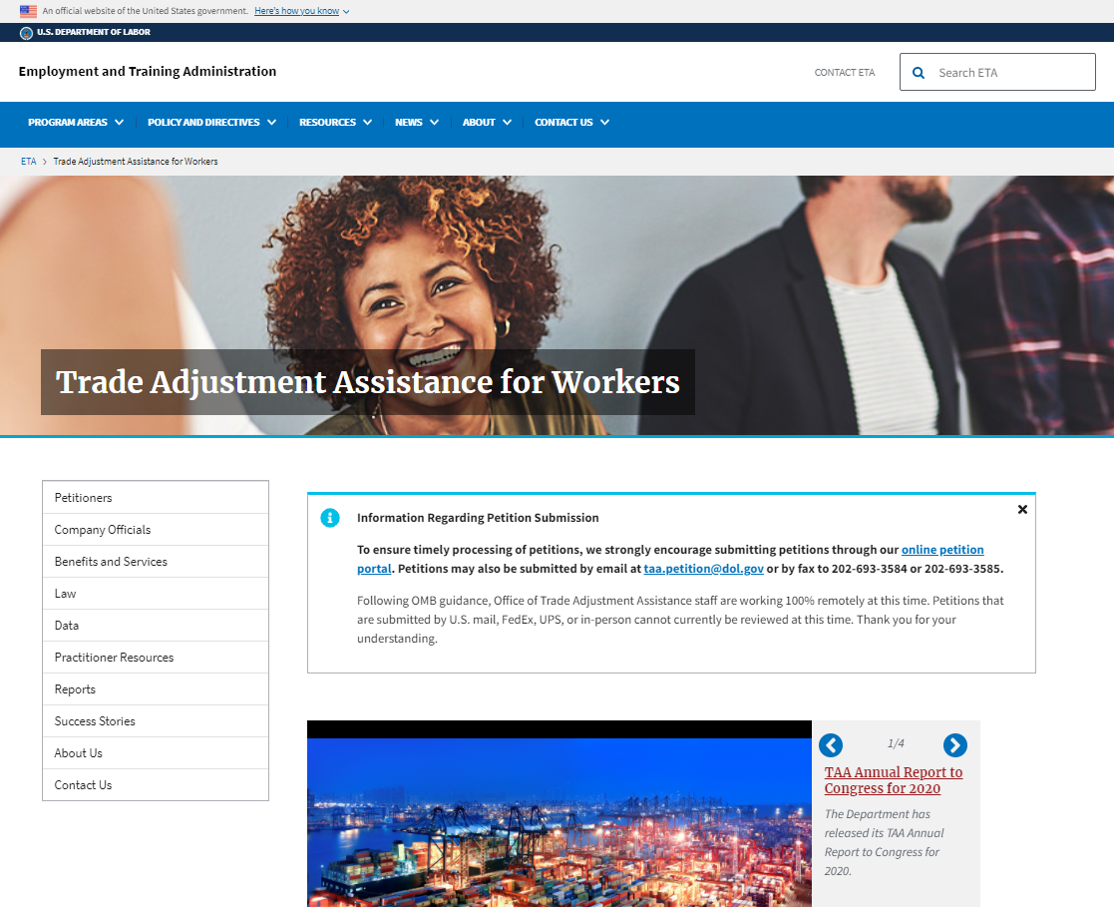
Finding Resources: DOL TAA Page
DOL/ETA Navigation
TAA Navigation

Slide 7
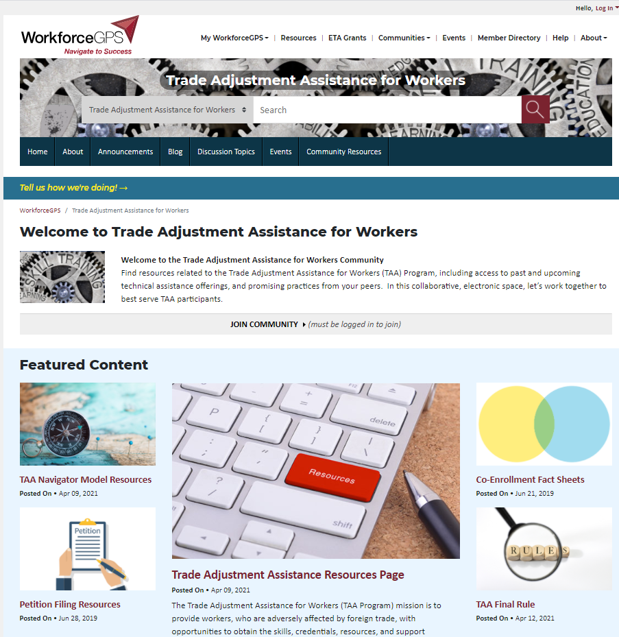
Finding Resources: TAA Community on WorkforceGPS
Log In

Slide 8
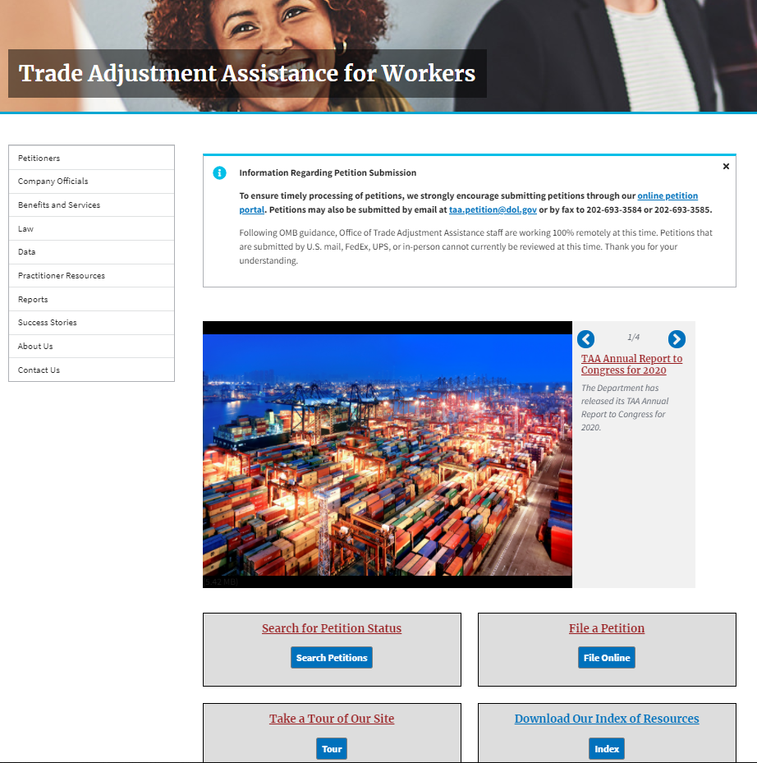
Finding Resources: Index

Slide 9
Who to Contact
This section helps you find contact information.

Slide 10
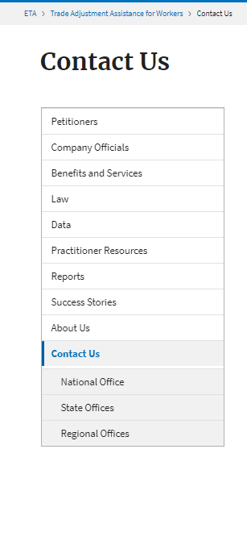
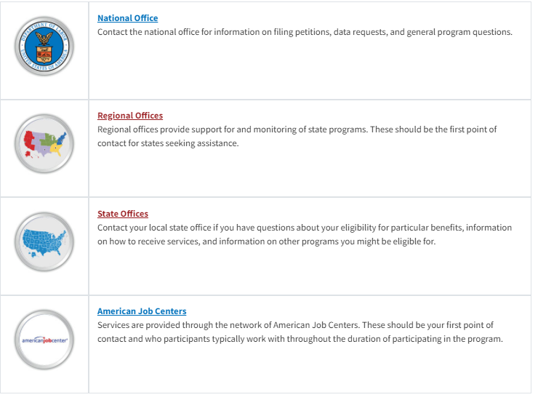
Finding All Contacts

Slide 11
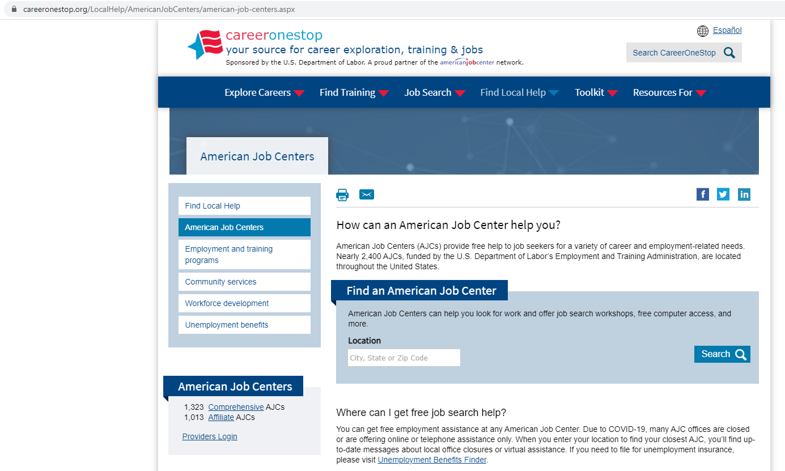
American Job Centers (AJCs)

Slide 12
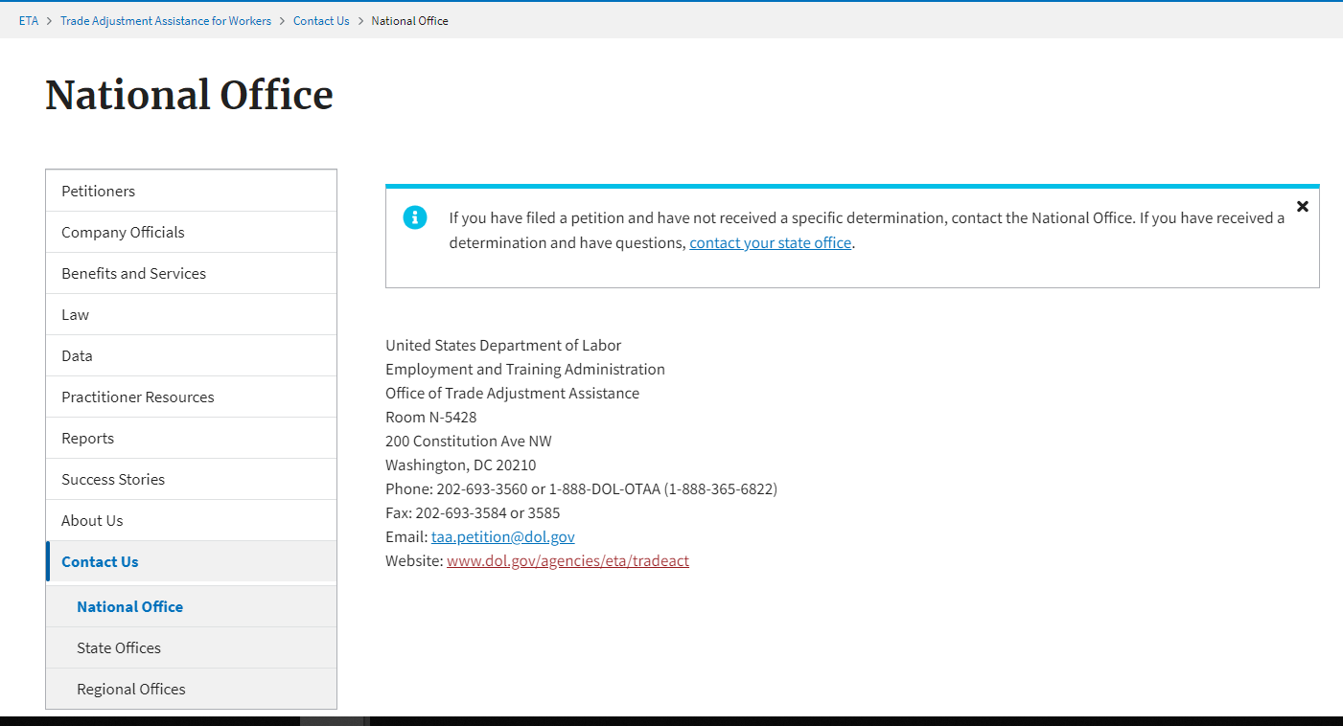
Federal Questions
Contact the OTAA National Office

Slide 13
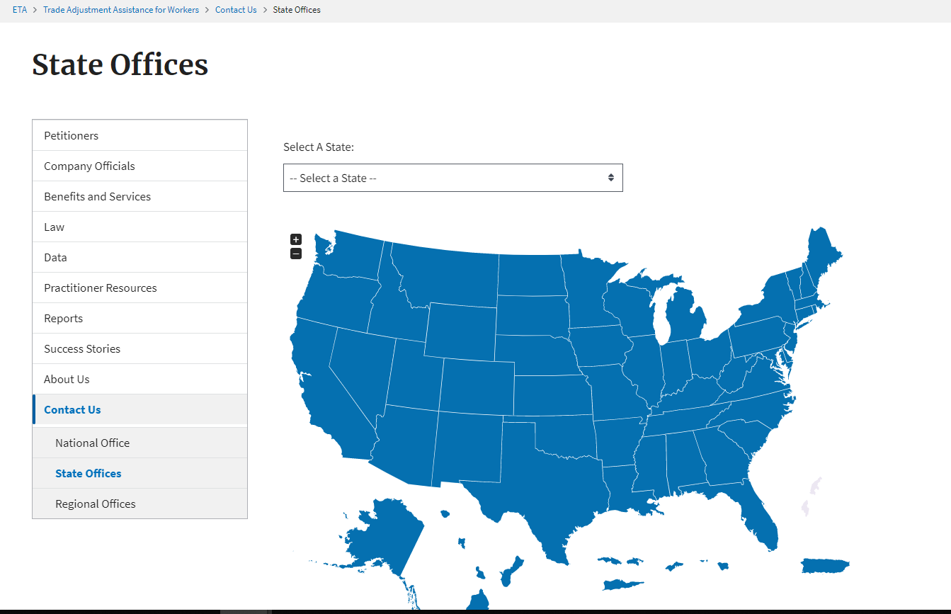
State Contacts

Slide 14
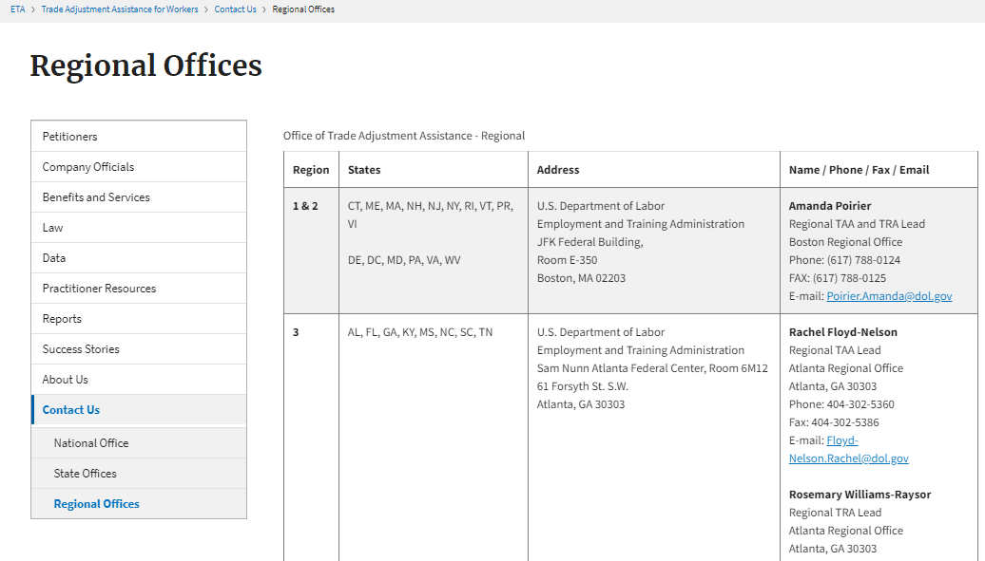
Regional Contacts

Slide 15
Workers
If you are a worker looking for information, review this section.

Slide 16
Petition Filing

Slide 17
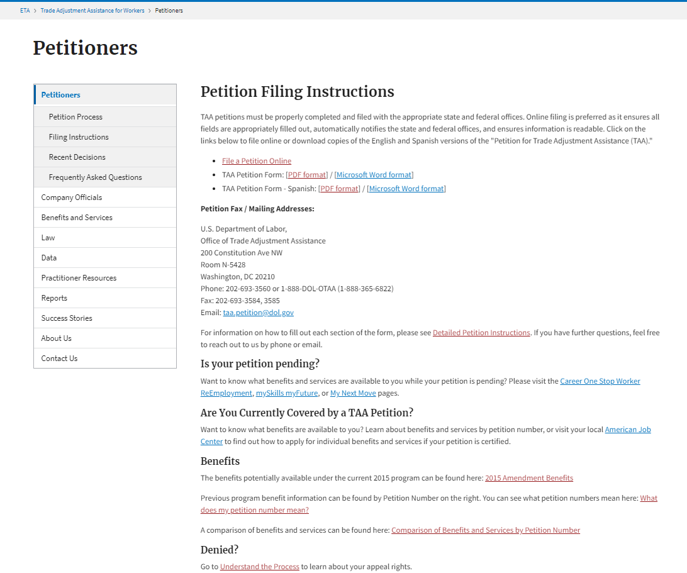
Petition Filing

Slide 18
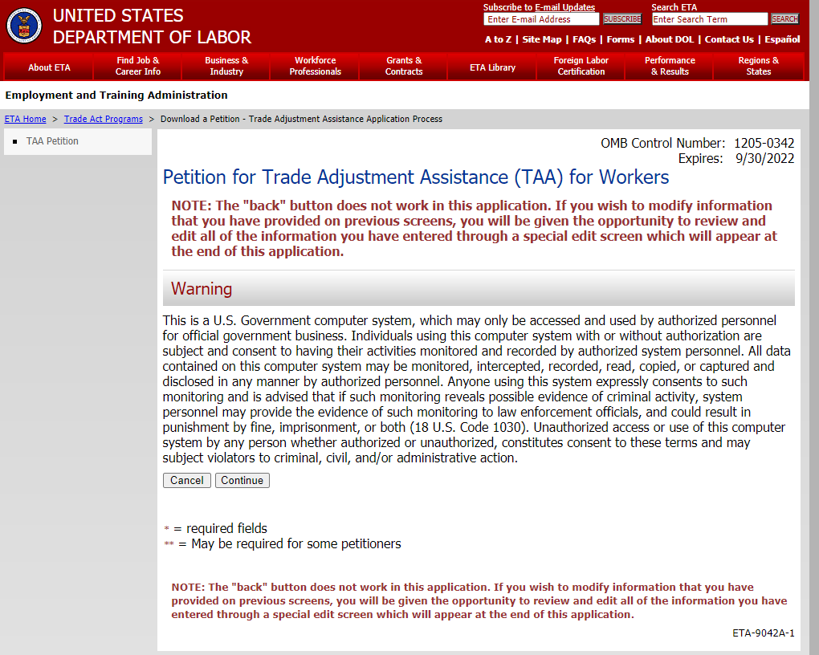
Petition Filing

Slide 19
American Job Centers (AJCs)

Slide 20
State Contacts

Slide 21
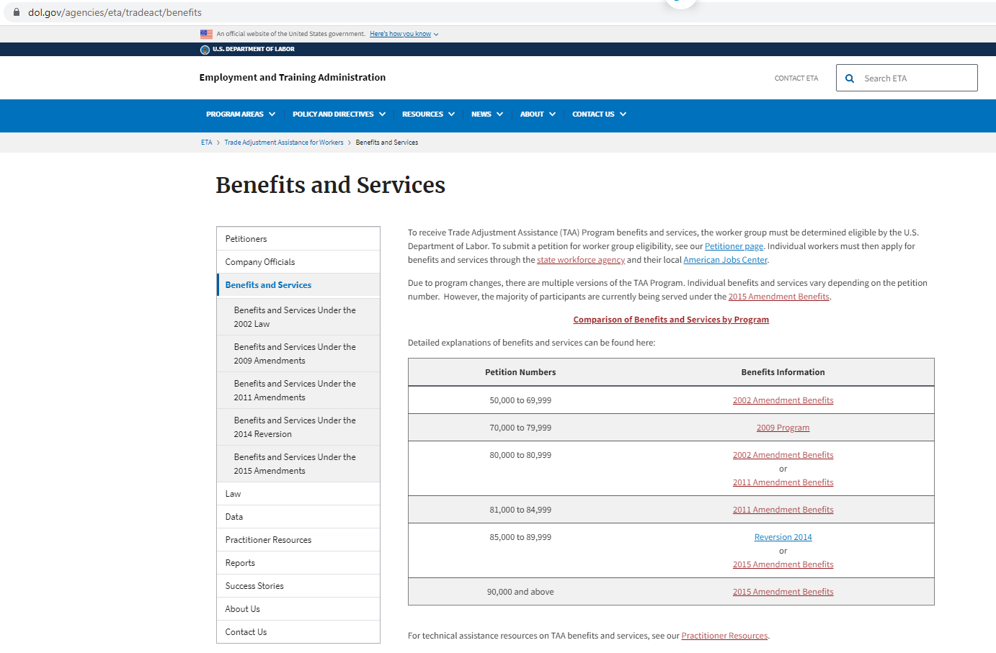
Benefits and Services

Slide 22
Petition Search

Slide 23
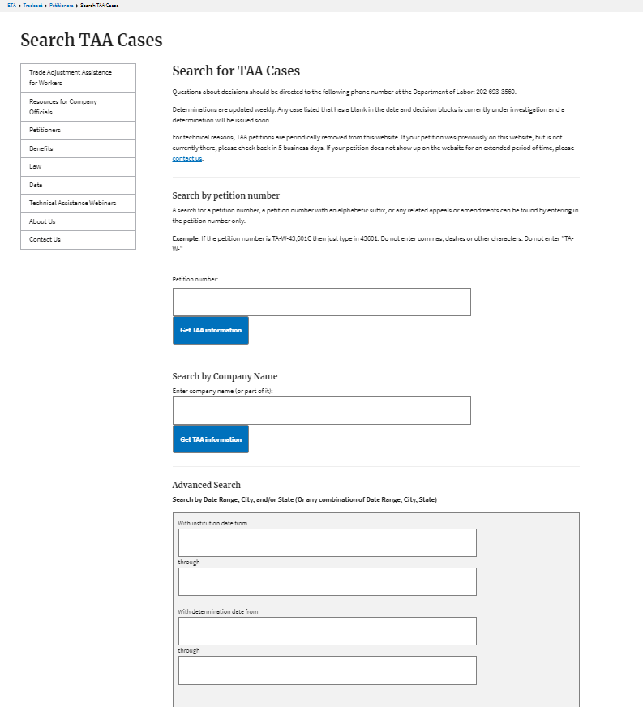
Petition Search: Search Terms

Slide 24
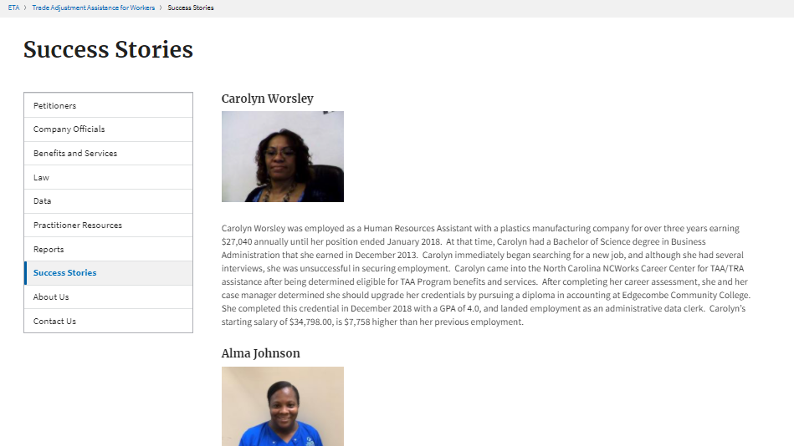
Success Stories

Slide 25
Contact Us
Robert Hoekstra
  Program Analyst
    Office of Trade Adjustment Assistance
      hoekstra.robert@dol.gov
        202-693-3522
Susan Manikowski
  Program Analyst
    Organization
      manikowski.susan@dol.gov
        202-693-3545

Slide 26
Company Official
If you are a company official looking for information, review this section.

Slide 27
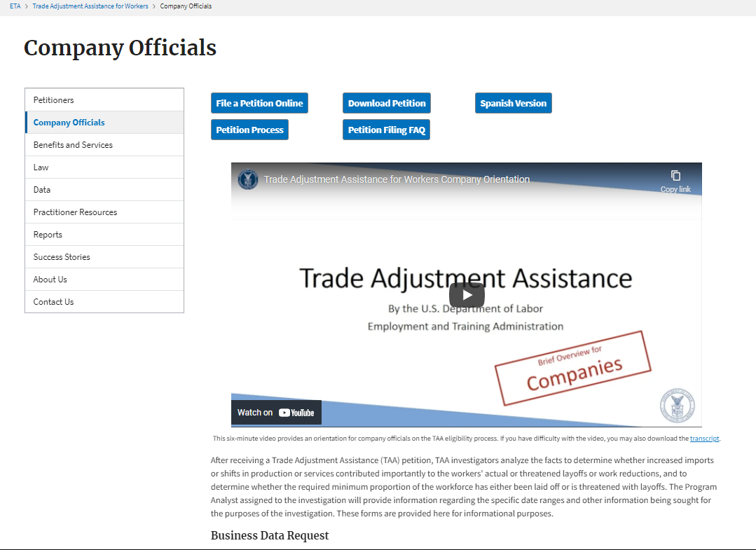
Company Officials Overview Video

Slide 28
Company Officials Page

Slide 29
Petition Search

Slide 30
Petition Search: Search Terms

Slide 31
Contact Us
Robert Hoekstra
  Program Analyst
    Office of Trade Adjustment Assistance
      hoekstra.robert@dol.gov
        202-693-3522
Susan Manikowski
  Program Analyst
    Organization
      manikowski.susan@dol.gov
        202-693-3545

Slide 32
Government Stakeholders
If you are a government stakeholder (such as Congressional Staff, state-staff, etc.) looking for information, review this section.

Slide 33
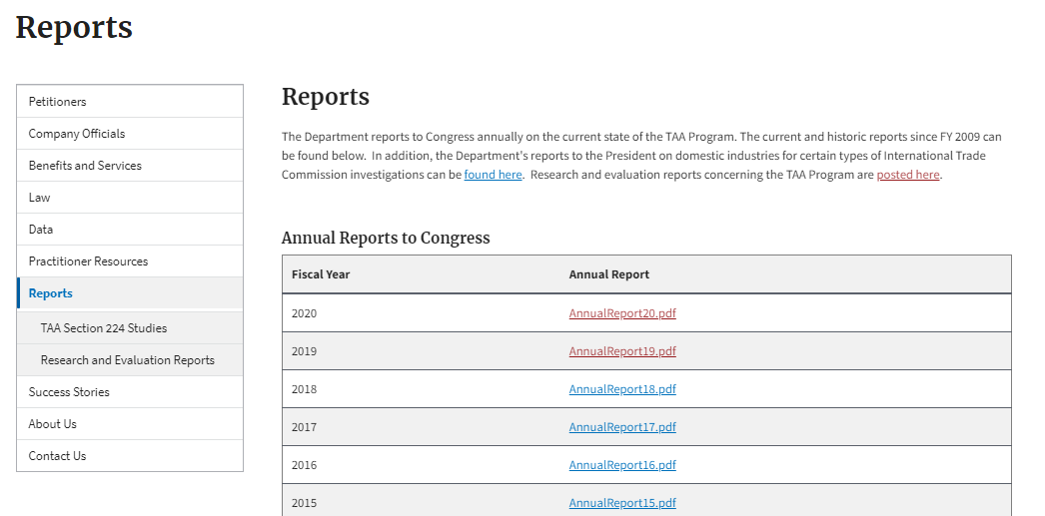
Annual Reports

Slide 34
Success Stories

Slide 35
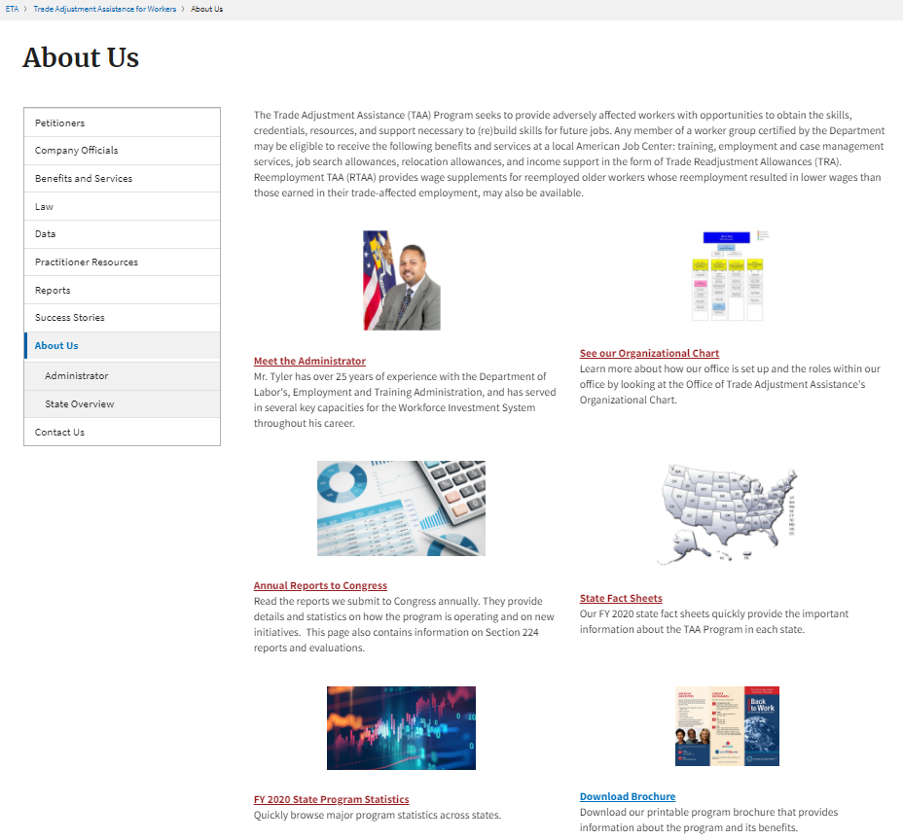
About Us

Slide 36
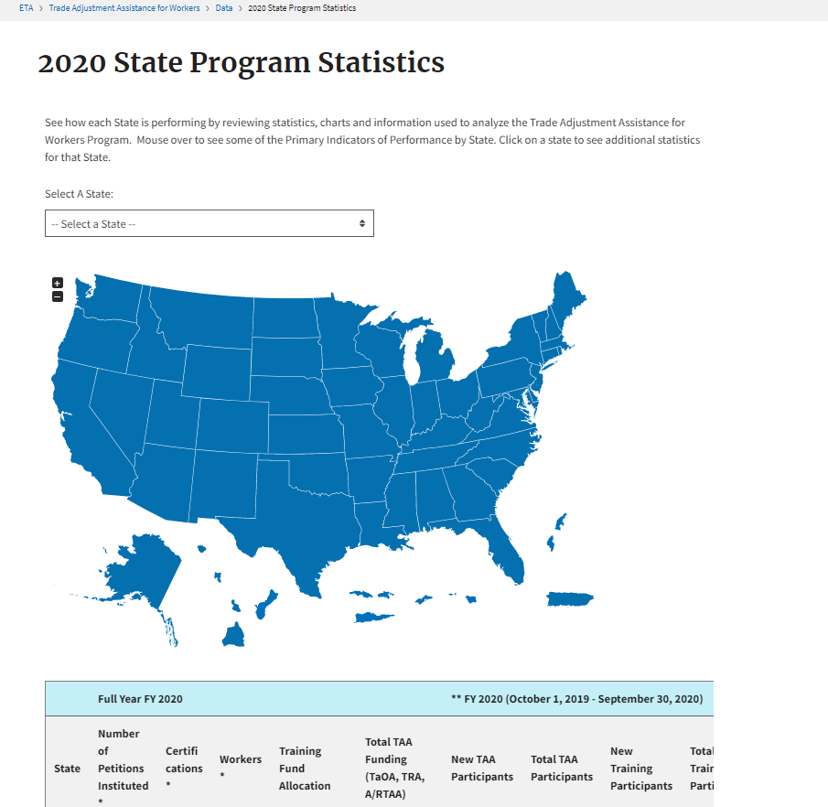
Annual Statistics

Slide 37
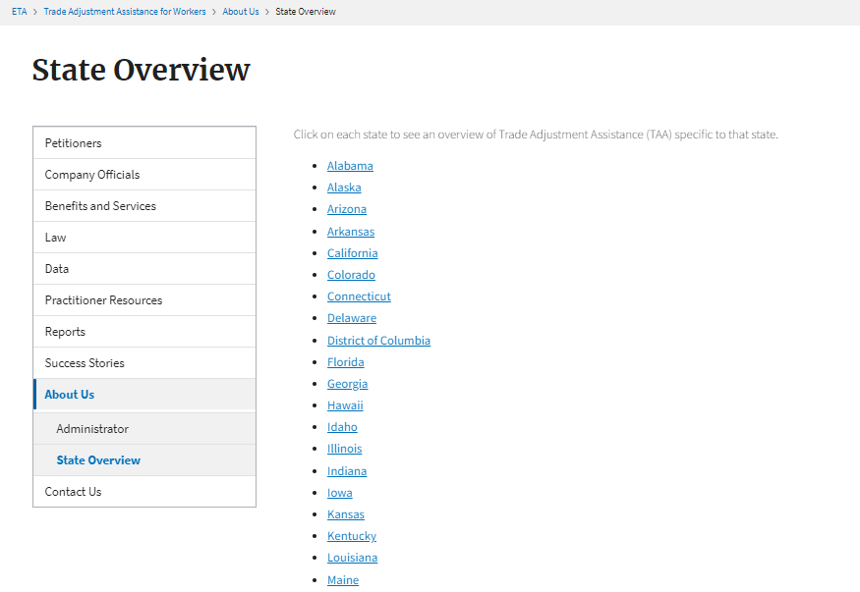
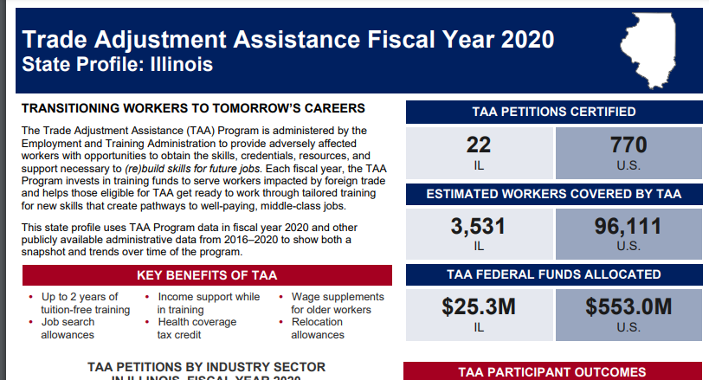
State Fact Sheets

Slide 38
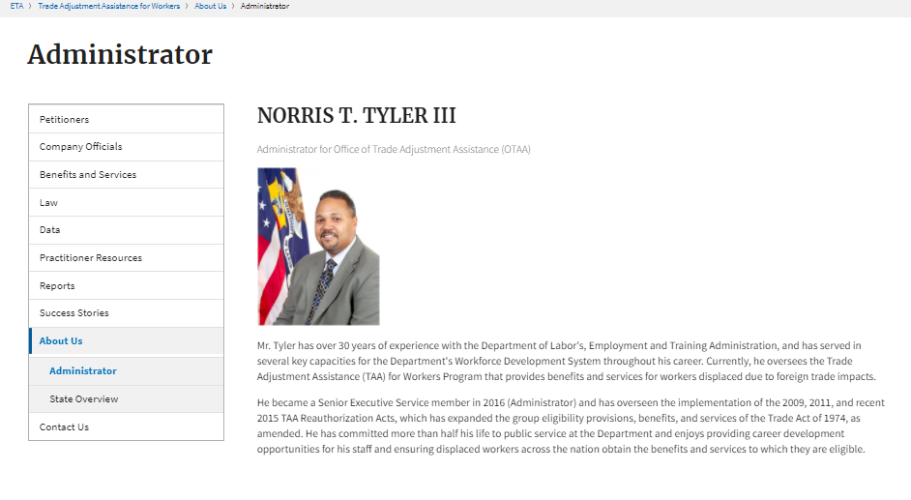
Administrator

Slide 39
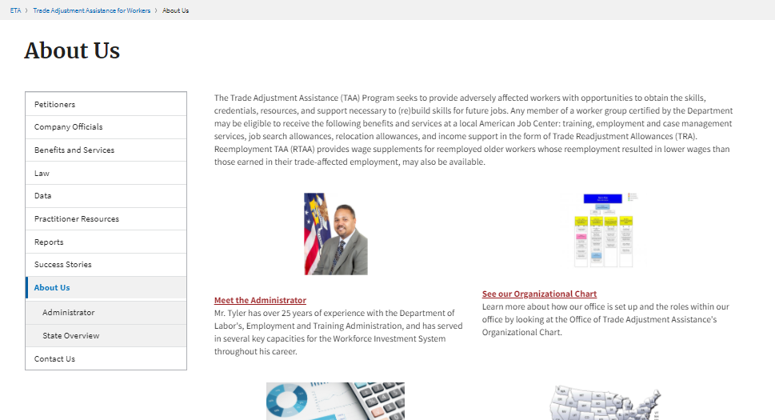
Organizational Chart

Slide 40
Contact Us
Robert Hoekstra
  Program Analyst
    Office of Trade Adjustment Assistance
      hoekstra.robert@dol.gov
        202-693-3522
Susan Manikowski
  Program Analyst
    Organization
      manikowski.susan@dol.gov
        202-693-3545

Slide 41
Researchers
Doing research on the TAA Program? Review this section.

Slide 42
Annual Reports

Slide 43
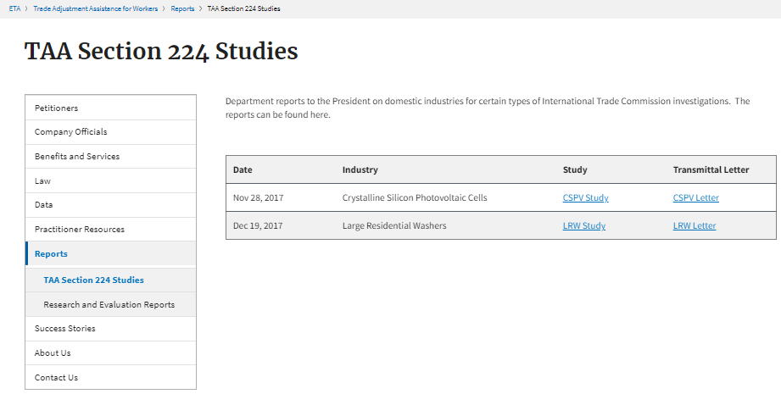
Other Reports

Slide 44
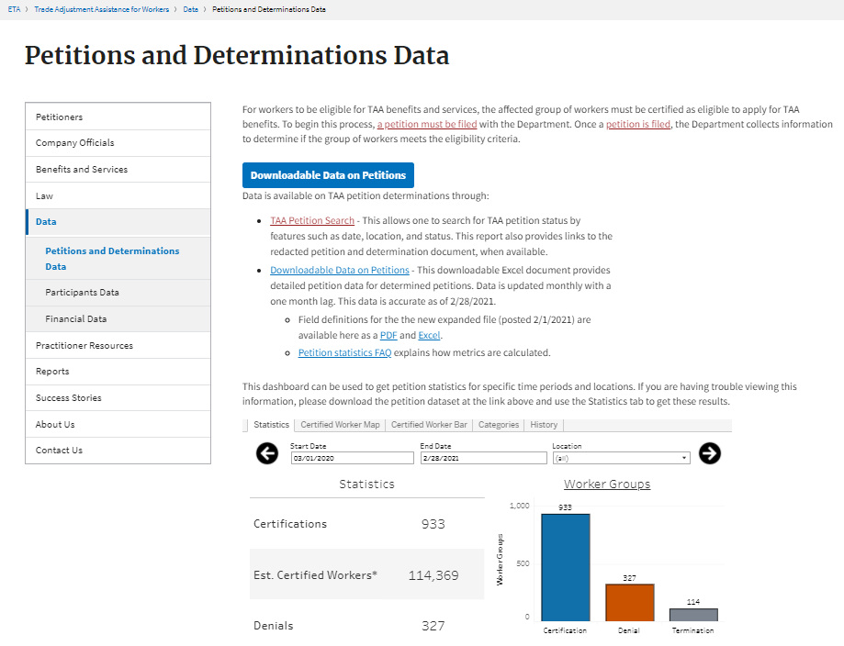
Petition Data

Slide 45
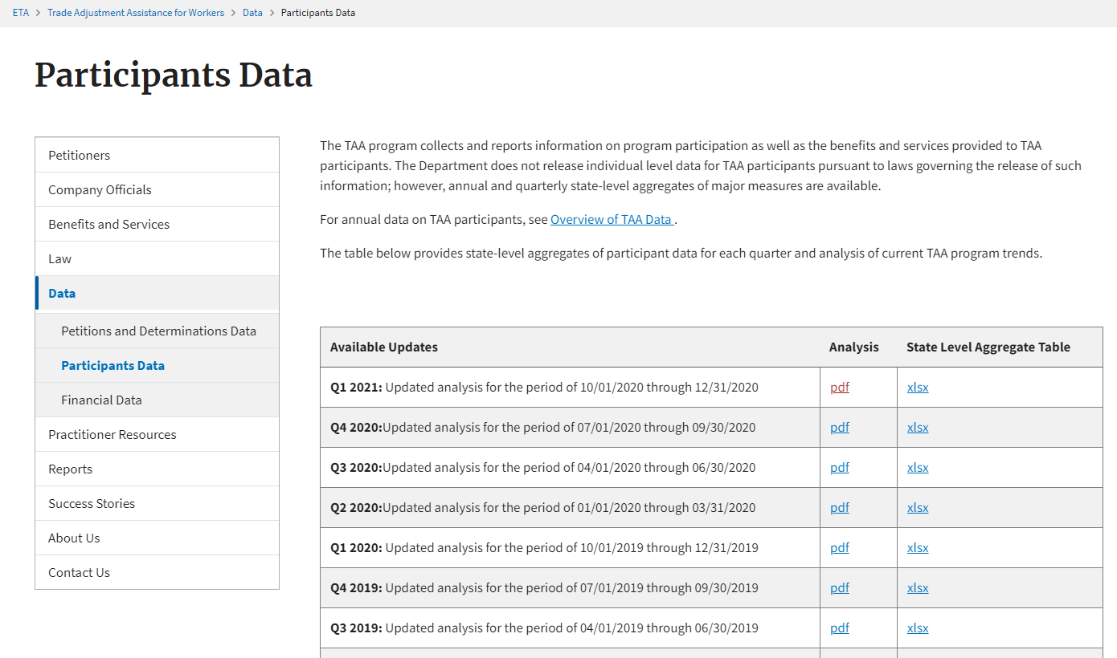
Participants Data

Slide 46
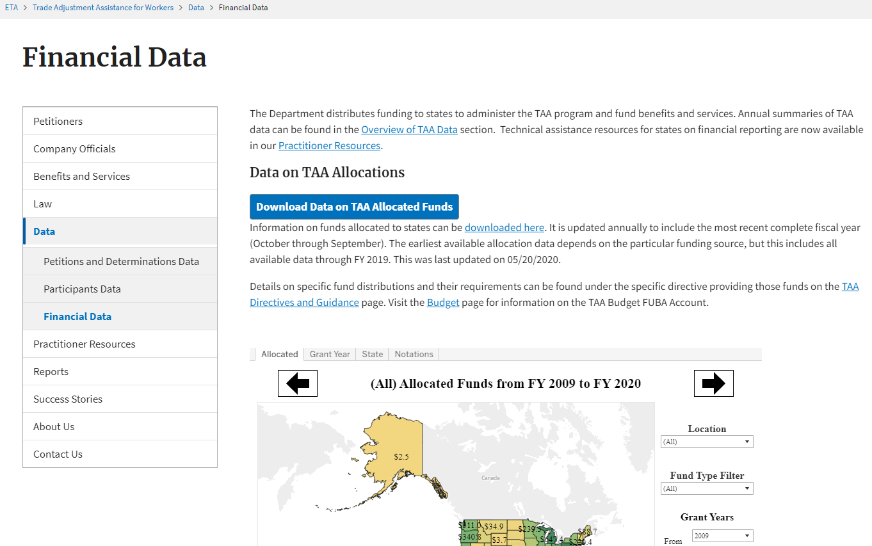
Allocation Data

Slide 47
Contact Us
Robert Hoekstra
  Program Analyst
    Office of Trade Adjustment Assistance
      hoekstra.robert@dol.gov
        202-693-3522
Susan Manikowski
  Program Analyst
    Organization
      manikowski.susan@dol.gov
        202-693-3545

Slide 48
Rapid Response Coordinators and Petition Coordinators
Are you engaged in outreach? This section is for you.

Slide 49
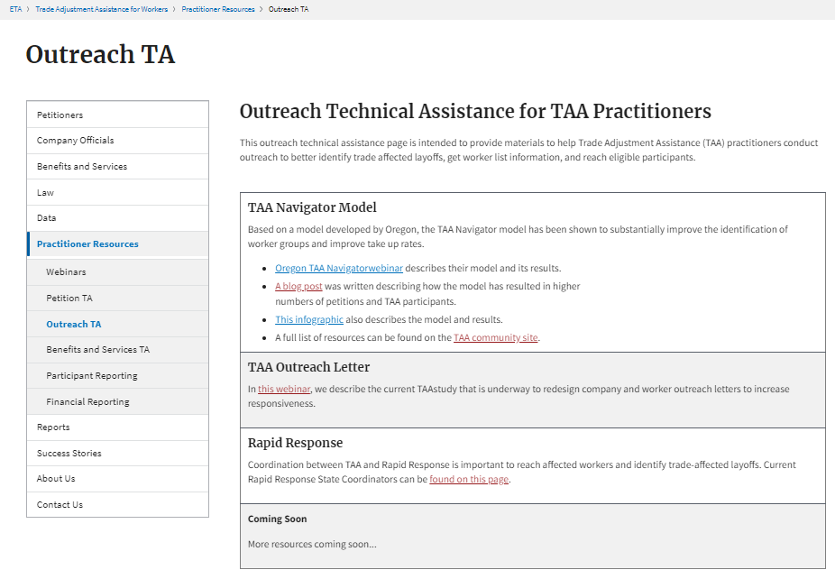
Outreach TA

Slide 50
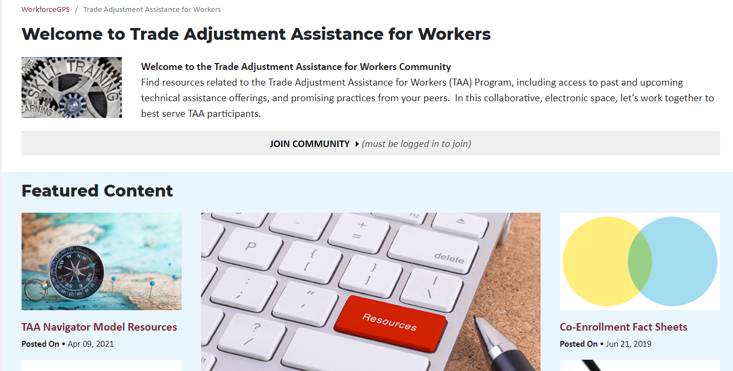
Navigator Resources on WFGPS

Slide 51
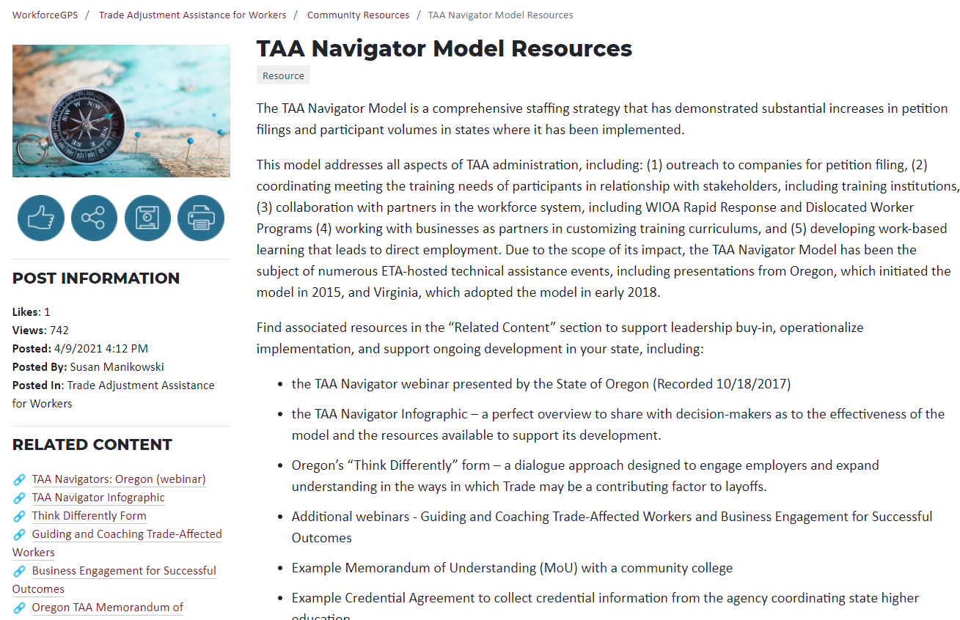
Navigator Resources on WFGPS (2)

Slide 52
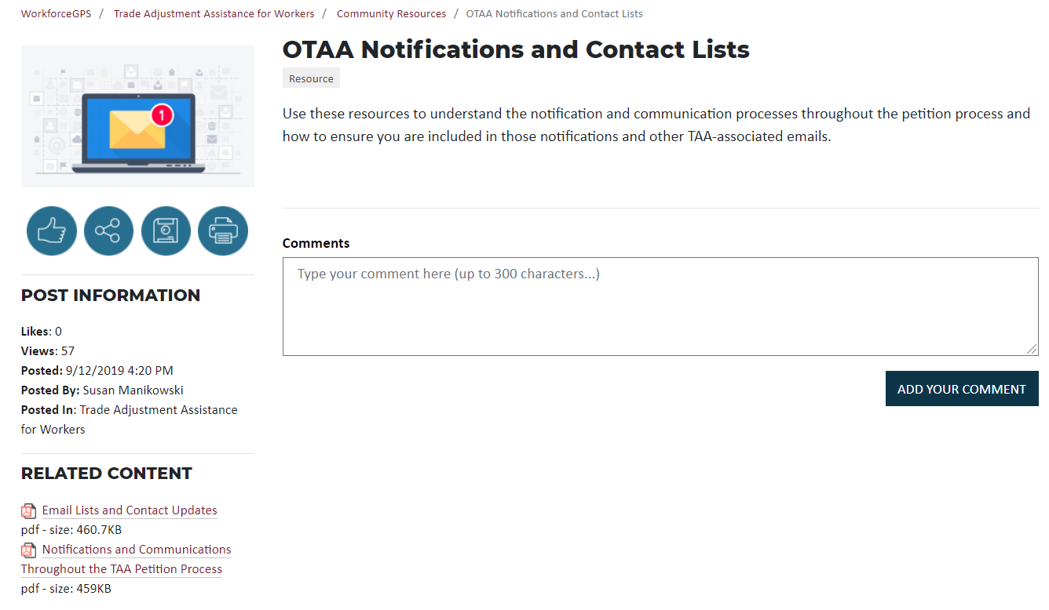
Email Lists & Notifications and Communications

Slide 53
Petition Search

Slide 54
Petition Search: Search Terms

Slide 55
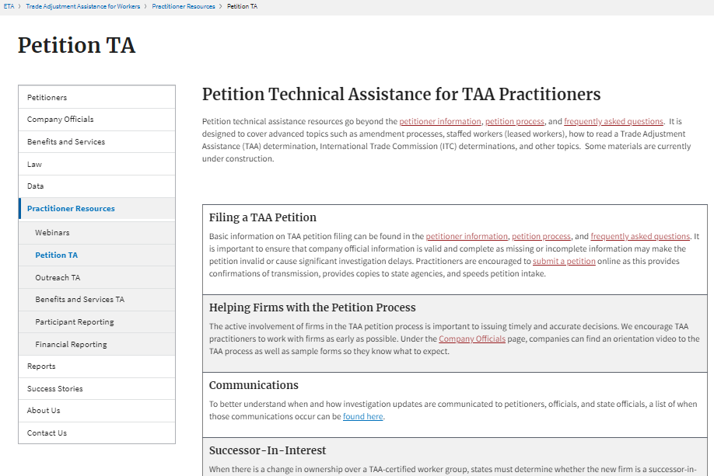
Petitions TA

Slide 56
Petition Filing

Slide 57
Company Officials Overview Video

Slide 58
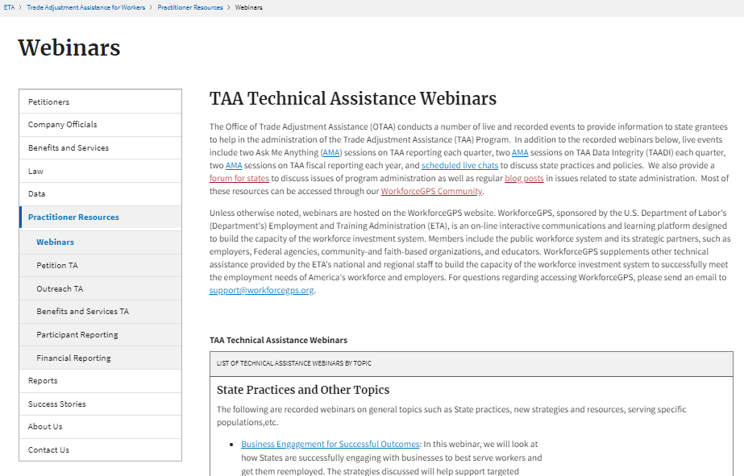
Webinars

Slide 59
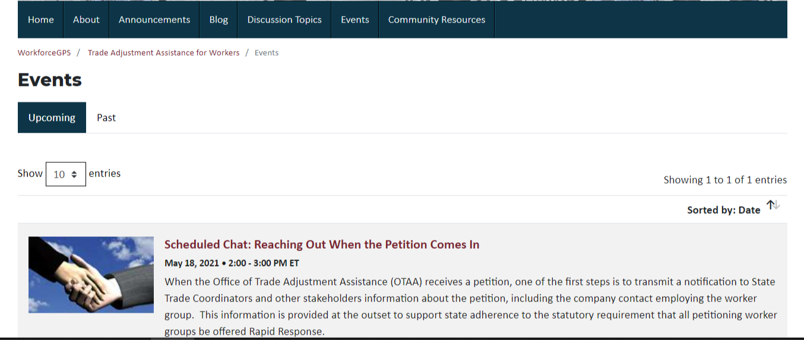
Webinars

Slide 60
Success Stories

Slide 61
Contact Us
Robert Hoekstra
  Program Analyst
    Office of Trade Adjustment Assistance
      hoekstra.robert@dol.gov
        202-693-3522
Susan Manikowski
  Program Analyst
    Organization
      manikowski.susan@dol.gov
        202-693-3545

Slide 62
State TAA Coordinators
State TAA Coordinators - this section is for you.

Slide 63
Benefits and Services

Slide 64
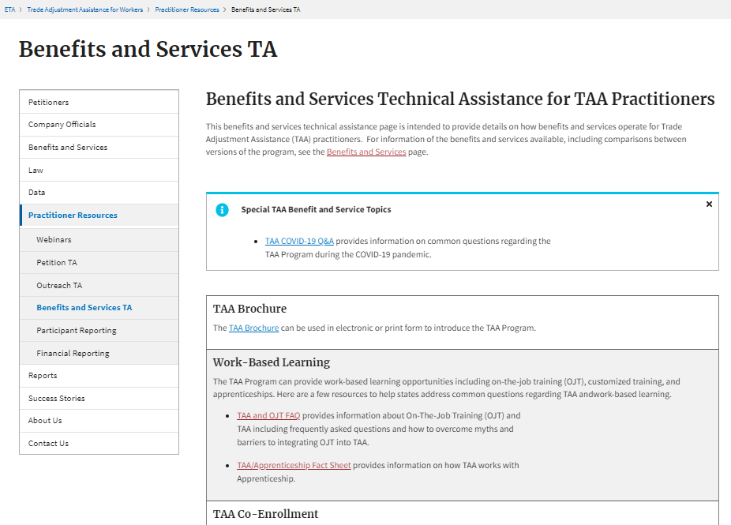
Benefits and Services TA

Slide 65
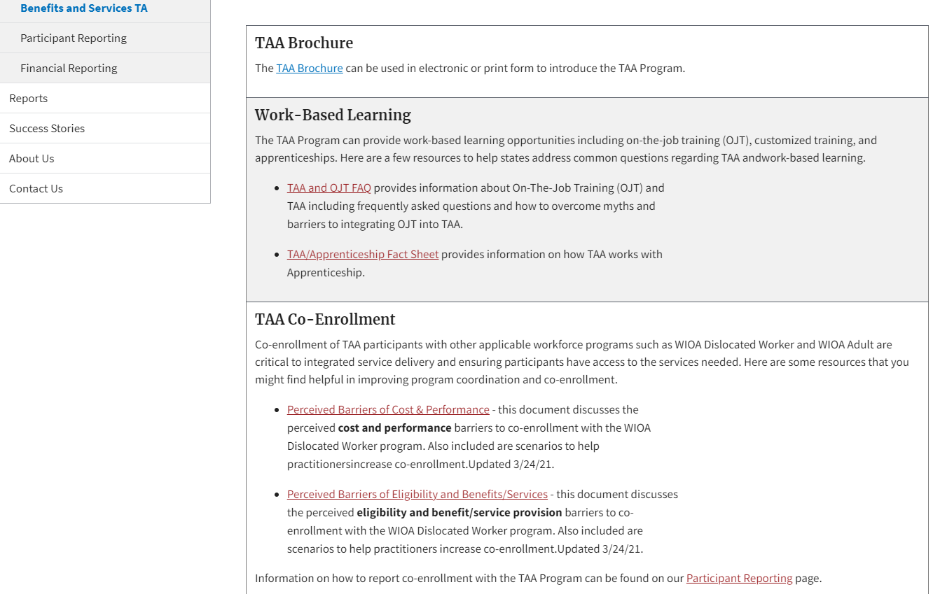
Co-Enrollment

Slide 66
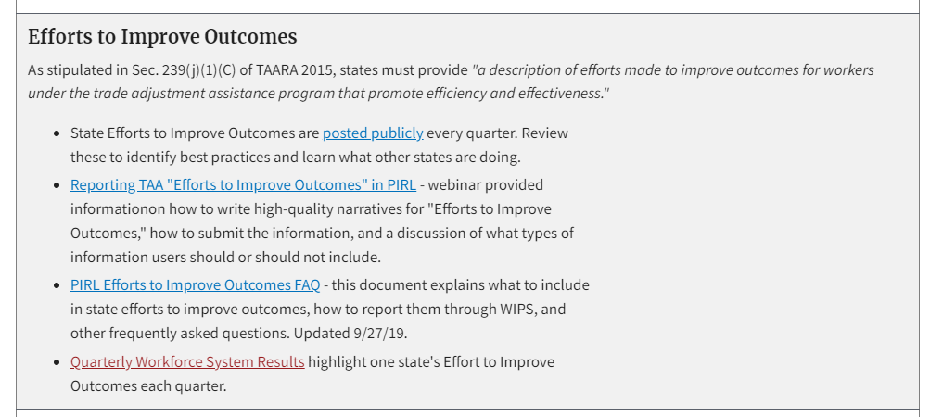
Efforts to Improve Outcomes

Slide 67
Email Lists & Notifications and Communications

Slide 68
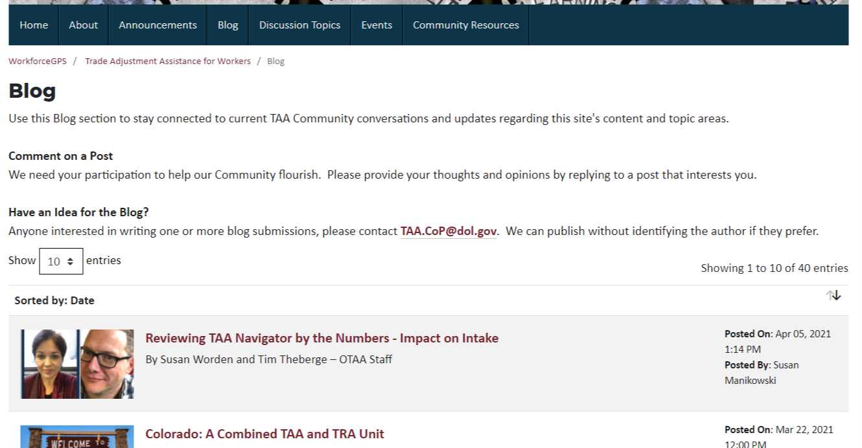
Blogs

Slide 69
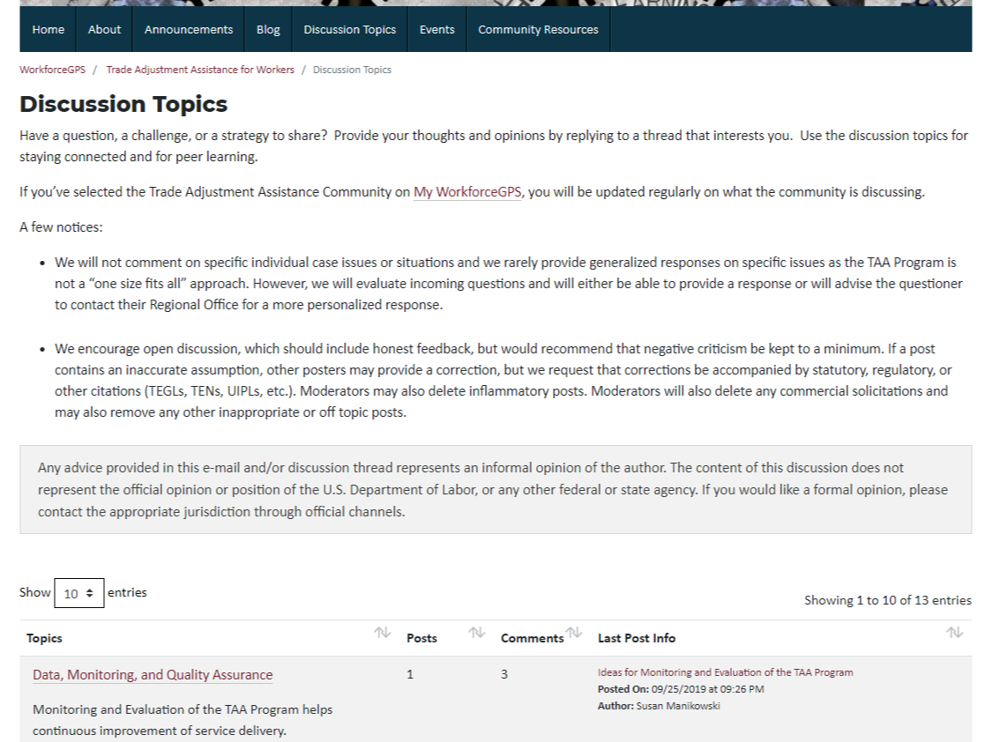
Discussion Forum

Slide 70
Navigator Resources on WFGPS

Slide 71
Navigator Resources on WFGPS (2)

Slide 72
Webinars

Slide 73
Webinars

Slide 74
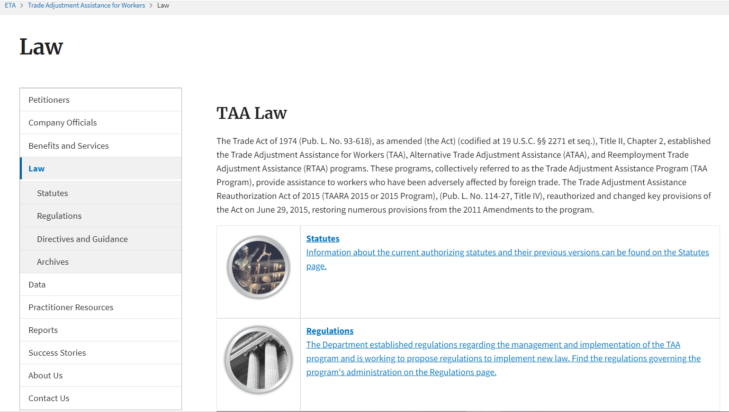
Law

Slide 75
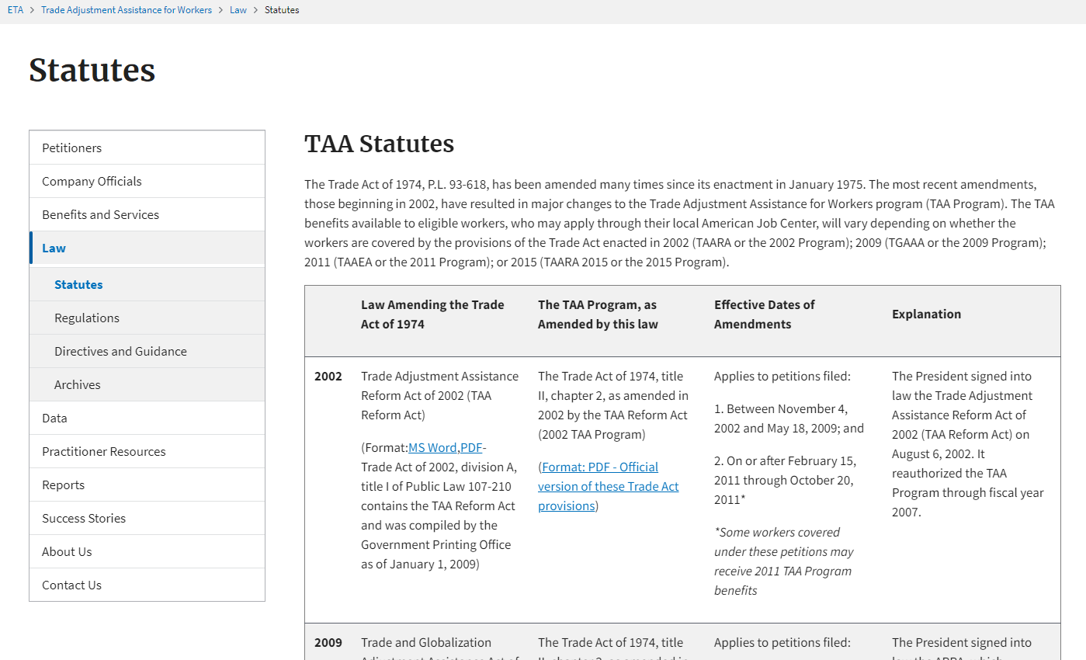
Statutes

Slide 76
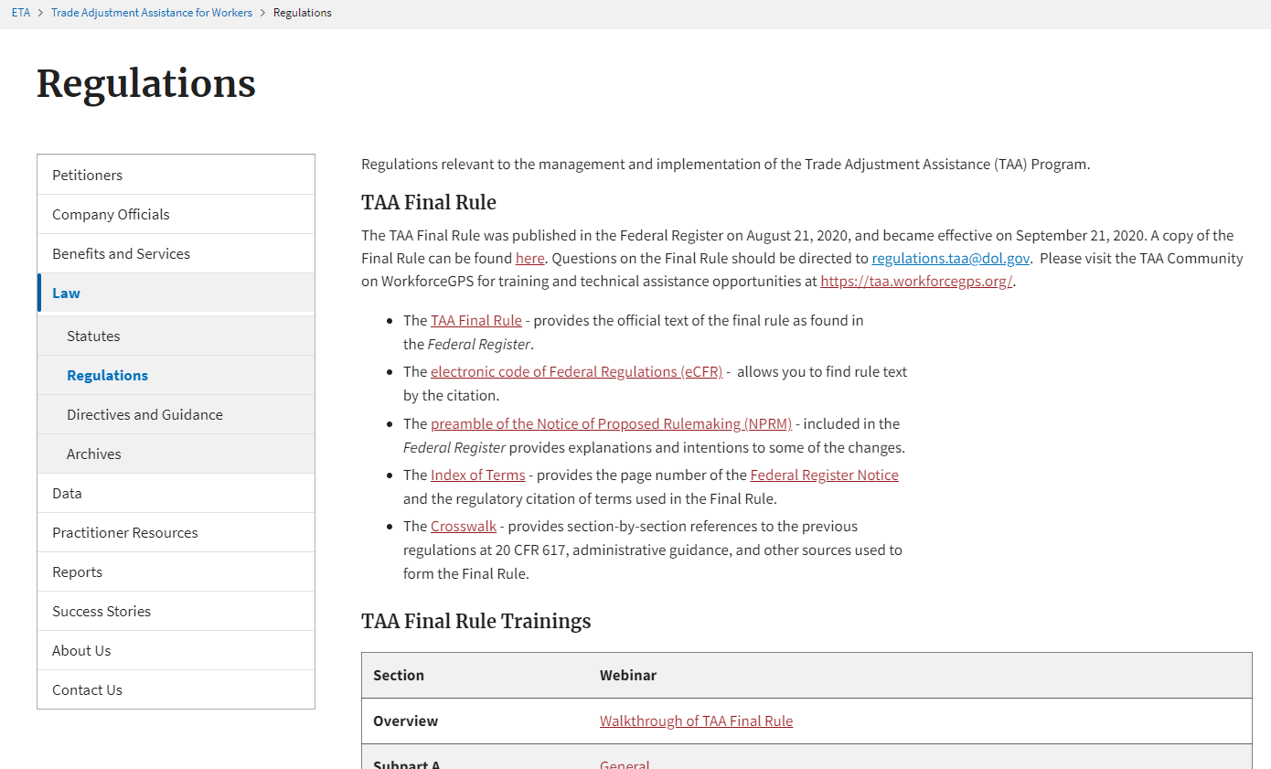
Regulations

Slide 77
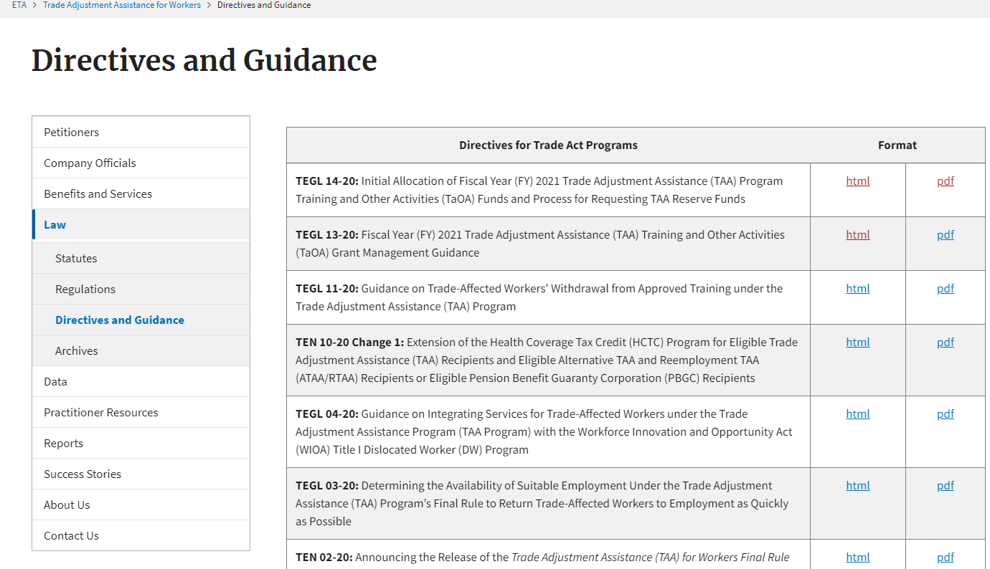
Directives and Guidance

Slide 78
Annual Reports

Slide 79
Success Stories

Slide 80
About Us

Slide 81
Administrator

Slide 82
Organizational Chart

Slide 83
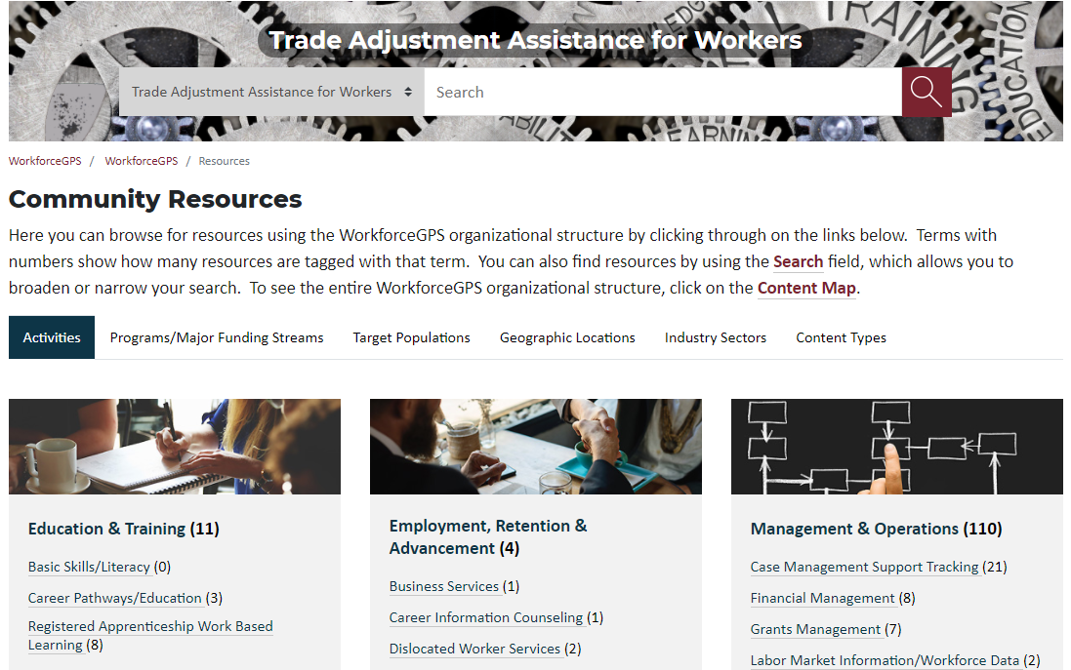
State Resources

Slide 84
Contact Us
Robert Hoekstra
  Program Analyst
    Office of Trade Adjustment Assistance
      hoekstra.robert@dol.gov
        202-693-3522
Susan Manikowski
  Program Analyst
    Organization
      manikowski.susan@dol.gov
        202-693-3545

Slide 85
Case Managers
Resources for those working with participants.
Notes:
If you are a case manager working with participants, these resources should be helpful for you.

Slide 86
Benefits and Services
Notes:
repeat

Slide 87
Benefits and Services TA
Notes:
repeat

Slide 88
Petition Search
Notes:
repeat

Slide 89
Petition Search: Search Terms
Notes:
repeat

Slide 90
Petitions TA
Notes:
repeat

Slide 91
Webinars
Notes:
repeat

Slide 92
Webinars
Notes:
Repeat

Slide 93
Success Stories
Notes:
Repeat

Slide 94
Contact Us
Robert Hoekstra
  Program Analyst
    Office of Trade Adjustment Assistance
      hoekstra.robert@dol.gov
        202-693-3522
Susan Manikowski
  Program Analyst
    Organization
      manikowski.susan@dol.gov
        202-693-3545
Notes:
repeat

Slide 95
State Reporting Staff
Reporting Staff should review this section for resources.
Notes:
Reporting is an integral piece of running the TAA Program. And admittedly, some of the reporting can be complicated. This section has resources to support accurate reporting and to get your questions answered.

Slide 96
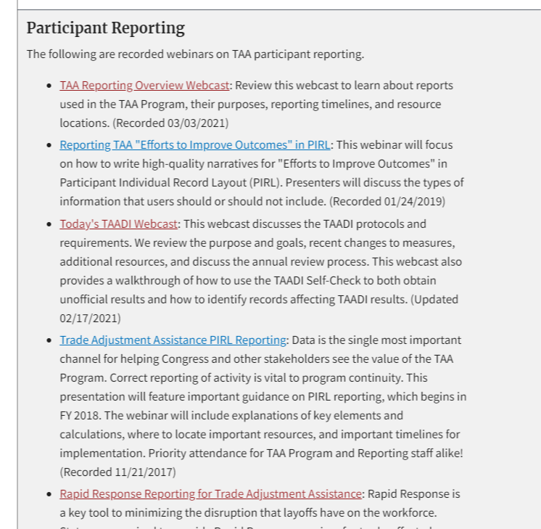
Participant Reporting Webinars & Webcasts
Notes:
The first resource to point out is the TAA Reporting Overview Webcast, found on the webinars page, under Participant Reporting. Review this webcast to learn about reports used in the TAA Program, their purposes, reporting timelines, and resource locations.

Slide 97
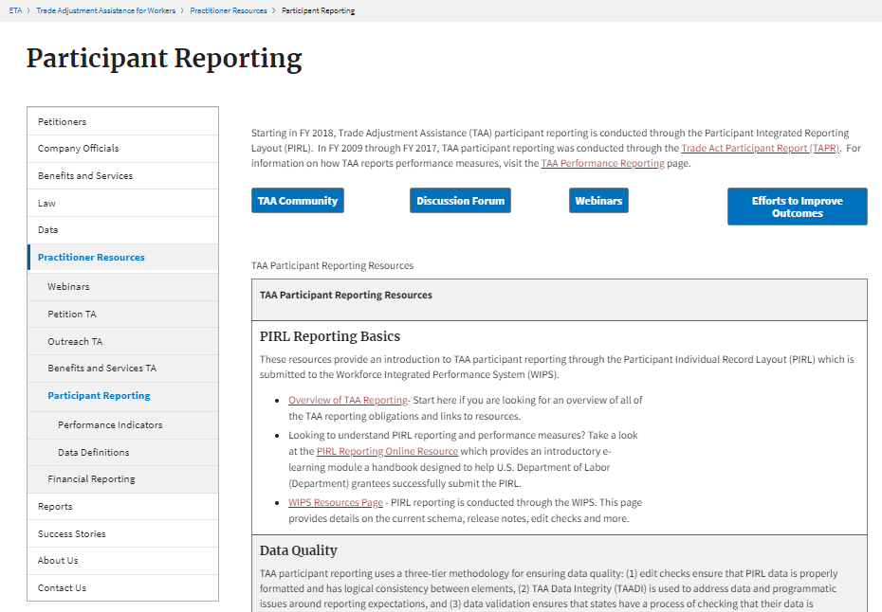
Participant Reporting
Notes:
The participant reporting page is the go-to place for information on data quality, TAADI, and Frequently Asked Questions.

Slide 98
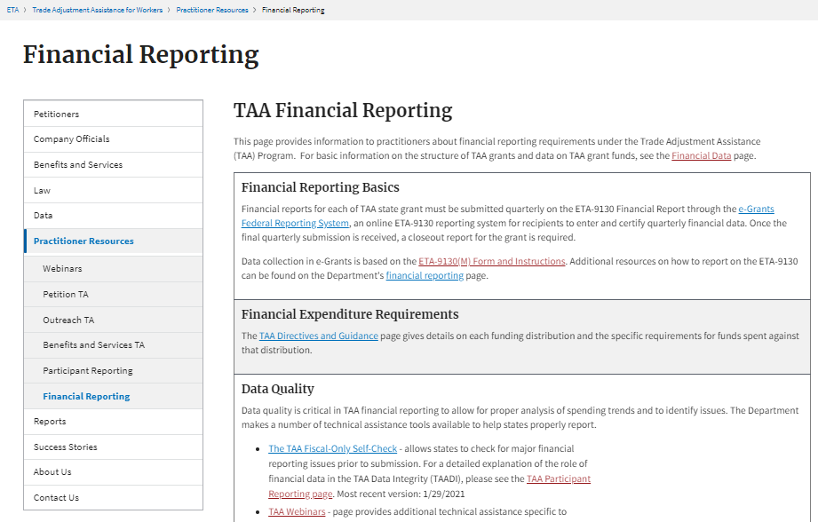
Financial Reporting
Notes:
The Financial Reporting section has information on financial data quality, the allocation process, and requesting additional funds.

Slide 99
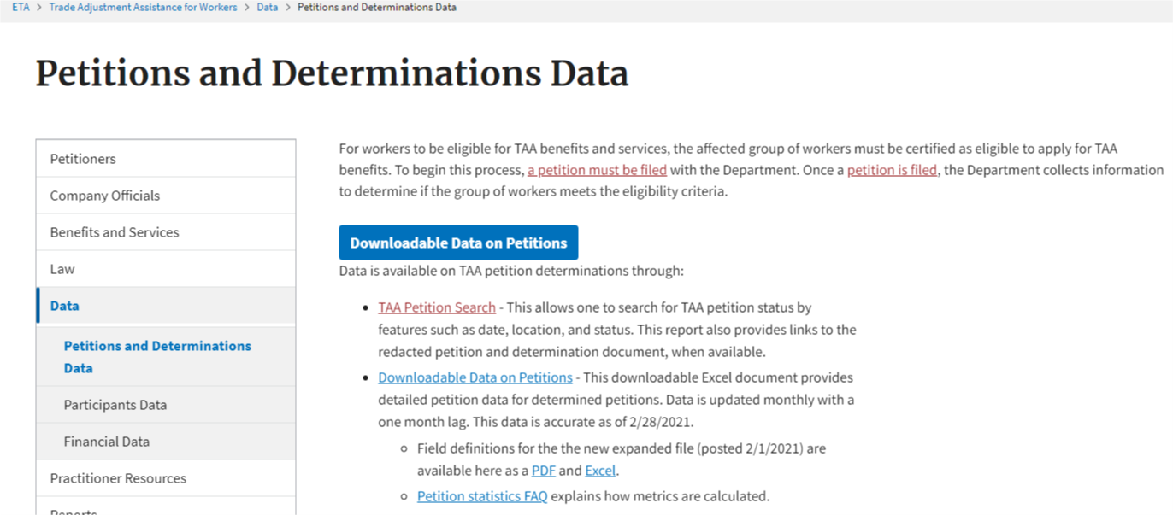
Petitions and Determinations Data – Downloadable Data
Notes:
Finally, under data, there is downloadable petition data. This is what is used in the Petition Number TAA Data Integrity (TAADI) measure.

Slide 100
Contact Us
Robert Hoekstra
  Program Analyst
    Office of Trade Adjustment Assistance
      hoekstra.robert@dol.gov
        202-693-3522
Susan Manikowski
  Program Analyst
    Organization
      manikowski.susan@dol.gov
        202-693-3545
Notes:
repeat

Slide 101
Thank You!
Need help? Email: Support@workforceGPS.org
Notes:
Thank you for viewing this webcast and for your interest in the TAA Program.

