Slide 1


UI Modernization
Content Focused Research Workshop (11/23)
U.S. Department of Labor
Office of the Secretary
Office of Unemployment Insurance Modernization

Slide 2
What we’ll be covering
Introduction – What is research and why does it matter?
Types of research
Research logistics
Synthesis
Q&A
Additional resources

Slide 3
Introduction

Slide 4

I'm not a researcher...am I?
When we think of researchers, particularly UX researchers, we may have a specific image in mind: someone asking neutrally worded questions, scribbling down notes, and placing sticky notes all over a whiteboard.
While this image isn't incorrect, it doesn't paint the full picture.
The truth is, we all have research experience.

Slide 5
What is UX research?
UX research is the practice of analyzing how users interact with the product, service, or experience you’re designing. User research helps us validate our assumptions (hypotheses), ensure that we’re meeting users’ needs, and help users accomplish whatever goals they’re trying to achieve by using our product or service.
UX research can be qualitative, quantitative, or a combination of both. It doesn’t need to be costly or time consuming to provide us with useful insights.
Your team may already be conducting UX research, or you may just be thinking about starting. Wherever you are, this workshop is intended to help you hone your research skills and feel more comfortable facilitating sessions.

Slide 6
Did you know?
Some estimates maintain that 70% of software projects fail.
Doing research throughout the content development cycle can help you ensure that your content meets claimants' needs.

Slide 7
Why is UX research important?
Helps us ensure we’re creating a useful, usable product or service with clear value to the user
Reduces design and development time
Helps us clearly understand how users interact with our product or service
May help us discover previously unacknowledged user needs
Eases prioritization – research lets us know what users find most important
Helps us save money
Helps us understand whether what we’re creating is relevant

Slide 8

In short:
Spending a few hours of research early in a project can save your team months' worth of work in the future.
By validating (testing) content with your actual users, you're setting yourself up for success.
Image from gnashingblog.com

Slide 9
Pitfalls of not doing research
Designing for the wrong user group
Designing the wrong product or experience for your target users
Prioritizing business goals over user needs
Inefficient use of time and budget
Lack of clarity on whether you’re improving your product/service
Increased likelihood of prioritization based on personal preference

Slide 10
TYPES OF RESEARCH

Slide 11
Before you start…
What are your research questions?
  What are the goals of your research? What are you hoping to learn?
What stage is your content (or concept) at?
What’s your timeframe?
With what type(s) of users would you like to conduct research?
Are you planning to hold in-person or virtual sessions?
What limitations are you facing?
How – and with whom – will you share your research findings?

Slide 12
What about time?
One concern we often hear from organizations that don't conduct research is that it's too time consuming. While some methodologies are time intensive, research doesn't have to take a lot of time. Here are some tips to consider:
Share facilitation duties: Having a few facilitators means that each person does less.
Shorten your sessions: Could you shorten your hourlong sessions to 45 minutes?
Aim for the minimum number of participants: Usability tests generally only need 5-7 participants to yield solid results.
Space out rounds of research: Center research around major updates or launches, and recognize that not all rounds of research must be equally comprehensive (smaller changes = more lightweight research).

Slide 13
Phases of content development
Ideating
Drafting
Validating
Revising
Publishing

Slide 14
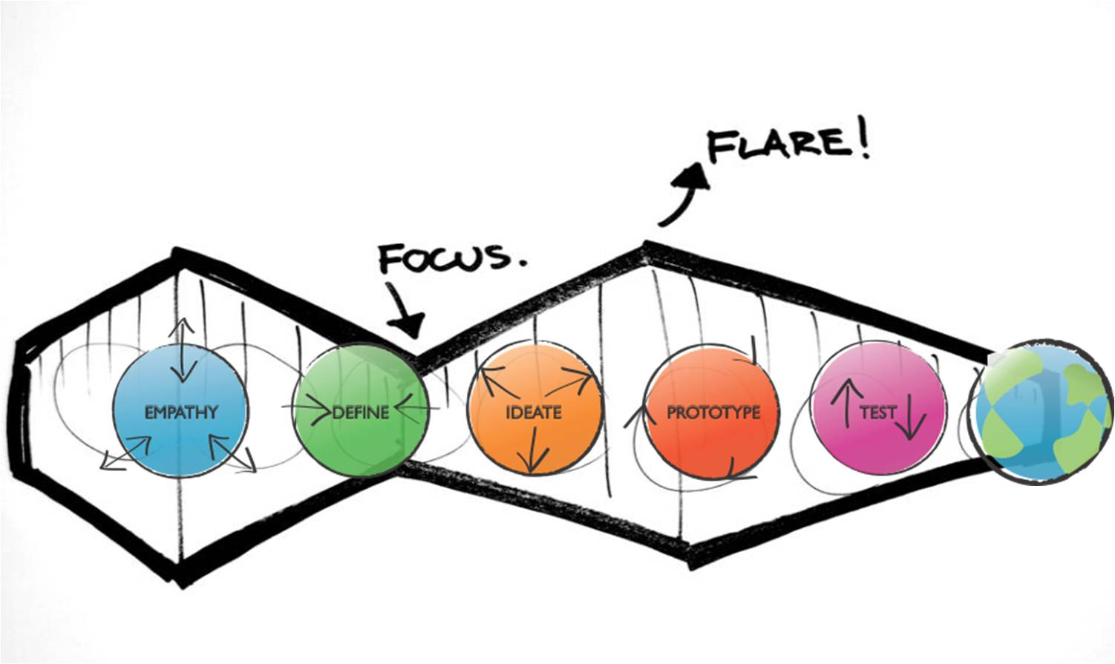
Design thinking

Slide 15
Types of research
Today, we’ll cover several methodologies – these are only a few of the many UX research methods available:
Variations of usability testing (concept testing, content-focused usability testing) – sharing a scenario with participants and asking them to complete predetermined tasks
Cloze testing – a Mad-Libs-style activity that helps you understand how readers rely on context to understand a piece of content
Highlighter testing – Asking participants to rate the clarity of short, discrete bits of content

Slide 16
Concept testing
What it is: Testing (validating) a concept with your target user group(s).
When to use it: Can be done at various points in the content development process, but it may be most useful when you're thinking about introducing new content (ideation phase).
When not to use it: Late in the development phase or after publication.
What it can help you learn: Whether a concept appeals to your target users, what changes might improve the concept, what aspects of the concept are working well. It can also help you prioritize what features or aspects to focus on.

Slide 17
Content-focused usability testing
What it is: Like more general usability tests, content-focused usability testing asks participants to engage with content by performing one or more predetermined tasks; this helps the facilitator see how user friendly the content is/how to improve it.
When to use it: Once you have fairly high-fidelity content and would like to learn how to improve it (after drafting).
When not to use it: At the earliest stages of a project (e.g., before you have a solid draft of your content).
What it can help you learn: How understandable and actionable your content is, what sections may need improvement, whether anything is missing.
Things to consider: Moderated tests are much more successful than unmoderated; usability testing sessions may take up to an hour, depending on length of content.

Slide 18
Highlighter testing
What it is: A quick way to determine the comprehensibility of short sections of content (interface copy, sentences, or paragraphs).
When to use it: Use this method to assess copy that’s relatively finalized (after drafting or revision).
When not to use it: This method isn’t helpful for very early-stage (draft) content – it’s more suited to content that has undergone internal assessment. It’s also not great for longer content.
What it can help you learn: Which words and phrases your target audience understands and which need rephrasing or clarification.
Things to consider: You can facilitate highlighter tests in person or virtually; if conducting virtually, make sure your participants are comfortable sharing their screen and using Drive or Word.

Slide 19
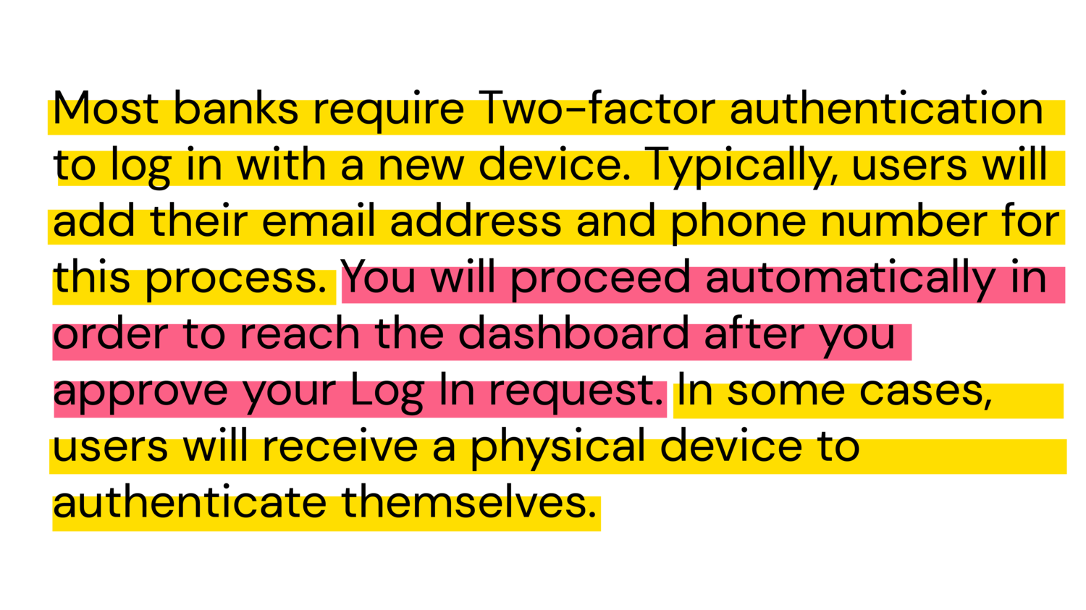
Highlighter testing – an example
Image by Gloria Li

Slide 20
Cloze testing
What it is: A way to assess how understandable content is by having participants fill in missing words (a Cloze test resembles a Mad Lib).
When to use it: Cloze tests are best for shorter pieces of content (paragraphs) that are relatively finalized.
When not to use it: To test interface copy or very long pieces of content, or to test concepts that aren't well developed.
What it can help you learn: Whether a piece of content is the appropriate difficulty for your target audience; whether you need to add more contextual information to your content.
Things to consider: A score of 60% or higher generally means your content is the right difficulty for your audience.

Slide 21
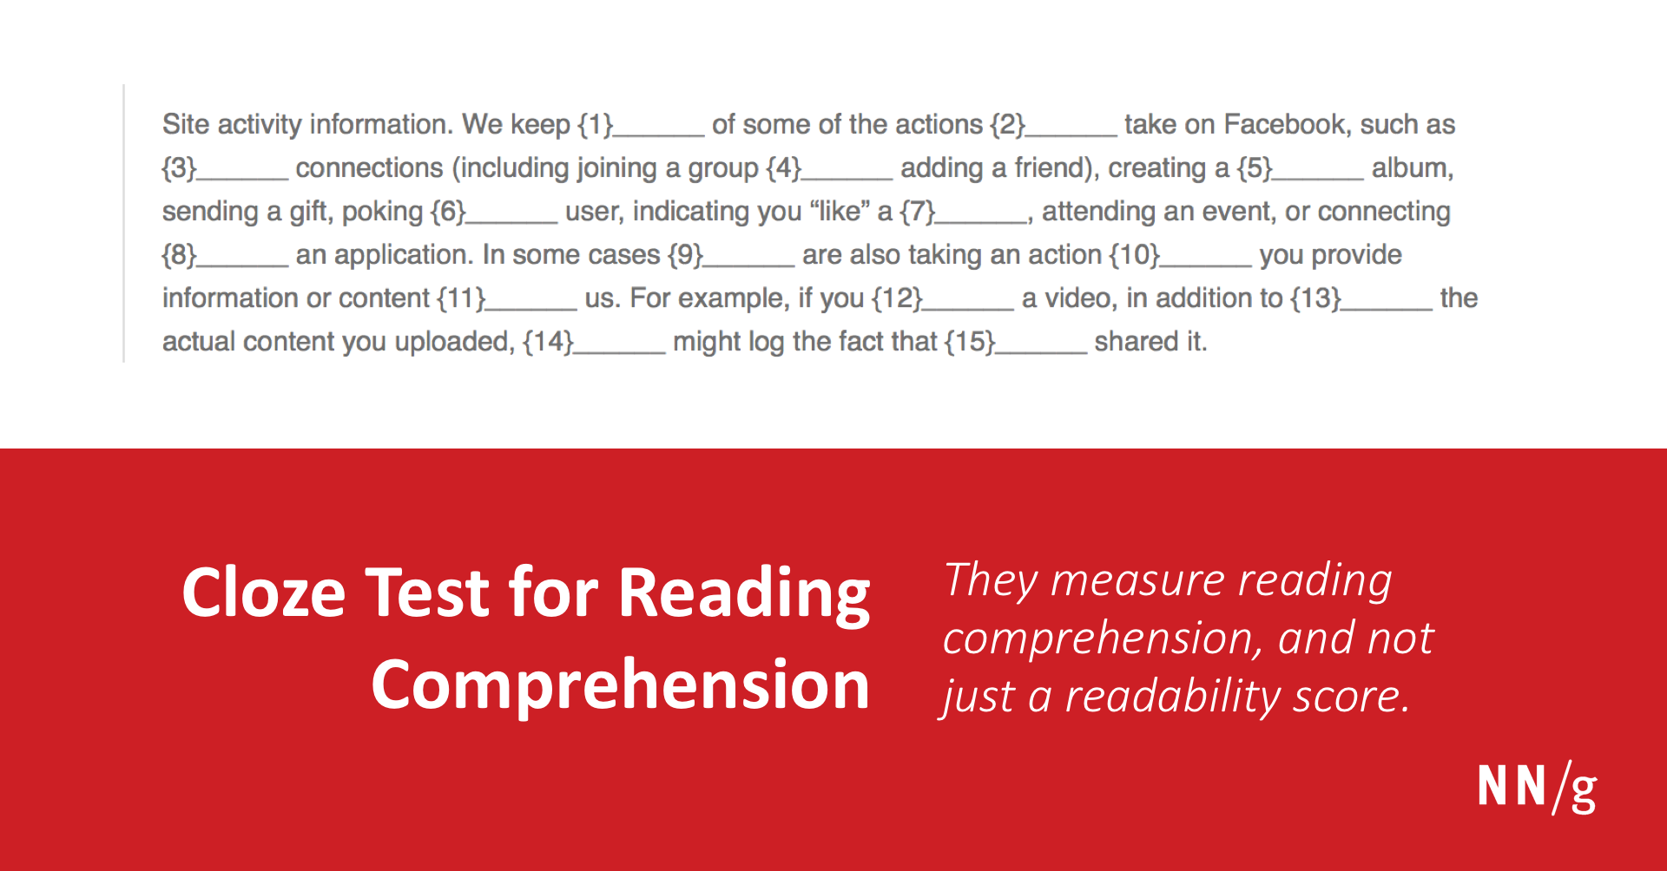
Cloze testing – an example
Example of a cloze test (featured in the NN article Cloze Test for Reading Comprehension)

Slide 22

Which techniques are most interesting to you?
Which would fit best with your current workflow?
Which seem like they might present challenges?

Slide 23
Card sort
What it is: A research method by which participants sort content items into categories (either predetermined or determined by the participant); the design team can use synthesized data to inform the structure of a site’s information architecture.
When to use it: During site builds or redesigns – any time you’re considering restructuring content on your website.
When not to use it: Prior to having the bulk of your site content developed/planned.
What it can help you learn: Card sorts provide insight into how your target users categorize information, which can help you better understand how they might expect to navigate your site.
Things to consider: You can conduct card sorts in person or online (using software like Optimal Workshop). Consider whether to conduct an open, closed, or hybrid sort.

Slide 24
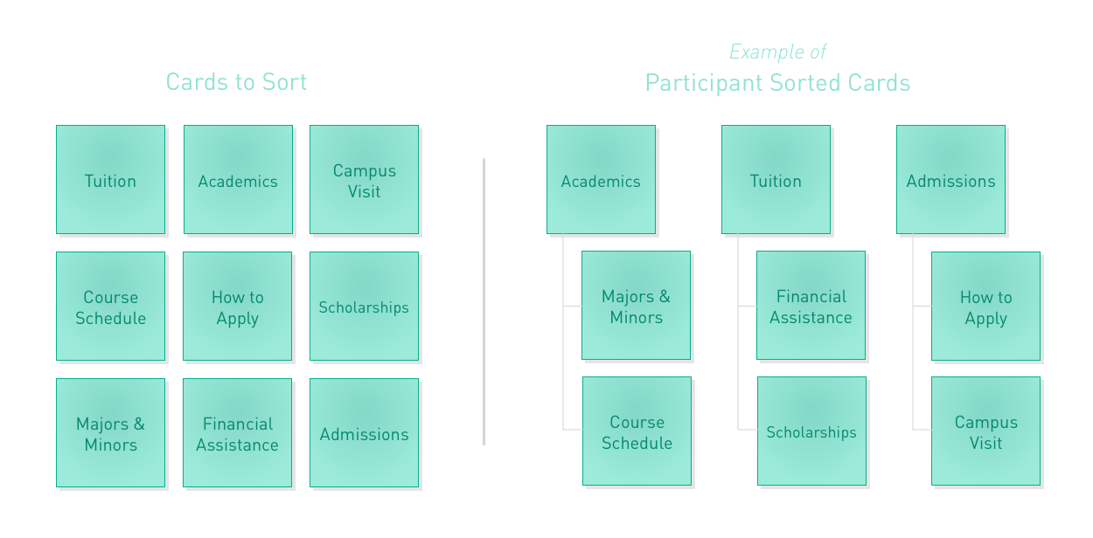
Card sort – an example
Illustration from Atomic Objects

Slide 25
Research questions vs. interview questions
Research questions
Interview questions
Research questions capture what you want to learn to be able to inform future strategic decisions.
Research questions should be “specific, actionable, and practical.” (Erika Hall)
Example: How do recent college graduates decide what to have for dinner?
What factors do families take into account when vacation planning?
Interview questions should encourage your participants to share honest responses about their processes, needs, and preferences.
Don’t ask directly about needs and preferences – you won’t get useful answers. It’s often better to ask a participant to walk you through an example.
Example: What did you eat yesterday?
Describe your last vacation.

Slide 26
Creating your research plan
Your research plan is the backbone of each round of content-focused research – it will guide your team’s focus and help ensure that you stay on track relative to your research goals. As you draft your research plan, keep the following in mind:
Spend time brainstorming research questions: These form the foundation of your plan, so leave enough time to craft thoughtful questions and gain team alignment.
Consider including the following sections: Research plans often include sections on Objectives, Research questions, Methodology/ies, Recruiting and Participant information, Research timeline, and other logistical considerations. Feel free to add other sections, as necessary.
Don’t reinvent the wheel: When you’re just beginning to write research plans, don’t be afraid to draw on examples that resonate with you. Your team can also create a template to work from – this will help you save time during future rounds of research (and will ensure consistency among your research plans).
This Nielsen Norman post covers the basics of writing a research plan.

Slide 27
Creating your interview guide
Just as your research plan outlines your key goals and methodologies, your interview guide provides structure for the conversations you’ll be having with individual participants.
Writing a clear interview guide is important for a few reasons. First, it will ensure that you cover the same themes and topics during each research session (and therefore maintain consistency across sessions, which will make synthesis easier). Second, it will enable any member of your team to facilitate research sessions – a team member can review the guide to increase their facilitation comfort level prior to a session.

Slide 28
Sections in an interview guide
Introduction
  Roles and introductions of people on the call
  Purpose of the conversation/what participant should expect
  Reassurance to participant
  Verbal confirmation of consent (to take notes, to record)
  Oppty for participant to ask questions
Background questions
Main questions
  These will form the bulk of your research session
  Focus on tasks that will help you evaluate the effectiveness of a product or feature set
  Prior to actual sessions, do a dry run (or several) with your internal team
Wrap up
  Any questions you weren’t able to ask
  Chance for participant to ask questions

Slide 29
Research logistics

Slide 30
Identifying participants
Recruiting suitable participants requires you to know whom you’ll be creating content for – before you can start recruiting, you need to know your target audience(s).
Keep the following in mind:
What are your users’ needs and motivations?
Are you targeting multiple audiences? A complex audience?
  If multiple audiences: How is your team prioritizing audiences’ needs?
Who is not part of your target audience?

Slide 31

Recruiting
Focus on your target user group: The more clearly you define your target participant group, the more easily you’ll find participants suited to your research needs.
Identify strong recruiting channels: Work with stakeholders to identify potential participants who have already shared feedback/expressed interest.
Use incentives, if possible: Check your state’s laws around this.
Templatize your comms: Having template recruiting, confirmation, and thank-you emails streamlines the process.
Have backup participants: Nielsen Norman reports an 11% no-show rate for usability studies – having backup participants will ensure you meet your participant target.

Slide 32
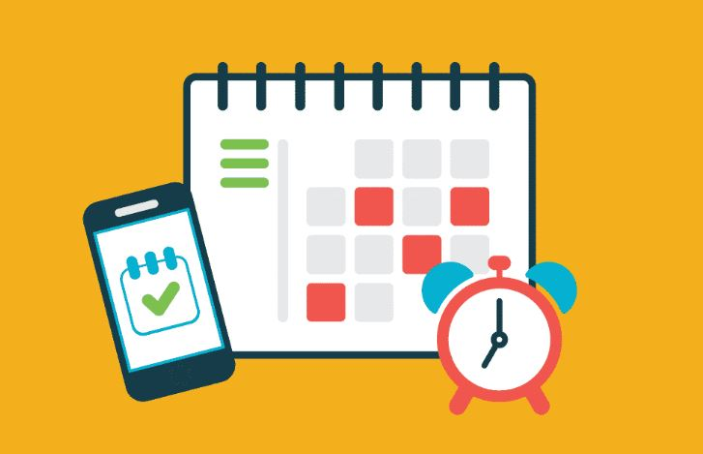
Scheduling
Set core hours for research sessions: This is especially important if your team is distributed across multiple time zones. Your team could also consider doing research in shifts to accommodate participants’ schedules.
Use scheduling tools (if allowed): Check your state’s laws/regulations. Using scheduling tools can drastically reduce the amount of time you devote to scheduling.
Limit daily sessions: If you’re just starting out, limit sessions to two per day.
Identify notetakers and observers beforehand: Assigning notetaking duties in advance will minimize confusion and ensure that each session has a notetaker.
Send day-of confirmations to participants: Several hours before each session, send a confirmation email to participants; this can minimize no-shows (or give your team time to reschedule sessions).

Slide 33
Other considerations
As you plan your research, keep these additional logistical questions in mind:
Will you be holding sessions in person or remotely? Each option has its pros and cons – if holding remote sessions, though, you may need to provide technical guidance ahead of time (and make contingency plans for tech snafus, such as connectivity issues).
Will team members have static roles, or will you rotate roles? Having fixed roles may minimize confusion, and rotating roles allows each team member to gain experience with various research duties.
How would you like to debrief with your team? After each session? At the end of each day? Asynchronously?
How much time will you leave between sessions?
Will you have a research retrospective (debrief session)? Although scheduling can be challenging, a retro will help your team connect over what worked well and identify opportunities for improvement.

Slide 34
Synthesis

Slide 35
Synthesis: bringing it all together
Synthesis is a very important stage of the research process – it’s the practice of interpreting your data and drawing actionable insights from it. It’s common to share synthesized data with other project teams and stakeholders in the form of a research report or presentation deck. Analysis, in contrast, involves categorizing and sorting your data (quantitative or qualitative) – you can analyze your data before synthesis or during synthesis, depending on your synthesis framework.
Although synthesis is overlooked by some teams, it shouldn’t be: it’s the process that helps us communicate our findings – and the impact of those findings – to people who weren’t directly involved in the research process. In other words, it helps us tell the story uncovered by our research.

Slide 36
Pre-synthesis preparation (analysis)
How you analyze your data will depend on what sort of data you’re collecting, your team composition, your chosen synthesis methods, and other factors, but these tips will help you simplify your analysis:
Debrief after each research session: If possible, dedicate 15 minutes after each session for a quick debrief with your research team. During this time, note themes/trends from the session you just completed; you can take debrief notes in the same document that contains your session notes. Debriefing while the session is still fresh in your mind prevents details from being lost.
Co-create coding conventions: If you’re coding (or tagging) your research notes to help surface themes/trends, work with your team to create a coding convention (e.g., common tags and methods). Using duplicative tags will make it more difficult for you to spot trends.
Use tools to make data storage easier: There’s nothing wrong with using a simple document or spreadsheet for analysis, but some tools (such as Airtable and Dovetail, to name a few) make analysis even easier by offering advanced tagging, filtering, and sorting features.

Slide 37
Synthesis methods
Synthesis can be most successful when it’s completed as a group activity. Before starting synthesis, make sure everyone on your team has reviewed your research notes and/or recordings. You can choose from various synthesis methods, and also combine methods:
Affinity mapping
Insights and actions
“How might we” statements

Slide 38
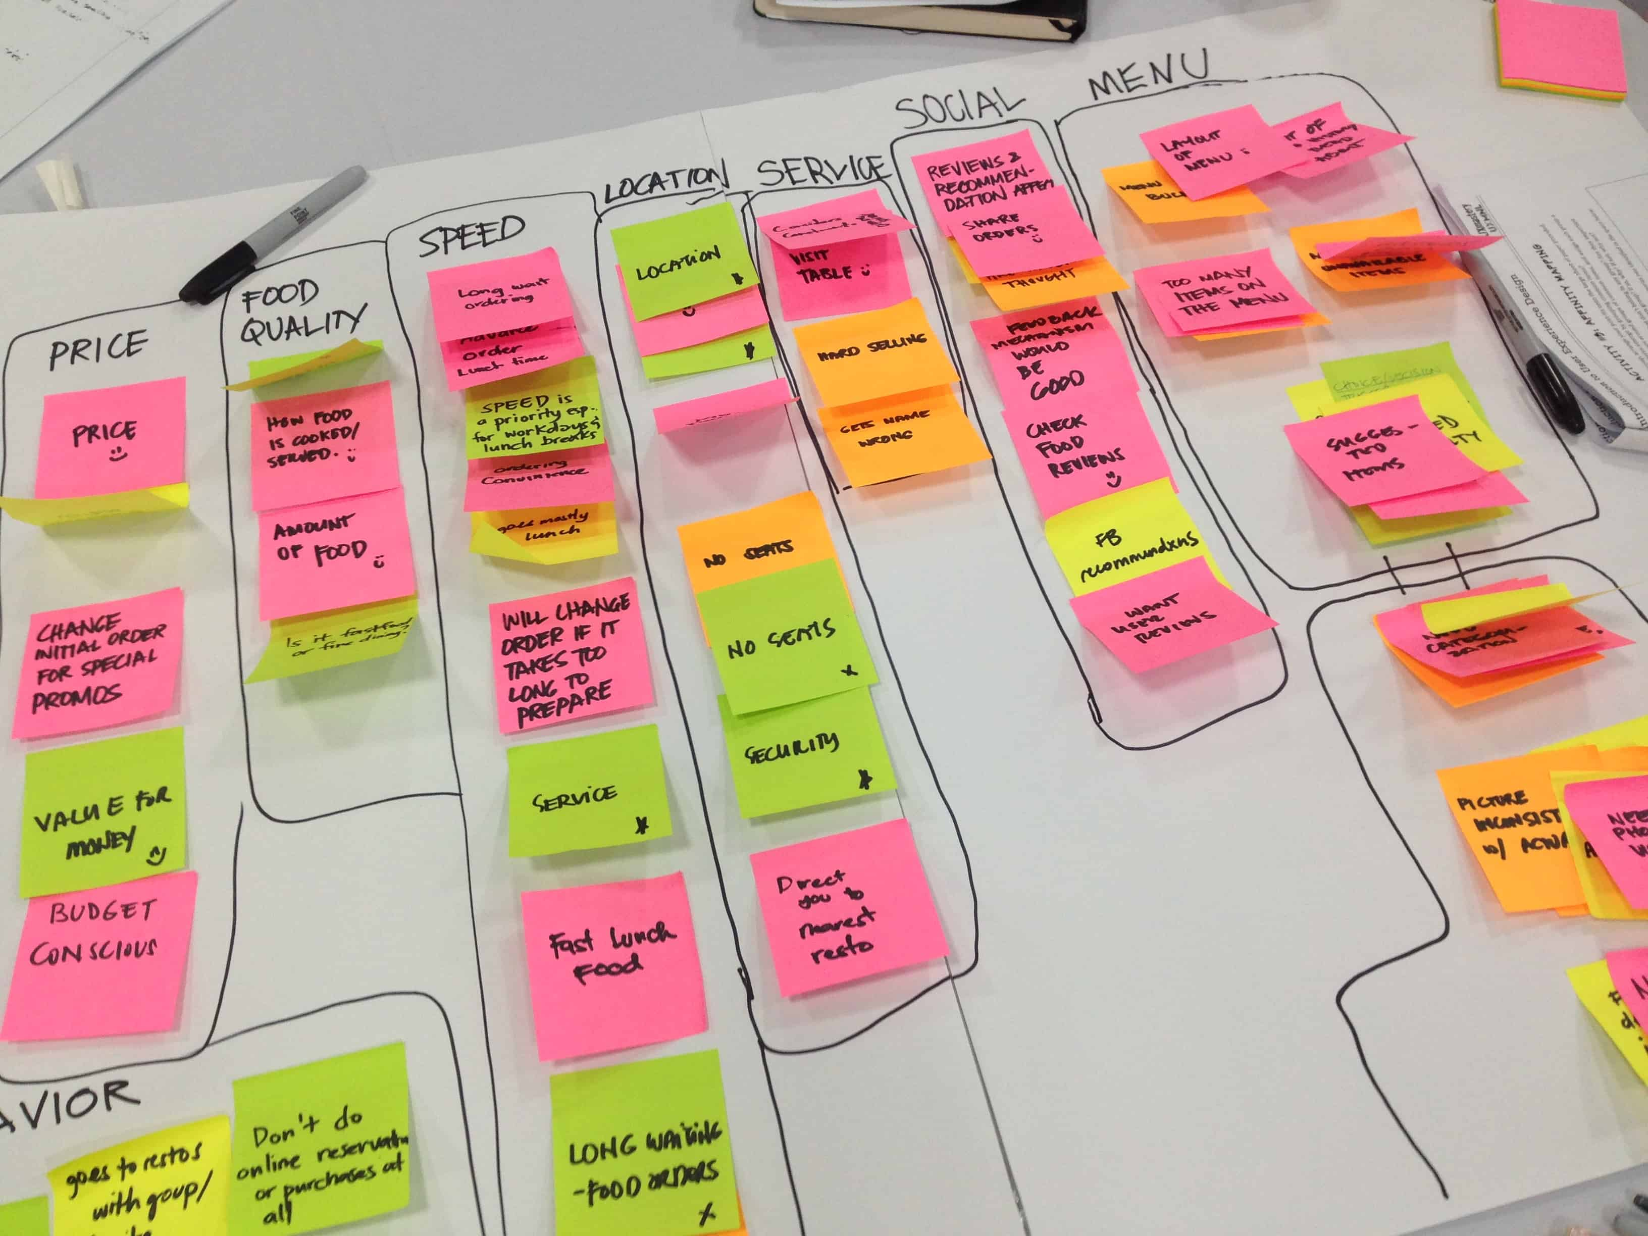
Affinity mapping – an example
Image from UXmastery.com

Slide 39
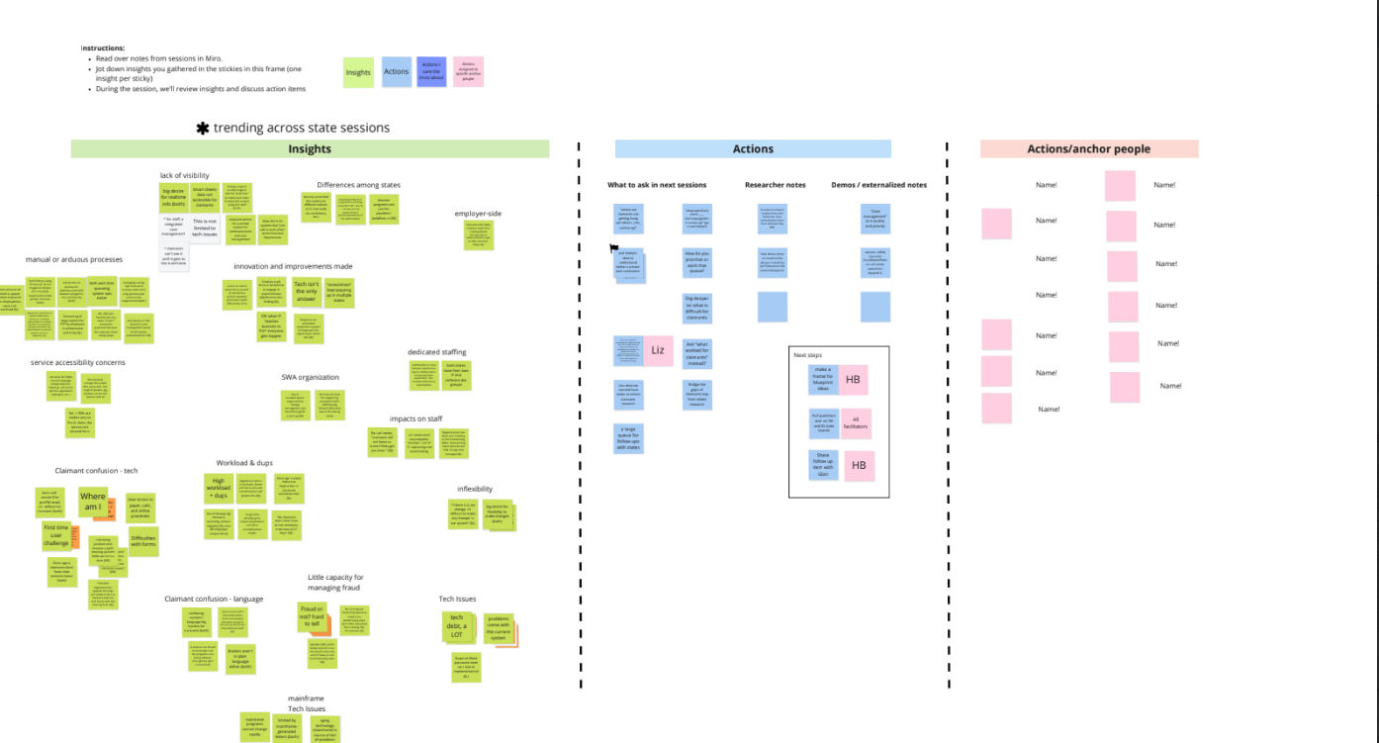
Insights and actions – an example
Insights
Point people for AI
Action items
This image shows one way to surface insights and actions (using an affinity diagram).
You can also use a spreadsheet for this activity; you'll need a column for insights, a column for associated action items, and a column for point people.

Slide 40
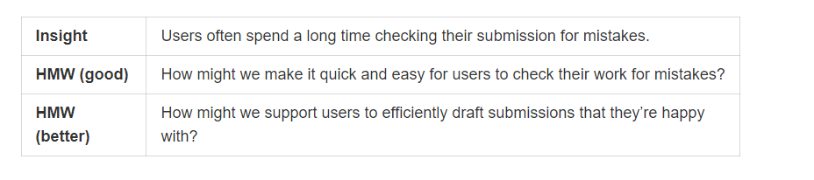
"How might we?" statements – an example
Screenshot from Nielsen Norman

Slide 41
Turning insights into actions
Research method | Potential actions
Concept testing | If concept tests well, develop the content. If the concept doesn't test well, keep refining it until it reflects claimants' needs/preferences.
Content-focused usability testing | Change the structure, length, or tone of the content to meet claimants' needs; add more content to improve clarity; delete content that's confusing or unhelpful.
Highlighter testing | Revise confusing sentences; replace jargon with more familiar terminology; consider adding contextual help.
Cloze testing | Revise content to provide adequate context.

Slide 42
Q&A

Slide 43
Additional resources

Slide 44
For more information, check out the following resources
18F User Experience Design Guide – Research
18F Methods
OUIM Reference Site – Evaluating CX with survey design
Nielsen Norman’s UX Research Cheat Sheet
Nielsen Norman: Using "How Might We" Questions to Ideate on the Right Problems
Smashing Magazine’s Comprehensive Guide to UX Research
Research Questions are not Interview Questions (Erika Hall, Mule Design)
Nicole Fenton: Putting Plain Language to the Test
Josh Tong: Ways to Test Content with Users

