Slide 1

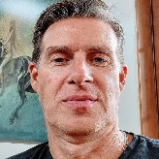






The COVID-19 Education and Workforce Data Challenge
November 16, 2021
Kevan Fish
Colorado Department of Labor and Employment
Mark Duey
Colorado Department of Labor and Employment
Patti Schnoor
Illinois Department of Commerce and Economic Opportunity
George Putnam
Illinois Department of Employment Security
Jeni Spaulding
Michigan Department of Labor and Economic Opportunity
Vern Westendorf
Michigan Department of Labor and Economic Opportunity
Bill Hurwitch
SLDS State Support Team
Kristin Wolff
Workforce Data Quality Initiative (WDQI) TA Team

Slide 2
Agenda
Welcome and Introductions
State Perspective
Questions for the Panel
Wrap-up

Slide 3
Introduction
The COVID-19 pandemic was more than a disruption. It broke programs and systems that were never designed to expand by a factor of thousands as one in eight people were unable to work because of the virus, and nine in ten students were sent home. Educators and workforce professionals responded to the best of their ability, finding solutions that engaged students and workers and applied information in new ways.
In this session, presenters from Colorado, Illinois, and Michigan share their most critical lessons, the changes they have made as a result of the pandemic, and the implications for data, data systems, and evidence-based decisionmaking going forward.

Slide 4

A Quick Overview of WDQI
The Workforce Data Quality Initiative (WDQI) is SLDS’s sister program supported by the U.S. Department of Labor
https://www.dol.gov/agencies/eta/performance/wdqi
Notes:
Kristin

Slide 5

WDQI Goal: Better data, better tools, better education + workforce connectivity
Build systems
Connect data
Improve data quality
Use data more effectively
  Reporting
  Evidence-based practices
  Consumer information
  Research
Photo by Bernie Almanzar on Unsplash

Slide 6

COVID-19 was a shock.
States responded with a range of approaches.
Operational changes
New partnerships
Product innovations
Many WDQI teams have become vastly more visible within their states.
Notes:
Kristin

Slide 7
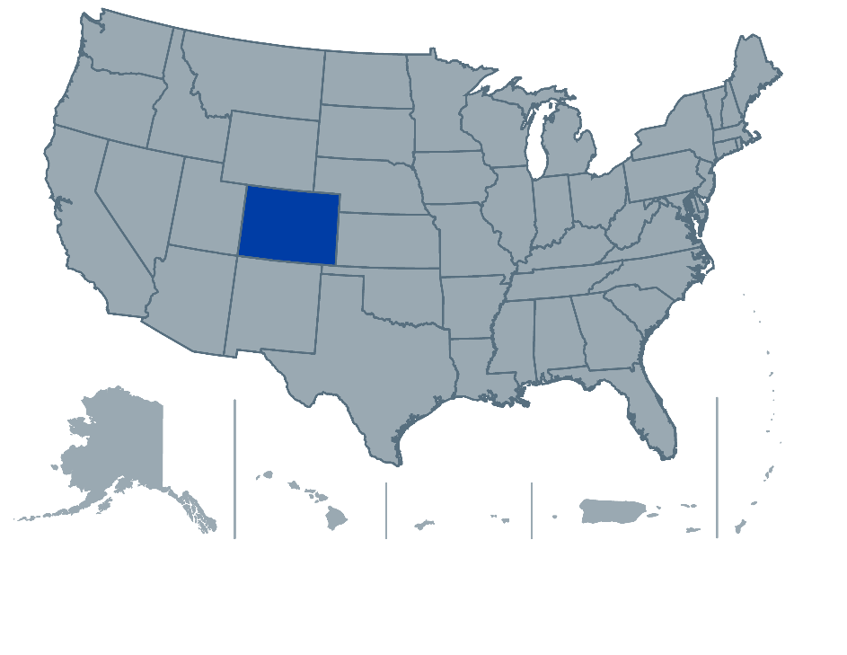
Colorado
Kevan Fish and Mark Duey, Colorado Department of Labor and Employment

Slide 8

SLDS-WDQI Joint Webinar
Colorado

Slide 9
Burning Glass Skills Application Programming Interface (API)
The Colorado Department of Labor and Employment (CDLE), Employment and Training Division (E&T) is updating the skills data in Connecting Colorado with an API developed by Burning Glass. The API will enhance skills data and the match between job seeker skills, training programs, and job opportunities.

Slide 10
Burning Glass Skills API
Connecting Colorado
Burning Glass skills API
Connecting job seekers to Training and Employment
&
Why?
Eligible Training Provider List

Slide 11
Research Data Lake (1)
With the WDQI grant, CDLE E&T and Research Improving People’s Lives (RIPL) are developing a data lake, to connect workforce data with education data. This database will include data from the Colorado Department of Higher Education and CDLE’s Unemployment Insurance Division.

Slide 12
Research Data Lake (2)
CDLE E&T and Workforce Development
Colorado Department of Higher Education
CDLE Unemployment Insurance
Job seeker, training, and employer data
Higher education and eligible training provider list data
UI participant and employer data
Data Lake
The de-identified data can be used for queries. More departments will be added.
Notes:
Kevan
Could cite mckinsey article on 2 mill women leaving wf (esp. Those with young children) and BLS data of the 140,000 loss all held by women (156,000 total job loss by women with a 16,000 gain by men nationwide)
“Historically, higher educational attainment has been strongly tied to lower unemployment. Americans with at least a four-year college degree have tended to have the lowest unemployment rates, while workers without a high school diploma have had the highest. That trend has continued through the pandemic. While unemployment shot up to historically high levels for each educational group, rates were much higher among Americans with lower educational attainment.” Andy Kiersz, (2020). The business Insider: The coronavirus recession has slammed American workers at every education level, but it's hit the least educated the worst
“Payroll employment data for March show that women were the hardest hit by initial job losses in the COVID-19 labor market; women represented 50.0% of payroll employment in February, but represented 58.8% of job losses in March.” Elise Gould, Ben Zipperer, and Jori Kandra, (2020). Women have been hit hard by the coronavirus labor market
“Workers of color are overrepresented in many of the low-wage jobs that are most vulnerable to potential layoffs during the coronavirus pandemic.” Connor Maxwell and Danyelle Solomon, (2020). The Economic Fallout of the Coronavirus for People of Color.”
"The preservation and improvement of rural hospitals is crucial to the growth of the rural economy, particularly amid the current pandemic. Without accessible and good-quality healthcare, rural workers won’t be able to effectively work and promote growth within their local economies." Raksha Kopparam (2020) Gaps in U.S. rural and urban economic growth widened in the post-Great Recession economy, with implications amid the coronavirus recession
“Machine learning is a field that develops algorithms designed to be applied to data sets, with the main areas of focus being prediction (regression), classification, and clustering or grouping tasks.” Susan Athey, (2018). The Impact of Machine Learning on Economics
"Random forest, like its name implies, consists of a large number of individual decision trees that operate as an ensemble. Each individual tree in the random forest spits out a class prediction and the class with the most votes becomes our model’s prediction. A large number of relatively uncorrelated models (trees) operating as a committee will outperform any of the individual constituent models." Tony Yiu, (2019) How the Algorithm Works and Why it Is So Effective

Slide 13
Takeaways
Burning Glass API
Research Data Lake
Match job seekers to training
Match job seekers to employment
Combined, de-identified data from different departments
Use queries to make informed decisions
Next Steps
Build the data lake and add the data from CDLE and CDHE.
Add Burning Glass skills data to Connecting Colorado/ETPL.
Get additional departments to add to the data lake.

Slide 14
Through WDQI, Colorado will bridge the skills gaps between job seekers, training programs, and employment opportunities and will securely collect, store, analyze, and produce actionable outcomes through data from different and disparate Colorado agencies and divisions.

Slide 15
Thanks!

Slide 16
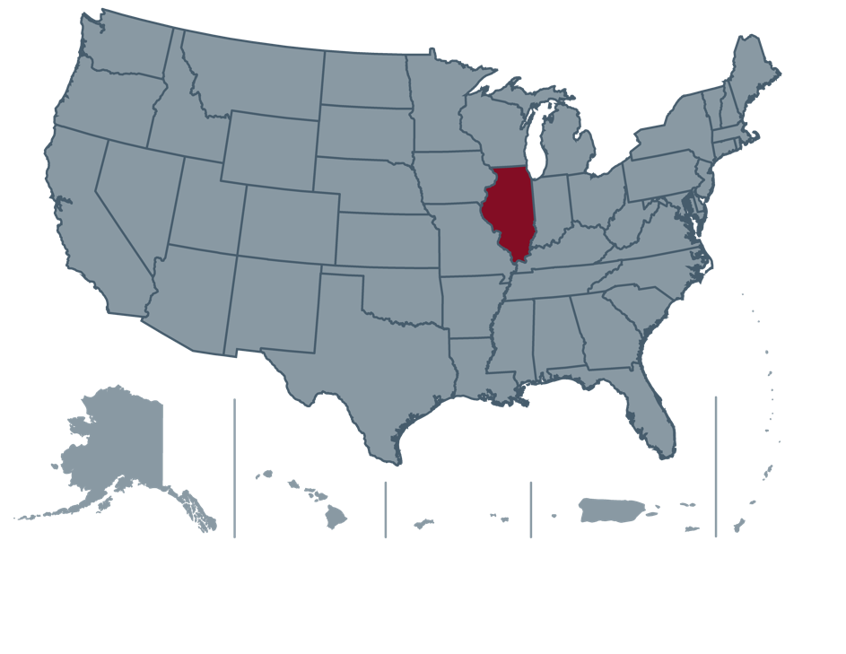
Illinois
Patti Schnoor, Illinois Department of Commerce and Economic Opportunity,
Office of Employment and Training
George Putnam, Illinois Department of Employment Security

Slide 17

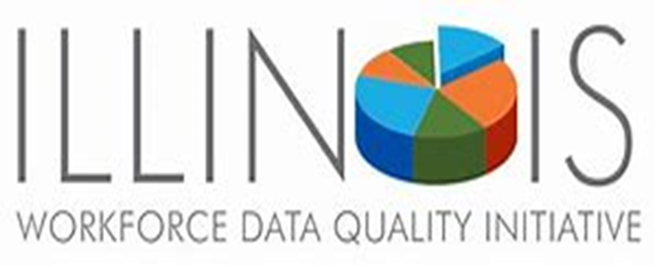

SLDS/WDQI Joint Webinar
Leveraging State Longitudinal Data Systems (SLDS) and Workforce Data Quality Initiative Data (WDQI) to Evaluate Workforce Outcomes
November 2021

Slide 18
Illinois – WDQI Round VII
Major Area of Focus for WDQI State Data and Technology Innovation and Development
ProPath Illinois Universal Integrated Provider Platform
Coleridge Initiative Research & Socializing the IL WDQI
Uses Southern Illinois University’s Illinois workNet technology in tandem with the National Credential Engine Registry innovation schematics and profiles to create a cloud-based statewide platform that links program data with pathways, credentials, competencies, and outcomes data.
ETPL Public Directory widget
Illinois has joined the New York University-Coleridge Initiative to use the most innovative data sharing strategies available to measure and tell the story of unemployment to reemployment of UI claimant behavior.
Illinois is leading the charge for a multistate longitudinal linkage of UI claimant records known as The MidWest Collaborative.

Slide 19
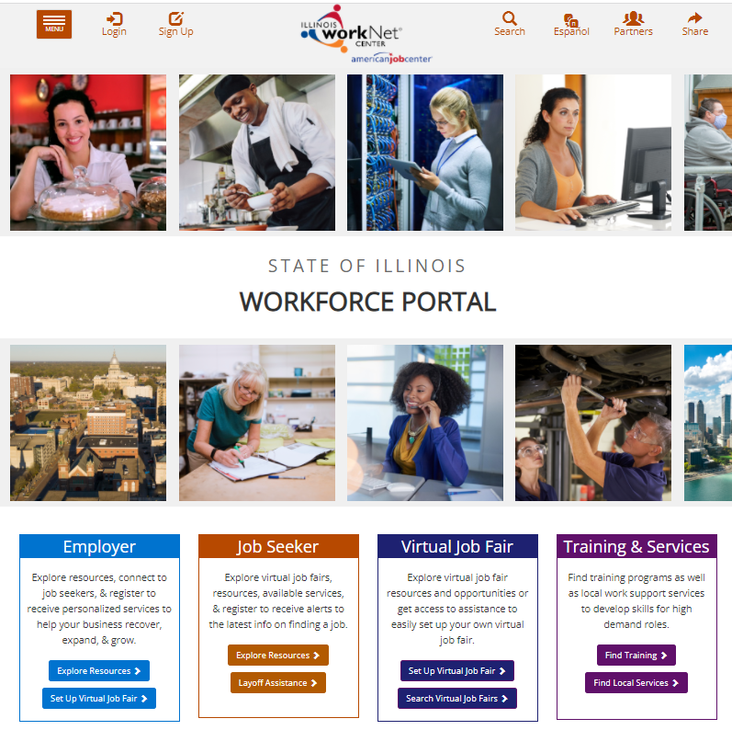
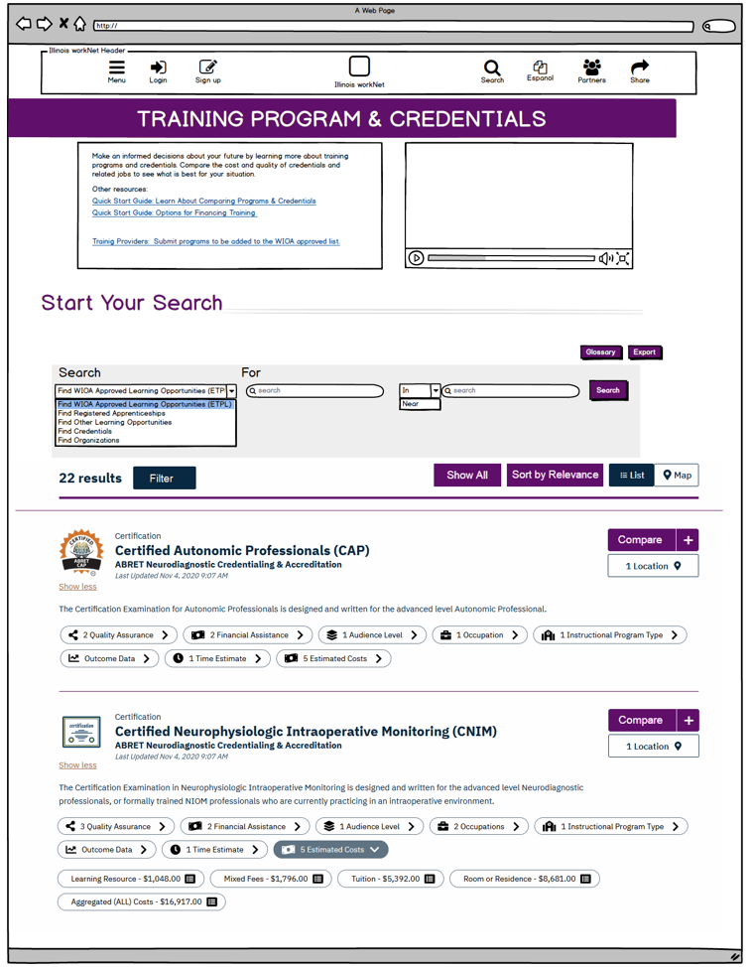
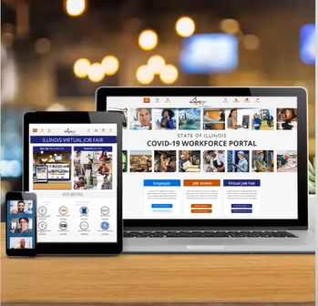
Illinois Statewide Universal Training Provider Platform
Illinois workNet Cloud Technology, Credential Engine Schemas, ProPath Publishing

Slide 20
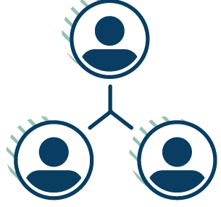



Credential Engine: National Infrastructure
Credential Engine provides national infrastructure used by 27 states and regions. The infrastructure provides a common language and linked open data for systems and web applications.
ProPath Illinois is using CTDL, Credential Registry API, and Credential Registry.
Credential Transparency Description Language (CTDL)
Common language that describes key features of credentials/qualifications.
Publishing Tools
Organizations use the API or any of the Publishing System tools to convert information to CTDL and publish to the Registry as Linked Open Data.
Credential Registry More than a database, the Registry collects and connects credential data described with CTDL and supports an open applications marketplace.
Linked Open Data & Consuming Tools
Powers an open applications marketplace for data use.

Slide 21
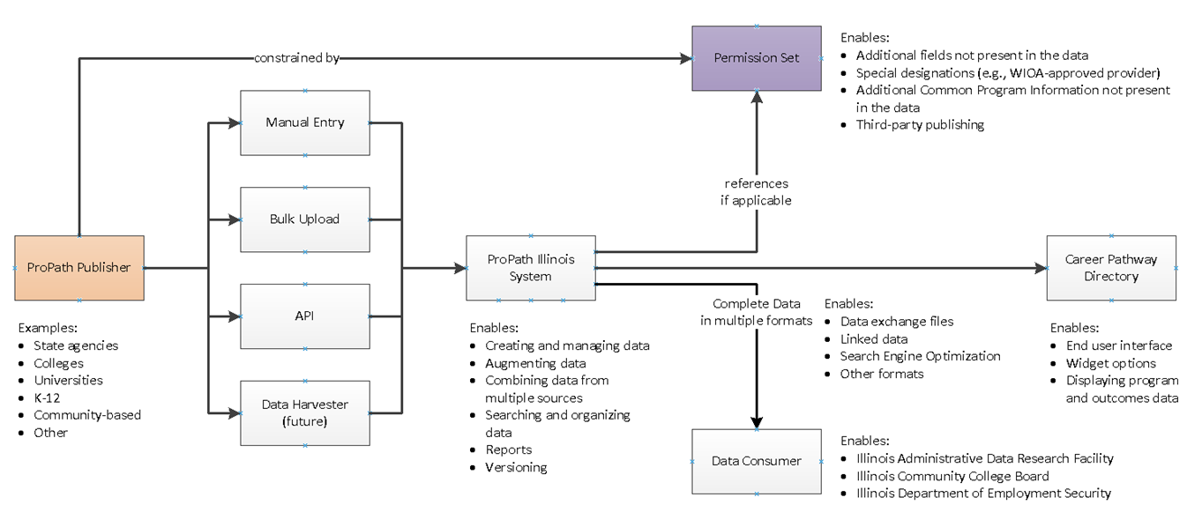

ProPath Illinois Planned Publishing Workflow
The planned workflow supports the Illinois ETPL and other credential information from multiple sources.
It uses the state’s workforce portal, Illinois workNet, and Credential Engine’s national infrastructure.

Slide 22
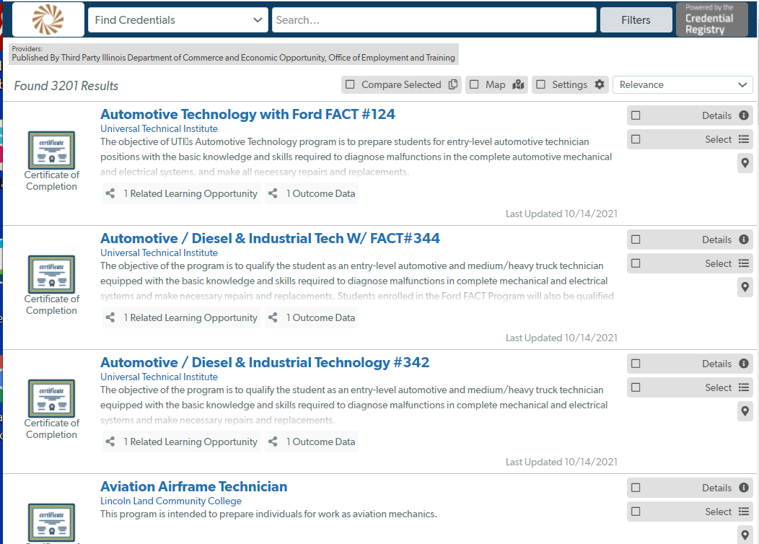
ETPL Status and Next Steps
The process of mapping WIOA-approved programs to the CTDL and publishing them in the Credential Registry Sandbox revealed data quality and process workflow challenges.
These challenges are being addressed through ProPath modernization.
The widget on the right is being used to test and review ETPL data.

Slide 23
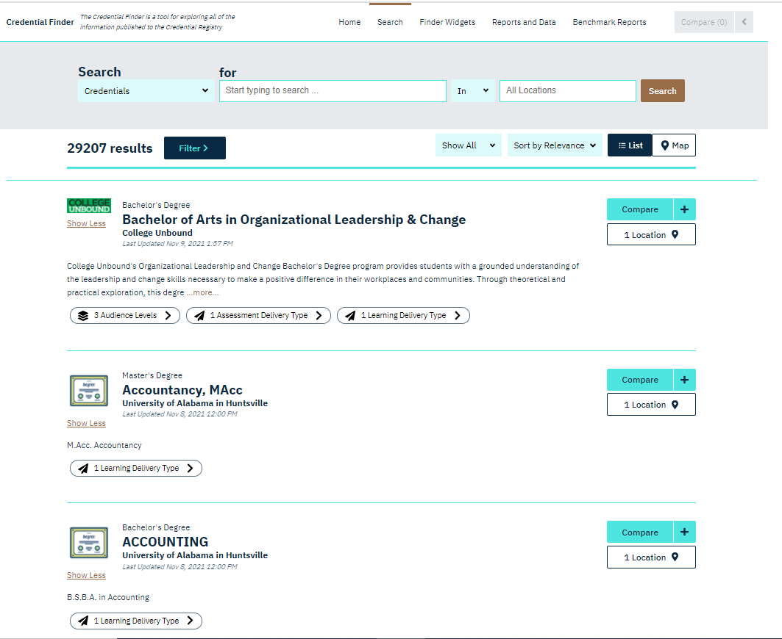
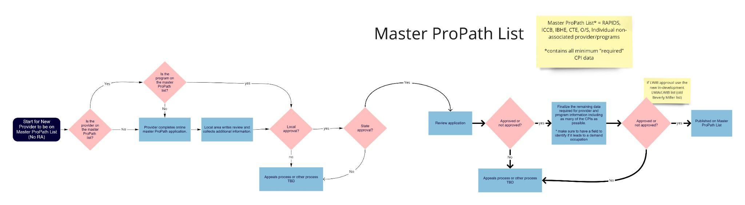
ETPL Process and the Public Directory Plans
We are creating detailed process flow documentation and planning a public search function using the Credential Engine’s search API and aspects of the Credential Finder search.

Slide 24

Coleridge Initiative Research & Socializing the Illinois WDQI
Unemployment to Reemployment Portal
MidWest Collaborative and USDOL/ETA Training

Slide 25
Unemployment to Reemployment Portal: Common Data Model
Repurposing PROMIS UI claimant files
  Program for Measuring Insured Unemployed Statistics (PROMIS) was implemented in the BLS’s federal-state Local Area Unemployment Statistics program.
Measuring the behavioral dynamic of unemployment
  Unemployment claims → individual claimant
  Weekly cross-section of claims → weekly flows of claimants
Standardization of UI claimant measures
  Person-based relevance
    Time stamp: benefit week when a claimant files a new initial claim
    Context: cohort of claimants who share the same benefit year start/end date
  Geographic relevance
    Place of residence
  High-frequency periodicity
    Weekly data

Slide 26
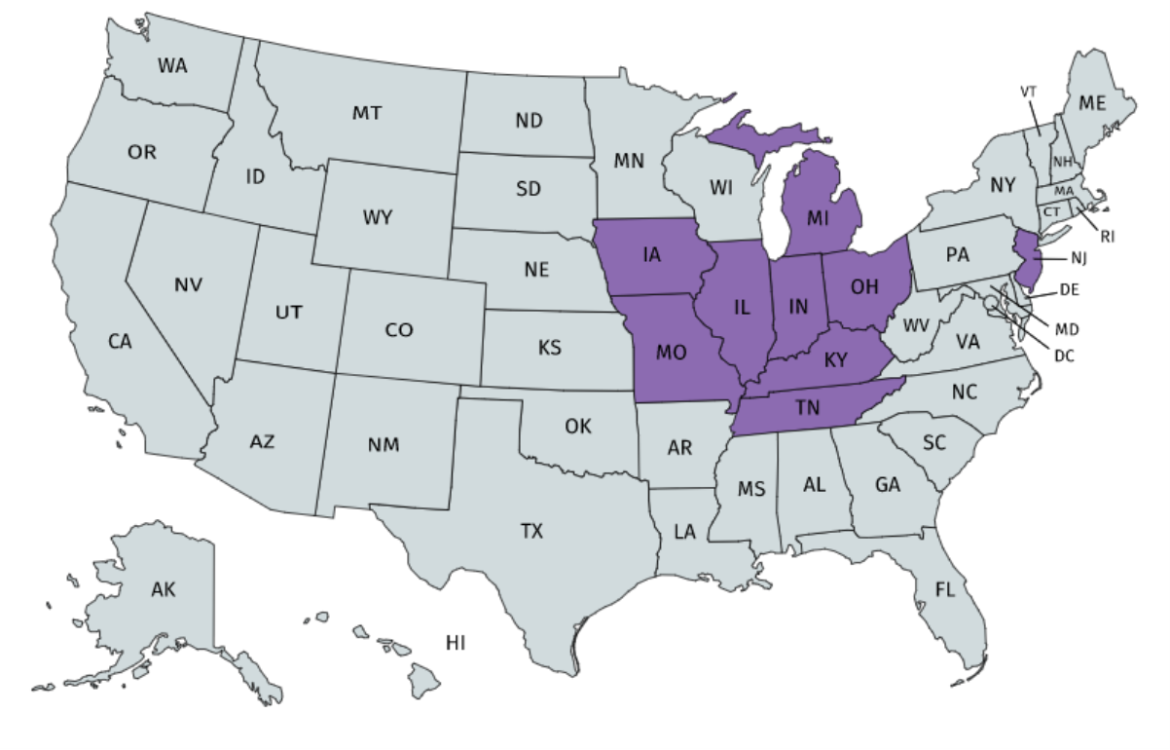
Socializing the Illinois WDQI:
MidWest Collaborative and USDOL/ETA Training

Slide 27
Unemployment to Reemployment Portal: Measuring UI Claimant Behavior
Measuring UI claimant inflow (done)
  Demographic composition of claimants
  Demographic composition of claimants by industry
  Occupational composition of claimants by industry
Measuring UI claimant through flow (done)
  Duration of unemployment
    Continuous versus discontinuous unemployment spells
    Proximity to benefit exhaustion
    Economic impact, wage replacement
Measuring UI claimant outflow (in process)
  Reemployment
    Same employer, different employer/same industry, or different industry
    Single job or multiple jobholding

Slide 28
Reemployment of Temp Help Workers: Racial Disparities
UI certified claimant inflow during first 8 weeks of pandemic and outflow from July 2020 to May 2021
Reemployment in July 2020
  25% of Black workers versus 38% of White workers
Among reemployed in July 2020
  46.9% of Black workers versus 65.3% of White workers were reemployed in the same firm
Among not reemployed in July 2020
  Approximately 85% remained in certified status

Slide 29
Reemployment of Workers in Production Occupations: Gender Disparities
UI certified claimant inflow during first 8 weeks of pandemic and outflow from July 2020 to May 2021
Reemployment in July 2020
  55% of female and male workers
Among reemployed in July 2020
  90% of female and male workers were reemployed in the same firm
Among not reemployed in July 2020
  Approximately 75% remained in certified status

Slide 30
Questions?
Illinois Department of Commerce and Economic Opportunity
Patti Schnoor Patricia.schnoor@Illinois.gov – DCEO
Illinois Department of Employment Security
George Putnam George.putnam@Illinois.gov - IDES

Slide 31
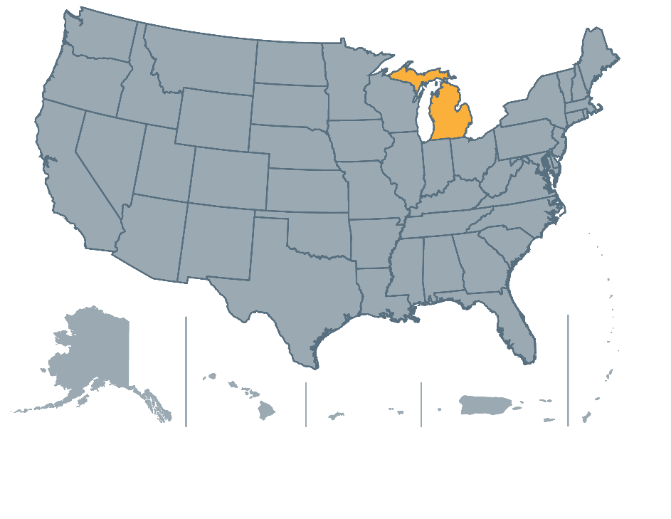
Michigan
Jeni Spaulding and Vern Westendorf, Department of Labor and Economic Opportunity

Slide 32
COVID-19 Education and Workforce Data Challenge
Michigan Department of Labor and Economic Opportunity
Employment and Training

Slide 33
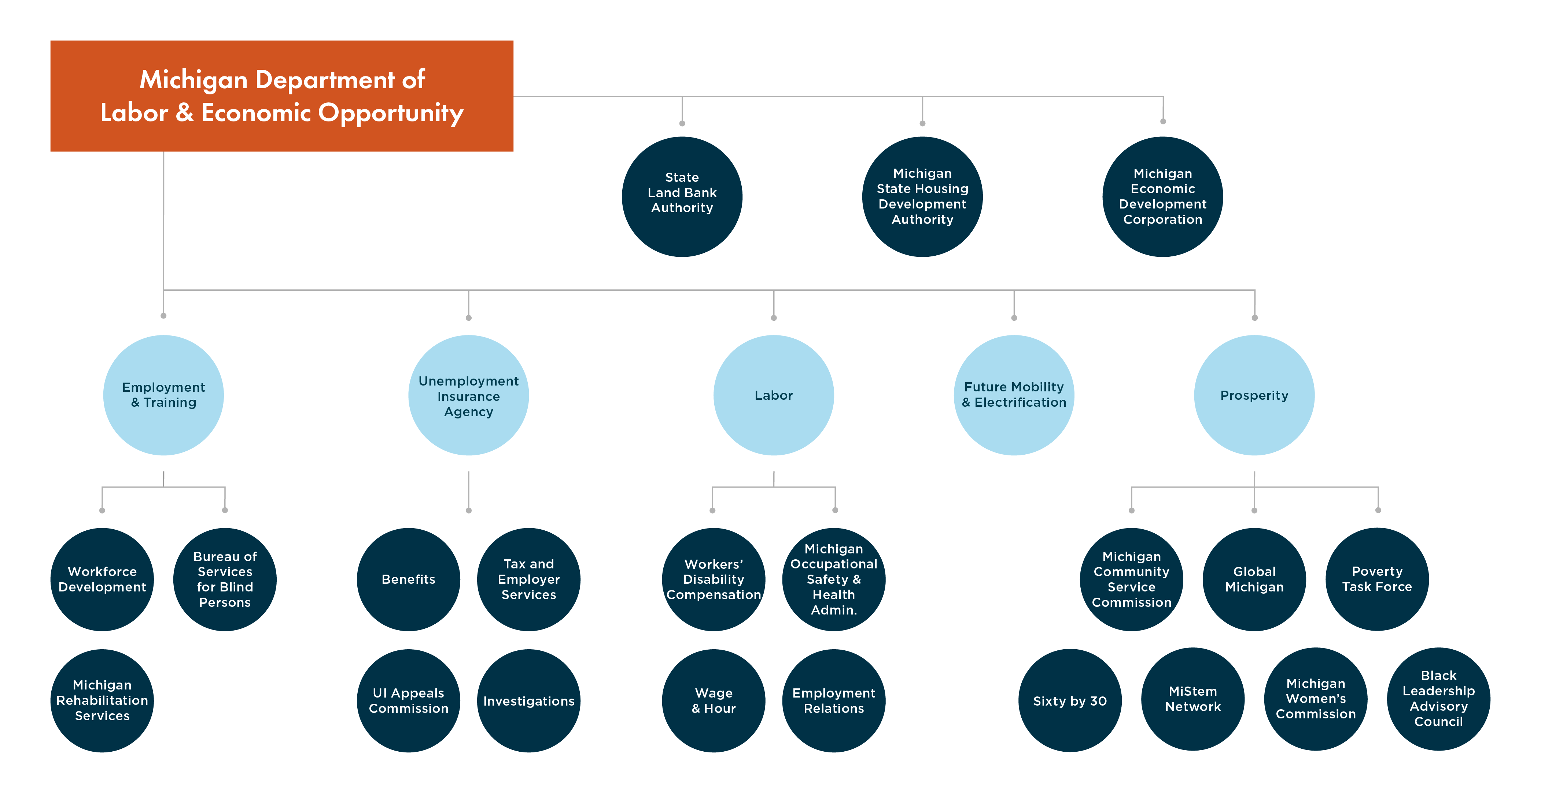
Michigan Department of Labor & Economic Opportunity

Slide 34
Agenda
U.S. Departments of Labor and Education grant projects
Michigan initiatives
Related projects
WDQI grant deliverables
Notes:
Provide a glimpse into pandemic response opportunities and challenges to meeting increased technology and data demands

Slide 35
Michigan’s Data Challenge
Michigan Department of Technology, Management and Budget (DTMB) – Agency Services is responsible for delivering all technology solutions to state agency partners.
Two teams focus on all systems creation and interaction, website design, programming, and reporting functions:
        WIOA, Perkins, Labor Exchange, Eligible Training Provider List, Apprenticeships, etc.

Slide 36
Reimagine Workforce Preparation Grant
MICHIGAN LEARNING & EDUCATION ADVANCEMENT PROGRAM (MILEAP)
MiLEAP assists job seekers in transitioning from short- and mid-term education and training programs to high-skill, high-wage employment and career pathways, resulting in industry-recognized credential attainment and reduced educational debt.
$17.8 million U.S. Department of Education grant to respond to the economic impact of COVID-19
4,500+ job seekers over a 3-year period
Short- and mid-term customized education and training
Michigan Works! agencies, Michigan Community Colleges, and other institutions of higher education and the Michigan Department of Health and Human Services partners
Multi-employer consortia to address regional workforce needs and advance existing employees through re- and up-skilling

Slide 37
H-1B Rural Healthcare Grant
Michigan Rural Enhanced Access to Careers in Healthcare (MiREACH)
MiREACH will identify targeted healthcare occupations based on employer demand and feedback, design training responses, and implement w­­orkforce solutions for rural communities.
$2.5 million, 4-year U.S. Department of Labor grant to address healthcare staffing shortages in rural communities throughout the state
400 new healthcare workers and incumbent workers advanced into new positions over a 3-year period
Provide training, education, and supportive services leading to placement in in-demand healthcare occupations
Select Michigan Works! agencies and the Workforce Intelligence Network (WIN) partners
Partner network will support the recruitment of program participants through its broad community outreach and service delivery strategies

Slide 38
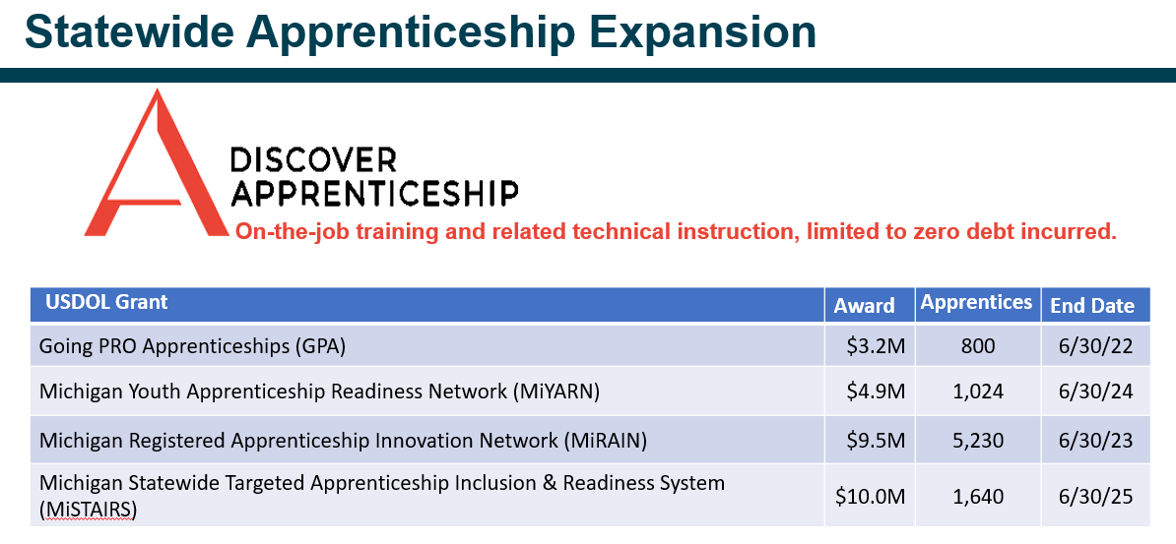
Apprenticeship Expansion Grants

Slide 39
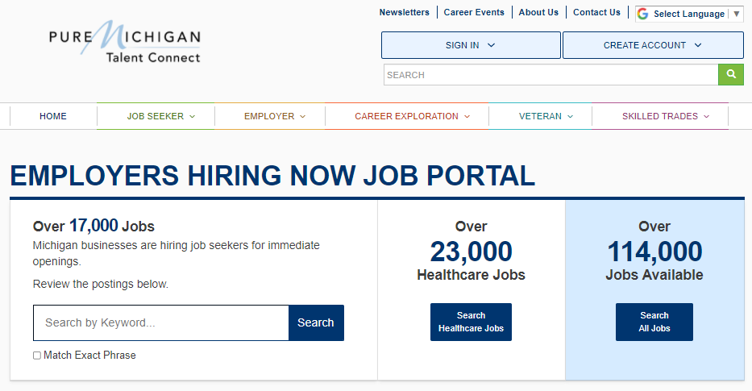
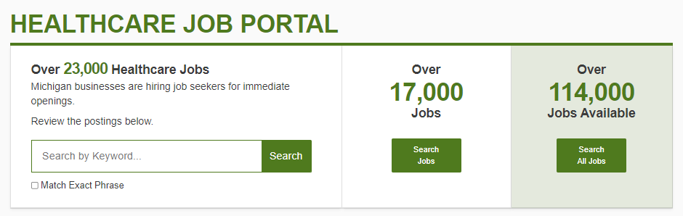
Labor Exchange Response
Pure Michigan Training connect
Immediate response needed to meet early pandemic job openings

Slide 40

Michigan Reconnect Grant Recipient Act 68 of 2020
Reconnect programs and initiatives support Michigan's goal to increase the number of working-age adults with a skill certificate or college degree from 49% today to 60% by 2030.
Sixty by 30 seeks to build a better Michigan in three ways:
Increase opportunity for all Michiganders and give residents greater access to the education and skills that create opportunities for better jobs and bigger paychecks
Close the skills gap that challenges the success of our businesses and our state's prosperity. Jobs requiring skilled employees today, as well as jobs on the horizon, demand greater education and training than ever before
Make Michigan more competitive for inclusive economic growth

Slide 41
Michigan Reconnect
Reconnect: Free tuition at in-district community colleges to earn an associate degree or Pell-eligible skill certificate for residents 25+.
Skills Scholarship: Up to a $1,500 tuition scholarship at a private training school or program for residents 25+.
For-profit or nonprofit private organizations in Michigan
Institutions that provide occupational training but not 4-year postsecondary degrees
Providers/programs must be listed on the state's eligible training provider list and opt in to accept the Skills Scholarship

Slide 42
Postsecondary Schools Automation
Michigan Department of Labor and Economic Opportunity is authorized to enter reciprocal distance learning compacts, ensure distance learning providers meet standards of practice, set annual fees, protect student records, and establish a student complaint system.
Created an application and renewal process portal:
Proprietary Schools – Trade & Career (400+)
Educational Corporations – Private Colleges and Universities (70)
Distance Education Authorizations – Degree and Non-degree granting (100+)
Notes:
Maintain existing and planned enhancements and systems

Slide 43
Credential Transparency
Michigan provides support to state government departments, secondary schools, postsecondary institutions, apprenticeship program sponsors, and other credential owners to publish credentials to the Credential Registry. Credential transparency aligns directly with the governor’s statewide goal to increase the number of Michiganders with a postsecondary credential (a high-quality industry certificate, associate degree or higher) to 60 percent by 2030.
Michigan credential data will be leveraged to:
expand Registered Apprenticeship utilization and resource support;
enhance and unify Michigan’s Eligible Training Provider List, Michigan Education and Career Pathfinder (career exploration website), and Labor Exchange; and
map high-demand Career Pathways.

Slide 44
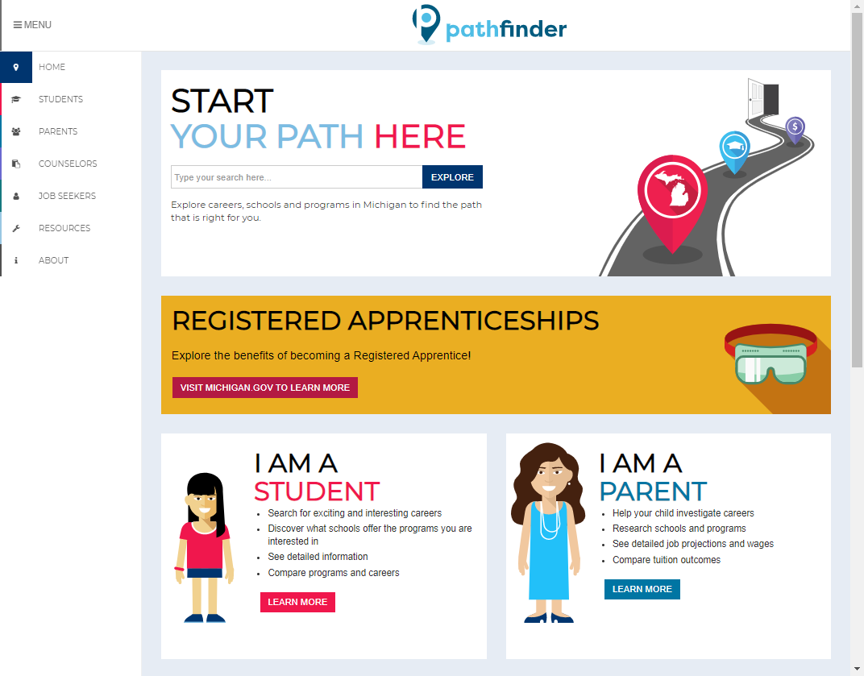

WDQI Grant Deliverables
Incorporate four state licensing databases to assess credential attainment
Expand Pathfinder to include related credential data
Map career pathways
Pathfinder.MiTalent.org

Slide 45
Pathfinder 2017
Michigan’s free online career exploration tool
Created to provide information to students, parents, and counselors to help make informed choices about education and career options, as well as create education development plans
Uses the Workforce Longitudinal Data System (WLDS) to provide outcome information at the school and field of study levels with Michigan wages
Connects education and training programs with employment
Pathfinder.MiTalent.org

Slide 46
Michigan’s Challenge Response
Technology Prioritization
IT project specialist hired within Operations to help coordinate work and engage and schedule technology resources
Pathfinder Project: Adjusted Timeline
2021: Moved all design and platform updates (September relaunch)
2022: Pursue and assemble new and enhanced data sources

Slide 47
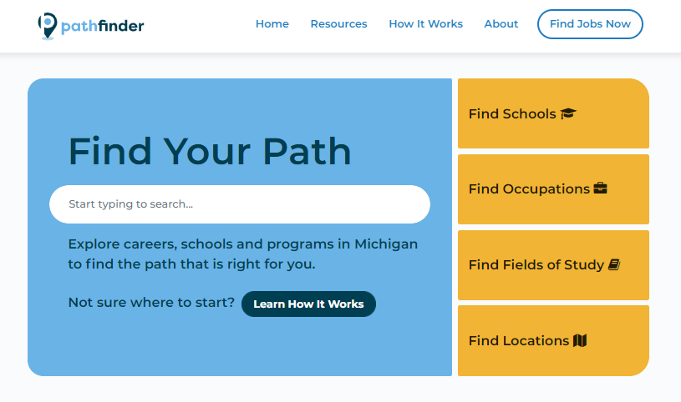
Pathfinder 2021
Launched in September
Implemented elements that were outside of scope and budget in the initial version
Incorporated customer feedback
Mobile friendly
Concise messaging
Intuitive navigation
Data comparisons
Pathfinder.MiTalent.org

Slide 48
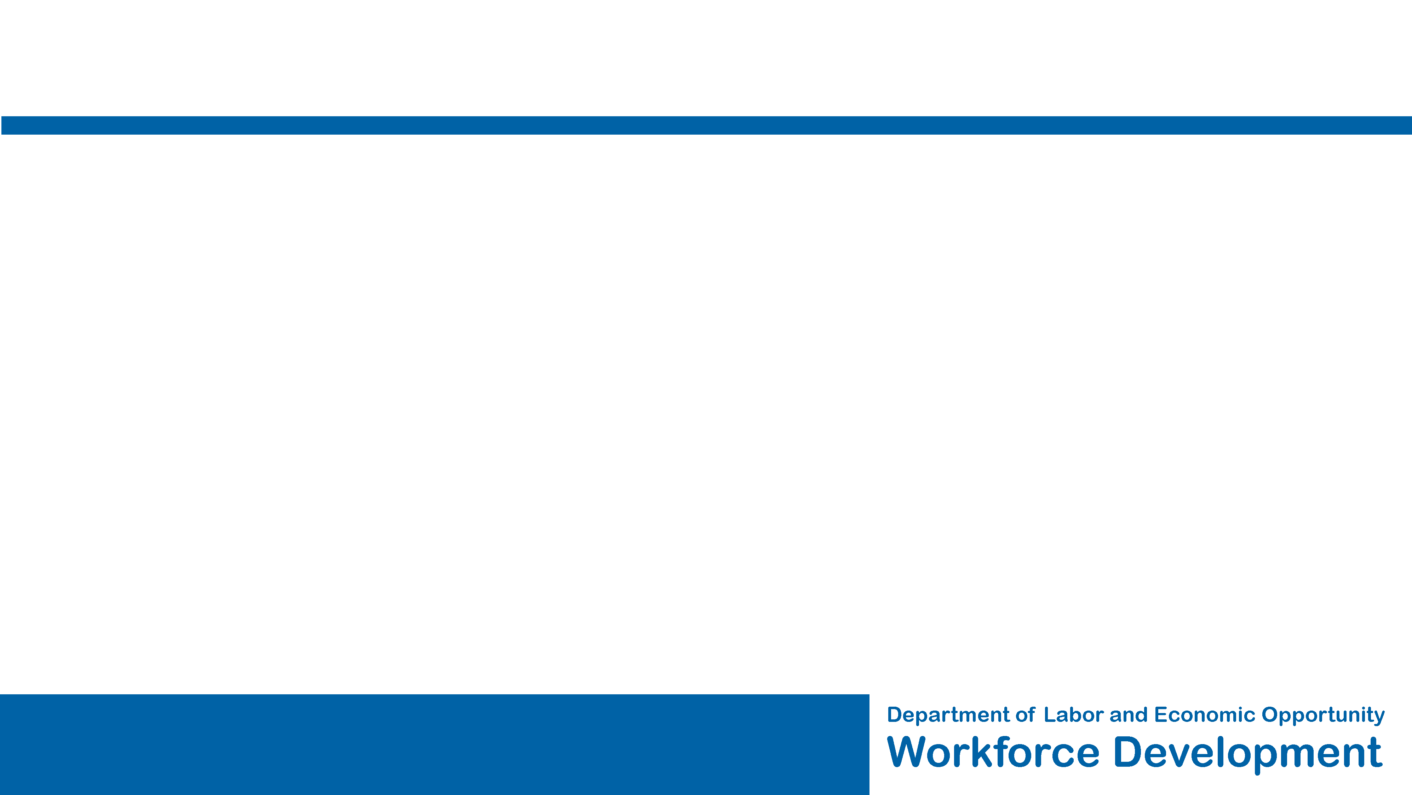
Pathfinder 2022
Include Michigan Training Connect program data and outcomes
Connect Registered Apprenticeship Programs with occupational data
Expand “Field of Study” (4-digit CIP) to offer program-level data (6-digit CIP) when available
Connect to certification and license information
Include graduate degree outcome data
Provide state-issued credential attainment verification when available
Additional changes as a result of user experience testing

Slide 49
Michigan Department of
Labor and Economic Opportunity
Employment and Training
Michigan.gov/LEO
Jeni Spaulding
spauldingj@michigan.gov

Slide 50
Questions?
Notes:
Kristin

Slide 51
Contacts
Contact Information
Kevan Fish, Colorado Department of Labor and Employment, kevan.fish@state.co.us
Mark Duey, Colorado Department of Labor and Employment, mark.duey@state.co.us
Patti Schnoor, Illinois Department of Commerce and Economic Opportunity, patricia.schnoor@illinois.gov
George Putnam, Illinois Department of Employment Security, george.putnam@illinois.gov
Jeni Spaulding, Michigan Department of Labor and Economic Opportunity, spauldingj@michigan.gov
Vern Westendorf, Michigan Department of Labor and Economic Opportunity, westendorfv@michigan.gov
Bill Hurwitch, SLDS State Support Team, bill.hurwitch@sst-slds.org
Kristin Wolff, WDQI Team, kristin_wolff@spra.com
For more info about the SST and to request support
SLDS Communities360 website, http://slds.ed.gov
Contact your state’s SST Point of Contact for assistance: https://slds.ed.gov/#communities/pdc/documents/14522

Slide 52
Resources
Michigan
  Michigan Department of Labor and Economic Opportunity’s Office of Employment &Training, https://www.michigan.gov/leo/0,5863,7-336-94266---,00.html
  Pure Michigan Talent Connect Labor Exchange, https://www.mitalent.org/
  Pure Michigan Talent Connect Eligible Training Provider List, https://jobs.mitalent.org/mitc/Search/Training
  Credential Transparency, www.michigan.gov/credentialtransparency
  Michigan Reconnect, www.michigan.gov/reconnect
  Postsecondary Schools, www.michigan.gov/pss
  Career Exploration Website, https://pathfinder.mitalent.org/
WDQI
  WDQI Community of Practice on Workforce GPS, https://wdqi.workforcegps.org/
  U.S. Department of Labor’s WDQI Information Page, https://www.dol.gov/agencies/eta/performance/wdqi
  #MakingBetterWork November 2021 Newsletter, https://mailchi.mp/5870ae4fe1af/light-darkness-workforce-data-just-for-you
  Podcast, https://podcasts.apple.com/us/podcast/making-better-work/id1453703241
SLDS
  SLDS Webinar: COVID-19 and Equity: How the Pandemic Has Revealed and Exacerbated Inequities and How States Are Addressing Them, https://slds.ed.gov/#communities/pdc/documents/20211

Slide 53
Thank you!

