Slide 1
Visual Introductions to States
WDQI
Round VI
April 17
2019
Notes:
Maureen
2 minutes

Slide 2




The Team
Kristin Wolff
Senior Associate
Social Policy Research Associates Kristin_Wolff@spra.com
Maureen Sarver
Associate
Social Policy Research Associates Maureen_Sarver@spra.com
Eduardo Ortiz
Research Assistant
Social Policy Research Associates Eduardo_Ortiz@spra.com
Toquir Ahmed
National Office Liaison
ETA, DOL Ahmed.Toquir@dol.gov
Notes:
Maureen to introduce the team + our transcription service
2 minutes

Slide 3
Visual Introductions
5 minutes per state!
A map, chart or org chart
Data flow
Where is the project housed?
Who is the fiscal agent?
Who are the data providers and where are they housed?
Who provides the data?
Where does it go?
Who links/shares, etc.?
Notes:
Kristin to introduce the activity. Encourage states to explain the logic behind decision making.
3 minutes

Slide 4


FISCAL AGENT
State Agency
GOVERNING ENTITY AND PROJECT LEAD
Policy-Making Body
PROJECT VENDORS
University
Software Developer
DATA PROVIDERS
Public Entities
DataSpark
RI Talent Dashboard (P20W)
Kenzan
Real Jobs IT System Development
State Agencies
DLT, RIDE, OPC, DMV, etc.
RI Department of Labor and Training
Public Higher Ed Institutions
URI, RIC, CCRI
Rhode Island WDQI Team: Operational Infrastructure
Notes:
Maureen to introduce teams and ask who else is in attendance from each state
Megan Swindal, Amelia Roberts, Kimberly Pierson
5 minutes

Slide 5
Rhode Island WDQI Project: Data Flow
RI Talent Dashboard (P20W)
Other State Agency Data
RIDE, DMV, etc.
Office of the Postsecondary Commissioner
RI DataHUB
Workforce Grantees, Partners, Training, and Service Provides
RI Department of Labor and Training
CCRI, RIC, URI
LEAs and Programs
DataSpark Data Scientists and Subject Matter Experts

Slide 6
New Jersey’s Education to Earnings Data System Overview
NJEEDS is a centralized, secure longitudinal data system that links information on students and job holders from four partner agencies:
  Education,
  Higher Education,
  Higher Education Student Assistance Authority, and
  Labor and Workforce Development.
NJEEDS is governed by an Executive Leadership Council with representatives from each of the entities.
The Heldrich Center at Rutgers University is responsible for the governance, maintenance, and analysis of NJEEDS.
Notes:
David Ramsey

Slide 7

Department of Education
NJEEDS
K-12 NJSMART Completions Data
K-12 NJSMART Enrollment Data
Student Unit Record (SURE) Completions Data
Student Unit Record (SURE) Enrollment Data
Financial Aid and Application Data
Unemploy-ment Insurance Wage Records
Unemploy-ment Insurance Claims Records
Literacy Adult and Community Education System (LACES) Data
WIOA Participant Individual Record Layout (PIRL) Program Data
AWARE Vocational Rehab-ilitation Case Management System
Labor and Workforce Development
Office of the Secretary of Higher Education
Higher Education Student Assistance Authority

Slide 8
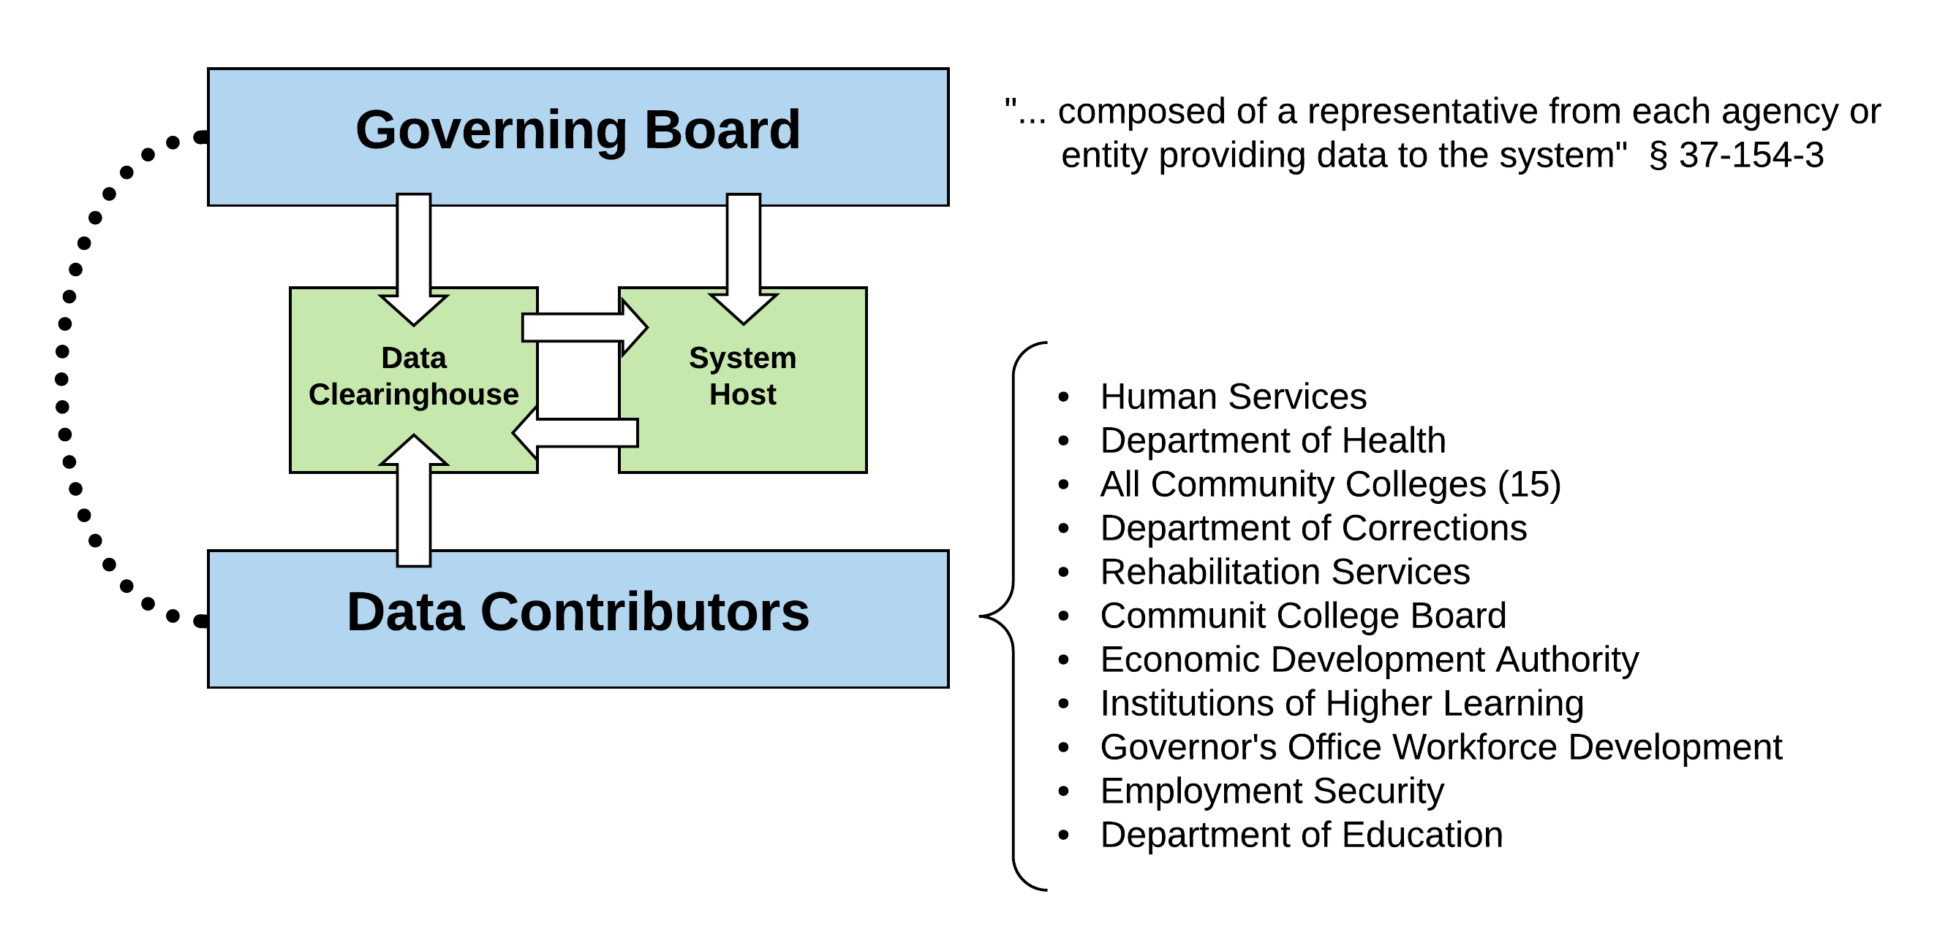
Mississippi SLDS Structure
Notes:
Jonathan Barlow, Laura Ring

Slide 9
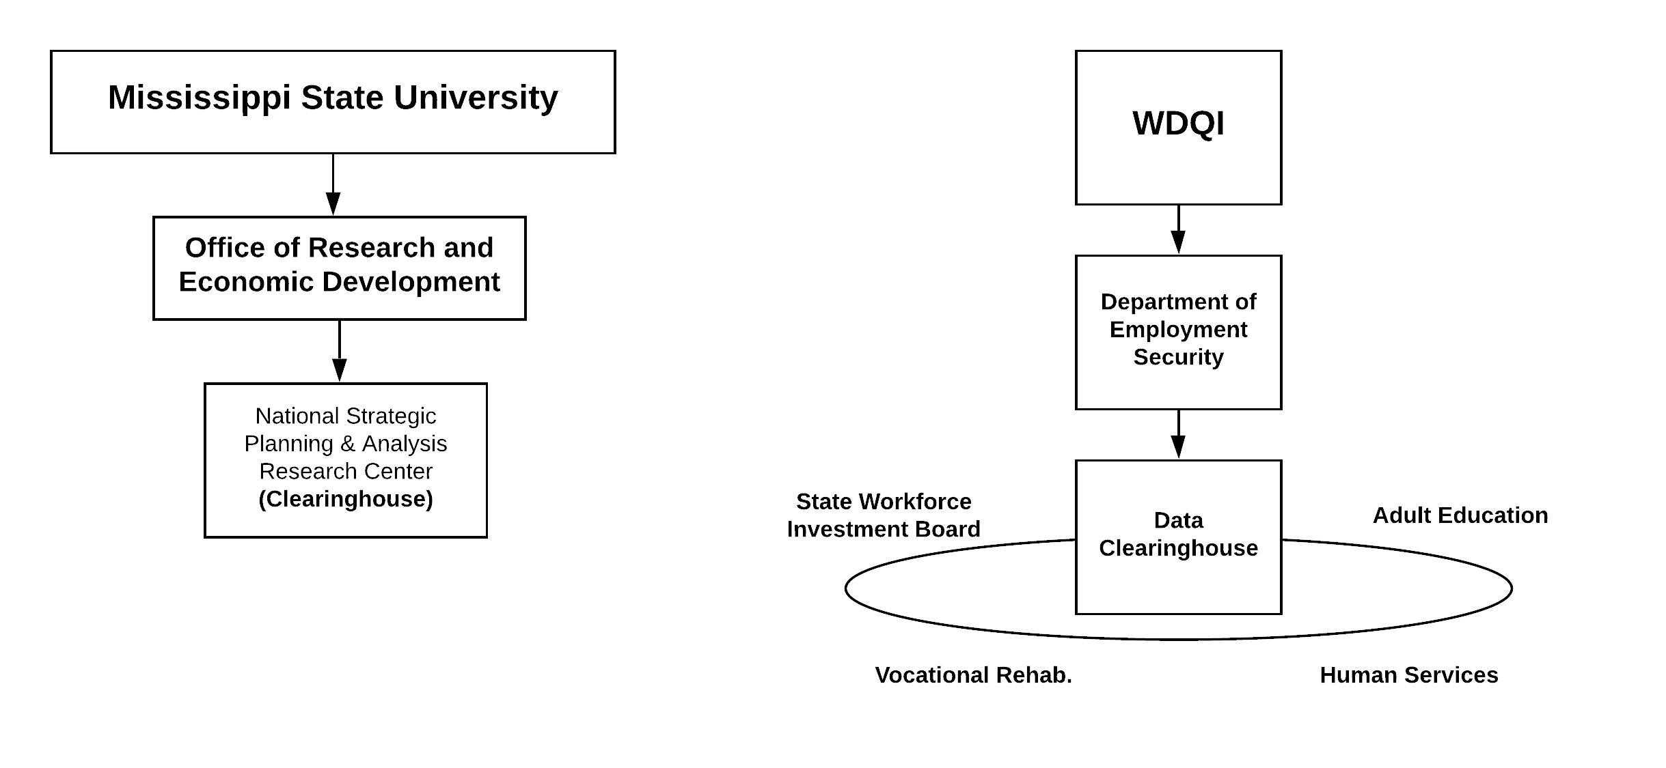
Clearinghouse and WDQI Grant

Slide 10

Notes:
Clint Flowers, Ruth Eggermeyer, Samantha Heckemeyer

Slide 11
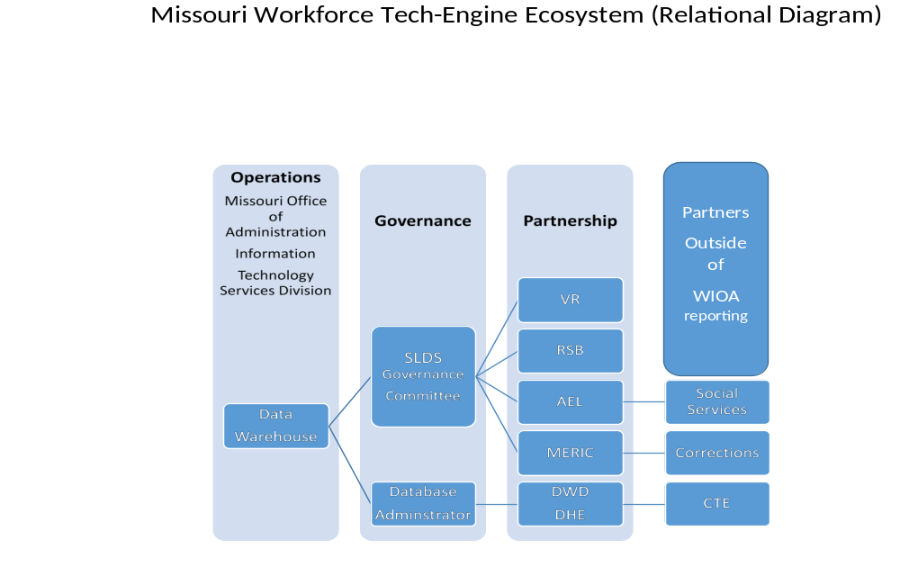
Operator of the Data Warehouse
Missouri State Data Center – Office of Information Technology
Governance
Interagency Memorandum of Agreement authorizes approval of matching based on unanimous approval of each agency’s Data Steward.
How projects originate, how approved, how matched are prescribed in the MOA.
The Fiscal Agent will be the Missouri Department of Higher Education
Partnership
Focuses on WIOA, but non-WIOA are invited and have participated.

Slide 12
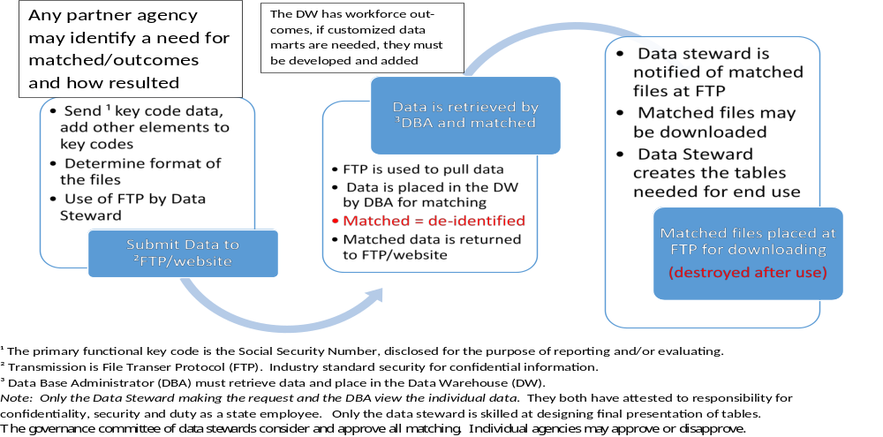

Slide 13
Placeholder for Michigan slides
Notes:
Jeni Spaulding

Slide 14
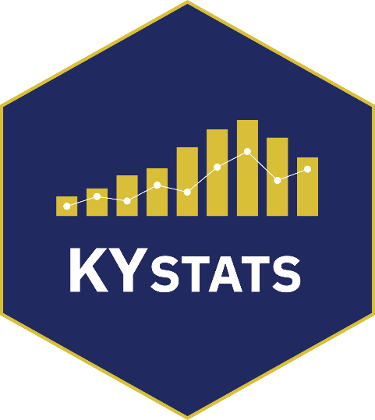
Kentucky State Government Cabinets
General Government
Cabinet
Personnel
Cabinet
Cabinet for Health & Family Services
Finance & Administration Cabinet
Energy & Environment
Cabinet
Justice & Public
Safety Cabinet
Tourism, Arts & Heritage Cabinet
Labor
Cabinet
Education & Workforce
Development Cabinet
Transportation
Cabinet
Public Protection
Cabinet
SLDS & WDQI
Notes:
Jessica Cunningham, Martha Dyer

Slide 15
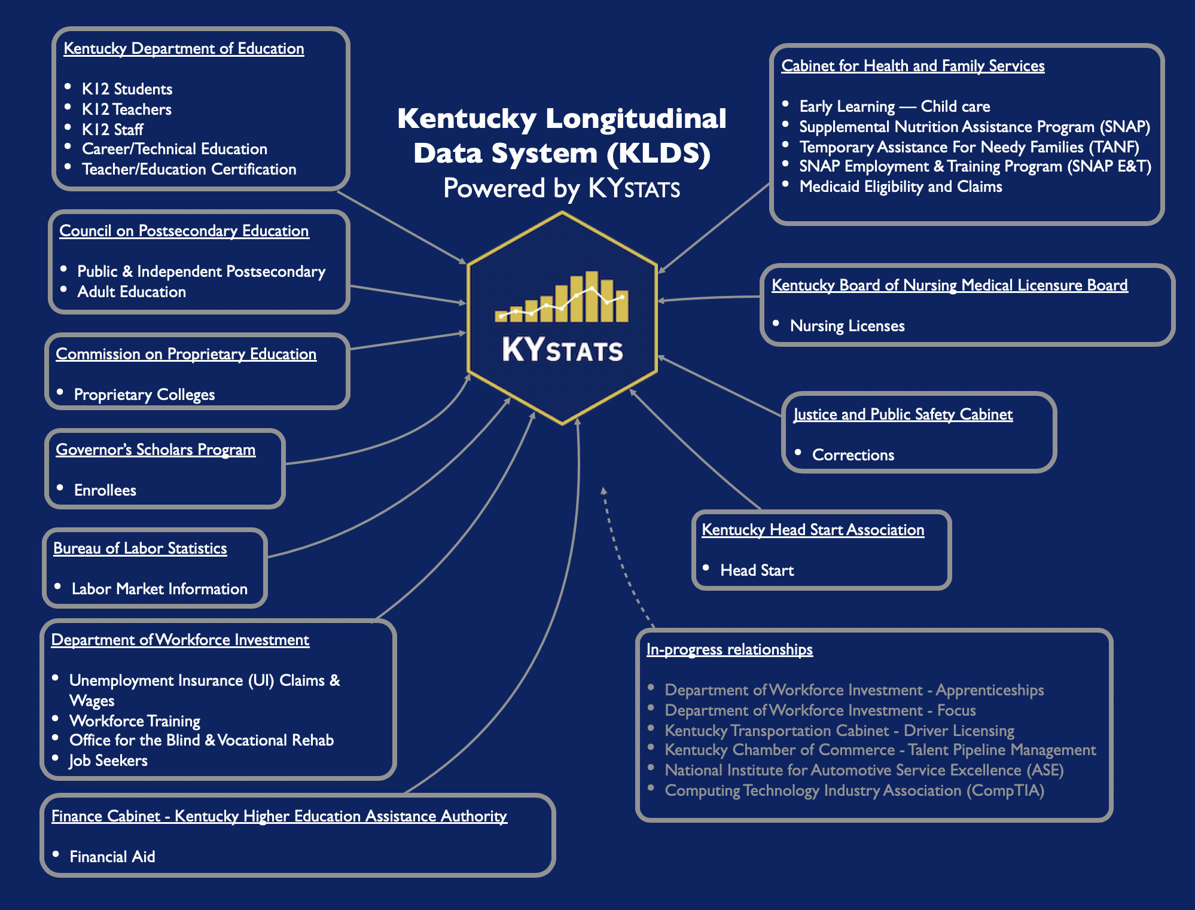

Kentucky Department of Education
K12 Students
K12 Teachers
K12 Staff
Career/Technical Education
Teacher/Education Certification
Cabinet for Health and Family Services
Early Learning — Child care
Supplemental Nutrition Assistance Program (SNAP)
Temporary Assistance For Needy Families (TANF)
SNAP Employment & Training Program (SNAP E&T)
Medicaid Eligibility and Claims
Kentucky Longitudinal Data System (KLDS)
Powered by KYSTATS
Council on Postsecondary Education
Public & Independent Postsecondary
Adult Education
Kentucky Board of Nursing Medical Licensure Board
Nursing Licenses
Commission on Proprietary Education
Proprietary Colleges
(ETPL)
Justice and Public Safety Cabinet
Corrections
Governor’s Scholars Program
Enrollees
Bureau of Labor Statistics
Labor Market Information
Kentucky Head Start Association
Head Start
Department of Workforce Investment
Unemployment Insurance (UI) Claims & Wages
Workforce Training
Office for the Blind & Vocational Rehab
Job Seekers
In-progress relationships
Department of Workforce Investment - Apprenticeships
Department of Workforce Investment - Focus
Kentucky Transportation Cabinet - Driver Licensing
Kentucky Chamber of Commerce - Talent Pipeline Management
National Institute for Automotive Service Excellence (ASE)
Computing Technology Industry Association (CompTIA)
Finance Cabinet - Kentucky Higher Education Assistance Authority
Financial Aid

Slide 16
Kansas WDQI
Kansas has developed a website to provide career guidance and job opportunity options to jobseekers and to students. Primary focus is on high demand/high wage careers.
KSCareerNav.gov
Four state agencies provide data to support site.
KBOR – Kansas Board of Regents
(Post Secondary Education)
KSDE – Kansas Department of Education ( K-12)
KDOL – Kansas Department of Labor
KDOC – Kansas Department of Commerce
KBOR
KBOR – Provides all post secondary education information. Educational programs, estimated costs, time to completion and recent completers.
KSDE – Provides High School Career Pathway information. Provides information on pathway programs available in each high school.
KDOL – Provides occupation data (salary, demand projections and trends) and Labor Market Indicators by county.
KDOC – Provides Current job openings by area and links to KansasWorks open job orders for related occupations.
KSDE
KDOL
KDOC
Notes:
David Eisenbarth (May be unable to attend)

Slide 17


Slide 18

Iowa WDQI
Partnership in Practice
Notes:
Ryan Murphy

Slide 19
Operational Infrastructure
Disseminated
Department of Labor
Iowa Community Colleges
Iowa Depart. of Ed. Website
Iowa Workforce Dev. Website
Interactive Dashboard
Link:
https://educateiowa.gov/iowa-community-college-program-outcomes#Iowa_Community_College_Program_Outcomes_Interactive_Charts
Iowa Workforce Development
(fiscal agent)
Iowa Department
of Education
(contracted)
Beth Townsend, Director
Ryan West, Management Assigned
Ryan Murphy, Designated Project Manager
David Parziale, Contracts/Reporting
Jason Crowley, Technical/Project
Brett Connor, Financial Management
Ryan Wise, Director
Barbara Burrows, Management Assigned
Paula Nissen, Contracts/Reporting
Vlad Bassis, Technical/Project
Angela James, Financial Management

Slide 20
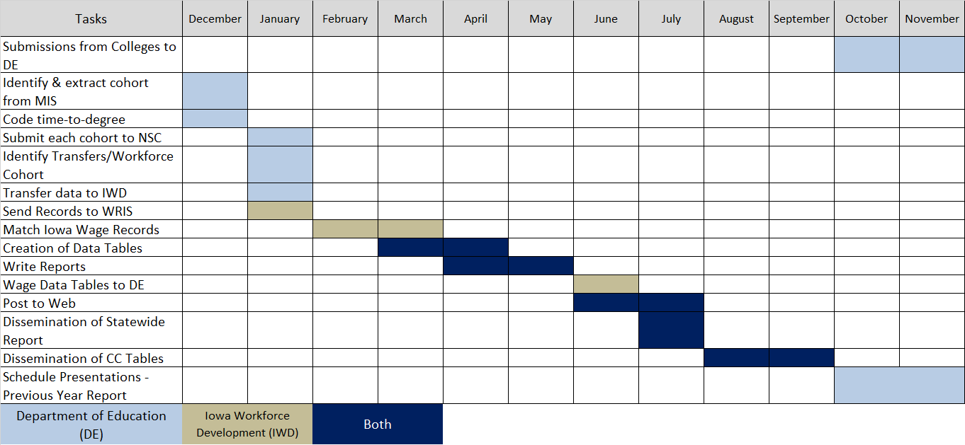
Annual Timeline/Data Flow

Slide 21



INDIANA – Building an Occupation Data Ecosystem
WDQI Round VI is the second round of WDQI grants awarded to Indiana.
Goals: close critical data gaps through UI system enhancements; refine data quality; enable improved outcome and pathway analysis related to individuals traveling from education to workforce.
Actions: employers are prompted to assign occupations to the UI filings that they submit quarterly (other fields explored: PT/FT status, start/end date, average hours range). Those occupations then become part of the longitudinal data warehouse and feed research initiatives and outcomes evaluations.
Notes:
Lori Wasson, Fran Valentine, Kent Sellers, Carol Rogers, Alisa Wood

Slide 22
DWD (R&A) & IBRC
Develop Occucoder / Knowledge Transfer
DWD (UI) & Contractor
Employer Self Service
Indiana Employers
Supply SOC Codes for all employees
SOC Codes
in
Employer Self Service system
DOC
FSSA
RAW
(Research & Analysis Warehouse)
Longitudinal database
CHE
DOE

Slide 23
Alabama’s Plan for SLDS
ALABAMA’S WORFORCE LONGITUDINAL DATABASE SYSTEM (WLDS):
The Alabama Department of Commerce manages the Workforce Longitudinal Database System (WLDS).
The WLDS is the existing system that serves as a workforce data repository of information.
Since 2003, the infrastructure of the system has been in place and operational, storing and reporting workforce agency partner data.
State Agency partners and workforce funding streams:
Commerce – AL Dept of Commerce (WIOA Title I)
ACCS – AL Community College System (WIOA Title II)
ADOL – AL Dept of Labor (WIOA Title III)
ADRS – AL Dept of Rehabilitation Services (WIOA Title IV)
DHR – AL Dept of Human Services (TANF & SNAP)
ADSS – AL Dept of Senior Services (WIOA Title I)
AIDT – Alabama Industrial Development Training (ETF)
Governor’s Office of Education and Workforce Statistics
The Education partners ACHE, ACCS, K-12, and Early Childhood would enter into data sharing agreements with Office of Education and Workforce Statistics
This office responsible for matching algorithm and data security connecting data from the WLDS and Education to create Alabama Terminal for Linking and Analyzing Statistics (ATLAS).
Also responsible for maintaining an online dashboard Alabama College and Career Exploration Tool (ACCET)
Notes:
Tonya Lee, Nick Moore, John Demas

Slide 24





Alabama’s Plan for SLDS
Governor’s Office of Education and Workforce Transformation (GOEWT)
Office of Education and Workforce Statistics
Office of Education and Workforce Statistics
Development and management of the Alabama Terminal for Linking and Analyzing Statistics (ATLAS) under advisement of P20 Council and GOEWT Coordinator
Implementation Plan to create a secure and efficient data exchange, secure linking, deidentification, and data review procedures
Coordination with all agencies sharing data
Perform research according to P20 Council recommendations
Manage online dashboard, Alabama College and Career Exploration Tool (ACCET)
Support P20 Council and offer suggestions of potential research options
OIT Chief Security Officer will advise on matters of data matching algorithm, data security, secure data transfer, and application development.
P20 Council
Oversee the development of ATLAS and develop and manage governance
Establish research agenda
Approve reports before they are published
Advise Office of Education and Workforce Statistics regarding operation and maintenance, data security,
Meet semiannually to conduct business
Create committees to accomplish functions as necessary
Governor Ivey
GOEWT
Coordinator
P20 Council
Commerce, ACCS, ADOL, ADRS, DHR, ADSS, AIDT, ALSDE, ACHE
Office of Education & Workforce Statistics
Outreach & Workforce Stats Advisor & Director
Chief Security Officer

Slide 25
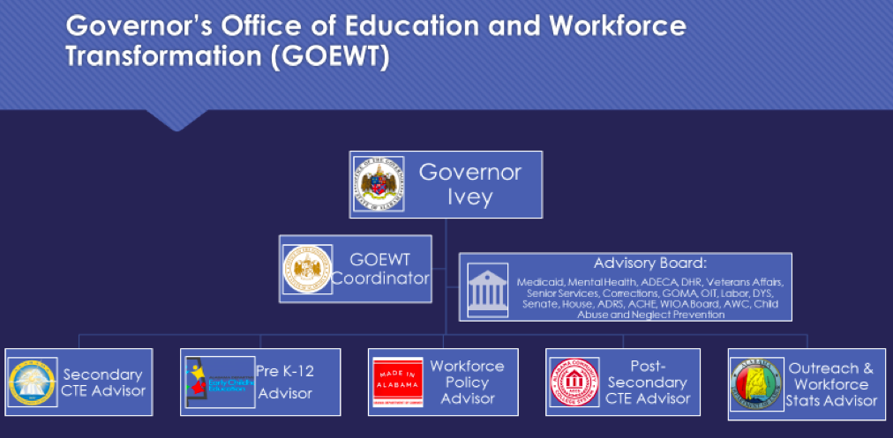
Alabama’s Plan for SLDS

Slide 26
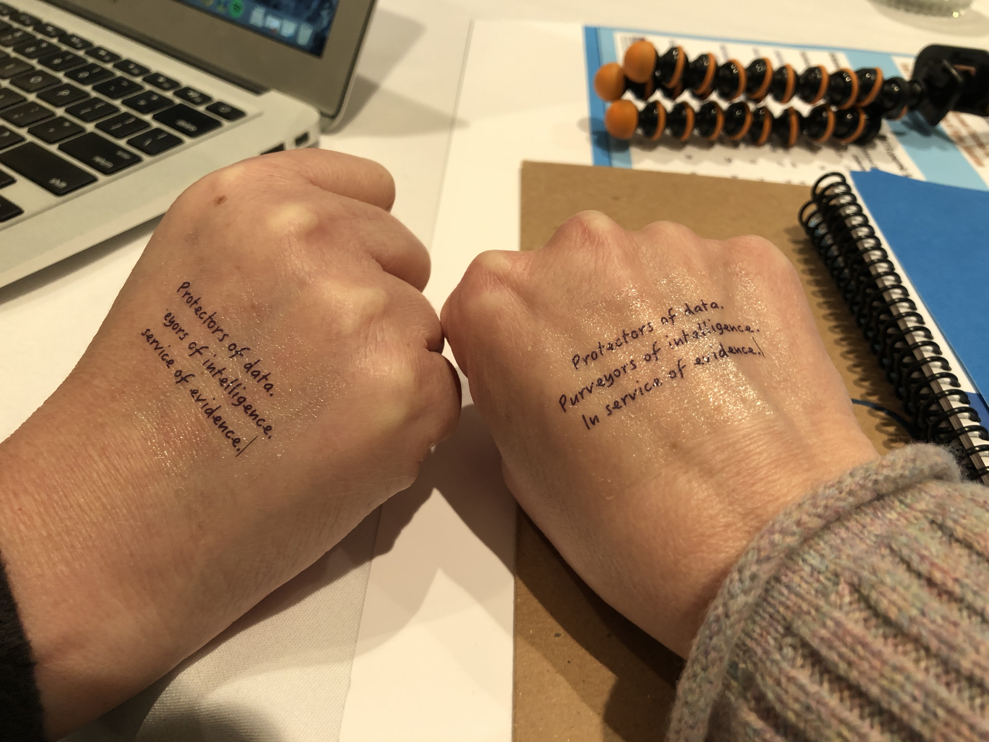
QUESTIONS?
(Chat or ask aloud)
Notes:
Kristin to facilitate Q&A 30 minutes

Slide 27
THANK YOU!
Contact:
Maureen Sarver (SPR)
Phone:
510.788.2480
Email:
Maureen_Sarver@spra.com
This Photo by Unknown Author is licensed under CC BY-SA
Notes:
Maureen to close

