Slide 1



Apples, Oranges & Employment Data:
Toward Standardization and Better Data Quality
The WDQI Technical Assistance Team & Guests
October 15th, 2020

Slide 2
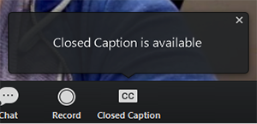
Here’s how to access live caption updates.
https://www.streamtext.net/player?event=CFI-SPRA-MS

Slide 3








The WDQI TA Team
Kristin Wolff
SPR
Maureen Sarver
SPR
Caitlin Grey
SPR
Toquir Ahmed
USDOL
Katie Mehin
BrightHive
Natalie Evans
Harris
BrightHive
Samantha Levy
BrightHive

Slide 4
News & Announcements
The 2020 SLDS Best Practices Conference will convene virtually November 18-19. (Making Better Work)
Add your announcements in chat

Slide 5
Key Ideas in WDQI
Improve the quality of workforce data, especially UI wage record data
  Add data elements
  Improve data validity and reliability (e.g., location, occupation, etc.)
Improve reporting
Link data from one source to data from another source
  In the moment
  Over time

Slide 6
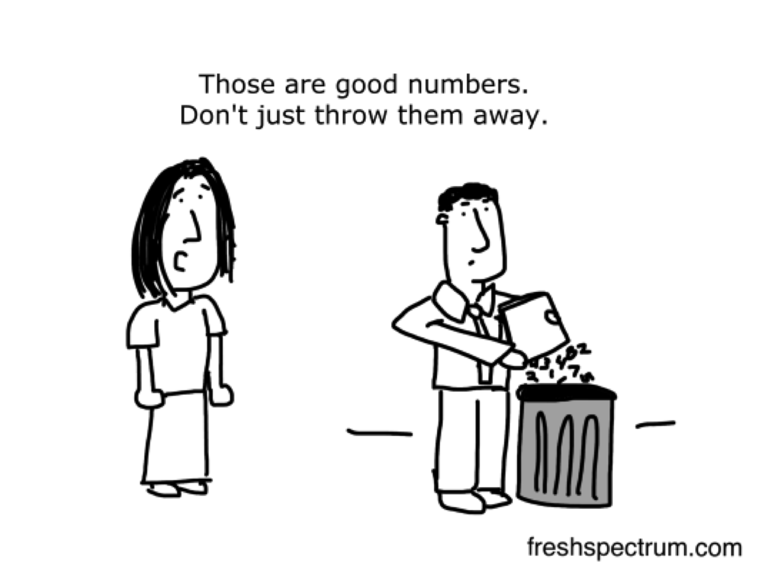
Standards can help. (They can cut down on waste too.)

Slide 7


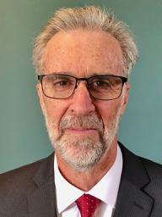
Special Guests
Bob Sheets
Consultant
Josh Westfall
U.S. Chamber of Commerce Foundation
Steve Saxton
Consultant

Slide 8


EMPLOYMENT AND EARNINGS
RECORDS STANDARDS
WDQI Briefing
Notes:
Josh

Slide 9



Meeting Objectives
Provide an overview of the T3 Network’s Employment and Earnings Records Standards Project
Provide opportunities for states to review the data standards and explore their use in UI wage record enhancement
Consider future state engagement to design a consistent approach to enhancing UI wage records
Notes:
Josh

Slide 10
Agenda
T3 Innovation Network and Project Overview
Project Objectives and Why Important
Use Cases, Data Model and Standards
Opportunities for Input and Involvement
Q & A
Notes:
Josh

Slide 11
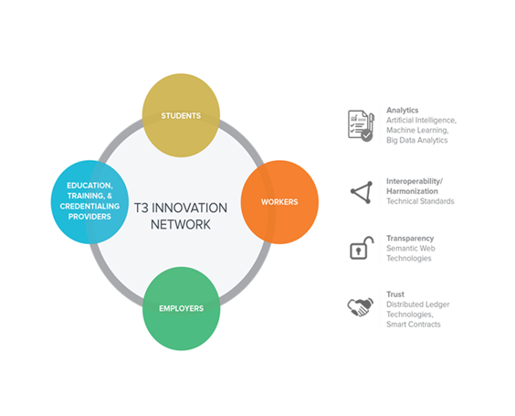
The T3 Innovation Network
Launched in 2018 as an open innovation network to support the digital transformation of the talent marketplace
Made up of over 500 organizations, including business, education, government, nonprofits, technology vendors, etc.
Focused on projects that are use case driven, standards-based, and vendor neutral
Promotes solutions that are open, ethical, and equitable
Notes:
Josh

Slide 12
Project Objectives & Timeline
Objectives:
Develop employee employment and earnings records standards (including data elements, definitions, and formats) for use in the public and private sectors
Explore the use of these standards in:
  Improving employer HR systems
  Enhancing state Unemployment Insurance (UI) wage records
  Improving federal statistical data collection
Project Timeline:
June 2019 – December 2020
Notes:
Bob

Slide 13
Why Important?
Improve data quality and reduce reporting time, complications, and costs to employers and government
Improve labor market information (LMI)
  Labor market dynamics
  Employment and earnings returns to education and training investment
Pioneer new public-private collaborative process
Notes:
Bob
Took these bullets off from original:
Accelerating structural change in local and regional markets
More difficult transitions for businesses and workers

Slide 14
Project Team
US Chamber of Commerce Foundation/T3 Innovation Network
Jason Tyszko and Joshua Westfall, Center for Education and Workforce
T3 Network Team Leads
    Andrew Reamer and Bob Sheets, Research Professors, George Washington University’s Institute of Public Policy
    Steve Saxton, Consultant
HR Open Standards Consortium
Kim Bartkus, Executive Director, HR Open Standards Consortium
Michael Moon, Work Group Chair, ADP
NASWA
Yvette Chocolaad, Policy Director, NASWA
Julie Squire, Policy Director and General Counsel, NASWA
Liam Sullivan and Hillary Hewko, Policy Analysts, NASWA
Notes:
Bob

Slide 15
Project Work Plan
Develop use cases and draft data standards
Conduct stakeholder forums
Finalize standards
Report on benefits and costs of enhanced wage records based on standards
  Benefits and costs for employers and HR technology vendors
  Benefits and costs for government
Explore with states a consistent approach to enhancing UI wage records
Develop report on improving federal statistical systems based on standards
Notes:
Bob

Slide 16
Government & Employer Use Cases
Employer reporting of employment and earnings data to government
Producing and using labor market information
Program application and eligibility determination
Notes:
Bob

Slide 17
Potential Government Reporting Benefits
Improve data quality and reduce reporting costs by using common data standards across federal and state reporting systems
Explore further government and employer cost savings by replacing federal and state surveys through enhanced employment and earnings administrative records
Notes:
Bob

Slide 18
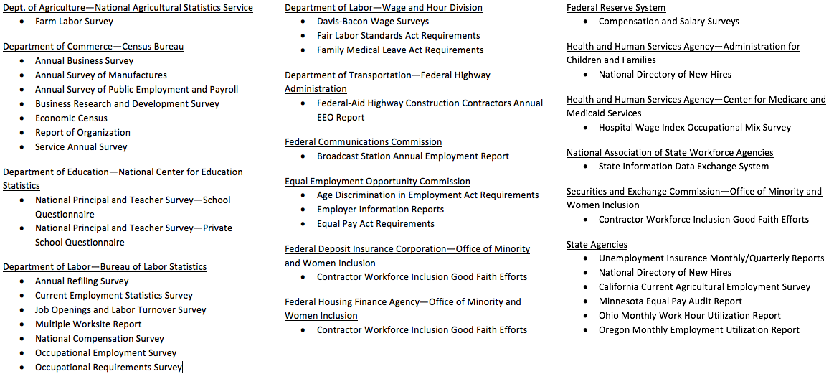
Government Data Collection
Notes:
Steve

Slide 19
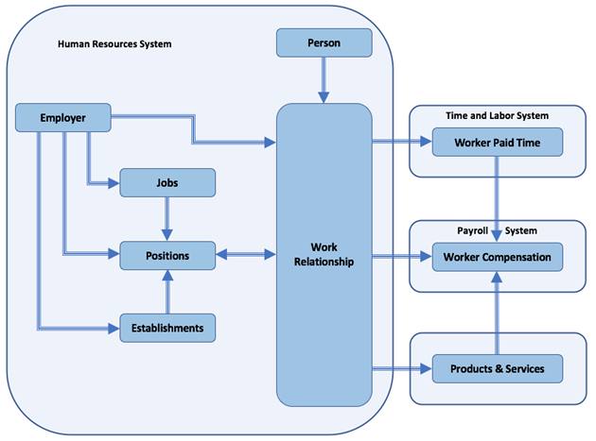
Conceptual Data Model and Standards
Notes:
Steve

Slide 20
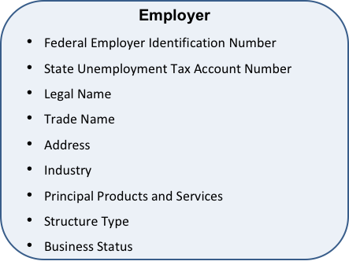
Conceptual Data Model and Standards
Notes:
Steve

Slide 21
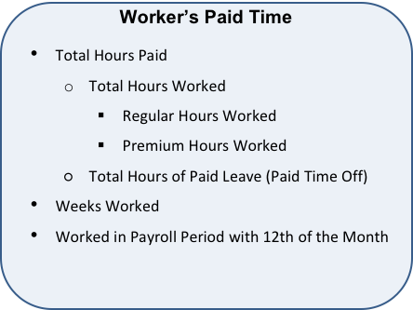
Conceptual Data Model and Standards
Notes:
Steve

Slide 22
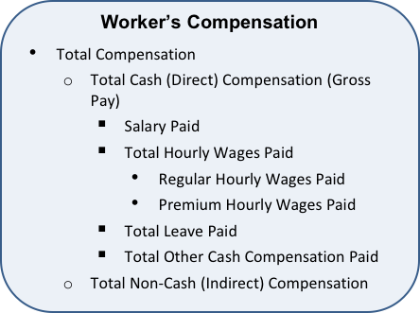
Conceptual Data Model and Standards
Notes:
Steve

Slide 23
HR Open Data Dictionary
Properties (data elements) and definitions
Guidance for application within the U.S. context
https://bit.ly/313HQUB
Notes:
Steve

Slide 24
Review and provide input on the draft employment and earnings records standards starting the first week of November (two options)
  Independent review using a google sheet; and/or
  Attend a deep dive stakeholder forum in December to further discuss the data elements, definitions, and formats
Explore with states a consistent approach to enhancing UI wage records
  Attend 2-3 group webinars
  Follow up interview with our team
  Review final report and guidance
Attend the final capstone event on December 15 at 1:00 p.m., ET
Engagement Opportunities
Notes:
Bob

Slide 25
Engagement Survey (1 min)
https://bit.ly/2QybxqR
Notes:
Josh

Slide 26
Q & A
Notes:
Josh

Slide 27

CONTACT INFORMATION
Webpage: www.uschamberfoundation.org/t3-innovation
Join the T3 Network: https://pub.s1.exacttarget.com/n4hpnhdcqzk
Joshua Westfall
Director
U.S. Chamber of Commerce Foundation
Jwestfall@uschamber.com
Notes:
Josh

Slide 28
Thank you for joining today, and for the work you do every day.
Kristin, Maureen, Caitlin, Katie, Natalie & Sam
The SPR/BrightHive TA Team @Social_Policy #MakingBetterWork
Maureen_Sarver@spra.com

