Slide 1


VOCATIONAL REHABILITATION AND WIOA YOUTH PROGRAMS
Collaboration Opportunities
Part 1: An Introduction to vocational rehabilitation (VR) services for students and youth with disabilities

Slide 2

Today’s Speaker
Adrienne Bailey
  Workforce Program Specialist
    ETA, U.S. Department of Labor

Slide 3
U.S. Department of Labor, Employment and Training Administration:
Workforce Innovation and Opportunity Act (WIOA) Youth Program
The WIOA Youth program provides a comprehensive array of services that focus on assisting both out-of-school youth (OSY) and in-school youth (ISY) with one or more barriers to employment to prepare for postsecondary education and employment opportunities, attain educational and skills training credentials, and secure employment with opportunities for advancement.

Slide 4
Oversight and Funding of WIOA Youth Program Activities
State Agency/State Workforce
Development Board
Local Workforce
Development Boards
Service Providers, including
American Job Centers
U.S. Department of Labor
http://www.servicelocator.org

Slide 5
WIOA Youth Program Overview
  Focuses on serving out-of-school youth ages 16-24 and in-school youth ages 14-21.
  Funds activities to provide career exploration and guidance, continued support for education attainment, opportunities for skills training in in-demand industries, and good jobs along a career pathway, enrollment in postsecondary education, or a Registered Apprenticeship.
  Local program design provides objective assessment of skill levels and needs, develops service strategies and career pathways, and provides activities leading to attainment of secondary and post-secondary credentials and preparation for unsubsidized employment and connections to employers.

Slide 6
Who WIOA Youth Program Serves
WIOA Youth program serves out-of-school youth (OSY) who:
    Is not attending school
    Age 16-24
    And has one or more employment barriers
And in-school youth (ISY) who:
    Is attending school
    Age 14-21
    Low income
    And has one or more employment barriers
Where can you find additional information on program eligibility?
https://youth.workforcegps.org/resources/2017/03/09/11/34/WIOA-Youth-Program-Eligibility

Slide 7
WIOA Youth Program Priorities
Out-of-school youth (OSY)
      Minimum of 75% of funds allocated to States and local areas, except local area funds for administrative expenses, must be used to provide services to OSY
Work experience
      Not less than 20% of funds allocated to local areas, except local area funds for administrative expenses, must be used to provide ISY and OSY with paid and unpaid work experience

Slide 8
Objective Assessment
Under WIOA the youth program design requires an objective assessment of academic levels, skill levels, and service needs of each participant, which include a review of basic skills, occupational skills, prior work experience, employability, interests, aptitudes, supportive service needs, and developmental needs. Assessments must also consider a youth’s strengths rather than just focusing on areas that need improvement.

Slide 9
14 Elements WIOA Youth May Receive:
Tutoring;
Alternative secondary school services;
Paid and unpaid work experiences, including:
  summer and year-round employment opportunities;
  pre-apprenticeship programs;
  internships;
  job shadowing; and
  on-the-job training;
Occupational skill training;
Education offered concurrently with workforce preparation and training;
Leadership development opportunities;
Supportive services;
Mentoring;
Follow-up services;
Comprehensive guidance and counseling;
Financial literacy education;
Entrepreneurial skills training;
Services that provide labor market and employment information; and
Postsecondary education and training preparation activities.

Slide 10
14 Program Elements Continued
The program elements required under WIOA section 129(c)(2) and 20 CFR 681.410 are discussed further in TEGL 21-16: https://wdr.doleta.gov/directives/attach/TEGL/TEGL_21-16.pdf
You can also find additional information on program element resources on the Youth Connections Community of Practice on the Program Element page. https://youth.workforcegps.org/resources/2017/01/19/13/56/WIOA-Youth-Program-Element-Resources

Slide 11
Individual Service Strategy (ISS) for WIOA Youth Services
Section 129 c (1)(b) requires that all eligible youth have an Individual Service Strategy (ISS).
The ISS should be linked to one or more WIOA indicators of performance, identify career pathways that includes education and employment goals, appropriate achievement objectives, and appropriate services for the participant.
The counselor working along with a youth to identify their personal and career goals, how to achieve their goals, and resources needed support them in obtaining their goals.

Slide 12

Individual Service Strategy (ISS) Sample
To view the Sample Youth ISS, visit the Youth Connections Community of Practice https://youth.workforcegps.org/resources/2019/06/20/18/30/Youth-Individual-Service-Strategy-ISS.

Slide 13
Primary Youth Program Indicators of Performance Under WIOA
Six Primary Indicators of Performance:
Employment Rate 2nd Quarter after Exit
-(Education/Employment for youth)
Employment Rate 4th Quarter after Exit
-(Education/Employment for youth)
Median Earnings in the 2nd Quarter after Exit
Credential Attainment Rate
Measurable Skill Gains
Effectiveness in Serving Employers

Slide 14

Promoting Partnerships

Slide 15
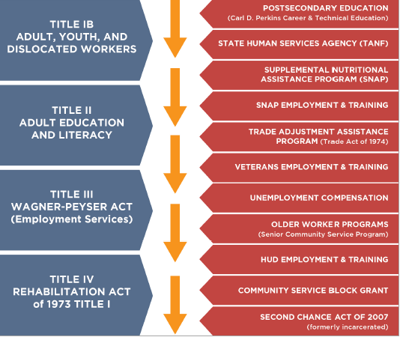
Core and Additional Partner Programs

Slide 16
Benefits of Partnerships
Access to information and data to improve services and increase efficiencies such as recruitment processes, referrals, and case management.
Aid in providing the most effective, targeted, and appropriate services that can help youth identify and successfully progress along a career pathway.
Career Pathways Toolkit: An Enhanced Guide and Workbook for System Development https://careerpathways.workforcegps.org/announcements/2016/10/20/09/37/Career_Pathways_Toolkit_An_Enhanced_Guide_and_Workbook

Slide 17
Additional WIOA Youth Program Information
To learn more about the WIOA Youth program and to access relevant policies and technical assistance resources, visit: https://youth.workforcegps.org/.

Slide 18


Slide 19
Contact Us
Sara Hastings
  Unit Lead, DYS, ETA, U.S. Department of Labor
    Organization
      Hastings.sara@dol.gov
        (202) 693-3599
For General Inquiries, email Division of Youth Services
      Youth.services@dol.gov

Slide 20
Thank You!
Need help? Email: Support@workforceGPS.org

