Slide 1


VOCATIONAL REHABILITATION AND WIOA YOUTH PROGRAMS
Collaboration Opportunities
Introduction to the webcast series

Slide 2
Federal Partners and Technical Assistance Organization
U.S. Department of Labor, Employment and Training Administration
U.S. Department of Education’s Rehabilitation Services Administration (RSA)
Workforce Innovation Technical Assistance Center (WINTAC) Technical Assistance Provider

Slide 3
WIOA Youth Program Overview
Four webcasts
  Overview of the VR Program
  Overview of the WIOA Youth Program
  Collaboration Opportunities between the two programs
  Examples of collaborative practices

Slide 4
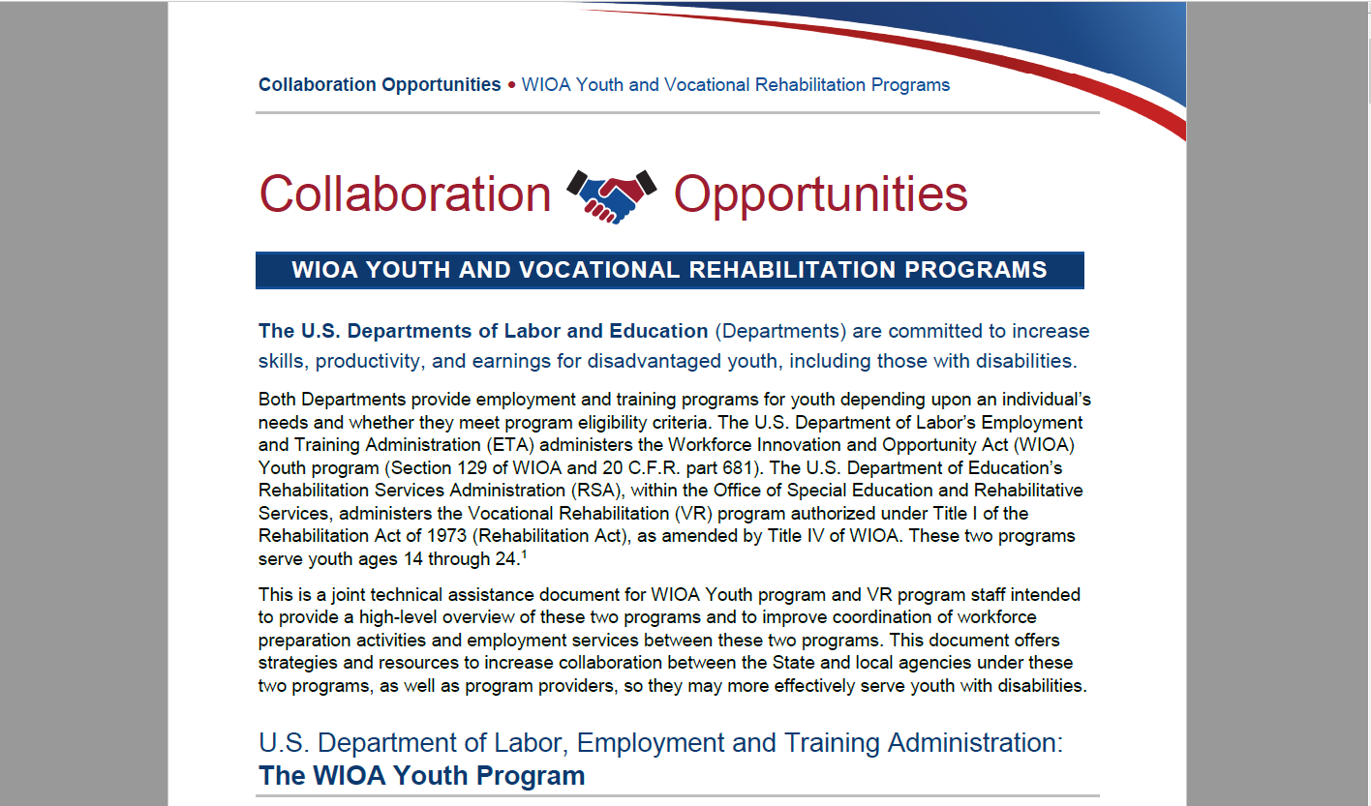
Collaboration Resource
The resource is available at: https://youth.workforcegps.org/resources/2019/08/13/16/46/~/link.aspx?_id=EF76C6ED7D344E32A8517C943C5ADC87&_z=z

Slide 5
Thank You!
Need help? Email: Support@workforceGPS.org

