Slide 1
Using the Placement Scaffold for Successful Placement and Career Success

Slide 2

Introduction to the Placement Scaffold Framework
What is it? The Placement Scaffold is a framework for programs to help match all participants to job and postsecondary (PSE) opportunities.
Why use it? The goal is to help program teams think about how to aim for 100% placement.
When to use it? Anytime, but we recommend midway through the program, 1 month before participants are exiting, and again in Q2 and Q4 after exit.
Use the Instructional Guide when you complete the steps.

Slide 3

A Youth-Centered Focus in Placement
Many young people are:
Eager to work and earn doing something they enjoy.
Still figuring out their identity, values and interests.
Building work stamina.
According to the Bureau of Labor Statistics, people ages 18-24 change jobs 5.8 times– almost every year.
Notes:
Source: (1) https://www.bls.gov/news.release/pdf/nlsoy.pdf
Photos are from YouthBuild Lake County website – publicly available success stories.

Slide 4
Four Out of Six DOL Performance Measures Depend on Placement
Placement in Q2
Placement in Q4
Credential Attainment
Median Earnings in Q2
Measurable Skill Gains
Effectiveness in Serving Employer
% of participants who are placed in employment, secondary education, postsecondary education, military, registered apprenticeship, or long-term occupational training (including AmeriCorps and Job Corps) in the 2nd quarter or 4th after exit
The median earnings of participants
who are in unsubsidized employment two quarters after exit
% of participants who achieve a gain in a Program Year
Examples
EFL gain (TABE/CASAS)
Passing a GED section
OSHA-30
Passing a unit test (NCCER, HBI, MC3)
*This list is not exhaustive
% of participants who are placed with the same employer 2nd and 4th quarter after exit
% of participants who attain Occupational credential
OR
HSE + Placement
Reference: TEGL 10-16, Change 3

Slide 5
Definition and Examples of Placement
Registered Apprenticeship
Trade Union Registered Apprenticeship
Other DOL Registered Apprenticeship
Placement in Non-Subsidized Employment
Entry level or career pathway job
Part-time or full-time job
Non-registered apprenticeship e.g., culinary
Postsecondary
2-year college certificate or associate’s program
4-year college or university
Technical college or postsecondary program
Service
Military
Full year of service: NCCC, AmeriCorps

Slide 6
Steps to Use the Placement Scaffold Framework
1. Define readiness levels
2. Identify employer and PSE partners
3. Evaluate participant’s readiness
4. Match participants to opportunities

Slide 7
Step 1: Define Readiness
Directions: Define each readiness level for the career pathway(s) in your YouthBuild program.
Readiness Levels:
  Not Quite Ready Yet (for work or college/post-secondary education)
  Part-Time Work or On-Demand Job Ready
  Basic Job Ready – Full Time Work
  College/Postsecondary Education Ready
  Career Ready
  Registered Apprenticeship Ready

Slide 8
Define Readiness by Career Pathway Template - Construction
Pathway | Not Quite Ready Yet | Part-Time or On-Demand Job Ready | Basic Job Ready – Full-Time Work | College/PSE Ready | Career Ready | Registered Apprenticeship Ready
Construction

Slide 9
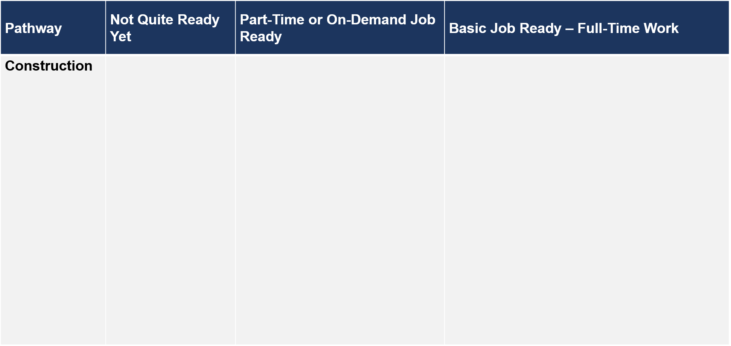
Example: Definitions of Readiness
May have challenges that extend beyond active programming
May need additional supportive services
Irregular attendance
May not have any prior work experience
May have personal circumstance that requires flexibility
Able to follow directions
Solid communication skills
Has personal identification documents – government-issued identification card (ID), Social Security (SS) card, etc.
80-90% attendance
Able to interview
Able to work independently and as part of a team
Able to handle job time management
Able to follow directions and manage impulses
Solid communication skills
Has personal papers – ID, SS card, etc.
Interest in the field or able to tie learning to interest area

Slide 10
Example: Definitions of Readiness
Pathway | College/PSE Ready | Career Ready
Construction
Self-starter and self-motivated
Able to manage time effectively to get homework completed
Willing to navigate system for registration, financial aid, etc.
Solid reading, writing and math skills
Interest in the field or able to tie learning to interest area
Higher level of attendance, 95+% attendance
May need high school diploma (HSD) or GED​
May need transportation or driver's license
Some work experience, often in customer service
May be drug tested or have a background check required
Able to adapt and learn on the job
May need more computer skills, driving skills, or job-related skills
Interest in the field or able to tie learning to interest area

Slide 11
Example: Definitions of Readiness (2)
Pathway | Registered Apprenticeship Ready
Construction
Be at least 17
Extremely reliable, and able to set and keep appointments, good time management
Able to show HSD or GED Certification
ID, SS card, Proof of citizenship or legally able to work
Proof of reliable transportation
Drug-free
Show proof of experience, education or certification
May need to pass physical fitness test
May need to pass proficiency tests

Slide 12
Define Readiness by Career Pathway Template - Construction
Pathway | Not Quite Ready Yet | Part-Time or On-Demand Job Ready | Basic Job Ready – Full-Time Work | College/PSE Ready | Career Ready | Registered Apprenticeship Ready
Construction

Slide 13
Define Readiness by Career Pathway Template – C+
Pathway | Not Quite Ready Yet | Part-Time or On-Demand Job Ready | Basic Job Ready – Full-Time Work | College/PSE Ready | Career Ready | Registered Apprenticeship Ready
Construction Plus (C+): __________

Slide 14
Now pause the webcast and work together as a team to define readiness.

Slide 15
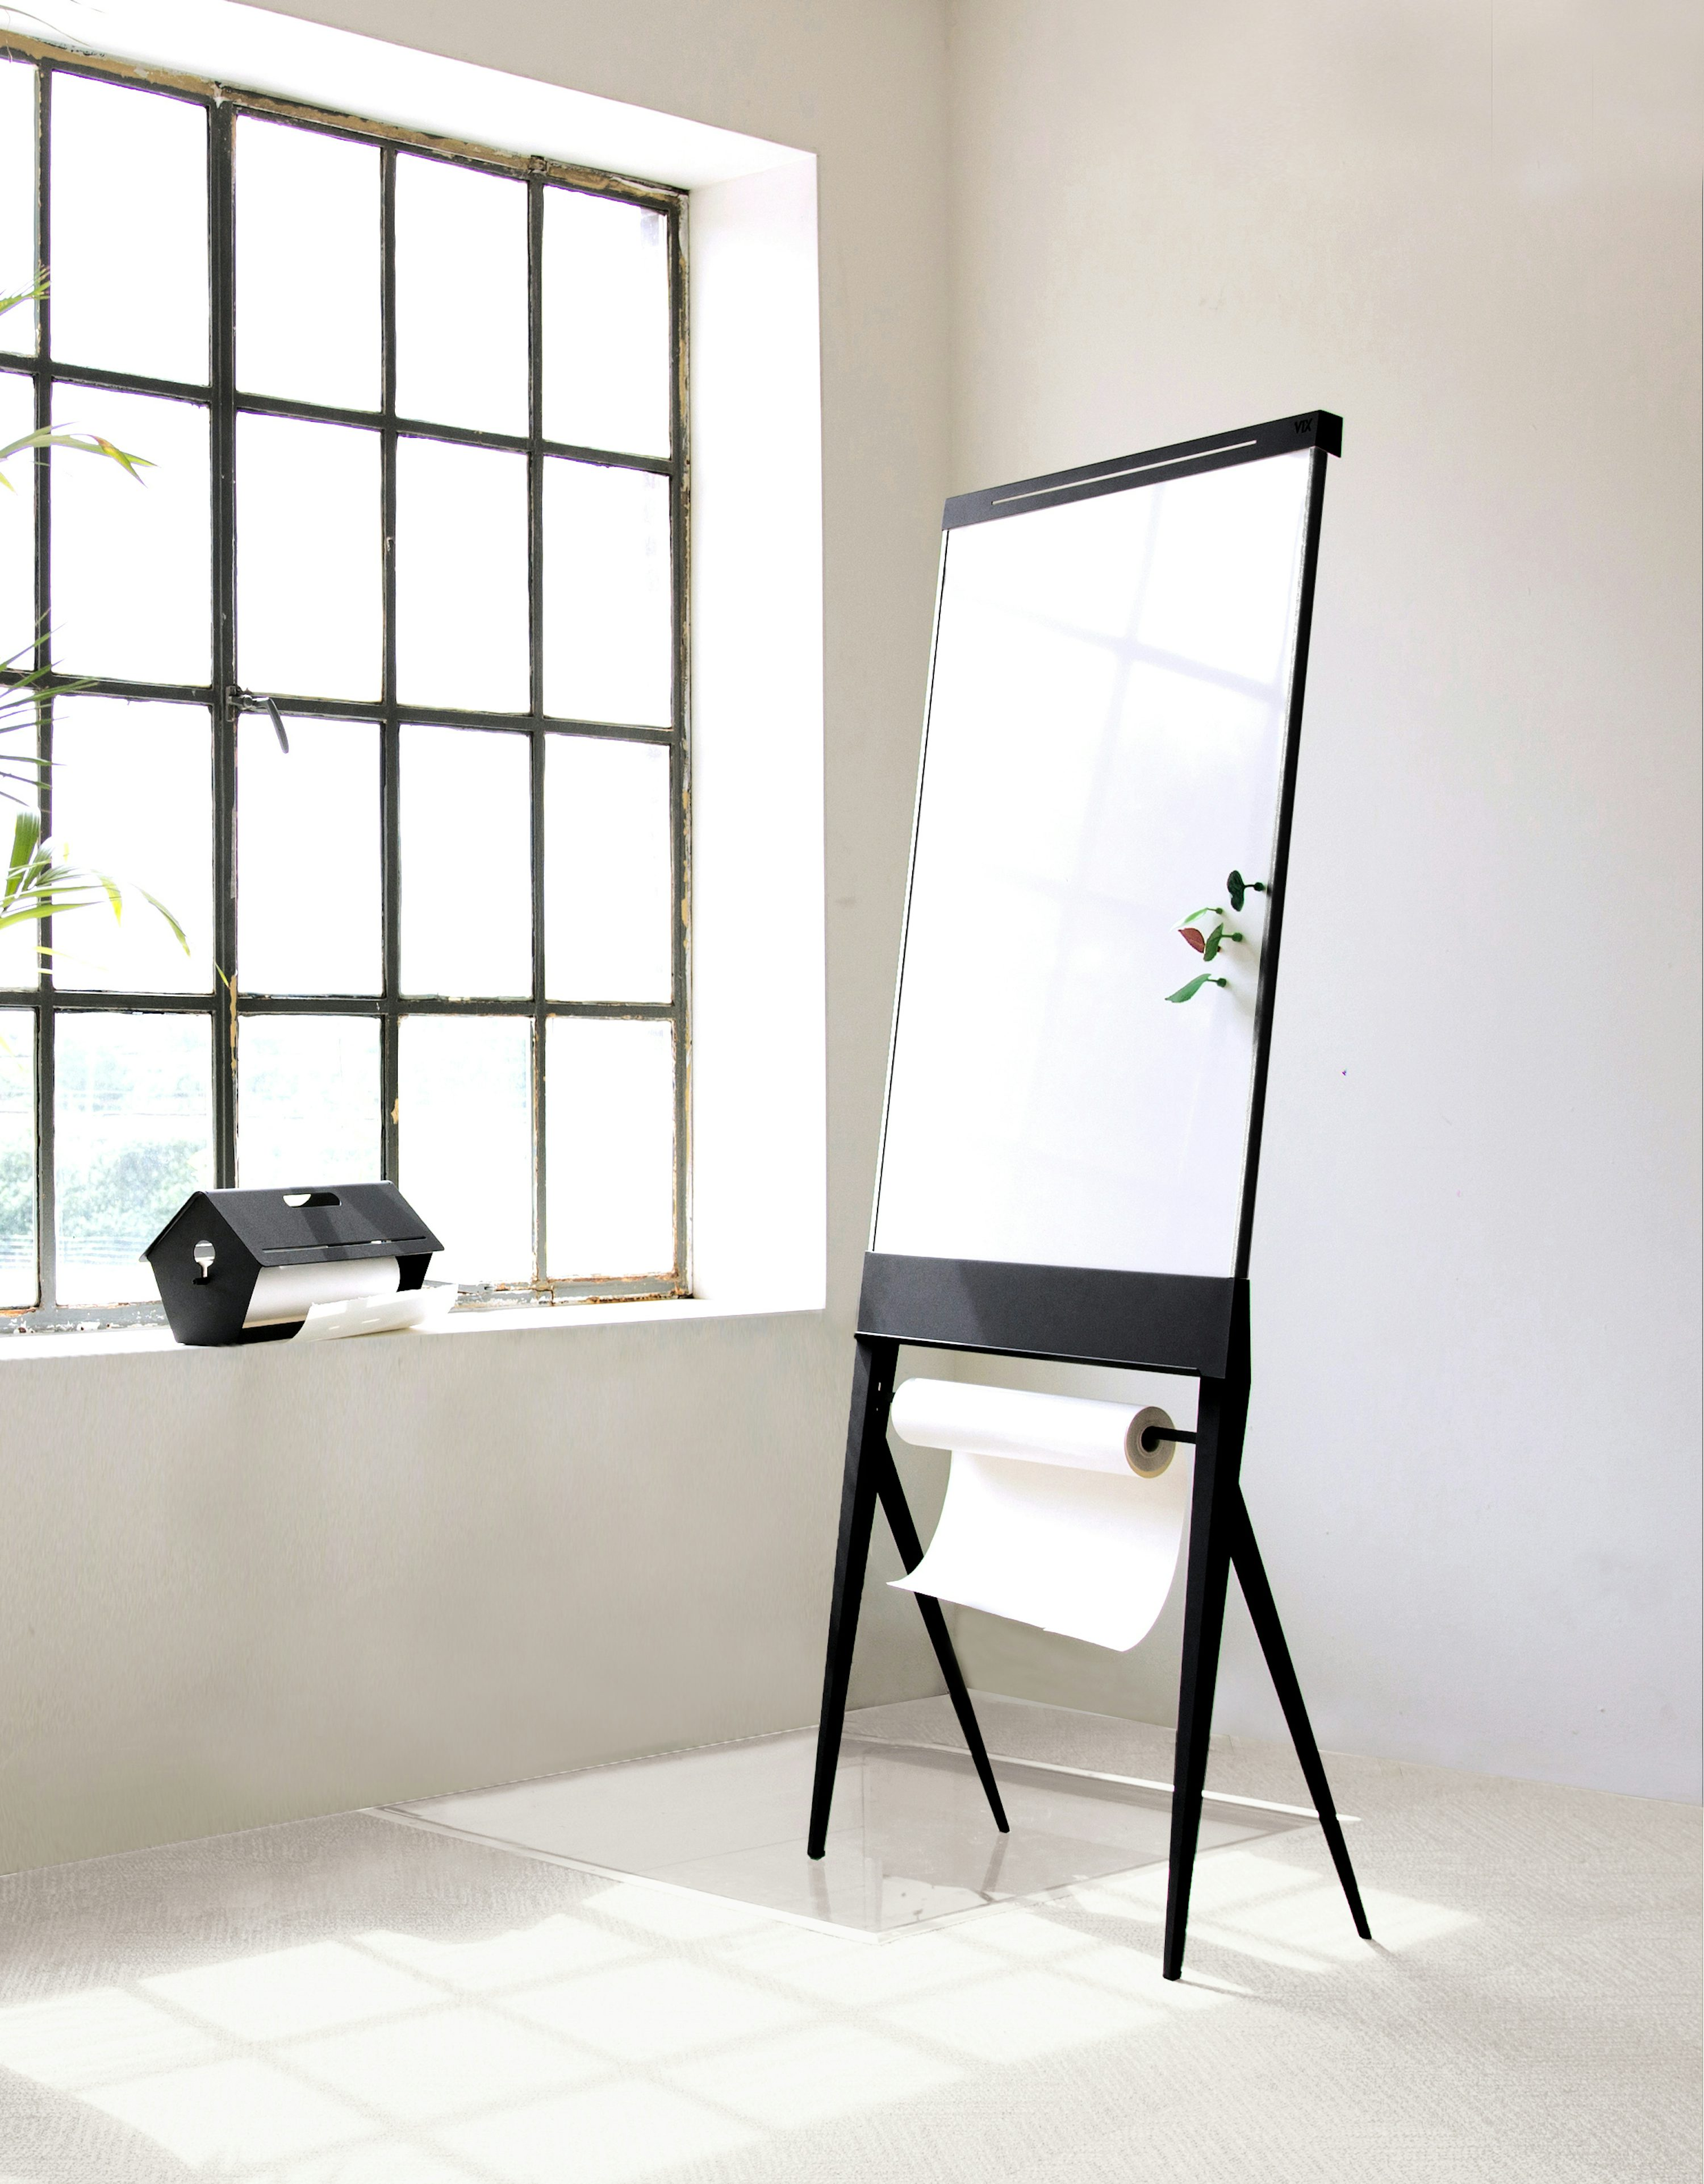
Step 2: Match Partners to Defined Readiness Levels
Directions:
Brainstorm a list of your current employer and PSE partners.
Consider the opportunities your partners currently offer or could potentially offer. Evaluate where each partner would fall within the readiness levels.
Place your partners into the applicable readiness level.
Photo by Studio VIX on Unsplash

Slide 16
Example: Employer Scaffold for Construction
Pathway | Not Quite Ready Yet | Part-Time or On-Demand Job Ready​ | Basic Job Ready – Full-Time Work ​ | College/PSE Ready | Career Ready | Registered Apprenticeship Ready
Construction | WEX with a community partner like Habitat, Habitat Restore, Housing Authority, or other. Temp Services Job Corps Additional Construction Training through organization like Chicago Women in Trades. | Part time retail – Hardware store Part time customer service for Supplier Temp Services AmeriCorps Role | Construction Retail: Home Depot/Lowe’s Construction Yard with contractor Facility Maintenance with hospital, offices, manufacturing, apartments. Front Desk For Supplier Laborer or Assistant for non-union contractor | Local Community College: HVAC Fiber Optic Tech Construction Management Electrical Solar panel training | Flooring Co. Roofing Co. Painting Co. Other contractors Cable installer Grainger Green Jobs Contractor | Carpenters Union Carpentry Contractors Laborers Union Contractors Electrical Union Plumbers Union Painting Contractors/Painters Union
Other | WEX with Local Nonprofit Partners | Recreational Center or Fitness Club Restaurants Retail | Lots of opportunities related to career interests Retail Entry level positions | Community College First Nursing School Trucks R US: Commercial Drivers License | Local Hospital | Walgreens and CVS Registered Apprenticeships

Slide 17
Example: Employer Scaffold for Multiple Career Pathways
Pathway | Not Quite Ready Yet | Part-Time or On-Demand Job Ready​ | Basic Job Ready – Full-Time Work ​ | College/PSE Ready | Career Ready | Registered Apprenticeship Ready
Healthcare | Volunteer/Intern at Nursing Homes Senior Community Programs Hospitals Veterinary Clinics | Receptionist Pharmacy Cashier Home Health Aide Patient Support Specialist Food Service Assistant | Entry Level Patient Care Receptionist Pharmacy Home Health Aide | CNA Sterile Process Tech Patient Care Tech Medical Billing Pharmacy Tech | Placement After Certificate – Nursing Aide, Patient Care Tech, Pharmacy Tech Medical Receptionist Medical Billing | Unionized Healthcare Staff Walgreens/CVS Registered Apprenticeships
Information Technology (IT) | Building Website For Nonprofits Social Media for Nonprofits Job Corps | Cell Phone stores Retailers like Target, Walmart, Best Buy | Help Desks Retailers like Best Buy | IT Certifications like Comp TIA A+ Cybersecurity Microsoft Certified Professional (MCP) Adobe Certified Professional | Corporate Help Desk Desk top support technician Graphic Design Web Design | Electrician IBM Registered Apprenticeships

Slide 18
Example: Employer Scaffold for Manufacturing and Logistics
Pathway | Not Quite Ready Yet | Part-Time or On-Demand Job Ready​ | Basic Job Ready – Full-Time Work ​ | College/PSE Ready | Career Ready | Registered Apprenticeship Ready
Manufacturing | Job Corps | Production Graphics Assembly Support Production Associate | Assembler Production Associate | Certified Production Associate (CPT) Drill Press, Machining Computer Numerical Control - CNC Mill and Lathe Industrial Machinery Repair/Automation Technician | Semiconductor manufacturer Other local manufacturers Welder | United Auto Workers United Steel Workers International Association of Machinists and Aerospace International Brotherhood of Electrical Workers
Logistics | Food Bank Book Bank Habitat Restore | Retail store stocker Delivery driver (Uber/Grubhub/Retail) | Picker/Packer Forklift Operator | Certified Logistics Associate (CLA) CDL (Commercial Drivers License) | Delivery Driver Logistics Tech | International Brotherhood of Teamsters Dock and Shipping Unions

Slide 19
Employer Scaffold Template
Pathway | Not Quite Ready Yet | Part-Time or On-Demand Job Ready​ | Basic Job Ready – Full-Time Work ​ | College/PSE Ready | Career Ready | Registered Apprenticeship Ready
Construction | - | - | - | - | - | -
C+ | - | - | - | - | - | -
C+ | - | - | - | - | - | -
Other | - | - | - | - | - | -

Slide 20
Now pause the webcast and work together as a team to develop the Employer Scaffold for each of your Career Pathways.

Slide 21
Step 3: Placing Youth on the Participant Scaffold
Directions:
Evaluate the readiness of each participant.
Place the names of the participants under their readiness level.
Tip:
If a participant is not interested in Construction or your C+ pathways, place them in the row marked “Other” with a brief note about their career interests.

Slide 22
Example: Participant Scaffold
Pathway | Not Quite Ready Yet | Part-Time or On-Demand Job Ready​ | Basic Job Ready – Full-Time Work ​ | College/PSE Ready | Career Ready | Registered Apprenticeship Ready
Construction | Joe – Attendance issues due to problems at home. Maybe Job Corps Janet – Wants plumbing but has attendance challenges and young children | Lulu – wants a job indoors Lonnie – wants hands- on work | Leticia – wants a job indoors Lauren – wants hands on, prep for Carpenters RA Levi – wants hands on, prep for Electrical RA | Mike – HVAC | Jacqui – wants facility work in healthcare, considering nursing later Jackson – wants corporate job with paid college benefits Johanna – wants to make money to buy car, apply for Carpenters Union | Amber – Laborer/Flagger Antonio –Carpenter
Other | Josephine – Has a young child. WEX at daycare? Or recreational center? | Lucy – Culinary Lexi –UberEats/Grubhub (has car) Lucas – Sports/recreational center position | Lorenzo – Healthcare Lisa – Automotive | Maddie – CNA Max- Autobody Lavonne –CNC Matt – CDL/Truck Driving |  | Anastasia – Pharmacy Tech Apprenticeship

Slide 23
Participant Scaffold Template
Pathway | Not Quite Ready Yet | Part-Time or On-Demand Job Ready​ | Basic Job Ready – Full-Time Work ​ | College/PSE Ready | Career Ready | Registered Apprenticeship Ready
Construction | - | - | - | - | - | -
C+: _______ | - | - | - | - | - | -
C+: _______ | - | - | - | - | - | -
Other | - | - | - | - | - | -

Slide 24
Now pause the webcast and work together as a team to place your participants on the scaffold according to their career interests and readiness levels.

Slide 25

Step 4: Match Participants to Employers or PSE Partners
Directions: Complete the “Matching Scaffold Template” by matching specific Employer and PSE Partnerships opportunities for each young person.

Slide 26
Example: Matching Scaffold for YouthBuild ABC, 1 month before exit
Pathway | Not Quite Ready Yet | Part-Time or On-Demand Job Ready​ | Basic Job Ready – Full-Time Work ​ | College/PSE Ready | Career Ready | Registered Apprenticeship Ready
Construction | Joe – Job Corps Janet – Chicago Women in Trades Both may work temp jobs through Aerotek until their programs start | Lulu – Part time delivery role at Home Depot Lonnie – Habitat AmeriCorps 3 month position | Leticia –Home Depot/Lowes/Ace/ True Value Lauren – Laborer for Home Rehab Partner Levi – Laborer for Home Rehab Partner | At Community College: Mike – Residential HVAC | Jacqui – Hospital Maintenance Jackson – Grainger Branch Customer Service Johanna - ABC Non-union Home Builder | Amber – Laborer/Flagger Antonio –Carpenters Union
Other | Josephine –Daycare at Recreational Center | Lucy – Chick-Fil-A Lexi – Uber Eats/Grubhub Lucas – Recreational Center | Lorenzo – Cashier at Walgreens Lisa – Reilly Auto Parts | At Community College: Max- Autobody Lavonne –CNC Matt –Trucks R US CDL School At First Nursing School: Maddie – CNA | - | Anastasia – Walgreens Registered Apprenticeship for Pharmacy Tech

Slide 27
Matching Scaffold Template
Pathway | Not Quite Ready Yet | Part-Time or On-Demand Job Ready​ | Basic Job Ready – Full-Time Work ​ | College/PSE Ready | Career Ready | Registered Apprenticeship Ready
Construction | - | - | - | - | - | -
Other | - | - | - | - | - | -

Slide 28
Matching Scaffold Template
Pathway | Not Quite Ready Yet | Part-Time or On-Demand Job Ready​ | Basic Job Ready – Full-Time Work ​ | College/PSE Ready | Career Ready | Registered Apprenticeship Ready
C+: _______ | - | - | - | - | - | -
C+: _______ | - | - | - | - | - | -

Slide 29
Thanks for following along!
Share your feedback and experience using the tool with dolyb.content@youthbuild.org.

