Slide 1
Where Are You?
Please enter your program and location in the chat box.

Slide 2
Interviewing Strategies for Effective Case Management

Slide 3

Today’s Moderator
Amanda Brenner
  Workforce Analyst
    U.S. Department of Labor
3

Slide 4


Q&A Versus Chat Features
vs.

Slide 5

Today’s Presenter
Kate Henneberry, MSW, LCSW
  Senior Manager, Alumni Relations
    YouthBuild USA

Slide 6
Today’s Objectives
Articulate the relationship between case management
and trauma-informed care
Discuss the case management approaches of Motivational Interviewing (MI) and wraparound services
Demonstrate examples of interviewing in case management
Engage in peer learning
Explore the referral and partnership process

Slide 7
What is Case Management?

Slide 8

Case Management
Case management and counseling are both integral parts of the YouthBuild model.
CASE MANAGEMENT is beneficial for opportunity youth as it provides individualized support, resource coordination, advocacy, crisis intervention, and long-term support. It helps young people overcome barriers, access necessary services, and achieve their personal, educational, and career goals.

Slide 9
Approaches to
Trauma-Informed
Case Management

Slide 10
Poll: Trauma-Informed Care Practices
I consistently apply trauma-informed care techniques.
I am somewhat familiar with trauma-informed
care principles, but I don't always apply them in my interviews.
I have limited knowledge of trauma-informed care practices and need further guidance.
I have just started exploring trauma-informed care and its application in case management interviewing.
I do not use trauma-informed care practices.
Which statement best reflects your current practice regarding trauma-informed care in your case management interviewing process?
Choose one answer.

Slide 11

Trauma-Informed Lens
Trauma-informed care is a strengths-based framework grounded in an understanding of and responsiveness to the impact of trauma.
It emphasizes physical, psychological, and emotional safety for providers and survivors and creates opportunities for survivors to rebuild a sense of control and empowerment.
Six Principles of Trauma-Informed Care
Safety
Trustworthiness and Transparency
Peer Support
Collaboration and Mutuality
Empowerment and Choice
Cultural, Historical, and Gender Issues
Source: SAMSHA
Notes:
Brief overview on the trauma informed lens and concept of interviewing to ground audience in shared definition for this webinar. Important to emphasize that case management is a trauma informed approach
What is Trauma
SAMSHA
https://www.samhsa.gov/trauma-violence?gclid=Cj0KCQjwwvilBhCFARIsADvYi7IIHFw2-Os_3Gb9aDbcIAX3ttzw4inc4ez21y_TqpX75pYJoDaGGv4aAkm8EALw_wcB

Slide 12

Interviewing
Why is interviewing a key aspect of case management? You can…
  Gather information
  Build rapport
  Assess needs
  Identify resources
  Develop a plan
  Monitor progress
  Interviewing facilitates effective communication, assessment, planning, and monitoring of needs, leading to better outcomes and support for young people.
Notes:
Relate to the intake process-taking place around admission to program or during/after mental toughness

Slide 13

Motivational Interviewing (MI)
An interviewing style designed to help individuals resolve ambivalence and increase motivation to change
MI encourages participants to collaborate with the case manager to:
Identify their personal goals
and values
Develop a plan for change that aligns with those goals and values
Source: CARE, How to Increase Motivation
Notes:
Motivational Interviewing Principles and Theory
https://www.bumc.bu.edu/care/files/2008/09/1how-to-increase-motivation-saitz-2008.pdf
Spoken for line one: it is client-centered and collaborative. MI is often used in the context of behavior change, such as substance use. However, it can also be used in areas like health behavior change, education, and career development.

Slide 14
Motivational Interviewing
Core Principles
  Express empathy.
  Develop discrepancy.
  Roll with resistance.
  Support self-efficacy.
Strategies
  Ask open-ended questions.
  Affirmation.
  Reflection.
  Summarize.
  Plan.
  Use change-oriented
  language.
Notes:
Further explain principles i.e. discrepancy, roll with resistance, self-efficacy. How to use strategies.

Slide 15
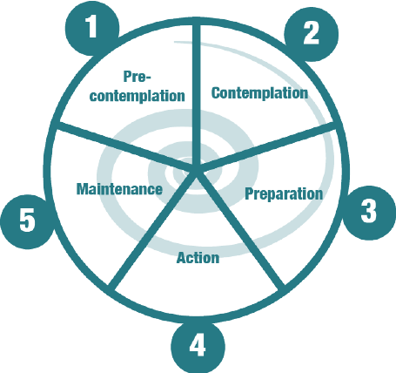
Motivational Interviewing: Wheel of Change
Pre-contemplation
Contemplation
Preparation
Action
Maintenance
Source: Payton, Joanne & Robinson, Amanda. (2015). Motivating Respect: A Welsh intervention into youth-perpetrated domestic abuse.
Notes:
Payton, Joanne & Robinson, Amanda. (2015). Motivating Respect: A Welsh intervention into youth-perpetrated domestic abuse.

Slide 16
Motivational Interviewing
Stage | Description | Response
Precontemplation | Not yet considering change, unwilling or unable to change | Establish rapport, ask permission, and build trust. Raise doubts or concerns with the person about current, unwanted behavior patterns. Express concern and keep the door open.
Contemplation | Aware of the problem and seriously considering change, but no commitment to take action | Raise awareness of the needed change by observing behavior. Help resolve ambivalence about change. Address the person's belief that change is possible.
Preparation | Leaning towards change, intends to change and makes small behavioral changes | Encourage these steps and support the change process. Commit to making change a top priority. Consider possible barrier and how to lower them.
Action | Takes steps to change but has not yet reached stabilization | Make an action plan, reinforce changes, and provide support guidance.
Maintenance | Maintain the accomplishment of change, practice a daily routine, and appear to sustain the change | Assist the person in re-entering and understanding the change cycle. Support positive decision to get back on track.
Source: Accend Services
Notes:
http://accendservices.com/guides/trainingguide-motivationalinterviewing.php

Slide 17
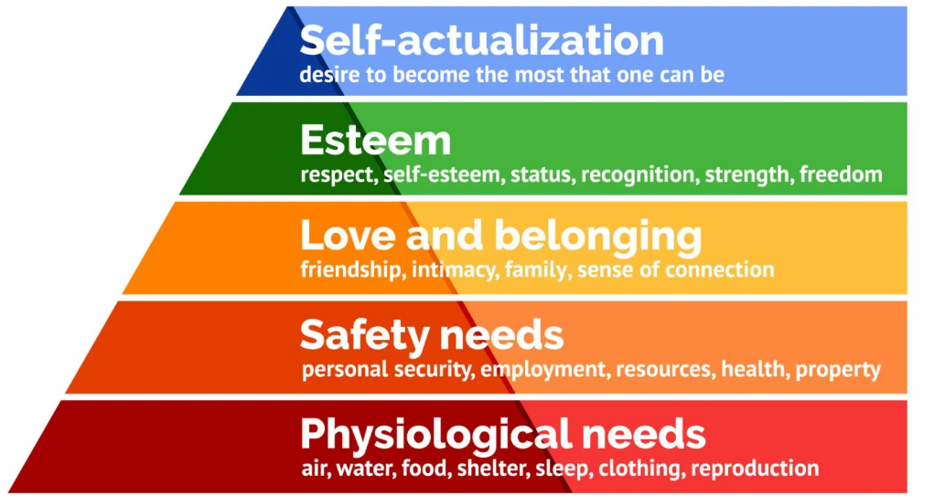
Wraparound/Whole Person: Maslow’s Hierarchy of Needs
The wraparound/whole person approach recognizes that young people have complex needs that must be addressed
for them to achieve their goals and
reach their full potential.
This includes addressing housing,
food, transportation, mental health, finances, race,
and culture.
Source: https://www.simplypsychology.org/maslow.html

Slide 18
Wraparound/Whole Person: Key Techniques
ENGAGEMENT - Build relationships and identify strengths, needs, and goals.
PLANNING - Develop a comprehensive plan that addresses all aspects of a person's life, including physical, emotional, social,
and educational needs.
IMPLEMENTATION - Put the plan into action while providing the necessary support and services to help clients achieve their goals.
REVIEW - Regularly review the plan and adjust based on progress and changing needs.

Slide 19
Recommendations for Conducting a Trauma-Informed Interview

Slide 20

Interview/Intake
Create a safe and welcoming environment.
Use open-ended questions.
Listen actively and empathetically.
Be aware of triggers and boundaries.
Focus on strengths and goals.
Elicit change talk.
Roll with resistance.
Notes:
Create a safe and welcoming environment: Begin by creating a safe and welcoming environment for the student, such as a private and quiet space where they feel comfortable and at ease. Introduce yourself and explain the purpose of the interview. Let the student know that they can take breaks or stop the interview at any time if they feel uncomfortable.
Use open-ended questions: Use open-ended questions that allow the student to share their experiences and goals in their own words. Avoid leading questions or questions that assume certain experiences or feelings.
Listen actively and empathetically: Listen actively and empathetically to the student's responses and validate their experiences and feelings. Use reflective listening techniques, such as summarizing or paraphrasing what the student has said to show that you are listening and understanding.
Be aware of triggers and boundaries: Be aware of potential triggers for the student, such as certain topics or questions and be respectful of their boundaries. If the student becomes upset or uncomfortable, offer support and validation. And consider taking a break or rescheduling the interview if necessary.
Focus on strengths and goals: Focus on the student's strengths and goals and help them to identify their own strengths and resources. Foster a student's sense of resilience and ability to overcome challenges.
Elicit change talk: Elicit change talk by asking questions that encourage the student to talk about their desire, ability, reasons, and need for change. This can help to promote a sense of motivation and commitment to making positive changes.
Roll with resistance: If the student expresses resistance or ambivalence about making changes, avoid arguing or confronting them. Instead, roll with their resistance by acknowledging their concerns and exploring their reasons for not making changes. This can help to promote a sense of autonomy and respect. It can also help to identify areas where the student may need additional support or resources.

Slide 21
Interview/Intake: Sample Questions by Topic
Introduction
Can you tell me a little bit about yourself and your background?
Housing, Food, Transportation, Finances, and Basic Needs
How would you describe your current living situation? Do you feel safe and comfortable where you are living?
Mental Health
Are you currently experiencing any challenges related to mental health, such as anxiety, depression, or trauma symptoms?
Notes:
We should link the interview form for attendees to open and download
Introduction
1. Can you tell me a little bit about yourself and your background?
2. What are some of your strengths and skills that you will bring to the program?
3. What are some of the challenges or barriers that you have faced in the past?
4. What are some of your goals for the future, both short-term and long-term?
5. What are some of the things that you are most proud of in your life?
Housing, Food, Transportation, Finances, and Basic Needs
1. How would you describe your current living situation? Do you feel safe and comfortable where you are living?
2. Are you currently experiencing any challenges related to housing, such as difficulty paying rent or finding a stable place to live?
3. How would you describe your current access to food and nutrition? Are you able to access food on a regular basis Are you able to access healthy and nutritious food on a regular basis?
4. How would you describe your health? Are you able to access healthcare on a regular basis?
Mental Health
1. Are you currently experiencing any challenges related to mental health, such as anxiety, depression, or trauma symptoms?
2. Have you ever received any mental health services or counseling in the past? If so, how did that experience go for you?
3. Are you currently receiving any mental health services or counseling? If not, would you be interested in exploring those options?
4.Are there any specific challenges or barriers that you are currently facing that are impacting your day-to-day life?

Slide 22
Interview/Intake: Sample Questions by Topic
Substance Use and Court Involvement
Have you ever used drugs or alcohol in the past? If so, can you tell me about that experience?
Learning and Leadership
Are there any education-related support services you may need to fully participate in the program?
Family and Support Networks
Can you tell me a little bit about your family and social support networks?
Notes:
We should link the interview form for attendees to open and download
Substance Use and Court Involvement
1. Have you ever used drugs or alcohol in the past? If so, can you tell me about that experience?
2. Are you currently using drugs or alcohol? If so, how often and how much?
3. Have you ever received any treatment or support for substance use in the past? If so, how did that experience go for you?
4. Have you ever been involved with the court system in the past? If so, can you tell me about that experience?
Learning and Leadership
1. Are there any education related support services that you may need in order to fully participate in the program?
2. How would you describe your learning style and preferences?
3. Are there any specific areas of interest or passion that you have that you would like to explore in the program?
Family and Support Networks
1. Can you tell me a little bit about your family and social support networks?
2. How do you see your family and social support networks impacting your participation in the YouthBuild program?
3. Are there any specific challenges or barriers related to your family or social support networks that you anticipate facing in the program?
4. Are you a parent?
5. Do you need support with child care?

Slide 23
Discussion

Slide 24

What questions does your program ask during intake? Are there questions you find very useful?​
​
What questions come to mind now that you would like to ask in the future?
Please place your answer in the chat.

Slide 25
Referrals,
One-on-One Meetings, and Partnerships

Slide 26

Referrals
Upon review of answers to the interview questions, the case manager will want to make referrals to services and resources in collaboration with the participant.
EXAMPLES
Mental Health: NAMI, NIMH
Substance Use: SAMHSA
Food: USDA
Housing: SAMHSA
Medical Care: Health Resources
and Services Administration
Childcare: Childcare.gov
Notes:
From Amanda:
Note that these apply to all but knowledge of local resources is ideal.

Slide 27

Continued Case Management: One-on-One Meetings
    Regular meetings with participants (weekly or biweekly)
    Use the case note template
    Ask open-ended questions
    Practice empathy
    Engage in mindfulness practices
    Check in about topics from the intake interview
      Goals
      Referrals
      Housing, food, medical, support networks

Slide 28

Continued Case Management: One-on-One Meetings
      EXAMPLES OF CASE NOTE COMPONENTS
What goals were discussed today?
What referrals are in place?
Updates on progress
Updates on mental health, physical health, housing, nutrition, substance use, other wellness/holistic topics
Upcoming opportunities for learning and leadership
Updates on legal or court involvement
Family and support network updates
New goals or new referrals needed
Additional notes, information, or observations
Always schedule the next meeting!

Slide 29

Partnerships: Community Partners
REACH OUT TO COMMUNITY ORGANIZATIONS
Food banks
Grocery stores
Restaurants
Health and wellness (e.g., yoga, fitness, nutrition)
Mental health agencies
Daycare
Transportation services (e.g., community bikes, bus passes)

Slide 30
Discussion
& Peer-Sharing

Slide 31

What are some supportive service organizations that
your program partners with?
Please place your answer in the chat.

Slide 32

Webinar Evaluation

Slide 33
Any Questions?

Slide 34
Poll: Additional Needs
Follow-up time with our FPO
Related electronic resources (toolkits, guidebooks, webinar recordings, etc.)
Follow-up time with our TA Coach
Additional training
More learning from peers about the topic
None, I have what I need to implement what I’ve learned
Other (write in chat)
What additional resources, technical assistance, or support would you need to implement more of what you learned from today's webinar?
Choose all that apply.

Slide 35
Chat
What is one takeaway from today's webinar that you can commit to implementing in your program?
Please place your answer in the chat.

Slide 36
Resources
Name of Reference Item
  Additional information about this resource
    www.resource-link-here.com
Name of Reference Item
  Additional information about this resource
    www.resource-link-here.com
Name of Reference Item
  Additional information about this resource
    www.resource-link-here.com
Name of Reference Item
  Additional information about this resource
    www.resource-link-here.com
What is Trauma?
    SAMHSA Trauma and Violence
    SAMHSA's Concept of Trauma and Guidance for a Trauma-Informed Approach
Motivational Interviewing Principles and Theory
    How to Increase Motivation
Effective Case Management: How to Set Up a Case File

Slide 37
Save the Date
OSHA #500
    October 23 – 26, 9 a.m. – 6 p.m. ET
Introduction to the Grantee Performance Management System (GPMS)
    October 26, 1 – 4 p.m. ET

Slide 38
Contact Us
Amanda Brenner
  Workforce Analyst
    U.S. Department of Labor, Employment and Training Administration
      brenner.amanda.r@dol.gov
Kate Henneberry
  Senior Manager, Alumni Relations
    YouthBuild USA
      khenneberry@youthbuild.org
        617-741-1253

Slide 39
Thank You!
Need help? Email: Support@workforceGPS.org

