Slide 1













































ETA-9143 Work Site Information Form Tutorial
Notes:
Welcome to the YouthBuild ETA-9143 "work site information form" tutorial!

Slide 2
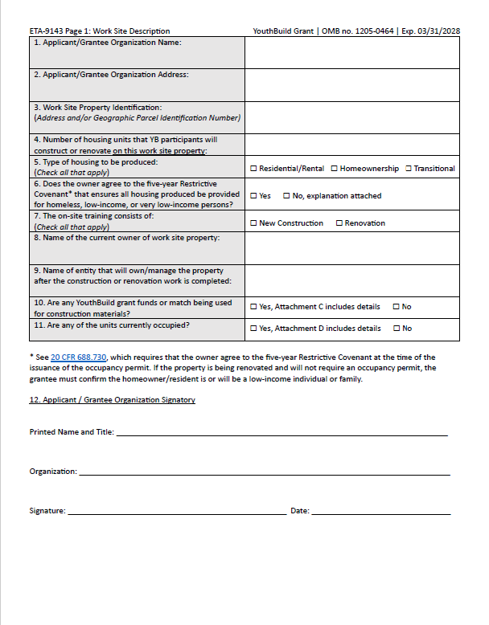
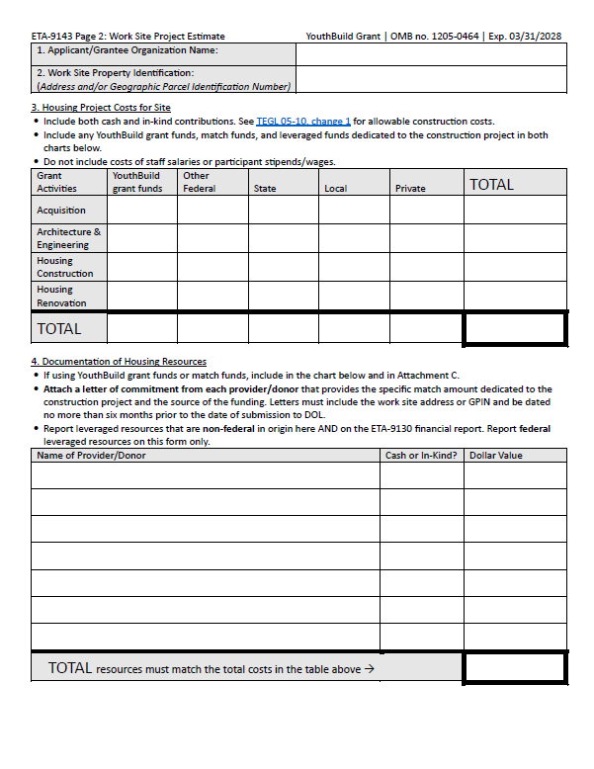
ETA-9143 Work Site Information Form
Link to ETA-9143 Work Site Information Fillable PDF Form
Notes:
Before I provide you with directions and tips on thorough completion, I would like to tell you about the importance of the ETA-9143. Participant training in the field of construction is a requirement for every DOL YouthBuild grant and this training must consist of substantive hands-on experience on a construction site. A core aspect of YouthBuild is that participants give back to their own communities by engaging in the construction of affordable housing for low-income, homeless, or transitionally housed community members.
The ETA-9143 documents that an applicant and/or grantee has access to a suitable work site where participants can receive all required construction training. Applicants for YouthBuild grants must include at least one completed ETA-9143 form with their application for funding. Applications submitted without at least one completed ETA-9143 will be screened out. Current grantees may use the ETA-9143 form to request additional or replacement work sites during the grant period of performance.
This is what the ETA-9143 looks like. The form is available in the format of a fillable PDF.

Slide 3
Avoid Common Mistakes
DOL must approve your work site before training begins.
Ensure that the Costs and Resources charts on page 2 are complete and the totals match.
Each resource listed in the chart must include the provider organization name, whether it is cash or in-kind, and the dollar value.
Attach a letter of commitment for each Provider/Donor listed in the Resources chart.
When using YouthBuild grant funds for work site construction (but not for stipends/wages paid to participants or trainers), include details in the program budget and Attachment C.
Notes:
The following is information to help you avoid making common mistakes when filling out the ETA-9143
DOL must approve your work site before training begins.
Ensure that the Costs and Resources charts on page 2 are complete and the totals match.
Each resource listed in the chart must include the provider organization name, whether it is cash or in-kind, and the dollar value.
Attach a letter of commitment for each Provider/Donor listed in the Resources chart.
When using YouthBuild grant funds for work site construction (but not for stipends/wages paid to participants or trainers), include details in the program budget and Attachment C.

Slide 4
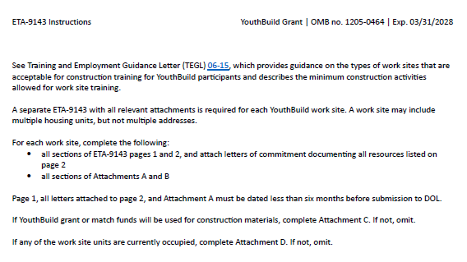

Instructions
Link to TEGL 06-15
Notes:
The ETA-9143 has built-in instructions that are mirrored throughout this webcast. You can always refer to both this recording, and these instructions on the cover page.

Slide 5












Let's go through it together!
Notes:
Note that errors in ETA-9143s for awardees are not marks against your program, but they will be returned for correction and resubmission.
Let’s go through it together!

Slide 6
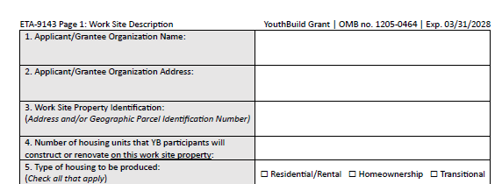

ETA-9143 Page 1: Work Site Description
Workforce of the Future--Waterbury
The Workforce of the Future—Waterbury, 1234 Main St., Waterbury, CT, 55555
1255 Pine St, Waterbury, CT 55555
1
Link to 20 CFR 688.730
Notes:
On ETA-9143 Pg. 1, you will begin the work site documentation process by responding to 11 brief prompts that help us understand the nature of your identified work site. There may only be one work site address given per 9143, but multiple 9143s may be submitted if you have additional work sites.
Often, 9143s are returned for correction only because addresses are missing or because 1-2 boxes are not filled in or checked. However, every box serves a purpose and, so, all are important to document. We cannot accept a form that has empty sections.
In Box 1, put the name of your organization that is either an applicant for DOL YouthBuild funding or a current grantee.
In Box 2, put the mailing address of your organization’s office or main building.
In Box 3, write the address of your work site. Please note that this is different from your organization’s address. Unincorporated land may be identified by geographic parcel identification number.
In Box 4, fill in the number of housing units that YouthBuild participants will work on at the given work site property address. There can only be one address per 9143 but there can be multiple units at one address. Please only include units in which your participants will do hands-on work and training, even if other units are under construction.
In Box 5, check the box for rental, homeownership, or transitional housing for formerly homeless individuals. For mixed use housing, check all boxes that apply.

Slide 7
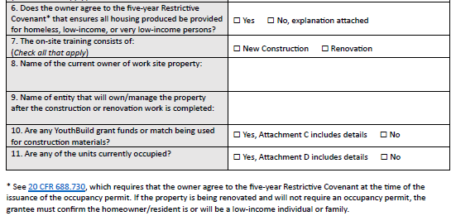
ETA-9143 Page 1: Work Site Description (cont.)
Nonprofit for Family Housing
Nonprofit for Family Housing
Link to 20 CFR 688.730
Notes:
Box 6 addresses the restrictive covenant. A restrictive covenant is a legal commitment that says a home or unit can be sold only to homeless or low-income individuals and families for at least 5 years. The property owner must agree to the restrictive covenant as work on affordable housing projects is a core element of YouthBuild.
In Box 7, check one or two boxes to indicate whether your on-site training will be a new construction project, a substantive renovation project, or both.
In Box 8, write the name of the current owner of the property. This may be that of your organization or a partner nonprofit, it could be for an individual homeowner, or even a commercial company if they formally agree to the restrictive covenant requirement.
In Box 9, write the name of the person or organization that will own the property after construction or renovation work is done even if the deed will soon change hands. This may be the same answer as Box 9.
In Box 10, check whether you are using YouthBuild grant funds or match funds for this work site. If you are using YouthBuild grant funds, you will need to complete and submit Attachment C.
In Box 11, check whether the units on the work site are occupied with residents. If at least one unit is occupied, you will need to complete and submit Attachment D.
We will discuss these attachments in detail further on.

Slide 8
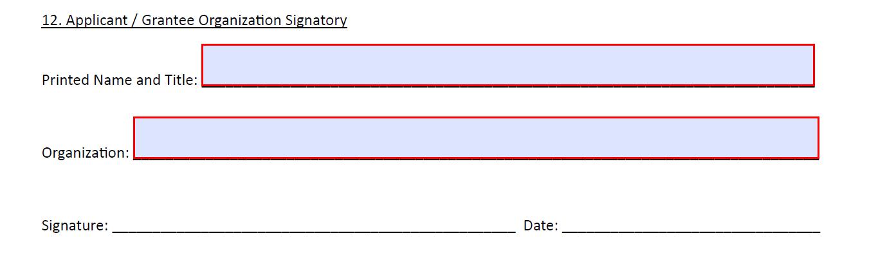

















ETA-9143 Page 1: Applicant/Grantee Organization Signatory
Shawn Fisher, Executive Director
Workforce of the Future--Waterbury
Shawn Fisher
8/23/23
Notes:
Prompts that seem repetitive like those for names, signatures, and dates are actually very important. To make this documentation official, we need a dated signature from an authorized representative.
The date must be within six months of submission to DOL. Handwritten or valid electronic signatures are acceptable.
Remember to include the professional title of the signee.

Slide 9















ETA-9143 Page 2: Heading
Workforce of the Future--Waterbury
1255 Pine St, Waterbury, CT 55555
Notes:
Complete headings are vital because they make sure the pieces of information on separate pages always stay together. These are often forgotten and will be returned for correction.

Slide 10
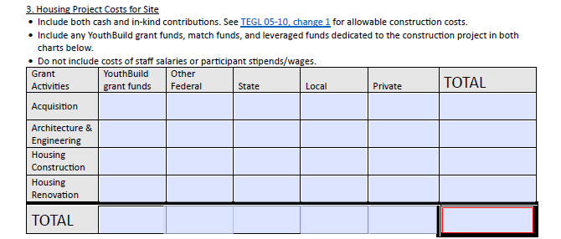
ETA-9143 Page 2: Housing Project Costs for Site
--
--
--
--
$125,000
$125,000
--
--
--
--
--
$0
$10,000
--
$15,000
--
--
$25,000
--
--
--
--
--
$0
$10,000
$0
$15,000
$0
$125,000
$150,000
Link to TEGL 05-10 Change 1
Notes:
This table documents the costs of your work site project, so you can then establish how those costs will be covered.
In this example, $10,000 of YouthBuild grant funds will be used for housing construction on this work site, which you can see in the first column here.
This example also has $15,000 of grant funding from their state being put towards the housing construction on the work site and $125,000 of private funding, maybe from their organization’s donations, a partner, another grant awarding body, and/or an individual philanthropist.
Note that you must total both rows and columns, as seen here. The totals for both rows and columns should be the same and written in the red box.

Slide 11
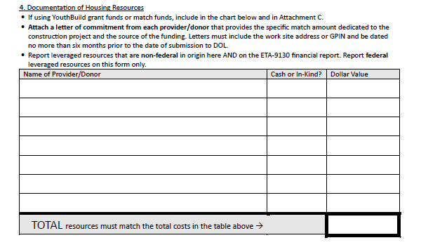
ETA-9143 Page 2: Documentation of Housing Resources
Nonprofit for Family Housing
In-Kind
$125,000
State of Connecticut Affordable Housing Grant
Cash
$15,000
YouthBuild Grant Funds
Cash
$10,000
$150,000
Notes:
In this table on the same page, you must demonstrate how the costs you just specified on the previous table will be covered.
There are two possible funding streams here: cash and in-kind. In-kind refers to the calculated monetary value of goods and services that will be exclusively committed to the work site. Examples are the provision of a house from a community housing nonprofit or volunteer hours worked by a community expert in a trade that the construction instructor will invite to teach a skill.
Add up the Dollar Value column and put the total in the highlighted box. The total dollar values of both cash and in-kind commitments should match the costs you entered in the previous table. By writing the provider/donor name, you show the source of the funding you will use to meet your costs on this work site.
In this example, all commitments add up to $150,000. This $150,000 in resources demonstrates how they will meet their $150,000 in costs.

Slide 12
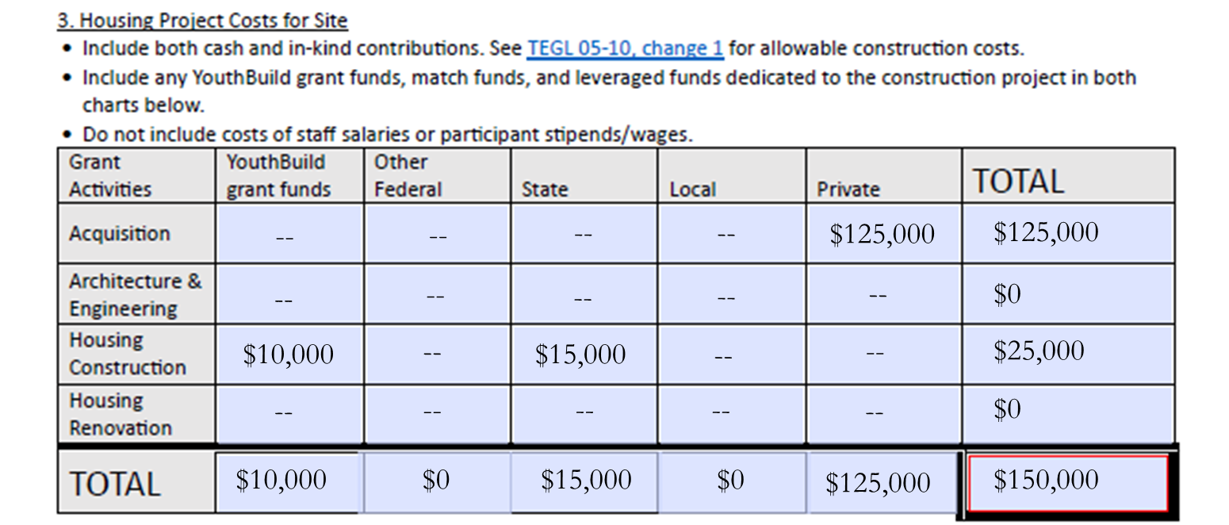

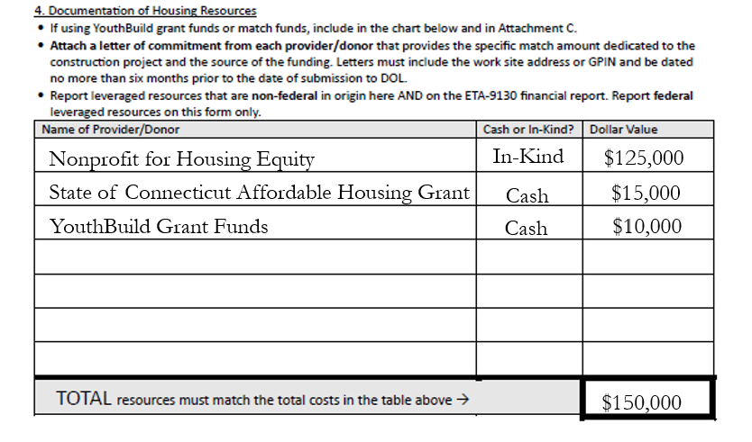

Reminder: Housing Project Costs and Resources Must Match
Family Housing
Notes:
Please remember that total costs and resources must match!

Slide 13

Documentation of Housing Resources Support Letter(s)
6/20/2023
Dear USDOL,
Nonprofit for Family Housing commits to providing a building at 1255 Pine Street, Waterbury, Connecticut 55555 for YouthBuild participants at Workforce of the Future-Waterbury to use as their program work site. The house on the property has been damaged in a storm and needs to be demolished and replaced with new construction. The acquisition value of this house is $125,000 in-kind.
As Vice President of Housing Services, I have the authority to make this decision.
Sincerely,
Carlos Borges
Vice President of Housing Services
Nonprofit for Family Housing
1299 Orange Street, Waterbury CT 55555
Nonprofit for Family Housing
In-Kind
$125,000
Carlos Borges
Notes:
To support Page 2, you need letters of commitment. These are simple letters from each of your funding sources that confirm that both the grantee and their funders understand exactly what will be given and received and have formally agreed on these commitments.
These can be short letters, but the following are the essential elements:
The letter should be on official letterhead
The letter must be dated.
The letter must be signed by the funder or someone within their organization that has the authority to sign on their behalf.
The letter must be explicit in the dollar value being committed to this work site address and your organization’s program specifically. For example, you could write, “Nonprofit for Family Housing” commits the work site at 1255 Pine Street in Waterbury, CT valued at $125,000 in-kind to the YouthBuild program at Workforce of the Future—Waterbury”
If funds internal to the grantee are being documented as resources, you still must include a brief letter demonstrating the commitment to set those resources aside for this work site signed by someone authorized to make that decision.
The only resource type that does not require a letter of commitment is DOL YouthBuild grant funds. All other resources must be documented with a letter of commitment.

Slide 14
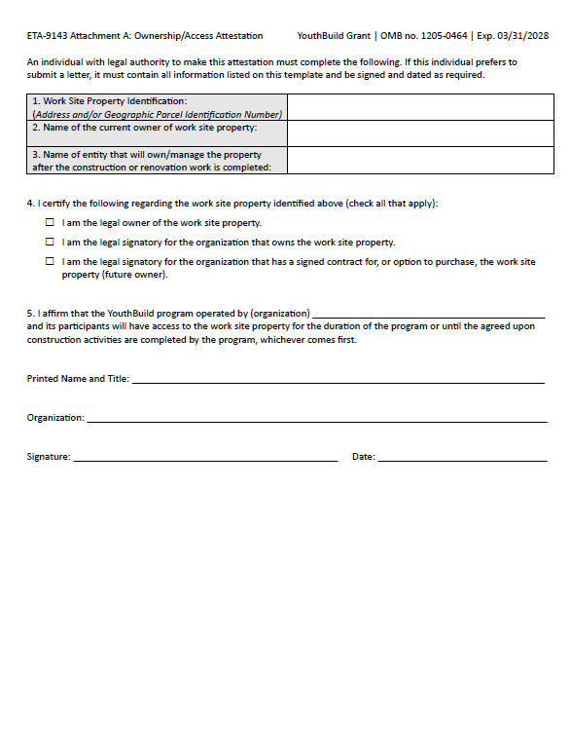
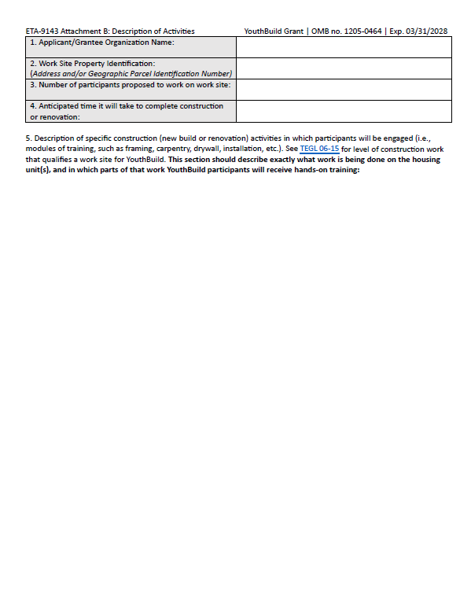
Attachments A and B
Notes:
The ETA-9143 has 4 possible attachments. Attachments A and B are required for ALL CONSTRUCTION WORK SITES.

Slide 15
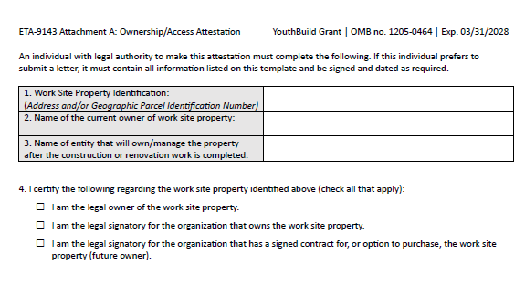
ETA-9143 Attachment A: Ownership
1255 Pine St, Waterbury, CT 55555
Nonprofit for Family Housing
Nonprofit for Family Housing
Notes:
Attachment A establishes ownership of the home.
In Box 1, make sure you give your work site address again, not your program address.
In Box 2, the name of the current owner must match that given on Pg. 1.
In Box 3, the name of the entity that will own/manage the property after the work is complete may be a new owner, or it may be retained by the original owner for future sale or rent and must also match that given on Pg. 1.
In Part 4, please check all that apply.

Slide 16
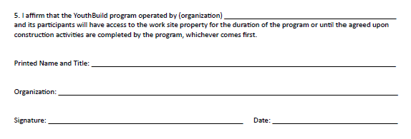
ETA-9143 Attachment A: Access Attestation
Workforce of the Future--Waterbury
Carlos Borges, Vice President of Housing Services
Nonprofit for Family Housing
Carlos Borges
6/20/2023
Notes:
Again, do not leave any boxes for names, signatures, or dates empty. This is very easily overlooked.

Slide 17
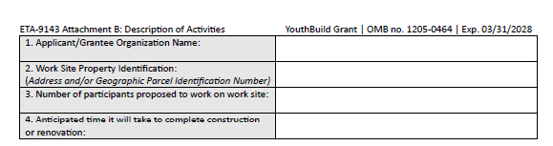












ETA-9143 Attachment B: Description of Activities
Workforce of the Future--Waterbury
1255 Pine St, Waterbury, CT 55555
20
1 year
Notes:
Attachment B describes the hands-on construction training that YouthBuild participants will receive on the work site.
Do not leave boxes 3 or 4 blank. These numbers only need to be estimates. They may be adjusted as long as you will still meet all grant requirements before the end of your period of performance. If you have not done a similar project before, make your best guess based on location and resources. These estimates must be written as numbers and not in general descriptions such as “some time this year”.

Slide 18
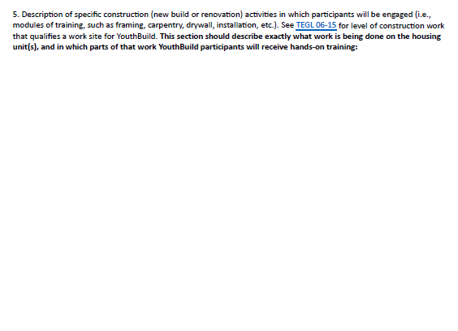
ETA-9143 Attachment B: Description of Construction Modules of Training
Every participant will be engaged in brick masonry, carpentry, painting, and plumbing. This will be done on a rotational basis so that every student gets substantive instruction and hands-on learning experiences in each of these construction modules.
Participants will frame a house together using hand tools and lumber under the supervision of our master carpenter instructor.
Participants will create a brick façade for the house by learning to mix cement and to lay bricks using their math skills on measurements commonly used in masonry.
Participants will get to compare the experiences of indoor and outdoor painting by painting the brick they laid and by taping and using various painting brushes and rollers in the interior.
Participants will install plumbing for sinks, toilets, and showers. They will also install a sump pump in case of unprecedented river swell.
Only participants over 18 years of age will work on roofing with proper PPE. This is a program policy that aligns with federal and state law.
Link to TEGL 06-15
Notes:
When you write the description of activities, Training and Employment Guidance Letter (TEGL) number 6-15 will be an important guide. This guidance instructs that participants must complete 2 or more modules within 2 or more construction skill areas. Qualifying modules include brick masonry, carpentry, painting, or plumbing, just to name a few.
While it may be allowable for programs to also provide more general rehabilitation work, such as deconstruction, landscaping, screen repair, fence building, gutting etc., none of these activities qualifies without also including experience in two or more modules within two or more skill areas. (TEGL 6-15).
You should only include work site activities that YouthBuild participants will work on directly, and not the work of supervisors or instructors.

Slide 19
YouthBuild Construction Training and Age Restrictions on Activity
The Fair Labor Standards Act (FLSA) restricts 16- and 17-year-olds from various work tasks, including using certain power tools and performing work on or about a roof.
For the FLSA to apply, there must be an employment relationship between an "employer" and an "employee."
Where a state child labor law is less restrictive than the federal law, the federal law applies. Where a state child labor law is more restrictive than the federal law, the state law applies.
For more details, check out this page on YouthRules.gov.
If you have questions, check out the FLSA Advisor.
Notes:
Please check state labor law to identify any restrictions that might limit activity by age. An example in federal law is the Fair Labor Standards Act, or FLSA, that restricts youth under 18 from work on roofing projects and the use of heavy machinery. Such activities are still allowable for older youth as long as age restrictions are documented in your written YouthBuild program policy and procedures, and they are strictly upheld.

Slide 20

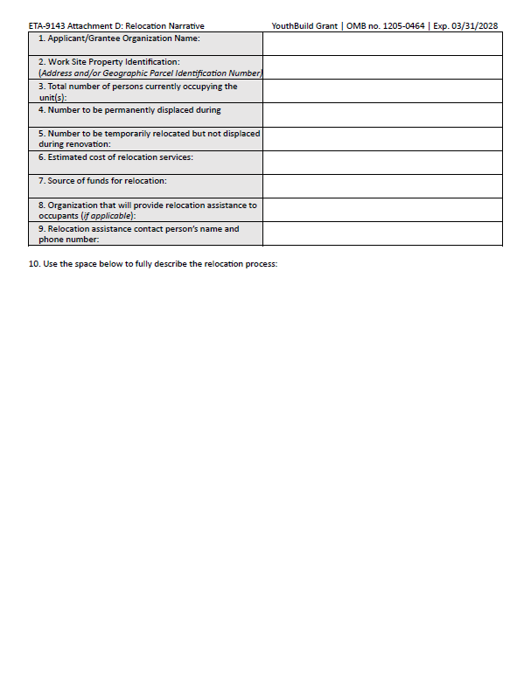
Attachments C and D
Notes:
Attachments C and D are only required in certain circumstances.
Attachment C is required only if YouthBuild grant funds will be used towards construction or renovation activities.
Attachment D is required only if occupants of a housing unit on your work site will need to be temporarily or permanently relocated because of the construction or renovation activities.

Slide 21
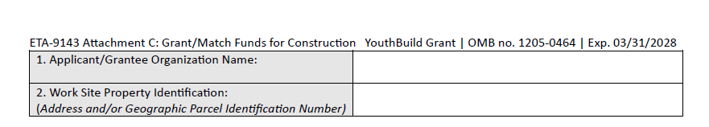














ETA-9143 Attachment C: Heading
Workforce of the Future--Waterbury
1255 Pine St, Waterbury, CT 55555
Notes:
Attachment C starts with another heading that includes your organization’s name and the address of the work site.

Slide 22
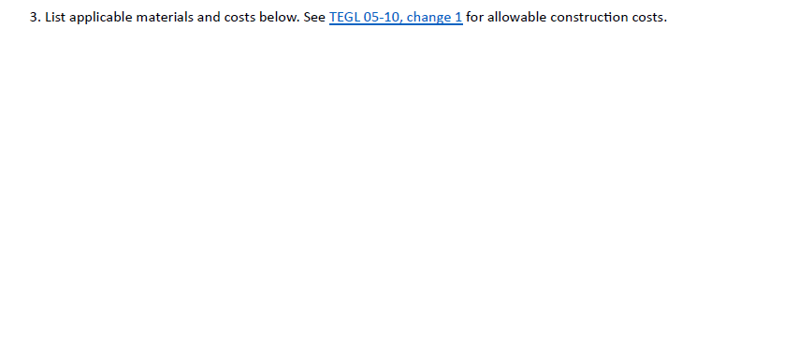
ETA-9143 Attachment C: Grant/Match Funds for Construction
We will purchase a portion of applicable materials with $10,000.00 in YouthBuild grant funds.
This will include:
8 Vinyl Double-Hung Windows at $500.00 a window for a total of $4,000.00
1 Hot Water Tank for $2,000.00
1 Stationary AC unit for $2,000.00
2,000 bricks at $1.00 per brick for a total of $2,000.00
Total: $10,000.00
Link to TEGL 05-10 Change 1 YouthBuild Selected Cost Items Attachment
Link to TEGL 05-10 Change 1
Notes:
It is essential that you review TEGL 05-10 Change 1 and its cost item attachment to determine what is an allowable construction cost when using grant or match funding. The attachment clearly shows whether applicable items are Allowable, Unallowable, or Allowable with certain conditions. The conditions are determined by the Grant Officer if necessary. Attachment C Part 3 must include a list of the specific items being purchased, their price per unit, and the total cost for each item based on the quantity to be purchased. These costs should be equivalent to the amount of YouthBuild grant funding you indicated earlier in the 9143 under costs and resources.

Slide 23
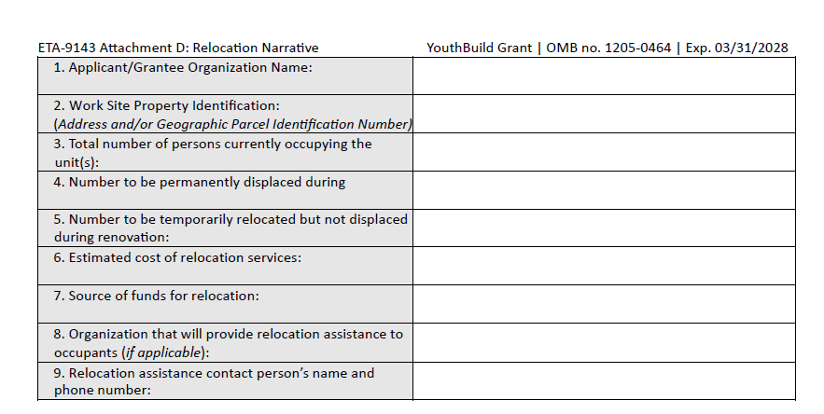
ETA-9143 Attachment D: Relocation Narrative
YouthBuild Catonsville
1277 High St, Catonsville, MD 55555
6
renovation:
0
6
$11,000
The Nonprofit for Safe Housing
The Nonprofit for Safe Housing
Jieun Suh, 203-555-5555
Notes:
Attachment D asks for details of the relocation process if a person or persons are currently occupying any of the units your participants work on. You must give the cost of any relocation service, the source of the funds that will be used to meet that cost, and organization, name, and contact information for the person(s) leading the relocation assistance efforts.

Slide 24
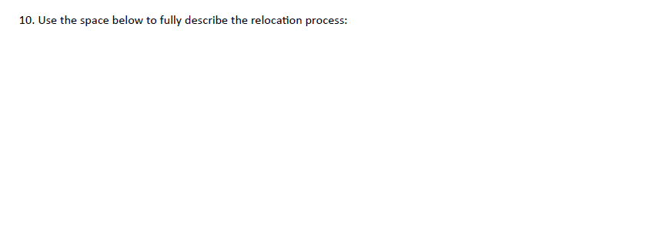
ETA-9143 Attachment D: Relocation Description
One of the core services provided by our partner, The Nonprofit for Safe Housing, is temporary relocation in pursuit of their mission to make the homes of low-income families safe and accessible when they have fallen into disrepair. Their relocation services officer, Jieun Suh, will find temporary space in 2 short-term rental apartments for both families in the same school district. The apartments will have basic furnishings and will be located on the same bus route that both families utilize. The estimated cost of the relocation service to house both families is $11,000.00. The Nonprofit for Safe Housing will incur the $11,000 cost. YouthBuild Catonsville will not have any financial obligation in relocation.
Notes:
In Box 10 of Attachment D, you should write a narrative on the full process of relocation including the involvement of the organization that will provide relocation assistance.

Slide 25
ETA-9143 Submission
Your first ETA-9143 will be included in your grant application.
Additional or substitute work sites should be sent for approval by attaching an ETA-9143 form for each site in an email to your Federal Project Officer. Include a cover letter that clearly states your request, and why you are requesting a work site change.
Notes:
Your first ETA-9143 will be included in your grant application.
Additional or substitute work sites should be sent for approval by attaching an ETA-9143 form for each site in an email to your Federal Project Officer. Include a cover letter that clearly states your request, and why you are requesting a work site change.

Slide 26


Have I Checked All the Boxes Before Submission?
Page 1 Signature
Page 2 Signature
Attachment A
Attachment B
Resource letters
Every box completed on Pages 1 and 2, Attachments A and B,
and C and D, if applicable
If Yes to Pg 1 Box 10, then Attachment C
If Yes to Pg 1 Box 11, then Attachment D
Notes:
For awardees, incomplete or unsatisfactory items will be returned. To minimize time and effort on addressing corrections, please check your work.

Slide 27

Applicable Guidance
TEGL No. 05-10, change 1
TEGL No. 06-15
20 CFR 688.730 What requirements apply to YouthBuild housing?
Notes:
All DOL guidance cited in this presentation is also linked here for convenience.

Slide 28







Contact Information
DOL YouthBuild
Employment and Training Administration
U.S. Department of Labor
youth.build@dol.gov
DEPARTMENT OF LABOR
Notes:
Thank you for watching this webcast!

