Slide 1

YouthBuild Grantee Performance Management System (GPMS)
Data Entry Video Series
Credential Attainment
Notes:
Welcome to this YouthBuild GPMS training video, where you will learn the basics about the Credential Attainment WIOA performance indicator and related GPMS performance reporting.

Slide 2
For more information and resources related to YouthBuild performance reporting, see the guidance listed on the WorkforceGPS resource page for this video.
Notes:
On-slide text: For more information and resources related to YouthBuild performance reporting, see the guidance listed on the WorkforceGPS resource page for this video.

Slide 3
Credential Attainment
Notes:
Let’s begin.

Slide 4
Credential Attainment
Definition
  The percentage of program participants who attain a recognized postsecondary credential or a secondary school diploma (or its recognized equivalent) during participation in or within one year after exiting from the program.
Notes:
The Credential Attainment performance indicator counts participants who attain a recognized postsecondary credential or a secondary school diploma (or its recognized equivalent) during participation in or within one year after exiting from the program.

Slide 5
Credential Attainment
Secondary School Diplomas and Equivalencies
  Program participants who attain a secondary school diploma or its recognized equivalent shall be included in the percentage (numerator) only if such participants are also placed within one year after exiting from the program.
Notes:
While this performance indicator includes participants who attain a recognized postsecondary credential and high school diplomas or equivalencies, participants who only attain a secondary school diploma or its recognized equivalent shall be included in the percentage (numerator) only if such participants are also placed within one year after exiting from the program.

Slide 6
Credential Attainment
Additional Guidance
Awarded in recognition of an individual’s attainment of measurable technical or occupational skills necessary to gain employment or advance within an occupation.
Technical/occupational skills are based on standards developed/endorsed by employers.
Certificates awarded by workforce development boards and work readiness certificates are not included.
Notes:
When determining attainments that count towards this measure, it is important to follow these important guidance points:
Awarded in recognition of an individual’s attainment of measurable technical or occupational skills necessary to gain employment or advance within an occupation.
Technical/occupational skills are based on standards developed/endorsed by employers.
Certificates awarded by workforce development boards and work readiness certificates are not included or counted.

Slide 7
Credential Attainment
Participant Scenarios
Notes:
Now let’s review an individual participant’s performance calendar and demonstrate credential attainment scenarios and how they are represented in performance reports.

Slide 8
Credential Attainment
Participant Performance Calendar
Calendar Year 2024 |  |  |  | Calendar Year 2025
Jan-Mar | Apr-Jun | Jul-Sep | Oct-Dec | Jan-Mar | Apr-Jun | Jul-Sep | Oct-Dec
Active |  |  | Exit-Q | Q1 Follow-up | Q2 Follow-up | Q3 Follow-up | Q4 Follow-up
Enrolled
Exit
NCCER
CNA
Notes:
In this timeline you will see the calendar year at the top and the participant timeline, including the active period through follow-up, at the bottom. In this scenario the participant enrolled in February of 2024 and exited in October of the same year. The participant attained an NCCER certification in July and a nursing CNA in January. Both of these certifications would count positively for this measure as they are recognized certifications that were attained while the participant was active or within one year after exit.

Slide 9
Credential Attainment
Participant Performance Calendar
Calendar Year 2024 |  |  |  | Calendar Year 2025
Jan-Mar | Apr-Jun | Jul-Sep | Oct-Dec | Jan-Mar | Apr-Jun | Jul-Sep | Oct-Dec
Active |  |  | Exit-Q | Q1 Follow-up | Q2 Follow-up | Q3 Follow-up | Q4 Follow-up
Enrolled
Exit
HSE
Job
Notes:
In this scenario the participant enrolls and exits in the same months and attains ahigh school equivalency while active and is placed in employment in quarter 3 of the follow-up period. This equivalency will count positively for the credential attainment indicator because the participant was placed within the follow-up period.

Slide 10
Credential Attainment
Participant Performance Calendar
Calendar Year 2024 |  |  |  | Calendar Year 2025
Jan-Mar | Apr-Jun | Jul-Sep | Oct-Dec | Jan-Mar | Apr-Jun | Jul-Sep | Oct-Dec
Active |  |  | Exit-Q | Q1 Follow-up | Q2 Follow-up | Q3 Follow-up | Q4 Follow-up
Enrolled
Exit
HSE
Job
Notes:
(scenario continued) In this same scenario, if the participant is not placed (placement graphic will disappear), the equivalency would not count positively for the credential attainment indicator.

Slide 11
Credential Attainment
Participant Performance Calendar
Calendar Year 2024 |  |  |  | Calendar Year 2025
Jan-Mar | Apr-Jun | Jul-Sep | Oct-Dec | Jan-Mar | Apr-Jun | Jul-Sep | Oct-Dec
Active |  |  | Exit-Q | Q1 Follow-up | Q2 Follow-up | Q3 Follow-up | Q4 Follow-up
Enrolled
Exit
HSE
CNA
Notes:
Finally, if a participant attains both a recognized credential and an equivalency or diploma, the participant would count positively for this performance indicator based on the credential attainment alone; with or without the placement.

Slide 12
Credential Attainment
Report Data

Slide 13
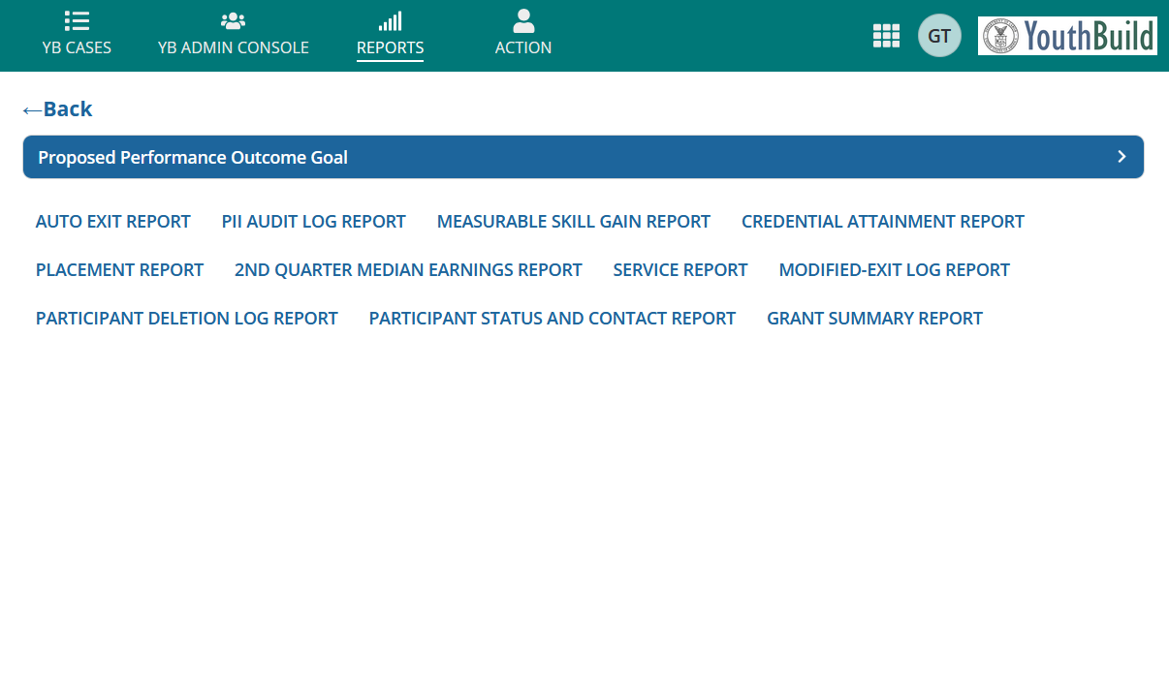

Notes:
In the GPMS there are many user reports which allow you to see outcomes in real time using GPMS data. For this example, we will use the Credential Attainment report.

Slide 14
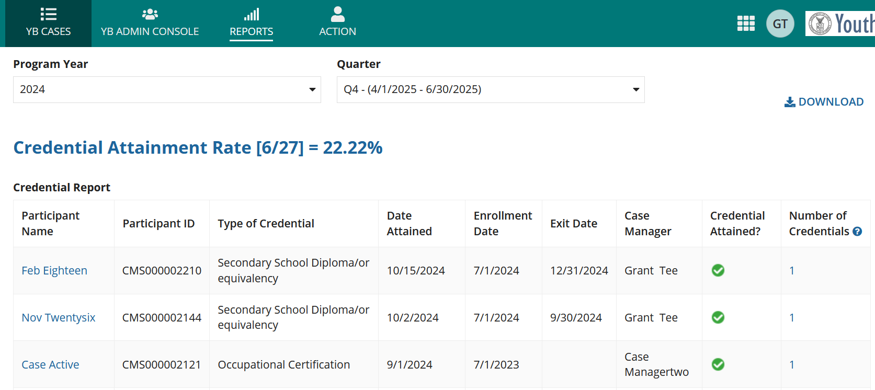
Credential Attainment
User Report
Notes:
We suggest starting by selecting the current program year. This will give you results for all participants that were enrolled from the beginning of the grant through the quarter-end date. After those selections are made you will see your participant data organized below.
To be clear as soon as your participants are enrolled, they will appear in this report, even if they are listed as active.

Slide 15
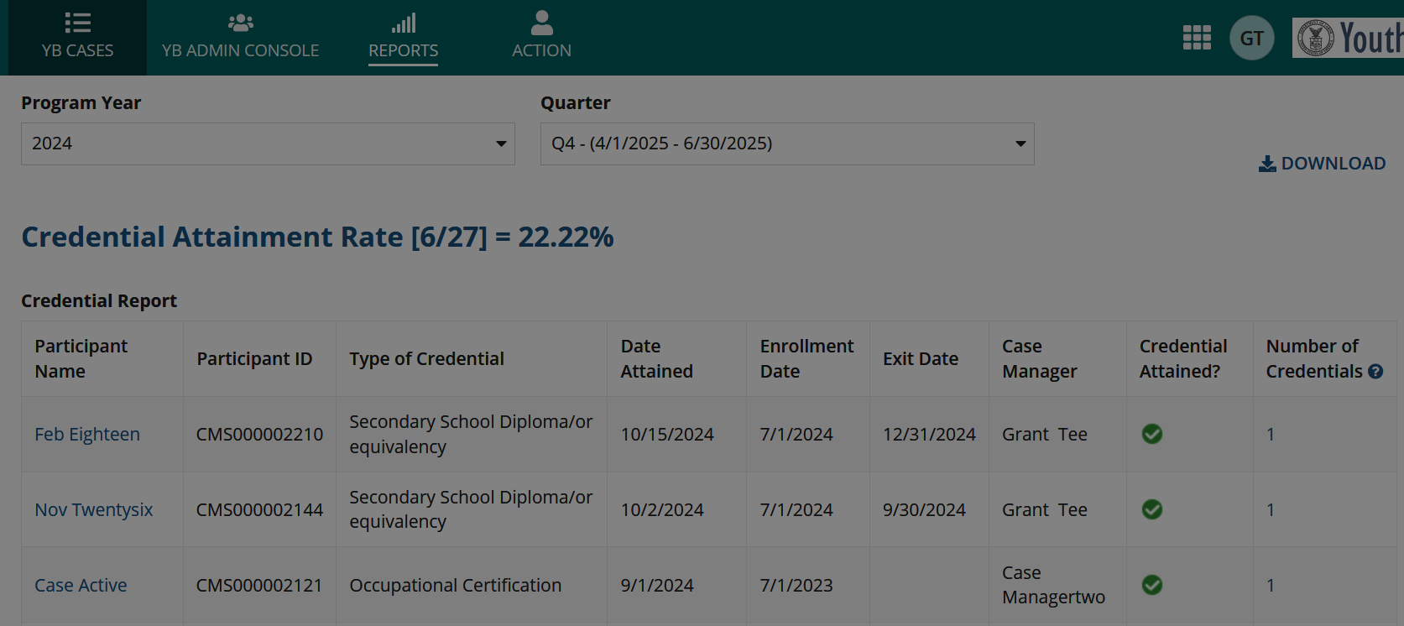
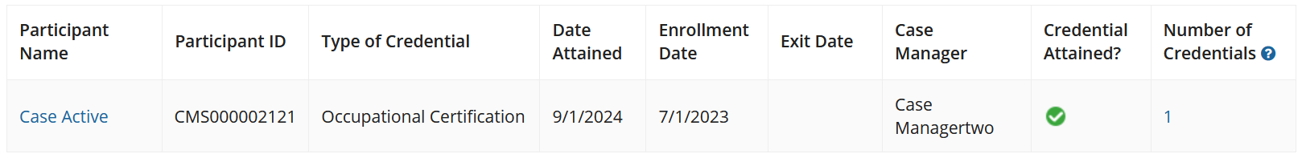
Credential Attainment
User Report
Notes:
Each line of the report will show a participant’s information related to attained credentials and if they will count positively for the credential attainment performance indicator. Here we see one for an occupational certification.

Slide 16
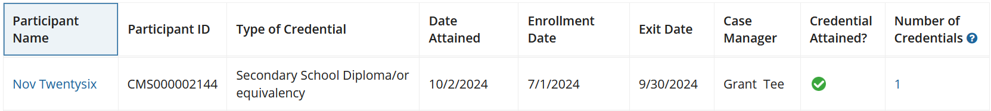
Credential Attainment
User Report
Notes:
In this example we are seeing a high school diploma or equivalency attainment. Remember, in this scenario this attainment will only show a green check, that the attainment counts positively, if they are also placed in their follow-up period. This is because of the placement requirement for high school diploma and equivalency attainments.

Slide 17
Credential Attainment
User Report
Notes:
In this example, the credential attainment rate demonstrates that 27 participants were enrolled and 6 of those participants attained a recognized credential while active or within one year after exit.

Slide 18
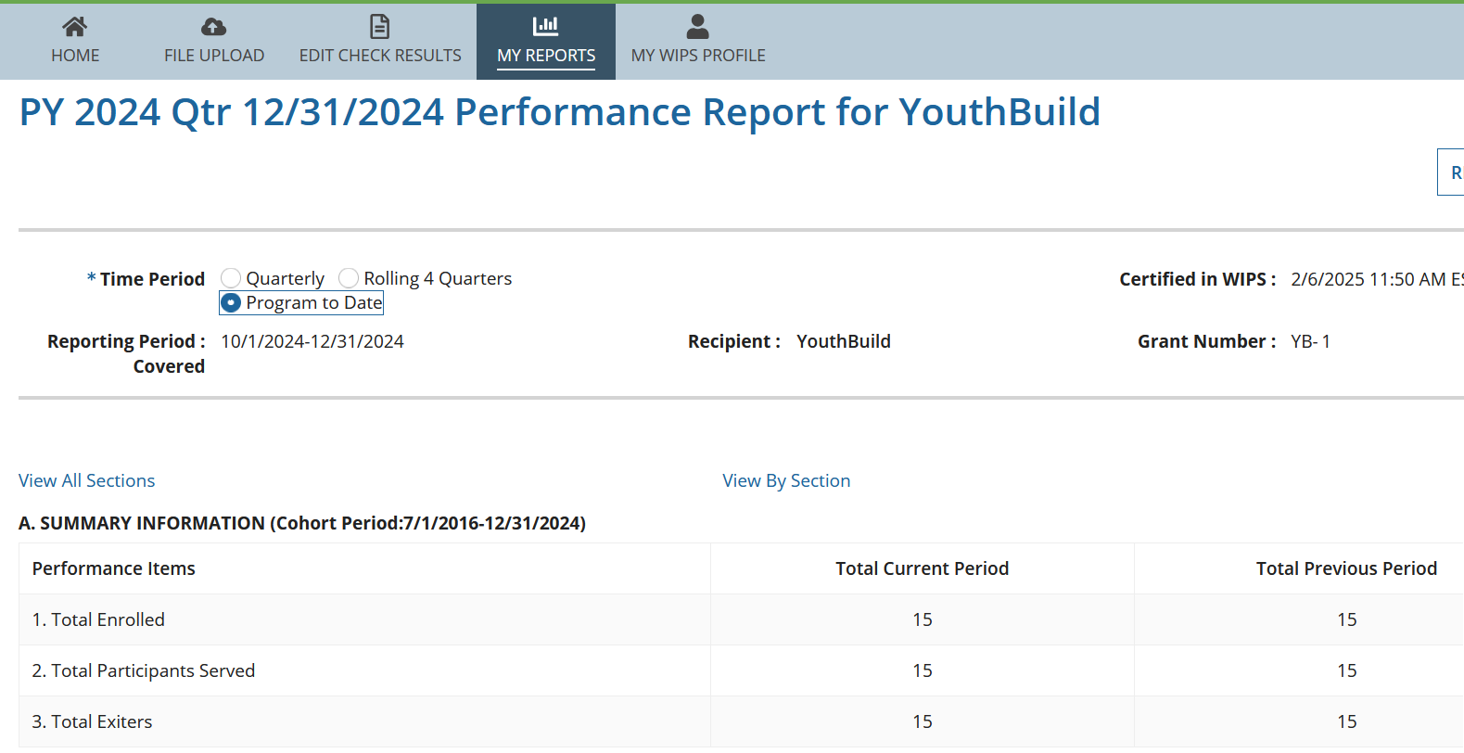
Credential Attainment
WIPS Quarterly Performance Report
Notes:
Now let’s review credential attainment in the WIPS quarterly performance report or QPR for the same program year.
In the WIPS QPR we see that the report is in the program to date view and that the reporting period ends in December of 2024. We suggest looking at the program to date view of the report so that the report includes all data from the beginning of the grant through the report quarter end date.

Slide 19

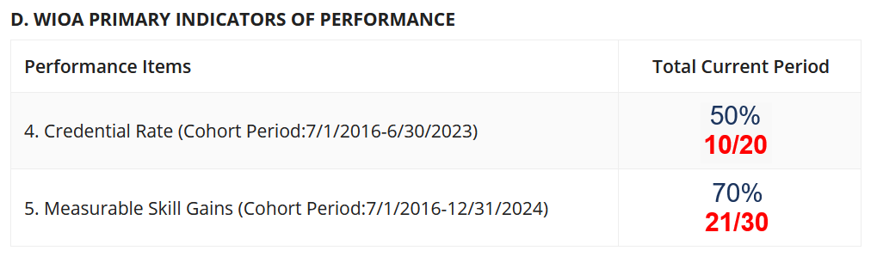
Credential Attainment
Section D: WIPS Quarterly Performance Report
Notes:
The credential rate line can be found in section D. Remember to click the show numerator/denominator link at the top of section D so that you can view the fraction.

Slide 20
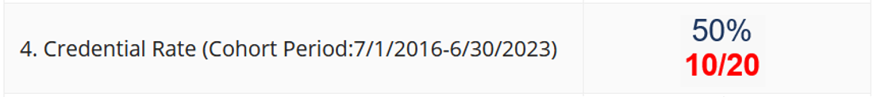
Credential Attainment
Section D: WIPS Quarterly Performance Report
Notes:
To understand the performance data included in sections D and E users must understand the cohort period listed next to each performance indicator. The cohort period indicates which participants will be included in each measure or line of the report. The cohort period for the credential rate, in the program to date view of the QPR, indicates that all participants that have exited by the end of the cohort period will be included.

Slide 21
WIPS Quarterly Performance Report
Cohort Period
Notes:
If we compare the reporting quarter we generated the QPR for, ending in December of 2024, and the end of the cohort period, ending in June of 2023, we can see that participants need to have exited six quarters before the reporting quarter to be included in this line of the QPR.

Slide 22
WIPS Quarterly Performance Report
Cohort Period and 2-Quarter Performance Delay
  There is a 2-quarter performance delay for all performance indicators in sections D and E except Measurable Skill Gains.
  This delay allows for UI wage match data to be added to your reports.
  Although the credential attainment rate does not incorporate UI wage match data, there is a 2-quarter performance delay to be in line with other performance indicators.
Notes:
To be clear, there is a 2-quarter performance delay for all performance indicators in sections D and E of WIPS QPR except for Measurable Skill gains. While credential attainment is counted through a year from exit this 2-quarter delay means that participants will not be included in this line of the QPR until they have exited and have made it to 6 quarters after exit.
This delay allows for UI wage match data to be added to your reports. Although the credential attainment rate does not incorporate UI wage match data, there is a 2-quarter performance delay to be in line with other performance indicators.

Slide 23
Credential Attainment
Section D: WIPS Quarterly Performance Report
Notes:
In this example, this fraction demonstrates that 20 participants have exited within the cohort period and 10 of those participants have attained a recognized credential while enrolled or within one year from exit.

Slide 24
Thank you for viewing
this YouthBuild GPMS data entry video!
GPMSSupport@youthbuild.org
Notes:
Please reach out to GPMS Support if you have further questions about credential attainment.
Thank you for viewing this YouthBuild GPMS training video.

Slide 25
Thank you for viewing
this GPMS data entry video!
GPMSSupport@youthbuild.org

