Slide 1


Serving Youth with Psychiatric Disabilities
For Workforce Development Practitioners
Division of Youth Services
Employment and Training Administration
Office of Workforce Investment
U.S. Department of Labor

Slide 2

Learning Objectives
Understand psychiatric disabilities
Learn actionable steps for welcoming and accommodating youth with psychiatric disabilities
Highlight resources

Slide 3

Fast Facts
Up to 80% of children in foster care have significant mental health issues, compared to approximately 18-22% of children overall. (National Conference of State Legislatures)
8.9% of adolescents attempted suicide in 2018-2019 (CDC)
Over 36,000 youth are incarcerated in the United States, a drop of ~34% since 1997, but as many as 70% of today’s incarcerated youth have a diagnosable mental illness (DOJ, NIH)

Slide 4
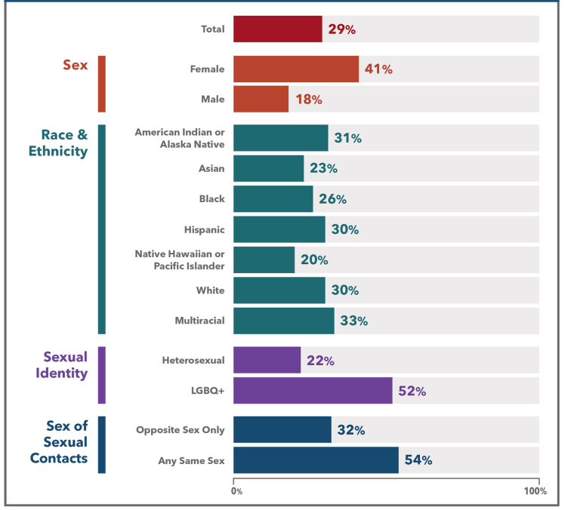
Percentage of High School Students Who Experienced Poor Mental Health During the Past 30 Days (2021)
CDC, 2021

Slide 5
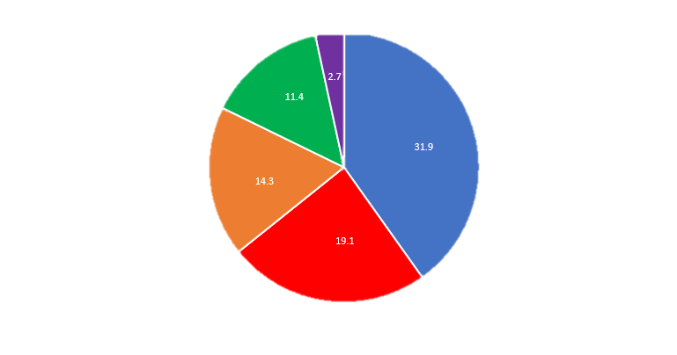
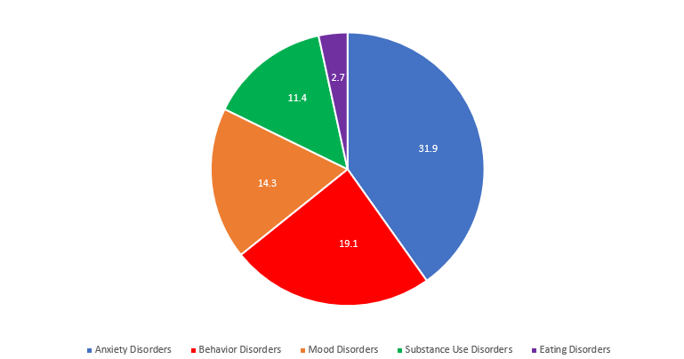
Prevalence of Various Disorders
The proportion of psychiatric illness types in all youth with diagnosed psychiatric disorders (2010):
Journal of the American Academy of Child and Adolescent Psychology

Slide 6


The Mental Health Continuum
Emotional Problems and Concerns
Mental Illness Severe Mental Illness
Well-being
Contentedness to manageable stress to occasional mild distress
No impairment
Mild to moderate distress
Mild or temporary impairment
Marked Distress
Moderate or
rapidly increasing impairment
Disabling chronic impairment
Extreme distress

Slide 7
Common Challenges Faced by Participants with Mental Health Conditions
Distrust in authority, including that of teachers and case managers, especially if youth voice is not centered in program design
Barriers to career advancement due to symptoms of psychiatric disability, or prejudice when a disability is disclosed
The stigma attached to mental health treatment or frank discussion of mental illness
Low self-esteem and self-worth

Slide 8
Signs of Potential Mental Illness
There are several indications that may signal potential mental health needs in youth and adults. One or two alone are not enough to indicate mental illness, but combinations of these behaviors coupled with problems getting along with family members or peers or doing well at school may indicate a need for further evaluation. Each illness has its own symptoms, but common signs of mental illness in adults and adolescents can include the following (NAMI):
Multiple physical ailments without obvious causes (such as headaches, stomach aches, vague and ongoing “aches and pains”)
Difficulty perceiving reality (delusions or hallucinations, in which a person experiences and senses things that don't exist in objective reality)
Inability to perceive changes in one’s own feelings, behavior or personality (”lack of insight” or anosognosia)
Changes in sex drive
Excessive worrying or fear
Feeling excessively sad or low
Confused thinking or problems concentrating and learning
Extreme mood changes, including uncontrollable “highs” or feelings of euphoria
Overuse of substances like alcohol or drugs

Slide 9
Signs of Potential Mental Illness (cont.)
Prolonged or strong feelings of irritability or anger
Avoiding friends and social activities
Difficulties understanding or relating to other people
Changes in sleeping habits or feeling tired and low energy
Thinking or about or romanticizing suicide
Inability to carry out daily activities or handle daily problems and stress
An intense fear of weight gain or concern with appearance
Changes in eating habits such as increased hunger or lack of appetite

Slide 10
Programmatic Cliffs
Typical Ages at Which Youth Services Terminate

Slide 11

Needs Assessment
Individual needs to assess, document, and address at intake and throughout active service
Psychological
Medical
Cognitive abilities, behavioral, social, and emotional behaviors and skills
Physical and functional capacities and useful accessibility tools
Vocational
Educational
Occupation and career interests, worksite accommodations, job
aptitudes and skills
Accommodations to support academic performance or achievement

Slide 12

How Can I Best Support Youth with Disabilities?
Involve all youth in program and policy development, integrate knowledge from lived experience
Train all program staff to individualize program activities when possible - meet youth “where they are”
Train all youth in skills needed for self-reliance - communicating own goals and needs, finding resources
Assist youth in articulating on-the-job needs to employers and obtain accommodations (JAN)
Build and sustain partnerships with service providers
Family Involvement

Slide 13
What are examples of supports a participant with a psychiatric disability might need?
  Graduated opportunities to gain and practice their work skills
  Excellent supervision on the job
  Employed peers and role models with lived experience
  Stress management skills to cope with the pressures of work
  Workplace supports and accommodations
  Additional time on exams due to concentration, executive function, and memory symptoms

Slide 14

How do I avoid stigma?
Personalized approach that fosters trust
“Anywhere, anytime” treatment – integrate counseling into daily activities
Honest discussions, not file reading -- allow youth to initiate self-exploration; goal setting; and voice concerns
On-site social worker or experienced case manager to serve as staff guide on language and inclusion

Slide 15

Recap
  Understanding benefits and services for which they will be eligible in adulthood
Discovering how they can communicate disability-related needs
  Learning how they can find, formally request, and secure supports and accommodations

Slide 16
Resources
JAN - Job Accommodation Network (askjan.org)
ODEP | U.S. Department of Labor (dol.gov)
Substance Abuse and Mental Health Services Administration (SAMHSA-HHS)
US DOL and The Office of the US Surgeon General on Supporting Youth Mental Health in the Workforce System
WorkforceGPS - Effective Case Management Webinar Series
WorkforceGPS - Implementing Effective, Inclusive, and Evidence-Based Substance Use Policies
WorkforceGPS - Introduction to Youth Suicide Prevention (Webcast)
WorkforceGPS - Mental Health Resources
WorkforceGPS - YouthBuild Program Information Webcast
Youth Employment: A Foundation for Mental Health and Well-Being | U.S. Department of Labor (dol.gov)

Slide 17

Credits
Original presentation by Laura Ibañez, ODEP, and Mindy Larson, IEL, for YouthBuild (2010)
Version 2.0 by YouthBuild National Office, A. Brenner LMSW (2023-24)

