Slide 1


Notes:
Thank you for your interest in the Department of Labor’s YouthBuild program.

Slide 2

Objectives
Requirements
Funding Opportunities
Additional Resources
Notes:
This webcast will cover basic program requirements and resources available to organizations interested in applying for a DOL YouthBuild grant.

Slide 3


What is YouthBuild?
Workforce Innovation and Opportunity Act (WIOA)
Pre-apprenticeship
  Aligned with local employer needs
  Supportive services for participants
  Career exploration
  Credential opportunities
  Partnership with registered apprenticeship programs
Employment and Training Administration (ETA)
Notes:
YouthBuild is a workforce development program that provides education, training, and leadership development opportunities to young people who face barriers to employment. The Workforce Innovation and Opportunity Act (WIOA) designates YouthBuild as a pre-apprenticeship model, which requires alignment with local employer needs, supportive services for participants, career exploration, credential opportunities, and partnership with one or more registered apprenticeship programs. YouthBuild is administered by the US Department of Labor’s (DOL) Employment and Training Administration (ETA).

Slide 4

Participant Eligibility
§ 688.300 Who is eligible to participate in YouthBuild?
  16-24 years old
  Left high school without a diploma
  One or more of the following:
Low-income family | Youth with a disability
Foster care youth | Child of an incarcerated parent
Court-involved youth | Migrant youth
Stock Image Designed by Vextok on FreePik
Notes:
YouthBuild participants must be between the ages of 16 and 24. Most participants left high school without a diploma and are either a member of a low-income family, a foster care youth, a court-involved youth, a youth with a disability, a child of an incarcerated parent, or a migrant youth. There are limited exceptions to these eligibility requirements.
<a href="https://www.freepik.com/free-vector/linear-flat-people-faces-professions-illustration_3330558.htm#query=consturction%20black%20man&position=7&from_view=search&track=ais">Image by vextok</a> on Freepik

Slide 5



Program Time
Workforce/Skills
Required: construction
Optional: other in-demand industries (Construction Plus)
Education
Diploma or
State-recognized equivalent
Leadership Development and Community Service
§ 688.350 How do YouthBuild participants spend their time in the program?
Notes:
Participants spend at least 50 percent of program time receiving education services that may lead to either a high school diploma or its State-recognized equivalent. They spend at least 40 percent of program time engaged in workforce and skills development activities. All DOL-funded YouthBuild programs must train participants in construction while they build or significantly renovate at least one unit of housing for homeless individuals or low-income families, or transitional housing for homeless individuals. Most programs also train participants in other in-demand industries such as healthcare, advanced manufacturing, or hospitality – this additional training is known as Construction Plus. Participants spend up to 10 percent of program time engaged in leadership development and community service activities.

Slide 6

Supportive Services
§ 681.570 What are supportive services for youth?
Notes:
Supportive services enable the youth to succeed in the classroom and the workforce by addressing barriers that may hinder educational and career progress. They include, but are not limited to: assistance with transportation, childcare, housing, supplies, and/or testing; needs-related payments; and reasonable accommodations for youth with disabilities.

Slide 7


Pre-Apprenticeship
§ 681.480 What is a pre-apprenticeship program?
DOL Office of Apprenticeship
  Youth Apprenticeship Readiness Grants
  Youth Apprenticeship Intermediaries
Notes:
YouthBuild has traditionally provided connections to apprenticeship opportunities in the building trades, and continues to strengthen connections to career pathways in other fields through training and partnerships in Construction Plus. YouthBuild aligns with initiatives from the DOL Office of Apprenticeship, including Youth Apprenticeship Readiness Grants (YARG), which support youth enrollment in registered apprenticeships with wraparound services, and Youth Apprenticeship Intermediaries (YAI), which work to engage underrepresented populations in YARG programs.

Slide 8


Grant Funding
§ 688.120 Who is eligible to apply for YouthBuild funding?
Grants.gov
  Subscribe to a saved search
ETA grants
Notes:
Eligible applicants for DOL YouthBuild grants include non-profit agencies or organizations. DOL publishes an annual Funding Opportunity Announcement (FOA) on grants.gov. While they vary each year, the most recently published FOA is a good resource to prepare for future opportunities. To receive the announcement, subscribe to a saved search for YouthBuild. More information about applying for grants is available on the ETA grants website.

Slide 9

Grant Timeline
Up to 4
months
24 months
12 months
PLANNING ACTIVE SERVICES FOLLOW-UP
§ 688.120 What are follow-up services?
Notes:
The period of performance for YouthBuild grants is 40 months: a planning period of up to 4 months; two years of active program services for one or more cohorts of youth; and 12 months of follow-up services and tracking of participant outcomes. Cohort schedules vary, but an eligible individual selected for participation in the program must be offered full-time participation in the program for not less than 6 months and not more than 24 months.

Slide 10

DOL Assessment
§ 688.400 What are the performance indicators for YouthBuild grants?
Notes:
Grantees submit required reports to DOL, including Quarterly Performance Reports that track progress on six WIOA performance indicators. Grantees report on participants’ placement in employment, education, and training; credential attainment; measurable skill gains; and earnings.

Slide 11

DOL Support
Notes:
Each grantee receives assistance from a DOL Federal Project Officer, and has the opportunity to attend regular events and training.
YouthBuild USA provides technical assistance (TA) to grantees through a five-year contract with DOL. YouthBuild USA is a 501(c)(3) non-profit that supports an affiliate network of programs. Separate from the DOL contract, YouthBuild USA provides training and TA, leadership development, funding for innovative program enhancements, and advocacy for their affiliate network programs.

Slide 12
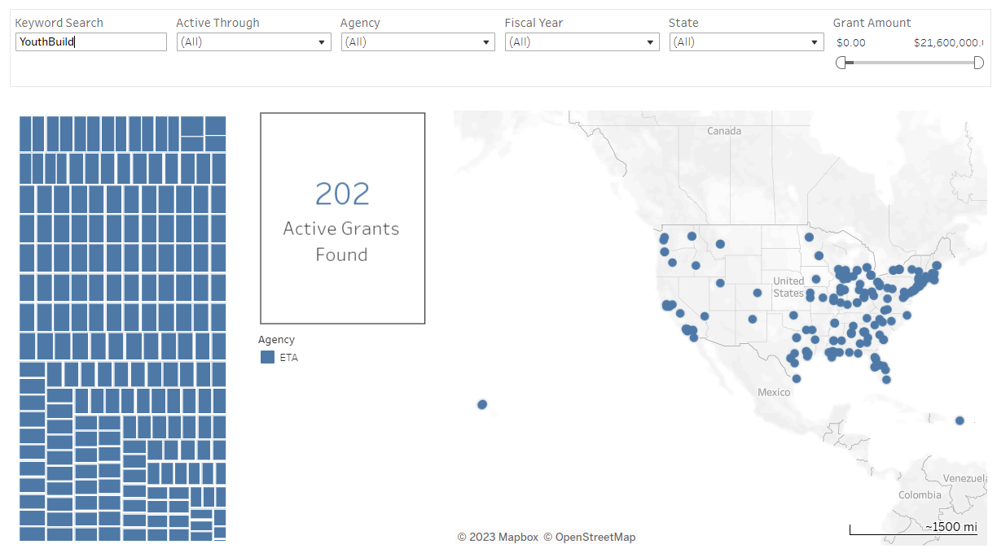

Active Grants
DOL YouthBuild website
dol.gov/grants
Keyboard: Stock Image Designed by rawpixel.com on Freepik
Notes:
At any given time, there are approximately 200 DOL-funded YouthBuild grants in operation throughout the country. This includes programs in all phases of the grant: planning, active services, and follow-up.
Details about active programs, including Construction Plus fields and contact information, are on the DOL YouthBuild website.
On dol.gov/grants, search for the keyword “YouthBuild” to see a map of currently active grants.
Keyboard: Image by rawpixel.com on Freepik

Slide 13


Resources and References
2018 Final Report from YouthBuild Evaluation
YouthBuild Community of Practice
Workforce Innovation and Opportunity Act of 2014 (WIOA)
YouthBuild regulations
Email additional questions to youth.build@dol.gov
Free Stock Vectors: Designed by macrovector on Freepik unless otherwise noted
Notes:
Download this presentation to access links throughout. This slide includes access to the final report from a comprehensive evaluation of YouthBuild that DOL commissioned, and the YouthBuild Community of Practice, a collection of resources for YouthBuild grantees. You can also access the law and regulations, and email additional questions to youth.build@dol.gov.
All free stock vectors designed by macrovector on Freepik

