Slide 1

Getting Started with Social Media, Part one
Webinar Date: April 19, 2015
2:30PM ET
Presenters: Division of Youth Services
U.S. Department of Labor
Employment and Training Administration

Slide 2
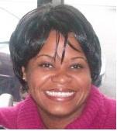
Moderator
Maisha Meminger
Division of Youth Services
U.S. Department of Labor
Employment and Training Administration

Slide 3
Objectives
Understand the role social media plays in your overall communication plan
Selecting the right channel
Creating content that gets attention
Developing your community
2

Slide 4
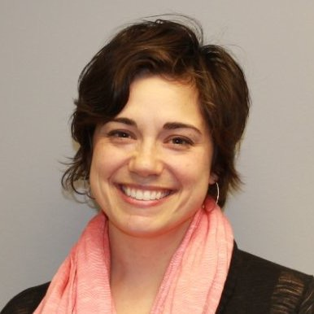
Subject Matter Expert
Elizabeth Vassolo
Director of Marketing and Communications, Women’s Business Development Center
@Liz_Vassolo

Slide 5

3

Slide 6
Did you know…
100 billion monthly users on
social media networks
4

Slide 7


Slide 8
2 things to know about Social Media
Social Media alone won’t save your communication efforts.
You are only as good as your content.
6

Slide 9

3 things to make your social sing!

Slide 10

Connect with your community

Slide 11

Hashtags
Use hashtags to organize your conversation or event and connect with more people.

Slide 12

Pay to Promote Your Post
* Talk to your FPO if you have questions about your budget or spending funds.

Slide 13

Pick a channel and really own it.

Slide 14
But Lizzzz… Which one do I pick??
Do some digging. Determine your audience and pay attention to what they are using.

Slide 15
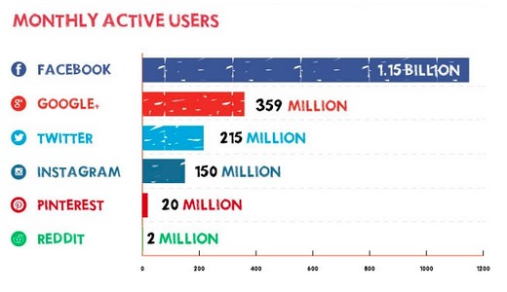
Social Media Users
Source: Kissmetrics.com

Slide 16

Facebook

Slide 17
Example

Slide 18

Twitter

Slide 19
Example

Slide 20

Instagram
18

Slide 21
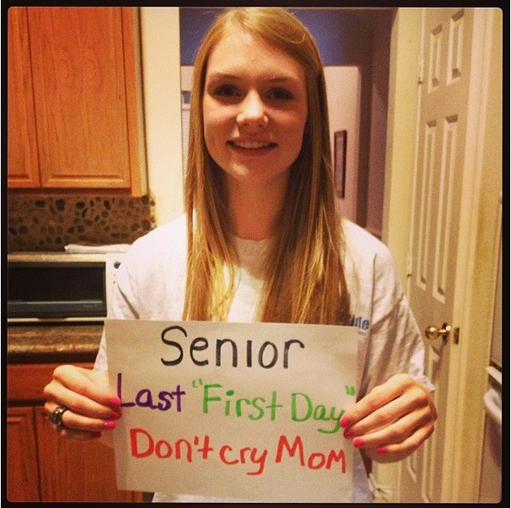
Example

Slide 22

LinkedIn

Slide 23
Example

Slide 24

Please enter your questions in the Chat Room!

Slide 25

CONTACT US
U.S. Department of Labor
Employment and Training Administration
200 Constitution Avenue, NW, Room N-4456
Washington, DC 20210
Email: ycc@dol.gov
24

Slide 26
Next training:
Social Media, Part 2
Tuesday, May 17th at 2:00pm ET
YCC National Grantee Conference
July 20-21, 2016

Slide 27
Thank you!

