Slide 1

Using Data to Manage Your YCC Program
Presentation at the YCC Grantee Convening
Washington, DC
July 21, 2016
Presented by:
Evan Rosenberg, U.S. Department of Labor (DOL)
Alicia Leonard, Mathematica Policy Research

Slide 2
Agenda
Topic | Presenter
Introduction | Evan Rosenberg (DOL)
Troubleshooting Quarterly Performance Report (QPR) data issues | Alicia Leonard (Mathematica)
Creating user-defined fields for grant management | Alicia Leonard Julie Anderson (NE Iowa Career Learning Link)
Additional Excel resources | Alicia Leonard
Questions and answers | Alicia and Evan

Slide 3
Importance of Performance and Reporting System
To provide program operators and frontline staff with information for decision making and continuous improvement
To provide DOL with information to ensure program accountability, assist in identifying technical assistance needs, and aid evaluation
To demonstrate program success to stakeholders (for example, the community or Congress)

Slide 4
Importance of QPR Analysis
Critical for Project Directors to analyze QPRs on a quarterly basis (for both entire grant and by school) in order to track grant progress and identify potential issues
Areas to focus on in Section B:
  Numbers enrolled should be close to or exceed yearly goal
  Number receiving services should match (or be close to) number enrolled
  Number exited should be relatively low
Areas to focus on in Section D:
  Ensure all program services are reflected in various categories and good mix of services provided
Areas to focus on in Section E:
  Industry-recognized credentials are reflected in credential count

Slide 5
Importance of QPR Analysis
Areas to focus on in Section F:
  Enrollment Rate is close to or above 100%
  Attendance Rate accurately reflects attendance and at or above 90%
  Chronic Absence Rate accurately reflects attendance and at or below 10%
  Mentoring Rate accurate and meeting goal
  Yearly Retention accurate and meeting goal
  Internship Placement and Completion accurate and meeting goals
  Post-Secondary measures accurate and meeting goals
Areas to focus on in Section G:
  Probably too early to focus on long-term measures; begin to focus on once first cohort completes the program

Slide 6
Session Examples Will Use a Fictional Grantee
The grant manager is preparing to submit the QPR for 2016 Q2 (ending June 30, 2016).
A relatively small number of students (six) have enrolled, and none have exited.
YCC focuses on internships, and four students completed internships this year.

Slide 7
QPR Troubleshooting:
Example #1

Slide 8
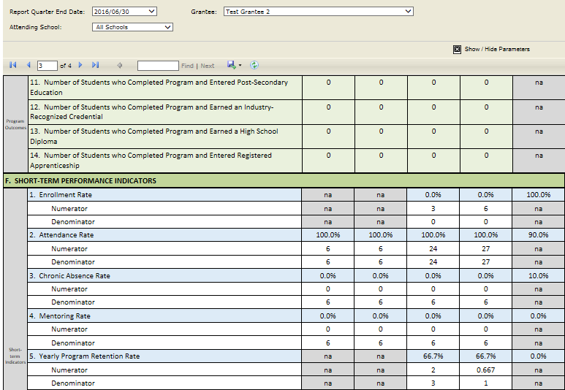
Review of Draft QPR
The Yearly Program Retention Rate calculation appears incorrect:

Slide 9
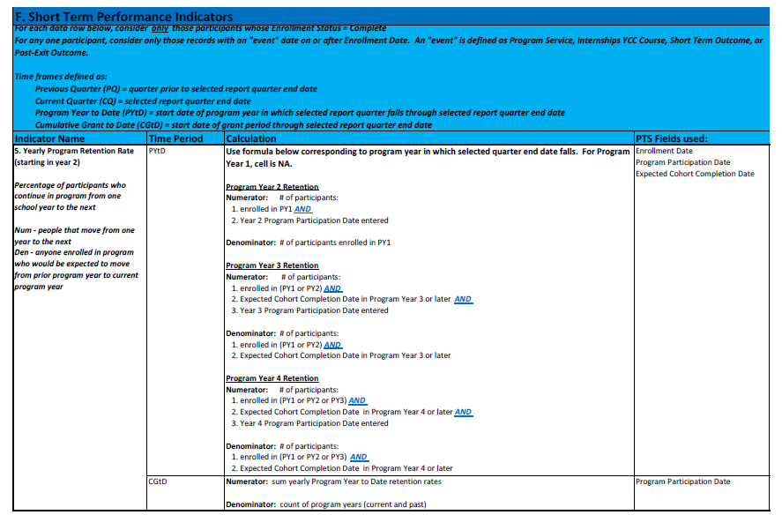
Step 1: Review QPR Calculations
Calculations are available in Appendix C of the latest version of the PTS Manual

Slide 10
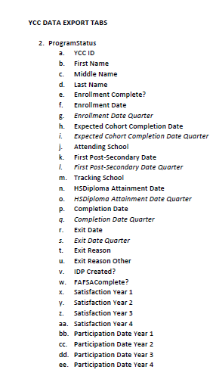
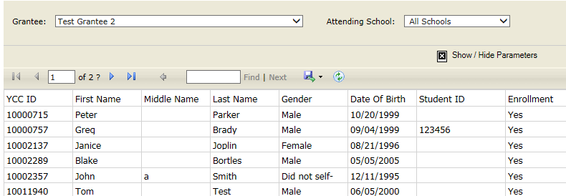
Step 2: Run PTS Data Export

Slide 11
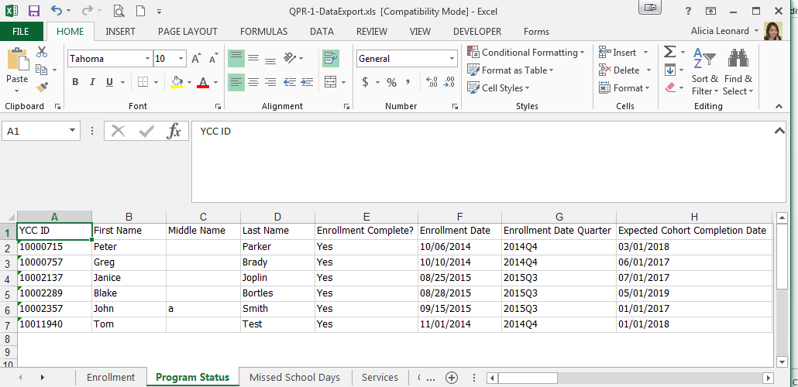
Step 2: Run PTS Data Export (cont’d)

Slide 12
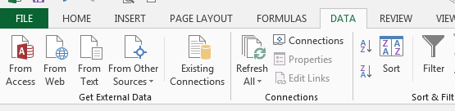
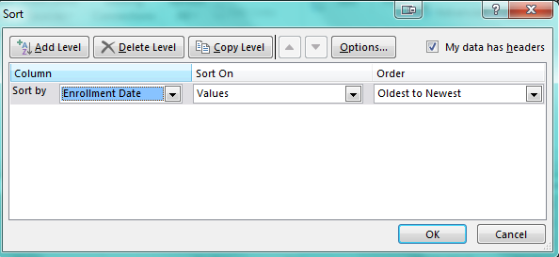
Step 3: Explore Data in the PTS Export
Select the Sort option from the Data tab:
Select the fields you want to use for sorting:

Slide 13
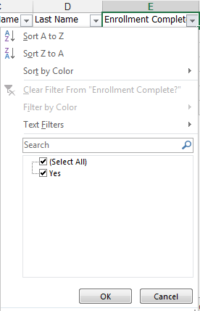
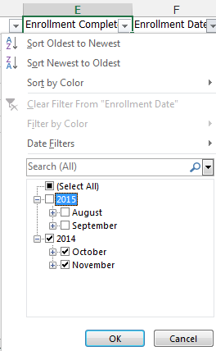
Step 3: Explore Data in PTS Export (cont’d)
Select the Filter option from the Data tab:
Identify the fields you want to use in your filter:

Slide 14
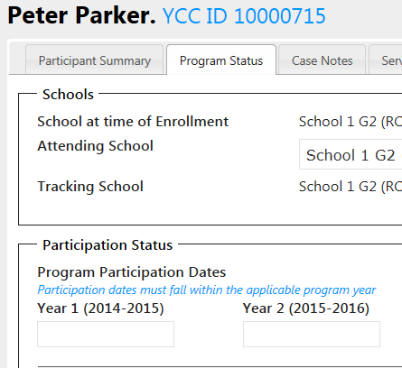
Step 4: Correct PTS Data
Make the data correction in the PTS:
Rerun the draft QPR to confirm data have been corrected:

Slide 15
QPR Troubleshooting:
Example #2

Slide 16
Review of Draft QPR
The Internship Completion Rate calculation appears incorrect:

Slide 17
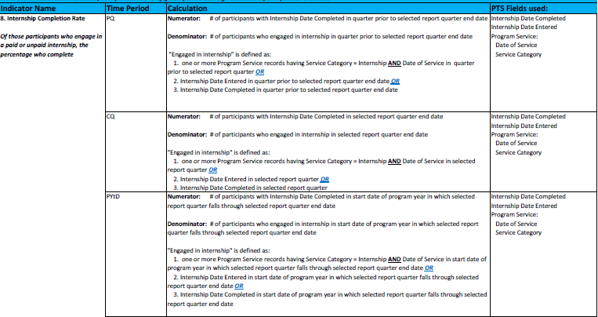
Step 1: Review QPR Calculations
Calculations are available in Appendix C of the latest version of the PTS Manual

Slide 18
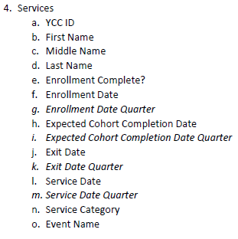
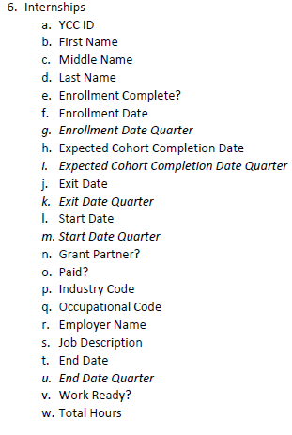
Step 2: Run PTS Data Export

Slide 19
Step 2: Run PTS Data Export (cont’d)

Slide 20


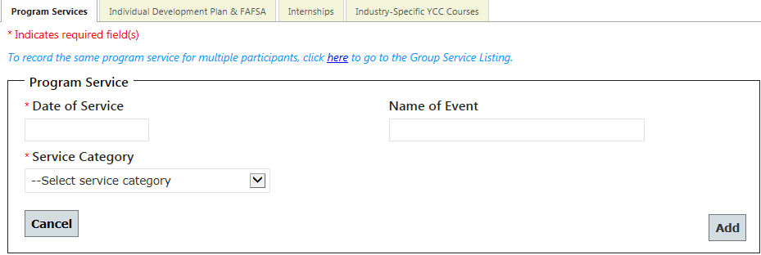
Step 3: Explore Data in PTS Export
In the QPR, the discrepancy is in the Program Year to Date and Cumulative Grant to Date cells.
Review variables used in QPR calculation
  The denominator is correct, showing two internships on the Services tab and two internships on the Internships tab.
  The numerator calculates based on “Internship Date Completed” which is a field captured only on the Internships screen and not at the service level.

Slide 21
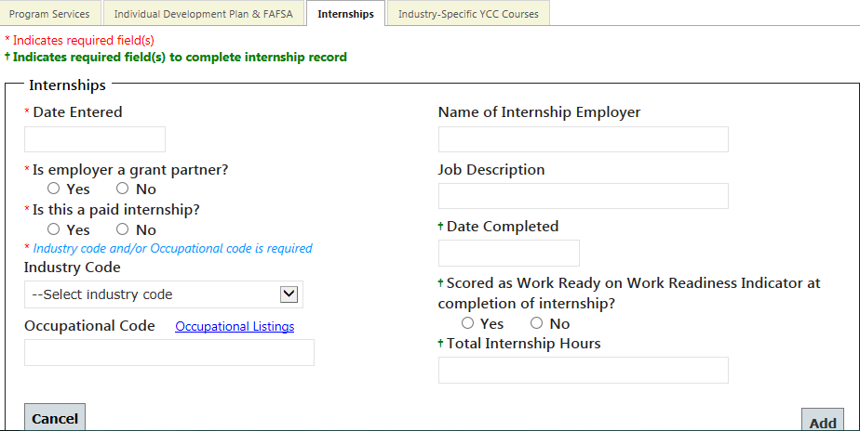
Step 4: Correct PTS Data
Make the data correction in the PTS:
Re-run the draft QPR to confirm data has been corrected:

Slide 22
Questions?

Slide 23
User-Defined Fields

Slide 24
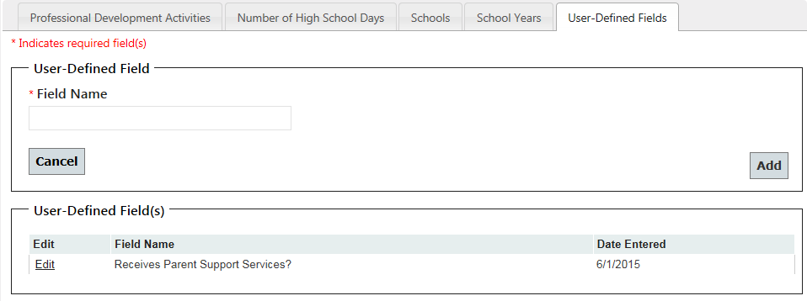
Creating User-Defined Fields
We wanted to provide grantee with the ability to track site-specific data elements.
Grantee-level users can create an unlimited number of user-defined fields through the “Grantee” link in the main menu.
Fields are editable, but cannot be deleted.
After they are created, fields are tracked at the participant level.

Slide 25
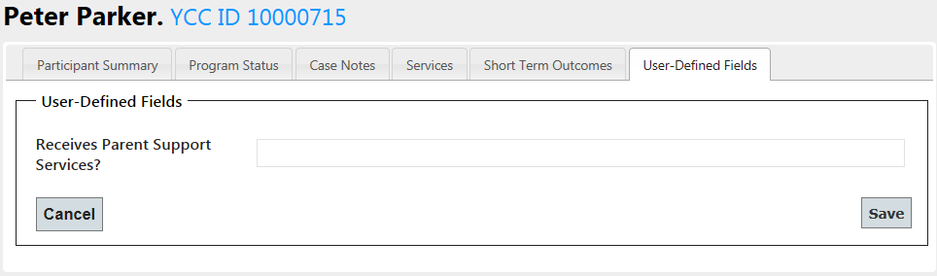
Entering Data in User-Defined Fields
User-defined fields appear in a new tab on participants’ records.
Fields will display for all schools within a grantee.
Fields display in alphabetical order.
These are open text fields; grantee staff must ensure that data is entered using a consistent format across all participants.

Slide 26



Example of User-Defined Fields:
Julie Anderson, Coordinator of Career & Intermediary Programs

Slide 27
Example of User-Defined Fields:
Northeast Iowa Career Learning Link
Uses
  Input data that we need to track for our grant, not already in PTS.
  Run reports, after export, of various data for tracking and analysis.
Examples of data collected
  Career Coach assigned to student
  Does the student have an IEP?
  Has student completed a job shadow?
  Has the student completed the National Career Ready Certificate (NCRC)?
  Has the student been deemed “work-ready”?

Slide 28
Example of User-Defined Fields:
Northeast Iowa Career Learning Link
Data Collection
Student/Parent/School Application
Quarterly Submission Report
  Career coaches submit one per student per quarter
  Form has all PTS fields, including user-defined fields

Slide 29
Questions?

Slide 30
Additional Excel Resources

Slide 31
Microsoft Office Tutorials
Sorting: https://support.office.com/en-us/article/Quick-start-Sort-data-in-an-Excel-worksheet-60153f94-d782-47e2-96a8-15cbb7712539
Filtering: https://support.office.com/en-us/article/Filter-data-in-an-Excel-table-7D8E9739-2898-4BFE-9D0F-C6204E6E5C8A
Vlookup: https://support.office.com/en-us/article/VLOOKUP-function-0bbc8083-26fe-4963-8ab8-93a18ad188a1
  May be used to link data in columns across tabs of data export (for example, pull a participants gender into the services tab)

Slide 32
Contact Information
Questions related to the definitions of data elements recorded in the PTS, reporting requirements, and policy or programmatic issues should be directed to DOL:
  ycc.ycc@dol.gov
Questions related to technical issues logging into or operating the PTS or FileXchange site should be directed to Mathematica’s YCC PTS technical support team:
  ycc_support@mathematica-mpr.com
  Remember to never send PII via email (including in screenshots from the PTS)! Use the YCCID to identify records.

Slide 33
Questions?

