Slide 2
Who are you?
TAA Staff (state or local)
TRA Staff (state or local)
WIOA Staff (state or local)
Both TAA and WIOA Staff (state or local)
Other (write in comments)

Slide 3
What needs does your unit/office have?
Select all that apply
Improve staff morale and/or motivation (SUPPORT STAFF)
Increase communication between staff and managers (INTRA-UNIT COMMUNICATION)
Identify road blocks and duplicative steps in case management processes (EVALUATION)
Support ongoing assessment of policy or processing changes over time (EVALUATION)
Eliminate Paper files (PROCESSING)
Develop protocols to standardize case management processes between TAA and TRA units (PROCESSING/INTER-UNIT PROTOCOLS)
Communicating referrals to WIOA partners/improve communication protocols with WIOA (PROCESSING/INTER-UNIT PROTOCOLS)
Streamline customer and program forms (PROCESSING)
Increasing the number of Trade participants (CUSTOMER SERVICE)
Increasing ability to address participant needs (CUSTOMER SERVICE)
Prioritize acquisition of materials or equipment that will expedite case management processing (EVALUATION/PROCESSING)

Slide 5
Applying "Lean" Strategies to Case Management
May 29, 2019
May 30, 2019

Slide 6

Amanda Poirier
  Regional TAA and TRA Lead
    USDOL/ETA/Region 1

Slide 7
Lean Overview
  A systematic approach for analyzing current processes with an eye toward creating better ones
Federal Perspective
  Targeting areas for Lean in government programs
  Bend the Curve Model
Rhode Island
  Breakdown of process journey from “Current State” to “Future State”
  Hard and Soft Benefits/Lessons Learned
Arizona
  Application of standardized work, visual process adherence, and problem solving
  Spotlight on program solving for Lean: Low Co-Enrollment
Questions
Related Resources

Slide 8
What is Lean?
Lean, in its purest sense, is a methodology that aims to organize human activities to deliver more value while eliminating waste.
Highly Visual
Very Structured
Began in manufacturing industry, with a goal of eliminating literal waste.
It has since evolved to include “knowledge work”.
  Incorporates Continuous Process Improvement (CPI) which looks to empower incremental improvements that lead to better value to the customer

Slide 9
Bend the Curve - Maine
Lean is a state of mind, not a one-time solution.

Slide 10
Bend the Curve - Maine
Timeline
  Fall 2003 to present…
Why was it needed?
  Flat funding = 2% reduction in actual annual revenue due to inflation, benefit costs, etc.
  Perceived waste in government of 30 – 80% by members of the public
  No increase in staff levels despite retirements and additional responsibilities

Slide 11
Bend the Curve - Maine
Mythbusters: Myths that stop radical improvement in government
  1) We don’t make widgets
  2) We don’t have customers
  3) We don’t make a profit
  4) We don’t have time to do this
Started with Maine DOL, now a statewide effort

Slide 12
Bend the Curve - Maine
Goals
  Provide the same or better customer service;
  Shift the work of the department to match customer expectations and needs;
  Achieve efficiencies by fundamentally changing how work gets done;
  Improve intradepartmental collaboration and service integration; and
  Decrease expenditures by at least $9M and significantly reduce staffing levels over three years while minimizing layoffs.

Slide 13
Rhode Island

Slide 14
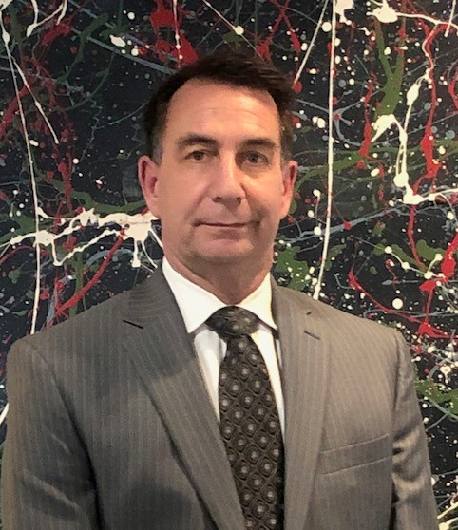
Scott Greco
  Chief of Labor and Training Operations
    Rhode Island Department of Labor and Training

Slide 15
What Is LEAN
Lean is a business methodology that promotes the flow of value to the customer through two guiding tenets:
  Continuous improvement
  Respect for people
Lean is both a philosophy and a discipline which, at its core, increases access to information to ensure responsible decision making in the service of creating customer value.

Slide 16
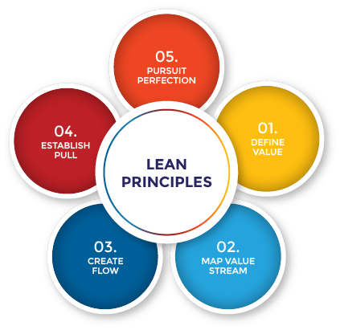

Slide 17
LEAN Principles
Define Value
Map the Value Stream
Create Flow
Establish Pull ( Individualized Service)
Pursue Perfection

Slide 18
Program Overview
The Trade Adjustment Assistance (TAA) Program is an entitlement program that assists U.S. workers who have lost or may lose their jobs as a result of foreign trade.
The program provides adversely affected workers the opportunity to obtain the skills, credentials, resources and supports necessary to become reemployed.
The TAA staff is extremely dedicated and provides excellent customer service.
Trade customers become “friends for life” with their counselors.
The purpose of the project was to streamline processes and create a more value added experience for the customers.

Slide 19
Customer Paths
Job Counseling to Entered Employment
Remedial Education or ESOL
Occupational Training
RTAA (Wage Subsidy for up to 2 years)

Slide 20

Team Photo & Participants

Slide 21
Project Summary
The Trade Program is administered by the Workforce Development Services Unit of the RI Department of Labor and Training.
The program currently suffers from inefficient workflow processes that:
      Limits the effectiveness of the program
      Frustrates staff with administrative challenges
      Contains Redundant steps
      Produces too much paperwork (excessively large files)
      Has unnecessarily complex processes
      Creates difficulty tracking cases

Slide 22
Goals & Objectives
Objective: Eliminate Paper Files
Goal: Establish an electronic file system
Objective: Eliminate redundant processes
Goal: Streamline counseling process and develop Standard Operating Procedures (SOP)
Objective: Evaluate all forms and documents
Goal: Eliminate and/or redesign forms
Objective: Capture all Trade Customers
Goal: Train UI and WDS staff to identify adversely affected workers

Slide 23

Current State

Slide 24
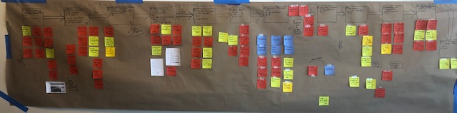
Current State Map

Slide 25
Current State – Key Points
Customer notification needs improvement (First contact)
Customer’s first TAA counseling appointments are inconsistent
Occupational and transferable skill assessments to determine customer’s needs are outdated or lacking
Paper files need to be eliminated
The approval process for customer training by management needs to be created and streamlined for electronic files

Slide 26
Current State – Key Points
TAA forms are outdated and need elimination, consolidation or redesign
Customer’s TRA (UI) payments are often inconsistent and late
Credentials are hard to obtain by vendors and customers
Difficult to engage customers after attainment of credentials

Slide 27
Process Changes to be Made
A “Welcome” email was created to establish the first appointment, inform the customer of what the process entails and lists the necessary documentation needed to proceed
Standard Operating Procedures need to be created for TAA appointments
Identify and implement new Career Interest and Aptitude Assessment tools
Create an Electronic Filing System
Streamline Management approval process for customer training

Slide 28
Process Changes to be Made
Redesign, Consolidate and Eliminate TAA forms
Proposal to allow WDS Principal Interviewers to make UI payments (limited only to TRA customers)
Addendum to TAA Vendor Contracts
Develop incentives for customers to return for job search assistance and job placement

Slide 29

Future State

Slide 30
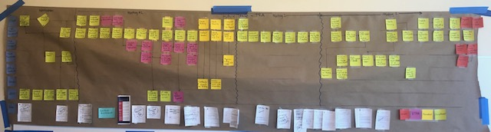
Future State Map

Slide 31
Closing the Gaps
Gap | Goal | Complete
Develop Rapid Response information for workers still employed after certification date | 30 | X
Redesign TRA 16 to include customer sign-off | 30 | X
Develop Welcome Email for trade customers | 30 | X
Develop Communication process for TRA certifications to UI and WDS staff | 30 | X
Combine ESOL and Remedial referral form | 30 | X
Verify original signature requirements with Feds | 30 | X
Provide Letter of Authorization to clients | 30 | X
Check Benchmark requirements | 30 | X
Determine fact from fiction | 30 | X
Authorize TRA counselors to make UI payments | 30 | N/A

Slide 32
Closing the Gaps
Gap | Goal | Complete
Revise TRA 858 | 60
Create Initial Assessment Questionnaire | 60
Train UI and WDS staff on TRA overview | 60
Purchase scanners | 60 | x
Create electronic file system | 60 | x
Eliminate TABE | 60 | x
Simplify Training proposal | 60
Edit TRA checklist and incorporate RTAA | 60
Revise waiver form and combine with the extenuating circumstances form | 60
Incorporate credential requirement into vendor contracts | 60

Slide 33
Closing the Gaps
Gap | Goal | Complete
Redesign TRA Website | 90
PDF TRA forms | 90
Redesign Form UI TRA L | 90
Identify and Train back-up counselors | 90
Identify Career Assessment tool | 90
Create standard casenote templates | 90
Develop tracking method for RTAA payments | 90
Develop SWISS forms | 90

Slide 34
Hard Benefits of the Future State
Elimination of Paper files
Consistent case management processes
Better ability to determine customer needs
Increase the number of Trade customers by educating staff and companies
Streamlining customer and program forms

Slide 35
Soft Benefits of the Future State
Improved morale
Increased staff motivation
Increased customer satisfaction
Increased communication between staff and managers
Less Stress

Slide 36
Areas of Opportunity
Share best practices with other program coordinators to create consistent counseling methods
Formalize the standard work developed in the project for the new process
Educate all staff about the program

Slide 37
Lessons Learned
The team approach is a valuable tool
The program overall has been an excellent value to our customers
Staff is extremely knowledgeable and dedicated
There is always room for improvement

Slide 38

Incorporating Lean Principles Into TAA Business Practices

Slide 39

Susan Standen
  TAA State Coordinator
    State of Arizona

Slide 40
Lean Management Background
Arizona Management System – results driven management system that focuses on delivering customer value and vital mission outcomes for our program participants
Based on the principles of Lean Management; requires every state employee at every level to reflect daily on performance, while always seeking a better way
Employees are empowered to make data driven decisions and use a common problem solving process, which affords them greater creativity and control while expanding their capacity to do more good for the individuals we serve

Slide 41
What Is Lean?
A culture whereby everybody is constantly engaged in team based collaborative problem solving
  Continuous Improvement
  Shared learning experience
Lean Principles and elements are implemented to:
  Remove Waste
  Reduce Defects
Improving Customer Facing Processes and Value
AMS COMPONENTS

Slide 42
Lean Components
Adapted for TAA Case Management
Standardized Work
Visual Process Adherence
  Gemba Walks
  Scorecards
  Flow Boards
Problem Solving

Slide 43
I. Standard Work
Standard Work is the current least waste way to complete the process tasks, based on what we know today, and is the basis for continued improvement
If someone has a better idea about how to complete the work, we test the idea to see if improvement happens, then we change to the new Standard Work
If we don’t have consistency on how the work is done today, how can we figure out what went wrong when problems do occur?

Slide 44
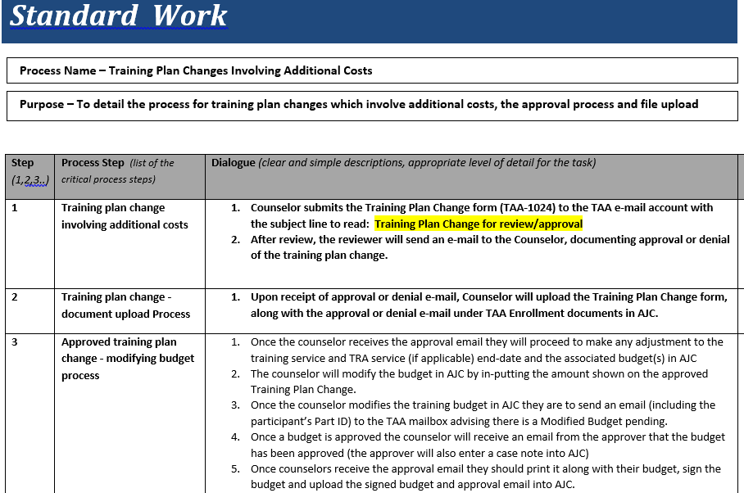

Slide 45
Judy V.
I like having the Standard Works; they clearly outline what all is required for approval. I also appreciate the fact that they are all inclusive from beginning to end of each task.
TAA Counselor

Slide 46
Rosamaria E.
This tool has assisted me in making sure that I have completed all required steps required for a client’s benefits/training. It also informs me what actions need to be taken in each individual case, depending on the necessity of each client. It has made my job a lot easier.
TAA Counselor

Slide 47
II. Visual Management:
Visual Process Adherence
What
Visual Process Adherence
Why
Check adherence to standard work
Where
Gemba Walks, Scorecards, Flow Boards

Slide 48
a) Gemba Walk
Go where the work is being done
See first hand what is happening
Ensure process adherence and sufficiency
  Are the Standard Works being followed?
Hear from employees what is important to them and what problems they see
Focus on purpose, process and people
Coach staff in problem solving

Slide 49
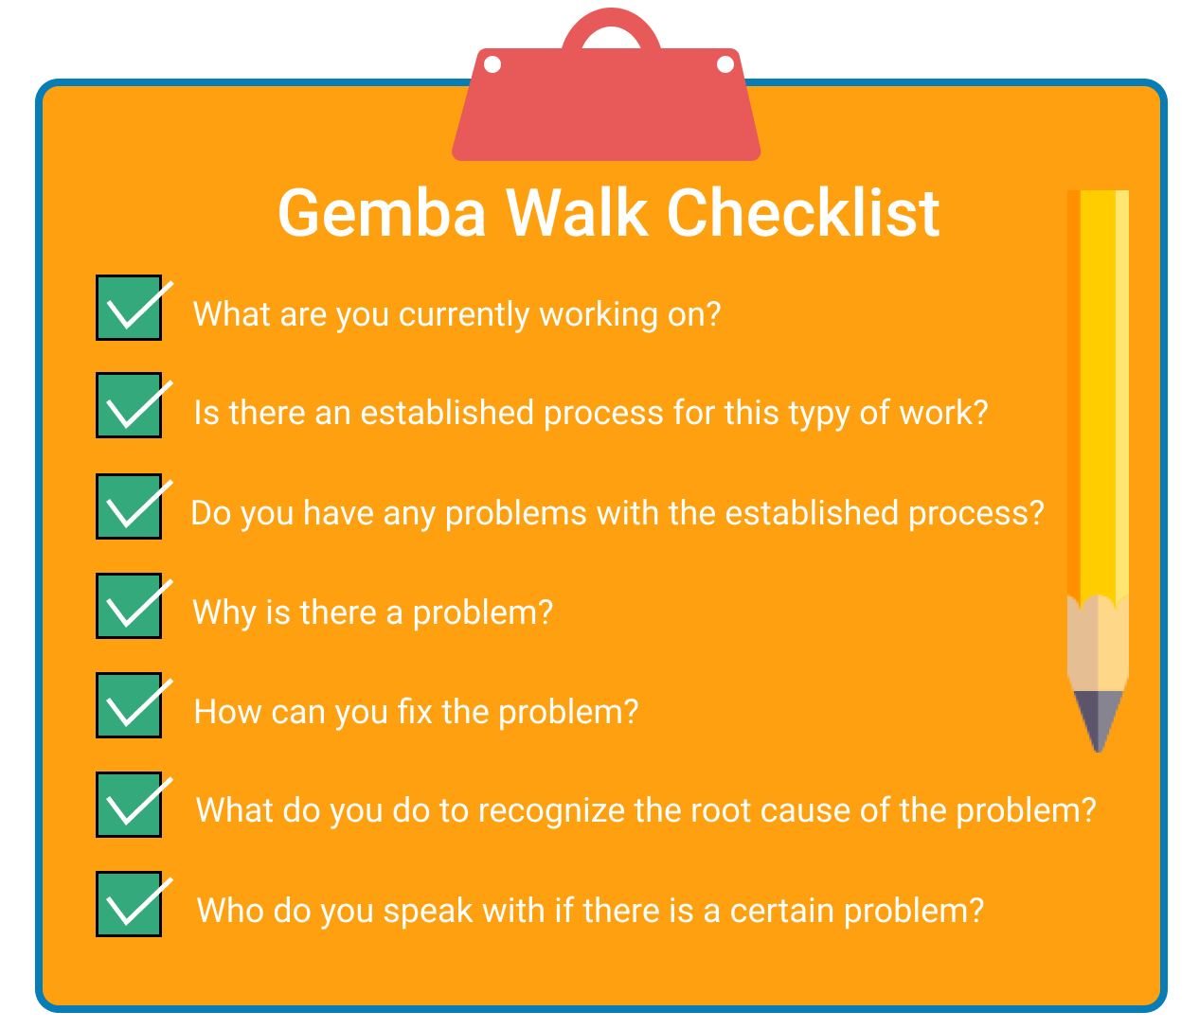
Gemba Walk - Be Prepared:

Slide 50
Resulting Action from a Gemba Walk
Observation:
  Staff repeatedly having to walk across the building to be able to scan documents for uploading to our electronic files
Listening:
  Staff reported frustrations due to holding onto documents for several case files in order to make the most of a trip to the scanner
  Documents to be uploaded could be misplaced, resulting in document never making it to the participant’s file
Problem Solving:
  Reviewed and inquired about other State agencies’ electronic file practices
  Obtained desk scanners for each counselor

Slide 51
Alana C.
Gemba Walks are my personal favorite, maybe because I’m the one walking…I as a supervisor, am the one doing the Gemba Walk and I feel that it’s important especially because I’m not located where the staff is. It’s important that I get out and see what’s going on: What is going well, what isn’t? How can we improve? What is preventing us from doing our jobs? The Gemba Walks help to build better relationships between staff and the supervisor. I, the supervisor, have a better understanding of the volume of work, the working conditions, the pressure staff are under, if any. I make myself available for the staff and I think they appreciate that. The open communication is Key and by communicating, we can only get better.
TAA Supervisor

Slide 52
b) Scorecards:
Metrics & Measurement
Metrics = key performance indicators
Evaluation of factors crucial to the success of the program
Multiple metrics are needed to provide a balanced scorecard
Metrics tell the story of the program over time

Slide 53
TAA Scorecard:
Working Toward Continuous Improvement
Allows us to examine Case Management practices based on implementation of a TAA Scorecard
  Weekly reporting of TAA case statuses on shared drive / monthly roll-up of statewide activity
    Helped in developing metrics to track TAA participation and progress on all levels
      Accurate active case load sizes
      Better accountability
      Allows for a drill-down of all benefits and services participants are receiving during a given month

Slide 54
c) Flow Boards
Flow Boards provide a visual representation of the “product” as it flows through the Value Stream. The idea is to be able to see the flow of the work in the timeframe the process is designed to achieve.
Without a Flow Board, we have only isolated knowledge of inventory or delivery status, along with hidden problems, unless we dig through multiple stockpiles of information.

Slide 55
Flow Boards for TAA Case Loads
Visual indicators enable a quick, informed assessment of how a process is performing
Creates a visual flow of the services and status of all TAA participants
Helps to determine if pace of work is meeting the participants’ requirements
Each Counselor has their own Flow Board, based on a Standard Work developed with team consensus

Slide 56
Flow Boards for TAA Case Management
Wall chart categorized by TAA Service currently receiving, and the targeted industry of the employment goal
  Job Search – 3 columns designating length of time in activity: 30, 60 or 90 days
  In Training
  RTAA
A proxy card (Yellow sticky note) is created for each new participant, to include: participant’s first name, last initial, participant ID number, date enrolled, job goal, date current activity is to be completed and the training enrollment/TRA deadline date:
    Bill S. Part ID: 123456
    Date enrolled: 5/25/18
    Job goal: Dental Hygienist
    30 day: 6/24/18
    60 day: 7/24/18
    90 day: 8/23/18
    TRA Deadline Date:7/21/18

Slide 57
Flow Board Operation:
Job Search: proxy card shall be placed on the flow board in the row (designated by industry) appropriate for the type of work the participant is seeking.
  During the first 30 days of job search, the proxy card is placed in the 30-day column. Once the 30-day follow-up is completed, the proxy card is moved to the 60-day column, etc. (if reach 90 day follow-up and still not employed, re-visit IEP to determine different course of action)
In Training: once a participant enters training, the proxy card will be moved from the Job Search column to the In Training column. Create a new card with the following:
  Client First name and last initial
  Part ID
  Training start and end date
  Status of TRA, if applicable
  **All individuals receiving TRA are designated by a blue proxy card for ease of tracking
RTAA: once eligibility for RTAA is confirmed, the proxy card will be moved to the RTAA column. Create a new proxy card in GREEN that includes
  Client first name and last initial
  Part ID
  RTAA eligibility period

Slide 58
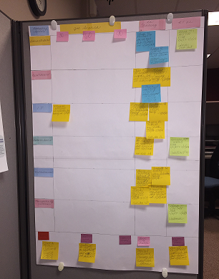
Example of a Flow Board…

Slide 59
Julie T.
I feel the flow board is an efficient tool that I use daily to visually manage my customers, helping them move thru the process from job search to employment. I can also easily tell if they may be in need of training to receive the skills and knowledge for them to become reemployed. At a glance, I can visually see what each of my customers are doing and identify those I need to focus more attention on.
TAA Counselor

Slide 60
III. Problem Solving
Through Lean Management Principles, we have learned:
Problems are Treasures – they require we take a step back and examine what is, or is not happening; what do we think should be happening?
Problem Solving is Everyone’s Job – Involves all levels of staff and partners to evaluate the problem and determine a possible resolution
  Staff engagement!

Slide 61

Evaluate the Problem

Slide 62
Problem Solving Process:
“Continuous improvement is better than delayed perfection.”
-Mark Twain
1) Define the Problem:
What should be happening?
What is really happening?
2) Causes:
Explore the potential causes
Brainstorm (why or why not is something happening?)
3) Countermeasures:
Explore countermeasures (How can we eliminate or at least mitigate the cause?)
Consider impact & effort, urgency & priority

Slide 63
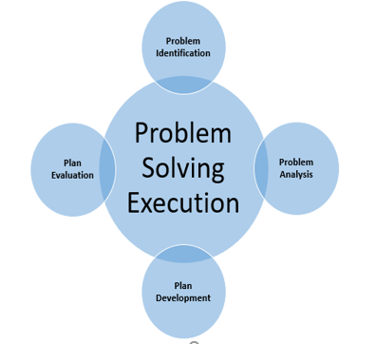

Slide 64
Problem: Low percentage of active TAA participants who are co-enrolled with WIOA
What should be happening?
Majority (over 50%) of active TAA participants should be co-enrolled with WIOA Title IB
TAA Referral for Co-Enrollment forms should be returned indicating WIOA action taken and results
What is actually happening?
TAA Referral forms are e-mailed to WIOA staff
No follow-up to find out status of referral
Low percentage of TAA participants are co-enrolled with WIOA
What could be the cause?
Lack of knowledge and/or understanding about TAA
  Benefit for co-enrollment is not clear
  Staff turnover; new individuals in the local offices
Idea that participant has to wait to enroll with other programs until they complete services with current program
Participant does not understand benefit of co-enrollment and does not follow-through
Lack of statewide standardized guidance and practices
  Each local area operates under different rules and guidance

Slide 65
Problem Resolution = Develop a Plan
Possible Countermeasures:
Educate WIOA Local Area Administrators, Managers, Supervisors and Case Managers about the benefits of co-enrollment
  Educate about the benefits and services provided by the TAA Program
  Each program can piggyback on services the other program provides = Leveraging of services
  TAA has training funds, so WIOA can save their training funds for non-TAA eligible individuals
Open lines of communication between both programs
  Shared case management system – eases sharing of case notes, IEPs, assessments, services provided and status
  Cross-train TAA staff on WIOA’s co-enrollment requirements
  Hold regular meetings to bring together staff from both programs to discuss any roadblocks encountered
Identify areas which have experienced success with co-enrollments and review their processes

Slide 66
Resolution Execution – Take Action
Establish formal statewide policy and business practices for handling of TAA referrals for co-enrollment
  Provide guidance for both programs on how the referral process should work
  Determine contacts in each local office to receive and disseminate the TAA referrals to WIOA case managers
  Develop procedures for handling of referral forms to report back on status of referral and outcomes
Evaluate monthly co-enrollment rates for increase, stagnancy or decrease in rate
  Address any roadblocks staff may encounter
  Adjust policy and procedures based on feedback from both programs’ staff

Slide 67
Monthly Monitoring:
Check Progress / Adjust if Necessary
Check status of co-enrollment rates:
  January - March, 2019: Co-Enrollment Rate = 38%
  April 2019: Co-Enrollment Rate = 46% (Progress!)
Make adjustments to the process if we start seeing the rate fall; implement a new plan if necessary

Slide 68
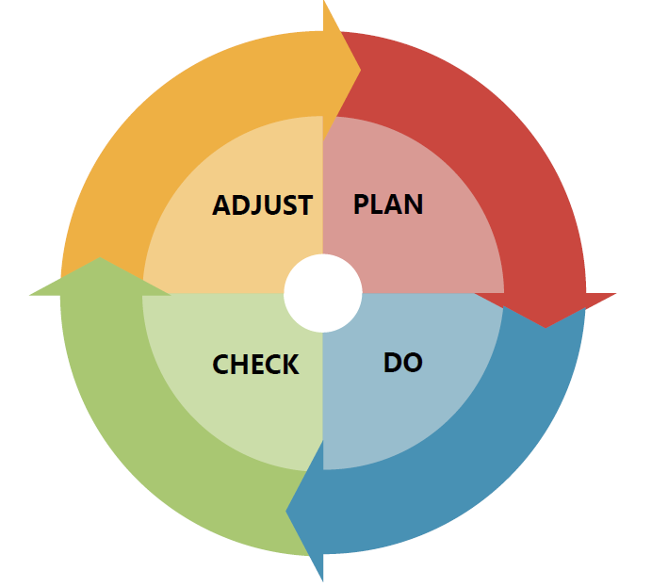

Slide 69
Conclusion:
Benefits of Lean Management:
  Increases customer value
  Creates a stable workflow / engagement at all levels
  Continuous process improvement– it never ends!
To be successful, every employee must understand that collectively and individually, our job is to do more good for Arizona. To do this we all must understand customer needs, identify problems, improve processes, and measure results.

Slide 70
Trade Adjustment Assistance (TAA) Case Management
  This webinar from November 2018 discusses case management, discusses why it is important, and includes state best practices.
    https://www.workforcegps.org/events/2018/10/11/14/17/TAA-Case-Management
Reporting Case Management in PIRL FAQ
  FAQ that details how to report case management activities in PIRL
    https://www.doleta.gov/tradeact/taa-data/participant-reporting/docs/PIRL_TAA_Case_Management_Reporting_FAQ.pdf

Slide 72
Trade Adjustment Assistance Community of Practice on WorkforceGPS
    June 2019
Promising Practices that Support Accurate Fiscal Tracking and Reporting
    June 18, 2019, 1-2:30PM Eastern
Serving English Language Learners under the Trade Adjustment Assistance (TAA) Program
    July 19, 2019, 1-2:30PM Eastern

Slide 73
Amanda Poirier
  Regional TAA and TRA Lead
    Boston Regional Office (Region 1)
      Poirier.Amanda@dol.gov
        617-788-0124
Scott Greco
  Chief of Labor and Training Operations
    Rhode Island Department of Labor and Training
      Scott.Greco@dlt.ri.gov
        401-462-8797
Susan Standen
  TAA State Coordinator
    State of Arizona
      Sstanden@azdes.gov
        520-209-1032

