Slide 1
Measurable Skill Gains and
Credential Attainment Data
Module 3
2019 WIOA National Performance Training
U.S. Department of Labor
Employment and Training Administration

Slide 2
National Breakouts of Each Measurable Skill Gain Type, by Program WIOA Adult
Educational Functioning Level
Secondary School Diploma or Equivalent
Transcript or Report Card
Progress Report towards Milestones
Passage of Exam
Source: PY 2017 Q4 and PY 2018 Q2 WIOA Performance Individual Record Data

Slide 3
National Breakouts of Each Measurable Skill Gain Type, by Program
WIOA DW
Educational Functioning Level
Secondary School Diploma or Equivalent
Transcript or Report Card
Progress Report towards Milestones
Passage of Exam
Source: PY 2017 Q4 and PY 2018 Q2 WIOA Performance Individual Record Data

Slide 4
National Breakouts of Each Measurable Skill Gain Type, by Program
WIOA Youth
Educational Functioning Level
Secondary School Diploma or Equivalent
Transcript or Report Card
Progress Report towards Milestones
Passage of Exam
Source: PY 2017 Q4 and PY 2018 Q2 WIOA Performance Individual Record Data

Slide 5

Discussion Question – National MSG Data
What is most surprising about this data?

Slide 6
National Breakouts of Each Credential Type, by Program
Source: PY 2018 Q2 WIOA Performance Individual Record Data

Slide 7

Discussion Question – National Credential Data
What is most surprising about this data?

Slide 8
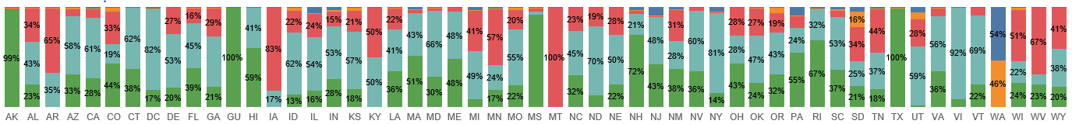
State Reporting Breakouts of Each Measurable Skill Gain Type (Adult)
Source: PY 2018 Q2 WIOA Performance Individual Record Data

Slide 9
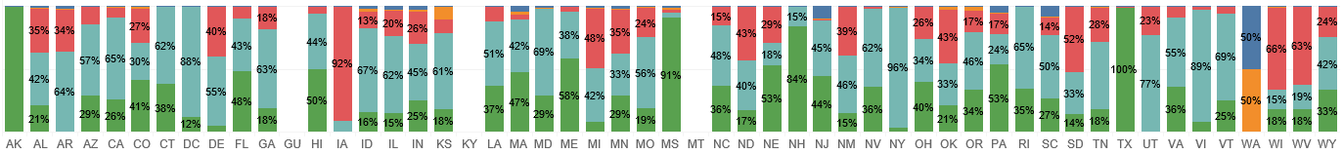
State Reporting Breakouts of Each Measurable Skill Gain Type (DW)
Source: PY 2018 Q2 WIOA Performance Individual Record Data

Slide 10
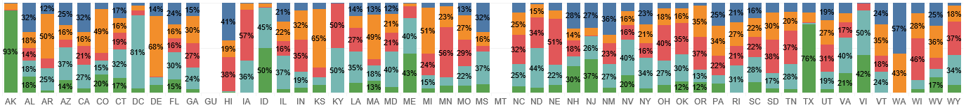
State Reporting Breakouts of Each Measurable Skill Gain Type (Youth)
Source: PY 2018 Q2 WIOA Performance Individual Record Data

Slide 11
Discussion Questions – State MSG Data
Visualizations link:
  https://public.tableau.com/profile/scott8222#!/vizhome/MeasurableSkillGainsCY18Outcomes_PY18Q2PIRL/CY18_MSG
  Also see tables in data supplement handout
What is most surprising about this data?
What are your state’s largest hurdles in reporting MSG accurately?
  Policy-related
  Operational
  Technical
How can ETA help?

Slide 12
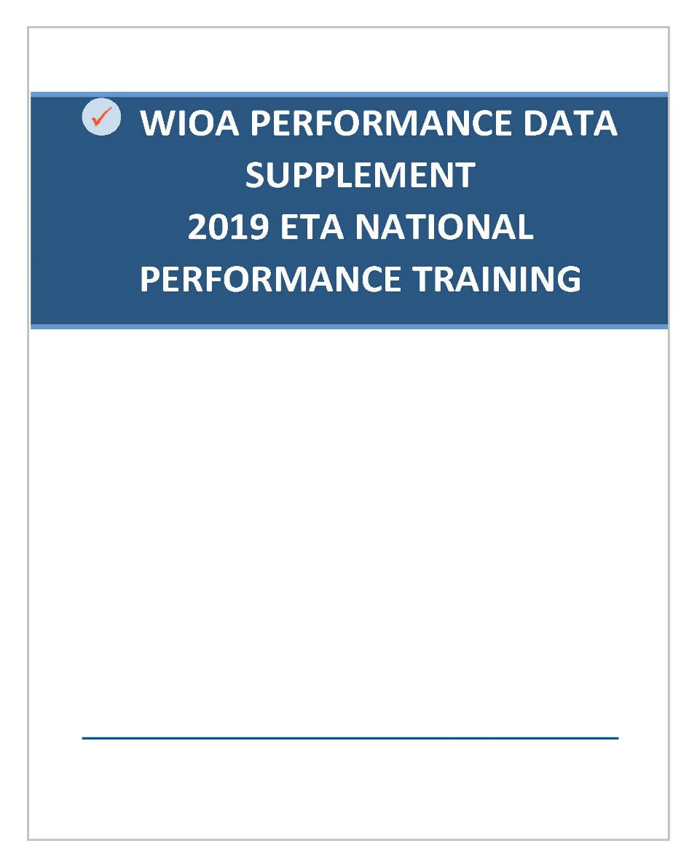
State Reporting Breakouts of Each Credential Type, by Program
Refer to data supplement handout

Slide 13
Discussion Questions – State Credential Data
What is most surprising about this data?
What are your state’s largest hurdles in reporting Credential Attainment accurately?
  Policy-related?
  Operational
  Technical
How can ETA help?

Slide 14
Any Questions?

Slide 15
Contact
 ETAPerforms@dol.gov

Slide 16
Please complete your evaluations.

